Slide 2
MSK 1st YEAR MODULE (RADIOLOGY) “RADIOGRAPH OF THE HIP BONE Understanding the Anatomy & Pathology” By. Dr. Aniqua Saleem Senior Registrar, HFH Hospital, Rawalpindi Medical University

Slide 3
 | Mission Statement To impart evidence-based research-oriented health professional education in order to provide best possible patient care and inculcate the values of mutual respect, ethical practice of healthcare and social accountability. Vision and Values Highly recognized and accredited center of excellence in Medical Education, using evidence-based training techniques for development of highly competent health professionals, who are lifelong experiential learner and are socially accountable. Goals of the Undergraduate Integrated Modular Curriculum To provide you with quality medical education in environment designed to: Provide thorough grounding in the basic theoretical concepts underpinning the practice of medicine. Develop and polish the skills required for providing medical services at all levels of the Health care delivery system. Help you attain and maintain the highest possible levels of ethical and professional conduct in your future life.
TRUTH, WISDOM & SERVICE
“OUT MOTTO”

Slide 4
NUMBER OF SLIDES ACCORDING TO DR UMAR LGIS MODEL
Introductory slides
Bismillah 1
Introduction 1
Mission vision 1
Dr. Umar model of LGIS 1
Gain attention slides 2
Learning objectives 1
Core Concept 10
Horizontal Integration 2
Vertical integration 4
Recent Articles 1
Assessment 2
Recommended Books 1
Take home message 1

Slide 5
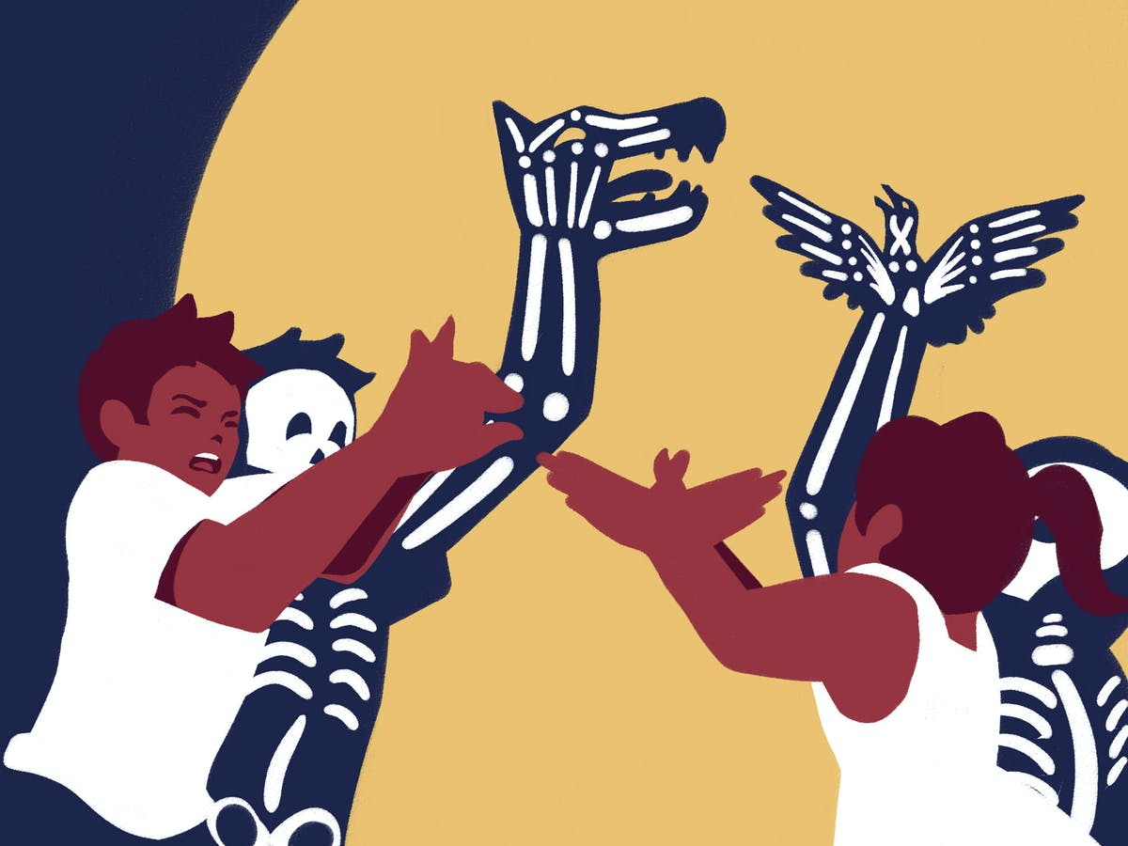
WHAT DOES PICTURE SHOW???????

Slide 6
XRAYS ALSO FORM SHADOWS!!!!

Slide 7
Core Concept

Slide 8
LEARNING OBJECTIVES
Upon completion of the session, students will be able to
To enlist indications /contraindications of performing x-ray of hip bone
To recognize and differentiate between different radiological densities
To identify basic film projections (hip series)
To understand the importance of hip bone in human skeleton & demonstrate normal hip bone anatomy
To identify common abdominal emergencies and their importance requiring urgent treatment

Slide 9
INDICATIONS
Hip bone radiographs are performed in following conditions:
Trauma
Hip pain
Limping or abnormal gait
Inability to weight bear
arthropathies
Knee pain
Core Concept

Slide 10
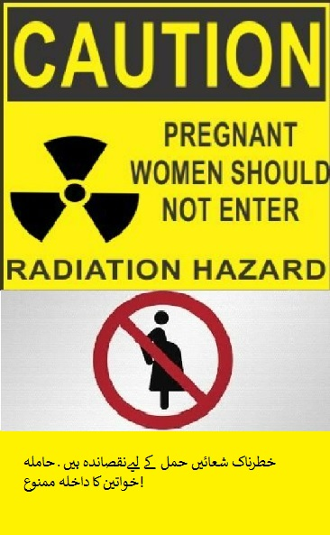
CONTRAINDICATIONS
Pregnancy
Non-ionizing studies (e.g. ultrasound or MRI)
should be tried first
Core Concept

Slide 11
IMPORTANCE OF HIP BONE IN HUMAN BODY
Structural support
Weight bearing
Attachment of muscles & Ligaments
Role in child birth
Stability of the hip joint
Maintenance of posture
Core Concept

Slide 12
PROJECTIONS “HIP SERIES”
Standard projections
AP supine view
Hip in AP plane, with internal rotation
Lateral view
Standard rolled lateral view to demonstrate femoral neck and acetabular rim
Only performed on non-traumatic patients
Hip Series comprises of AP & lateral both
Other projections
Frog leg
Flamingo
Core Concept

Slide 13
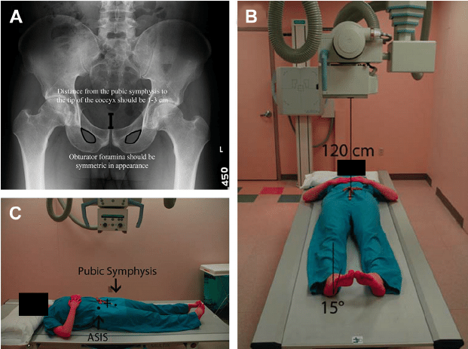
AP PROJECTION
Core Concept

Slide 14
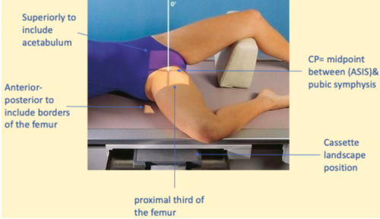
LATERAL PROJECTION
Core Concept

Slide 15
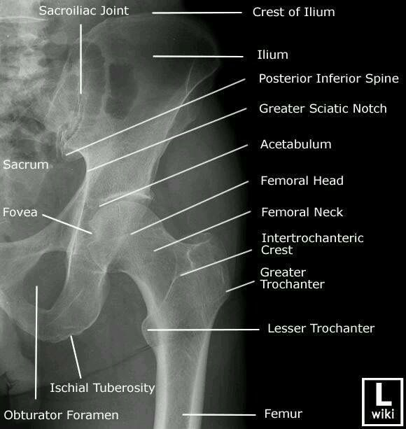
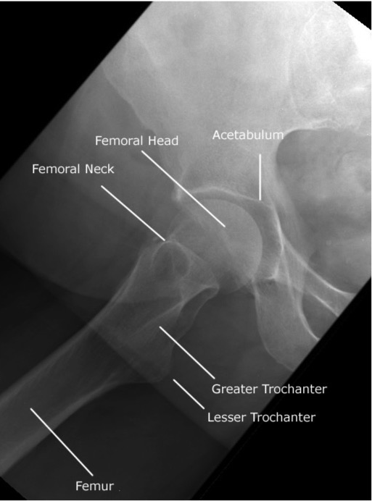
Horizontal Integration

Slide 16
COMMON HIP BONE PATHOLOGIES
Fractures
Arthritis
Dislocation
Developmental anomalies
Horizontal Integration

Slide 17
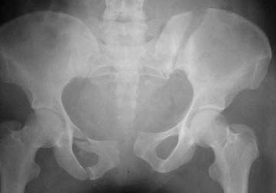
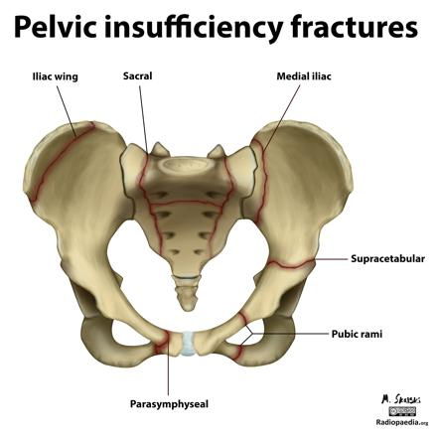
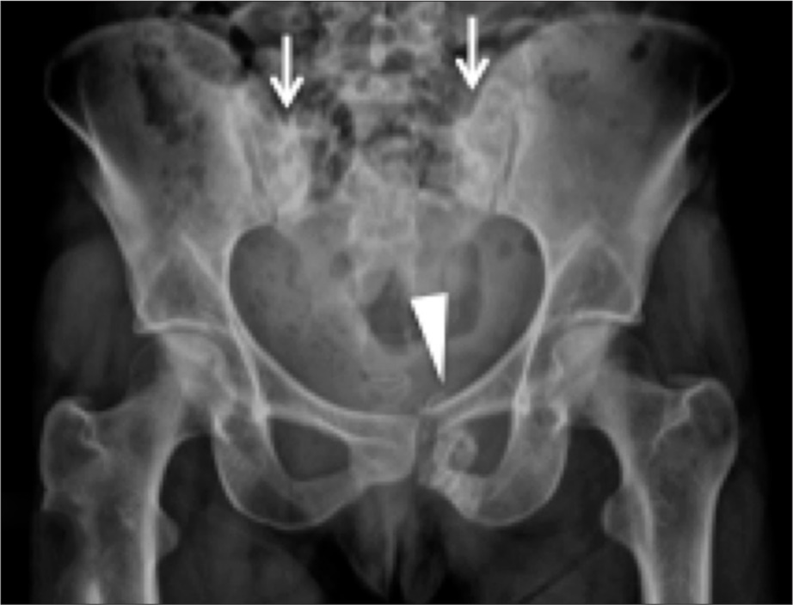
PELVIC /HIP BONE FRACTURES
Vertical Integration

Slide 18
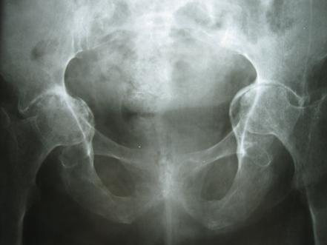
HIP JOINT ARTHRITIS
Vertical Integration

Slide 19
HIP JOINT DISLOCATION
Vertical Integration

Slide 20
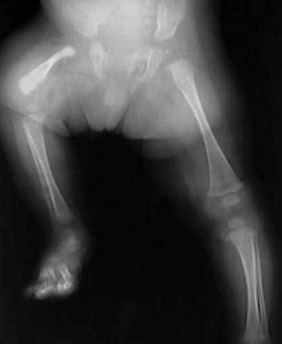
HIP JOINT ANOMALIES
Vertical Integration

Slide 21
ARTIFICIAL INTELLIGENCE
Core Concept

Slide 22
ROLE OF AI IN DIAGNOSTIC IMAGING
The initial applications of AI in medicine have focused largely on image-recognition diagnostic tasks such as detecting retinopathy in diabetic people via photographs of the retinal fundus, detecting mammographic lesions, and recognizing skin cancer
The key applications of AI will help address the shortcomings of human intelligence that make us susceptible to the magician’s sleight of hand and, likewise, to overlook important details in distracting circumstances.
AI might be useful to aid the diagnostic aspects of ANOMALIES, FRACTURES, ARTHRITIS, TUMOR DETECTION IN RADIGRAPH
Research work undergoing on AI detection of ABNORMALITIES ON CHEST XRAY INCLUDING RIB FRACTURES, in radiology department holy family hospital.
Core Concept AI

Slide 23
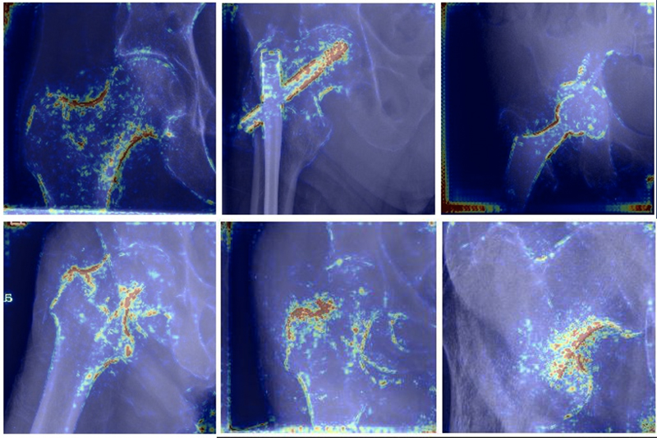
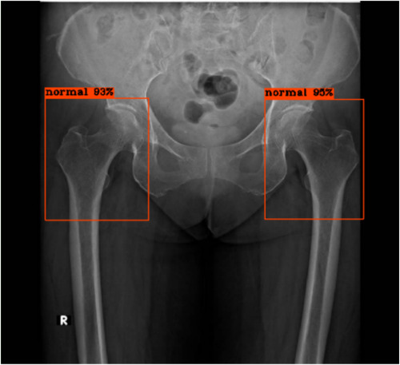
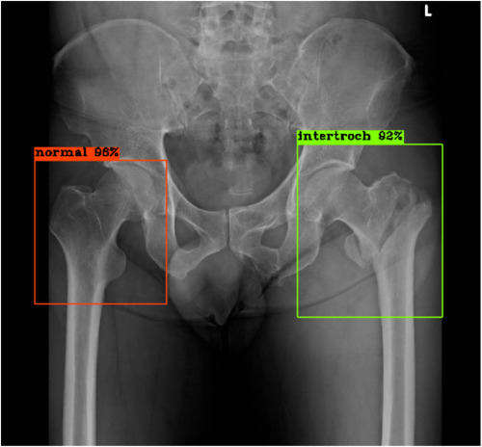
AI DETECTION OF PELVIC HIP BONE FRACTURES
Core Concept AI

Slide 24
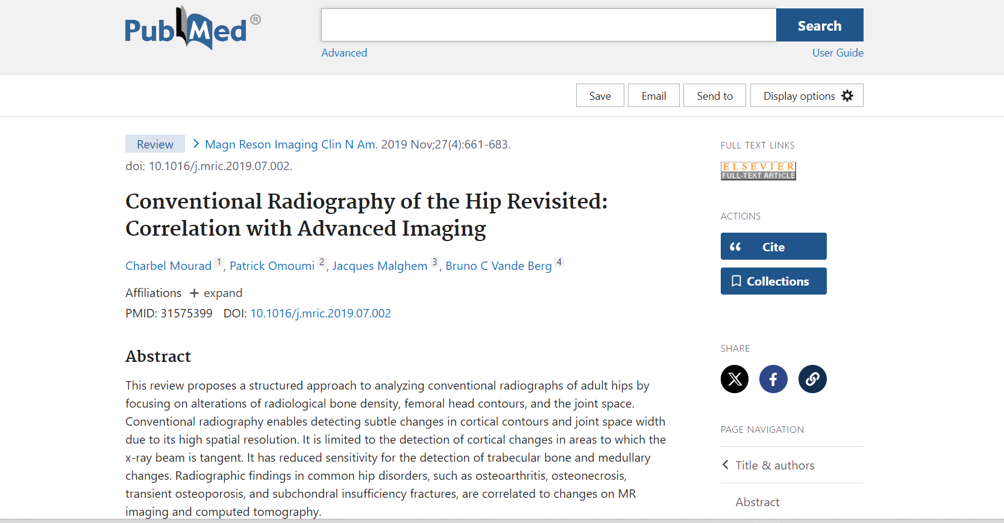
Recent Articles

Slide 25
Assessment

Slide 26
Iliac crest
Ilium bone
Posterior inferior iliac spine
Greater Sciatic Notch
Acetabulum
Femoral Head
Femoral Neck
Inter Trochanteric Crest
Greater Trochanter
Lesser Trochanter
Femoral Shaft
Assessment

Slide 27
RECOMMENDED BOOKS:
1. Aids to Radiological Differential Diagnosis by Chapman S. and Nakielny R. 4th ed. Elsevier Science Limited; 2003.
2. Online Journals and Reading Materials through HEC Digital Library Facility.

Slide 28
TAKE HOME MESSAGE
Knowing anatomy of the bone is most important to make diagnosis
Hip bone is major weight bearing structure and its pathologies like fracture, arthritis, anomalies and tumor conditions if detected earlier could prevent crippling and debilitation

