Slide 2
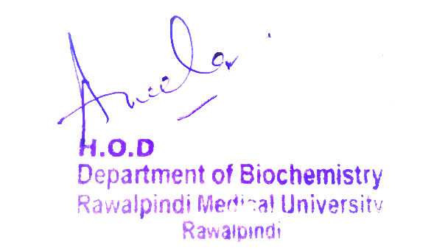
Reproductive System Module 2nd year Year MBBS(SGD) Purine Synthesis
Presenter: Dr. Romessa Naeem Date: 24-01-25
(Demonstrator)

Slide 3
Motto, Vision, Dream
To impart evidence based research oriented medical education
To provide best possible patient care
To inculcate the values of mutual respect and ethical practice of medicine
Wisdom
Truth
Service

Slide 4
Professor Umar Model of Integrated Lecture

Slide 5
Learning Objectives
At the end of this session students should be able to
Learn about the structure of purine and pyrimidine bases, nucleosides and nucleotides.
Describe the de novo synthesis of purine nucleotides.
Explain the salvage pathway for purines and rare X-linked recessive disorder Lesch Nyhan syndrome.

Slide 6
Interactive Session
A 2-year-old boy presents with delayed milestones, spasticity, involuntary movements, and self-mutilation (biting lips and fingers). Examination reveals hyperreflexia, dystonia, and urate crystal deposits (orange sand) in urine. Serum uric acid is elevated, and genetic testing confirms an HPRT1 gene mutation. The condition is due to HGPRT enzyme deficiency, leading to purine overproduction and hyperuricemia. Allopurinol helps manage uric acid levels but does not improve neurological symptoms.

Slide 7
Structure of Nucleoside and Nucleotide
Core Knowledge

Slide 8
Structure of Purine & Pyrimidine
Core Knowledge

Slide 9
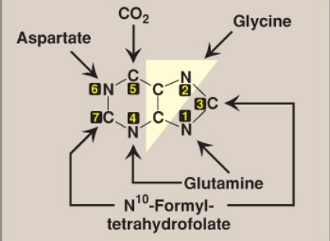
Sources of Purine Ring
Core Knowledge

Slide 10
Overview : Purine Synthesis
Core Knowledge

Slide 11
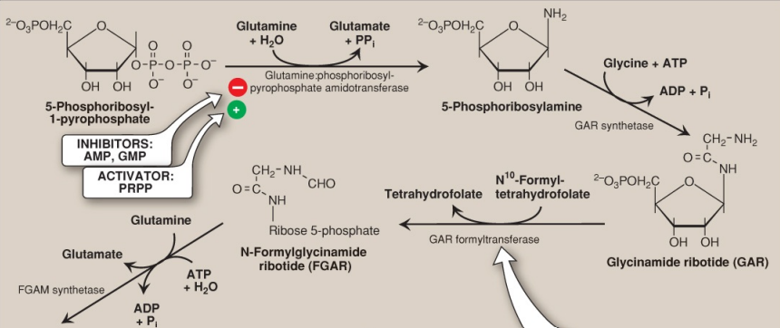
De novo Synthesis of Purine
Core Knowledge

Slide 12
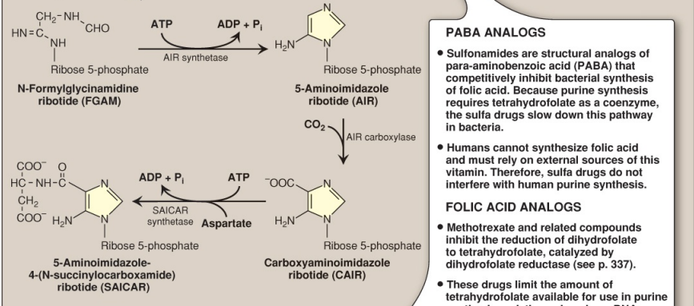
De novo Synthesis of Purine
Core Knowledge

Slide 13
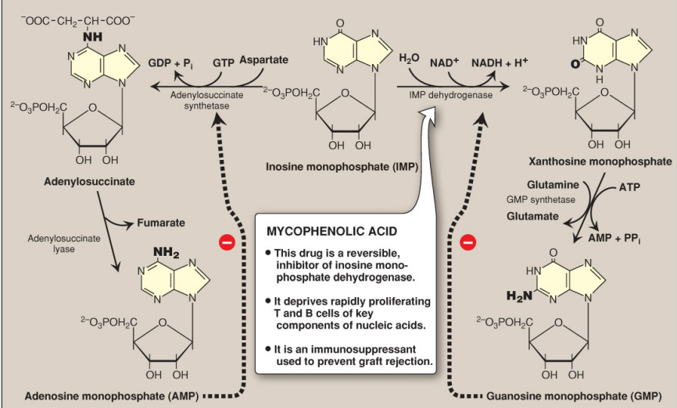
Conversion of IMP to AMP & GMP
Core Knowledge

Slide 14
Nucleoside Di- & Triphosphate Synthesis
Core Knowledge

Slide 15
Salvage pathway of Purine Synthesis
Core Knowledge

Slide 16
Anatomical Aspects of Nucleus

Slide 17
Physiology of Nucleus
Storage of Genetic material
Transcription and Gene Regulation
Ribosome Biogenesis
Cellular Metabolism
Cell Division

Slide 18
Lesch – Nyhan Syndrome

Slide 19
Management of Lesch – Nyhan Syndrome
Spiral Integration
Family Medicine plays important role in following manner:
Diagnosis
Education
Dietary Guidance
Monitoring
Refer to Specialists

Slide 20
Ethical Consideration
Spiral Integration
Informed Consent
Access to healthcare
Privacy on genetic information needs to be addressed
The development and use of germ-line gene therapy (GLGT)

Slide 21
Role of AI in Managing Lesch – Nyhan Syndrome
Spiral Integration
Artificial Intelligence plays role in following aspects:
Personalized Nutrition
Remote Monitoring
Food Recommendations
Drug Development

Slide 22
Suggested Research Article
Introduction
Lesch Nyhan syndrome is an inborn disorder caused by a deficiency of hypoxanthine-guanine phosphoribosyltransferase (HPRT) enzyme, an enzyme of the purine salvage pathway. The enzyme is responsible for recycling purines by converting guanine and hypoxanthine into guanosine monophosphate and inosine monophosphate, respectively. Lack of the enzyme causes an increase in guanine and hypoxanthine, which eventually is converted into uric acid. HPRT deficiency results in a spectrum of clinical presentations depending on the severity of enzyme deficiency. With an enzyme activity of less than 1.5%, Lesch Nyhan falls towards the severe end of the spectrum. The characteristics defining the disease are hyperuricemia, neurodevelopmental abnormalities with global developmental delay, involuntary movements, and self-injurious behavior.[1] Other less severe variants include HPRT related hyperuricemia, also known as Keeley–Seegmiller syndrome (enzyme activity 8% to 60%, and only hyperuricemia related symptoms), and hyperuricemia with neurological disability (enzyme activity 1.5 to 2% with hyperuricemia symptoms and neurological symptoms like dystonia, choreoathetosis, spasticity, intellectual disability).[1][2]
Link:
https://www.ncbi.nlm.nih.gov/
Journal Name:
Statpearls
Title:
Lesch-Nyhan Syndrome
Author Name:
Apoorva Nanagiri¹; Nadeem Shabbir²

Slide 23
How To Access Digital Library
Steps to Access HEC Digital Library
Go to the website of HEC National Digital Library.
On Home Page, click on the INSTITUTES.
A page will appear showing the universities from Public and Private Sector and other Institutes which have access to HEC National Digital Library HNDL.
Select your desired Institute.
A page will appear showing the resources of the institution
6. Journals and Researches will appear
7. You can find a Journal by clicking on JOURNALS AND DATABASE and enter a keyword to search for your desired journal.

Slide 24
Learning Resources
Lippincott Illustrated Reviews Biochemistry, 8th Edition, Chapter no.22 page no.324-330
Google scholar
Google images

Slide 25
THANK YOU

