Slide 2
THEME:Patient with Neck Swelling and Spontaneous Fracture of Bones.
To impart evidence-based research-oriented health
To impart evidence-based research-oriented health
To impart evidence-based research-oriented health
Dr Usman Qureshi
HEAD OF THE DEPARTMENT
SURGERY UNIT–II, BBH
RAWALPINDI MEDICAL UNIVERSITY

Slide 3
University Motto, Vision, Values & Goals
Mission Statement To impart evidence-based research-oriented health professional education .Best possible patient care Mutual respect, ethical practice of healthcare and social accountability. Vision and Values Highly recognized and accredited centre of excellence in Medical Education, using evidence-based training techniques for development of highly competent health professionals, who are lifelong experiential learner and are socially accountable. Goals The Undergraduate Integrated Learning Program is geared to provide you with quality medical education in an environment designed to:

Slide 4
PROF UMER MODEL OF INTEGRATED LECTURE

Slide 5
Clinical Scenario
A 45-year-old woman presents with complaints of bone pain, muscle weakness, and recurrent kidney stones. Laboratory tests reveal hypercalcemia and elevated parathyroid hormone (PTH) levels. Imaging studies show a mass in one of the parathyroid glands. What is the most likely diagnosis?
A. Primary hyperparathyroidism
B. Secondary hyperparathyroidism
C. Tertiary hyperparathyroidism
D. Hypercalcemia of malignancy
E. Vitamin D intoxication

Slide 6
Answer: A. Primary hyperparathyroidism
Explanation: Primary hyperparathyroidism is characterized by excessive secretion of PTH due to a parathyroid adenoma (most common), hyperplasia, or rarely, carcinoma. The presence of hypercalcemia and elevated PTH levels, along with the imaging findings, strongly suggests a parathyroid adenoma, which is the most common cause of primary hyperparathyroidism.

Slide 7
Clinical Scenario
A 60-year-old woman presents with a history of recurrent nephrolithiasis. Her serum calcium is elevated, and her PTH level is significantly high. A sestamibi scan shows increased uptake in the left inferior parathyroid gland. What is the most likely underlying cause of her condition?
A. Parathyroid carcinoma
B. Parathyroid adenoma
C. Parathyroid hyperplasia
D. Ectopic parathyroid tissue
E. Pseudohypoparathyroidism

Slide 8
Answer: B. Parathyroid adenoma
Explanation: A parathyroid adenoma is the most common cause of primary hyperparathyroidism and is often associated with recurrent nephrolithiasis due to hypercalcemia. The sestamibi scan findings are typical for identifying parathyroid adenomas, which frequently show increased uptake in a single gland.

Slide 9
LEARNING OBJECTIVES
At The End Of This Lecture Students Shall Be Able To Learn:
To understand the surgical anatomy and pathophysiology of the parathyroid glands
To know the clinical presentation of the parathyroid diseases
To know the D/D of hypercalcemia
To know the radiographic investigation for parathyroid adenoma
Outline management plan for a patient with parathyroid disorders
Surgical Treatment Options For Primary Hyperparathyroidism

Slide 10
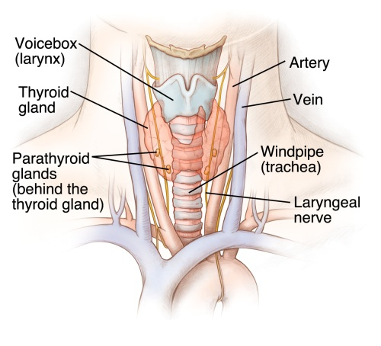
PARATHYROID ANATOMY
The parathyroid glands are two pairs of small, oval-shaped glands. They are located next to the two thyroid gland lobes in the neck. Each gland is usually about the size of a pea.

Slide 11
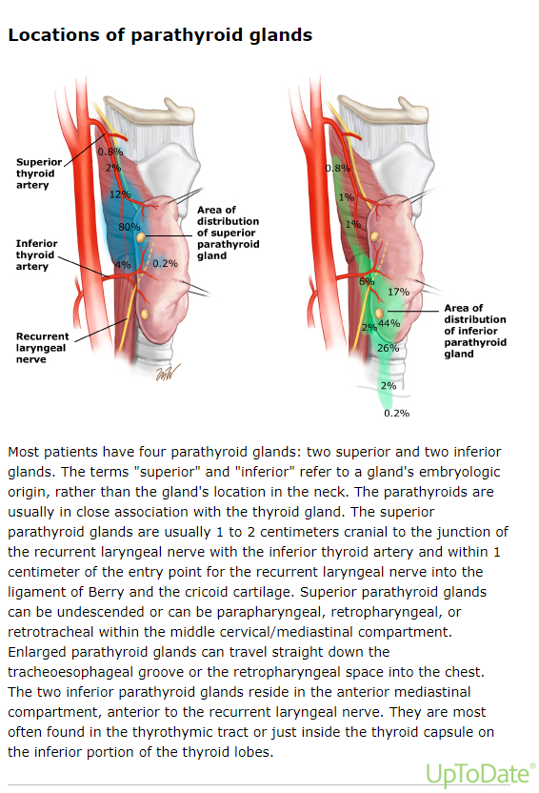

Slide 12
PARATHYROID PHYSIOLOGY
The parathyroid glands produce and secrete PTH, a peptide hormone, in response to low blood calcium levels.The parathyroid hormone stimulates the following functions:
Release of calcium by bones into the bloodstream
Absorption of calcium from food by the intestines
Conservation of calcium by the kidneys
Stimulates cells in the kidney to transforms weaker forms of vitamin D into the form that is strongest at absorbing calcium from the intestines

Slide 14
Introduction
Parathyroid Adenomas are abnormal growth of Parathyroid glands.
A parathyroid adenoma is part of a spectrum of parathyroid disease that also includes parathyroid hyperplasia and parathyroid carcinoma. History of radiation therapy and long-term calcium deficiency predisposes patients to parathyroid disease later in life.

Slide 15
Pathophysiology
Parathyroid adenoma results in an increase in parathyroid hormone secretion.
Calcium sensing receptor expression in reduced in parathyroid adenoma resulting in an increase in calcium sensing set point.
This in turn leads to increase in secretion of PTH in presence of normal serum concentration of extracellular ionized calcium.

Slide 16
Pathophysiology

Slide 17
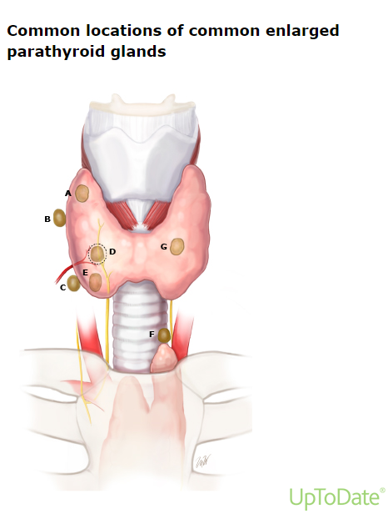

Slide 18
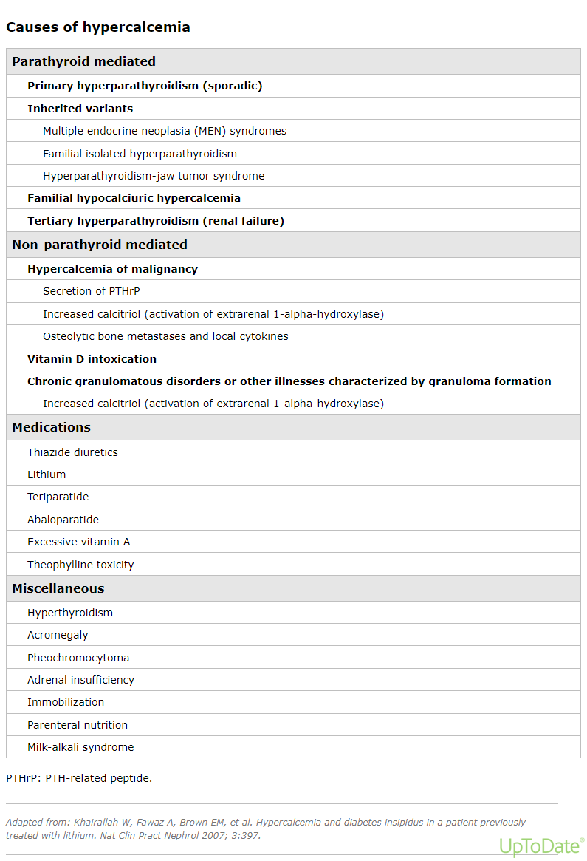

Slide 19
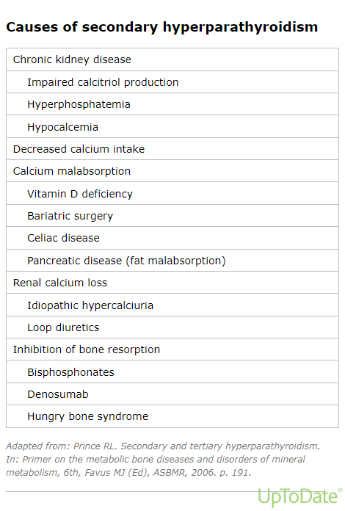

Slide 20
Clinical Menifestation
Asymptomatic
The most common clinical presentation of primary hyperparathyroidism (PHPT) is asymptomatic hypercalcemia detected by routine biochemical screening
Symptomatic Primary Hyperparathyroidsim
The classical symptoms and signs of PHPT are known as the bones, stones, abdominal moans, and psychic groans.
Classical manifestations
The classical manifestations of primary hyperparathyroidism (PHPT) are bone disease (bone pain, fractures, cysts, osteitis fibrosa cystica), nephrolithiasis/nephrocalcinosis, and proximal myopathy.

Slide 22
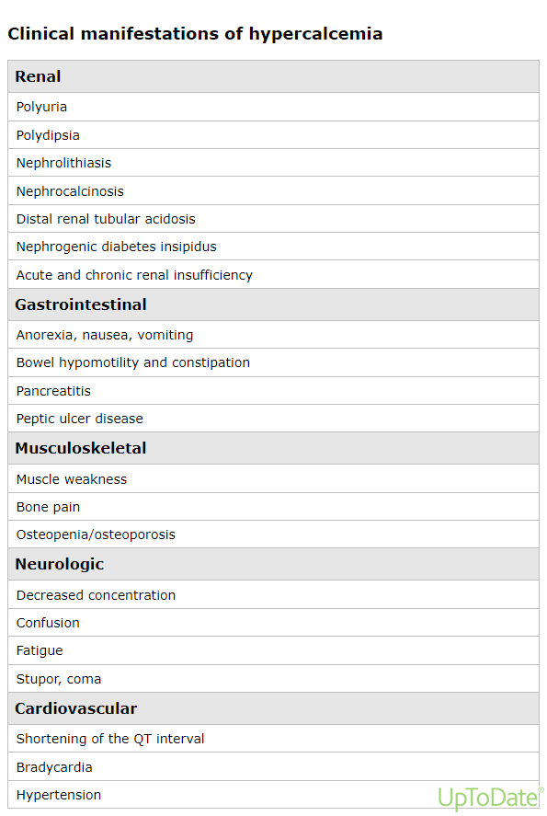

Slide 23
INVESTIGATIONS
Serum calcium
Serum PTH
24-hour urinary calcium
Serum 25-hydroxyvitamin D
Serum phosphorus
Neck ultrasonography
Subtraction thyroid scan
4D Parathyroid CT
MRI
Sestamibi scintigraphy
Vertebral imaging
Kidney imaging
Markers of bone turnover

Slide 24
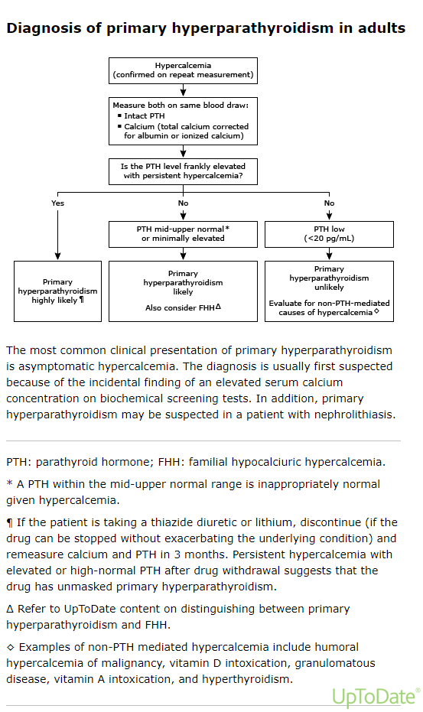

Slide 25
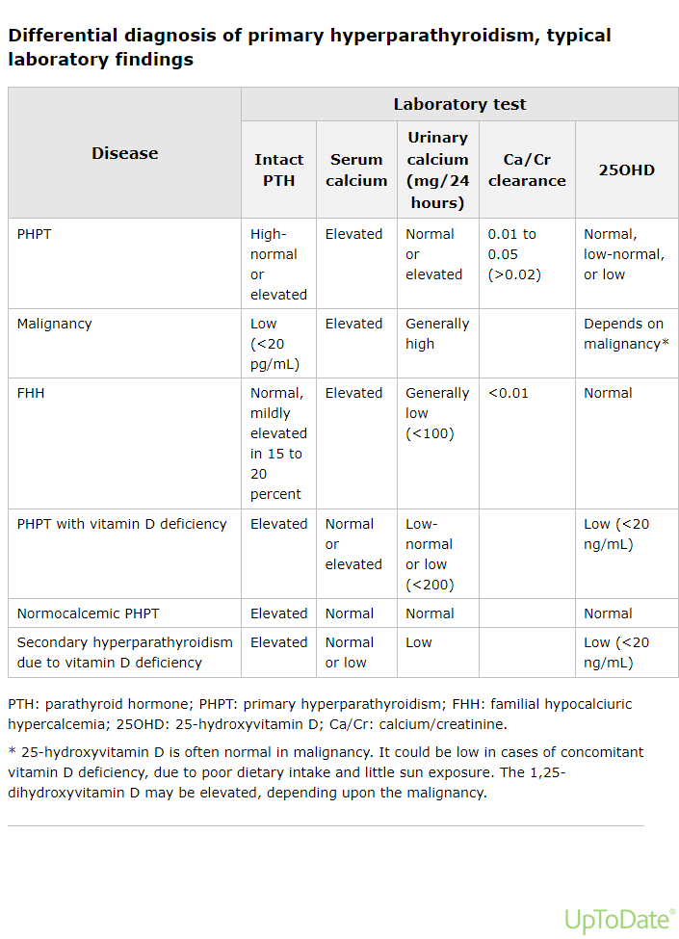

Slide 26
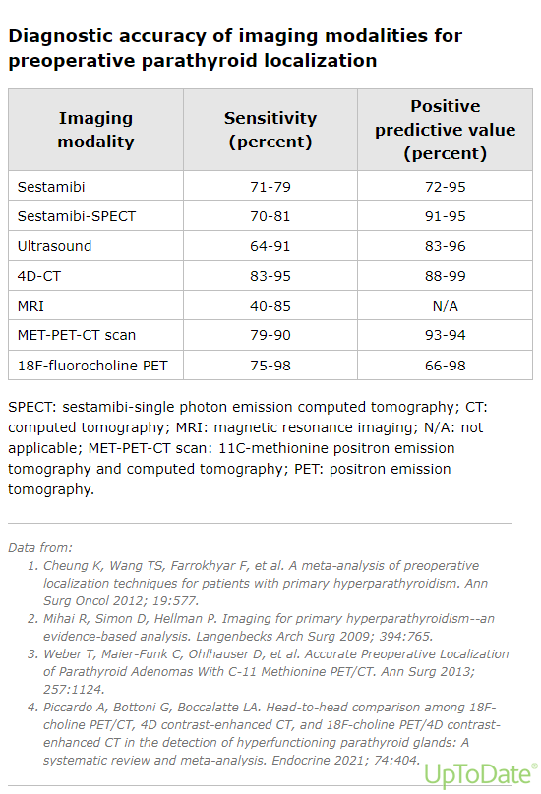

Slide 27
Surgical Treatment Options
Patients with symptomatic primary hyperparathyroidism(PHPT;nephrolithiasissymptomatic hypercalcemia) should have parathyroid surgery, which is the only definitive therapy.Surgical Treatment Options include:
Traditional Parathyroidectomy
Subtotal Parathyroidectomy
Total Parathyroidectomy
Scarless (Transoral) Parathyroidectomy

Slide 28
Parathyroidectomy
Subtotal Parathyroidectomy
The basic concept of this operation is to remove nearly all abnormal parathyroid glands, leaving only a well-vascularized remnant of one gland in its anatomic location.
Total parathyroidectomy with heterotopic autotransplantation
This procedure removes all cervical parathyroid glands that can be identified and simultaneously autotransplants a small portion of a gland to a new, nonanatomic site.
Total parathyroidectomy without autotransplantation
Total parathyroidectomy without autotransplantation is the most effective surgical treatment for patients with severe refractory HPT

Slide 29
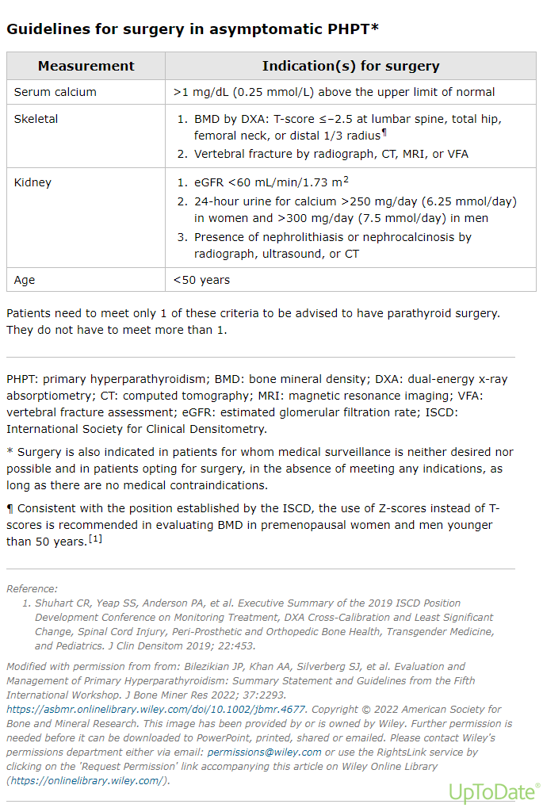

Slide 30
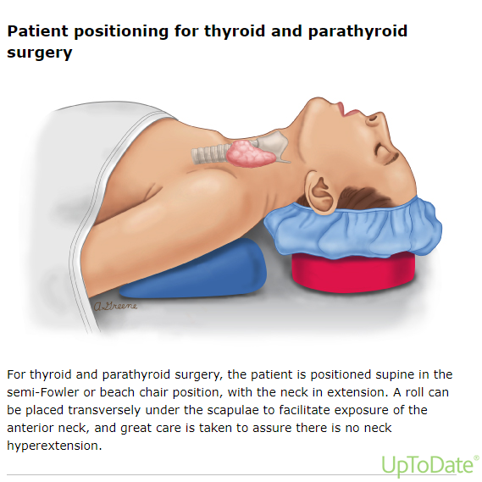

Slide 31
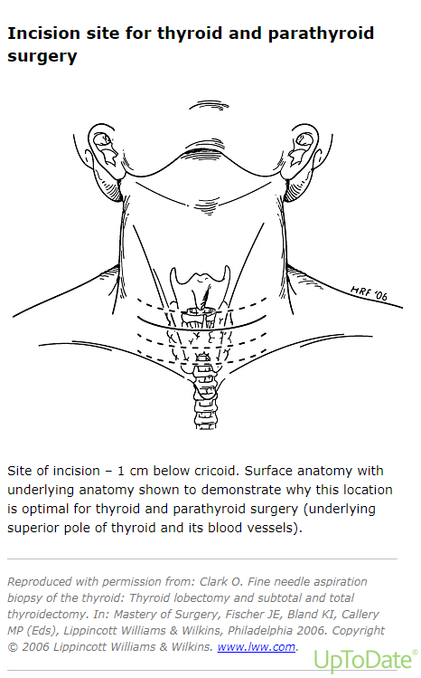

Slide 32
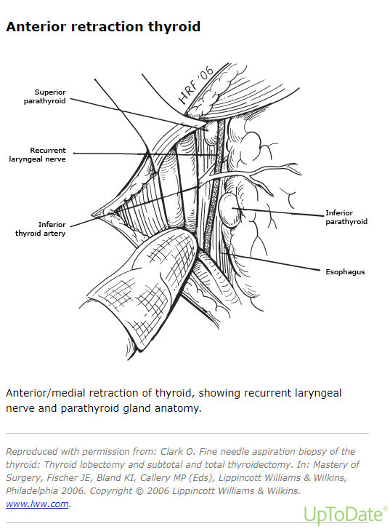

Slide 33
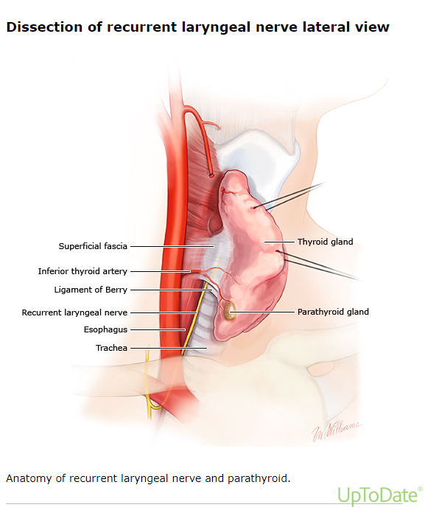

Slide 34
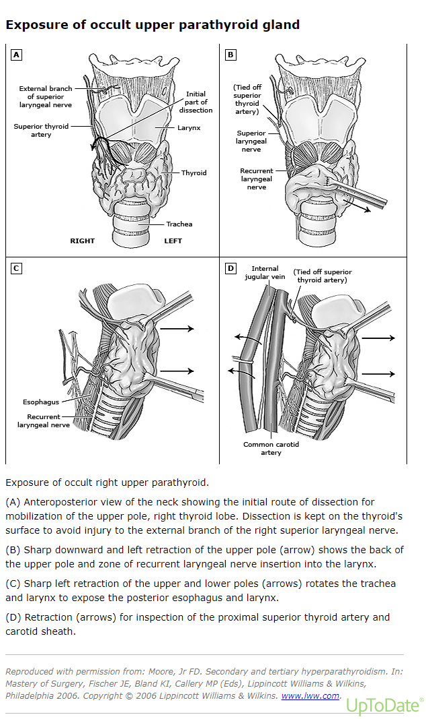

Slide 35
REFERENCES
Bliss RD, Gauger PG, Delbridge LW. Surgeon's approach to the thyroid gland: surgical anatomy and the importance of technique. World J Surg 2000; 24:891.
Richards ML, Thompson GB, Farley DR, Grant CS. Reoperative parathyroidectomy in 228 patients during the era of minimal-access surgery and intraoperative parathyroid hormone monitoring. Am J Surg 2008; 196:937.
Wilhelm SM, Wang TS, Ruan DT, et al. The American Association of Endocrine Surgeons Guidelines for Definitive Management of Primary Hyperparathyroidism. JAMA Surg 2016; 151:959. Silverberg SJ, Clarke BL, Peacock M, et al. Current issues in the presentation of asymptomatic primary hyperparathyroidism: proceedings of the Fourth International Workshop. J Clin Endocrinol Metab 2014; 99:3580.
Cusano NE, Silverberg SJ, Bilezikian JP. Normocalcemic primary hyperparathyroidism. J Clin Densitom 2013; 16:33.
Crowley RK, Gittoes NJ. Elevated PTH with normal serum calcium level: a structured approach. Clin Endocrinol (Oxf) 2016; 84:809.
Rosário PW, Calsolari MR. Normocalcemic Primary Hyperparathyroidism in Adults Without a History of Nephrolithiasis or Fractures: A Prospective Study. Horm Metab Res 2019; 51:243.

Slide 36
Any Question?
Thankyou

