Slide 1
Pregnancy and renal disease
Dr. ASMARA ASRAR
Assistant Professor Nephrology Department HFH

Slide 2
MOTTO AND VISION
Mission Statement
To impart evidence-based research-oriented health professional education
Best possible patient care Mutual respect, ethical practice of healthcare and social accountability.
Vision and Values
Highly recognized and accredited centre of excellence in Medical Education, using evidence-based training techniques for development of highly competent health professionals, who are lifelong experiential learner and are socially accountable.
Goals
The Undergraduate Integrated Learning Program is geared to provide you with quality medical education in an
environment designed to:

Slide 3
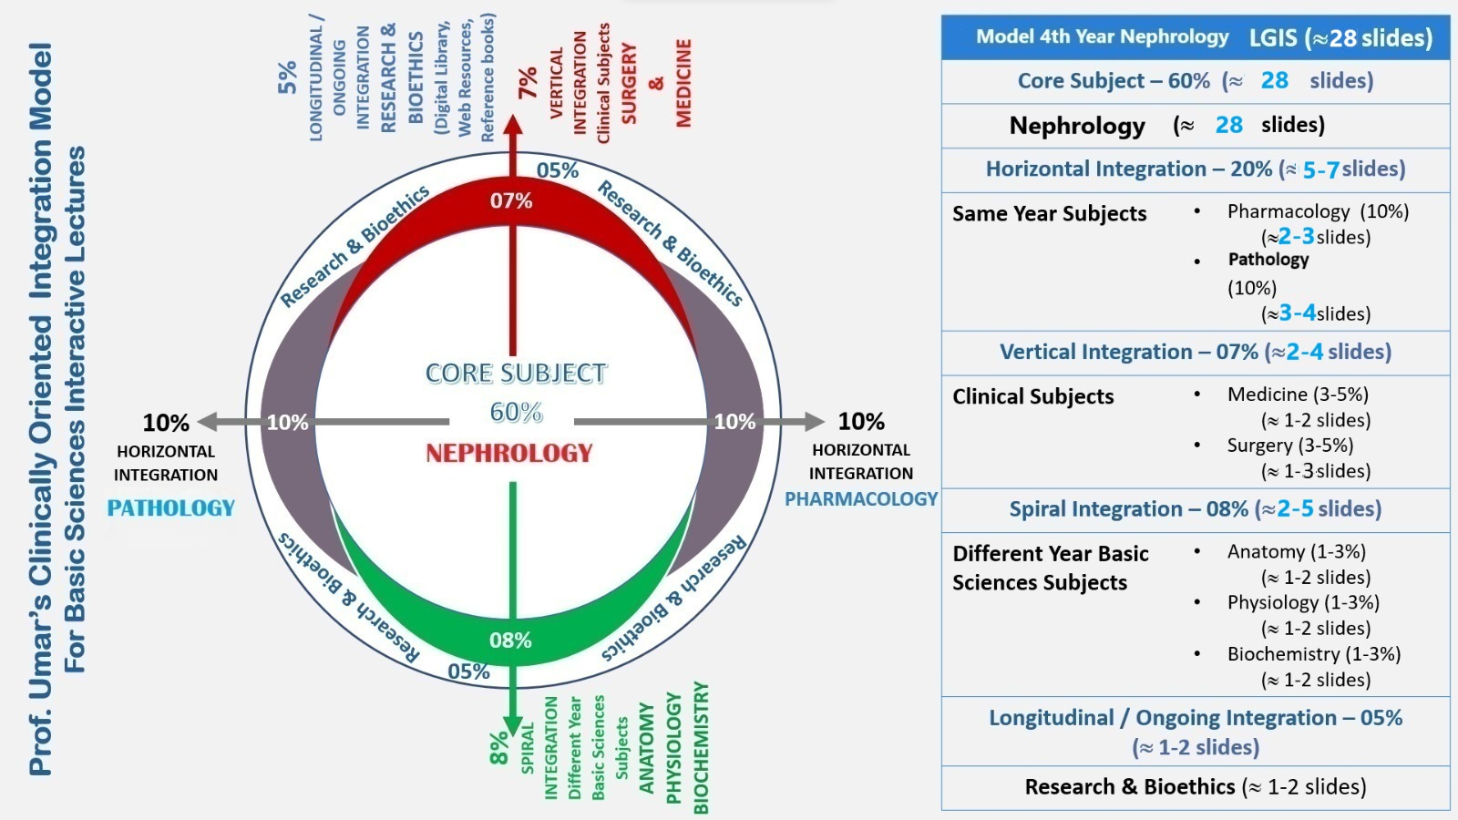

Slide 4
LEARNING OBJECTIVES
RENAL PHYSIOLOGY IN PREGNANCY
RENAL COMPLICATION IN PREGNANCY

Slide 5
Renal physiology in Pregnancy
Renal plasma flow increases by 80 percent
GFR increases by 50 percent
Renal sizes increase by 1-1.5 cm
Dilatation of renal pelvis, calyces and ureter
Renal volume increases by 30 %
Notes:
Plasma volume increases by 1.25L upto 32 -34 weeks of gestation
Cardiac output increases by 50 %
Systemic blood pressure decreases

Slide 6
Renal physiology in Pregnancy
Notes:
Serum creatinine concentration decreases to 0.4 to 0.8 mg/dl
Plasma volume expansion and decrease in oncotic pressure increases GFR
B-HCG and relaxin play a role in resetting vasopressin release respone
Serum osm decreases to 270 osm/L

Slide 7
Renal physiology in Pregnancy

Slide 8
Renal physiology in Pregnancy
Potassium remain in lower normal limits
Increased urinary calcium excretion
Uric acid falls in early pregnancy and regains normal values by 37 weeks of gestation
Mild respiratory alkalosis
Urinary protein excretion increases
Increased glycosuria
Notes:
Potasium remain low due to ant mineralocorticoid effect of progesterone
Excretion of Mg, citrate, acidic glycoproteins and nephrocalcin decrease risk of calcium stone formation.
Alkalosis may be due to the effect of progesterone
Proteinuria of upto 300 mg/day is normal in pregnancy
Increased glucose filteration coupled by decreased tubular reabsorption

Slide 9
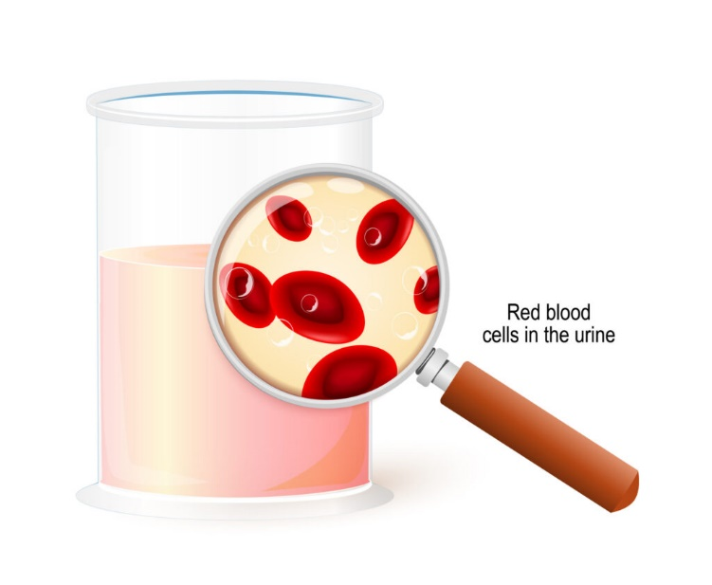
Renal Complications in Pregnancy
MICROHEMATURIA
Disappears in 75 % of the affected women after delivery.
Dysmorphic hematuria, indicates GN, LN or Pre-eclampsia
Isomorphic hematuria, bladder infection or compression
MACROHEMATURIA
Vaginal bleeding
Hemorrhagic bacterial cystitis
Renal calculi
Renal AVM
Adult PCKD
Renal neoplasm
Notes:
In 20 % of pregnant women, >3 RBCs/ HPF or greater then 2500 rbc/ml
If microhematuria is present, exclude infection. if no proteinuria and normal BP and RFTs further investigation can be delayed until 3 months post partum

Slide 10
Renal Complications in Pregnancy
PROTEINURIA
May be asymptomatic
Associated with GN
Associated with Pre-eclampsia
Associated with chronic systemic disease
24 hours urinary protein gold standard test > 300 mg /day
Urinary protein: creatinine 0.3 mg/mg or 30 mg/mmol
Notes:
Rise in urinary protein excretion in pregnancy, more in twins and it takes 5 to 6 months to resolve.
Usually renal biopsy not indicated except in nephrotic syndrome or worsening renal parameters where specific treatment may be beneficial
Proteinuria secondary to pre eclampsia and asymptomatic proteinuria usually resolves 3 months to maximum of 12 months post partum.

Slide 11
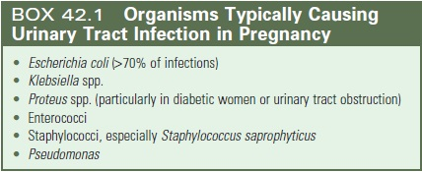
Renal Complications in Pregnancy
URINARY TRACT INFECTION
Asymptomatic bacteriuria
Acute bacterial cystitis
Acute pyelonephritis
Notes:
In ASB Urinary tract is colonized with a single specie of bacteria without any symptoms. Outside pregnancy ASB should not be treated with antibiotics, but in pregnancy treat to prevent pyelonephritis
ABC is characterized by uti with symptoms such as frequency, dysuria or stranguary.
In Acute pyelo there is fever, loin pain and systemic sepsis
Women who do not have antiobodies to O antigen of E.coli may have ASB. Dilated calyces, pelves, ureter can also cause ASB

Slide 12
Renal Complications in Pregnancy

Slide 13
Renal Complications in Pregnancy
RENAL CALCULI
Incidence is same as in non-pregnant women
Rarely present as acute flank pain radiating to groin, may present as hematuria
75-85 % stones pass spontaneously
For diagnosis transabdominal USG, Transvaginal USG, MR urography or low dose CT KUB ( in second or third trimester)
Conservative treatment with hydration, analgesics and antiemetic.
Surgical intervention only when stone causes obstruction, worsens renal parameters, intractable pain, infection or premature labor
Notes:
Majority stones are calcium oxalate or calcium phosphate stone
Next are struvite stones most common
Transabdominal USG rarely picks ureteral stones, if pain persists transvaginal USG may pick distal ureteral stone
Cystoscopy with uretral stenting or ureteroscopic removal of stone
Lithotripsy is avoided due to fetal adverse affects

Slide 14
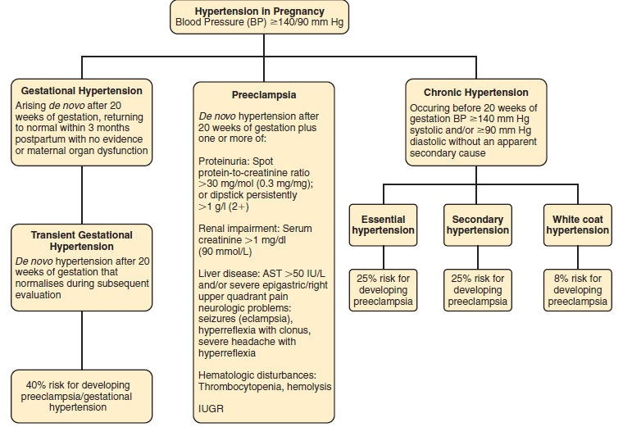
Renal Complications in Pregnancy
HYPERTENSION

Slide 15
Renal Complications in Pregnancy
PRE-ECLAMPSIA
Defined as hypertension manifesting after 20 weeks of gestation, with one or more of the following:
Proteinuria
Maternal organ dysfunction
Utero-placental dysfunction

Slide 16
Renal Complications in Pregnancy
Notes:
Renal impairment with creat >1
Liver impairment with raised bilirubin and elevated transaminases, RUQ pain or epigastric pain
Neurological impairment as fits, visual impairment, headache, hyperreflexia, clonus
Cardiac may present as pulmonary edema
Hematological complications
Utero-placental dysfunction i.e IUGR

Slide 17
Renal Complications in Pregnancy

Slide 18
Renal Complications in Pregnancy
Notes:
Placenta is the cause of pre-eclampsia
Abnormal placental implantation leading to placental hypoxia/ischemia
Ischemia/reperfusion injury causing maternal inflammatory response
PIGF ( placental growth factor) and VEGF bind to Soluble fms like tyrosine kinase ( Sflt-1) which is triggered by placental ischemia, due to which VEGF and PIGF cannot bind to endothelial receptor on cell surface leading to endothelial dysfunction and increase sestivity to inflammatory cytokines

Slide 19
Renal Complications in Pregnancy

Slide 20
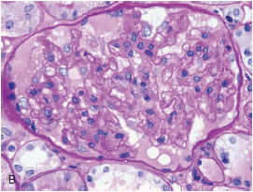
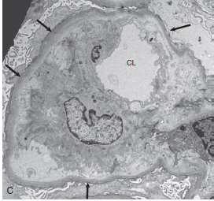
Renal Complications in Pregnancy
Notes:
Normal glomeruli
Occlusion of capillary lumen by swollen endothelial cells
Capillary basement membrane and marked occlusion of capillary lumen

Slide 21
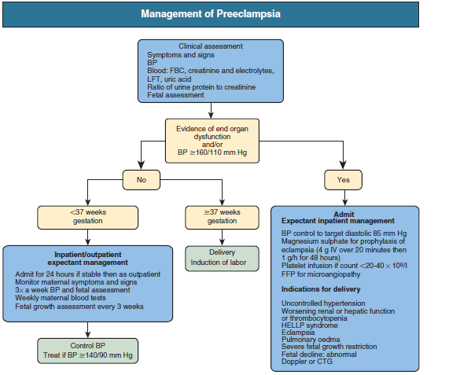
Renal Complications in Pregnancy
TREATMENT OF PRE-ECLAMPSIA
Definitive treatment is delivery of placenta
Indication of delivery are
Progressive evidence of maternal organ dysfunction
Inability to control B.P
Failure of fetal growth
Gestational age beyond 37 weeks

Slide 22
Renal Complications in Pregnancy

Slide 23
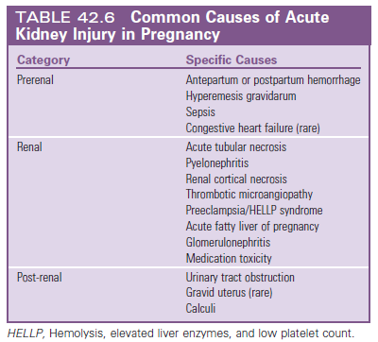
Renal Complications in Pregnancy
ACUTE KIDNEY INJURY
Serum creatinine of more than 1mg/dl or and increase in serum creatinine of more than 0.5 mg/dl from baseline in less than 48 hours.

Slide 24
Renal Complications in Pregnancy
ACUTE KIDNEY INJURY
Treatment
Mainstay of treatment is correction of the fluid deficit, delivery of placenta and fetus in later stages of pregnancy
Dialysis should be commenced earlier in pregnant women as the uremic environment has a negative effect on fetal survival
Hemodialysis is required more frequently in pregnant women

Slide 25
HOW TO ACCESS DIGITAL LIBRARY
Go to the website of HEC National Digital Library.
On Home Page, click on the INSTITUTES.
A page will appear showing the universities from Public and Private Sector and other Institutes which have access to HEC National Digital Library HNDL.
Select your desired Institute.
A page will appear showing the resources of the institution
Journals and Researches will appear
You can find a Journal by clicking on JOURNALS AND DATABASE and enter a keyword to search for your desired journal.

Slide 26
QUESTION 1
A 30-year-old woman with chronic kidney disease (CKD) stage 3 is planning to become pregnant. What is the most important consideration for her pregnancy outcome?
A) Close monitoring of blood pressure
B) Strict control of blood glucose
C) Avoidance of non-steroidal anti-inflammatory drugs (NSAIDs)
D) Assessment of kidney function and potential need for dialysis

Slide 27
qUESTION 2
A pregnant woman develops preeclampsia at 28 weeks of gestation. Which of the following is a potential renal complication of preeclampsia?
A) Acute kidney injury (AKI)
B) Chronic kidney disease (CKD)
C) Nephrotic syndrome
D) Hemolytic-uremic syndrome (HUS)

Slide 28
ANSWERS
Answer 1: D) Assessment of kidney function and potential need for dialysis
Answer 2: A) Acute kidney injury (AKI)
THANKYOU

