Slide 2
Foundation Module First Year MBBS
Introduction to Wintrobe & Westergen tube
Supervised by Prof. Samia Sarwar Chairperson Physiology Presenter :Dr. (FCPS PHY)
Dated : 00-00-2025
Physiology Department

Slide 3
Motto, Vision, Dream
To impart evidence based research oriented medical education
To provide best possible patient care
To inculcate the values of mutual respect and ethical practice of medicine
Wisdom
Truth
Service

Slide 4
Professor Umar Model of Integrated Lecture

Slide 5
Learning Objectives
To describe the physiological basis of ESR and its clinical significance.
To discuss the advantages and disadvantages of the ESR determination by Westergren and Wintrobe methods
To perform ESR measurement on a sample using the Westergren and Wintrobe methods.
To apply knowledge of ESR measurement in a clinical context to assist in making diagnostic decisions

Slide 6
Interactive Session

Slide 7
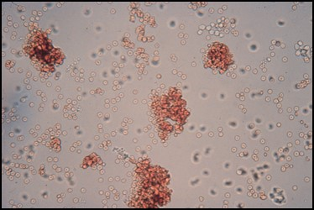
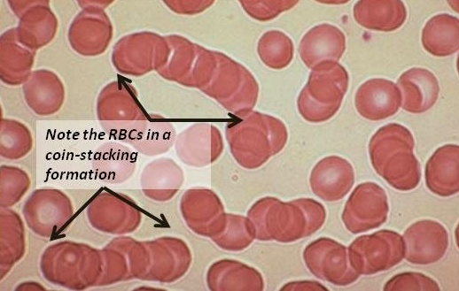
Autoagglutination vs Rouleaux Formation
Horizontal Integration with Histology
Rouleaux formation is the linking of RBCs into chains resembling stacks of coins.

Slide 8
Introduction
Core Concept
Definition
Erythrocyte sedimentation rate is the rate of fall (sedimentation) of red cells when anticoagulated blood is allowed to stand undisturbed for a specified period, usually 1 hour.
Expressed in mm/hr.
A nonspecific test
Used as an index of the presence and extent of inflammation (the so-called 'acute phase response' ) and its response to treatment, e.g., tuberculosis, and rheumatoid arthritis.

Slide 9
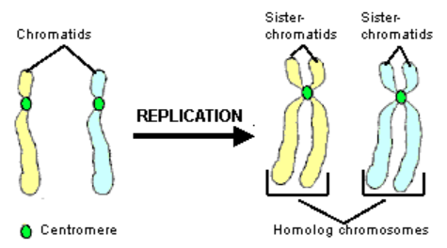
Clinical Significance
Core Concept
Raised in:
Majority of acute or chronic infections
Most neoplastic and degenerative diseases

Slide 10
Principle
Core Concept
The ESR is determined by filling a narrow pipette of predetermined length and bore, with well-mixed anticoagulated blood and placing it in a vertical position for a set time at the end of which the distance from the top of the column to the interface between the plasma and the sedimented red cells is recorded and expressed in mm/unit time.

Slide 11
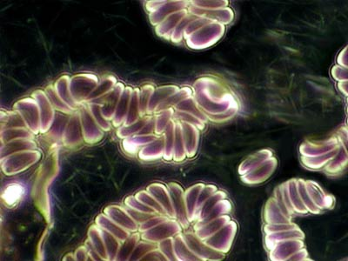
Stages in ESR
Core Concept
ESR has three stages:
An initial period of 10 minutes → rouleaux formation takes place
ii. A period of approximately 40 minutes → settling or sedimentation occurs at a constant rate, and
iii. A slower rate of fall (last 10 minutes)→ packing of the sedimented red cell column occurs.
* The second stage is the most significant phase.
RBCs Rouleaux

Slide 12
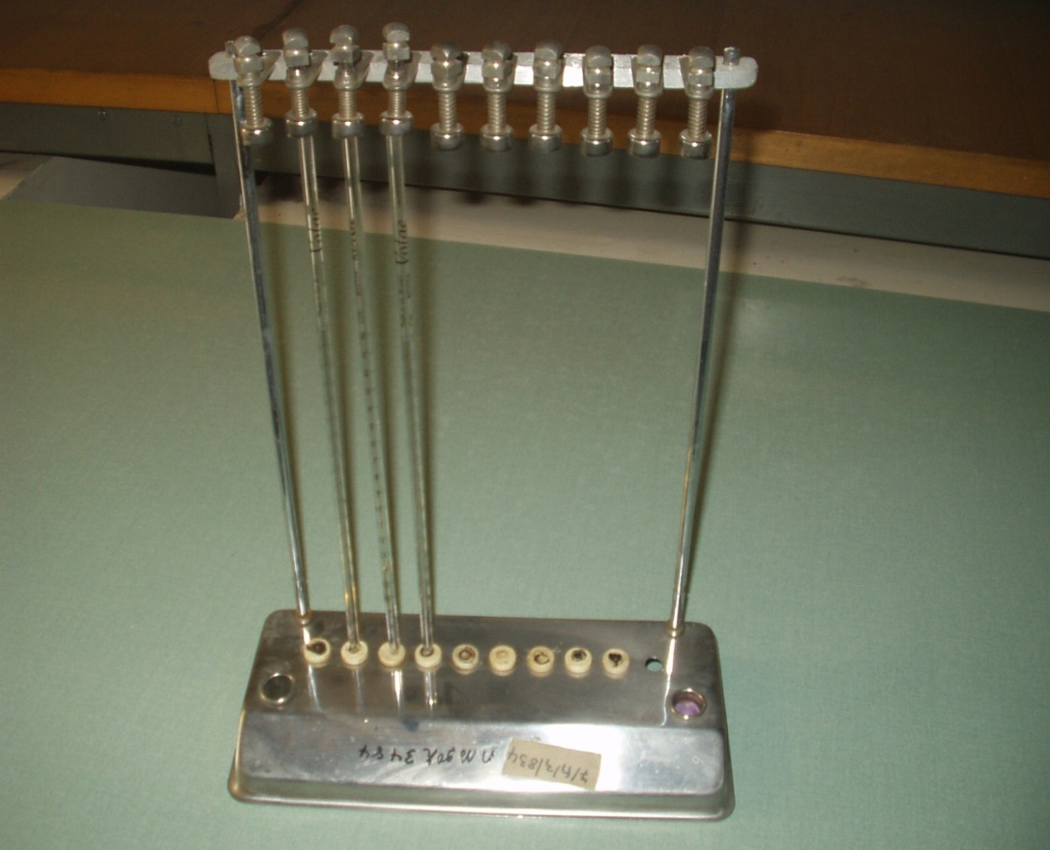
Determination of ESR
Core Concept
Two basic methods
Westergren Method
Wintrobe method
The Westergren Method
This is the ICSH reference method for ESR determination.
Westergren rack or stand with an open glass tube

Slide 13
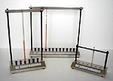
Core Concept
‘A type of cell division in which parent cell divides into two daughter cells and each of two daughter cells receive a chromosomal karyotype identical to parent cells’
Westergren rack & tube filled with blood sample

Slide 14
Procedure
Core Concept
Venous blood is diluted accurately in the proportion of one volume of citrate to four volumes of blood.
The blood may be directly collected into the citrate solution or an EDTA anticoagulated blood used.
Mix thoroughly by gentle repeated inversion.
ESR preparations should preferably be set up within 2 hrs of blood collection, but under extenuating circumstances may be refrigerated overnight at 4oC before testing.
2. A clean dry Westergren-Katz pipette is carefully filled and adjusted to the "0" mark on top.

Slide 15
Westergren Method Cont’d..
Core Concept
The pipet is placed in a strictly vertical position in the Westergren stand
under room temperature conditions
not exposed to direct sunlight and
away from vibrations and draughts
Allow it to stand for exactly 1 hour
After 1 hour read to the nearest 1mm the height of the clear plasma above the upper limit of the column of sedimenting red cells.

Slide 16
Westergren Method Cont’d..
Core Concept
Reporting
The result is expressed as ESR = X mm/hr
∗ A poor delineation of the upper layer of red cells, the so-called ‘stratified sedimentation’, has been attributed to the presence of many reticulocytes.

Slide 17
Westergren Method Cont’d..
Core Concept
Advantages
It more reliably reflects the clinical state
is the most sensitive method for serial study of chronic diseases, e.g., tuberculosis.
Disadvantages
Requires a large amount of blood.
Involves dilution which may be one source of error.
Normal Range:
Men: 0-15mm/hr
Women: 0-20mm/hr

Slide 18
The Wintrobe Method
Core Concept
Utilizes a tube closed at one end
Tube has a length of 11cm
Bore diameter of the tube is 2.5mm
Features a graduated scale ranging from 0-100mm
Requires a special Wintrobe rack for the ESR determination process.
Wintrobe rack

Slide 19
Procedure
Core Concept
1. Blood is collected with EDTA in the right proportion.
2. Enough blood to fill the Wintrobe tube (approximately 1ml) is drawn into a Pasteur pipette having a long stem.
3. The Wintrobe tube is then filled from the bottom up (so as to exclude any air -bubbles) to the "0" mark.
4. The tube is placed in the Wintrobe rack in exactly vertical position and the time is noted.
5. At the end of 1hour the ESR is read as the length of the plasma column above the cells and is expressed as x mm/hr.

Slide 20
Wintrobe method cont’d
Core Concept
Advantages
The method is:
simple
requires a small amount of blood
no dilution required
With the same preparation, once the ESR has been read, the hematocrit value can be determined after centrifugation.
Microbilirubin determination can be made on supernatant plasma and smears of buffy coat can be made.

Slide 21
Wintrobe Method Cont’d..
Core Concept
Disadvantages
Because of the short column, it is only sensitive when the ESR is low and when the disease is in the acute stage.
Normal Range
Men: 0-7mm/hr
Women: 0-15mm/hr

Slide 22
Quality control
Core Concept
Strictly adhere to SOP (timing, positioning the ESR rack, etc)!
Quality control samples are commercially available
Sources of error
Improper filling of tubes
Old specimen (should be performed within 2 hours of collection)
Cold agglutinins can cause a falsely elevated ESR
Clotted and hemolysed samples

Slide 23
Technical Tips
Core Concept
Tube must be completely filled to the zero mark
Hemolyzed specimen is not accepted
There should be no air bubble
Refrigerated specimens must come to room temperature for 30 minutes prior to testing
refrigerated sample is used within 24 hours, if the test can not be performed within 2 hours of sample collection
The ESR rack must be on a level surface and free of vibration
Strictly follow SOP

Slide 24
Vertical Integration

Slide 25
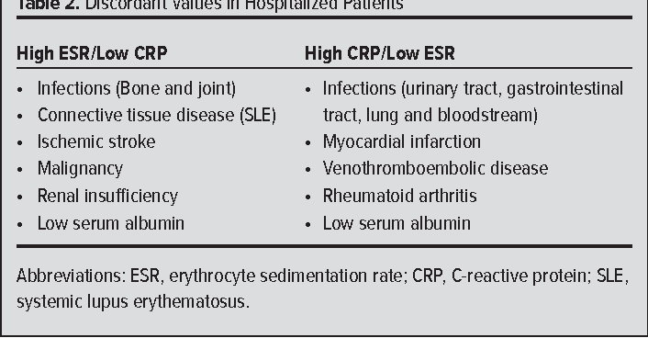
ESR & C-reactive Protein Measurements and Their Relevance in Clinical Medicine
Vertical Integration with Internal Medicine

Slide 26
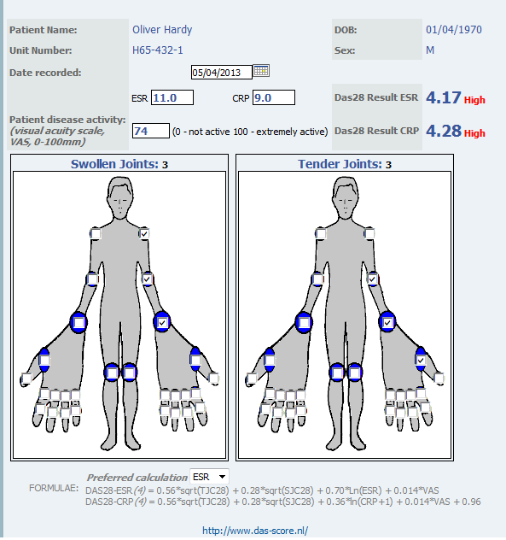
DAS28-ESR for Rheumatoid Arthritis
Vertical Integration/Internal Medicine
Vertical Integration with Internal Medicine

Slide 27
Spiral Integration

Slide 28
Autonomy
Spiral Integration with Biomedical Ethics
Autonomy means that the patients are able to make independent decisions. This means that doctors & nurses should be sure patients have all of the needed information that is required to make a decision about their medical care and are educated. They do not influence the patient's choice.
The Right of Self-Determination or Autonomy would include the right to refuse treatment, the right to participate in research or refuse it. To exercise this right would require Informed Consent.

Slide 29
Non-maleficence (Lesson of the day)
Spiral Integration/Biomedical Ethics
Spiral Integration with Biomedical Ethics
The principle of non-maleficence holds that there is an obligation not to inflict harm on others.
Example: stopping a medication known to be harmful or refusing to give a medication to a patient if it has not been proven to be effective.

Slide 30
Research

Slide 31
Suggested Research Article
Spiral Integration with Research

Slide 32
How To Access Digital Library
Promoting IT & Research Culture
Steps to Access HEC Digital Library
Go to the website of HEC National Digital Library.
On Home Page, click on the INSTITUTES.
A page will appear showing the universities from Public and Private Sector and other Institutes which have access to HEC National Digital Library HNDL.
Select your desired Institute.
5. A page will appear showing the resources of the institution
6. Journals and Researches will appear
7. You can find a Journal by clicking on JOURNALS AND DATABASE and enter a keyword to search for your desired journal. Link:https://www.topstudyworld.com/2020/05/access-hec-digital-library.html?m=1

Slide 33
Brainstorming

Slide 34
Structured Essay Question Related To Topic
Brainstorming
Question 1:
Define ESR.

Slide 35
Answer
Brainstorming
The Erythrocyte Sedimentation Rate (ESR) is a blood test that gauges the speed at which red blood cells settle, serving as a general marker for inflammation in the body and aiding in the detection and monitoring of various inflammatory conditions.

Slide 36
Structured Essay Question Related To Topic
Brainstorming
Question 2: List the items required in ESR determination using the Westergren method.

Slide 37
Brainstorming
Blood Sample (collected in an EDTA tube)
Westergren ESR Tube
Rack or Stand
Timer or Stopwatch
Laboratory Pipette
Mixing Device
Paper or Plastic Capillary Stopper
Clean Cloth or Tissue
Incubator or Room Temperature Control (if needed)
Refrigerator (if needed)

Slide 38
References
References
Guyton AC, Hall JE. Textbook of Medical Physiology. 14th ed. Philadelphia, PA: Saunders; 2020
Boron WF, Boulpaep EL. Medical Physiology: A Cellular and Molecular Approach. 3rd ed. Philadelphia, PA: Elsevier; 2017.
Sherwood L. Human Physiology: From Cells to Systems. 10th ed. Boston, MA: Cengage Learning; 2020.
Widmaier EP, Raff H, Strang KT. Vander's Human Physiology: The Mechanisms of Body Function. 16th ed. New York, NY: McGraw-Hill Education; 2021.
Costanzo LS. Physiology. 7th ed. Philadelphia, PA: Saunders; 2021.
Research papers
https://doi.org/10.1097%2FMD.0000000000016816
YouTube Video
https://youtu.be/gy8RpErVsqc

