Slide 2
Foundation Module First Year MBBS
Apparatus identification(Introduction to centrifuge machine)
Supervised by Prof. Samia Sarwar Chairperson Physiology Presenter :Dr. (FCPS PHY)
Dated : 00-00-2025
Physiology Department

Slide 3
Motto, Vision, Dream
To impart evidence based research oriented medical education
To provide best possible patient care
To inculcate the values of mutual respect and ethical practice of medicine
Wisdom
Truth
Service

Slide 4
Professor Umar Model of Integrated Lecture

Slide 5
Learning Objectives
To Understand concept of Centrifuge Machine
To Explain Hematocrit
To Perform Procedure of Hematocrit measurement by the use of centrifuge machine

Slide 6
Interactive Session

Slide 7
Micro Hematocrit Centrifuge Machine
Core Concept

Slide 8
Points of Identification (Centrifuge Machine)
Core Concept
This machine is identified by its different parts which are as follows:
Power
Braker
Timer
Opening lid
Rotor

Slide 9
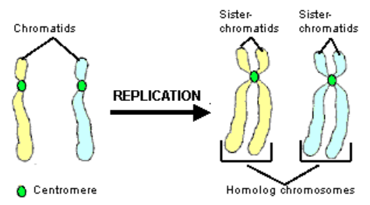
Principle of Centrifuge Machine
Core Concept
When anticoagulated whole blood is centrifuged, the space occupied by the packed red blood cells is defined as the hematocrit (HCT), and is expressed as the percent of red blood cells in a volume of whole blood.

Slide 10
Mechanism of Centrifuge Machine
Core Concept
A centrifuge works by using the principle of sedimentation: Under the influence of gravitational force (g-force), substances separate according to their density.

Slide 11
Function of Centrifuge Machine
Core Concept
Hematocrit is a blood test that measures how much of a person's blood is made up of red blood cells. This measurement depends on the number of and size of the red blood cells. Blood transports oxygen and nutrients to body tissues and returns waste and carbon dioxide.
Centrifuge Machine is used to measure hematocrit.

Slide 12
Development of Red Blood cells
Core Concept
Reference: Sherwood 9th Edition page number 384

Slide 13
Vertical Integration

Slide 14
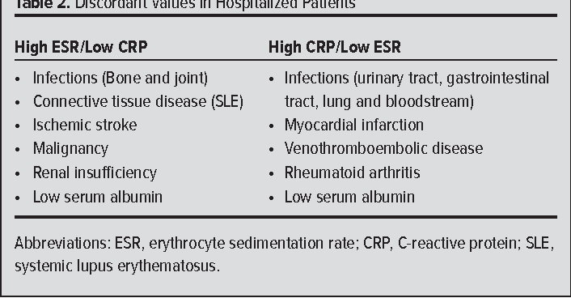
ESR & C-reactive Protein Measurements and Their Relevance in Clinical Medicine
Vertical Integration
Reference: Sherwood 9th Edition page number 387

Slide 15
Spiral Integration

Slide 16
Spiral Integration
A 70-year male smoker known case of severe chronic obstructive pulmonary disease presented to Family medicine outpatient department with complaints of shortness of breath, fatigue and dizziness. On examination his cheeks had reddish blue appearance, his CBC revealed 7 million /mm3 and hematocrit 70%. This condition is Polycythemia. What will be role of family physician in this condition?

Slide 17
Spiral Integration/Family Medicine
Approach of family physician in this scenario will be:
History
Examination
Appropriate investigations
Refer to patient to clinical hematologist.

Slide 18
Biomedical Ethics
Spiral Integration/ Ethics
Consent is the “autonomous authorization of a medical intervention by individual patients.
Relevant Case: If you want to draw sample of hospitalized patient, you must ask from patient before sampling.

Slide 19
Suggested Research Article
Spiral Integration/ Research
Journal Name: Microfluidics and Nanofluidics 2024
Reference: https://link.springer.com/article/10.1007

Slide 20
How To Access Digital Library
Promoting IT & Research Culture
Steps to Access HEC Digital Library
Go to the website of HEC National Digital Library.
On Home Page, click on the INSTITUTES.
A page will appear showing the universities from Public and Private Sector and other Institutes which have access to HEC National Digital Library HNDL.
Select your desired Institute.
5. A page will appear showing the resources of the institution
6. Journals and Researches will appear
7. You can find a Journal by clicking on JOURNALS AND DATABASE and enter a keyword to search for your desired journal. Link:https://www.topstudyworld.com/2020/05/access-hec-digital-library.html?m=1

Slide 21
Brainstorming

Slide 22
Structured Essay Question Related To Topic
Brainstorming
Q.NO.1: Mechanism of centrifugation is used for the measurement of:
Hematocrit
Erythrocyte sedimentation rate
Red blood cell count
Total leukocyte count
Bleeding time

Slide 23
Answer
Brainstorming
Q.NO.1: Mechanism of centrifugation is used for the measurement of:
Hematocrit*
Erythrocyte sedimentation rate
Red blood cell count
Total leukocyte count
Bleeding time

Slide 24
References
References
Books:
Guyton And Hall textbook of Medical Physiology 14th Edition
Ganong’s Review of Medical Physiology 25th Edition
Sherwood, 9th edition.
Silverthorn Physiology,6th edition
Vander’s Human Physiology,14th edition
Google images.
2.Medical Journal articles:
Reference: https://link.springer.com/article/10.1007
3.Video link /YouTube:
https://youtu.be/JtBtk00EiVM?si=y-2DAPW49eQwqU6N

Slide 25
Summary
Summary
Core knowledge:
Introduction to Centrifuge Machine
Integration:
Histology of Erythropoiesis
Research:
Label free cancer cell separation from whole blood on centrifugal micro fluidic platform using hydrodynamic technique
Biomedical Ethics: Consent is the “autonomous authorization of a medical intervention by individual patients.
Family Medicine: Polycythemia scenario

