Slide 2
Foundation Module First Year MBBS
Apparatus identification (Introduction to Neubauer’s chamber, Red Blood Cell (RBC) pipettes& White Blood Cell (WBC) pipette
Supervised by Prof. Samia Sarwar Chairperson Physiology Presenter : Dr. (FCPS PHY)
Dated : 00-00-2025
Physiology Department

Slide 3
Motto, Vision, Dream
To impart evidence based research oriented medical education
To provide best possible patient care
To inculcate the values of mutual respect and ethical practice of medicine
Wisdom
Truth
Service

Slide 4
Professor Umar Model of Integrated Lecture

Slide 5
Learning Objectives
To Understand Concept of Neubauer’s Chamber
To Explain Different Types of Cell Counts with the help of Neubauer’s Chamber
To Perform Procedure of Charging the Counting Chamber

Slide 6
Interactive Session

Slide 7
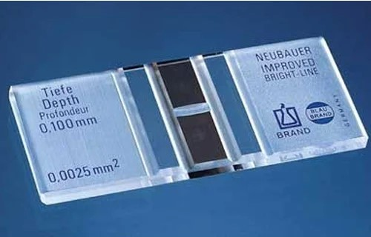
Improved Neubauer’s Chamber(Counting Chambers)
Core Concept

Slide 8
Improved Neubauer’s Chamber(Counting Chamber’s)
Core Concept
Single, solid, heavy glass slide.
Three parallel pillars seperated by gutters or troughs.
Central Pillar(Floor piece or Plateau):
Wider and 0.1mm lower
‘H shaped’ trench enclose 2 floor pieces
Counting Grids are etched on each floor piece

Slide 9
Improved Neubauer’s Chamber(Counting Chamber’s)
Core Concept
Lateral Pillars:
Support cover slip
Provide a capillary space 0.1mm deep between undersurface of cover slip and upper surface of floor piece.

Slide 10
Core Concept
Counting Grid:
9 large squares, each 1mm²
Four large corner squares divided into 16 medium sized squares, each of 1/4mm and area of 1/16mm².
Central densely etched large square called RBC Square is divided into 25 medium squares (each of 1/5mm).
Around the central RBC square are WBC squares.
Each 25 medium squares are divided into 16 smallest squares(each of 1/20mm and area of 1/400mm²)

Slide 11
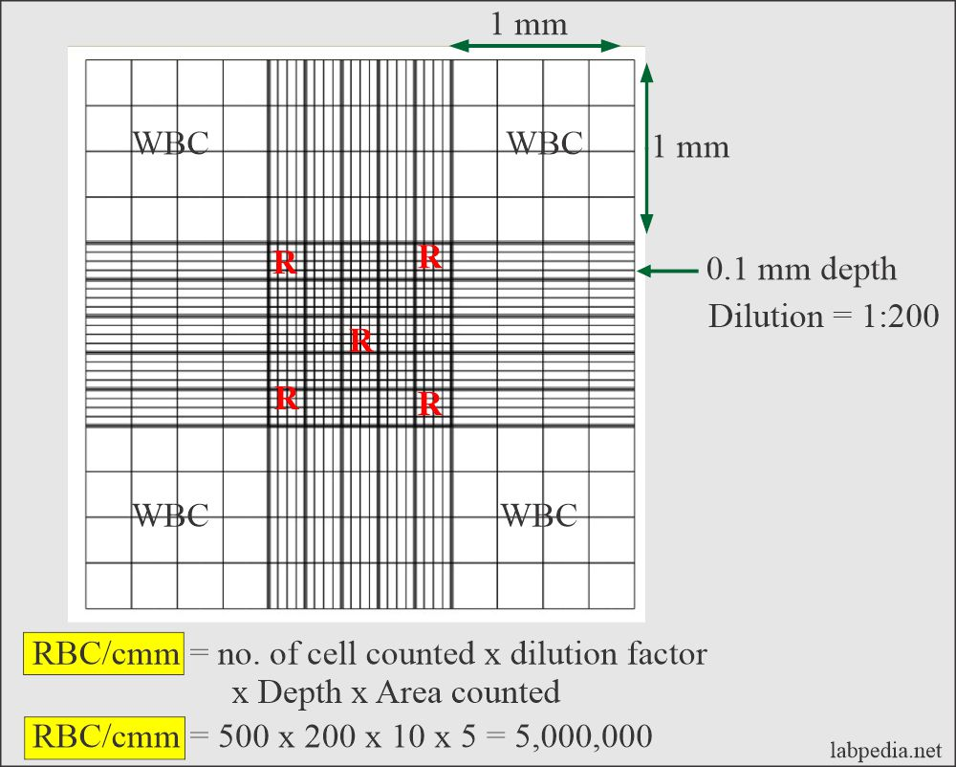
Cell Counting
Core Concept
ESR has three stages:
An initial period of 10 minutes → rouleaux formation takes place
ii. A period of approximately 40 minutes → settling or sedimentation occurs at a constant rate, and
iii. A slower rate of fall (last 10 minutes)→ packing of the sedimented red cell column occurs.
* The second stage is the most significant phase.
RBCs Rouleaux

Slide 12
Charging the Counting chamber
Core Concept
Mix blood and diluent properly and place a cover slip on the chamber and charge it.
Roll pipette between the palms.
Hold pipette at appropriate angle and allow drop of diluted blood to run under cover slip by capillary action and form a uniform film on floor piece.

Slide 13
Difference between RBC and WBC pipette
Core Concept
Venous blood is diluted accurately in the proportion of one volume of citrate to four volumes of blood.
The blood may be directly collected into the citrate solution or an EDTA anticoagulated blood used.
Mix thoroughly by gentle repeated inversion.
ESR preparations should preferably be set up within 2 hrs of blood collection, but under extenuating circumstances may be refrigerated overnight at 4oC before testing.
2. A clean dry Westergren-Katz pipette is carefully filled and adjusted to the "0" mark on top.
Red Blood Cell Pipette | White Blood cell Pipette
Size of lumen is larger. | Size of lumen is smaller.
It has gradation upto mark 101. | It has gradation upto mark 11.
Size of bulb is larger | Size of bulb is smaller
It has a red bead | It has a white bead

Slide 14
Westergren Method Cont’d..
Core Concept
The pipet is placed in a strictly vertical position in the Westergren stand
under room temperature conditions
not exposed to direct sunlight and
away from vibrations and draughts
Allow it to stand for exactly 1 hour
After 1 hour read to the nearest 1mm the height of the clear plasma above the upper limit of the column of sedimenting red cells.

Slide 15
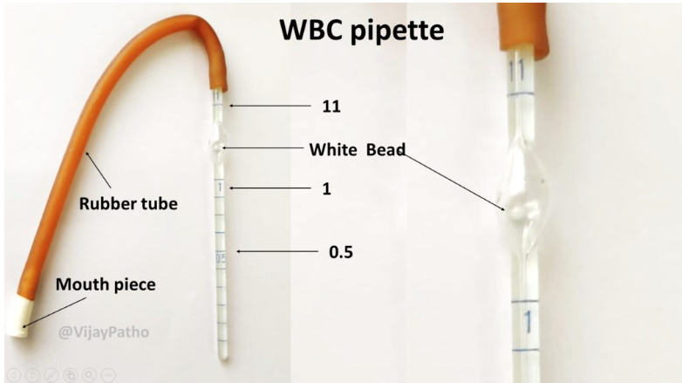
Westergren Method Cont’d..
Core Concept
Reporting
The result is expressed as ESR = X mm/hr
∗ A poor delineation of the upper layer of red cells, the so-called ‘stratified sedimentation’, has been attributed to the presence of many reticulocytes.

Slide 16
Vertical Integration

Slide 17
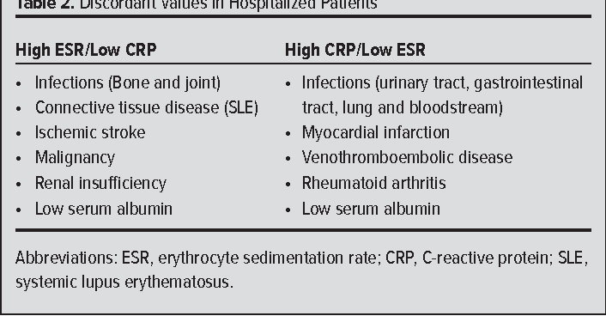
ESR & C-reactive Protein Measurements and Their Relevance in Clinical Medicine
Vertical Integration

Slide 18
Vertical Integration

Slide 19
Spiral Integration

Slide 20
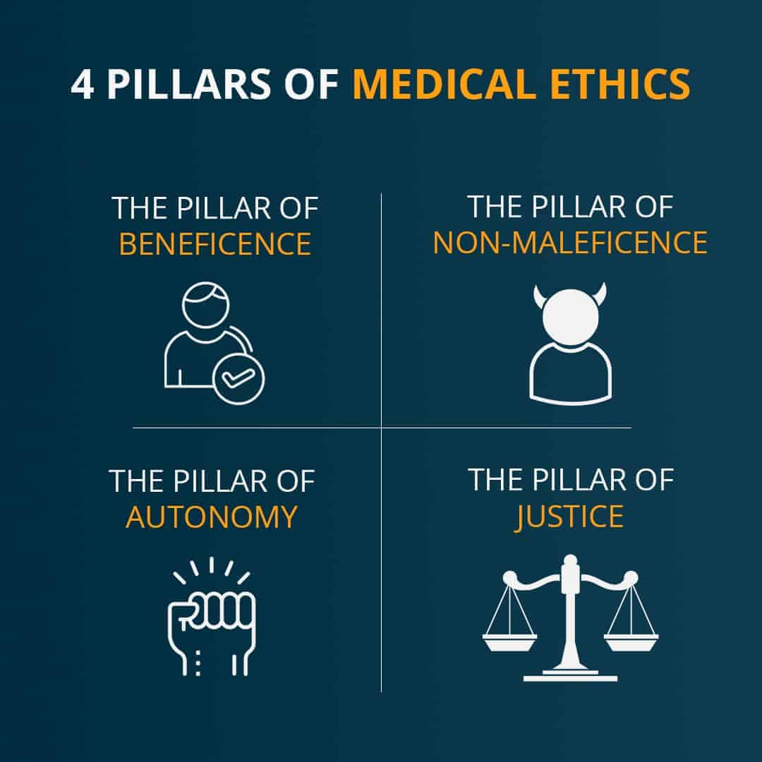
Autonomy
Spiral Integration/Ethics
Autonomy means that the patients are able to make independent decisions. This means that doctors & nurses should be sure patients have all of the needed information that is required to make a decision about their medical care and are educated. They do not influence the patient's choice.
The Right of Self-Determination or Autonomy would include the right to refuse treatment, the right to participate in research or refuse it. To exercise this right would require Informed Consent.

Slide 21
Role of Family Physician
Spiral Integration/Family Medicine
Case Scenario: A 14 years boy presented to the medical outpatient department with the complaints of shortness of breath, fatigue, repeated chest infections and bruises on the body for 2 weeks. Complete blood count revealed decreased level of red blood cells and platelets and abnormally high white cell count.
What is the most likely diagnosis?

Slide 22
Spiral Integration/Family Medicine
Early detection and diagnosis
Education of the patient and their families regarding leukemia, its treatment options, and side effects.
Monitoring of patients' overall health by regular check-ups and follow-up visits.
In cases where leukemia cannot be cured, family physicians play role in palliative care to manage symptoms, improve quality of life, and support patients and their families.

Slide 23
6 Steps Strategy
Spiral Integration/Family Medicine
(Breaking Bad News)

Slide 24
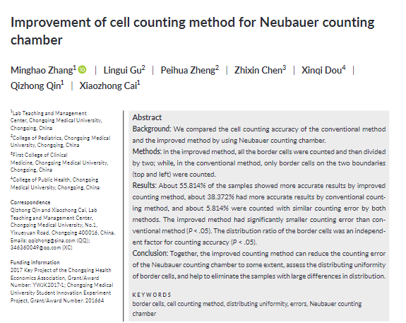
Suggested Research Article
Spiral Integration/ Research
https://onlinelibrary.wiley.com/doi/epdf/10.1002/jcla.23024

Slide 25
How To Access Digital Library
Promoting IT & Research Culture
Steps to Access HEC Digital Library
Go to the website of HEC National Digital Library.
On Home Page, click on the INSTITUTES.
A page will appear showing the universities from Public and Private Sector and other Institutes which have access to HEC National Digital Library HNDL.
Select your desired Institute.
5. A page will appear showing the resources of the institution
6. Journals and Researches will appear
7. You can find a Journal by clicking on JOURNALS AND DATABASE and enter a keyword to search for your desired journal. Link:https://www.topstudyworld.com/2020/05/access-hec-digital-library.html?m=1

Slide 26
Brainstorming

Slide 27
Structured Essay Question Related To Topic
Brainstorming
Q. In improved Neubauer’s chamber ,Counting grids are etched on :
Floor piece
Gutters
troughs
lateral pillar

Slide 28
Brainstorming
Q. In improved Neubauer’s chamber ,Counting grids are etched on :
Floor piece*
Gutters
troughs
lateral pillar

Slide 29
References
References
Books:
Practical physiology 1st year MBBS by DR Saqib Sohail.
Guyton And Hall textbook of Medical Physiology 14th Edition
Sherwood, 9th edition.
Silverthorn Physiology,6th edition
Vander’s Human Physiology,14th edition
Google images.
2.Medical Journal articles:
https://onlinelibrary.wiley.com/doi/epdf/10.1002/jcla.23024
3.Video link /youtube:
https://www.youtube.com/watch?v=ifMdyxL8Y2M

