Slide 1
Pneumonia
Prof Muhammad Khurram
medical unit-2, hfh

Slide 2
University Motto, Vision, Values & Goals
Mission Statement
To impart evidence-based research-oriented health professional education
Best possible patient care
Mutual respect, ethical practice of healthcare and social accountability.
Vision and Values
Highly recognized and accredited centre of excellence in
Medical Education, using evidence-based training techniques for development of highly competent health professionals, who are lifelong experiential learner and are socially accountable.
Goals
The Undergraduate Integrated Learning Program is geared to provide you with quality medical education in an environment designed to:

Slide 3
Sequence OF LGIs
Learning objectives
What is pneumonia? (core concept= 70%)
Related pathology and pharmacology (horizontal integration 15%)
Related recent advances (vertical integration – 10%)
Research article related to topic (3%) and Ethics (3%)

Slide 4
Learning Objectives
Describe etiopathogenesis
Discuss clinical feature, classification, and severity scores
Name complications
Outline management plan
MDM/Future perspective.-Research
AI/Family Medicine
Resources/Articles to go through-MCQs

Slide 5
PROF UMER MODEL OF INTEGRATED LECTURE

Slide 6
Horizontal Integration with Clinical
Disciplines
- Community Medicine: Epidemiology, risk factors, and vaccination programs.
- Pathology: Inflammatory response, alveolar damage, bacterial vs viral pneumonia.
- Family Medicine: Long-term pneumonia management, prevention strategies, and patient education.

Slide 7
Vertical Integration with Basic Sciences
- Anatomy/Physiology: Lung structure, alveolar gas exchange, immune defense.
- Immunology: Role of neutrophils, macrophages, and cytokines in pneumonia.
- Pharmacology: Mechanisms of antibiotics, antivirals, corticosteroids, and supportive therapy.

Slide 8
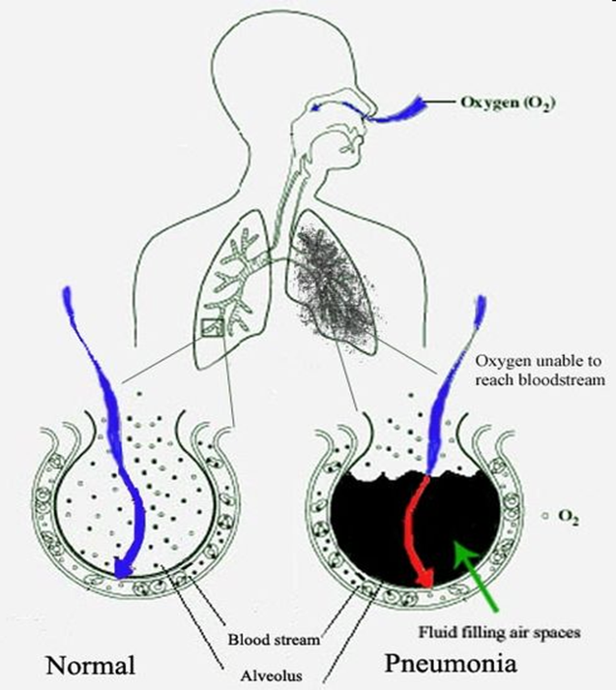
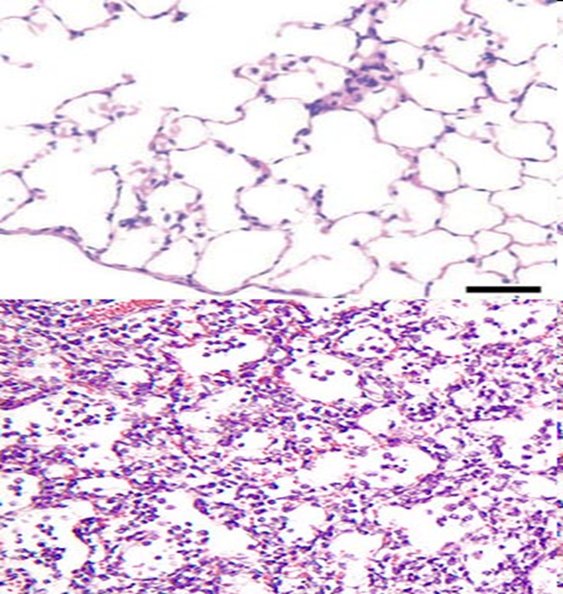
What is pneumonia?
Notes:
Hippocrates (c. 460 BC – 370 BC): Buqrat

Slide 9
Types
Community-acquired pneumonia (CAP) refers to an acute infection of the pulmonary parenchyma acquired outside of a health care setting.
Nosocomial pneumonia refers to an acute infection of the pulmonary parenchyma acquired in hospital settings and encompasses both hospital-acquired pneumonia (HAP) and ventilator-associated pneumonia (VAP).
HAP refers to pneumonia acquired ≥48 hours after hospital admission.
VAP refers to pneumonia acquired ≥48 hours after endotracheal intubation

Slide 10
Epidemiology
One of the most common and morbid conditions encountered in clinical practice.
In US, CAP accounts for over 4.5 million outpatient and emergency room visits annually
It is second most common cause of hospitalization and most common infectious cause of death.
Approximately 650 adults are hospitalized with CAP/year/100,000 population in the United States, corresponding to 1.5 million unique CAP hospitalizations/year.
Nearly 9% of patients hospitalized with CAP will be rehospitalized due to a new episode of CAP during the same year.
Pakistan ranks third in the list of 15 high burden countries where the estimated deaths of children by pneumonia is alarmingly high. According to the latest report, 71,000 children die of pneumonia every year in Pakistan.

Slide 11
Risk factors
Older age –About 2% of older adult population will be hospitalized for CAP annually.
Chronic comorbidities – The comorbidity that places patients at highest risk for CAP hospitalization is chronic obstructive pulmonary disease (COPD).
Other comorbidities associated with an increased incidence of CAP include other forms of chronic lung disease (eg, bronchiectasis, asthma), chronic heart disease (particularly congestive heart failure), stroke, diabetes mellitus, malnutrition and immunocompromising conditions.
Viral respiratory tract infection – Viral respiratory tract infections can lead to primary viral pneumonias and also predispose to secondary bacterial pneumonia. This is most pronounced for influenza virus infection
Impaired airway protection – Conditions that increase risk of macroaspiration of stomach contents and/or microaspiration of upper airway secretions predispose to CAP, such as alteration in consciousness (eg, due to stroke, seizure, anesthesia, drug or alcohol use) or dysphagia due to esophageal lesions or dysmotility.

Slide 12
Risk factors
Smoking and alcohol overuse – Smoking, alcohol overuse (eg, >80 g/day), and opioid use are key modifiable behavioral risk factors for CAP.
Other lifestyle factors – Other factors that have been associated with an increased risk of CAP include crowded living conditions (eg, prisons, homeless shelters), residence in low-income settings, and exposure to environmental toxins (eg, solvents, paints, or gasoline)].
Combinations of risk factors, such as smoking, COPD, and congestive heart failure, are additive in terms of risk

Slide 13
Bateriology
ATYPICAL
Legionella
Mycoplasma Pneumoniae
Chlamydia Pneumoniae
Chlamydia Psittaci
Coxiella Purnetii
TYPICAL
S. Pneumoniae
Haemophilus influenzae
Moraxella catarrhalis
Staphylococcus aureus
Group A streptococci
Aerobic gram-negative bacteria
Microaerophilic bacteria and anaerobes (associated with aspiration)

Slide 14
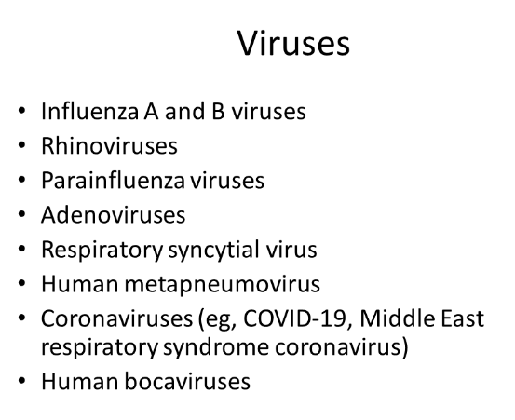
Causative organisms

Slide 15
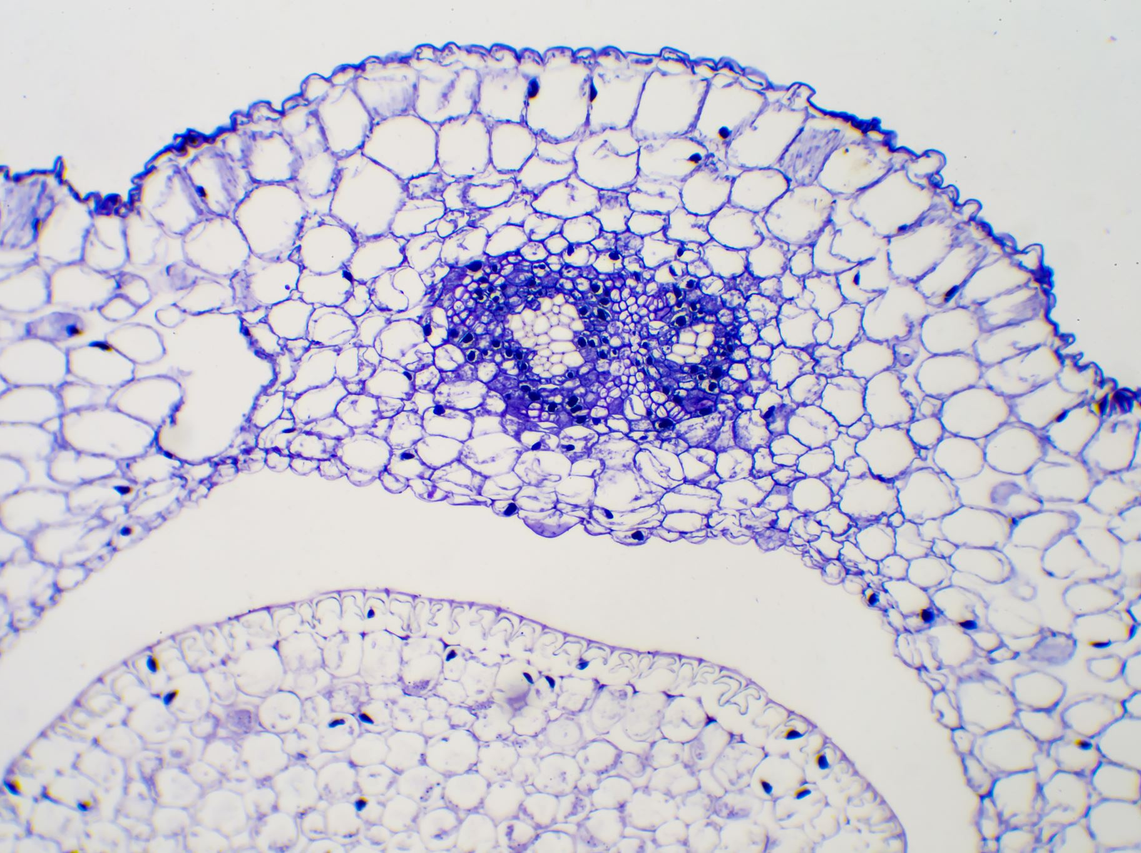
Pathophysiology
CAP has been viewed as an infection of the lung parenchyma, primarily caused by bacterial or viral respiratory pathogens. Respiratory pathogens are transmitted from person to person via droplets or, less commonly, via aerosol inhalation (eg, Legionella or Coxiella species). Following inhalation, the pathogen colonizes the nasopharynx and then reaches the lung alveoli via microaspiration. When the inoculum size is sufficient and/or host immune defenses are impaired, infection results. Replication of the pathogen, the production of virulence factors, and the host immune response lead to inflammation and damage of the lung parenchyma, resulting in pneumonia

Slide 16
Pulmonary features
Systemic features
Symptoms- Cough (with or without sputum production), dyspnea, and pleuritic chest pain
Signs- fever, tachypnea, consolidation signs, crackles and rub
CXR- Airbronchogram
Fever, anorexia
Leukocytosis with a leftward shift, or leukopenia
Inflammatory markers, such as the erythrocyte sedimentation rate (ESR), C-reactive protein (CRP), and procalcitonin
MOD- Hypotension, altered mental status, and other signs of organ dysfunction such as renal dysfunction, liver dysfunction, and/or thrombocytopenia
Notes:
Artificial Intelligence (AI) in Tuberculosis Management
Diagnosis and Imaging: AI algorithms can analyze chest X-rays and CT scans to identify patterns indicative of TB, aiding in faster and more accurate diagnosis.
Predictive Models: AI can predict the likelihood of treatment success, drug resistance, and patient outcomes based on clinical data, genetic information, and treatment history.
Treatment Optimization: AI systems can assist in selecting appropriate drug regimens based on resistance patterns and patient-specific factors, improving treatment efficacy and reducing the risk of drug resistance.
Family Medicine's Role in Tuberculosis
Early Detection and Management: Primary care physicians play a key role in identifying symptoms of TB, initiating diagnostic tests, and starting treatment in collaboration with TB specialists.
Continuity of Care: Family practitioners monitor patients throughout the course of treatment, ensuring adherence to medication and managing side effects.
Prevention and Public Health: They are involved in TB screening programs, contact tracing, and vaccination efforts (e.g., BCG vaccine) to prevent the spread of TB in the community.

Slide 18
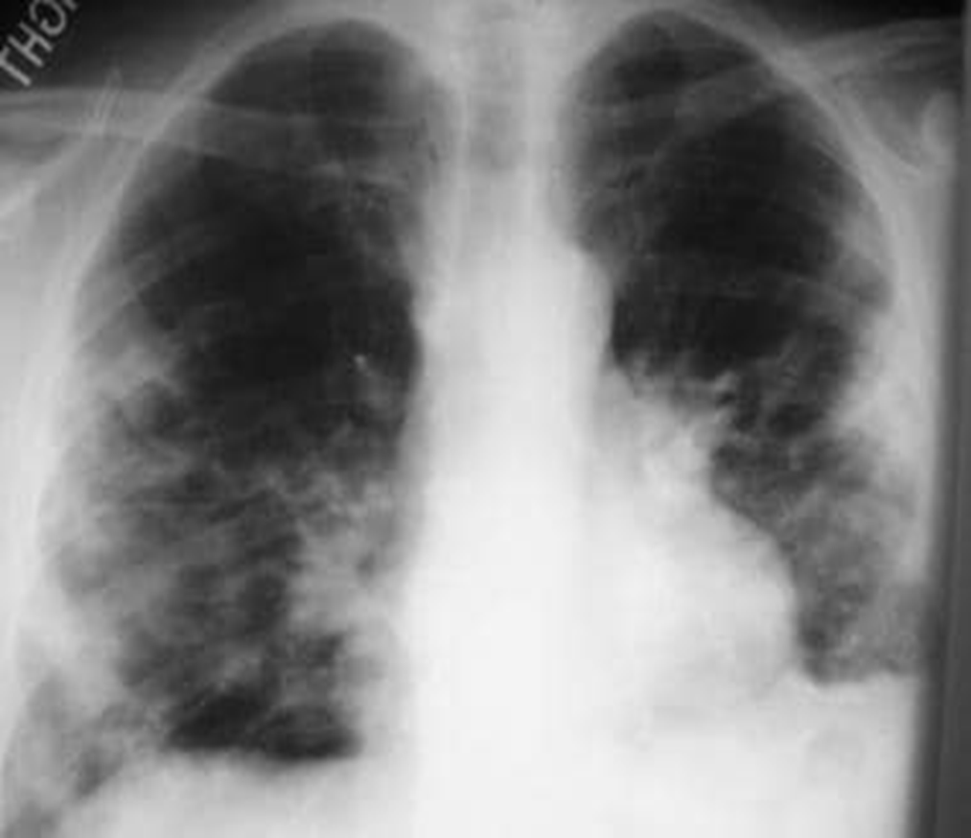

Slide 19
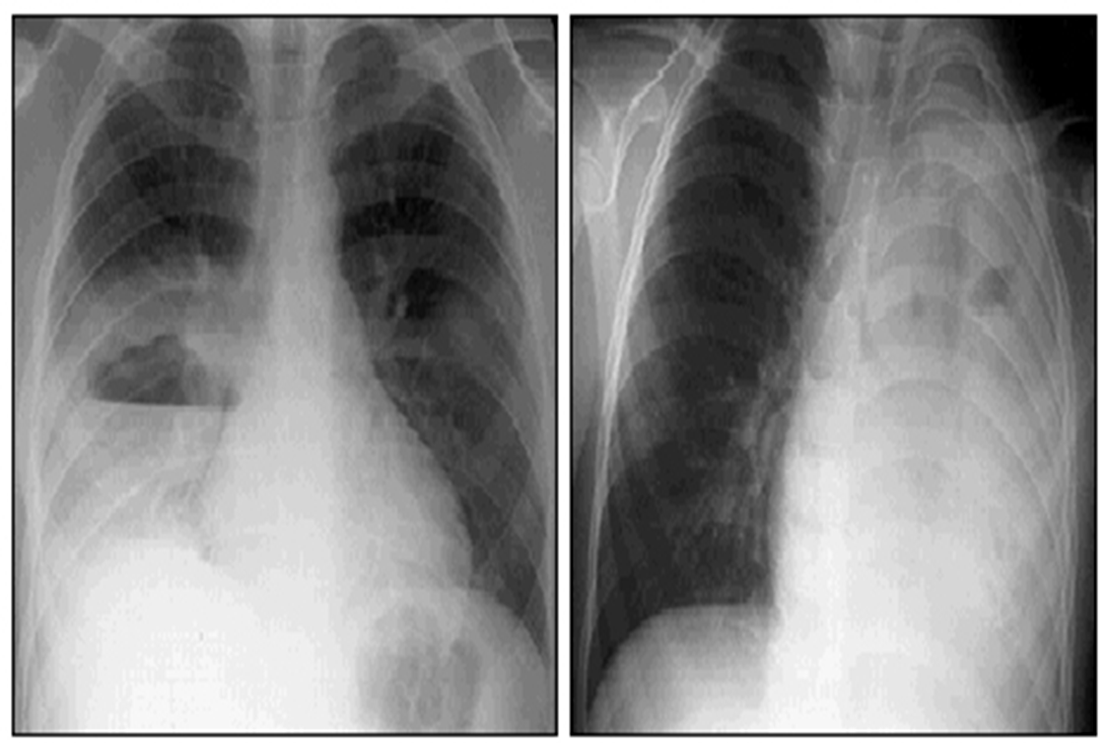

Slide 20
Other Investigations
CBC
CRP
Cultures
SO2 and ABGs
Pneumococal and Legionella antigens

Slide 21
Where to treat
Outpatient
Inpatient- Medical ward
ICU
CURB 65
PSI
IDSA/ATS

Slide 23
How to treat
O
Oral- Amoxycilin, Clarithromycin, Doxycyclin
1
Amoxycilin, Clarithromycin, Doxycyclin
1-2
Oral or IV- Amoxycilin + Clarithromycin,
Oral- Levo, Moxi, Doxi
≥3
Coamoxiclav+Claritrho
Quinolone
Benzyl Pencillin+Quinolone

Slide 25
Remember
Steroids
Oseltamivir
Remedisivir
For patients with sepsis or respiratory failure plus one or more of the following criteria: metabolic acidosis with an arterial pH of <7.3, lactate >4 mmol/L, or a C-reactive protein >150 mg/L.
5 days duration
Methylprednisolone 0.5 mg/kg intravenously every 12 hours.
Prednisone 50 mg orally daily.
No adjunctive glucocorticoids for influenza or other forms of viral pneumonia or in patients at risk of aspergillosis.

Slide 26
Complications
Mortality
Parapneumonic effusion and empyema
Lung abscess
Sepsis, MOD
One of the top 10 most common causes of death
Thirty-day mortality rates vary with disease severity, ranging from >1% in ambulatory patients to approximately 20-25% in patients with severe CAP.

Slide 27
Prevention
Smoking cessation (when appropriate)
Influenza vaccination for all patients
Pneumococcal vaccination for at-risk patients
COVID 19 vccination

Slide 28
MDM
Future perspective – Research
Pulmonology and Infectious Disease Specialists
Nursing Care
Respiratory Therapy
Social Work and Rehabilitation
Clinical Trials
Epidemiological Studies
Health Services Research
Notes:
Research in Pneumonia
Clinical Trials: Research into new antibiotics, antivirals, and adjunctive therapies is essential for advancing pneumonia treatment, especially in the face of emerging drug-resistant pathogens.
Epidemiological Studies: Understanding the patterns of pneumonia, risk factors, and the impact of interventions like vaccination programs is crucial for public health planning and policy.
Health Services Research: Investigating the effectiveness of different care models, such as outpatient vs. inpatient treatment for specific patient groups, helps optimize resource utilization and patient outcomes.
Multidisciplinary Management Components
Pulmonology and Infectious Disease Specialists: Expertise in complex cases, severe infections, and immunocompromised patients is essential for managing challenging pneumonia cases.
Nursing Care: Nurses play a vital role in administering medications, monitoring vital signs, and providing patient education on medication adherence and symptom management.
Respiratory Therapy: Respiratory therapists are key in managing oxygen therapy, nebulization treatments, and ventilatory support for patients with severe pneumonia.
Social Work and Rehabilitation: Addressing social determinants of health, providing post-discharge support, and assisting in the recovery and rehabilitation process are important for a holistic approach to pneumonia care.
Integrating these components provides a multidimensional approach to pneumonia management, encompassing early detection, evidence-based treatment, ongoing research, and comprehensive support from various healthcare disciplines to improve patient outcomes.

Slide 29
AI
Family Medicine
Diagnosis and Imaging
Predictive Models
Treatment Optimization
Early Detection and Management
Follow up care
Prevention
Notes:
Artificial Intelligence (AI) in Pneumonia Management
Diagnosis and Imaging: AI algorithms can analyze chest X-rays and CT scans to identify patterns indicative of pneumonia, aiding in faster and more accurate diagnosis.
Predictive Models: AI can predict the severity of pneumonia, potential complications, and patient outcomes based on clinical data, helping clinicians make informed decisions about treatment and hospitalization.
Treatment Optimization: AI systems can assist in selecting appropriate antibiotics based on resistance patterns and patient-specific factors, reducing the risk of antibiotic
Family Medicine's Role in Pneumonia
Early Detection and Management: Primary care physicians are often the first point of contact for patients with respiratory symptoms. They play a key role in diagnosing pneumonia, initiating treatment, and deciding on the need for hospitalization.
Follow-up Care: After acute treatment, family practitioners monitor recovery, manage any lingering symptoms, and ensure that patients complete their course of antibiotics.
Prevention: Family physicians are instrumental in implementing preventive measures, such as vaccination against pneumococcal disease and influenza, and advising on lifestyle modifications to reduce the risk of respiratory infections.

Slide 30
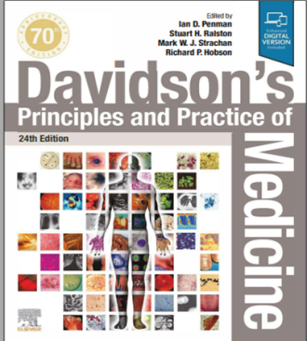
Resources/References
Article to go though/MCQs
RMU Portal

Slide 31
Recent Advances in Pneumonia
Management
- Novel Antibiotics: Addressing multi-drug resistant (MDR) pathogens.
- AI in Radiology: AI-assisted pneumonia detection in imaging.
- Immunotherapy: Vaccine developments for bacterial and viral pneumonias.

