Slide 2
GIT Module LGIS PHYSIOLOGY)
2nd Year MBBS (2025)
Physiology of Liver and Gall Bladder
Liver Functions
Dr. Ali Zain
PGT physiology
Date: 00-00-0000

Slide 3
Table of contents
Sr # | Content | Slide #
1 | Motto, Vision | 5
2 | Professor Umar Model of Integrated Lecture | 4
3 | Bloom’s Taxonomy (Domains of learning) | 6
4 | Diagrammatic representation of Blooms taxonomy | 7
5 | Learning Objectives | 8
6 | Horizontal Integration | 9,10, 11, 19,21,20,22
7 | Core Concept | 12,13, 14, 16, 17, 18,19,20,21,22,23
8 | Vertical Integration | 24’25’26’27’28’29’30’31’32’33
9 | Biomedical Ethics (Lesson of the day) | 34
10 | Suggested research article | 35’36
11 | Promoting IT and Research culture (Digital library) | 37
12 | References of this lecture | 38

Slide 4
General Format for Large Group Interactive Session of Physiology:
S. No. Headings Domains/Type of Integration Ap roximate %
1. Title
Motor Functions of Stomach.
Physiology of regulation of gastric emptying
2.
Learning Objectives
Mentioned on the separate slide
Mentioned on the separate
slide
3.
Physiologic Anatomy (Histology)
Brain Storming/ Horizontal Integration
Interactive
15%
4.
Core Concepts of the Topic
Core concepts of Physiology
60%
5.
Concept explained through Animations
Core Concepts of Physiology
10%
6.
Topic with key
Interactive
5%
7.
Research article relevant to the topic with reference
Promotion of research culture
Use of Digital Library
Critical Thinking
Self-directed Learning
5%
8.
PM&DC Code of Ethics/Professionalism/Communicati on Skills with reference
Professional Ethics
Self-directed Learning
Interactive
5%

Slide 5
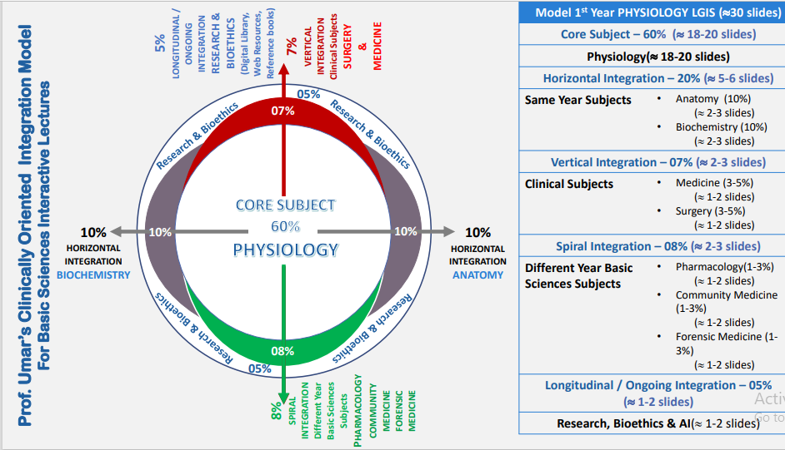
Physiology of Pancreas Pancreatic secretions
LGIS Physiology

Slide 6
Vision; The Dream/Tomorrow
To impart evidence-based research oriented medical education
To provide best possible patient care
To inculcate the values of mutual respect and ethical practice of medicine

Slide 7
BLOOM'S TAXONOMY : DOMAINS OF LEARNING
Sr. # | Domain of learning | Abbreviation | Levels of the domain | Meaning
1 | cognition | C | C1 | Recall / Remembering
2 |  |  | C2 | Understanding
3 |  |  | C3 | Applying / Problem solving
4 | Psychomotor | P | P1 | Imitation / copying
5 |  |  | P2 | Manipulation / Follows instructions
6 |  |  | P3 | Precision / Can perform accurately
7 | Attitude | A | A1 | Receiving / Learning
8 |  |  | A2 | Respond / Starts responding to the learned attitude
9 |  |  | A3 | Valuing / starts behaving according to the learned attitude

Slide 8
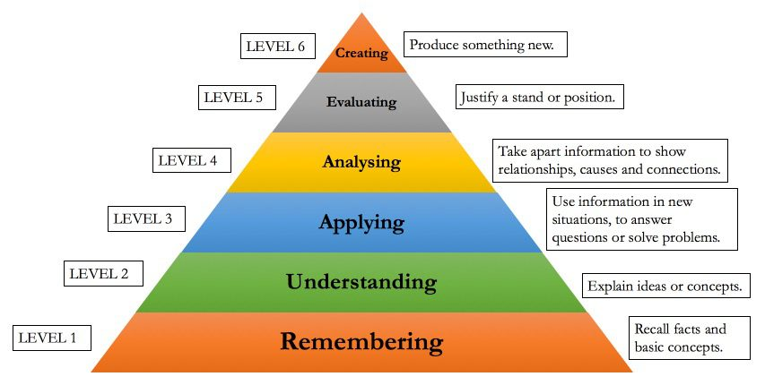
BLOOM'S TAXONOMY OF THE COGNITIVE DOMAIN

Slide 9
Learning objectives
classify blood vessels functionally | C1
2. Recall histological differences in structure of blood vessels | C1
3. Describe Volumes of Blood in the Different Parts of the Circulation | C2
4. Describe Pressures in the Various Portions of the Circulation | C2
5. Define and describe Ohm’s law: | C1+C2
6. Enlist methods of measurements of blood flow, explain them | C1+C2

Slide 10
Horizontal integration (Anatomy )

Slide 11
Physiological Anatomy of Liver and Gall Bladder
Horizontal integration with Anatomy

Slide 12
Physiological Anatomy of Liver and Gall Bladder
Horizontal integration with Anatomy

Slide 13
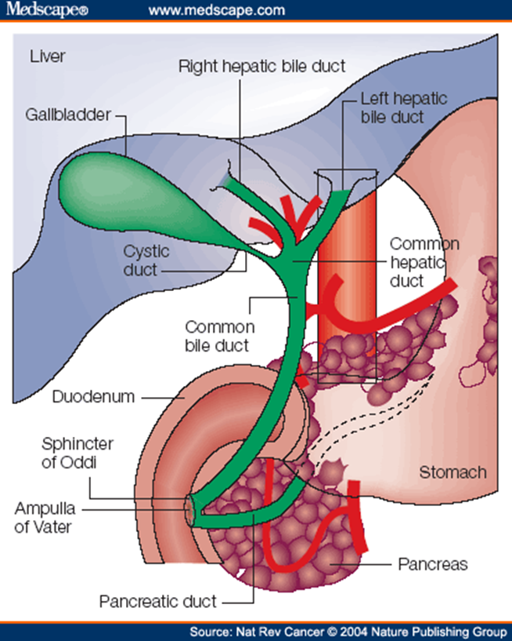
Physiological Anatomy of Liver and Gall Bladder
Horizontal integration with Anatomy

Slide 14
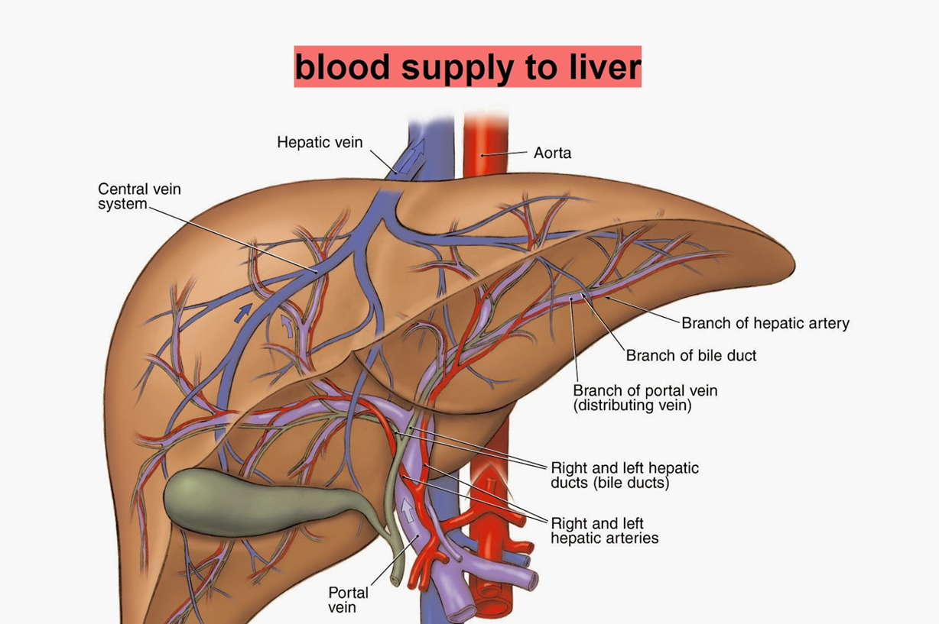
Horizontal integration with Anatomy

Slide 15
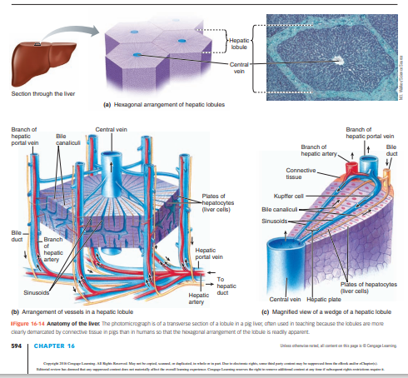
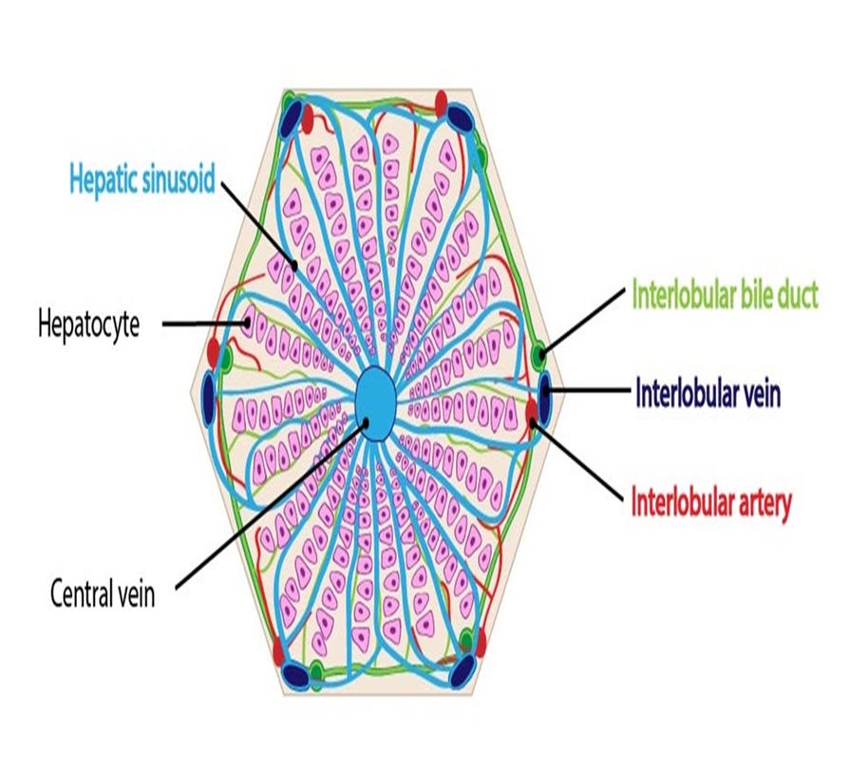
Horizontal integration with Anatomy\histology

Slide 18
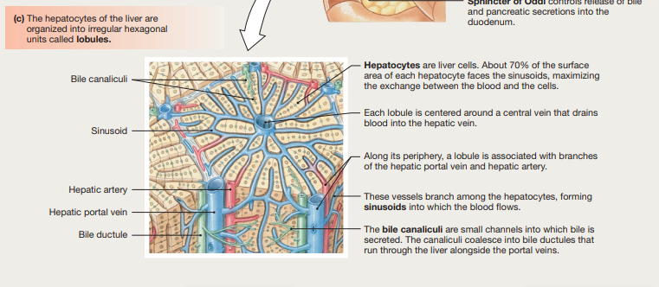

Slide 19
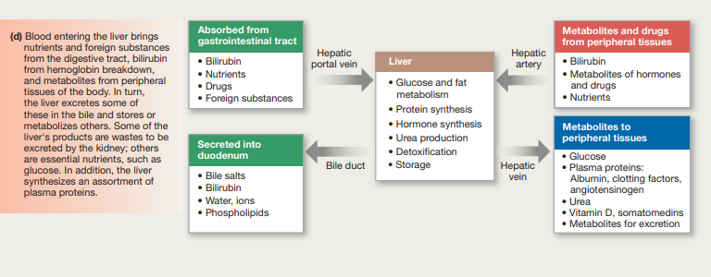

Slide 20
Functions of Liver
Vascular Functions
Metabolic Function
Bile Formation & Excretion

Slide 21
Core concept

Slide 22
Core concept

Slide 23
Core concept

Slide 24
Liver lymph flow
Core concept
Very high
Lymph drainage has a protein concentration 6g/dl
High permeability of liver sinusoids allows large quantities of lymph to form
Half of lymph formed in the body under resting conditions arises from liver

Slide 25
Core concept

Slide 26
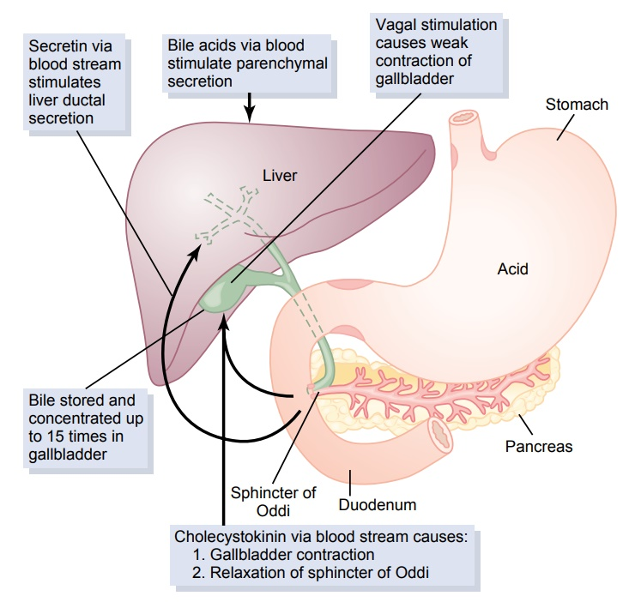
Bile Production
Horizontal Integration with anatomy/
histology

Slide 27
Bile Concentration
The gallbladder has to concentrate the bile so that it can store the bile salts and waste products of the liver bile. It actively transports sodium through the gallbladder mucosa. The other constituents like water, chloride and electrolytes then diffuse through the gallbladder lining.
By doing this, gallbladder bile is 5 to 20 times more concentrated than liver bile. At this point, gallbladder bile is mainly composed of bile salts, and smaller volumes of bilirubin, cholesterol, lecithin and other electrolytes stay in the gallbladder
Core concept

Slide 28
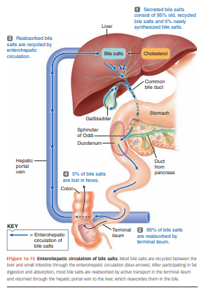
Enterohepatic circulation
Core Concept

Slide 29
Bile Composition
Bile, whether from the liver or gallbladder, contains the following substances :
water
bile salts
bilirubin
cholesterol
fatty acids
lecithin
sodium
potassium
calcium
chlorine
bicarbonate ions
Core concept

Slide 30
As mentioned, gallbladder bile is concentrated compared to liver bile. Bile salts make up the largest volume of gallbladder bile and can be 6 times more concentrated than bile salts in liver bile.
Liver bile, however, has higher concentrations of :
water
sodium
chlorine
bicarbonate
Core concept

Slide 31
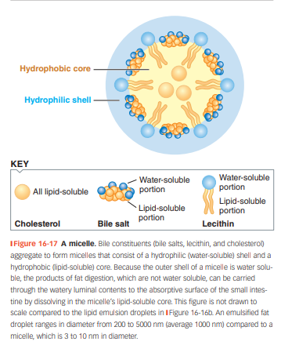
Core Concept and Horizontal Integration with Biochemistry

Slide 32
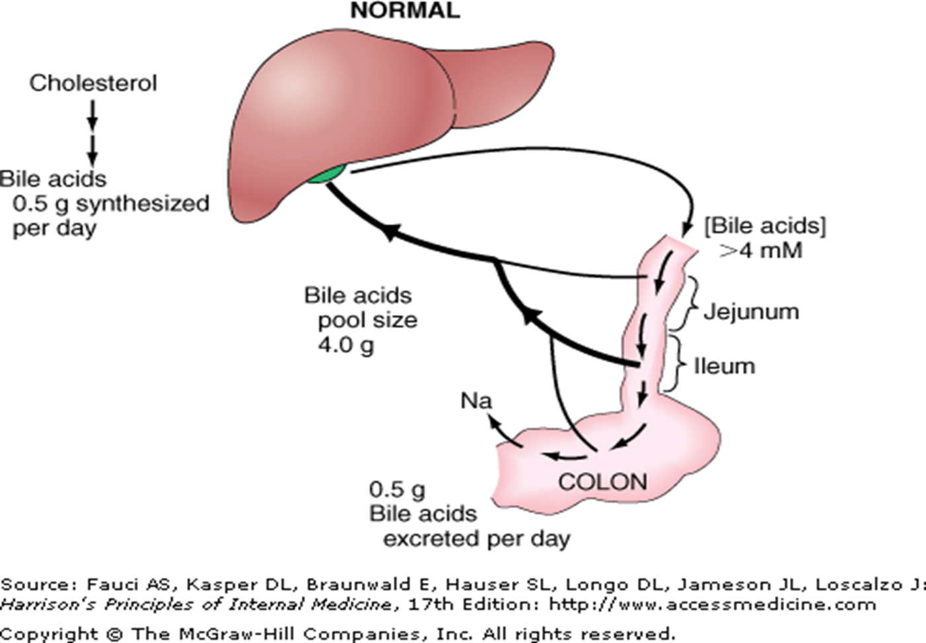
Bile Salts and Enterohepatic Circulation
Core concept

Slide 33
Brainstorming/Review
Brainstorming
Question & Answer

Slide 34
Brainstorming/Review
Two medical students studying for their physiology final decide to take a break for a lunchtime hamburger. Before reaching the cafeteria, nervous impulses from the dorsal vagal complex will initiate gastric acid secretion by triggering release of which neurotransmitter from the enteric nervous system?
Norepinephrine
Vasoactive intestinal polypeptide
Substance P
Gastrin-releasing peptide
Nitric oxide

Slide 35
Brainstorming/Review
The correct answer is D.
The cephalic phase of the gastric secretory response is initiated by the release of gastrin-releasing peptide from enteric nerve endings adjacent to G cells in the antrum of the stomach. Gastric secretion during the cephalic phase, in common with most intestinal secretory responses, is not normally triggered by sympathetic nerve activity, nor is norepinephrine a transmitter expressed by the enteric nervous system (rules out option A). The remaining enteric neurotransmitters listed are predominantly involved in causing the contraction (substance P) or relaxation (vasoactive intestinal polypeptide, nitric oxide) of gastrointestinal smooth muscle (rules out options B, C, and E).

Slide 36
Vertical Integration

Slide 37
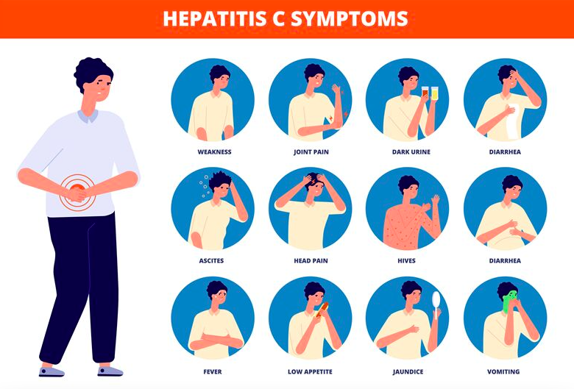
Vertical Integration

Slide 38
Understanding Biomedical Ethics
Biomedical Ethics

Slide 39
Bioethics
Non-maleficence
The principle of nonmaleficence holds that there is an obligation not to inflict harm on others. It is closely associated with the maxim primum non nocere (first do no harm).
Longitudinal Bioethics Curriculum

Slide 40
Suggested Research Article

Slide 41
Research
Longitudinal Research Curriculum

Slide 42
References
Books
Human Physiology by Dee Unglaub Silver thorn. 8TH Edition. Muscle (Chapter 12,Page 444)
Guyton textbook of physiology
Share wood textbook of physiology
Ganong textbook of physiology
Research
https://www.sciencedirect.com/science/article/abs/pii/S0344033823000754
Video link/youtube
https://youtu.be/cCyTYsxECLw?si=6lcLehpq8OOvJC8K

Slide 43
How To Access Digital Library
Steps to Access HEC Digital Library
Go to the website of HEC National Digital Library.
On Home Page, click on the INSTITUTES.
A page will appear showing the universities from Public and Private Sector and other Institutes which have access to HEC National Digital Library HNDL.
Select your desired Institute. 5. A page will appear showing the resources of the institution
6. Journals and Researches will appear
7. You can find a Journal by clicking on JOURNALS AND DATABASE and enter a keyword to search for your desired journal.

