Slide 2
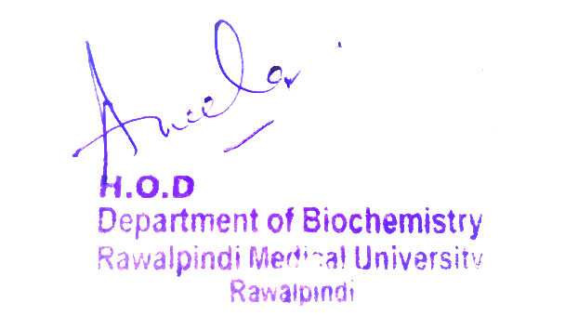
Renal Module 2nd Year MBBS(SGD) Phenylalanine Metabolism
Presenter: Dr. Romessa Naeem Date: 30-01-25
(Demonstrator)

Slide 3
Motto, Vision, Dream
To impart evidence based research oriented medical education
To provide best possible patient care
To inculcate the values of mutual respect and ethical practice of medicine
Wisdom
Truth
Service

Slide 4
Professor Umar Model of Integrated Lecture

Slide 5
Learning Objectives
At the end of this session students should be able to
Explain Metabolism of Phenylalanine
Explain its related clinical disorder.

Slide 6
Interactive Session
A 6-month-old male infant presents with developmental delay, irritability, vomiting, and a musty body odor. Parents report fair skin, light-colored hair, and eczema-like rashes. Neurological exam shows hypertonia and exaggerated reflexes.
Lab Findings:
↑ Plasma phenylalanine (>20 mg/dL)
↓ Tyrosine levels
+ Urine ferric chloride test (green color)
.

Slide 7
Conversion of Phenylalanine To Tyrosine
Core Knowledge

Slide 8
Steps Of Phenylalanine Metabolism
Core Knowledge

Slide 9
Fate Of Tyrosine
Core Knowledge

Slide 10
Anatomy of liver

Slide 11
Physiology of liver

Slide 12
Phenylketonuria

Slide 13
Biochemical Basis Phenylketonuria

Slide 14
Alkaptonuria: : causes and characteristics

Slide 15
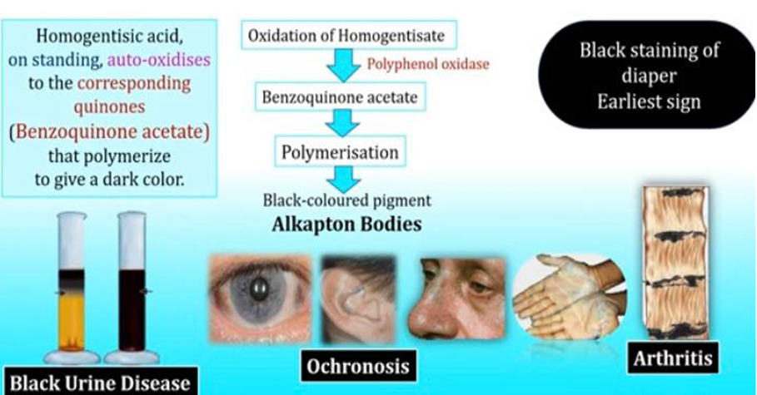
Biochemical Basis of Alkaptonuria

Slide 16
Management of Phenylketonuria
Spiral Integration
Family Medicine plays important role in following manner:
Diagnosis and Monitoring(new born screening test and phenylalanine levels regularly)
Counseling and support
Dietary Guidance (strict low phenylalanine diet)
Refer to Specialists

Slide 17
Ethical Consideration
Spiral Integration
Ethical Consideration regarding new born screening and research
Informed consent and privacy regarding genetic testing and counselling
Access to Healthcare

Slide 18
Role of AI in Managing Phenylketonuria
Spiral Integration
Artificial Intelligence plays role in following aspects:
Diagnosis( AI Algorithms and machine learning Models)
Treatment Optimization
Drug Discovery
Personalized meal plans

Slide 19
Suggested Research Article
Link : https://www.ncbi.nlm.nih.gov/
Journal Name :Cureus
Title : Recent Advances in Phenylketonuria
Author Name : Andrea M Zuñiga Vinueza
Abstract: This article highlights the significance of inborn errors of metabolism and focuses specifically on phenylketonuria (PKU), a well-known inheritance disorder caused by the deficiency or absence of phenylalanine hydroxylase (PAH). This review discusses associated mutations in the PAH gene and their impact on phenylalanine metabolism. A total of 40 articles were analyzed between 2019 and 2023, covering diagnostic innovations, advancements in treatment and management strategies, and the long-term implications of PKU. This study emphasizes the importance of early diagnosis and highlights the ongoing need for advancements in screening methods and treatment approaches to optimize patient outcomes in PKU patients. This review provides valuable insights for healthcare professionals involved in the care of children with PKU and contributes to the enhancement of clinical practice in this field.

Slide 20
How To Access Digital Library
Steps to Access HEC Digital Library
Go to the website of HEC National Digital Library.
On Home Page, click on the INSTITUTES.
A page will appear showing the universities from Public and Private Sector and other Institutes which have access to HEC National Digital Library HNDL.
Select your desired Institute.
A page will appear showing the resources of the institution
6. Journals and Researches will appear
7. You can find a Journal by clicking on JOURNALS AND DATABASE and enter a keyword to search for your desired journal.

Slide 21
Learning Resources
Lippincott Illustrated Reviews Biochemistry, 8th Edition, Chapter 20 page no. 268-271,274
Google scholar
Google images

Slide 22
THANK YOU

