Slide 1
Personal Identification-I
Dr Shahida Bashir
Dr Gulzaib Pervaiz
Forensic Medicine & Toxicology

Slide 3
Motto of RMU
Wisdom
Truth
Service

Slide 4
Vision of RMU The Dream/ Tomorrow
To impart evidence based research oriented medical education
To provide best possible patient care
To inculcate the values of mutual respect and ethical practice of medicine

Slide 5
Prof Umar’s LGIS model

Slide 6
Learning Objectives
Define Identification and briefly describe the M/L importance of personal identity in living and dead.
Enlist
Enumerate different Parameters of personal identity (Age, sex, race, stature, Tattoo marks, occupational status, Anthroprometry etc)
Briefly explain different methods to determine the personal identity.

Slide 7
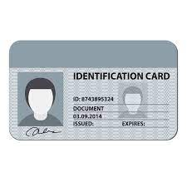
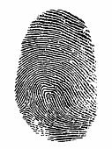
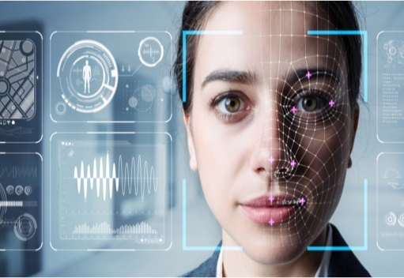
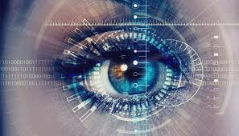
Personal identity
Identity or Identification means establishment of individuality of person.
In medico legal cases identification is very important in living as well as in dead

Slide 8
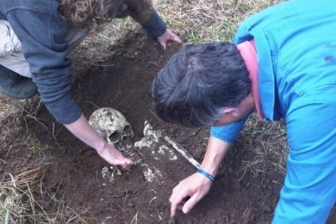
Personal identity
In Dead Persons: Identification of deceased is important in cases of
Mutilated,
Decomposed
Fragmentary remains
Bomb explosions,
Fire,
Air crash
Building collapse,
Railway accidents or
Bodies recovered from sea rivers, canals, wells,
Mutilated bodies

Slide 9
Personal identity
In Living Persons: The identification is necessary, in all medicolegal cases in civil and criminal courts, either they are victims or involved or accused of any crime, such as
Murder,
Rape,
Assault,
Absconding soldiers
In cases of inheritance, or
Adults who have lost memory

Slide 10
Personal identity
Obliteration of Identity: The Identity of the dead body may be obliterated or destroyed by
Man,
Animals
Nature
Purposive removal of identifying features e.g. Finger printings, tattoo marks, scars, hair, teeth etc. and other articles including clothing's belonging to the missing person.
Animals e.g. dogs, rats, jackals, birds as vultures.
Burning the body
Advanced putrefaction

Slide 11
Personal identity
Dismemberment
Throwing different parts of body in different places
Intermingling of parts from different bodies or animals
Throwing the body in sea, lake, well, canal or river
Dissolve the body in corrosive acids
Keeping the dead body in railway track so that the gross mutilation is brought about

Slide 12
Personal identity

Slide 13
Personal identity
Identification of dead bodies:
For known dead bodies: This is done before post mortem by accompanying relatives, friends and sometimes by police.
For unknown dead bodies: This is done by police and the medical officer.
Fingerprints
Photographs of dead body,
At least two marks of identification

Slide 14
Personal identity
Types of Identification:
Complete identification (absolute):
Means absolute fixation of individuality of a person.
Partial identification (Incomplete):
Means ascertainment of only some facts about identity and others remain still unknown

Slide 15
Personal identity
Methods of identification: Identification can be done by means of three methods.
Third party method
Subjective method
Objective method

Slide 16
Personal identity
Third Party Method:
It is most commonly used method.
Relative & friends
Subjective Method:
This method is applicable when third party is missing. In this case the examiner will collect the physical data of examinee such as:
height, weight, congenital malformations, shape of nose eyes, lips, chin, teeth, color of iris, finger prints.

Slide 17
Personal identity
Subjective Method:
These parameters can be classified by relating them to anatomy, physiology and even genetics.
Anatomical parameters which are further divided in to primary, which are present at the time of birth and secondary which develop subsequently at various stages of life such as cataract, arcus senilis in the eye due to old age.
Physiological parameters, such as gait, voice, tone and manner of speech.

Slide 18
Personal identity
Subjective Method:
Pathological parameters, related to contracted diseases such as eczema, scar etc.
Objective Method:
Here utilization of morphological and belongings data is analyzed.

Slide 19
Personal identity
The points to be noted for identification:
Name, ID card, CNIC (if present)
Age
Sex -Primary Characteristics & Secondary characteristics
Stature
Features Personal effects
Hair
Scars
Tattoos
External Peculiarities
Race, Religion & Nationality

Slide 20
Personal identity
Dental patterns
fingerprints,
footprints or
Handprints
superimposition technique
Neutron Activation comparisons
Trace Evidence Comparisons

Slide 21
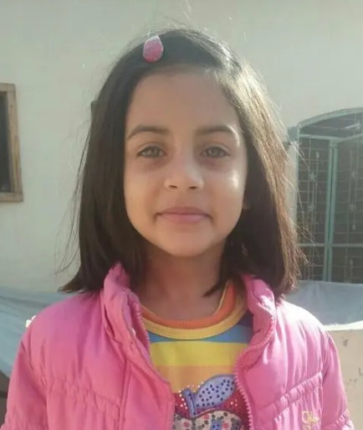
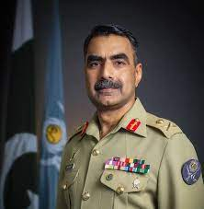
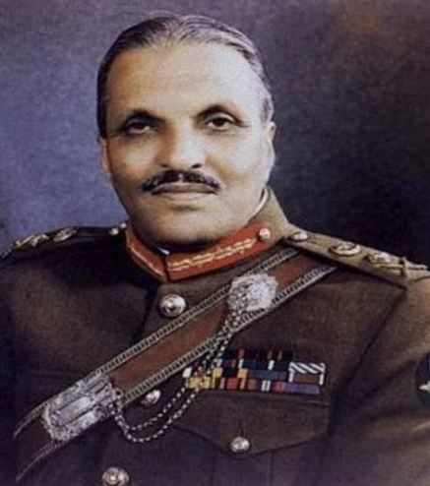
Personal identity

Slide 22
Personal identity
Race & Religion: The various races are:
Caucasian
Negroid
Mixed
Another classification of race is:
Caucasian
Black race
Red race
Yellow race (Ping pong race)

Slide 23
Personal identity
Questions of determining race in:
Mass disasters
Railway accidents
Air crash
Disposal of dead bodies according to their religion
Race can be easily determined from:
Clothes
Complexion.
Hair,Eyes,Lips
Teeth – Mongoloid groups →Shovel shaped upper median incisor
Bones- skull- race can be determine by cephalic Index

Slide 24
Personal identity
Cephalic Index/Breadth Index =
Max breadth of skull transversely x100
Max anterioposterior length of skull
Dolico cephalic or long headed:
Cephalic Index ranges between 70 and 74.9 e.g. Negroes, Aborigines.
Mesaticephalic or medium long headed:
Cephalic Index ranges between 75 to 79.9 e.g. Europeans, Pakistanis,
Brachycephalic or small headed:
Cephalic Index ranges between 80 to 84.9 e.g.
Mongolians & Chinese.

Slide 25
Personal identity
SEX
Identification of sex of an individual is important in medico legal cases. Sex has to be established positively for following reasons:
For purpose of simple identification in a living or dead person.
For purpose of Heir ship, disposal of property, marriage education and liability for Army Service.
In cases of impotency rape, legitimacy, divorce. Paternity etc.
For determining whether an individual can exercise certain civil rights reserved to one sex only.

Slide 26
Personal identity
Sex of a person can be determined from:
Physical Morphology
Microscopic study of Sex Chromatin
Gonadal biopsy
Other recent advanced methods
Physical Morphological features:
General Built
Wearing clothes & ornaments, etc
Scalp Hair
Eyebrow
Adam’s Apple Shoulders.

Slide 27
Personal identity
Nuclear Sexing: It is a probable evidence and resulting from microscopic study of Sex Chromatin.
Depending upon NUCLEAR SEXING, we have a nodule of Chromatin in the nucleus of the cell attached to nuclear membrane this is known as Barr body and depending upon its presence a person is said to be Chromatin Positive and present in Females
Males do not have it so known as chromatin negative.

Slide 28
Personal identity
Blood:
In Poly morphs of female blood, there is a drum stick projection from nuclear, known as Davidson bodies.
Male do not have it. In female blood we see Barr bodies in nucleated cells and Davidson Bodies in Polymorphs.

Slide 29
Personal identity
Method of nuclear sexing:
In living persons:
Scrapping are taken from buccal Mucosa to see Barr bodies and if blood also comes out we look for Davidson Bodies in Polymorphs i.e. Neutrophils.
In dead and putrefied bodies:
Sections are made of scalp hair root to see Barr bodies.
Davidson has divided congenital intersex states in to four Groups.

Slide 30
Personal identity
Gonadal Agenesis: Gonads completely absent.(46XY)
Gonadal Dysgenesis: Gonads of only 1 sex present ,but fail to develop at puberty.
Klinefelter’s syndrome(47XXY)
Turners’s syndrome(45XO)
True Hermaphrodite: Gonads of both sexes present.(46XX/46XY) or (46XX/47XXY)
Psuedohermaphrodite:Gonads of one sex present, but external sexual characteristics are of opposite sex.(Mostly bcoz of 5 alpha reductase deficiency)

Slide 31
Research
https://systematicreviewsjournal.biomedcentral.com/articles/10.1186/s13643-021-01879-z
https://www.longdom.org/open-access/personal-identification-in-forensic-examinations-33481.html#:~:text=The%20'big%20fours'%20of%20personal,%2C%20sex%2C%20stature%20and%20ethnicity.
https://www.researchgate.net/publication/281807738_I_Identify_with_Her_I_Identify_with_Him_Unpacking_the_Dynamics_of_Personal_Identification_in_Organizations

Slide 32
Biomedical Ethics
A dignified handling of corpses should be central in daily practice of forensic medicine and forensic staff should always have in mind the ethical dimension of human corpses in spite of their regular confrontation with the dead.
https://jfse-ojs-tamu.tdl.org/jfse/article/view/70
https://link.springer.com/book/10.1007/978-3-319-56869-0
https://pubmed.ncbi.nlm.nih.gov/19438443/

Slide 33
Family Medicine
Family medicine is the speciality that is responsible for providing comprehensive and continuing care to all individuals seeking medical advice, irrespective of gender, age and illness.
Medical expertise of a family physician is crucial in death investigations.
It begins with body examination and evidence collection at the scene and proceeds through history, physical examination, laboratory tests, and diagnosis – in short, the broad ingredients of a doctor’s treatment of a living patient.
The key goal is to provide objective evidence of cause, timing, and manner of death for adjudication by the criminal justice system.

Slide 34
How To Access Digital Library
1. Go to the website of HEC National Digital Library.
2. On Home Page, click on the INSTITUTES.
3. A page will appear showing the universities from Public and Private Sector and other Institutes which have access to HEC National Digital Library HNDL.
4. Select your desired Institute.
5. A page will appear showing the resources of the institution
6. Journals and Researches will appear
7. You can find a Journal by clicking on JOURNALS AND DATABASE and enter a keyword to search for your desired journal.

Slide 35
THANK YOU

