Slide 1
Celiac disease & chronic Diarrhea
in Children
Dr. Muhammad Hafeez
Assistant Professor
Paediatric Department
Rawalpindi Medical University, Rawalpindi

Slide 2

Motto Vision
To impart evidence based research oriented medical education
To provide best possible patient care
To inculcate the values of mutual respect and ethical practice of medicine
Wisdom
Truth
Service

Slide 3

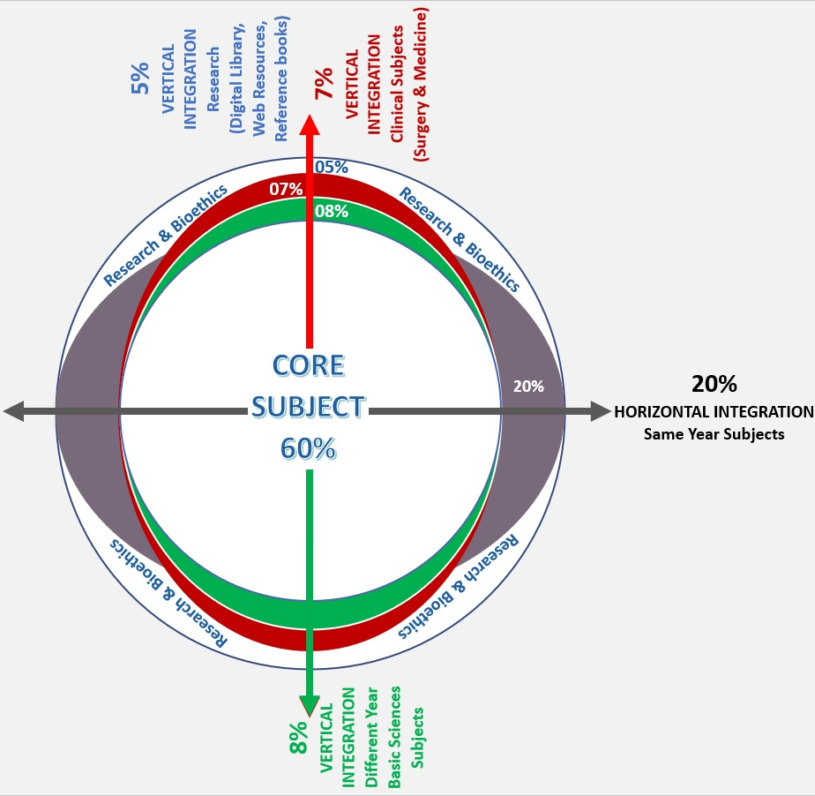
Professor Umar Model of Integrated Lecture

Slide 4
Learning Objectives
Definition
Epidemiology
Etiology
Clinical Features
Management
Complications
Prognosis and Prevention

Slide 5
VERTICAL INTEGRATION
ANATOMY
PHYSIOLOGY

Slide 6
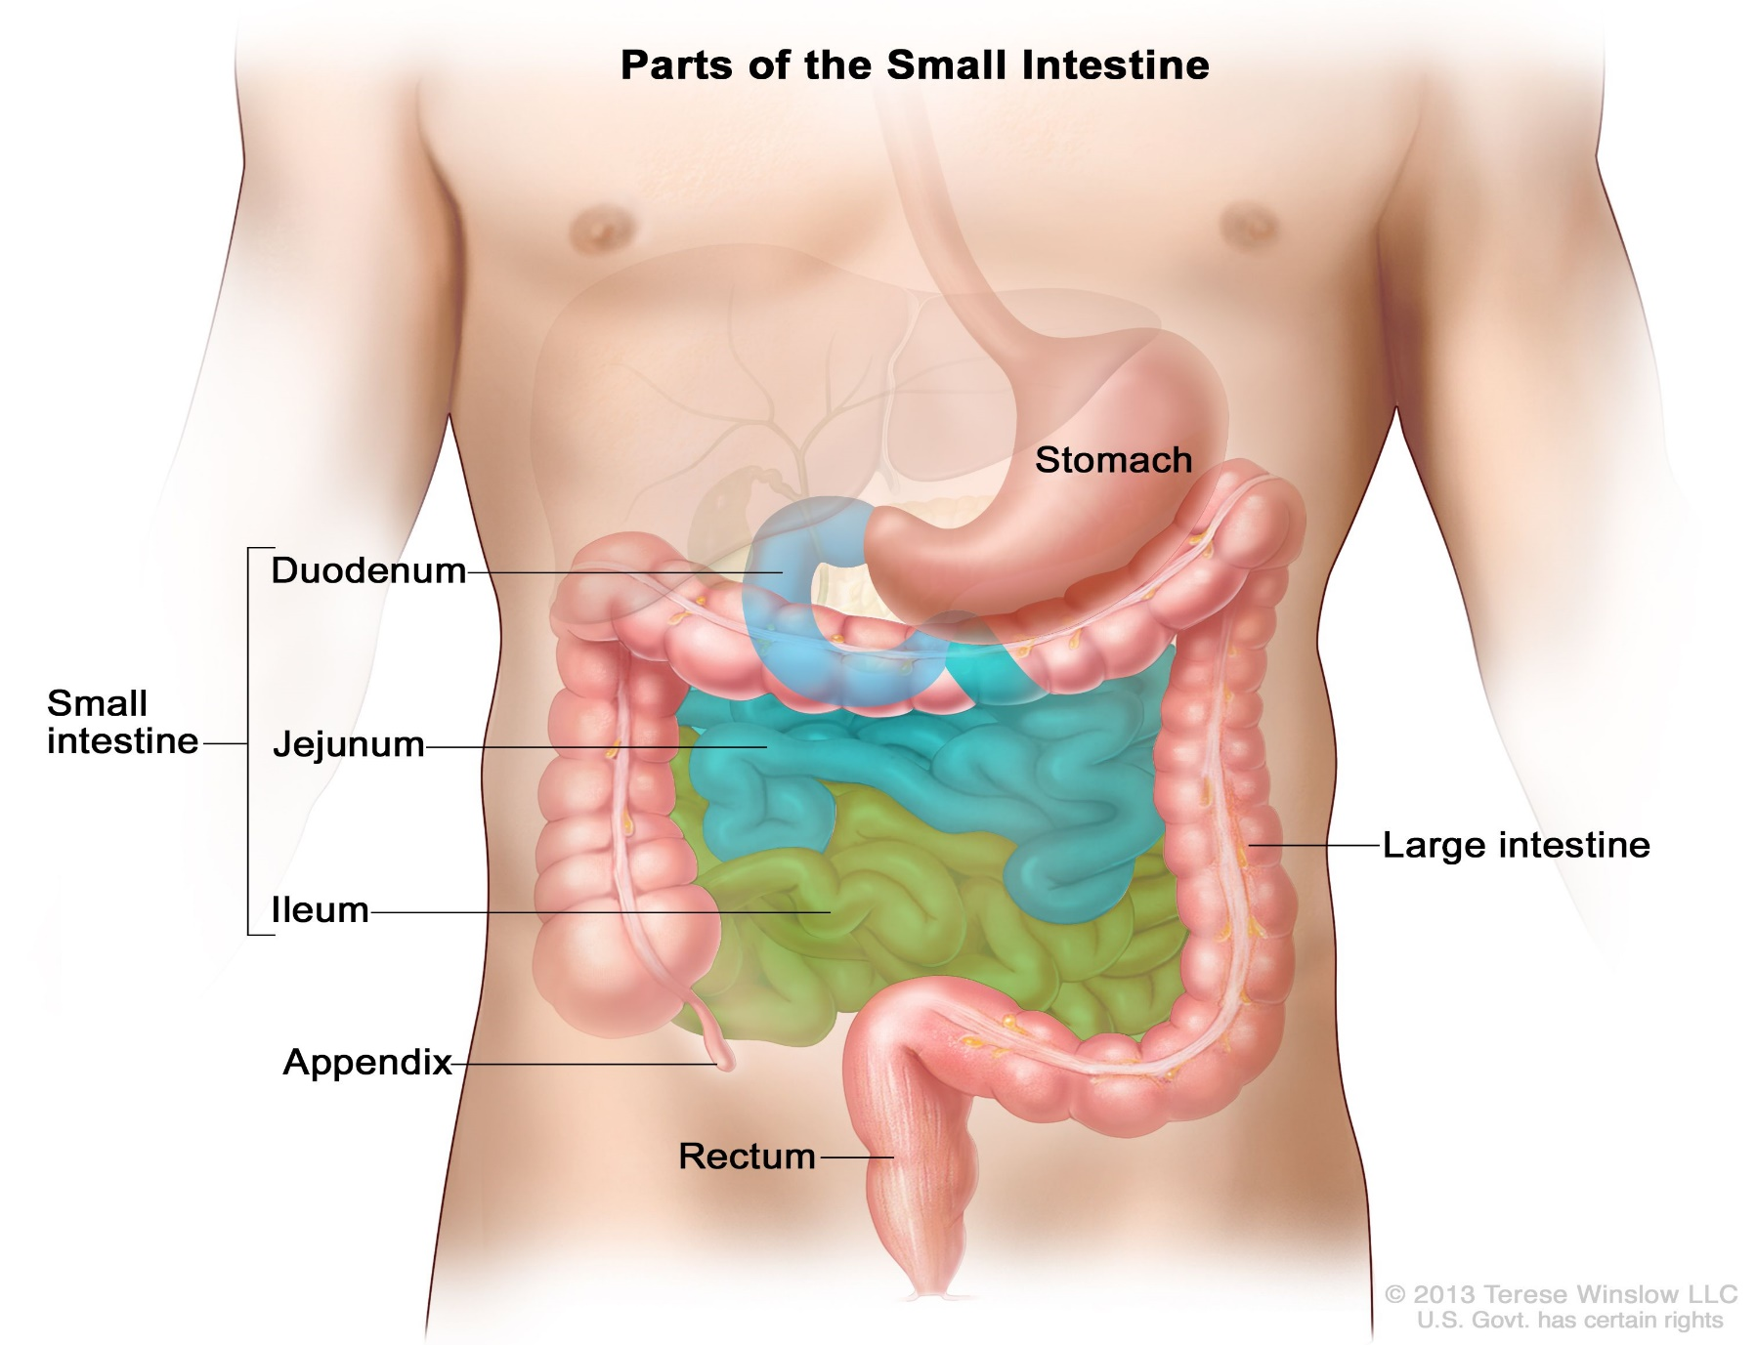

Slide 7
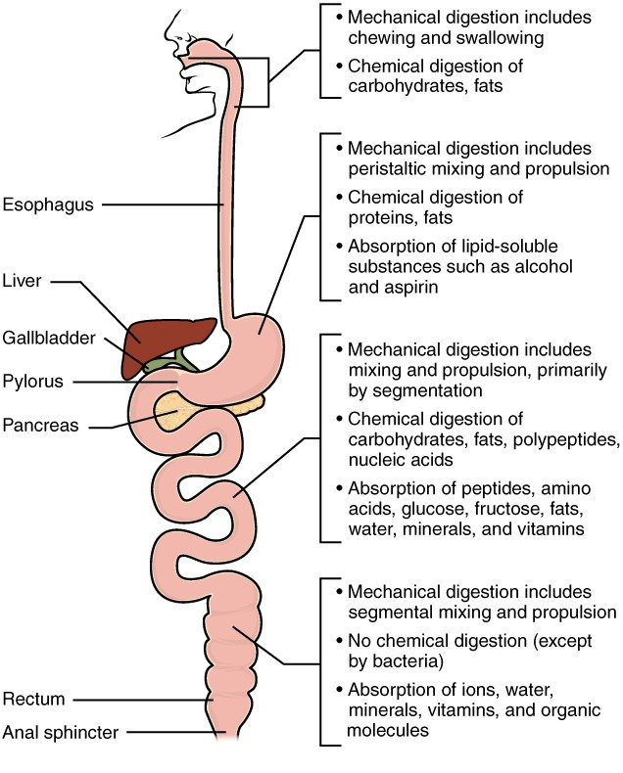

Slide 8
Horizontal integration
Epidemiology
Pathology

Slide 9
Celiac Disease (Gluten enteropathy) Epidemiology
It is estimated to affect 1 in 100 persons worldwide
Children with a first-degree relative having celiac disease (parent, sibling) have an increased (1 in 10) risk of developing celiac disease
Celiac disease can develop at any age when the child is eating foods that contain gluten. It is seen in adults also.
It is common cause of malabsorption and chronic diarrhea in Pakistani children

Slide 10
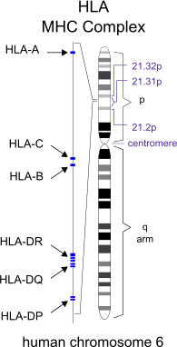
Celiac Disease (Gluten enteropathy)
Etiology
There is genetic predisposition
Human Leukocyte Antigen HLA DQ2 and DQ8 (which are present in 25-30% of the population) increase the risk of developing Celiac disease (gluten enteropathy) to 3 %
HLA DQ2 and DQ8 are present in almost all patients with Celiac disease

Slide 11
Celiac Disease - Pathophysiology
Genetic predisposition
Ingestion of Gluten in diet
Immune reaction to gluten
Antibodies to mucosal enzyme Tissue Transglutaminase
Lymphocyte infiltration
Immune mediated mucosal damage in small intestine
Villus atrophy and flat mucosa
Malabsorption and osmotic diarrhea
Malnutrition and growth failure

Slide 12
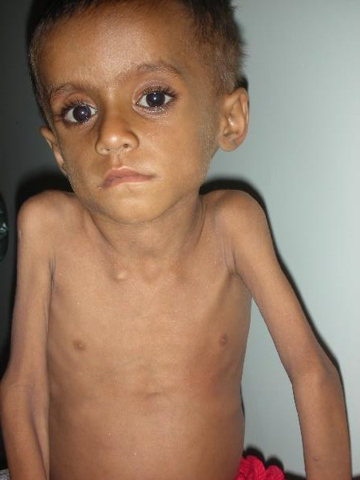
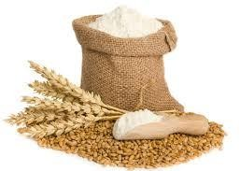
Celiac Disease (Gluten enteropathy)
Definition
Celiac disease is a genetically predisposed autoimmune disease in which ingestion of gluten in diet (present in wheat) causes immune-mediated mucosal damage in the small intestine resulting in malabsorption and growth failure

Slide 13
Celiac Disease
(Gluten enteropathy)
Immune mediated mucosal damage in small intestine
Villus atrophy and flat mucosa
Malabsorption and food intolerance
Malnutrition
Short stature

Slide 14
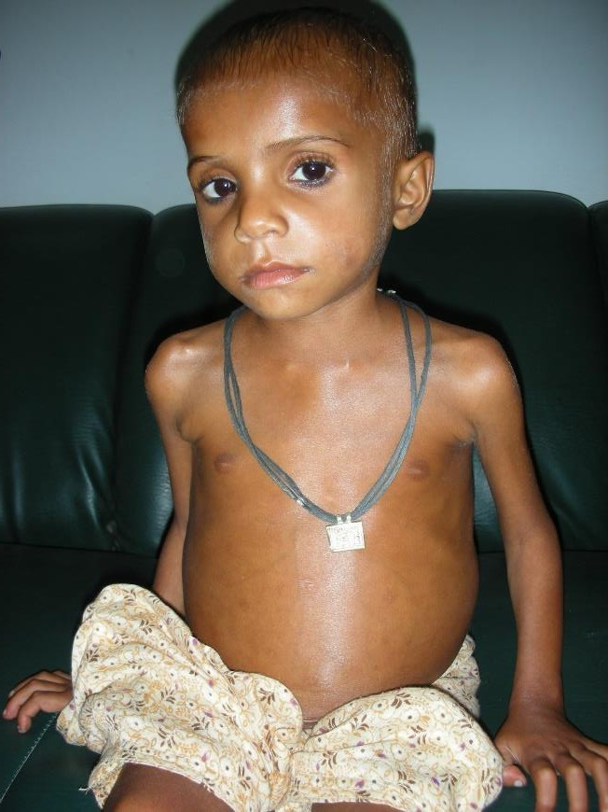
Celiac Disease (Gluten enteropathy) Clinical Features - GIT
Chronic diarrhea
Malabsorption
Abdominal distension
Pain abdomen
Vomiting
Constipation (rarely)
Anorexia
Aphthous ulcers

Slide 15
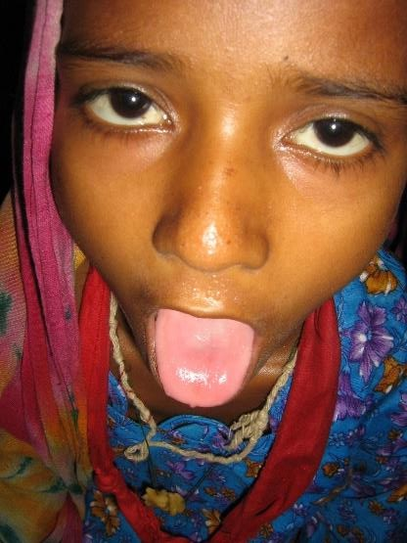
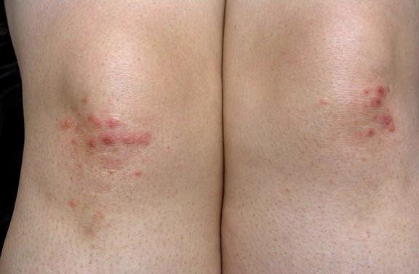
Celiac Disease (Gluten enteropathy) Clinical Features – Extra-intestinal
Failure to thrive / poor weight gain / weight loss
Short stature and delayed puberty
Iron-deficiency anemia
Fatigue
Osteopenia and osteoporosis
Dental enamel defects
Peripheral neuropathy
Dermatitis herpetiformis (itchy skin rash)

Slide 16
Celiac Disease (Gluten enteropathy) Diagnosis
Celiac Disease is suspected on clinical symptoms and signs
The First Step: anti-tissue Transglutaminase IgA antibodies (tTG – IgA) - titer 10 times upper normal limit is diagnostic
Duodenal biopsy (endoscopy) and Histopathology – (specific picture of intestinal mucosal damage) - in equivocal cases
Gluten – free diet resulting in clinical improvement confirms the disease

Slide 17
Celiac Disease (Gluten enteropathy) Diagnosis details
Celiac Disease is suspected on clinical symptoms and signs
The First Step: anti-tissue Transglutaminase IgA antibodies (tTG – IgA) anti - tTG - IgA titer 10 times upper normal limit is diagnostic for Celiac Disease
IgA Endomysial antibody (EMA): performed if tTG - IgA test is negative
(positive EMA test with high titer confirms CD)
Genetic test - HLA DQ2 and DQ8 (negative test excludes CD)
Duodenal biopsy (endoscopy) and Histopathology showing specific
picture of intestinal mucosal damage - in equivocal cases
Gluten – free diet resulting in clinical improvement confirms the disease
In selected cases, Gluten challenge (re-introduction) to detect relapse
(increased antibody levels) is needed later on for confirmation

Slide 18
Celiac Disease (Gluten enteropathy) Management
Eliminate all gluten intake
Micronutrients (Vitamin A, Zinc, Folic acid)
Adequate energy (calories)
Soft, easily digestible foods (rice, banana, egg white, potato, oil)
Recovery occurs quickly in weeks

Slide 19
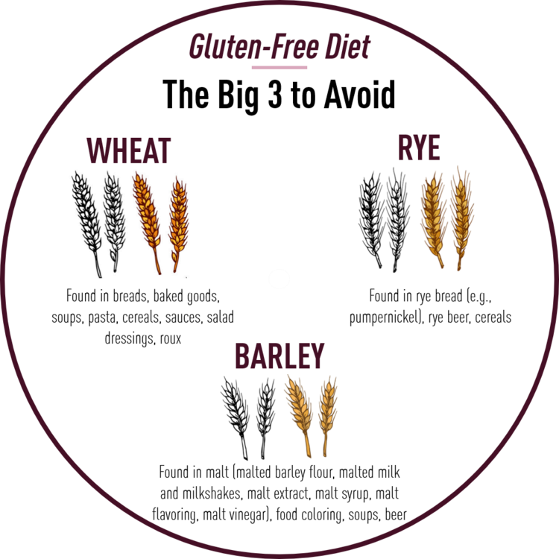
Celiac Disease (Gluten enteropathy) Management - Counselling
Celiac Disease is an auto-immune disorder with genetic
predisposition
Disease is likely to continue life-long
Management is to avoid all gluten in diet
Management (avoid all gluten intake) is life-long for confirmed Celiac Disease
Gluten intake by CD patients may result in relapse of
symptoms after a few weeks or months
Periodic follow-up is needed for clinical symptoms, adherence to gluten-free diet, and serological tests

Slide 20
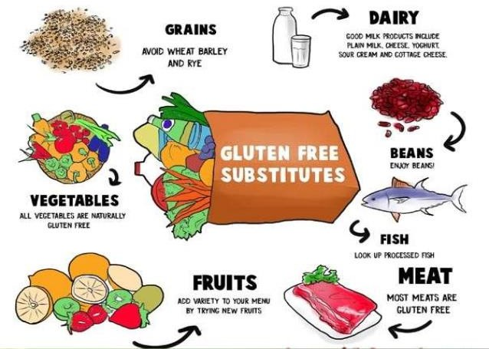
Celiac Disease (Gluten enteropathy) Gluten free Foods
Cereals – Rice, Corn (maize), Millet (bajra), Sorghum (jawar),
Buckwheat
Fruits
Vegetables
Meat and poultry
Fish and seafood
Milk and Dairy products
Beans and legumes

Slide 21
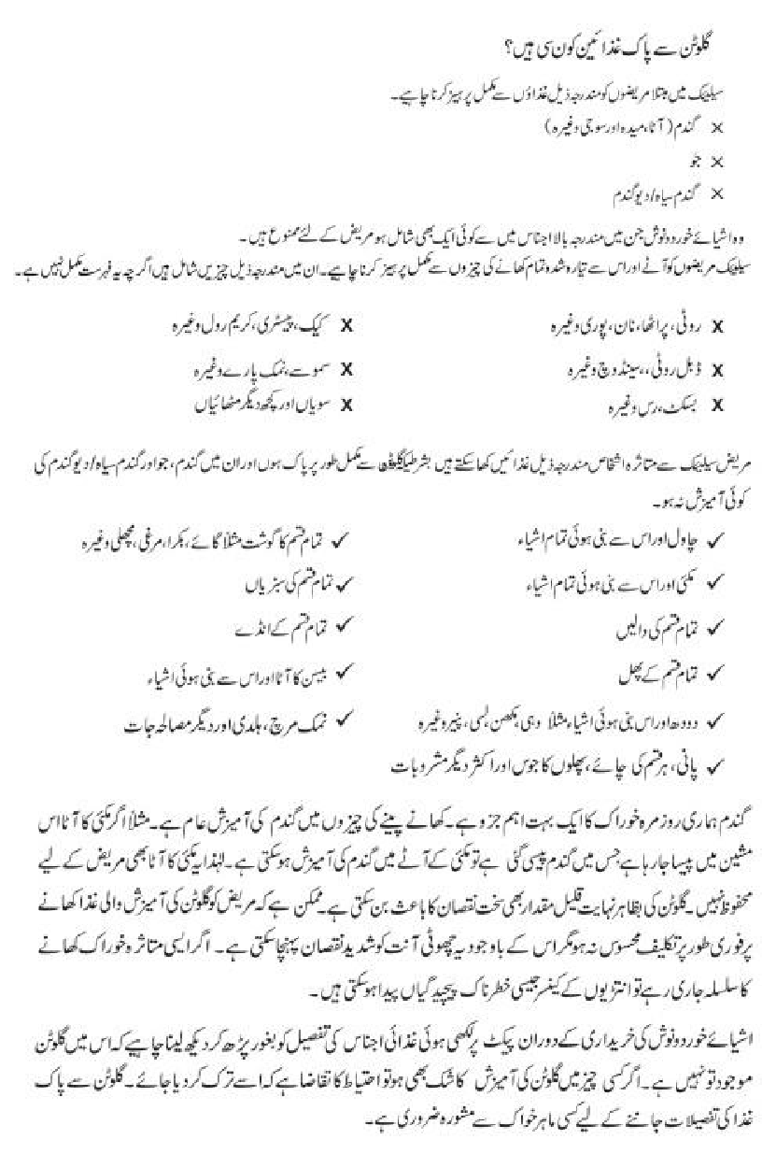
Patient information leaflet about Celiac Disease in Urdu language

Slide 22
Celiac Disease (Gluten enteropathy) Supportive Treatment
Micronutrients (Vitamin A, Zinc, Folic acid) to help in repair
of mucosal damage
Adequate calories (100 – 200 Cal /kg / day) to prevent or treat malnutrition and for growth
Foods intake should consist of gluten-free nutrients
During diarrhea – Cooked soft rice, banana, egg white,
potato, oil
After improvement – milk products, meat, gluten-free cereals, fruits and vegetables

Slide 23
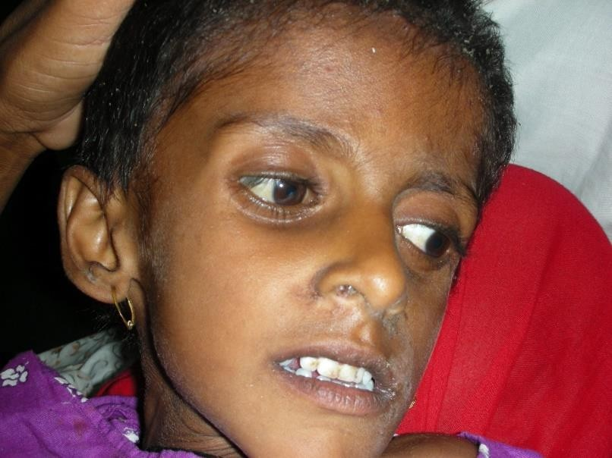
Celiac Disease (Gluten enteropathy) Complications
Failure to thrive / poor weight gain
Malnutrition / weight loss
Severe Acute Malnutrition (Marasmus / Kwashiorkor)
Short stature
Delayed puberty
Iron-deficiency anemia
Osteopenia and osteoporosis
Celiac crisis
Intestinal Lymphoma

Slide 24
Celiac Disease (Gluten enteropathy) Associated diseases
Many autoimmune disorders are associated with Celiac
disease
These are more common in patients with Celiac Disease (3 – 7 % )
Type I diabetes mellitus
Arthritis
Auto-immune hepatitis
Auto-immune thyroiditis
IgA nephropathy

Slide 25
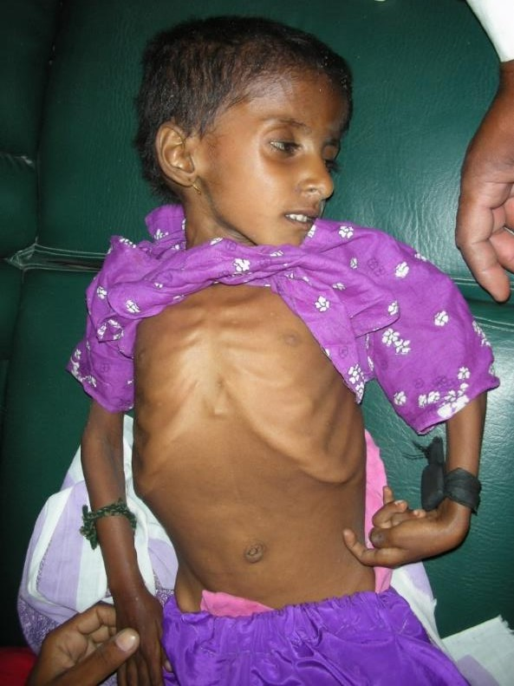
Celiac Disease (Gluten enteropathy)
Celiac crisis
Acute onset or rapid progression of gastrointestinal symptoms of Celiac Disease
Profuse diarrhea and Severe dehydration
Severe Acute Malnutrition (Marasmus / Kwashiorkor)
Hypo-proteinemia
Electrolyte abnormalities
Metabolic acidosis
Neurologic dysfunction

Slide 26
Celiac Disease (Gluten enteropathy) Management of Celiac crisis
Manage with protocol of SAM (Severe Acute Malnutrition)
IV rehydration – Ringer lactate / Normal saline
Monitor and treat Hypoglycemia - IV dextrose
Monitor and manage electrolytes – IV Potassium chloride,
Calcium gluconate and Magnesium Sulphate (infusions)
Micronutrients (Vitamin A, Zinc, Folic acid)
Corticosteroids IV
Antibiotics
Gluten and lactose free diet
Blood or blood products as needed

Slide 27
Celiac Disease (Gluten enteropathy) Conclusion
Celiac Disease (Gluten enteropathy) results in immune mediated
mucosal damage in small intestine after gluten intake in diet
Pathology - Villus atrophy and Malabsorption
Clinical features – Diarrhea, Malnutrition and growth failure
Diagnosis – serology and / or duodenal histology
MANAGEMENT
Eliminate all gluten intake from diet
Micronutrients (Vitamin A, Zinc, Folic acid)
Adequate energy (calories)
Initially gluten-free, soft diet (rice, banana, egg white, potato)
All gluten-free foods (according to age and choice) allowed after recovery

Slide 28
Chronic Diarrhea
Chronic diarrhea has an insidious (slow) onset
Mucosal damage and Malabsorption are often present
Malnutrition often develops in chronic diarrhea

Slide 29

Toddler’s diarrhea
Seen in children 1-2 years of age
Intestinal transit time is short
Stools are formed and passed many times during day in waking hours but not when child is sleeping
Food particles may be seen in stools
Child has adequate weight and height and malnutrition is not present

Slide 30
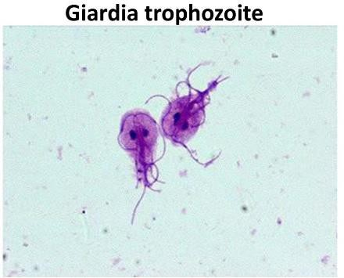
Giardiasis
Giardia lamblia is a protozoan parasite which causes intestinal infection
Giardiasis spreads by feco-oral route through ingestion of cysts in unclean environments
Giardiasis can cause pain abdomen, loose stools and malabsorption which can persist for weeks to months
Failure to thrive and poor weight gain occurs in children.

Slide 31
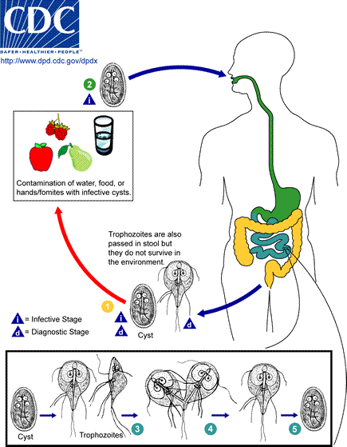
Giardiasis
Diagnosis
stool examination
endoscopy and microscopic examination of aspirated
duodenal fluid
Management
Metronidazole
Nitazoxanide

Slide 32
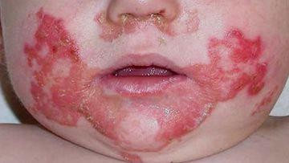
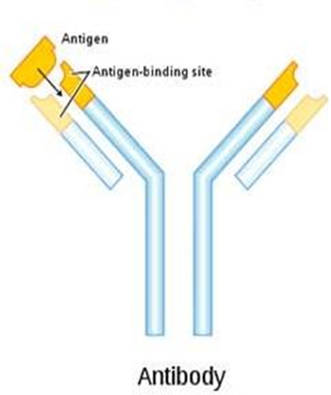
Rare causes of chronic diarhea
Acrodermatitis enteropathica
Cow milk protein allergy
Immunodeficiency
Cystic fibrosis
Inflmmatory bowel disease
p

Slide 33
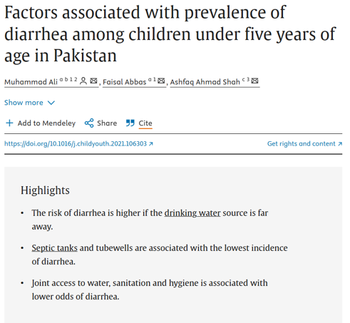

Slide 34
REFERENCE BOOKS
Pervez Akbar and Nelson Text book of Paediatrics

Slide 35
BIO-ETHICS
Delayed or missed diagnosis
Informed consent regarding Procedure(endoscopy)
Dietery restriction due to financial,cultural beliefs
Ethical responsibility beyond medical care(school providing gluten free meal)

