Slide 2
Second year MBBS (BATCH 50) GIT Module Case Based Learning (CBL) Peptic Ulcer Disease
Dr Iqra Ayub
Date: 01-02-2024

Slide 3
GIT Module 2nd Year MBBS (2025)
Case Based Learning (CBL) Peptic Ulcer Disease
Dr. Ali Zain
PGT physiology
Date: 00-00-0000

Slide 4
Table of Contents
Sr # | Content | Slide #
1 | Motto, Vision | 4
2 | Professor Umar Model of Integrated Lecture | 5
3 | Bloom’s Taxonomy(Domains of learning) | 6
4 | Diagrammatic Representation of Blooms Taxonomy | 7
5 | Conducting CBL And its Learning Objectives | 8,9,10,11
6 | Horizontal Integration | 13,14,
7 | Core Concept | 16-22
8 | Vertical Integration | 24-29
9 | Biomedical Ethics(lesson of the day) | 31-33
10 | Suggested Research Article | 35-37
11 | Brainstorming(SEQ relevant with lecture) | 24-29
12 | Promoting IT and research culture(Digital Library) | 37
13 | References of this lecture | 38

Slide 5
Motto Vision; The Dream/Tomorrow
To impart evidence based research oriented medical education
To provide best possible patient care
To inculcate the values of mutual respect and ethical practice of medicine
Wisdom
Truth
Service

Slide 6
Professor Umar Model of Integrated Lecture
60%
CORE SUBJECT
20%
HORIZONTAL
INTEGRATION
Physiology
biochemistry
8%
VERTICAL INTEGRATION
Pathology
pharmacology
7%
VERTICAL INTEGRATION
Clinical integration
5%
VERTICAL INTEGRATION
Research, professionalism
Ethics
Digital library

Slide 7
Bloom's Taxonomy : Domains Of Learning
Sr. # | Domain of learning | Abbreviation | Levels of the domain | Meaning
1 | cognition | C | C1 | Recall / Remembering
2 |  |  | C2 | Understanding
3 |  |  | C3 | Applying / Problem solving
4 | Psychomotor | P | P1 | Imitation / copying
5 |  |  | P2 | Manipulation / Follows instructions
6 |  |  | P3 | Precision / Can perform accurately
7 | Attitude | A | A1 | Receiving / Learning
8 |  |  | A2 | Respond / Starts responding to the learned attitude
9 |  |  | A3 | Valuing / starts behaving according to the learned attitude

Slide 8
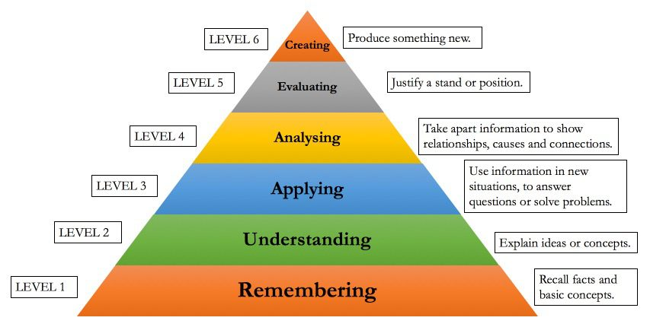
Bloom's Taxonomy Of The Cognitive Domain

Slide 9
CBL
Case-based learning (CBL) is a teaching method where students learn by analyzing real-life cases and applying their knowledge to solve problems or make decisions. CBL is often used in medical education, where students analyze patient cases to develop diagnostic and treatment skills.

Slide 10
Conducting CBL
Identify the learning objectives
Choose a case: Select a real-life case that is relevant to the learning objectives you have identified
Present the case
Analyze the case: Have students work in groups to analyze the case
Develop hypothesis

Slide 11
Conducting CBL (Cont.)
Test hypotheses: Have students test their hypotheses by using relevant diagnostic tests or other methods.
Discuss the results
Evaluate learning: Evaluate student learning by assessing their ability to analyze the case, develop hypotheses, and apply their knowledge of medical physiology to diagnose and treat the patient.

Slide 12
Learning Objectives
Sr. # | Learning Objective | Domain of Learning
1 | To Discuss gross Anatomy of Alimentary tract | C2
2 | To Discuss the Case Scenario and Diagnosis. | C2
3 | To Explain the Peptic Ulcer disease and its causes. | C3
4 | To Describe Pathophysiology of Peptic ulcer Disease | C2
5 | To Explain Treatment of Peptic Ulcer Disease. | C3

Slide 13
Horizontal Integration

Slide 14
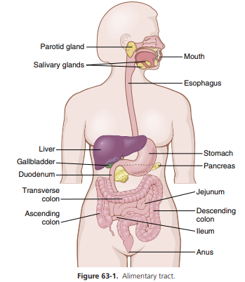
Horizontal
Integration/
Gross
Anatomy
Anatomy of Digestive Tract Wall
Reference: Textbook of Physiology by Gyton and Hall,14th edition Page No.788

Slide 15
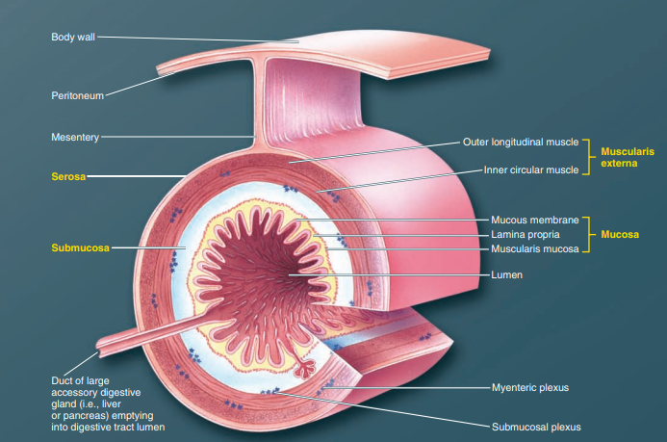
Layers of Digestive Tract Wall
Horizontal
Integration/
Gross
Anatomy
Reference: Sherwood Page No.571

Slide 16
Core Knowledge

Slide 17
Physiology of Gastrointestinal tract
Core Concepts
Core Knowledge
Gastrointestinal tract is well supplied with mucous glands that protects mucosa from gastric acid.
Duodenum is protected by the alkaline small intestinal secretions.
Sodium Bicarbonate in Pancreatic secretion, Brunner’s glands of the duodenal wall and bile coming from the liver neutralize the hydrochloric acid of the gastric juice, inactivate pepsin and prevent digestion of the mucosa.

Slide 18
Mechanism of Hydrochloric Acid Secretion
Core Knowledge
Reference: Textbook of Physiology by Guyton and Hall,14th edition Page No.812

Slide 19
Peptic Ulcer Disease
Vertical Integration with Internal Medicine/
Gastroentrology
A peptic ulcer is an excoriated area of stomach
or intestinal mucosa caused principally
digestive action of gastric juice or upper small intestinal secretions.

Slide 20
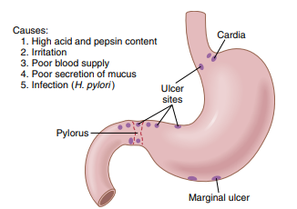
Causes and Most Frequent Locations of Peptic Ulcer Disease
Vertical Integration with Internal Medicine/
Gastroentrology
Reference: Textbook of Physiology by Guyton and Hall,14th edition Page No.834

Slide 21
Pathophysiology
Vertical Integration with Internal Medicine/
Gastroenterology
The basic causes of peptic ulceration is:
(1) Gastroduodenal mucosal barrier damage
(2) Lack of neutralization of the Gastric Acid by Duodenal Juices.

Slide 22
Pathophysiology
Vertical Integration with Internal Medicine/
Gastroenterology
Helicobacter pylori infection breaks down the Gastroduodenal mucosal barrier and stimulates Gastric Acid Secretion.
Factors that predispose to ulcers includes:
(1) smoking
(2) excess alcohol consumption
(3) Aspirin and other NSAIDs consumption

Slide 23
Treatment
Vertical Integration with Internal Medicine/
Gastroentrology
Antibiotics along with other agents to kill infectious bacteria
Administration of an antihistaminic acid suppressant drug, especially ranitidine.

Slide 24
(With Clinical and Para-clinical Sciences)
Vertical Integration

Slide 25
Case Scenario
Vertical Integration with Internal Medicine/
Gastroentrology
Vertical Integration
A 45 years male presented to medical opd with the complaint of pain epigastrium for two weeks. The pain was constant and mild in nature. Last night the pain aggravated after he took meal. His mother gave him a cup of milk saying that milk relieves the pain epigastrium. Also he took 2 teaspoonful of syrup Dijex MP after which he felt an improvement in the pain. The history revealed that he works in a software company and sits for a long time working on his desktop. He is non smoker and there is no other co-morbid condition. He is living a sedentary life style with no exercise and support. He likes eating spicy and hot foods along with the soft drinks and frequently visits restaurants. He daily takes 4 to 5 cups of tea and a cup of coffee.

Slide 26
Answer
Vertical Integration with Internal Medicine/
Gastroentrology
Vertical Integration
Peptic Ulcer Disease

Slide 27
Related Questions
Vertical Integration with Internal Medicine/
gastroenterology
Q.1. How do you control stomach acid production?

Slide 28
Related Questions
Vertical Integration with Internal Medicine/
gastroenterology
Q.1. How do you control stomach acid production?
Ans: Avoid eating spicy foods
Quit smoking
Weight reduction
Avoid eating high fat diet

Slide 29
Related Questions
Vertical Integration with Internal Medicine/
gastroentrology
Q.2. What is the relationship of the life-style with peptic ulcer?
Ans: The risk of developing Peptic Ulcer Disease (PUD) was shown to be associated with genetic inheritance, lifestyle and social status of the patients. Unhealthy lifestyle habits and failure in coping with stress have been closely associated with the occurrence of PUD.

Slide 30
Related Questions
Vertical Integration with Internal Medicine/
gastroentrology
Q.2. What is the relationship of the life-style with peptic ulcer?
Ans: The risk of developing Peptic Ulcer Disease (PUD) was shown to be associated with genetic inheritance, lifestyle and social status of the patients. Unhealthy lifestyle habits and failure in coping with stress have been closely associated with the occurrence of PUD.

Slide 31
Bioethics

Slide 32
Consent
Biomedical Ethics
Consent is the “autonomous authorization of a medical intervention by individual patients.”

Slide 33
Contd…
Biomedical Ethics
Q. A 35 years female presented with complaints of pain epigastrium, nausea and bloating. She used to eat hot and spicy foods alongwith 4 to 5 cups of tea and a cup of coffee. Doctor suspected peptic ulcer disease and recommended upper gastrointestinal endoscopy to confirm the diagnosis. Doctor explained the whole procedure of endoscopy but patient didn’t allow the procedure.
Solution : The patient didn’t allow the procedure . The doctor can’t proceed according to the medical ethics.

Slide 34
Role of Family Physician in Peptic Ulcer Disease
Family Medicine
By early diagnosis of the disease based on symptoms, medical history, and physical examination
By medications to treat peptic ulcer disease.
Advising patients to avoid smoking, reduce alcohol consumption, and make dietary changes to minimize triggers such as spicy or acidic foods.

Slide 35
Suggested Research Article
(To Promote Research Culture)

Slide 36
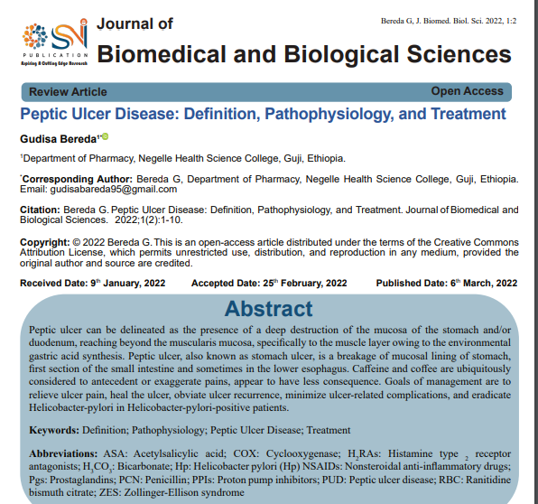
Promoting Research Culture
Journal of Biomedical and Biological Sciences
March 2022.
https://snipub.com/wp-content/uploads/2022/03/SNI-JBBS-22-02.pdf

Slide 37
Take Home Message/ Crux of the Suggested Research Article
Promoting Research Culture
H. Pylori infection, NSAID use, genetic and environment factors contribute to cause peptic ulcer disease. H. Pylori eradication therapy is recommended for H. Pylori infected patients.
Triple therapy with PPI once/bd + clarithromycin 500 mg bd + amoxicillin 1 g bd or metronidazole 500 mg bd for 10 to 14 days. Metronidazole should be substituted for amoxicillin in penicillin allergic individuals.

Slide 38
How To Access Digital Library
Promoting Research/IT Culture
Steps to Access HEC Digital Library
Go to the website of HEC National Digital Library.
On Home Page, click on the INSTITUTES.
A page will appear showing the universities from Public and Private Sector and other Institutes which have access to HEC National Digital Library HNDL.
Select your desired Institute.
5. A page will appear showing the resources of the institution
6. Journals and Researches will appear
7. You can find a Journal by clicking on JOURNALS AND DATABASE and enter a keyword to search for your desired journal.

Slide 39
References
Books:
Guyton And Hall textbook of Medical Physiology 14th Edition
Ganong’s Review of Medical Physiology 25th Edition
Sherwood, 9th edition.
Silverthorn Physiology,6th edition
Vander’s Human Physiology,14th edition
Research:
https://snipub.com/wp-content/uploads/2022/03/SNI-JBBS-22-02.pdf
YouTube/videolink:
https://www.youtube.com/watch?v=E0IBMWQDEH4

