Slide 2
THEME:Patients Presenting with Mass Coming Out of Rectum
To impart evidence-based research-oriented health
To impart evidence-based research-oriented health
To impart evidence-based research-oriented health
Dr Usman Qureshi
M.B.B.S F.C.P.S
Assistant Professor
SURGERY UNIT–II, BBH
RAWALPINDI MEDICAL UNIVERSITY

Slide 3
University Motto, Vision, Values & Goals
Mission Statement To impart evidence-based research-oriented health professional education .Best possible patient care Mutual respect, ethical practice of healthcare and social accountability. Vision and Values Highly recognized and accredited centre of excellence in Medical Education, using evidence-based training techniques for development of highly competent health professionals, who are lifelong experiential learner and are socially accountable. Goals The Undergraduate Integrated Learning Program is geared to provide you with quality medical education in an environment designed to:

Slide 4
PROF UMER MODEL OF INTEGRATED LECTURE

Slide 5
Clinical Scenario
A 70-year-old woman presents to the clinic with a history of a mass protruding from her anus, especially after bowel movements. She reports feeling a sensation of incomplete evacuation and occasional bleeding. On physical examination, a circumferential full-thickness protrusion of the rectal wall is noted. Which of the following is the most likely diagnosis?
A. Internal hemorrhoids B. Anal fissure C. Rectal prolapse D. Ulcerative colitis E. Rectocele

Slide 6
Answer: C. Rectal prolapse
Explanation: The patient's symptoms and physical findings are consistent with rectal prolapse, which is characterized by a circumferential full-thickness protrusion of the rectal wall. This condition often presents with a sensation of incomplete evacuation, bleeding, and a mass protruding from the anus after defecation.
Internal hemorrhoids may cause bleeding but do not result in a circumferential mass. An anal fissure causes pain and bleeding but does not present with a mass.
Ulcerative colitis involves inflammation of the colon and does not produce a protruding mass.
A rectocele is a bulging of the rectum into the vagina, not through the anus.

Slide 7
LEARNING OBJECTIVES
At The End Of This Lecture Students Shall Be Able To Learn:
Describe anatomy of rectum and anal canal
Enumerate causes of mass in the rectum and anal canal
Clinical Presentation of rectal prolapse
Pathology of rectal diseases
Differentials of rectal prolapse especially rectal polyp
Surgical Management of rectal prolapse

Slide 9
Anatomy

Slide 12
Differentials Of Mass Coming out of Rectum
Rectal prolapse
Prolapsed haemorrhoids
Rectal polyp
Anal fissure with sentinal tag of skin
Anal warts
Perianal haematoma

Slide 13
Rectal Prolapse

Slide 14
Prolapsed Hemorrhoids

Slide 15
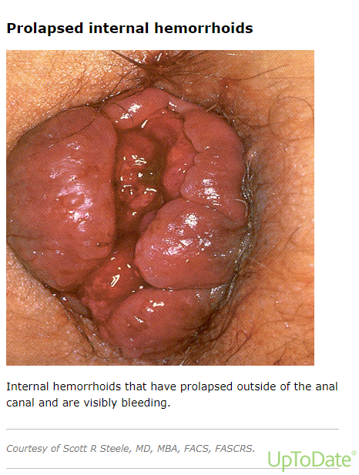

Slide 17
Rectal Polyp

Slide 18
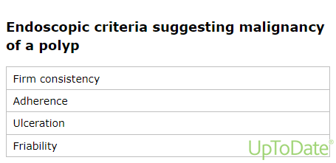

Slide 19
Perianal Hematoma

Slide 20
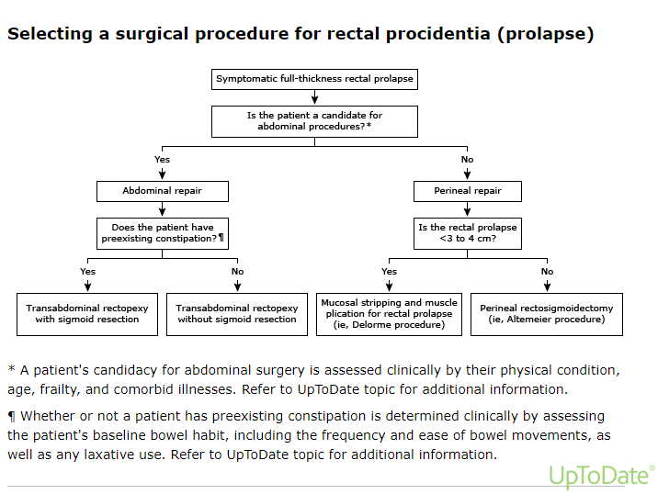

Slide 21
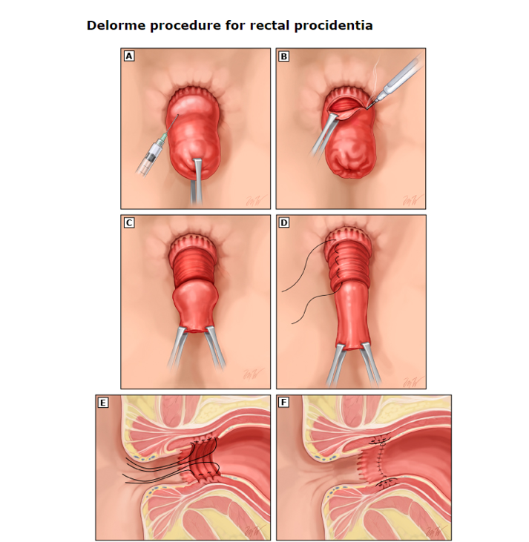

Slide 22
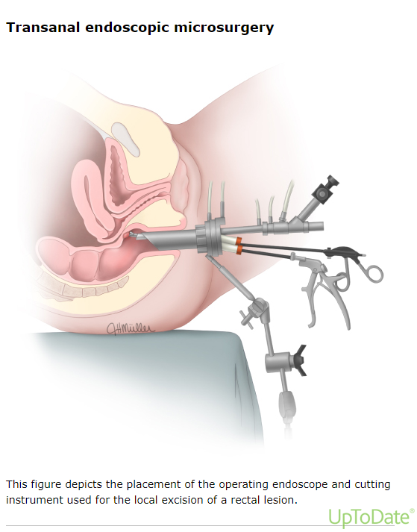

Slide 23
MCQ
A 55-year-old woman with a history of chronic constipation presents with a rectal prolapse. She has tried increasing dietary fiber and using laxatives without significant improvement. Which of the following is the most appropriate next step in management?
A. Observation B. Biofeedback therapy C. Laparoscopic rectopexy D. Hemorrhoidectomy E. Topical steroids

Slide 24
Answer: C. Laparoscopic rectopexy
Explanation:
Laparoscopic rectopexy is a surgical procedure that is often indicated for the treatment of rectal prolapse, especially when conservative measures have failed. It involves fixing the rectum in place to prevent it from prolapsing.
Observation and biofeedback therapy may be useful for mild cases or in the early stages, but in this case, surgical intervention is the most appropriate next step.
Hemorrhoidectomy and topical steroids are not treatments for rectal prolapse.

Slide 25
REFERENCES
Felt-Bersma RJ, Tiersma ES, Cuesta MA. Rectal prolapse, rectal intussusception, rectocele, solitary rectal ulcer syndrome, and enterocele. Gastroenterol Clin North Am 2008; 37:645.
Kairaluoma MV, Kellokumpu IH. Epidemiologic aspects of complete rectal prolapse. Scand J Surg 2005; 94:207.
Stein EA, Stein DE. Rectal procidentia: diagnosis and management. Gastrointest Endosc Clin N Am 2006; 16:189.
Tou S, Brown SR, Malik AI, Nelson RL. Surgery for complete rectal prolapse in adults. Cochrane Database Syst Rev 2008; :CD001758.
Bordeianou L, Paquette I, Johnson E, et al. Clinical Practice Guidelines for the Treatment of Rectal Prolapse. Dis Colon Rectum 2017; 60:1121.

Slide 26
Any Question?
Thankyou

