Slide 2
THEME:Patient With Prominent Tortuous Veins.
To impart evidence-based research-oriented health
To impart evidence-based research-oriented health
To impart evidence-based research-oriented health
PROF. DR. Usman Qureshi
M.B.B.S F.C.P.S
HEAD OF THE DEPARTMENT
SURGERY UNIT–II, BBH
PROFESSOR OF SURGERY
RAWALPINDI MEDICAL UNIVERSITY

Slide 3
University Motto, Vision, Values & Goals
Mission Statement To impart evidence-based research-oriented health professional education .Best possible patient care Mutual respect, ethical practice of healthcare and social accountability. Vision and Values Highly recognized and accredited centre of excellence in Medical Education, using evidence-based training techniques for development of highly competent health professionals, who are lifelong experiential learner and are socially accountable. Goals The Undergraduate Integrated Learning Program is geared to provide you with quality medical education in an environment designed to:

Slide 4
PROF UMER MODEL OF INTEGRATED LECTURE

Slide 5
SEQUENCE OF LGIS
Learning objectives
1) Causes and clinical Features of Venous Diseases and Varicose Veins (core concept = 70%)
2) Principles of Diagnosis and Surgical Treatment Of Varicose Veins(horizontal integration 10%)
3) Related clinical scenarios (vertical integration – 15%)
4) Research article related to topic (4%)
5) Ethics (1%)

Slide 6
LEARNING OBJECTIVES
At The End Of This Lecture Students Shall Be Able To Learn:
Venous anatomy of lower Limbs
The pathophysiology of venous diseases
Various Risk Factors associated with Varicose Veins
Enumerate investigations for varicose veins
Outline conservative management
Understands principles of operative management of Varicose Veins
Recent advances

Slide 7
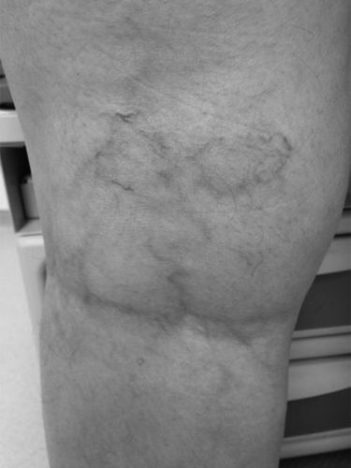
Clinical Scenario
A 38-year-old woman presented 6 months postpartum from the birth of her third child with pruritic bluish veins and a burning sensation behind her knees. On physical examination, she was obese and had prominent veins behind her knees and along her lateral lower thighs.
What are the Differential Diagnosis?

Slide 8
Differential Diagnosis
Varicose Veins
Lymphedema
Deep vein thrombosis
Cellulitis
Stasis dermatitis

Slide 9
Anatomy
Venous drainage of the lower extremities is accomplished by a network of superficial veins connected to the deep veins by small perforator veins. Although disease in any of these venous systems may result in varicose veins, symptoms and their severity increase with the number of systems affected.
Varicosities typically form in the greater and lesser saphenous veins but also develop in branch vessels. Obstruction of the iliac veins or inferior vena cava can result in extensive varicose veins.

Slide 10
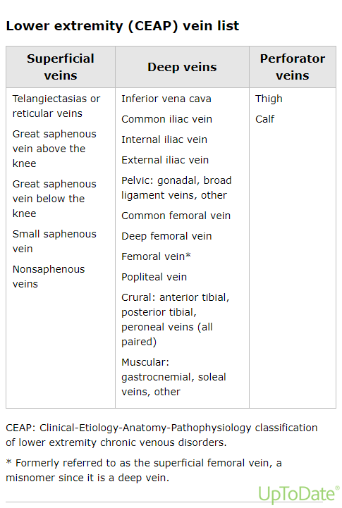

Slide 11
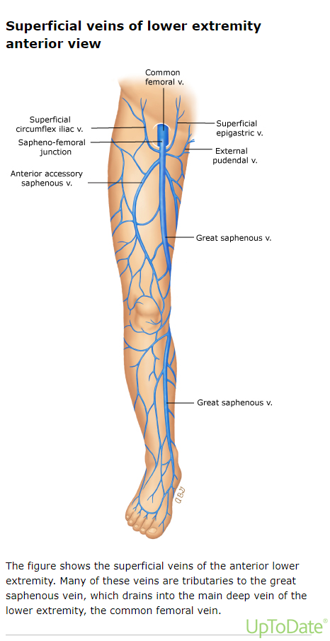

Slide 12
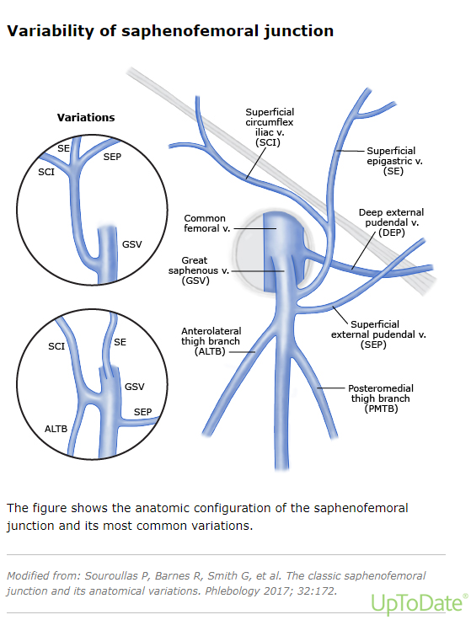

Slide 13
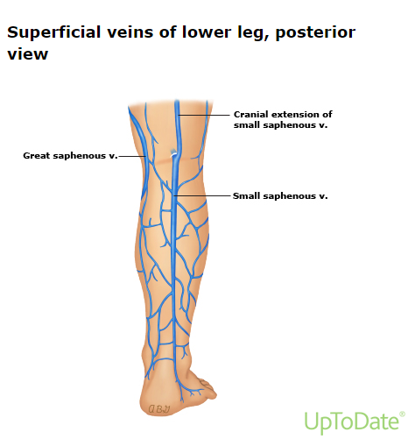

Slide 14
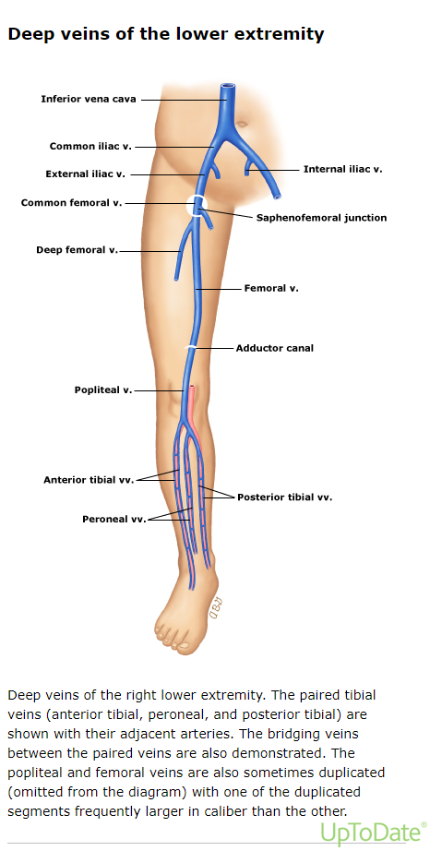

Slide 15
Physiology
Venous valves direct flow from distal to proximal and from the superficial veins to the deep veins. Blood is directed proximally within the deep venous system by muscular contraction (ie, the "venous pump").
The effectiveness of this pumping action depends on the presence of competent vein valves to prevent retrograde flow. When functioning properly, the ambulatory venous pressure in the superficial system is maintained between 20 and 30 mmHg.

Slide 16
Introduction
Varicose veins are characterized by subcutaneous dilated, tortuous veins greater than or equal to three millimeters, involving the saphenous veins, saphenous tributaries, or non-saphenous superficial leg veins with age and family history considered important risk factors.
Varicose veins are considered a common clinical manifestation of chronic venous disease.

Slide 17
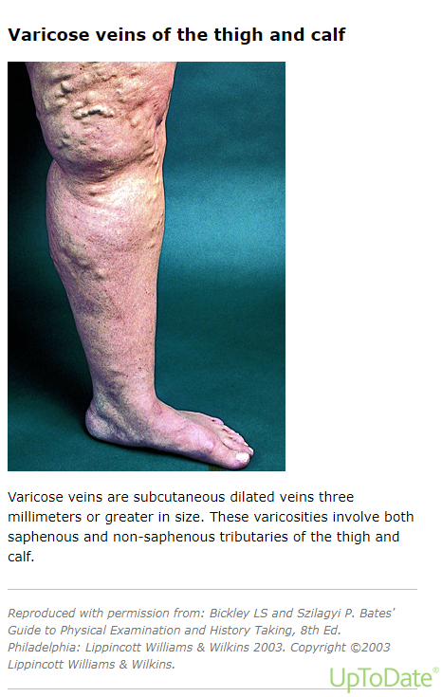

Slide 18
Risk Factors
The risk factors for varicose veins include
Advancing Age
Female sex
Multiparity
Obesity
Prolonged standing or walking
Lower Extremity Trauma
Smoking
History of venous thrombosis

Slide 19
Pathophysiology
The primary pathologies related to varicose veins are
elevated venous pressure in the extremities.
defective or incompetent valves resulting in reflux and, thus, elevated venous pressure in the extremity.
Incompetent venous valves result in the backward transmission of the pressure gradient. The pressure gradient would be transmitted from the deep to the superficial venous system via the saphenofemoral junction (SFJ) and perforator veins.

Slide 20
Pathophysiology
Venous hypertension – Valvular incompetence is the primary anatomic abnormality associated with venous hypertension, but obstruction (eg, deep vein thrombosis) and failure of the "venous pump" may contribute. Anatomic distortion of the vessel wall from excessive venous pressure exacerbates valvular incompetence.
Histologic changes – Sustained venous hypertension is associated with histologic and structural changes that lead to increased vascular permeability (edema) and the chronic release of inflammatory mediators that are the fundamental cause of cutaneous hyperpigmentation, trophic skin changes, and ulceration.

Slide 21
Clinical Menifestation
Symptoms include
Pain
Leg heaviness
Swelling
Skin dryness
Skin discoloration
Tightness
Itching, irritation
Muscle cramps
Clinical signs of chronic venous disorders in increasing severity include dilated veins (eg, telangiectasia, varicose veins), leg edema, skin changes, and skin ulceration.

Slide 23
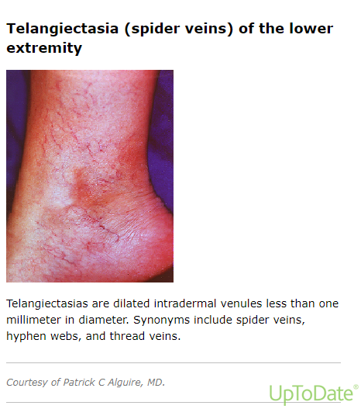

Slide 24
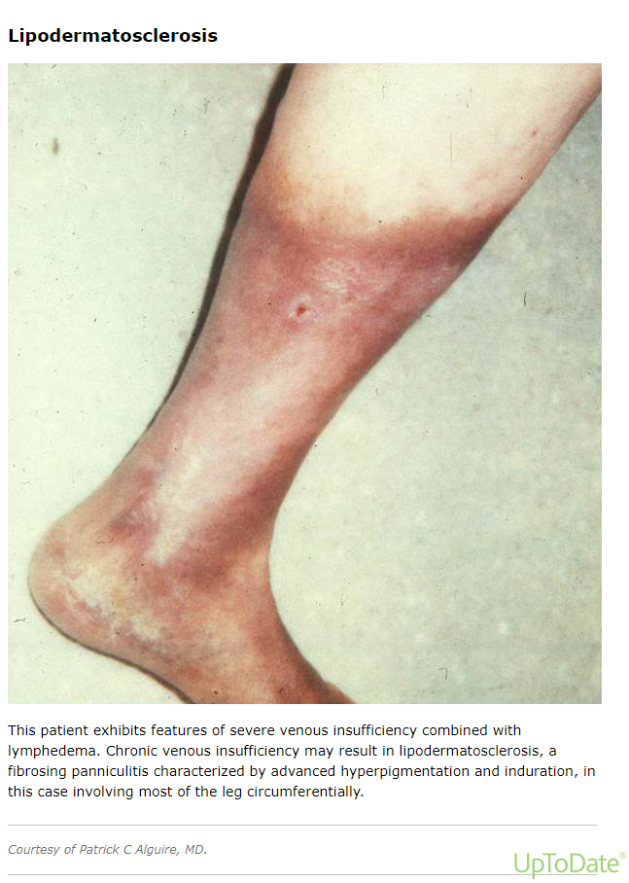

Slide 26
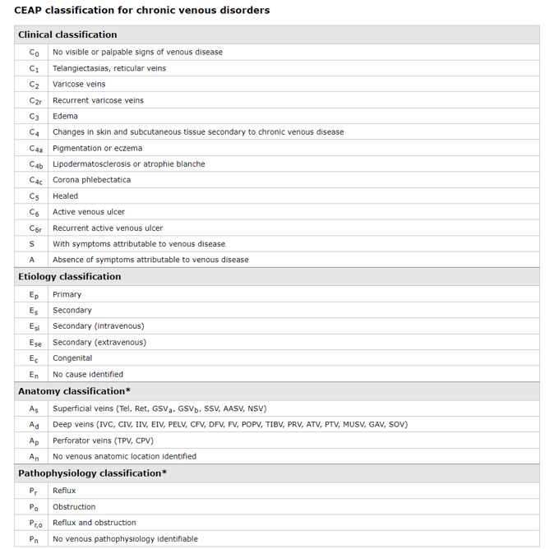

Slide 27
Investigations
Clinical Examination
The diagnosis of chronic venous disease is suggested by the presence of typical symptoms (leg pain, fatigue, heaviness) and physical examination findings.
The Brodie-Trendelenberg test
The Perthes test
Venous duplex ultrasound
patency and competency of the deep system.
patency and competency of the superficial system, including site of incompetent segments, site of junctions and perforators.
location and relationships of the sapheno-popliteal junction.
diameter of the affected vein.

Slide 28
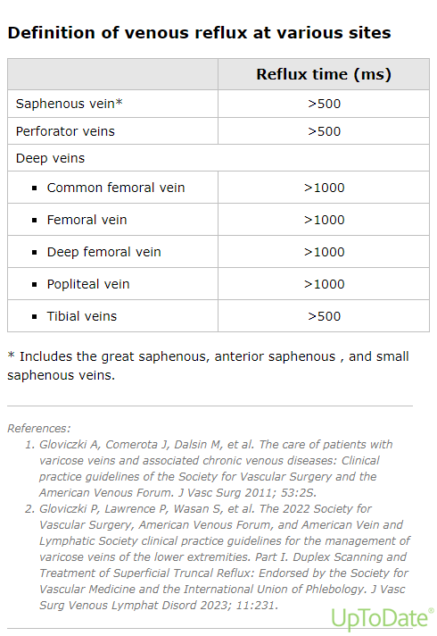

Slide 29
Conservative Management
Initial management includes:
Leg elevation, exercise, and compression therapy to improve oxygen transport to the skin and subcutaneous tissues, decrease edema, reduce inflammation, and compress dilated veins.
Skin changes ("stasis dermatitis") respond to topical dermatologic agents.
Venous ulceration is treated with a combination of ulcer wound management and compression therapy (stockings, bandaging systems).

Slide 30
Minimally Invasive Treatment Options
Minimally invasive treatment options are becoming increasingly popular and have shown equivalence in short term outcomes.This Includes
Sclerotherapy – using liquid or foam (can be ultrasound guided, UGFS)
Endovenous laser therapy (EVLT)
Radiofrequency ablation (RFA)

Slide 31
Endovenous Options
Thermal ablation – Thermal ablation involves generation of heat at a temperature high enough to denature the proteins that constitute the vein wall.
Nonthermal ablation
Mechanical occlusion chemically assisted (MOCA) ablation
Cyanoacrylate embolization
Polidocanol endovenous microfoam (PEM)

Slide 32
Surgical Treatment Options
Saphenous ligation with stripping and with the avulsion of tributary veins.
Saphenous ligation without stripping.
CHIVA — CHIVA (conservative venous ligation)
Stab/microincision phlebectomy

Slide 35
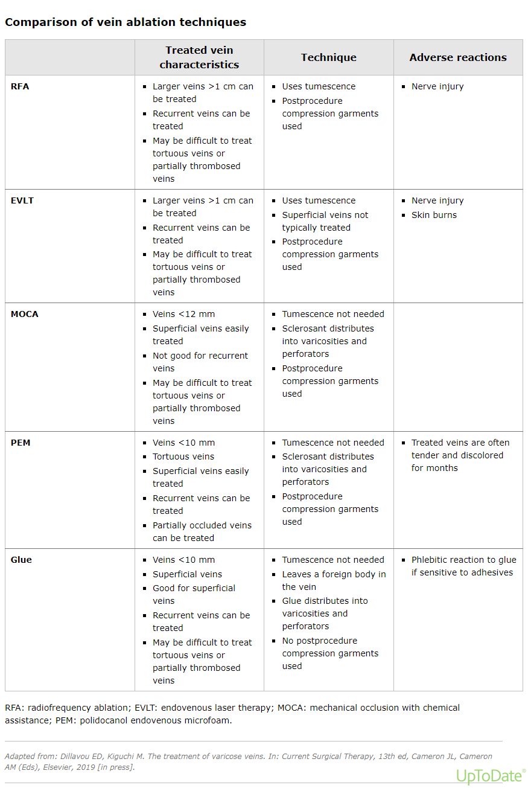

Slide 36
REFERENCES
Gloviczki P, Comerota AJ, Dalsing MC, et al. The care of patients with varicose veins and associated chronic venous diseases: clinical practice guidelines of the Society for Vascular Surgery and the American Venous Forum. J Vasc Surg 2011; 53:2S.
Wittens C, Davies AH, Bækgaard N, et al. Editor's Choice - Management of Chronic Venous Disease: Clinical Practice Guidelines of the European Society for Vascular Surgery (ESVS). Eur J Vasc Endovasc Surg 2015; 49:678.
O'Donnell TF Jr, Passman MA. Clinical practice guidelines of the Society for Vascular Surgery (SVS) and the American Venous Forum (AVF)--Management of venous leg ulcers. Introduction. J Vasc Surg 2014; 60:1S.
Zahariev T, Anastassov V, Girov K, et al. Prevalence of primary chronic venous disease: the Bulgarian experience. Int Angiol 2009; 28:303.
Dua A, Heller JA. Advanced Chronic Venous Insufficiency. Vasc Endovascular Surg 2017; 51:12. Criqui MH, Denenberg JO, Bergan J, et al. Risk factors for chronic venous disease: the San Diego Population Study. J Vasc Surg 2007; 46:331.
Prochaska JH, Arnold N, Falcke A, et al. Chronic venous insufficiency, cardiovascular disease, and mortality: a population study. Eur Heart J 2021; 42:4157.

Slide 37
Any Question?
Thankyou

