Slide 1
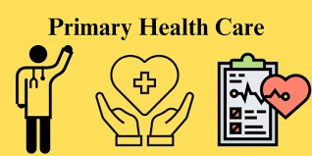
Primary Health Care

Slide 3
Prof Umer Model

Slide 4
Learning objectives
The students should be able to :
Explain concept for HFA-2000
Understand PHC concept, background and progress
Understand Goals for Health for all
Comprehend principles of Primary Health care
Narrate competent / elements of PHC

Slide 5
What is Health?

Slide 6
World Health Organization (WHO) defines health
"Health is a state of complete
Physical
mental and
social well-being
and not merely the absence of disease or infirmity.".

Slide 7
What is medical Care?
Personal services provided directly by physicians or rendered as the result of physicians’ instruction.

Slide 8
What is health Care?
Multitude of services provided to individuals or Communities by agents of health services or professionals for purpose of promoting maintaining, monitoring and restoring health.

Slide 9
Health services are:
Predominantly urban oriented
Mostly curative in nature
Accessible to only small population

Slide 10
The Joint WHO – UNICEF international conference in 1978 at Alma-Ata (USSR)launched a movement known as HFA(health for all) to address the existing
inequalities in the status of health both at level of country and globe

Slide 11
Health for all by 2000 AD The member countries of WHO at the 30th World Health Assembly in May 1977 )launched a movement known as HFA(health for all) by 2000AD
HFA was defined as
attainment of a level of health by the year 2000 AD that will enable every individual lead a socially and economically productive life
Notes:
`

Slide 12
John Bryant in his book “Health and the Developing World
What does health for all means?
“Large numbers of the world’s people, perhaps more than half, have no access to health care at all, and for many of the rest the care
they receive does not answer the problems they have.”
HFA aims to provide
and other physical and mental impairments in people
via the prevention, diagnosis, treatment,
recovery, or cure of disease, illness, injury,

Slide 13
The Joint WHO – UNICEF international conference in 1978 at Alma-Ata (USSR) on Primary Health Care reaffirms
HEALTH FOR ALL
as major social goal of the governments
and ‘Primary Health Care’ as a way to achieve Health For All
Notes:
TO attain Level of health by all citizens that permit them to lead socially and economically productive life

Slide 14
Primary Health Care

Slide 15
Agenda Points Alma – Ata Declaration
Health is a fundamental human right
Attainment of the highest possible level of health is a most important worldwide social goal.
Existing gross inequality in the health status particularly between developed and developing countries is politically, socially and economically unacceptable.
Economic and social development is of basic importance to the fullest attainment of health for all.
Notes:
Health is a fundamental human right and that the attainment of the highest possible level of health is a most important worldwide social goal.
The existing gross inequality in the health status of the people particularly between developed and developing countries is politically, socially and economically unacceptable.
Economic and social development, based on a new international economic order is of basic importance to the fullest attainment of health for all.
The people have the right and duty to participate individually and collectively in the planning and implementation of their health care.

Slide 16
Agenda Points Alma – Ata Declaration
The people have right & duty to participate individually and collectively in planning and implementation of their health care.
Government have a responsibility for the health of their people can fulfill
by the provision of adequate health and social measures.
to formulate national policies, strategies and plans of action to launch and sustain primary health care.
All countries should cooperate in a spirit of partnership and service to ensure PHC for all people.

Slide 17
A new approach to health care “Primary Health Care” came in to existence following Alma -Ata declaration. It was defined
“Primary health care is an essential health care based on practical, scientifically sound and socially acceptable methods and technology, made universally accessible to individual and families in the community, through their full participation and at a cost that the community and the country can afford”.

Slide 18
Primary Health Care
It is first level of contact between recipient of care and health care delivery system assignment
At Rural level these services are provided by?
In urban areas these services are given by?

Slide 19
Hint
It is close to the people where most of the problems of health care can be dealt and resolved

Slide 20
Integrated Health Complex Service delivery in Pakistan
Basic Health Unit
Serves 5,000-10,000 population
Services provided include-- MCH service
Diarrheal disease control, Child Care,
immunization, malaria control, family planning
mental health & school Health services
All BHUs are staffed by MOs, A male &
female Health technician & support personals.
5-10 BHUs link to a
Rural Health Centre
Each RHU has about 25 beds, a laboratory,
X-ray & provision for Minor surgery
RHU play a pivotal role, provides a dentist ,
a microscope, and sanitary inspector
RHU is linked to
Tehsil Hospital
Linked to
District Head Quarter
Hospital

Slide 21
Levels of Health Care Service Delivery
Primary health care
Secondary health care
Tertiary health care

Slide 22
Levels of Care
Primary health care
The “first” level of contact between the individual and the health system.
Essential health care (PHC) is provided.
A majority of prevailing health problems can be satisfactorily managed.
The closest to the people.
Provided by the primary health centers.

Slide 23
Levels of Care
Secondary health care
More complex problems are dealt with.
Comprises curative services
Provided by the district hospitals
The 1st referral level
Tertiary health care
Offers super-specialist care
Provided by regional/central level institution.
Provide training programs

Slide 24
HEALTH CARE DELIVERY FRAMEWORK PAKISTAN
Tertiary care
Secondary care
Primary care
Tertiary care
Secondary care
Primary care
Notes:
Over the years, health system in pakistan is faced with another challenge and that is of inverted pyramid of levels of health care compared to the WHO recommendations. Resources (both human and financial) are committed to less needed tertairy care ,leaving the essential Primary care perniciuos .

Slide 25
Elements(Core Activities) for PHC
There is a set of CORE ACTIVITIES, which were normally defined nationally or locally. According to the 1978 Declaration of Alma-Ata proposed that these activities should include:

Slide 26
1. Education concerning prevailing health problems and the methods of preventing and controlling them

Slide 27
2. Promotion of food supply and proper nutrition

Slide 28
3. An adequate supply of safe water and basic sanitation

Slide 29
4. Maternal and child health care, including family planning

Slide 30
5. Immunization against the major infectious diseases

Slide 31
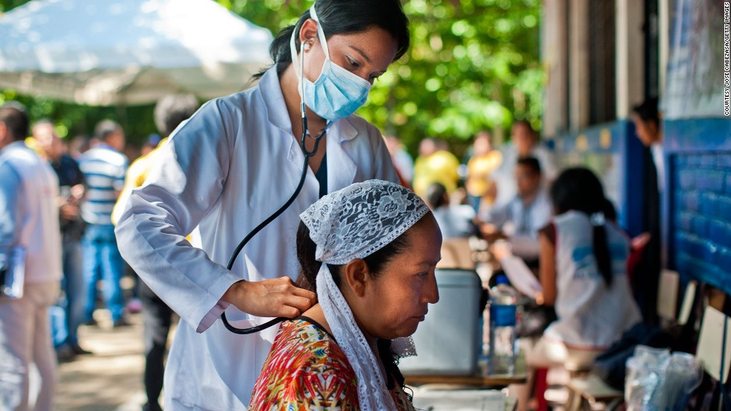
6. Prevention and control of locally endemic diseases

Slide 32
7. Appropriate treatment of common diseases and injuries and promotion of mental health

Slide 33
ELEMENTS
E-Education concerning prevailing health problems and the methods of identifying, preventing, and controlling them.
L– Locally endemic disease prevention and control.
E– expanded program of immunization against major infectious diseases.
M– Maternal and child health care including family planning.
E– Essential drugs arrangement.
N– Nutritional food supplement, an adequate supply of safe and basic nutrition.
T– Treatment of communicable and non-communicable diseases and the promotion of mental health.
S– Safe water and sanitation.

Slide 34
Principles Of Primary Health Care
1.Equitable distribution
2.Community participation.
3.Inter-sectoral coordination
4.Appropriate technology
5.Health Promotion

Slide 35
1. Equitable distribution
Some thing for all and most for those who need the most i.e.
target services for individuals, families and communities demonstrating the greatest existing or potential health risk.

Slide 36
2. Community participation
There must be a continuing effort to secure meaningful involvement of the community in the planning, implementation and maintenance of health services, besides maximum reliance on local resources such as manpower, money and materials
Families and communities assume responsibility of their own health

Slide 37
3.Intersectoral coordination
“ Primary health care involves in addition to the health sector, all related sectors and aspects of national and community development, in particular agriculture, animal husbandry, food, industry, education, housing, public works, communication and others sectors".
because no sector can approach its goal in isolation

Slide 38
4. Appropriate technology
“Technology that is scientifically sound ,simple adaptable to local needs, and acceptable to those who apply it and those for whom it is used, and that can be maintained by the people themselves in keeping with the principle of self reliance with the resources the community and country can afford"

Slide 39
5. Health promotion
Health promotion is “the process of enabling people to increase control over, and to improve their health” (WHO, 1986) .
health promotion is centered around the concepts of self-help, mutual aid and citizen participation
Notes:
Health is seen by Canadian health promoters to be enhanced by sensible lifestyles and the equitable use of public and private resources to permit people to use their initiative individually and collectively to maintain and improve their own well-being, however they may define it." (Rootman & Raeburn, 1994, p.69).

Slide 40
5. Health promotion
Health is seen by health promoters to be enhanced by sensible lifestyles and the equitable use of public and private resources to permit people to use their initiative individually and collectively to maintain and improve their own well-being, however they may define it.“
(Rootman & Raeburn, 1994.
Notes:
Health is seen by health promoters to be enhanced by sensible lifestyles and the equitable use of public and private resources to permit people to use their initiative individually and collectively to maintain and improve their own well-being, however they may define it." (Rootman & Raeburn, 1994, p.69).

Slide 41
Goals laid down in respect of various health indicators
Reduction of Crude Birth Rate
Reduction of IMR
Raise Life Expectancy at birth
Achieve a net reproduction rate of one
To provide potable water to entire rural population

Slide 42
PHC in Pakistan
Govt of Pakistan embarked up on primary health care provision prior to 1978 ALMA ATA Declaration of Health for All by the year 2000.
Nation wide health care provide a systematic link between the villages and the whole health care system– Integrated Rural health complex

Slide 43
Differentiate between comprehensive and selective PHC
Describe current comprehensive and selective primary healthcare programs
Identify and describe gaps in implementation of PHC
Comprehend Rural and Urban Health issues

Slide 44
Primary Health Care
In this era of increasing burden of disease and ever widening gulf of resources and requirements .
We are in constant quest for efficiency and balance .
A tipping point where a nation can take care of its morbidity burden, without pushing itself over into crisis.

Slide 45
Selective approach
Comprehensive Primary Health provision seemed not by most developing countries (resulted to be a failure in several countries) therefore a selective approach was put forward by intellects like Walsh & Warren .
They gave priority to certain diseases according to
Their prevalence
The morbidity or disability rate
The feasibility & effectiveness of control measures & cost of intervention
Aims at children under 3 years & women of child bearing age---if applied appropriately decline MMR. Five components
Measles & DPT vaccine for children >6 month
Tetanus toxoid for preg women
Encourage breast feeding
Chloroquin treatment during febrile episode for children < 3 years
ORS for treatment of Diarrhea

Slide 46
Comprehensive Approach
Selective Approach
Comprehensive PHC based on people ,for the people. Involves people at all stages , health services development including health services problems formulation & implementation
Less effective for specific problem focal points
Cost effective
All is coved but special priority areas are neglected
Selective PHC is a piece from the whole & reflects an adoption of an authoritarian approach in selecting limited health problems
Epidemiologically & socially more effective?
Yet to prove its cost effectiveness
Effective for priority problems By this approach Infant Mortality Rate has declined by 40% in < than a decade in Africa---- other vital areas are neglected

Slide 47
PAKISTAN - SUSTAINABLE DEVELOPMENT IN HEALTH
Pakistan has made progress in access to health care services- Universal health coverage is prime agenda
The National Health Vision 2016-2025 - provide a responsive unified national direction to confront various health challenges;
Notes:
adherence to Universal Health Coverage as its ultimate goal

Slide 48
Primary Health Care
In this era of increasing burden of disease and ever widening gulf of resources and This is a point where health systems need to be supported by strengthened Primary care services in a country.
So lets see how we need to view the things differently around us

Slide 49
NATIONAL HEALTH INFRASTRUCTURE
1201 hospitals,
5518 BHUs,
683 RHCs
5802 Dispensaries
731 Maternity & Child Health Centers and
347 TB centers and the total availability of beds in these health facilities is estimated at 1,23,394.

Slide 50
CONTD
Regularization of services of over 100’000 Lady Health Workers (LHWs) - significant step towards increasing the outreach and delivery of health care
National Health Insurance Initiative caters to the health needs of population living below the poverty line through provision of free health services(Health Cards)
Notes:
The flagship program of Pakistan health system i.e lady health workers

Slide 51
Some Facts
In young children, diarrhea and respiratory illness remain as the major killers
Maternal deaths due to preventable causes like sepsis, hemorrhage and hypertensive crises are common
Endemicity of hepatitis B & C in the general population with 7.6% affected individuals

Slide 52
Pakistan is one of the remaining country where Polio is still endemic
An established HIV concentration among high risk groups
The 5th highest tuberculosis burden in the world
Pakistan is ranked 7th highest in the world for diabetes prevalence
One in four adults over 18 years of age is hypertensive

Slide 53
Top health issues in Pakistan
Malaria
Tuberculosis
Dengue
Hepatitis(B&C)
Acute Respiratory infections
Diarrhea
Maternal and Child Health
HIV/AIDS

Slide 54
Malnutrition
Diabetes
Cancer
IHD
Stroke
Hypertension
Asthma
Mental Health

Slide 55
Urban and Rural Health Issues
Almost all health indicators are better for urban when compared to rural When the urban slums are taken many are worse than rural .
Poverty in slums Overcrowding, Migration, Floating population Poor water management

Slide 56
Urban and Rural Health Issues
Unhygienic living conditions – sanitation, solid waste, drainage Increased unsafe sex Low knowledge & awareness of healthy practices
Weak public health system + low access to available services Lack of preventive measures

Slide 57
Urban Health Issues
Non-communicable diseases like heart disease, high blood pressure, diabetes and obesity are linked to lifestyles in cities.
Communicable diseases such as diarrhea caused by unsafe food and water or tuberculosis due to overcrowded living conditions.
Increased risk of road traffic accidents, injury and violence.
Mental health disorders and substance abuse.
Exposure to air pollution and second-hand smoke.

Slide 58
Rural Health Issues
Economy is Based on Self-Employment and Small Business
A Stressed Health Care Delivery System
Health Care Provider and Workforce Shortage
An Aging Population

Slide 59
WAY FORWARD
Improving health system with a focus on developing
appropriate skilled and motivated Primary care workforce
Orienting the health system for providing full range of Primary care services
A mother caring for a sick child at home
Behavior change programs
Vector-control campaigns
Occupational health and safety
Notes:
in ways that achieve more equitable
A health system is more than the pyramid of publicly
owned facilities that deliver personal health services. It includes, and sustained improvements across health services and health outcomes

Slide 60
Let us work together for “Health for ALL.’’

Slide 61
Thank You

