Slide 1
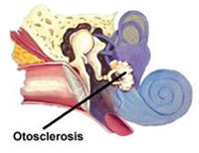
OTOSCLEROSIS

Slide 2
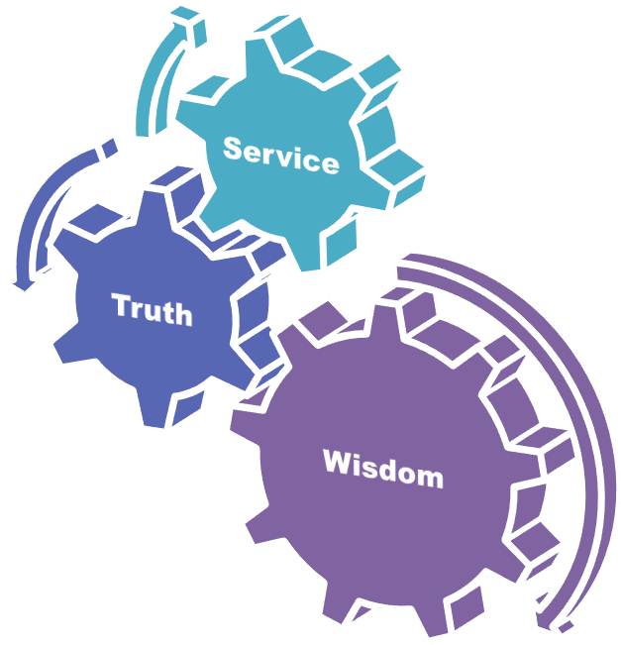
University Motto, Vision, Values & Goals
Mission Statement To impart evidence-based research-oriented health professional education Best possible patient care Mutual respect, ethical practice of healthcare and social accountability. Vision and Values Highly recognized and accredited centre of excellence in Medical Education, using evidence-based training techniques for development of highly competent health professionals, who are lifelong experiential learner and are socially accountable. Goals The Undergraduate Integrated Learning Program is geared to provide you with quality medical education in an environment designed to:

Slide 3
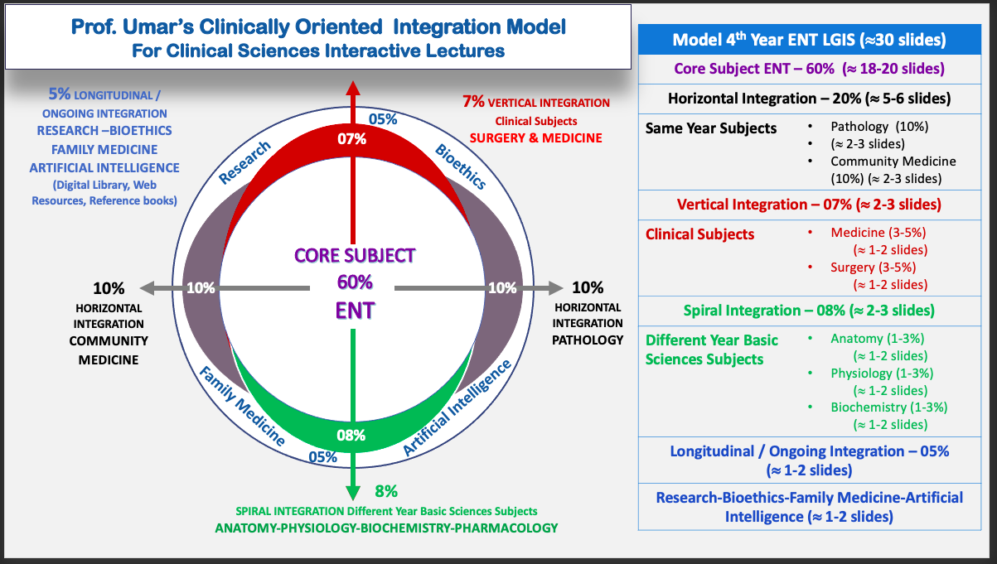
Prof Umer Model Of Integrated Lecture

Slide 4
Sequence of LGIS
Learning objectives
Development of cochlea (core concept = 60%)
Anatomy, physiology, biochemistry (spiral integration 8%)
Pathology and community medicine (horizontal integration 20%)
Related clinical medical surgical (vertical integration – 7%)
Research, family medicine, bioethics, artificial intelligence (5%)

Slide 5
Learning Objectives
At the end of this lecture students shall be able to learn:
Etiology of Otosclerosis
Stages
Signs and Symptoms
Examination
Investigations
Medical and Surgical Management
Recent Advances

Slide 6
Definition
CORE SUBJECT
It is also called Otospongiosis.
A primary disease of the bony otic capsule characterized by one or more foci of irregularly laid spongy bone replace part of normally dense enchondral layer of bony otic capsule
Most often focus involves the stapes region which leads to stapes fixation and results conductive deafness
It may involve other areas of bony labyrinth where it may cause sensori neurol-loss

Slide 7
Etiology
The exact cause is unknown but many factors have been proposed such as:
Hereditary
Endocrine (pregnancy)
Trauma
Infectious (eg: measles)
Vascular
Autoimmune
Notes:
Heriditary being strongest.

Slide 8
Sites Of Otosclerosis
CORE SUBJECT
Otic capsule
Bony labriynth
Stapes
cochlea

Slide 9
Types of Stapedial fixation
Anterior Focus
Posterior Focus
Circumferential
Biscuit type
Obliterative

Slide 10
Spiral Integration With Anatomy

Slide 11
Related Anatomy
Otic labyrinth
It also called membranous labyrinth.The endolymphatic labyrinth. Consists of utricle, saccule, cochlea, Semicircular canals, endolymphatic duct and sac.Endolymph
Periotic labyrinth
The perilymphatic labyrinth. Consists of vestibule, scala vestibula, scala tympani and perilymphatic space around semicircular canals. perilymph
Otic capsule
The embryonic cartilage capsule that surrounds the inner ear mechanism and develops into bony tissue.

Slide 12
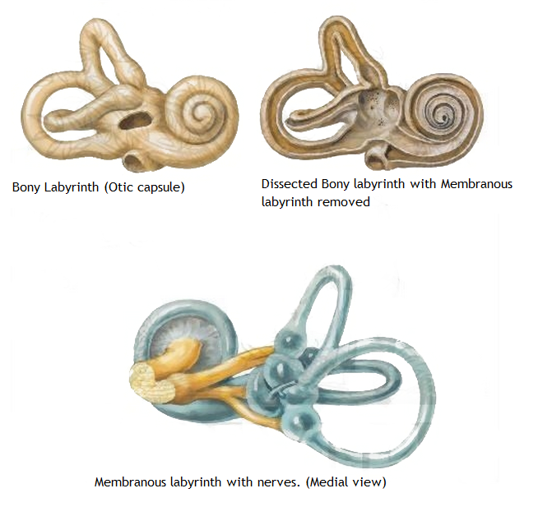
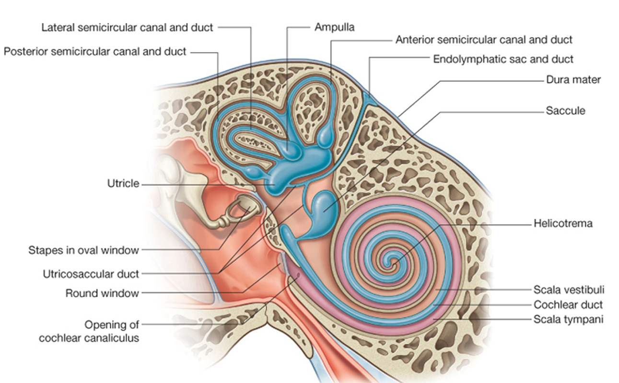

Slide 13
Horizontal Integration With Community Medicine

Slide 14
Epidemiology
Autosomal-dominant hereditary disease
Leads to progressive conducting hearing loss
It is one of the Most common cause of CHL in adults
Bilateral hearing loss in 70% cases
Male:Female is 1:2
Most commonly effected age group is 15-45 years with hearing loss manifesting typically in the third decade
Cochlear otosclerosis manifests with sensorineural hearing loss

Slide 15
Horizontal Integration With Pathology And Histopathology

Slide 16
PATHOGENESIS
Two phases of disease
Active (otospongiosis phase)
In this phase the active resorption of bone occurs
Dilation of vessels
Mature (sclerotic phase)
The Deposition of new bone occurs (sclerotic and less dense than normal bone), Chalky white

Slide 17
Pathological sites
Anterior to oval window (Fissula ante fenestrum) 90%
Round window 30%
Cochlear labyrinth 25%
Stapes footplate 12%
Posterior to oval window 5-10%

Slide 18
Clinical Features
CORE SUBJECT
unable to hear low-pitched sounds or can't hear a whisper.
dizziness,
balance problems
tinnitus. Tinnitus is a ringing, roaring, buzzing, or hissing in the ears or head that sometimes occurs with hearing loss

Slide 19
Hearing Loss
Conducting Hearing Loss (CHL)
Stapedial fixation
Sensorineural Hearing Loss (SNHL)
Cochlear otosclerosis
Mixed

Slide 20
DIAGNOSIS
History
Examination

Slide 21
History
Gradual onset of hearing loss progressing slowly
In 70% cases hearing loss is bilateral
Usually becomes apparent around the age of 30
Loss noticeable when it reaches 25 to 30 dB
Paracusis of Willis (characteristic of CHL)
Unilateral loss noticed even later, problem with localization of sound
Tinnitus
Positive family history
Notes:
Tinnitus indicates SNHL
Patients are soft speakers as they hear themselves thru bone conduction

Slide 22
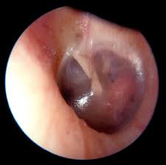
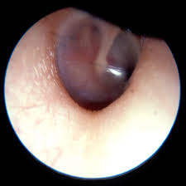
Physical Examination
Otoscopy
Schwartze sign; red blush occasionally seen over promontory or anterior to oval window
Pneumo-otoscopy used to rule out other causes of CHL such as middle ear serous fluid or small perforation
Tuning Fork Test
Weber Test
Rinne Test

Slide 23
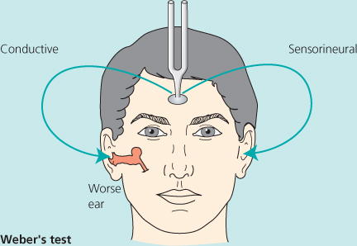
Weber test
Performed with 512 Hz tuning fork
Lateralizes to ear with conductive or greater conductive loss
Lateralizes with 5 dB of conductive hearing loss

Slide 24
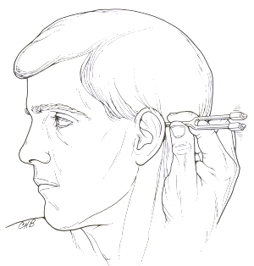
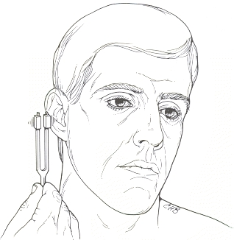
Rinne test
Performed with 512 or 1024 Hz tuning forks
Compares patient perception of loudness of air conduction versus bone conduction
If BC > AC on 512 Hz fork
Loss is 15 – 20 dB
If BC > AC on 1024 Hz fork
Loss is at least 30 db
Notes:
1024 not clinically used as it only picks loss at 30 dB and by that time loss is apparent to the patient anyway

Slide 25
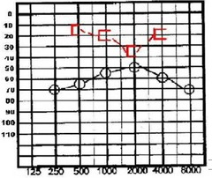
Audiometry (INTEGRATION WITH AUDIOLOGY)
Pure Tone Audiometry
Loss of air conduction at lower frequencies
Bone conduction normal, sometimes shows a dip at 2000 Hz (Cahart’s notch) which disappears after successful surgery.
Speech Audiometry
Normal except in those with cochlear involvement.
Notes:
Caharts notch a mechanical phenomenon. 2000 Hz is frequency at which ossicles resonate in humans.

Slide 26
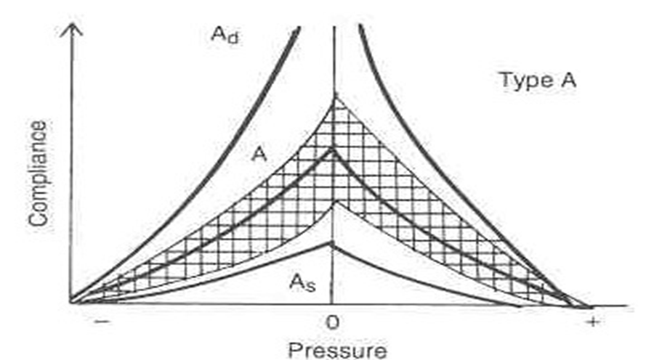
Impedance Audiometry
Tympanometry : As type curve

Slide 27
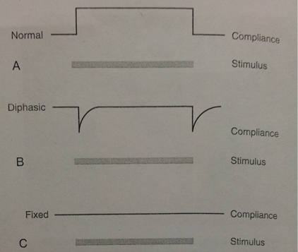
Acoustic reflex
Measure of movement of stapes at stimulus
Reflex is absent in otosclerosis
Progressive changes in the configuration of the acoustic reflex with stapedial fixation.
A, healthy reflex with a sustained change in compliance as long as stimulus is on.
B, diphasic reflex with on-off pattern. Seen in cases of early otosclerotic fixation.
C, Absent acoustic reflex

Slide 28
Radiological Investigations (INTEGRATION WITH RADIOLOGY)
High resolution CT scan
Shows subtle areas of demineralisation
In case of cochlear involvement it shows “double ring sign”
MRI
Done for patients with unusual presentation
Detects congenital anomalies of cochlea
Excludes retrocochlear pathology eg. Acoustic neuroma
Notes:
Only for complex presentations when we need to exclude differentials.

Slide 29
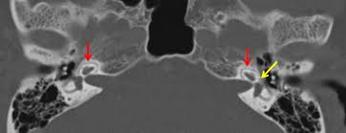

Slide 30
Differential Diagnosis
Serous otitis media.
Adhesive otitis media.
Congenital stapes fixation

Slide 31
Management / Treatment

Slide 32
Treatment Options
Hearing aid
Surgical management
Observation
Medical management
Notes:
Obervation: is an option. Only during early stage of disease when the CHL is minimum

Slide 33
Medical management
Aim is to Stabilize the disease by
reduction of the osteoclastic bone resorption increase osteoblastic bone formation
Inhibits proteolytic enzymes that are cytotoxic to cochlea.
Slows the progression of sensorineural hearing loss
Sodium Fluoride therapy
Mechanism
Fluoride ion replaces hydroxyl group in bone forming fluorapatite.
Resistant to resorption
Increases calcification of new bone
Causes maturation of active foci of otosclerosis

Slide 34
Contraindicated in patients with
Chronic nephritis
Chronic rheumatoid arthritis
Pregnant and lactating women
Children
Bisphosphonates
Inhibits bone resorption by inhibiting osteoclastic activity.
Often supplement with Vitamin D and Calcium.
Studies conducted on otosclerosis patients with neurotologic symptoms report the majority of patients with subjective improvement or resolution.

Slide 35
Hearing Aid
Very effective in early stage of disease
But can be used in advance stage, if:
Surgery is contraindicated
Patient refuses the surgery
In far-advance cases it is required, even after stapedotomy

Slide 36
Surgical Management
Poorer ear always chosen for surgery
Done preferably under local anesthesia so patient can notify surgeon if vertigo occurs during procedure
Options are:
Stapedotomy
Stapedectomy
Lesser complications due to use of Lasers now.
Notes:
Laser stapedotomy

Slide 37
Selection Criteria
Hearing threshold is 30dB or worse
AB gap at least 15dB
Rinne’s negative for 256 Hz and 512 Hz
Speech Discrimination Score is 60% or more
Notes:
1--- when pt feels socially handicapped

Slide 38
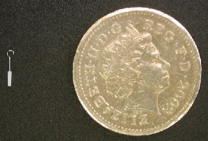
Prosthesis
Teflon piston
Stainless steel piston
Platinum Teflon piston
Titanium Teflon piston

Slide 39
Summary of small fenestra stapedotomy
Anethesia injected
Incisions at lateral process of malleus and inferiorly
Tympanomeatal flap elevated
Adequate exposure (facial nerve superiorly, pyramidal process inferiorly)
Distance from incus to footplate measured (usu. 4.5mm)
Microdrill used to create fenestra
Prosthesis placed on incus and crimped firmly in place.
Incudostapedial joint separated and stapedial tendon sectioned
Stapes superstructure fractured and removed
Prosthesis checked
Tympanomeatal flap returned to normal position
Notes:
Put pictures along with steps from Cummings volume 2 chap 144

Slide 40
Stapedotomy v/s Stapedectomy
Stapedotomy
Safer
Lower rate of high frequency sensorineural hearing loss post op.
Stapedectomy
Less chances of recurrence

Slide 41
Postoperative Care
Patient’s head elevated to 30º to reduce perilymph pressure in vestibule
Bed rest for at least 1 hour
If no vertigo on getting up then patient can go home
Patients can resume air travel after 5 days
Follow up with audiogram in 3 weeks

Slide 42
Contraindications
Only hearing ear
Meniere’s disease
Occupation
Experience frequent change in pressure
Works in noisy surrounding
Otitis externa
Perforated TM
Young children
Poor state of health
Notes:
1---absolute
Pressure change---diver, athelete, frequent air-traveller (experience vertigo)

Slide 43
COMPLICATIONS

Slide 44
Intra-Operative Complications
Exposed, overhanging Facial Nerve (9%)
Chorda tympani nerve damage (30%)
Solid or Obliterated Footplate
Floating Footplate
Persistent Stapedial Artery
Perilymph Gusher
Managed by placing tissue graft over oval window
Tympanic Membrane perforation
Intraoperative vertigo due to long prosthesis
Fixed Malleus

Slide 45
Post-Operative Complications
SNHL
Vertigo
Facial paralysis
Tinnitus
Taste disturbance
Perilymph fistula
Dead ear (1%)
Iatrogenic tympanic membrane perforation

Slide 46
Research
Longitudinal Integration
https://emedicine.medscape.com/article/859760-overview
According to Batson (2021) it is a complex and progressive disease
It is affecting 360 million people worldwide

Slide 47
Biomedical Ethics
Longitudinal Integration
Before doing any medical and surgical treatment, informed consent must be taken
Prognosis should be explained to patients and attendants

Slide 48
Family Medicine
Longitudinal Integration
Any patient who presents with progressive hearing loss in middle age should be referred to ENT specialist and tested for audiological assessment

Slide 49
Artificial Intelligence
Longitudinal Integration
The use of explainable artificial intelligence to explore types of fenestral otosclerosis misdiagnosed when using temporal bone high-resolution computed tomography

Slide 50
REFERENCES
SCOTT BROWN OTOLARYNGOLOGY 8th edition
Disease of ENT Saleem Iqbal Bhutta
PL Dhingra, 7th edition

Slide 51
THANKYOU

