Slide 1
OBSTETRIC EMERGENCIES
Dr. Aqsa Ikram-Ul-Haq
MBBS, FCPS
Assistant Professor
Obstetric & Gynaecology
Rawalpindi Teaching Hospital

Slide 2
Professor Umar Model of Integrated Lecture
60%
CORE SUBJECT
20%
HORIZONTAL
INTEGRATION
Physiology
biochemistry
8%
VERTICAL INTEGRATION
Pathology
pharmacology
7%
VERTICAL INTEGRATION
Clinical integration
5%
VERTICAL INTEGRATION
Research, professionalism
Ethics
Digital library

Slide 3
University Motto, Vision, Values & Goals
Mission Statement
To impart evidence-based research-oriented health professional education
Best possible patient care
Mutual respect, ethical practice of healthcare and social accountability.
Vision and Values
Highly recognized and accredited centre of excellence in Medical Education, using evidence-based training techniques for development of highly competent health professionals, who are lifelong experiential learner and are socially accountable.
Goals
The Undergraduate Integrated Learning Program is geared to provide you with quality medical education in an environment designed to.

Slide 4
SEQUENCE OF LGIS
Learning Objectives
Core Concept = 70%
Horizontal Integration 15%
Vertical Integration – 10%
Research Article Related To Topic (3%)
Ethics (2%)

Slide 5
LEARNING OBJECTIVES
At The End Of This Lecture Students Shall Be Able To :
Define obstetric emergencies.
Describe different types of it.
Enlist it main causes.
Identify the sings and symptoms of different emergencies.
Discuss management options for them.
Enlist the strategies to prevent them.

Slide 6
Obstetric Emergencies
Definition:
“It is a serious situation or occurrence that happen unexpectedly and demands immediate action”.
Anticipation preparation (regular drills) and prevention can reduce the risks of emergencies.
Broadly divided in to Maternal and Fetal Emergencies

Slide 7
OBSTETRICS EMERGENCIES
Maternal collapse
Major obstetric Haemorrhage
APH
PPH
Hypertensive disorders
Pre-eclampsia
Eclampsia
HELLP syndrome(Some cases may lead to DIC, placental abruption and fetal death).
Amniotic fluid embolism
Thrombosis and thromboembolism
Cardiac diseases
Shoulder dystocia
Uterine causes(Rupture, Inversion)

Slide 8
FETAL EMERGENCIES
Acute fetal distress
Cord prolapse
Shoulder dystocia

Slide 9
SUDDEN MATERNAL COLLAPSE
Shock
Sepsis
Haemorrhage
Anaphylaxis
Cardiac causes:
Arrythmias
Myocardial infarction
Intracranial causes
Haemorrhage
Thrombosis

Slide 10
Biochemical causes:
Hypoglycaemia
Anaesthetic causes:
Spinal shock
Aspiration of gastric contents
Cardiac arrest

Slide 11
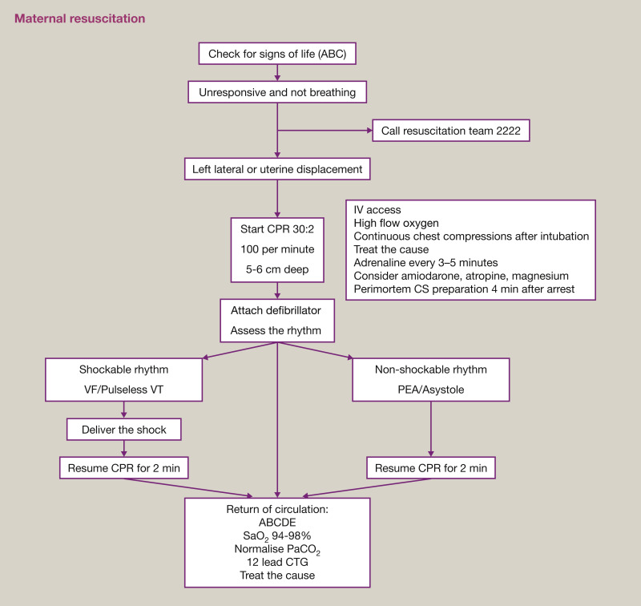

Slide 12
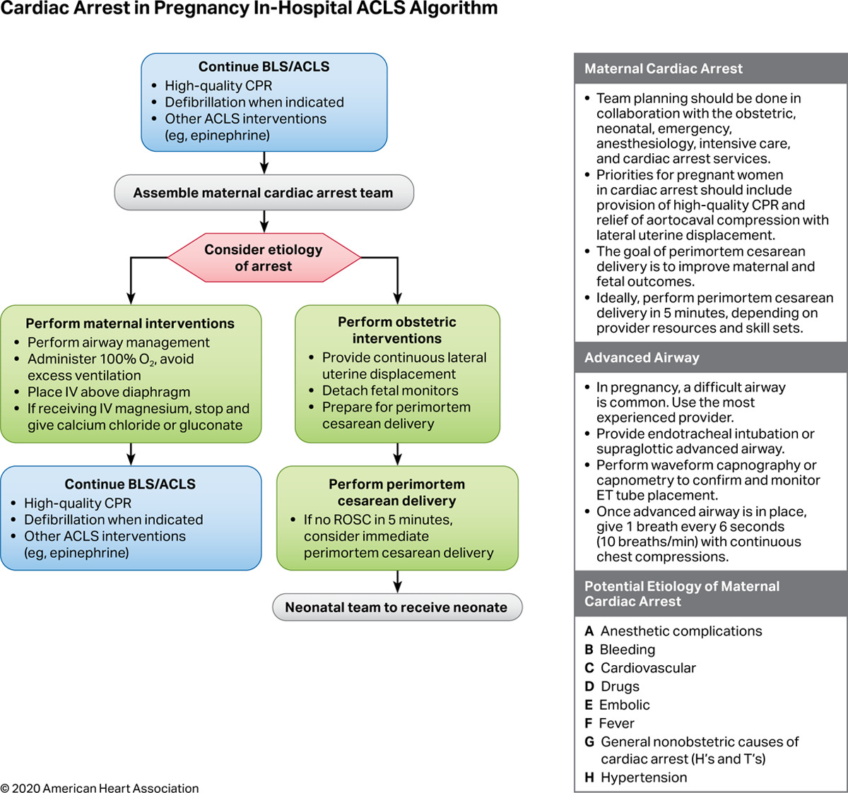

Slide 13
Uterine Rupture
Most commonly occurs during labour
Risk factors
Previous caesarean section
Previous uterine surgery
Induction and augmentation of labour
High parity
Macrosomic fetus
Manipulation
Congenital uterine anomalies

Slide 14
SIGNS AND SYMPTOMS
Shock
Abdominal pain
Cessation of contractions
Fetal heart deccelerations then IUD
Hematuria

Slide 15
MANAGEMENT
Maternal Resuscitation
Laparotomy
Repair
Hysterectomy

Slide 16
Uterine Inversion
A rare complication of 3rd stage of labour
Incidence(1:2000-1:6000)
Fundus of uterus descends through cervix os introitus
Caused by traction of umblical cord before separation of placenta

Slide 17
SIGNS AND SYMPTOMS
Shock
Haemorrhage +
Absence of palpable uterus on abdomen

Slide 18
MANAGEMENT
Resuscitation of patient
Replace uterus manually(don’t remove placenta if attached)
O`Sullivan (Hydrostatic) method of reduction
Tocolysis may be helpful in reduction
Surgery to reposition uterus is the last resort

Slide 19
PULMONARY EMBOLISM
One of the commonest causes of maternal collapse in developed countries
Can occur even in antenatal period
SIGNS AND SYMPTOMS
Shortness of breath
Anxiety,tachycardia,tachypnea
Cyanosis,apnea,unconsciousness
Chest pain and hemoptysis

Slide 20
INVESTIGATIONS
Arterial blood gases, blood cp, coagulation profile, chest X ray, Ventilation perfusion scan and ECG

Slide 21
MANAGEMENT
Resuscitation
Facial oxygen ,pulse oximetry
Continuous ECG
Anticoagulant therapy
Thrombopropylaxis
Early Mobilization
Hydration
TED stocking
LMWH

Slide 22
RISK FACTORS FOR THROMBOEMBOLISM
Age > 35
Obesity
Preoperative morbidity
Extended surgery
Patients with thrombophilias (Antiphospholipid syndrome, Activated protein C resistance, protein C or protein S deficiency)

Slide 23
AMNIOTIC FLUID EMBOLISM
Amniotic fluid entering maternal circulation →lungs
Anaphylactic type reaction
Maternal morbidity 60% and mortality is 0.33/100,000
SIGNS AND SYMPTOMS
Respiratory distress
Sudden circulatory collapse
May lead to DIC

Slide 24
RISK FACTORS
Precipitate labour
Caesarean section
Polyhydramnios
Hypertonic uterine activity

Slide 25
Talk to patient
↓
Responding ← → Not responding
↓
Call for help
↓
Left lateral tilt
↓
Assess the airway
↓
Breathing
↓
Circulation(IV line and inv)
↓
CPR(if patient in arrest)
↓
Consider and treat cause
↓
EMLSCS to aid resuscitation

Slide 26
MANAGEMENT
Structured approach ABC
Immediate delivery of fetus if alive
Reversal of bronchospasm and hypoxia
Administration of clotting factors including FFPs, fibrinogen and platelets
Inotropic support if needed

Slide 27
Fetal Emergencies
UMBLICAL CORD
PRESENTATION
PROLAPSE
INCIDENCE 1:500 Deliveries

Slide 28
Risk Factors
Maternal:
Pelvic tumor
Narrow pelvis
Fetal:
Prematurity
Malepresentation
Multiple pregnancy
Polyhydramnios

Slide 29
Diagnosis
Cord felt at vaginal examination or
seen at introitus
CTG (decceleration, bradycardia)

Slide 30
MANAGEMENT
Minimize pressure of presenting part on cord
Knee chest position
Fill bladder with 500 ml N/S
Replace the cord
If fully dilated Instrumental delivery otherwise LSCS

Slide 31
Shoulder Dystocia
When shoulders fail to deliver after delivery of head and additional obstetric maneuvers are needed to release the shoulders after gentle downwards traction has failed.

Slide 32
RISK FACTORS
Maternal diabetes
Obesity
Previous history of shoulder dystocia
Macrosomia
Prolonged labour
Instrumental delivery

Slide 33
RISKS RELATED
FETAL :
Trauma of long bones, clavicles and brachial plexus injury
Fetal hypoxia
Death
MATERNAL:
Bleeding
Perineal Trauma

Slide 34
MANAGEMENT
Call for help
Episiotomy
MacRoberts
Manoeuvre
Suprapubic pressure
Rubin manoeuvre
Wood’s screw manoeuvre
Symphysiotomy
Intentional fracture of the fetal clerical
Zavanelli’s manoeuvre

Slide 35
References
21st Edition Obstetrics by Ten Teachers
Dewhursts 9th edition
EBM 5th edition.

Slide 36
BIOMEDICAL ETHICS

