Slide 1


Slide 2

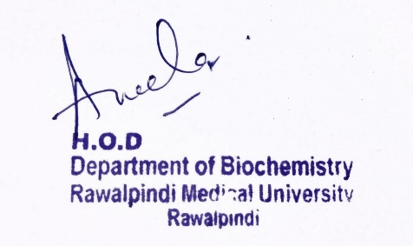
2nd Year MBBS
Gastrointestinal Tract Module
Large Group Interactive Session (LGIS)
Nutrition-III
dDdD
31-01-2025
Dr. Rahat Afzal
Biochemistry Department
Date: 00-00-2023
Date: 00-00-2024

Slide 3
Motto Vision; The Dream/Tomorrow
To impart evidence based research oriented medical education
To provide best possible patient care
To inculcate the values of mutual respect and ethical practice of medicine
Wisdom
Truth
Service

Slide 4
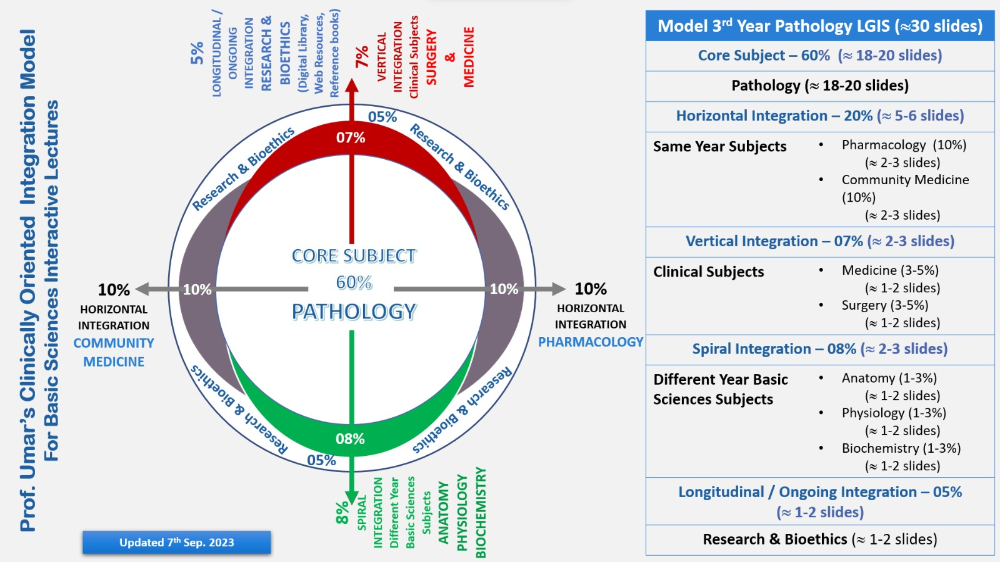
equence of LGIS

Slide 5
Learning Objectives
At the end of the lecture, students will be able to:
Explain
Calculation of caloric requirement of a person.
Starvation.
Dietary fiber.
.

Slide 6
Interactive Session
Patient presents to the emergency department with a 6 month history of progressive weight loss and fatigue. Patient reports that he has been eating very little due to a lack of appetite and financial difficulties.

Slide 7

CALORIE:
Core Knowledge
A calorie is a unit of energy that measures how much energy food provides to the body.
The body needs calories to work as it should.

Slide 8
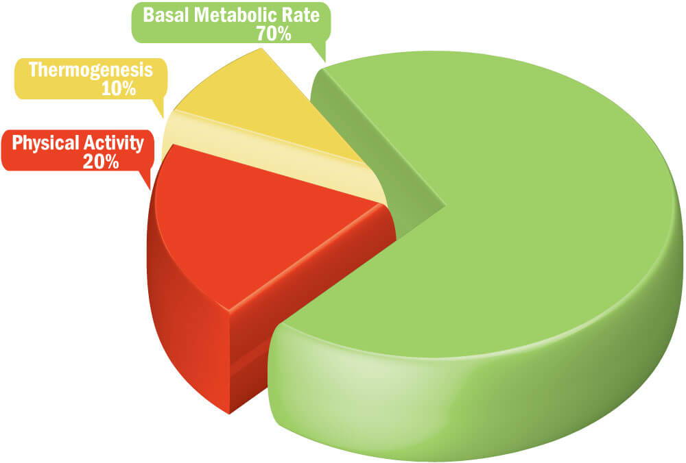
CALCULATION OF CALORIC REQUIREMENT OF A PERSON
Core Knowledge
There are six needs which must be met by food:
Basal metabolism/Basal energy expenditure:
These are calories used by an individual at complete physical or mental rest and have not taken food at least 14 hours before the measurement of BMR.
These are needed for working of internal body organs and maintaining muscle tone.

Slide 9
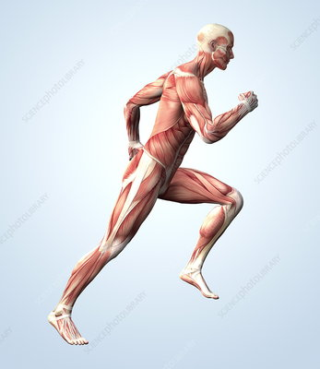
Core Knowledge
It is directly proportional to body weight and body surface area.
Any individual normally utilizes 1300-2000 kcal/day by BMR.
2) Muscular activity:
The calories which are used for muscular activity differs in every individual depending upon severity of work.
Laborers and athletes need 4000-8000 or more kcal/day

Slide 10
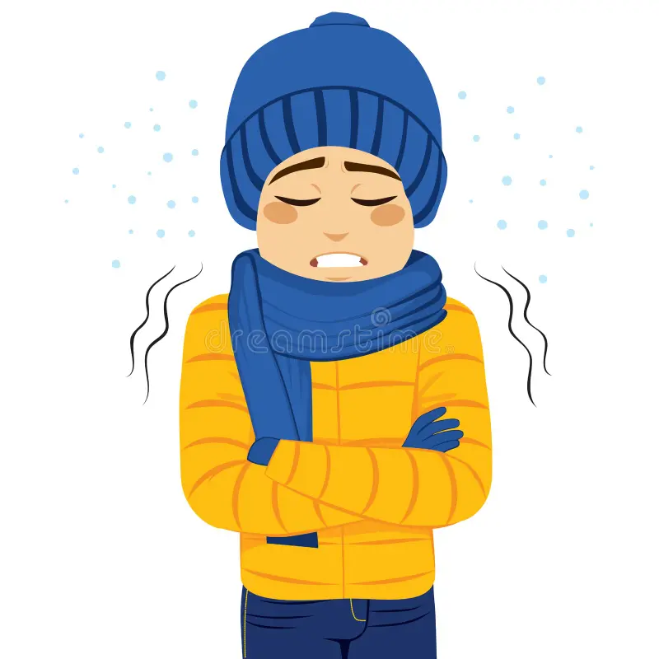
Core Knowledge
3) Shivering thermogenesis:
A person in cold loses calories by shivering (muscular activity) that is directly proportional to the rate of shivering.
4) Dietary thermogenesis:
Ingestion of food followed by its digestion and assimilation stimulates metabolism and thus increases the metabolic activity.
Diet thermogenesis is more marked with protein food.
30% of food intake (pure protein) is used by the body for heat (regulation of body temperature.)

Slide 11
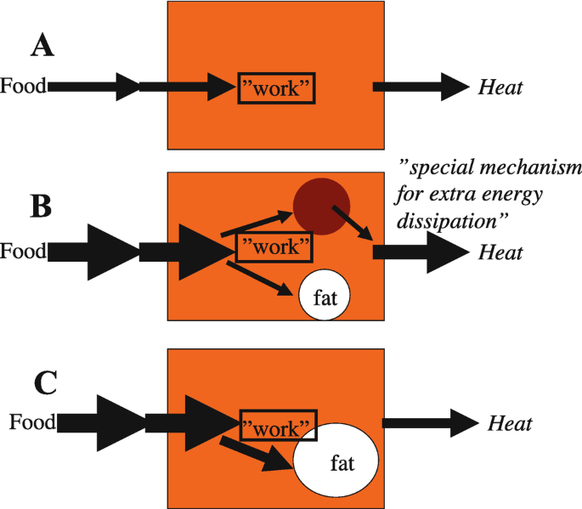
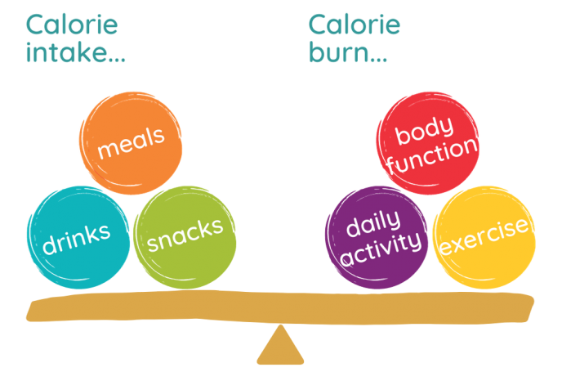
Core Knowledge
This action of carbohydrates and fatty acids is very low.
Dietary thermogenesis of mixed food (carbohydrates, fats, and proteins) is 6-10%.
So, mixed food is more beneficial to our body as relatively more food is utilized in a useful way.

Slide 12
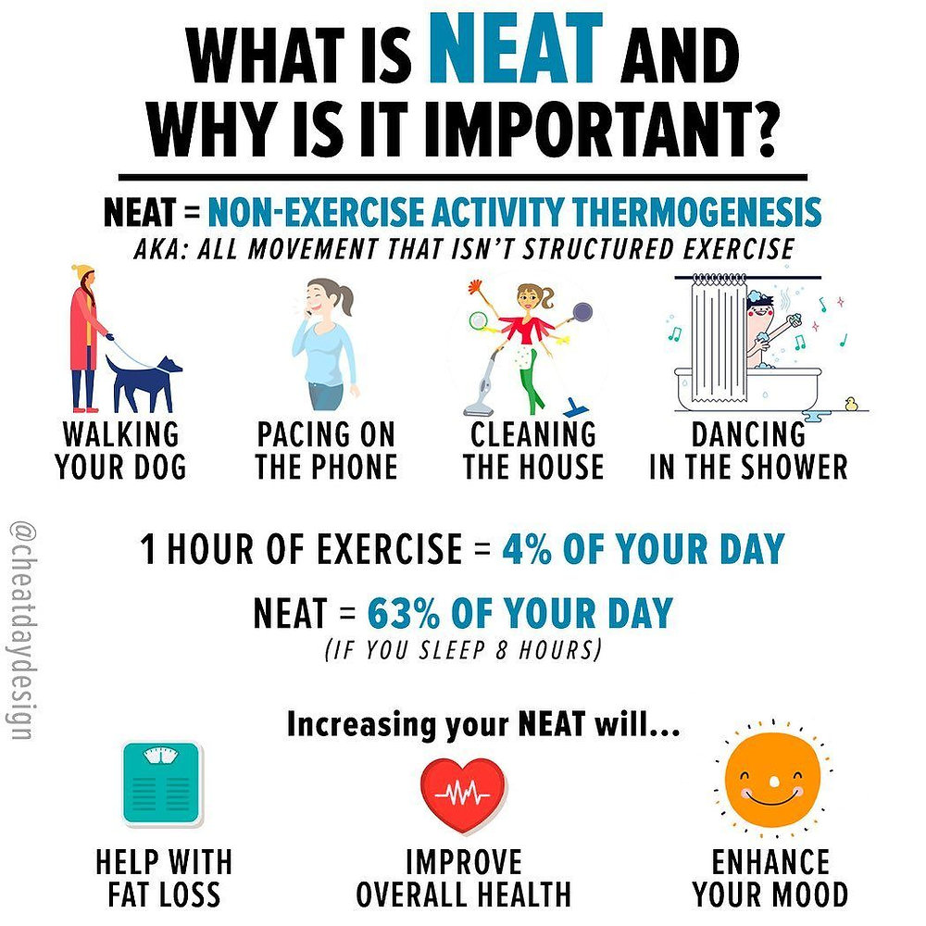
Core Knowledge
5) Non-Exercise Activity Thermogenesis (NEAT):
Small amount of thermogenesis occurs in individuals due to some physical activity (other than exercise) like spontaneous muscular contractions, maintaining posture, fidgeting (restless movements in nervous individual), chewing gum for long time.

Slide 13
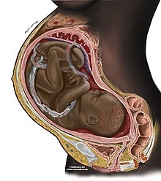
Core Knowledge
6) Growth and pregnancy:
These two conditions require more calories.
Total number of calories per day till 7-14 years is more than those required in 19-22 years.
After these requirements falls are seen in later life due to fall in BMR and lowered physical activity.
Calories required in male and female is same till 10 years of age. After this rises in male.
Children need more calories than adults due to increase in BMR is considerably high in children than adults as they expend more energy.
A major proportion of food is utilized for growth.

Slide 14
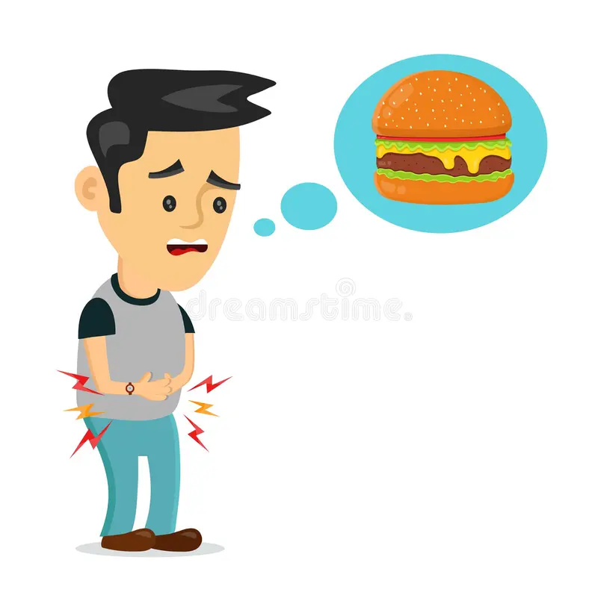
STARVATION
Core Knowledge
It is characterized by complete deprivation of food, and only water is supplied.
Death occurs in two months in previously well person.
Thin persons will die early than fat.
Women tolerate it better than men (greater percentage of fat in women.)

Slide 15
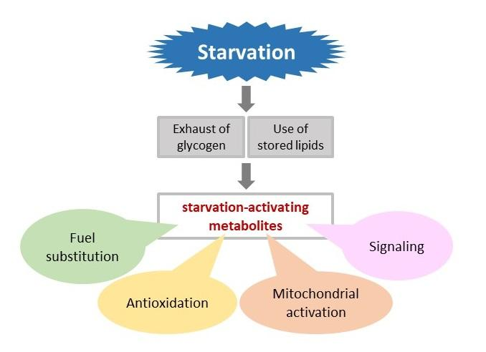
Core Knowledge

Slide 16
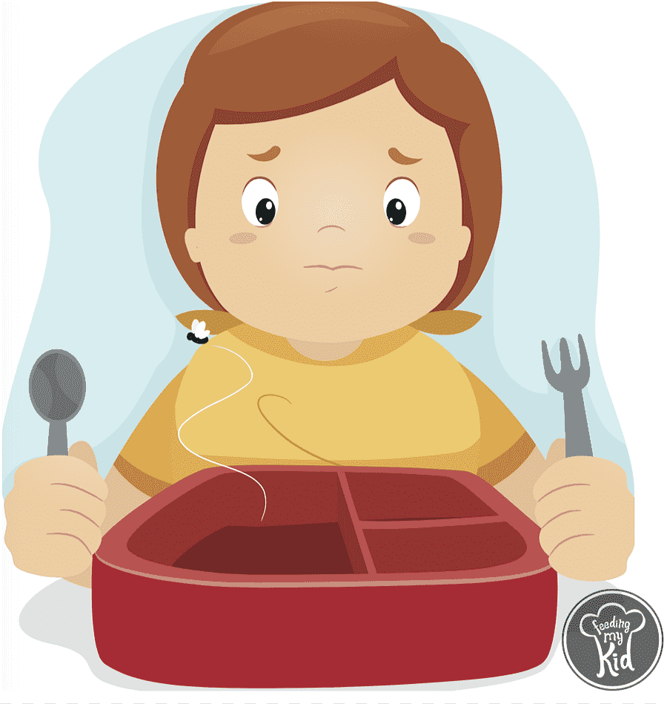
Core Knowledge
CAUSES OF STARVATION
Lesions of esophagus, stomach etc.
Chronic diseases, malignancy, CRF, hepatitis, AIDS.
Social causes.
Political protests.
Depression.
Personal low socio-economic status.

Slide 17
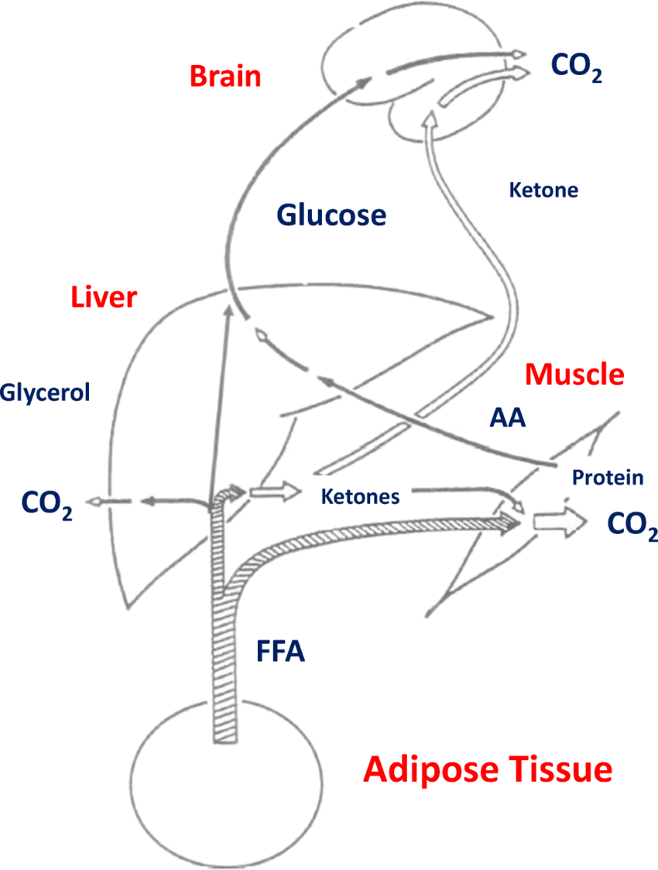
METABOLIC CHANGES DURING STARVATION
Core Knowledge
In starvation many metabolic and adaptive changes takes place.
In first 24 hours, circulating glucose, fatty acids, triglycerides, and liver and muscle glycogen are used as fuel.
The sum of this fuel is 1200kcal in 70kg man and is not sufficient for BMR of an adult for a single day.

Slide 18
CARBOHYDRATE METABOLISM
Core Knowledge
Liver glycogen falls (5% of liver mass) falls rapidly. Later this liver glycogen level might be raised due to synthesis from Cori's cycle and proteins (gluconeogenesis.) Muscle glycogen also fall but to a lesser level than liver glycogen.
Blood glucose remains normal for first 2 days. But then falls as low as 50mg/dl. Then it may rise due to increased gluconeogenesis.
Glucose is first provided to critical tissues like brain. Heart, kidneys and skeletal muscle change fuel from glucose to fatty acids and ketone bodies (sparing glucose.)

Slide 19
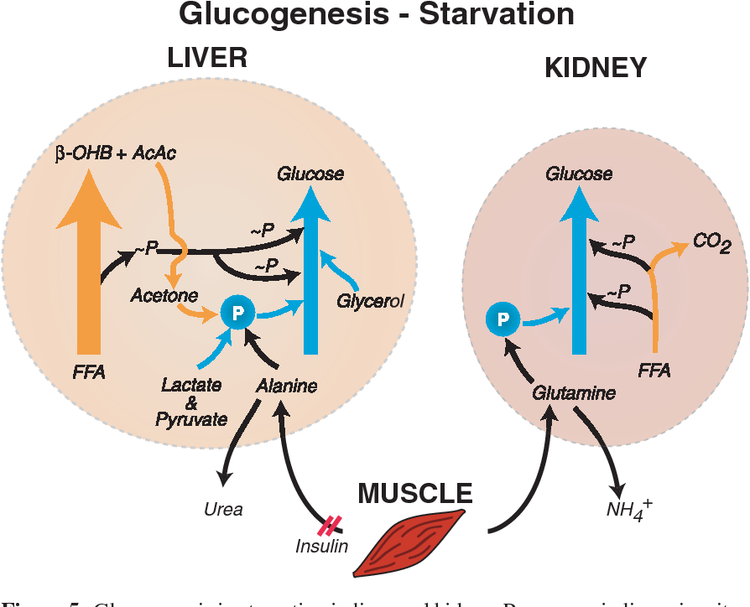
Core Knowledge
Other tissues like bone marrow, renal medulla and peripheral nerves starts anaerobic glycolysis (formation of lactate and pyruvate)
These undergo Cori’s cycle in liver and changed to glucose and enters circulation and supply glucose to brain.

Slide 20
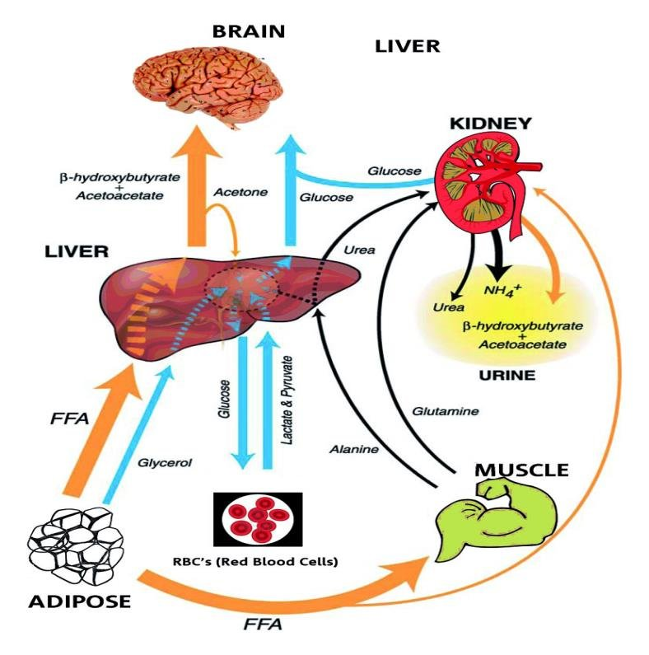
FAT METABOLISM
Core Knowledge
When stored carbohydrate reserves are utilized, fatty acids are mobilized from fat stores. There is excessive production of ketone bodies in liver causing ketoacidosis.
Fat deposited in liver results in causing fatty liver.
The brain now start utilizing ketone bodies as an energy source thus conceiving tissue protein

Slide 21
PROTEIN METABOLISM
Core Knowledge
There is continuous catabolism of protein with no intake, so there is negative nitrogen metabolism.
Skeletal muscles are a major source of proteins for catabolism.
Deamination of amino acids and resulting in formation of ammonia and urea.
Non-nitrogenous residues are converted to glucose and to acetyl-coA.

Slide 22
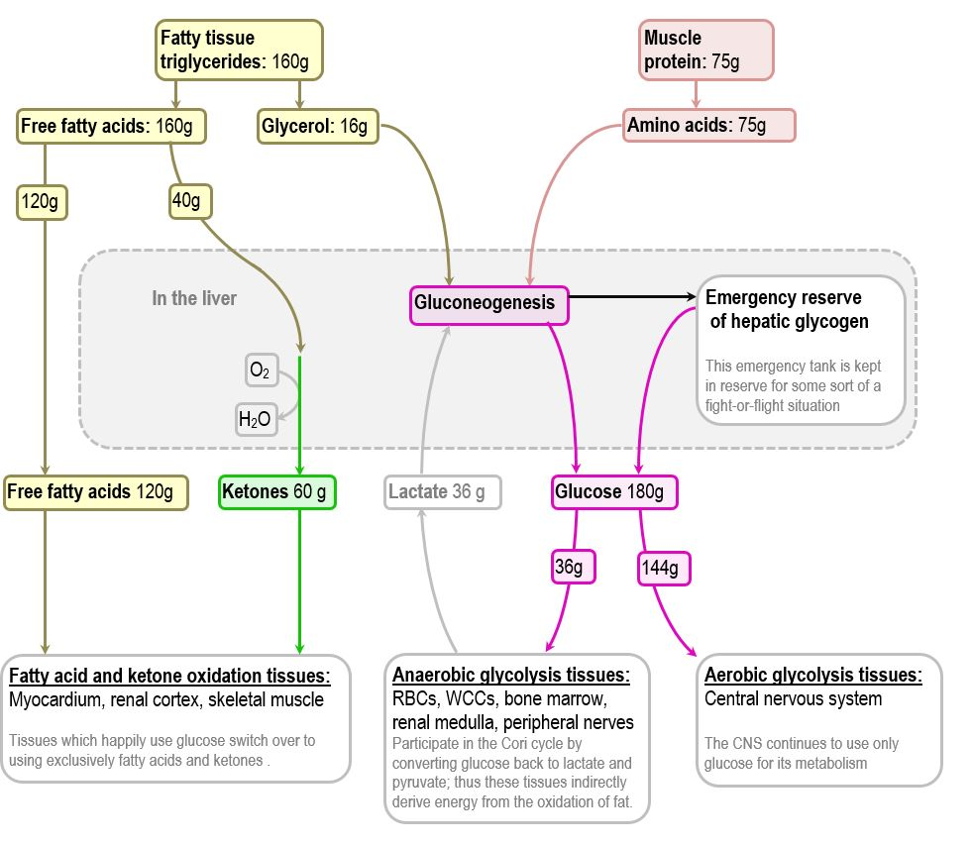
Core Knowledge

Slide 23
WEIGHT CHANGES
Core Knowledge
No calorie intake decrease great expenditure so negative energy balance so weight decrease.
The adipose tissue completely disappeared.
Liver, GIT and muscles lose one-third of their mass.
Heat size decreased markedly.
CNS loses 5% of its mass.
Urinary excretion of non-protein nitrogenous products.
  Urea: Initially increased later falls (renal failure)
  Ammonia: Excretion rises due to ketoacidosis.
  Creatinine and creatine: Remains unchanged.

Slide 24
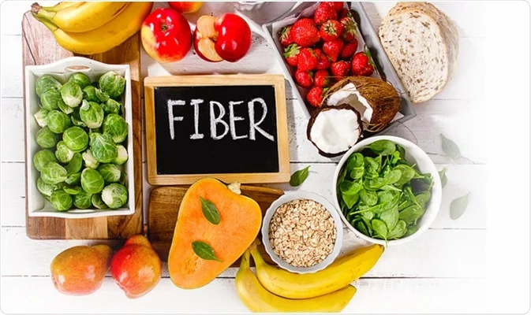
DIETARY FIBER
Core Knowledge
It is obtained from plant food.
It is not digested or absorbed by human intestine.
Fiber contains no calories.
Fiber plays an important role in maintaining normal health.

Slide 25
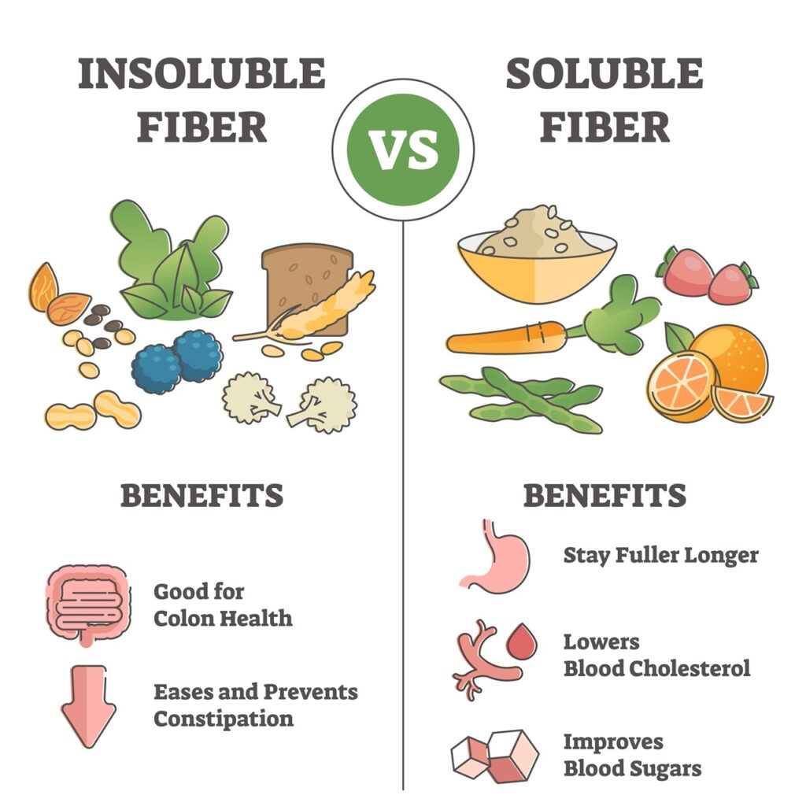
TYPES OF DIETARY FIBER
Core Knowledge
There are two types of fiber depending upon:
  Chemical Composition.
  Action in GIT.
The two types are:
  Insoluble fiber.
  Soluble fiber.

Slide 26
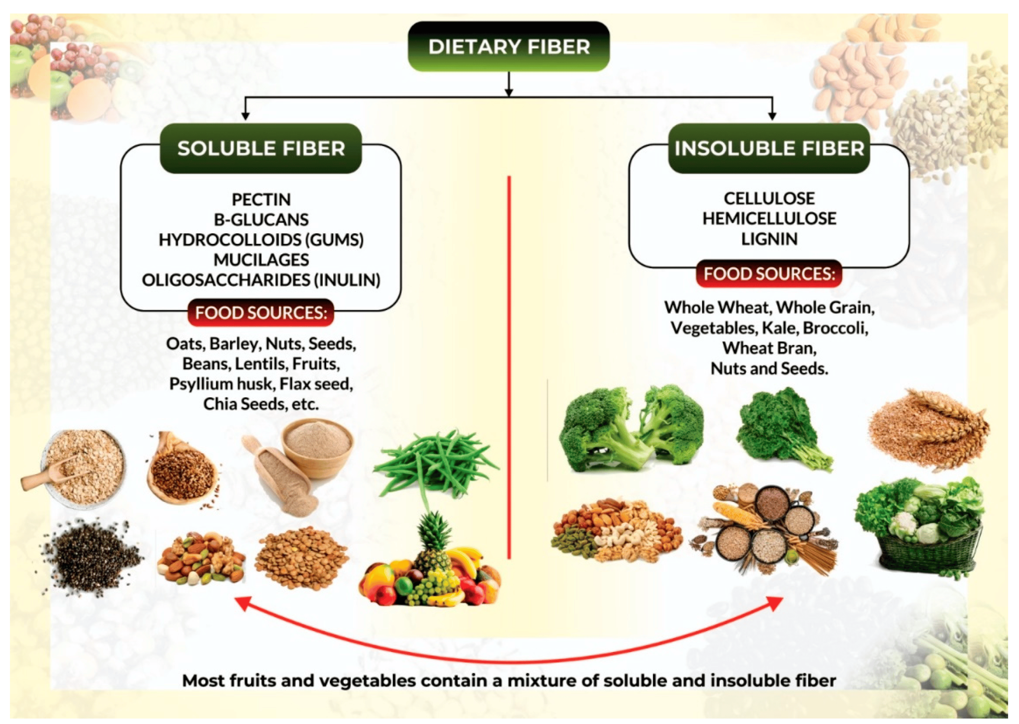
Core Knowledge

Slide 27
INSOLUBLE FIBER
Core Knowledge
It comprises of cellulose, hemicellulose and lignin in wheat bran.
Cellulose and hemicellulose are complex polysaccharides.
Lignin is a polymer of phenylalanine and tyrosine.
ACTION:
Retain water in GIT.
Makes feces soft and increase their bulk.
Prevents constipation and its sequelae such as hemorrhoids and anal fissure.

Slide 28
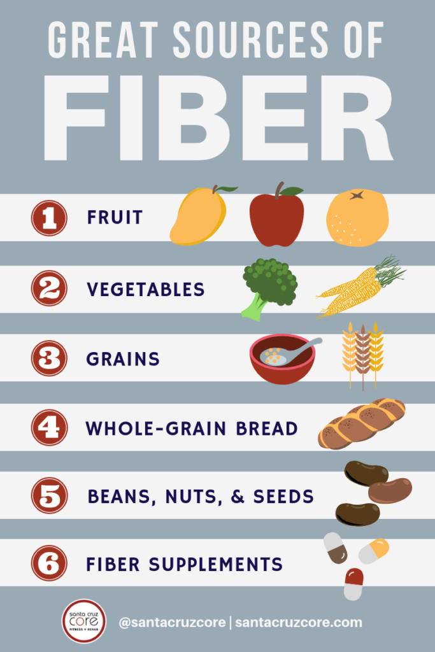
SOLUBLE FIBER
Core Knowledge
It contains gums, pectins (in legumes),oats and fruits.
ACTION:
Slows gastric emptying.
Delays absorption of glucose from GIT.
Decreases insulin secretion.
If insulin is excreted in excess causes reactive hypoglycemia.
Stimulates appetite.

Slide 29
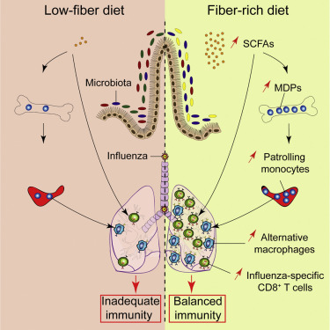
Core Knowledge

Slide 30
GOOD EFFECTS OF FIBER
Core Knowledge
Presence of fiber in diet decreases incidence of diseases such as appendicitis, diverticulitis, benign and malignant diseases of colon and rectum, MI and DM.
If taken in excess, they decrease the absorption of certain trace elements like zinc.
Play a role in absorption of fat soluble vitamins.
Fiber intake should not be exceeded beyond
20-35g/day.

Slide 31
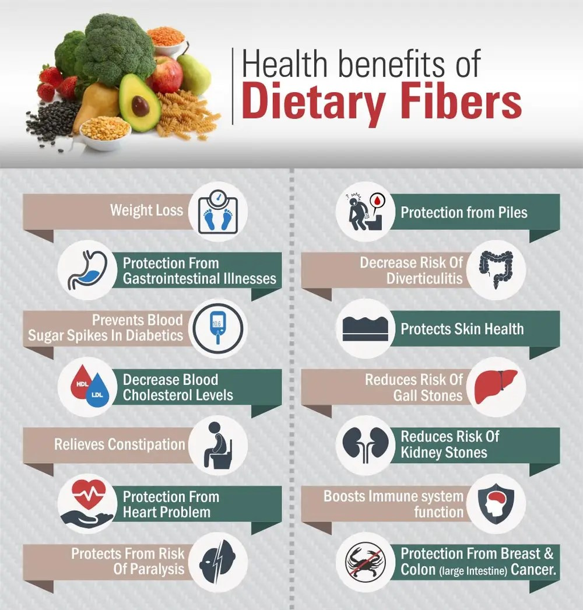
0
Core Knowledge

Slide 32
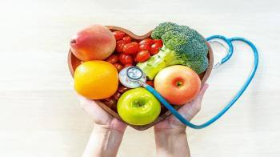
ADVICE FOR GOOD NUTRITION
Core Knowledge
Control caloric intake to control your weight.
Avoid food rich in calories and low nutritional value (sweets, pastries, cakes, soft drinks etc.)
Decrease the intake of fat.
Increase the physical activity.
Take 30 minutes brisk walk.
Take a balanced diet among various food groups.

Slide 33
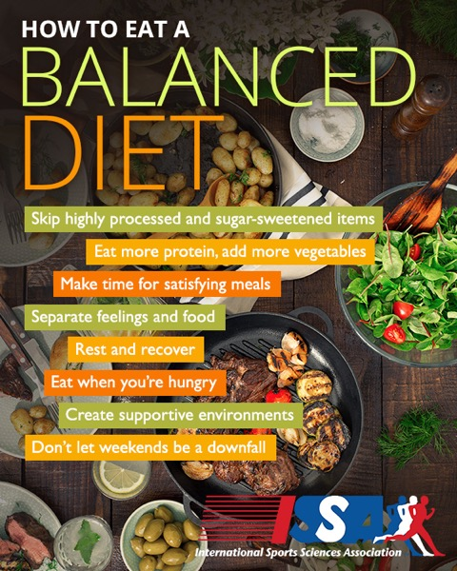
Core Knowledge
Ensure adequate intake of vitamins and minerals.
Replace fat with monounsaturated fatty acids (canola or olive oil) and polyunsaturated fatty acids.
Use margarines, sunflower, corn, canola, and olive oil.
Replace whole milk with low fat milk.
Increase total fiber intake to 20g/day.

Slide 34
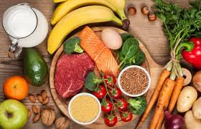
Core Knowledge
Eat more complex carbohydrates (like whole grain, bread, brown rice, potatoes, etc.)
Eat more fish than meat as it supplies essential fatty acids.
Decrease the intake of cholesterol.
Take breakfast daily.
Do not skip meal.
Eat only when you are hungry.
Limit your daily caffeine consumption.

Slide 35
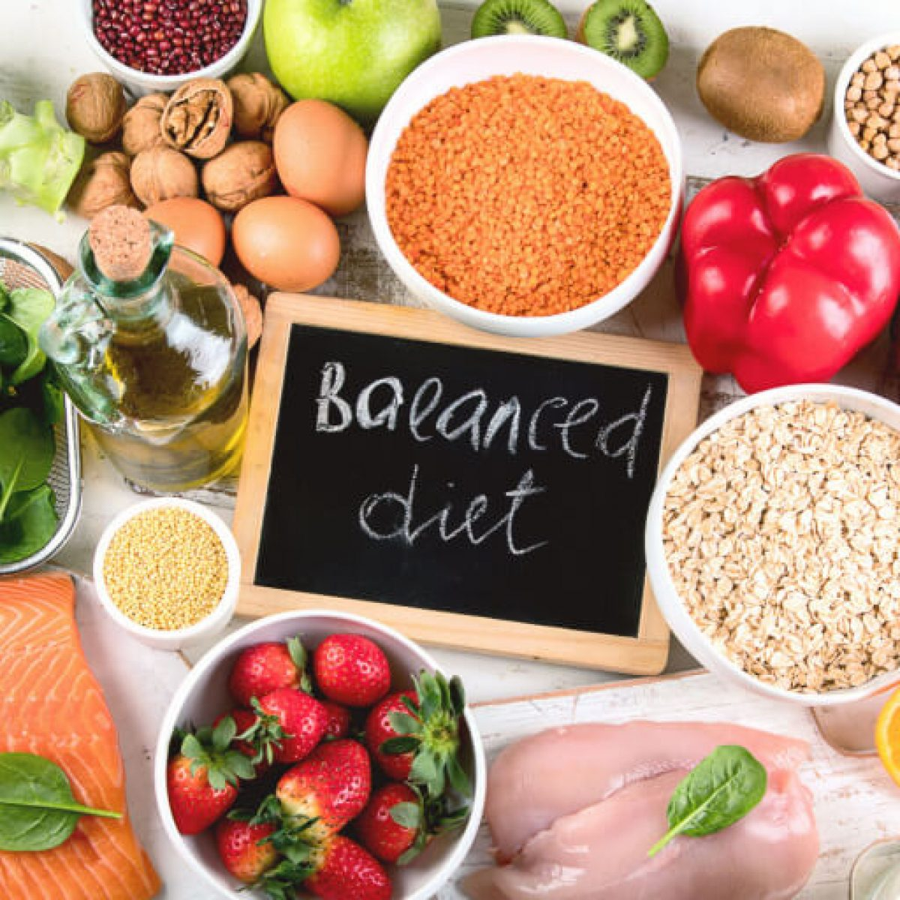
Core Knowledge
Eat small meal instead of big meal.
Decrease sugar intake.
Decrease sodium intake.
Restrict intake of saturated fatty acids (like coconut oil, palm oil etc.)
Drink a lot of water.
Increase the intake of trans fatty acids (They are present in hydrogenated vegetable oil.)

Slide 36
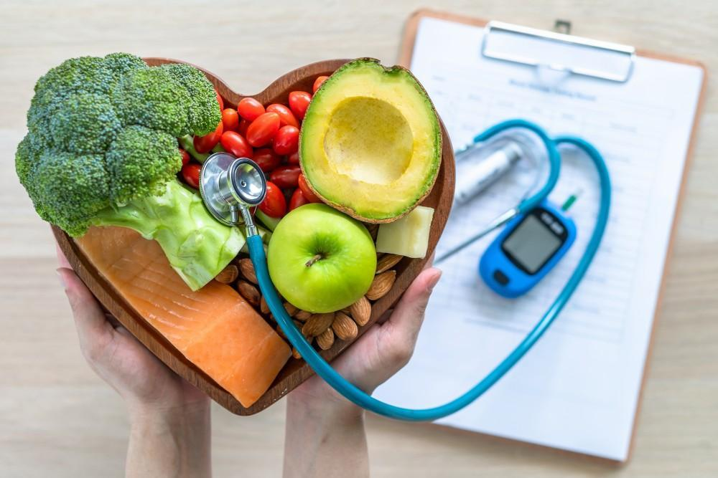
Core Knowledge
Peel/wash fruits before eating to avoid pesticides.
Eat whole fruit rather drinking juice especially the commercial preparations.
Eliminate alcohol from diet.
Increase the intake of vitamin C and E.
Avoid over grilled food as it is having carcinogenic agents.

Slide 37
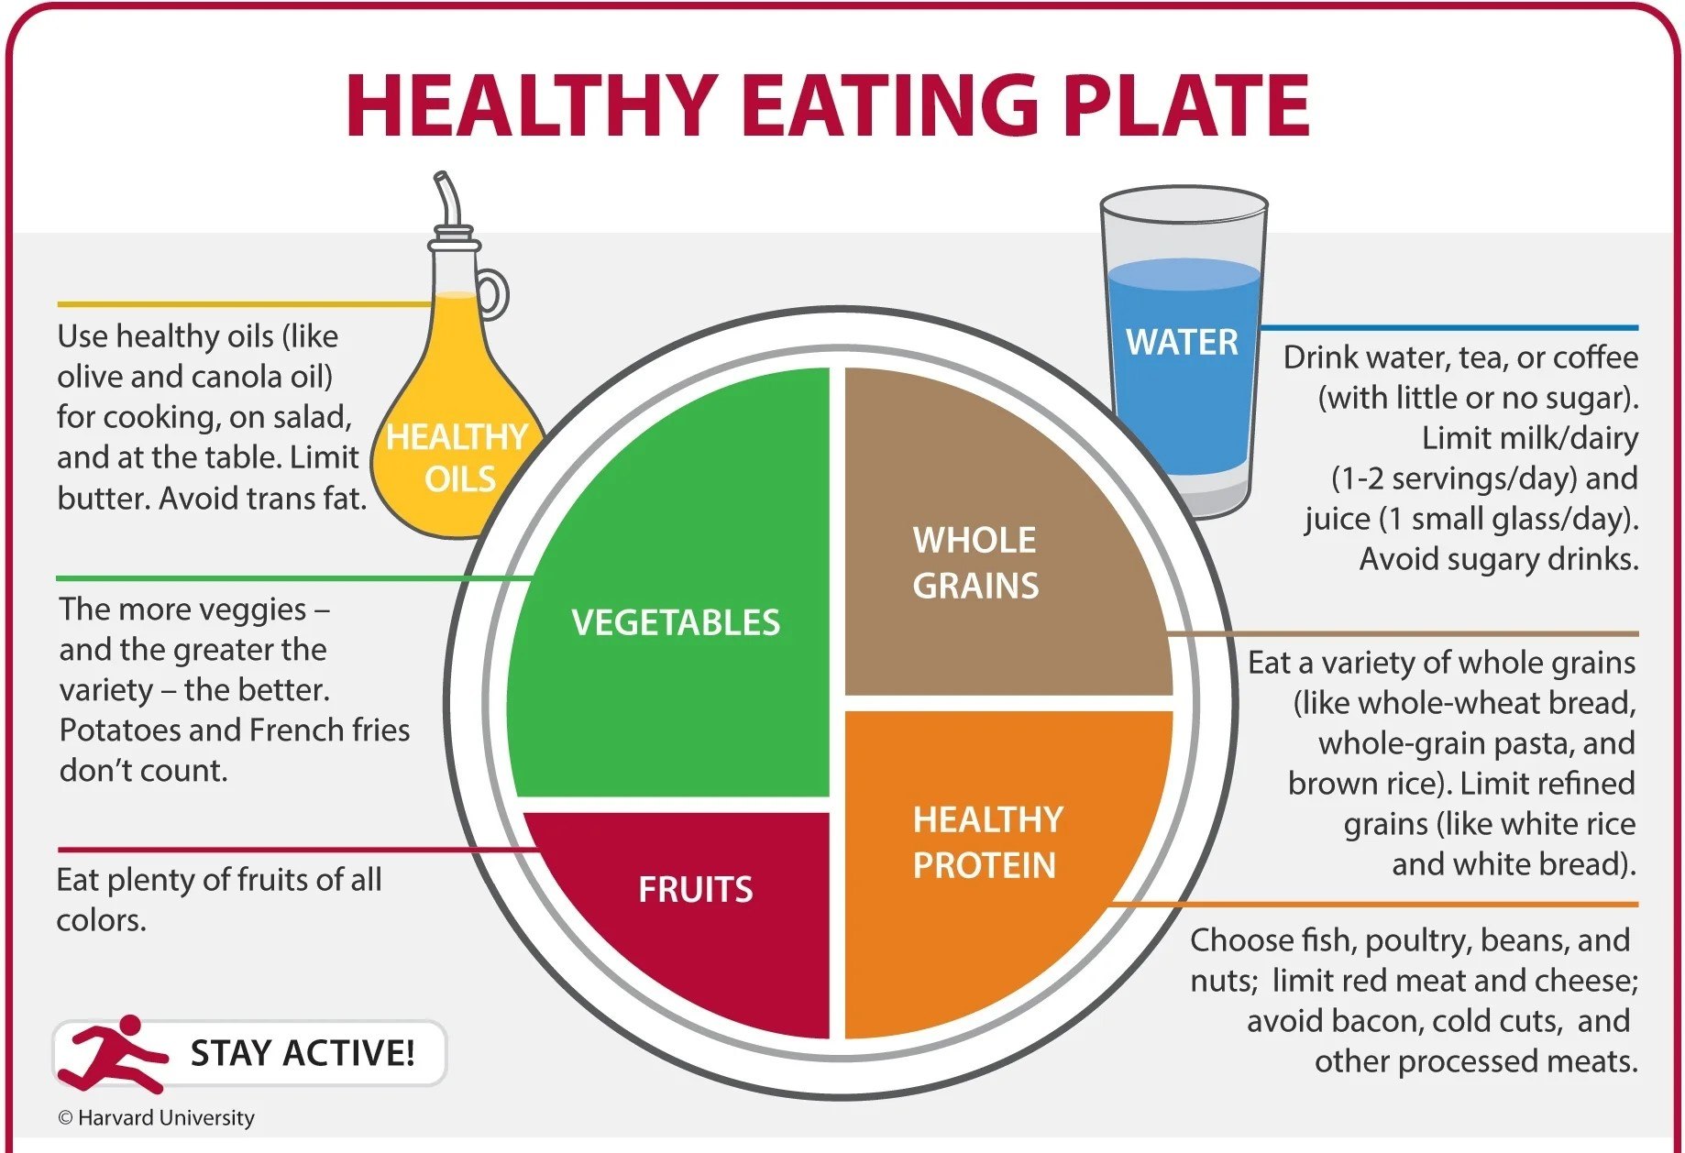
Core Knowledge

Slide 38
Vertical Integration

Slide 39
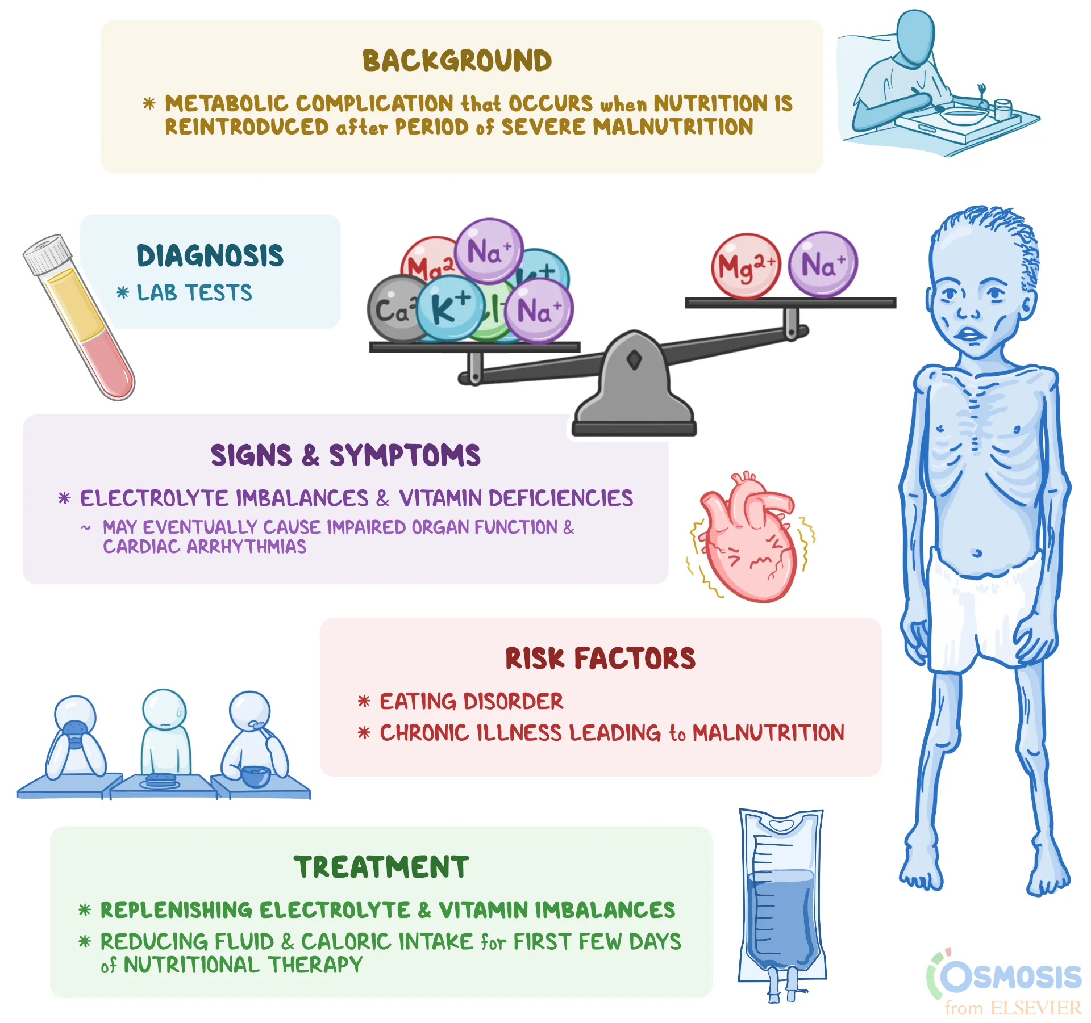
REFEEDING SYNDROME

Slide 40
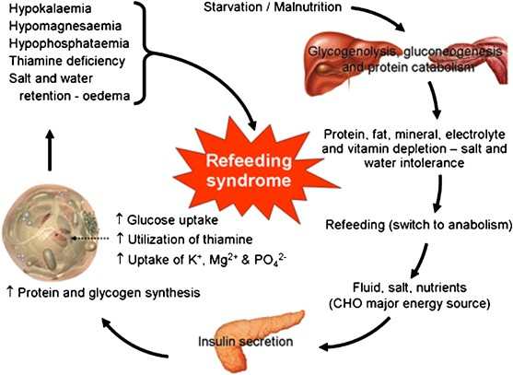

Slide 41
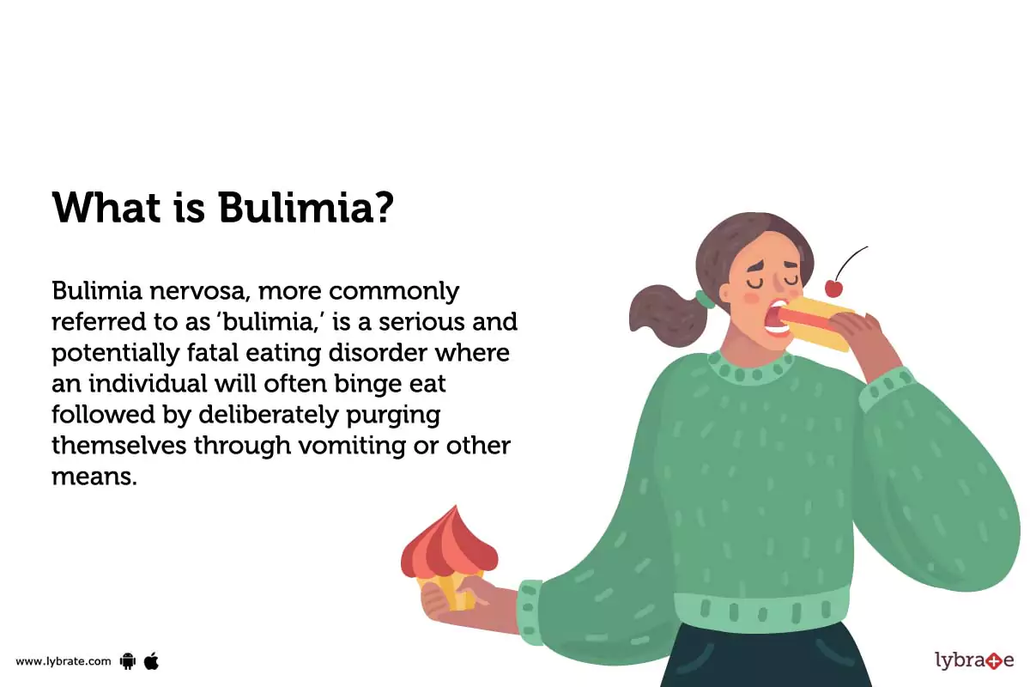
BULIMIA NERVOSA

Slide 42
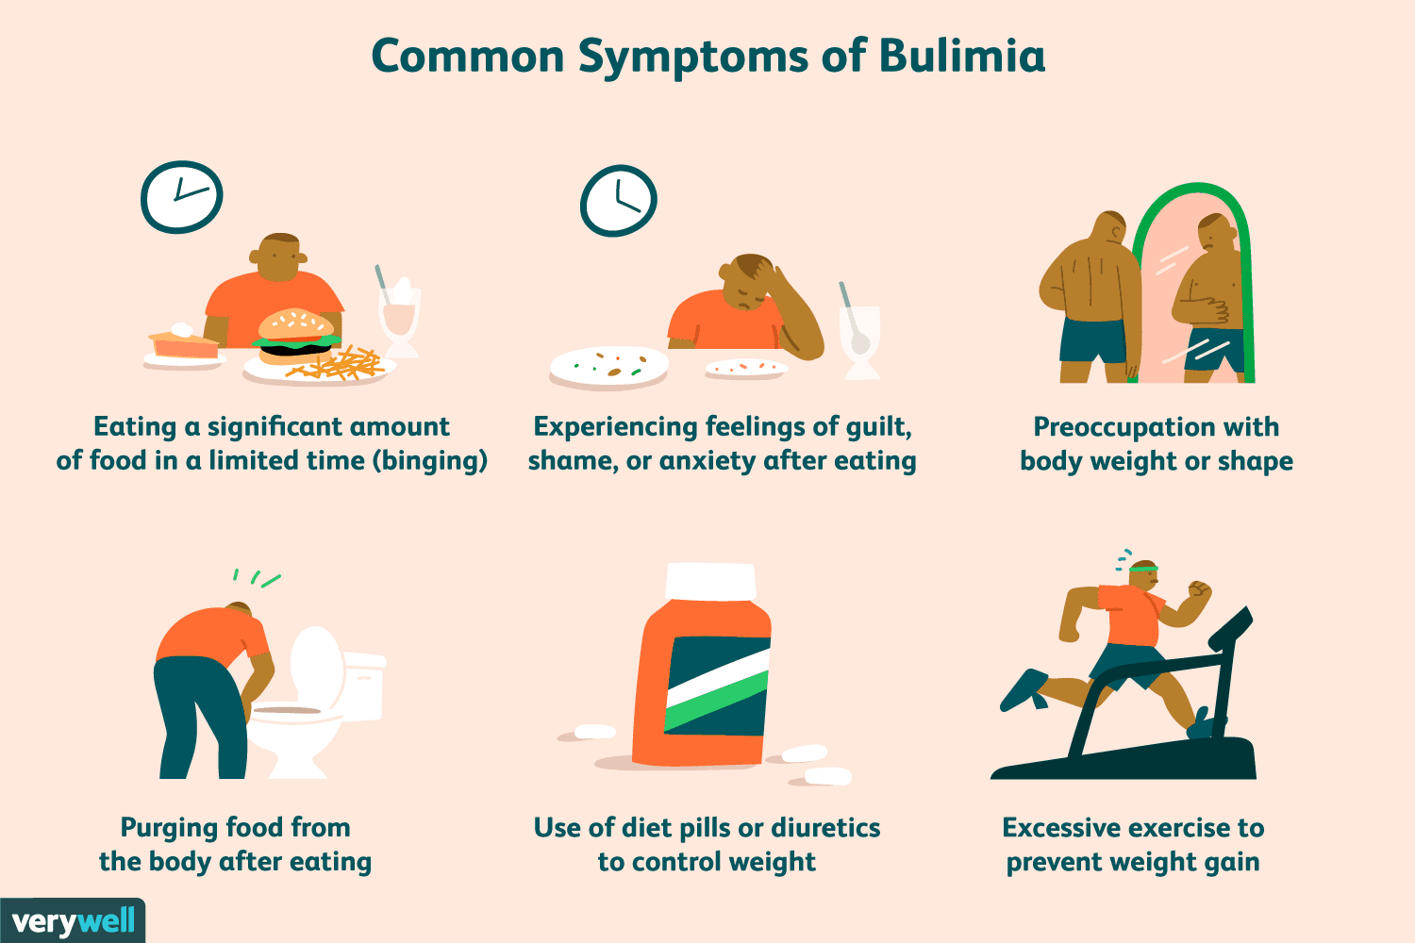

Slide 43
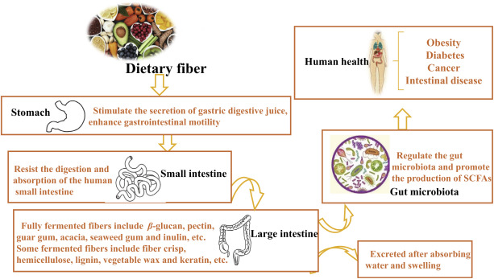
DIETARY FIBER

Slide 44
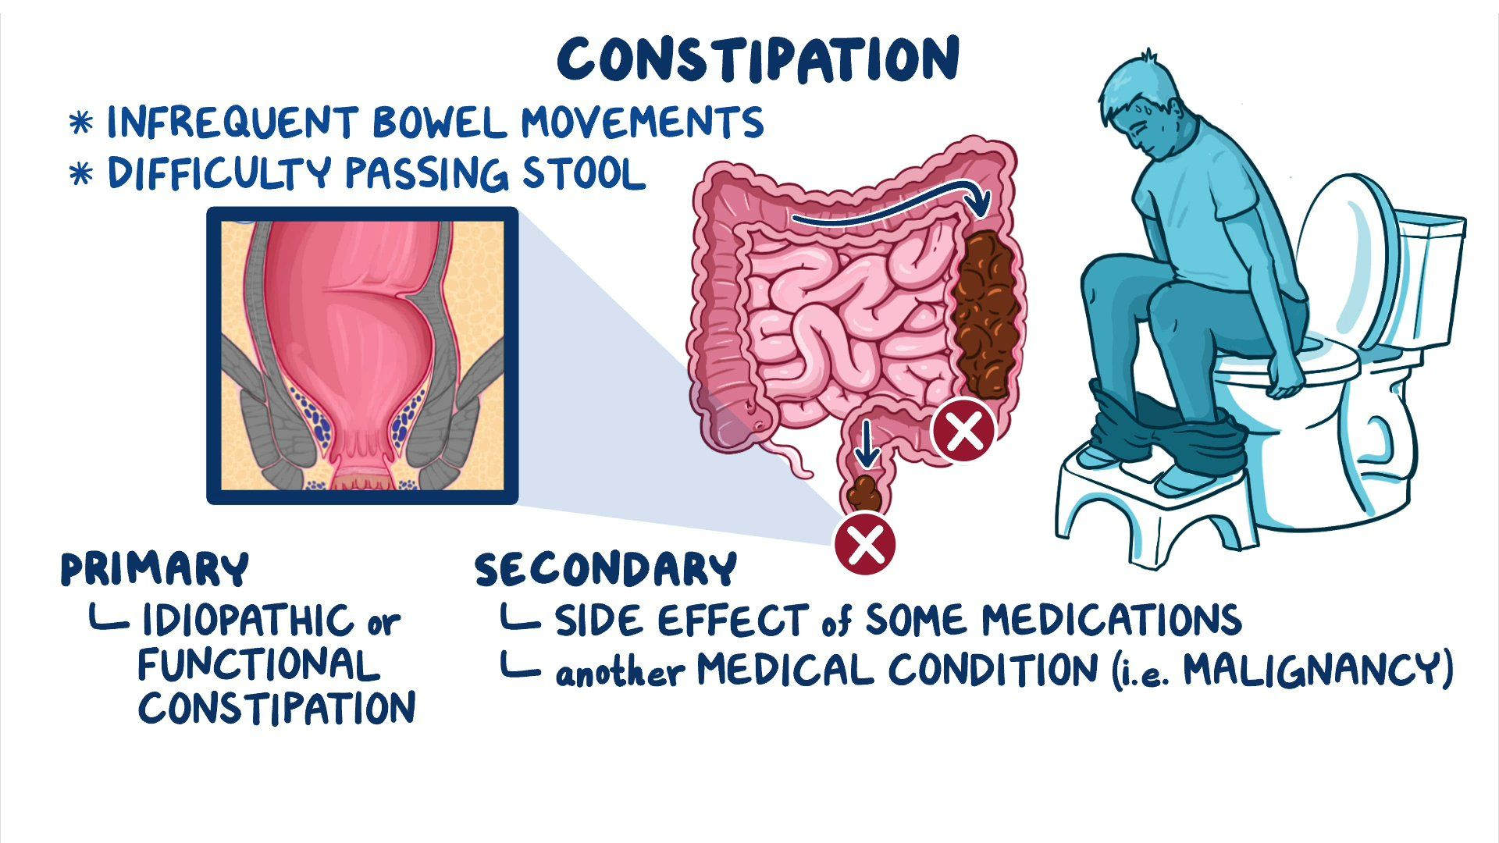
CONSTIPATION

Slide 45
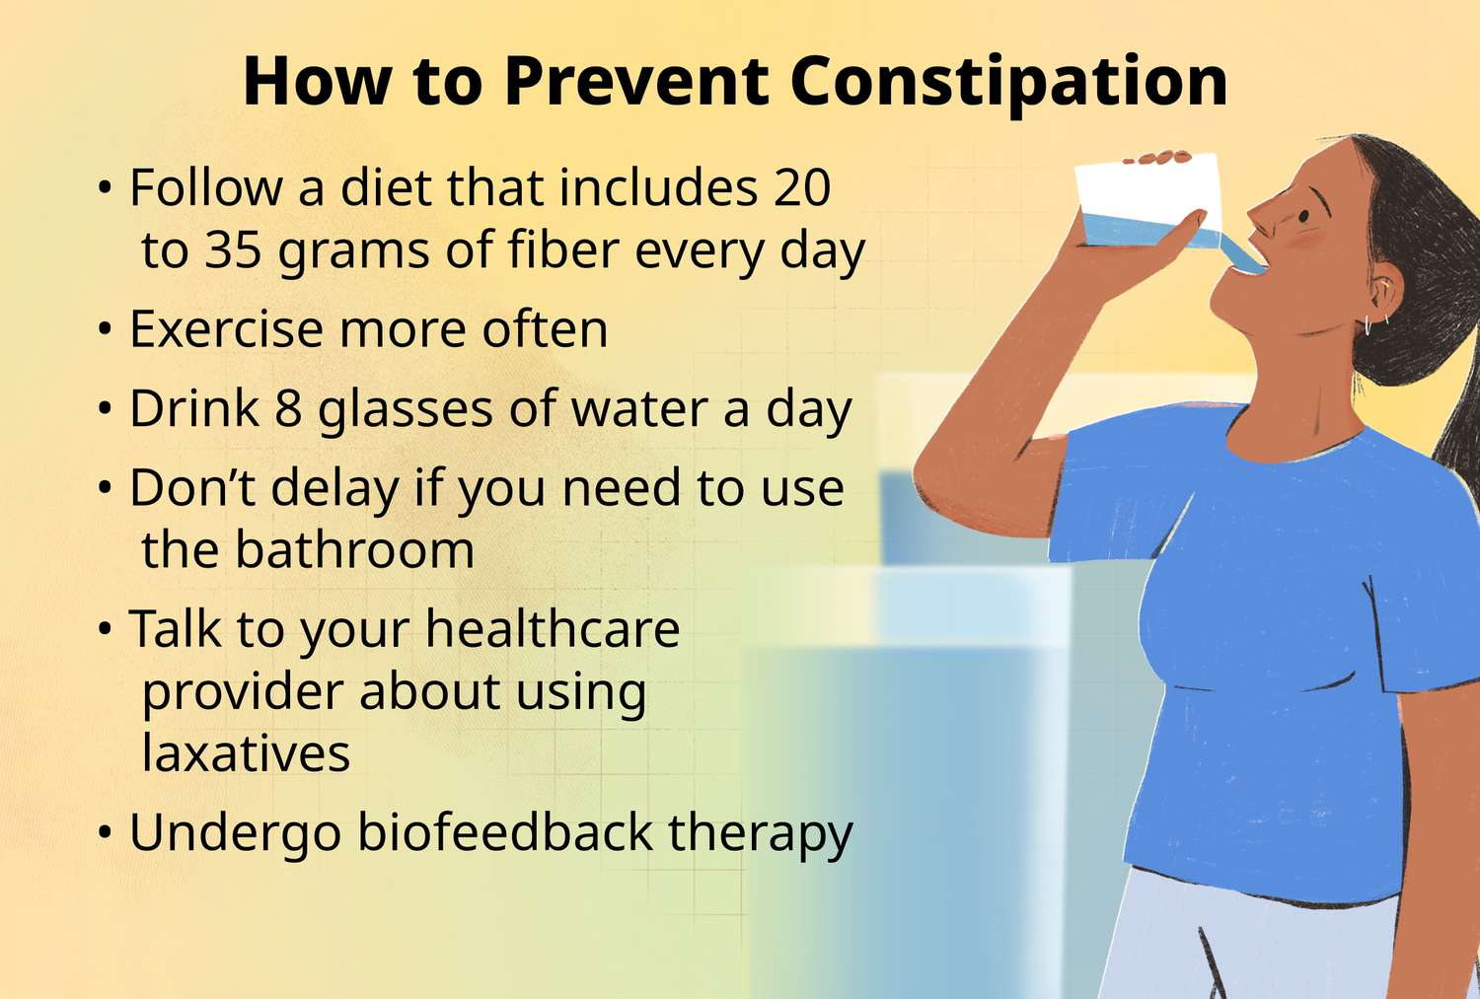

Slide 46
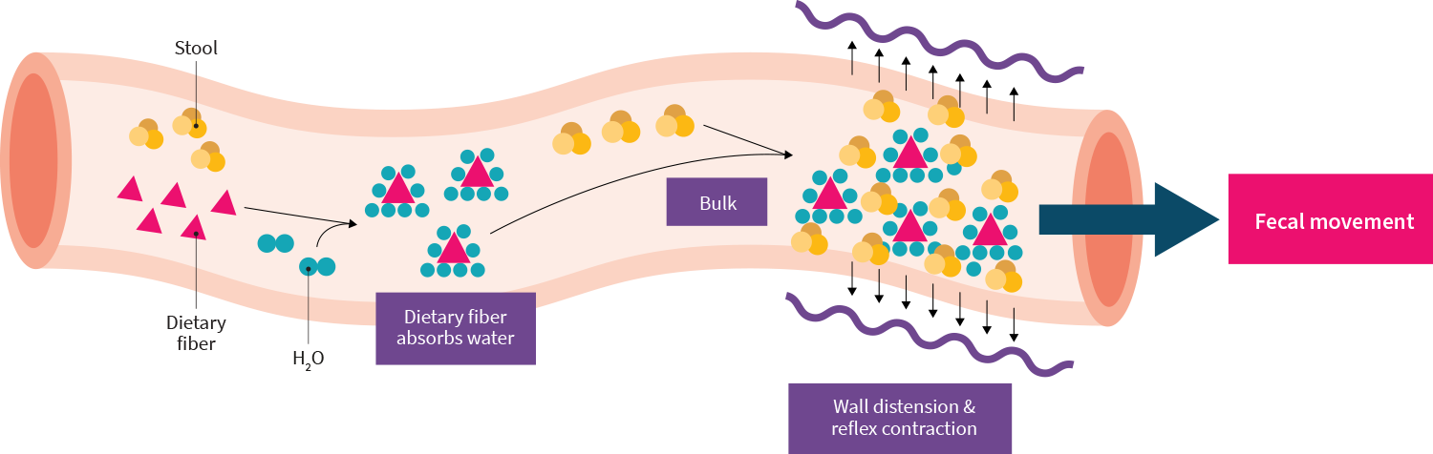
ROLE OF DIETARY FIBER IN CONSTIPATION

Slide 47
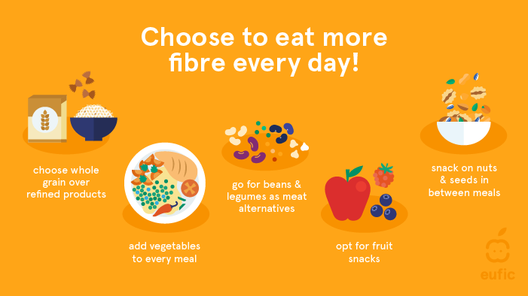

Slide 48

Family Medicine
Spiral Integration
Family Medicine plays important role in preventing and treating diseases in following manner:
Preventive care and education.
Early detection and screening.
Diagnostic evaluation.
Treatment planning and management.
Monitoring and follow-up.
Community out-reach and advocacy.

Slide 49
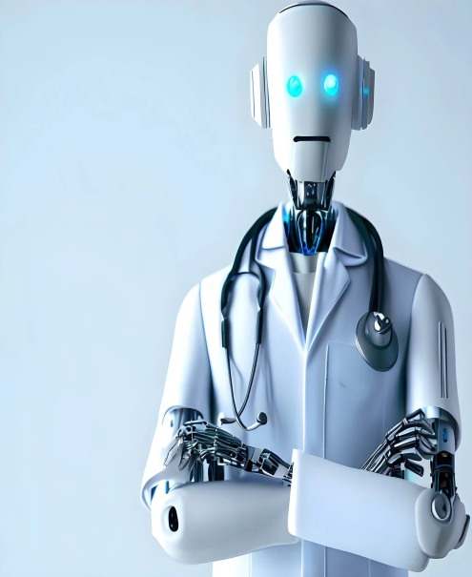
Artificial Intelligence
Spiral Integration
Artificial Intelligence plays role in following aspects to address the nutrition related issues:
Data analysis and prediction.
Early detection and diagnosis.
Personalized treatment planning.
Remote monitoring and support.
Decision support tools.
Public health surveillance and intervention.
Research and innovation.
Community engagement and education.

Slide 50
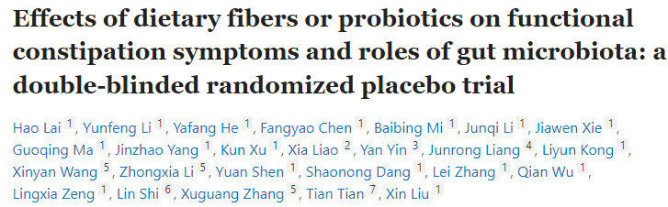
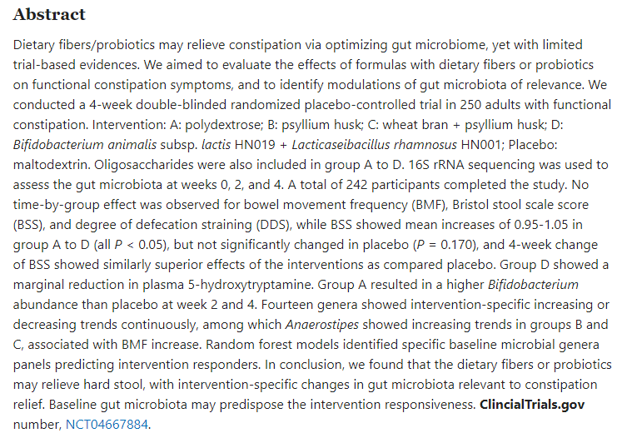
Suggested Research Article
Link: https://pubmed.ncbi.nlm.nih.gov/37078654/

Slide 51
How To Access Digital Library
Steps to Access HEC Digital Library
Go to the website of HEC National Digital Library
On Home Page, click on the INSTITUTES
A page will appear showing the universities from Public and Private Sector and other Institutes which have access to HEC National Digital Library HNDL
Select your desired Institute
A page will appear showing the resources of the institution
Journals and Researches will appear
You can find a Journal by clicking on JOURNALS AND DATABASE and enter a keyword to search for your desired journal

Slide 52
Learning Resources
Textbook of Biochemistry, Lippincott 8th edition, chapter no.27, page no. 717-753.
Google scholar
Google images

Slide 53


