Slide 2
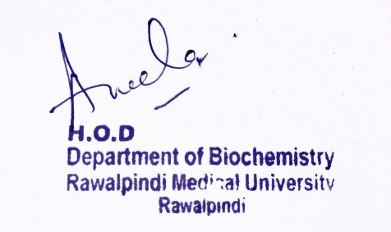
2nd Year MBBS Gastrointestinal Tract Module Large Group Interactive Session (LGIS) Nutrition
Date: 14-02-2023
Delivering Date: 21-03-2024
31-01-2025
Dr. Rahat Afzal
Biochemistry Department

Slide 3
Motto Vision; The Dream/Tomorrow
To impart evidence based research oriented medical education
To provide best possible patient care
To inculcate the values of mutual respect and ethical practice of medicine
Wisdom
Truth
Service

Slide 4
Learning Objectives
At the end of the lecture, students will be able to:
Explain:
What is balanced diet
What are proteins
Determination of comparative nutritional efficiency of proteins.
Protein Energy Malnutrition (PEM.)

Slide 5
Professor Umar Model of Integrated Lecture

Slide 6
Interactive Session
A 3-Year Old boy is brought to the pediatric clinic by his mother, who reports that the child has been experiencing:
Weight loss and fatigue over the past 6 months
Decreased appetite and interest in food
Hair loss and skin problems
Recurrent infections including diarrhea and respiratory tract infections

Slide 7
Core Knowledge

Slide 8
Balanced diet:
Core Knowledge
A diet consisting of a variety of different types of food and providing adequate amounts of all the essential nutrients necessary for normal growth and development of human body.

Slide 9
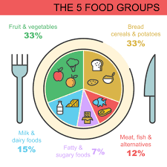
Core Knowledge
Five major food groups:
Fruits and vegetables
Starchy food:
Potatoes, bread, rice, pasta, and other carbohydrates
3. Proteins:
Beans, pulses, fish, eggs, meat and other proteins.
4. Dairy
5. Fats:
Oils and spreads.

Slide 10
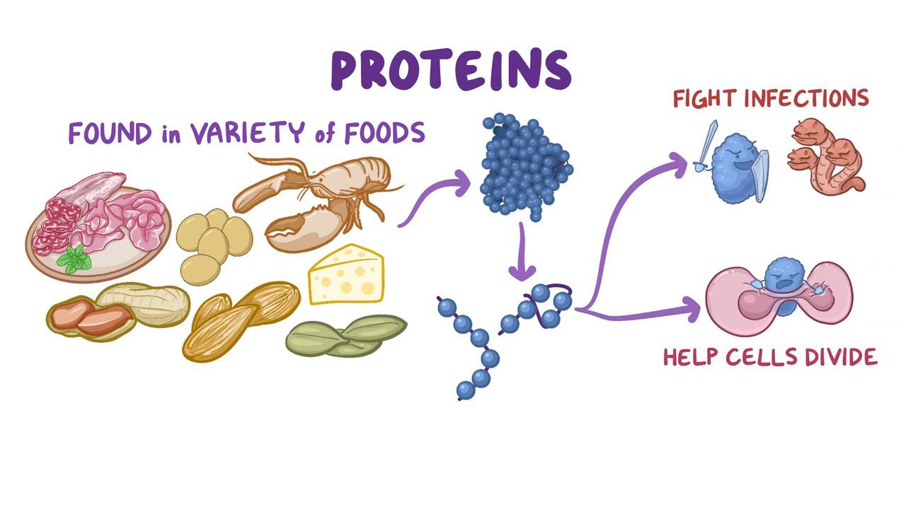
Proteins:
Core Knowledge
Building stones.
Required for growth.
Required to build proteins in wear and tear loss and to build new tissues after wasting illness.
Supply amino acids required for synthesis of enzymes.
Proteinous hormones.

Slide 11
Core Knowledge

Slide 12
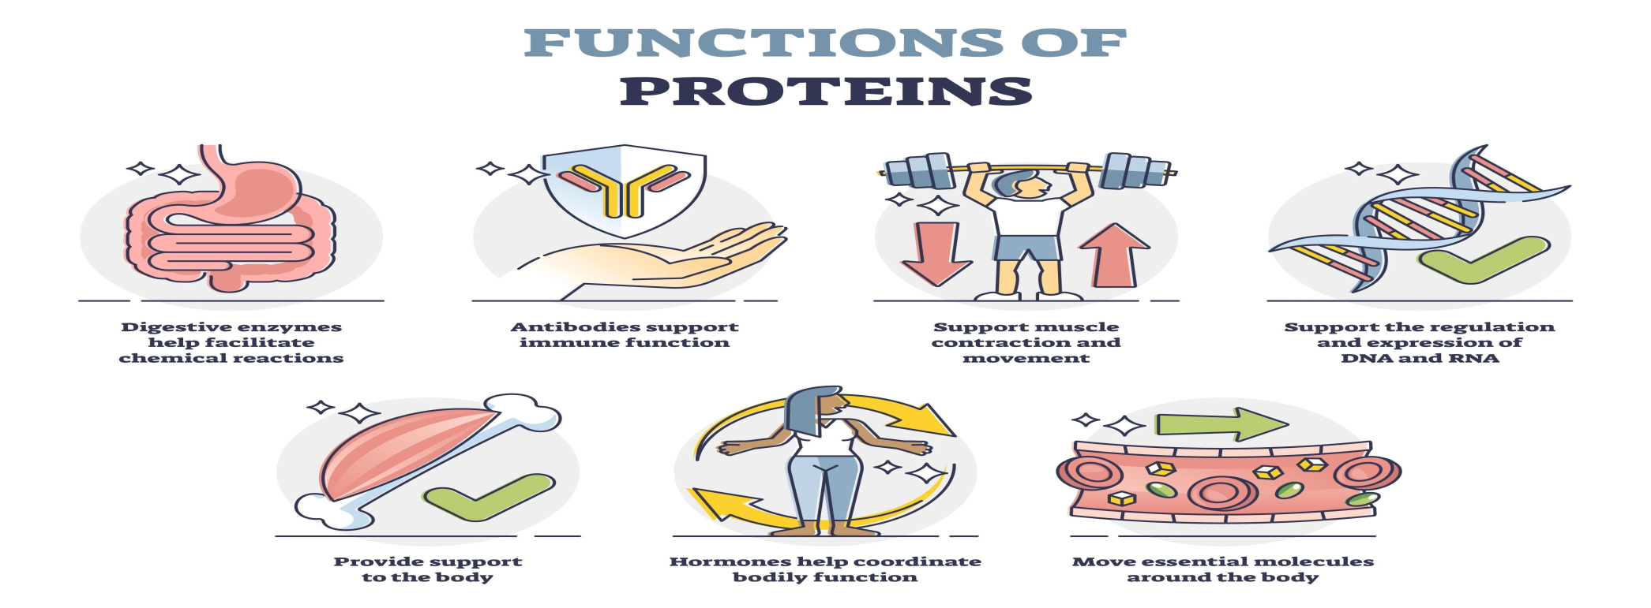
Core Knowledge
Nitrogenous substances, e.g. purines, pyramidines, RNA, DNA, and coenzymes receptors for hormones are also proteins.
Amino acids are required for synthesis of plasma proteins such as clotting factors, transport proteins, albumin and globulin.

Slide 13
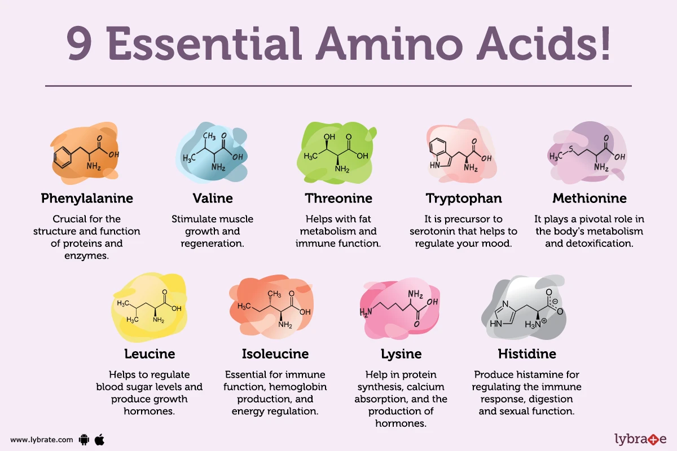
Essential Amino Acids:
Core Knowledge

Slide 14
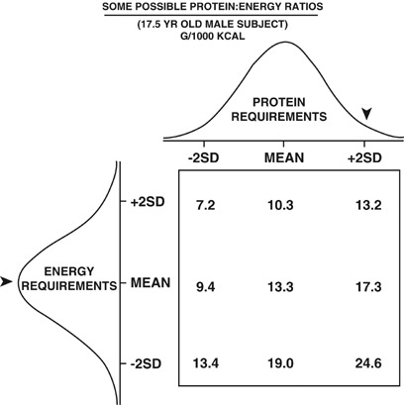
Determination of Comparative Nutritional Efficiency of Dietary Proteins:
Core Knowledge
Done by finding out certain values:
Net Protein Utilization (NPU) of proteins:
NPU= $\frac{Proteins digested and assimilated in gms}{protein intake in diet in gms}$ x 100
Increased NPU= Higher will be the nutritional value of protein
Protein Ratio:
Ratio of grams of body weight
gain to grams of proteins
consumed.

Slide 15
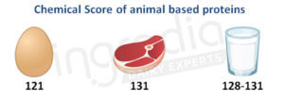
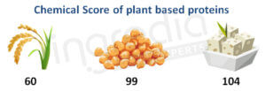
Core Knowledge
3. Chemical Score of a protein:
Content of essential amino acids of a protein is matched with that of egg protein(100%) to obtain its chemical score (c.s.)
Wheat flour protein c.s. = 40
Animal Protein (G1):
Plant Protein (G2):

Slide 16
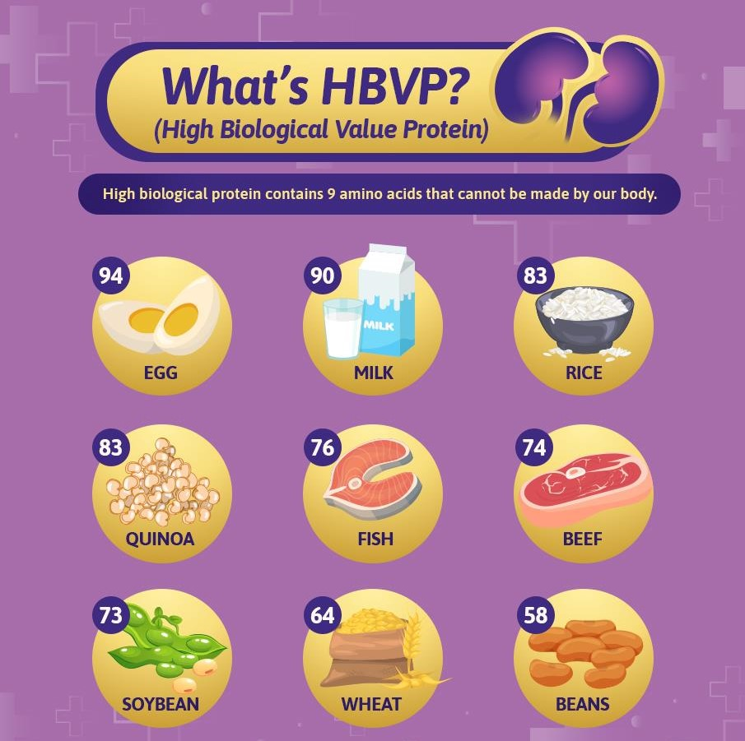
High Biological Value Proteins:
Core Knowledge
A protein with high biological value have following characteristics:
It should have all essential amino acids.
Essential amino acids should be present in optimal proportion.
Protein should be easily digestible.

Slide 17
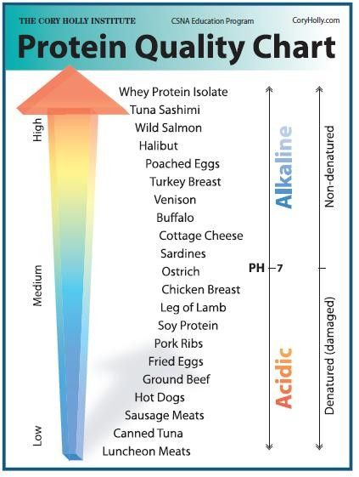
Methods to Improve Nutritional Value of Proteins of Plant Origin
Core Knowledge
Corn gem, wheat gem, yeast and soya beans (Good proportion of many amino acids.)
To use diet containing mixture of vegetable proteins.
To grow crops which yield a much higher protein content e.g. mutant strains of wheat and maize.
Genetically modified foods are being developed to solve the problems of food shortage.

Slide 18
Recommended Dietary Allowances (RDA) of Proteins
Core Knowledge
For average man minimum requirement is approx. 35gm/day.
People who do heavy work and severe muscular exercise need more proteins.
Depends on age, sex, physical requirement, and severe muscular exercise.

Slide 19
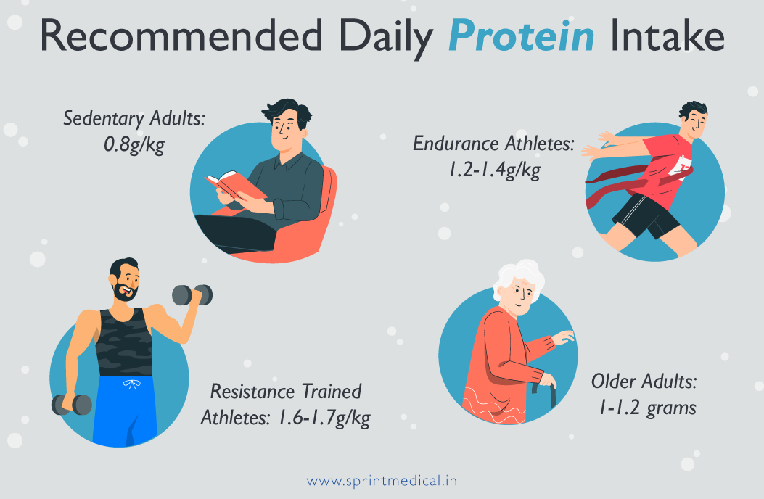
Core Knowledge
During pregnancy and lactation increased protein intake is recommended.
Protein deficiency is most commonly seen during infancy and resulted in:
Stunted growth.
Brain damage.
Increased mortality rate.

Slide 20
Protein Energy Malnutrition (PEM)
Core Knowledge
PRIMARY:
Due to inadequate intake of calories and proteins
SECONDARY:
Due to certain disease e.g. malignancy, intestinal malabsorption, IBD, AIDS, CRF, and anorexia nervosa.

Slide 21
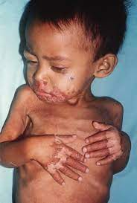
Protein Energy Malnutrition (PEM):
Core Knowledge
These individuals have prominent ribs, winged scapula, spindly arms and legs, flat buttocks.
Skin is dry and inelastic.
Skin ulcerations may be seen which occurs as shiny, arythematous atrophic areas.
Skin ulcerations may be seen.

Slide 22
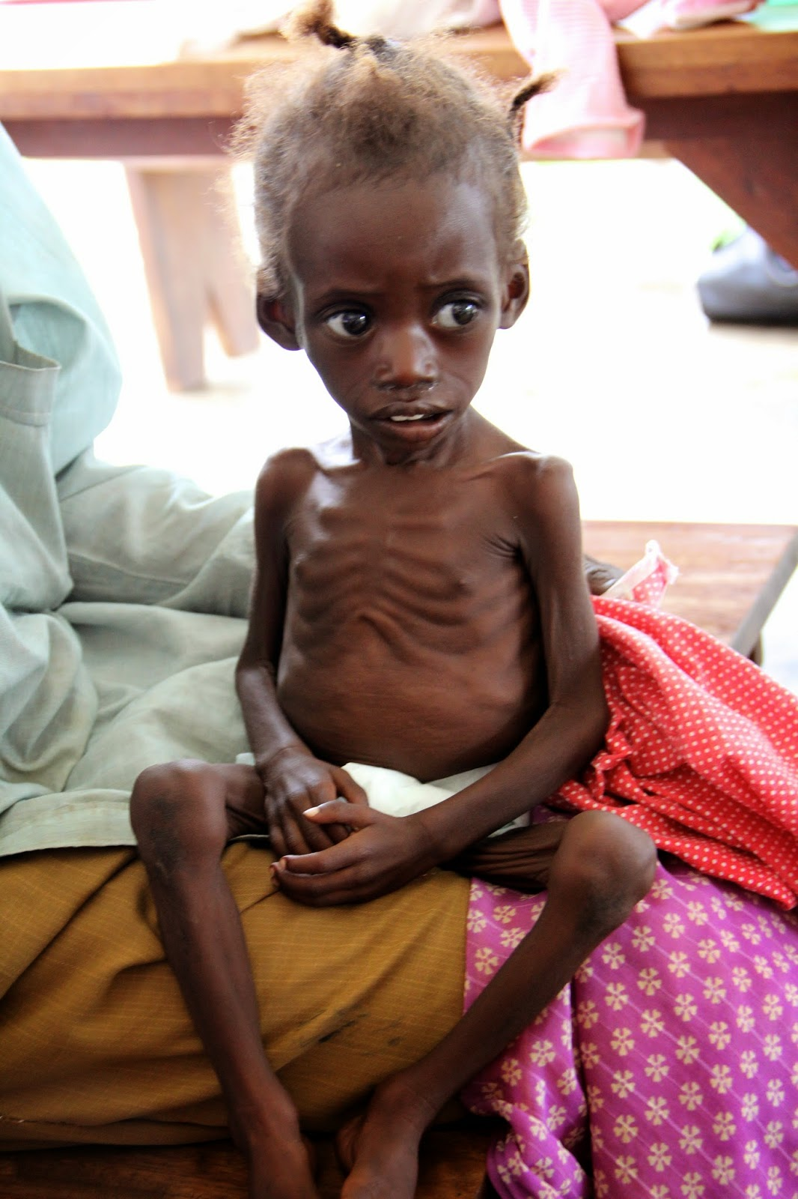
Core Knowledge
Hair are sparse and dry, lost their luster and weak.
Gross body edema.
Low serum albumin.
Blood level of glucose, amino acids, and insulin are decreased.
Growth hormone increases.
Cortisol increases.
Serum T3 and T4 decreases.
GnRH decreases.

Slide 23
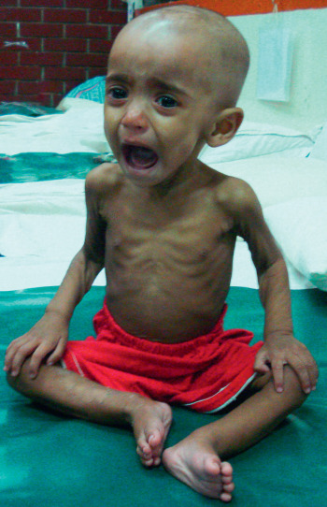
Core Knowledge
Plasma testosterone decreases.
Heart shows edema, patchy necrosis and infiltration with inflammatory cells.
Stroke volume and cardiac output decreases.
Weakness of inspiratory muscles causing decreased inspiratory and expiratory pressures.
Decreased metabolic activities.

Slide 24
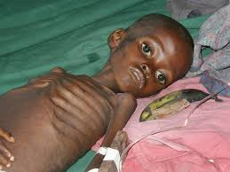
Core Knowledge
Reduction in cardiac work with low BP.
Deficiency of minerals.
Easy fatigue and lethargy.
Subject feels constant hunger.
There may be constipation.
Immunity is impaired.
Delayed wound healing.
Depression.

Slide 25
Kwashiorkor
Core Knowledge
Kwashiorkor is characterized by severe deficiency of good quality of protein.
It occurs in tropics and sub-topics where diet of young children lacks animal proteins.

Slide 26
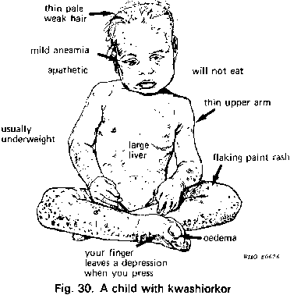
Core Knowledge
Features:
Growth failure, atrophy of muscles, weakness, nervous irritability.
Skin rashes.
Hair are thin, weak, and red.
Chilosis, xerophathalmia, stomatitis, diarrhea and cachexia.
Edema, moon face and large belly
Enlarged fatty liver
Rickets and scurvy.

Slide 27
Marasmus
Core Knowledge
It is an extremely severe type of nutrition disorder in which thee is significant wasting of fats, muscles and tissues of the body.

Slide 28
Horizontal Integration

Slide 29
Nutrition
Nutrition is the process by which the body metabolizes and utilizes nutrients from food.

Slide 30
Vertical Integration

Slide 31
Kwashiorkor
Vertical Integration
Causes:
Low protein diet.
Lack of essential vitamins and minerals.
Lack of dietary antioxidants.
Aflatoxins.
Parasites and infectious diseases particularly measles, malaria and HIV.
Significant life stress including famine, deprivation, war and natural disasters.

Slide 32
Marasmus
Vertical Integration
Causes
Chronic starvation.
Adulterated water.
Inadequate food intake.
Vitamin deficiencies.
Low birth weight.

Slide 33
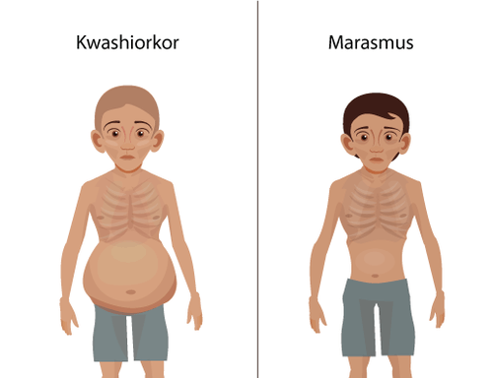
Vertical Integration

Slide 34
Vertical Integration
KWASHIORKOR | MARASMUS
Develops in children whose diets are deficient in proteins. | It is characterized by a deficiency of proteins and calories
Children of age: 6 months to 3 years. | Infants under 1 year of age.
Subcutaneous fat is preserved. | Subcutaneous fat is lost.
Edema is present. | Edema is absent.
Enlarged fatty liver. | No fatty liver.
Ribs are not prominent. | Ribs are prominent.

Slide 35
Treatment of PEM
Vertical Integration
FIRST STAGE | SECOND STAGE | THIRD STAGE
First 24-48 hours | Next 7-10 days | > 10 days
Infection and dehydration is treated first. | Diet of 76kcal/kg/day. | Aim is to restore patient’s protein and fat contents.
 | Antibiotics. | Diet of 175-200 kcal/kg/day for severe malnutrition.
 |  | Diet of 150kcal/kg/day for moderate malnutrition.

Slide 36
Spiral Integration
Family Medicine plays important role in preventing and treating PEM in following manner:
Preventive care and education.
Early detection and screening.
Diagnostic evaluation.
Treatment planning and management.
Monitoring and follow-up.
Community out-reach and advocacy.

Slide 37
Artificial Intelligence
Spiral Integration
Artificial Intelligence plays role in following aspects to address the nutrition related issues such as PEM:
Data analysis and prediction.
Early detection and diagnosis.
Personalized treatment planning.
Remote monitoring and support.
Decision support tools.
Public health surveillance and intervention.
Research and innovation.
Community engagement and education.

Slide 38
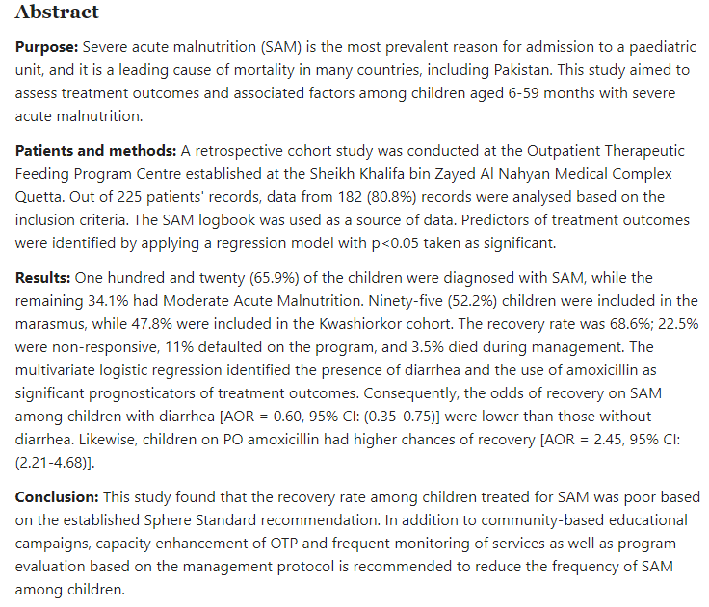
Suggested Research Article
Spiral Integration
Link: https://pubmed.ncbi.nlm.nih.gov/37753341/

Slide 39
Bioethics
Spiral Integration

Slide 40
LGIS Assessment
Q1. What is balanced diet ?
Q2. What are five major food groups?
Q3. Explain function of proteins?
Q4. What is chemical score of protein?
Q5. What are features of Kwashiorkor?

Slide 41
How To Access Digital Library
Steps to Access HEC Digital Library
Go to the website of HEC National Digital Library
On Home Page, click on the INSTITUTES
A page will appear showing the universities from Public and Private Sector and other Institutes which have access to HEC National Digital Library HNDL
Select your desired Institute
A page will appear showing the resources of the institution
Journals and Researches will appear
You can find a Journal by clicking on JOURNALS AND DATABASE and enter a keyword to search for your desired journal

Slide 42
Learning Resources
Textbook of Biochemistry, Lippincott 8th edition, chapter no.27, page no. 717-753.
Google scholar
Google images

