Slide 1
Non- Probability sampling
Block X Otorhinolaryngology
Module-II 4th Year MBBS Dr Afifa Kulsoom, Dr Mehwish Riaz

Slide 3
Vision & Mission of RMU
Wisdom
Truth
Service
To impart evidence based research oriented medical education
To provide best possible patient care
To inculcate the values of mutual respect and ethical practice of medicine

Slide 4
Sequence Of Lecture
Learning objectives (1 slide)
Core Subject (24 slides)
EOLA(End of lecture assessment) 1 slide
Digital Library References
Research 1 slide
Bioethics 1 slide
Artificial Intelligence 1 slide

Slide 5
Prof Umer Model

Slide 6
Learning Objectives
Define & comprehend definition & rationale of sampling
Understand the concept of non-probability sampling technique
Enlist the types of non-probability sampling
Appraise different scenarios to apply different non -probability technique

Slide 7
Core subject

Slide 8
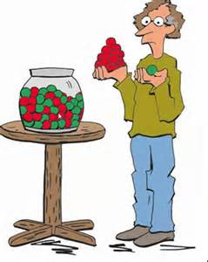
Sampling

Slide 9
What is Sampling???
Core Subject
A sample is a subset of a population and the process of drawing a part (subset) from whole set of population is called sampling.
A sample should be representative of the population to allow the generalizability of the results to the whole population.

Slide 10
What is Sampling???
Core Subject

Slide 11
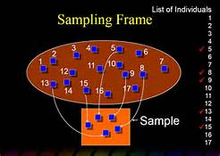
What is Sampling Frame ???
Core Subject
Sampling frame is the list of all persons/units of population from which the sample is selected.

Slide 12
Types Of Sampling
Core Subject
Sampling
Random/
Probability
Sampling
Non-random/
Non-probability
Sampling

Slide 13
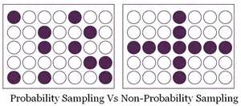
Non-Probability Sampling
Core subject
In non-probability/non-random sampling, every participant DOESN’T get an equal chance of being included or excluded from the study population.

Slide 14
Difference Between Probability & Non-Probability Sampling
Core subject

Slide 15
Types Of Non-Probability Sampling
Core subject
Convenience sampling
Purposive sampling
Quota sampling
Snowball sampling
Dimensional sampling
Consecutive

Slide 16
Convenience Sampling
Core subject
Convenience sampling is a type of sampling where the first available primary data source will be used for the research without additional requirements.
In other words, this sampling method involves getting participants wherever you can find them and typically wherever is convenient.
Generalizability of results is compromised.

Slide 17
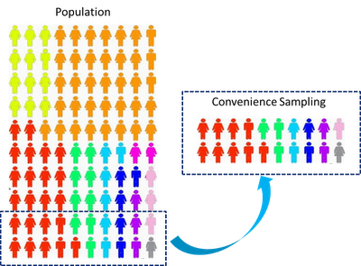
Core subject

Slide 18
Consecutive Sampling
Core subject
It involves taking every patient who
meets the selection criteria over a specified time interval or number of patients.
It is the best of the nonprobability techniques and one that is very often practical.

Slide 19
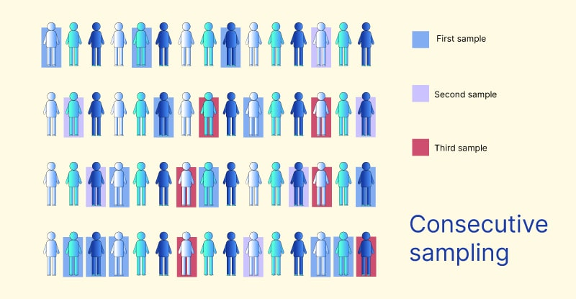
Consecutive Sampling
Core subject

Slide 20
Purposive Sampling
Core subject
Also known as judgment, selective or subjective sampling.
Researcher relies on his or her own judgment when choosing members of population to participate in the study.
useful in situationsto reach a targeted sample quickly, and where sampling for proportionality is not the main concern.

Slide 21
Purposive sampling
Core subject

Slide 22
Quota Sampling
Core subject
population is divided into subgroups and then sample is taken non-randomly from these subgroups.
Sub-groups are made on the basis of some shared characteristics like age, sex, religion, etc. These are called quota control factors.
It is widely used in public opinion polls and market research surveys.

Slide 23
Quota Sampling
Core subject

Slide 24
How To Do Quota Sampling??
Core subject
Divide the population into exclusive subgroups
Select sample by using non-random sampling technique.
Pool them all together

Slide 25
Important to Remember!!!
Core subject
It’s better to do quota sampling proportionately but can be done disproportionately as wellll….
As this is non- probability sampling!!!!

Slide 26
Snowball Sampling
Core subject
In this sampling, research participants recruit other participants.
Also called networking sampling.
Does that make any sense????

Slide 27
Why do we do snowball sampling??
Core subject
It is useful in finding subjects which may not like to disclose their identity.
e.g. homosexuals, drug addicts, sex workers, child abusers, etc..

Slide 28
How to do snowball sampling??
Core subject
Identify Potential Subjects in the Population
Ask Them to Recruit Individuals.
Repeat These Steps Till The Time That Desired Sample Size Is Achieved.

Slide 29
Dimensional Sampling
Core subject
It is an extension to quota sampling.
The researcher takes into account several characteristics e.g. gender, age, income, residence and education.
The researcher must ensure that there is at least one person in the study representing each of the chosen characteristics.

Slide 30
How to do dimensional sampling??
Core subject
Specify All The Dimensions or Variables.
Choose a Sample That Contains At-least One Case Of Each Variable

Slide 31
How To Do Dimensional Sampling??
Core subject
Example:
For example, out of 10 people the researcher ensures they have interviewed 2 people that are a certain gender, 2 a certain age group and 2 who have an income between £25000 and £30000.

Slide 32
The Ethics of Researching Friends: On Convenience Sampling in Qualitative Management and Organization Studies https://onlinelibrary.wiley.com/doi/abs/10.1111/1467-8551.12064
Ethics

Slide 33
Artificial Intelligence-Based Sampling Planning System for Dynamic Manufacturing Process https://doi.org/10.1016/S0957-4174(01)00049-5
Artificial intelligence

Slide 34
Sampling Techniques— Statistical Approach in Machine learning https://medium.com/analytics-vidhya/sampling-statistical-approach-in-machine-learning-4903c40ebf86
Research

Slide 35
End Of Lecture Assessment
A physician intends to conduct a study on prevalence and risk factors of hypertension in the community in which he is serving. For this purpose he selects 100 patients visiting his clinic. This sampling is of which type?
Convenience
Purposive
Quota
consecutive
Snowball

Slide 36
Suggested readings
K Park. Chapter health information & basic health statistics pg. 792,793

