Slide 1
NEPHRITIC SYNDROME
DR Asmara asrar
Assistant Professor of Nephrology
HOLY FAMILY HOSPITAL

Slide 2
MOTTO AND VISION
Mission Statement
To impart evidence-based research-oriented health professional education
Best possible patient care Mutual respect, ethical practice of healthcare and social accountability.
Vision and Values
Highly recognized and accredited centre of excellence in Medical Education, using evidence-based training techniques for development of highly competent health professionals, who are lifelong experiential learner and are socially accountable.
Goals
The Undergraduate Integrated Learning Program is geared to provide you with quality medical education in an
environment designed to:

Slide 3
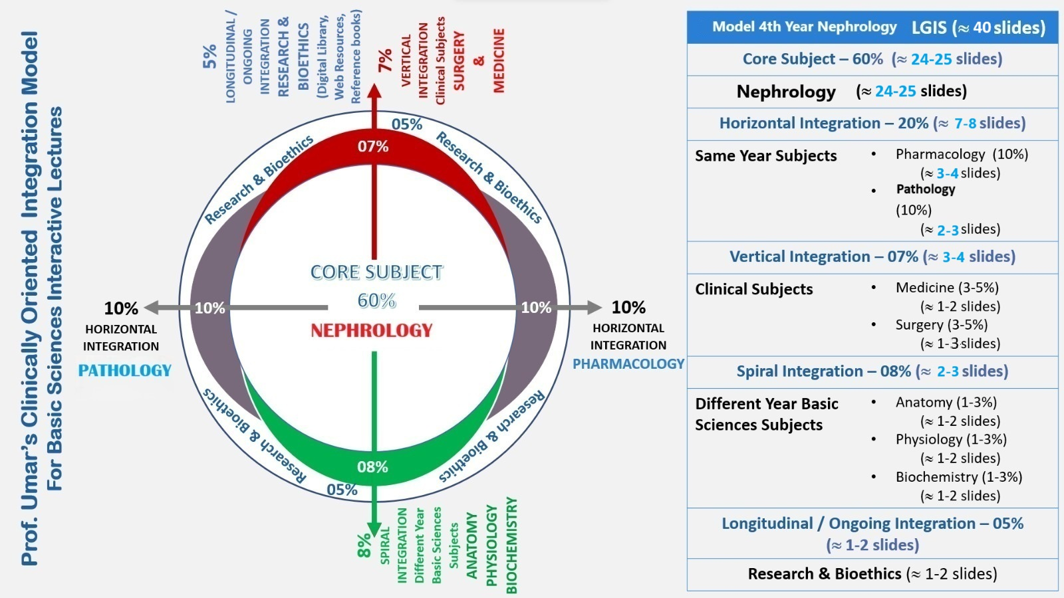

Slide 4
LEARNING OUTCOMES
DEFINITION
CAUSES
DIAGNOSIS
MANAGEMENT

Slide 6
1. CYCLOPHOSPHAMIDE
2.HEMODIALYSIS
3.MYCOPHENOLATE MOFETIL
4.FUROSEMIDE infusion at 10mg/hr
5.IV sodium bicarbonate

Slide 7
Acute nephritic syndrome
Glomerular injury
RBC cast in urine or dysmorphic rbcs
Hypertension
Oliguria
Azotemia

Slide 8
PATHOGENESIS

Slide 9
Normal glomerulus

Slide 10
RPGN
IgAN
Alports
Thin basement membrane disease

Slide 11
IgA Nephropathy

Slide 12
Management of IgAN
Supportive therapy
ACE-I or ARBs
Salt restriction
Diuretics
If proteinuria more than 1g steroids recommended.

Slide 13
Post- Streptococcal GN

Slide 15
MPGN

Slide 16
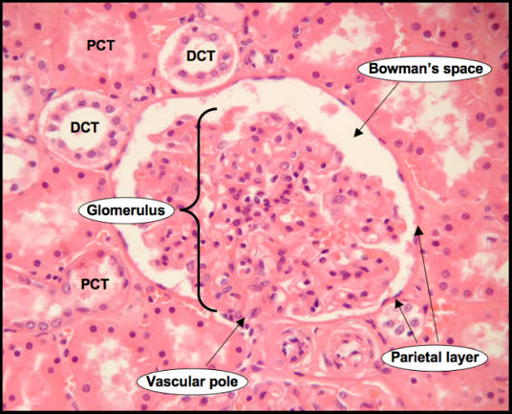

Slide 20
RPGN

Slide 21
RPGN

Slide 23
overlap

Slide 26
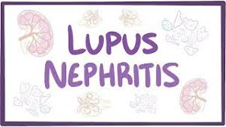

Slide 29
TREATMENT
Immunosuppressive therapy
Supportive measures
pulse methylprednisolone, followed by prednisone at a dosage of 1 mg/kg daily tapered over three month
cytotoxics
plasma exchange
Salt and water restriction
Control BP
RRT

Slide 30
Salt and water restriction
Fluid overload / pulmonary odema often complicates oliguric GN.
Limit salt intake <80mmol/day (<5g/day).
Set oral intake at 500 – 1,000mL/day (adjusted according to volume status and UO).
Diuretics may promote a natriuresis and provide symptomatic relief: use loop diuretic, e.g. furosemide 40 – 160mg/day PO or IV,titrated against response and renal function.
Review volume status and monitor weight daily, and chart input and output to plan following days fluid balance.

Slide 31
Control BP
BP is usually volume-related and may be significant. Aim for target BP of ≤ 130/80mmHg.
Diuretic (as described in salt and water restriction).
Stepwise add-on therapy B -blockers & calcium channel blockers.
ACE-I or ARB: titrate up from low dose with daily increments. ACE-I
or ARB offer theoretical advantages in the control of BP secondary
to renal disease due to their antifibrotic and anti-proteinuric effects.
However, their use in GN-associated with AKI may precipitate a
further decline in renal function. Careful monitoring is essential.

Slide 32
Other supportive measures
Prompt treatment of infection.
Adequate nutrition.
Management of the complications that may be associated with a systemic disease causing GN (e.g. lupus, vasculitis).
Renal replacement therapy, according to standard indications

Slide 34
1. CYCLOPHOSPHAMIDE
2.HEMODIALYSIS
3.MYCOPHENOLATE MOFETIL
4.FUROSEMIDE infusion at 10mg/hr
5.IV sodium bicarbonate

Slide 35
How to use HEC Digital Library
Steps to Access HEC Digital Library
Go to the website of HEC National Digital Library.
On Home Page, click on the INSTITUTES.
A page will appear showing the universities from Public and Private Sector and other Institutes which have access to HEC National Digital Library (HNDL).

Slide 36
QUESTION 1
A 30-year-old male presents with hematuria, proteinuria (1-2+), hypertension, and acute kidney injury. The most likely diagnosis is:
A) Nephrotic syndrome
B) Nephritic syndrome
C) Acute interstitial nephritis
D) Chronic kidney disease

Slide 37
QUESTION 2
Which of the following is a characteristic feature of nephritic syndrome?
A) Massive proteinuria (>3.5 g/day)
B) Hypoalbuminemia
C) Hematuria with red blood cell casts
D) Hyperlipidemia

Slide 38
ANSWERS
ANSWER 1 : B) Nephritic syndrome
ANSWER 2 : C) Hematuria with red blood cell casts

Slide 39
REFRENCES
1. Goodpasture EW. The signicance of certain pulmonary lesions in relation to the etiology of inuenza. Am J Med Sci. 1919;158:863–870.
2. Stanton MC, Tange JD. Goodpasture’s syndrome (pulmonary haemorrhage associated with glomerulonephritis). Aust NZ J Med. 1958;7:132–144.
3. Saus J, Wieslander J, Langeveld J, et al. Identication of the goodpasture antigen as the α3(IV) chain of collagen IV. J Biol Chem. 1988;263:13374–13380.
4. Turner N, Mason PJ, Brown R, et al. Molecular cloning of the human goodpasture antigen demonstrates it to be the alpha 3 chain of type IV collagen. J Clin Invest. 1992;89:592–601

Slide 40
Thankyou

