Slide 1

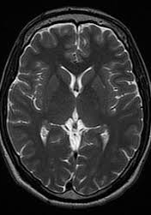
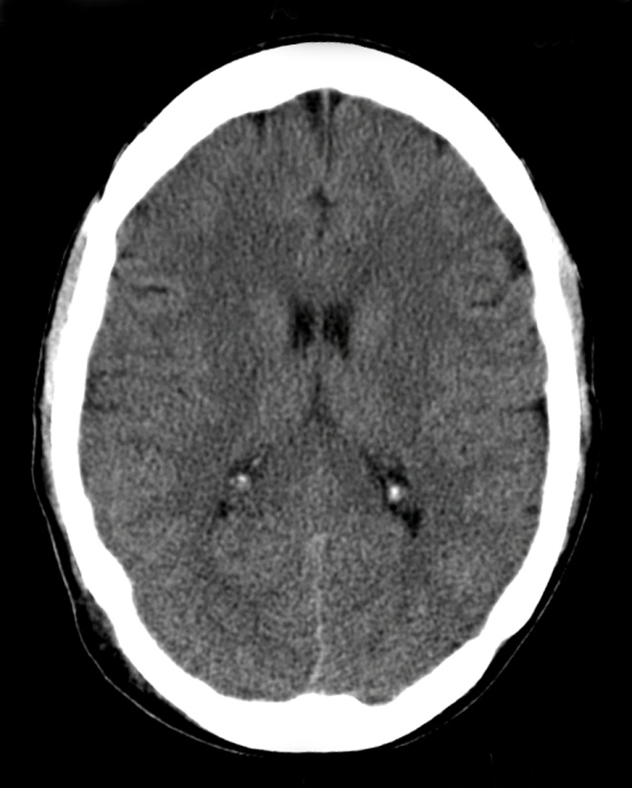
CNS MODULE
(RADIOLOGY)
BASIC CNS ANATOMY & PATHOLOGY ON CT AND MRI
By:
Dr. Zeenat Saulat
Consultant Radiologist, BBH
Dr. Fizza Batool
Senior Registrar Radiology, RTH.

Slide 2
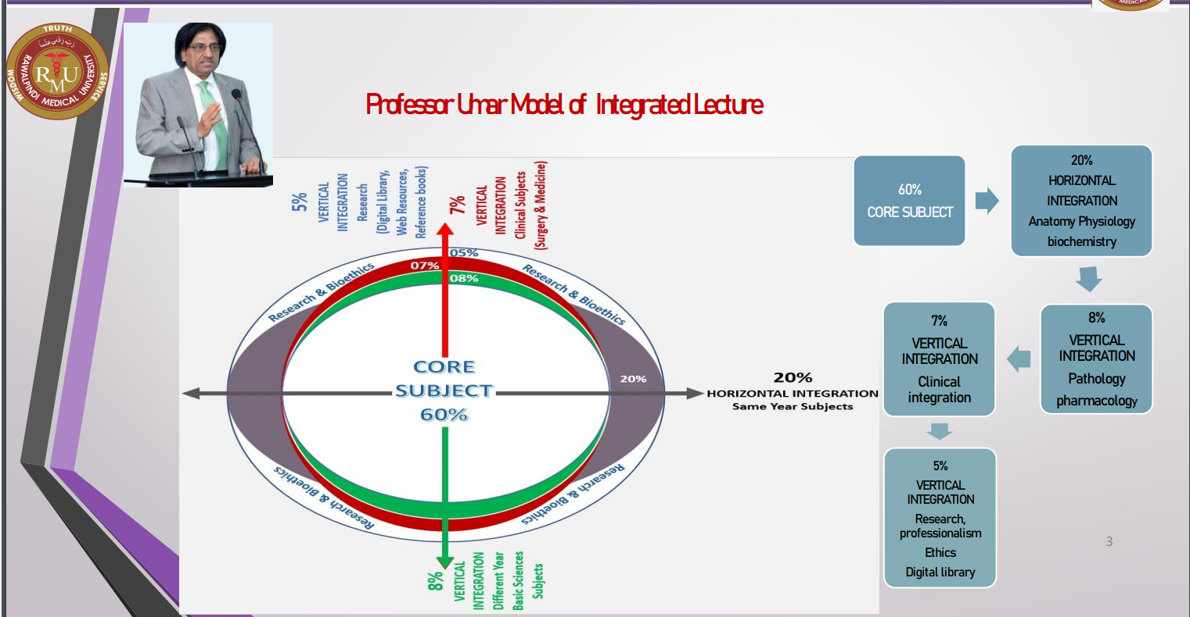

Slide 3
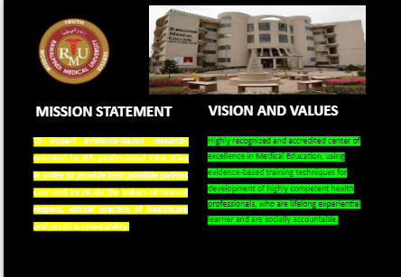

Slide 4
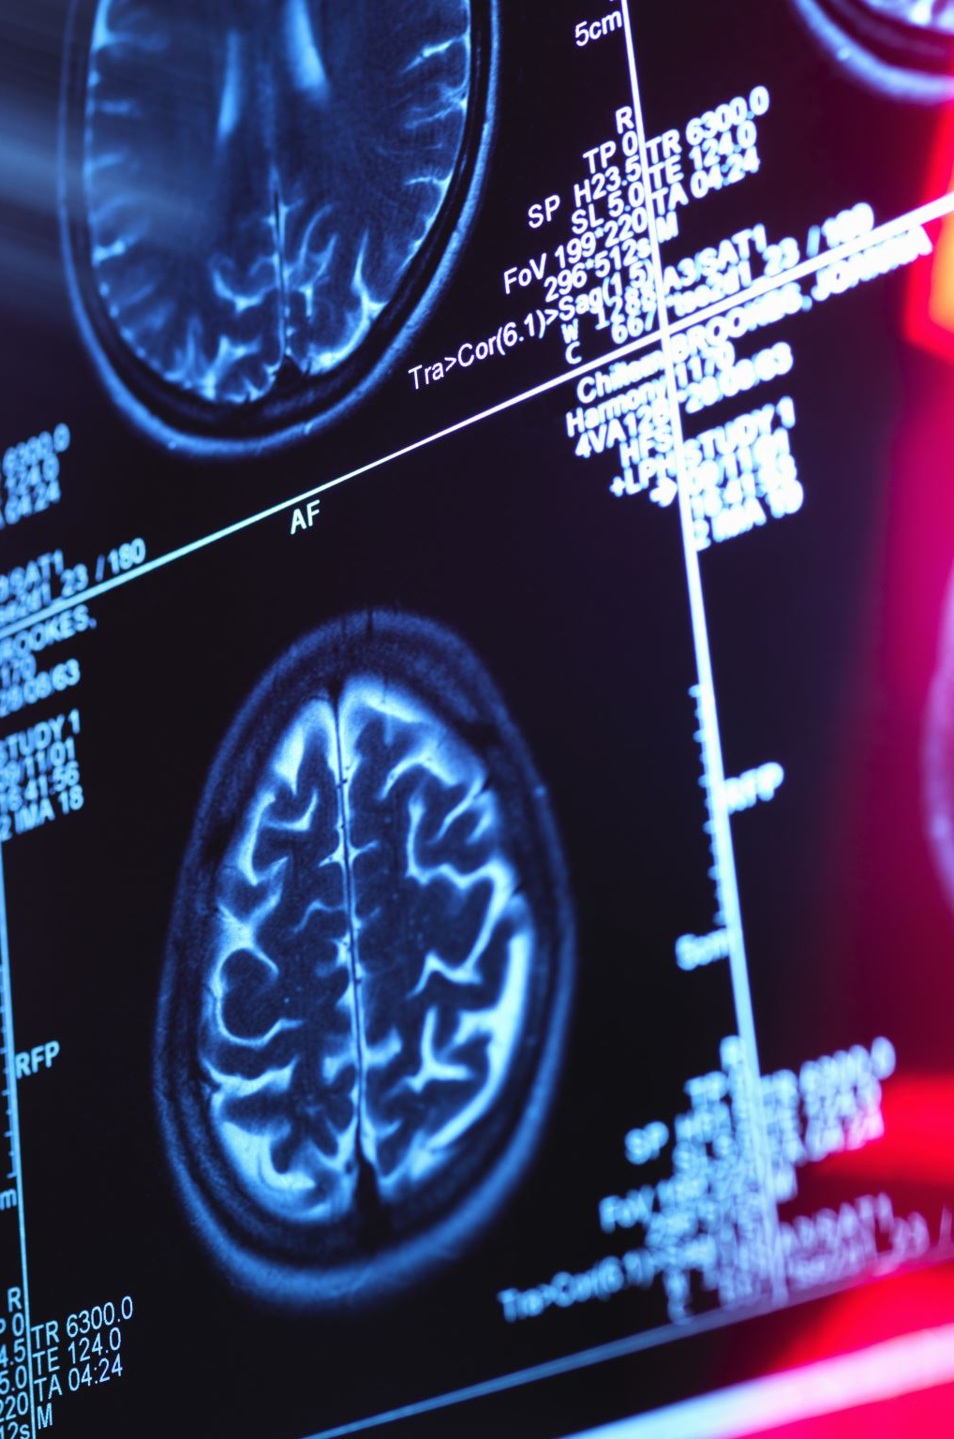

LEARNING OBJECTIVES
At the end of the LGIS. Students should be able to:
Describe …. Radiological techniques i.e CT and MRI
Identify…Radiological anatomy and pathology like Hydrocephalus, Cerebrovascular accidents
Classify…Cerebrovascular disease and hemorrhages
Explain…CNS trauma and clinical implications and management

Slide 5
Sequence of LGIS
Introduction To CT
Radiological anatomy on CT brain
Radiological pathology on CT brain
Introduction To MRI
Radiological anatomy on MRI brain and spine
Radiological pathology on MRI brain and spine
Clinical scenario and management
Research article
Biomedical ethics

Slide 6
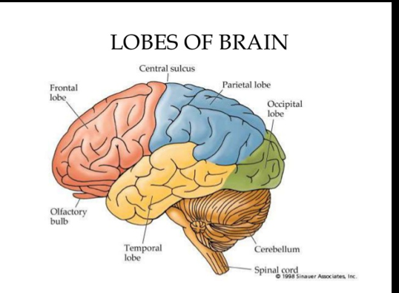
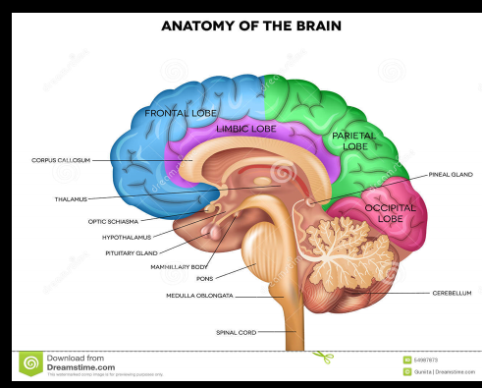
Horizontal integration

Slide 7
INTRODUCTION TO COMPUTED TOMOGRAPHY
CT (computed tomography)
Or CAT (computer assissted tomography)
Tomography refers to a process for generating 2D image slice of an examined organ of three dimensions 3D
Based on differential absorption of x ray by various tissues

Slide 8
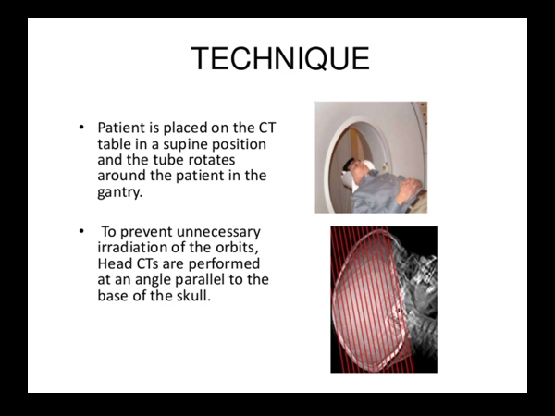

Slide 9
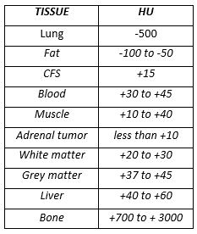
In CT, shades of gray correspond to a number on an arbitrary linear scale, expressed as HOUNSEFIELD UNITS (HU). (-1000 to +3000)
Human eye has limitations in number of different shades it can perceive. Monitors can display 256 gray scales & human eye can perceive 64 shades of gray
CT WINDOWING is done by setting the display to the HU of tissues of interest

Slide 10
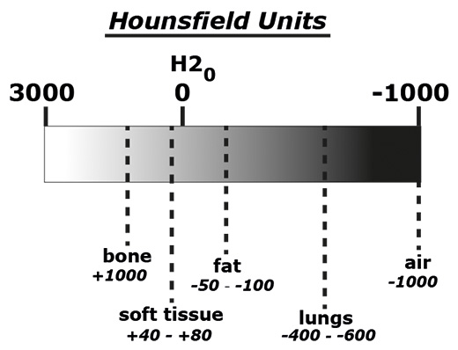

Slide 11
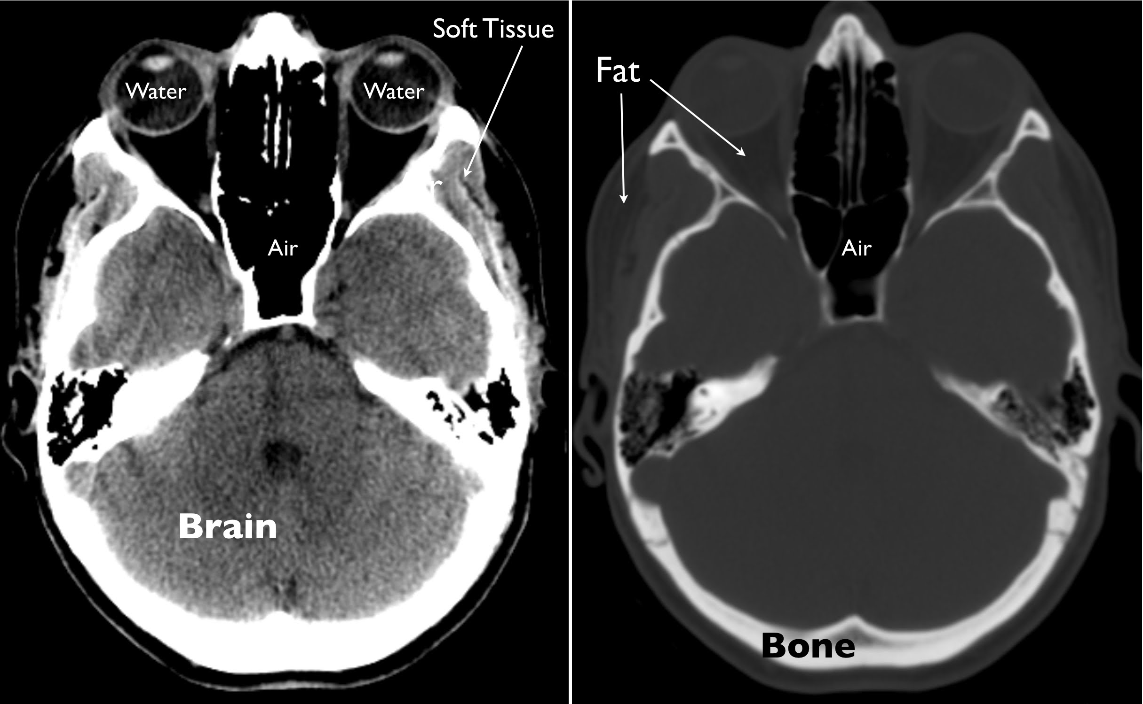

Slide 12
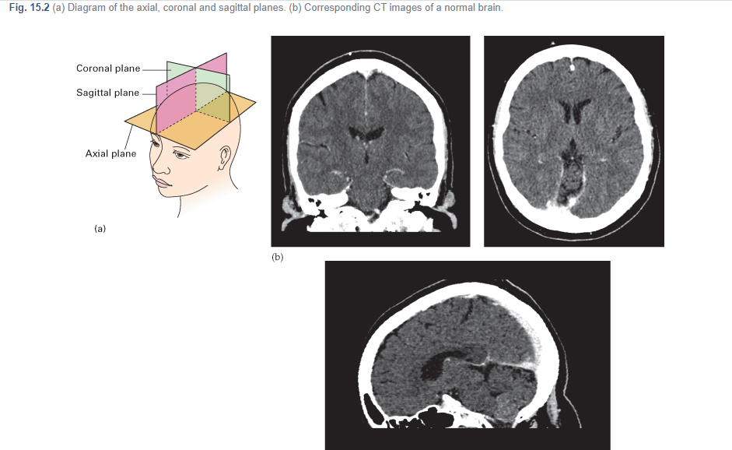

Slide 13
SYSTEMIC APPROACH TO CT INTERPRETATION
Symmetry: Compare left & right side
Midline: Look for midline shift
Cross sectional anatomy:
  Brain matter (gray matter, white matter, any lesions
  CSF & ventricles
  Skull & soft tissues
Subdural windows: Blood & collections adjacent to bone
Bone windows: Skull, orbit, sinuses, air

Slide 14
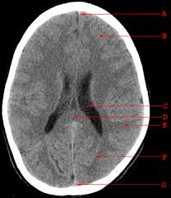
Interhemispheric fissure
Horizontal integration
Frontal Lobe
Lateral Ventricle
Splenium corpus callosum
Postcentral gyrus Parietal lobe
Occipital Lobe
Superior Sagittal Sinus

Slide 15
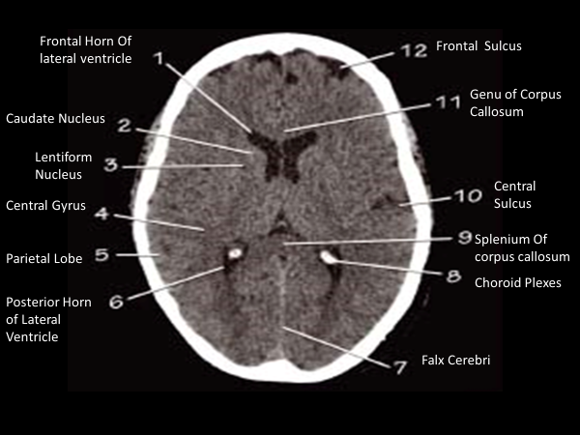

Slide 16
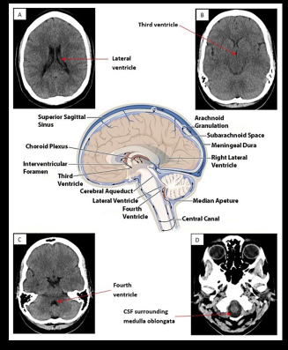

Slide 17
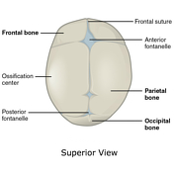
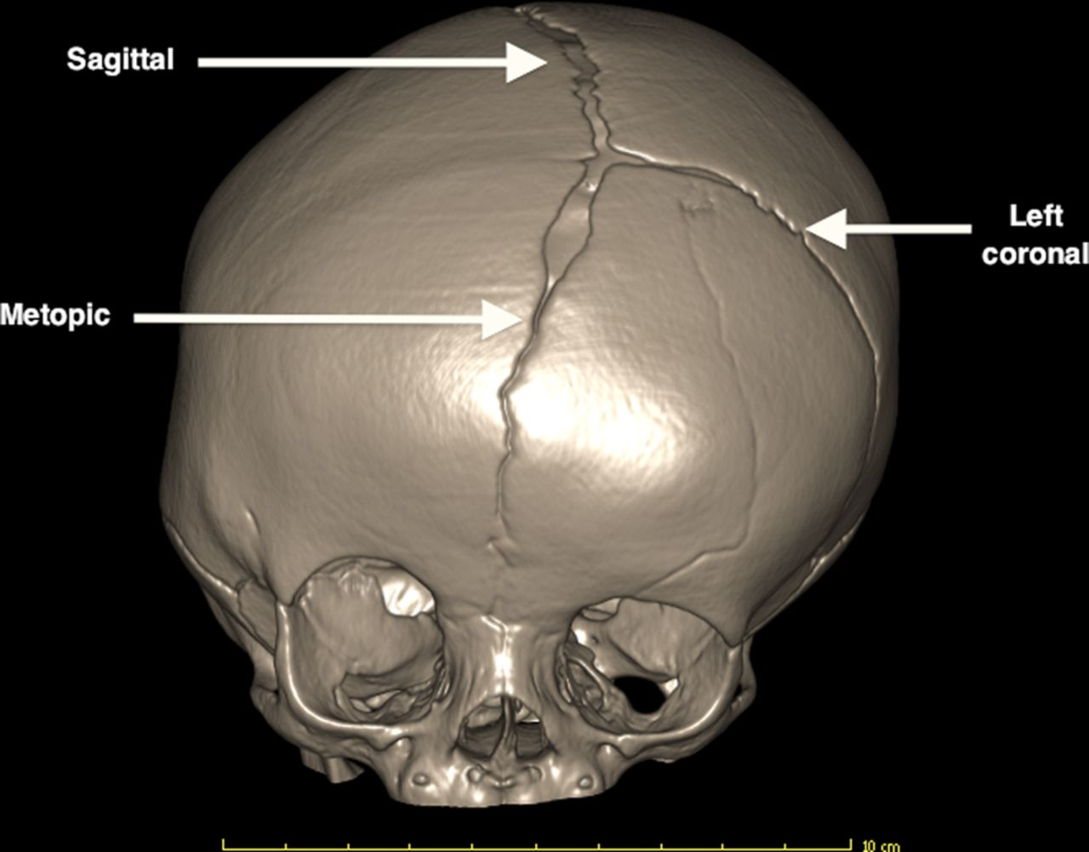

Slide 18
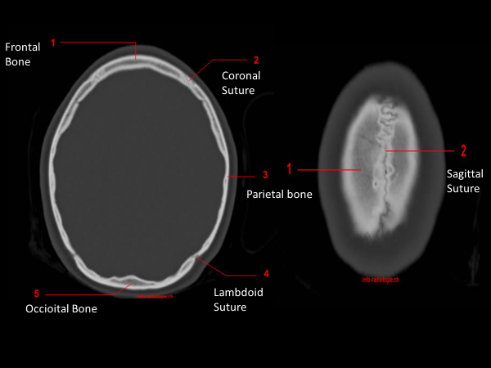

Slide 19
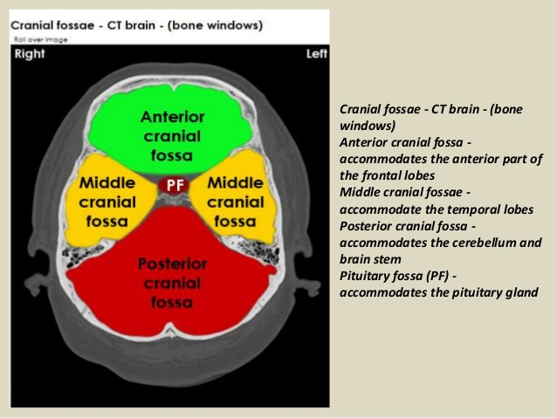

Slide 20
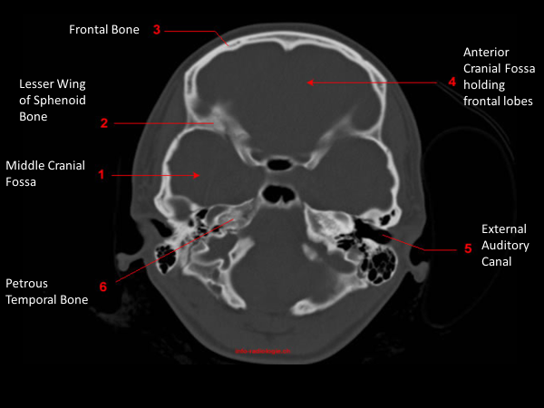

Slide 21
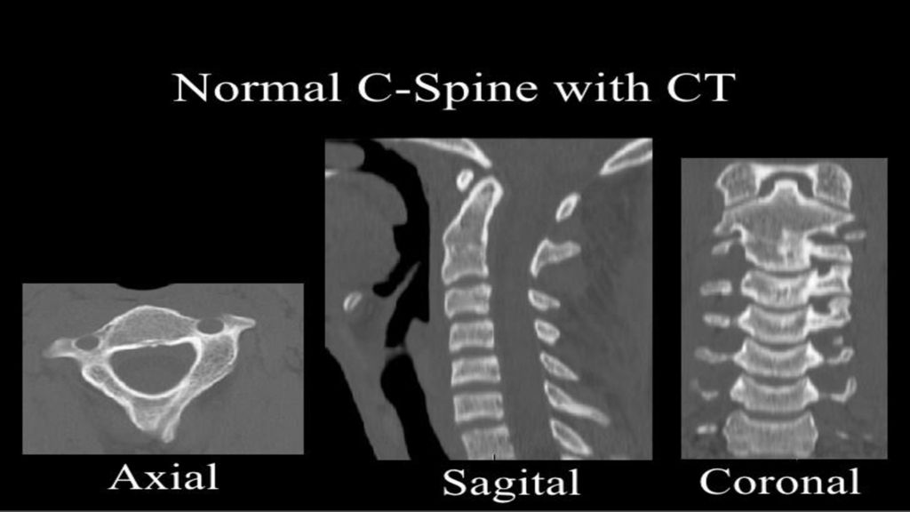

Slide 22
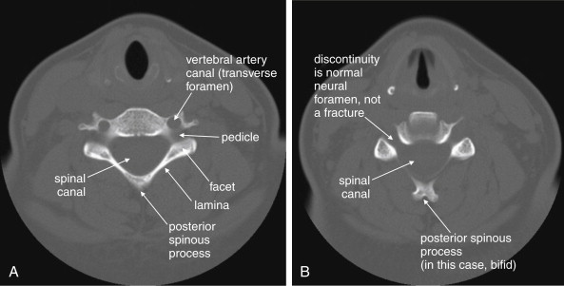
AXIAL IMAGES

Slide 23
Different Pathologies on CT
Vertical integration

Slide 24
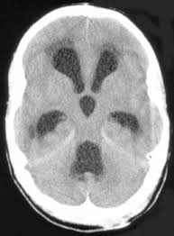
Hydrocephalus

Slide 25
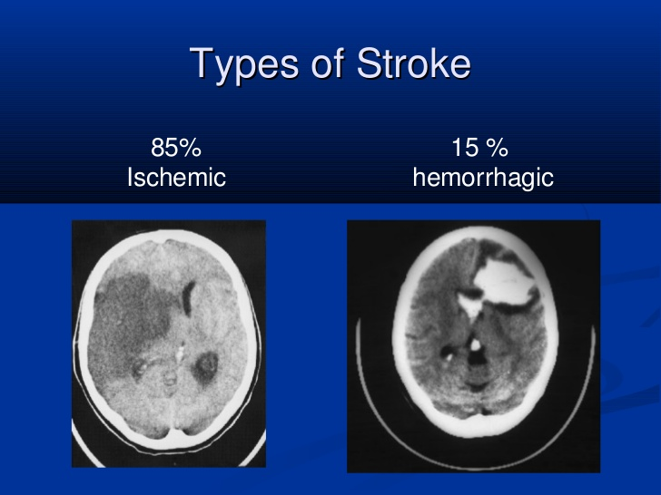

Slide 26
As a rule for ischemic infarcts best modality of choice is MRI (DWI)
First and best modality of choice for hemorrhagic stroke is CT

Slide 27
Epidural /subdural hemorrhage
Usually traumatic in origin
Subdural (concavoconvex)
  Venous bleed
  Low pressure
  Slow growth
Epidural (biconvex)
  Arterial bleed
  High pressure
  Rapid growth
Both may be life-threatening from mass effect and herniation

Slide 28
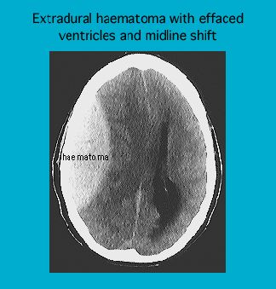
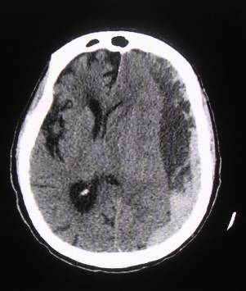

Slide 29
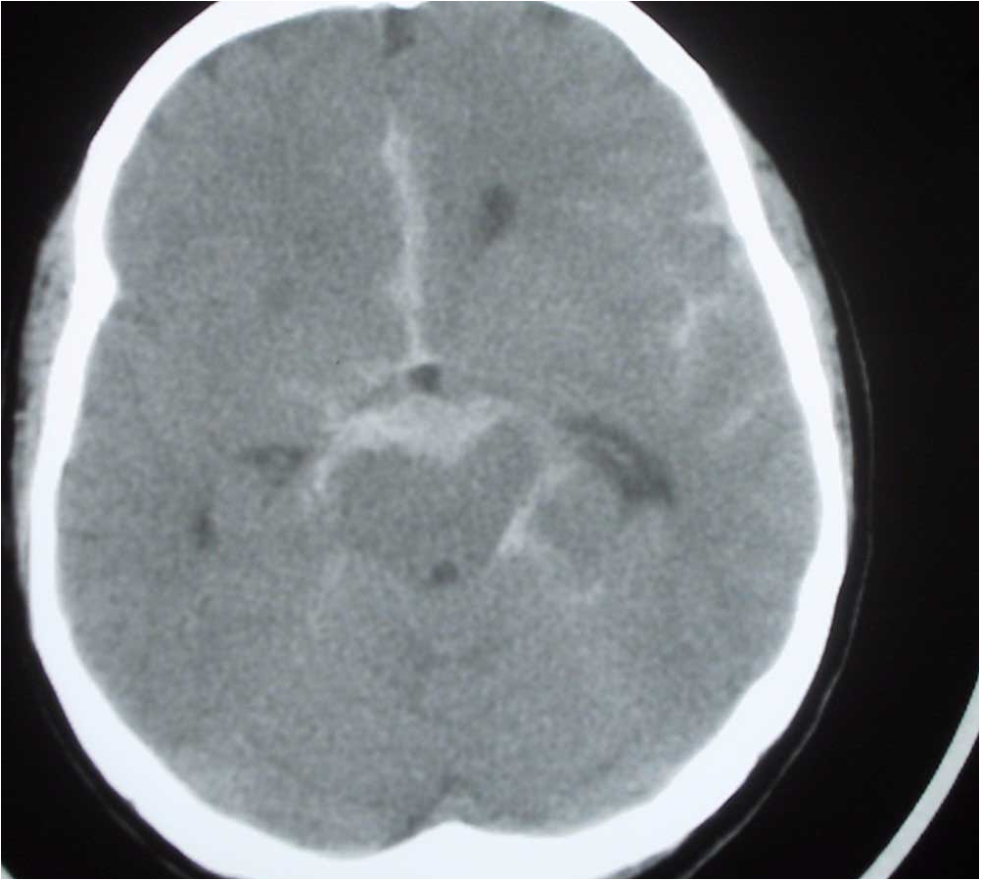
Subarachnoid bleed

Slide 30
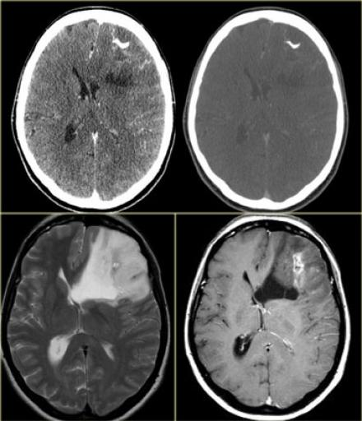
BRAIN SPACE OCCUPYING LESION

Slide 31
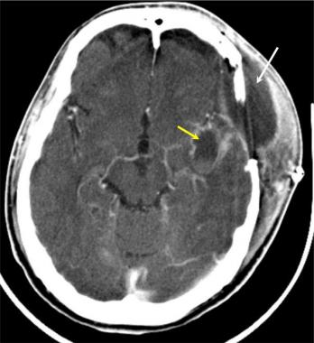
BRAIN ABCESS

Slide 32
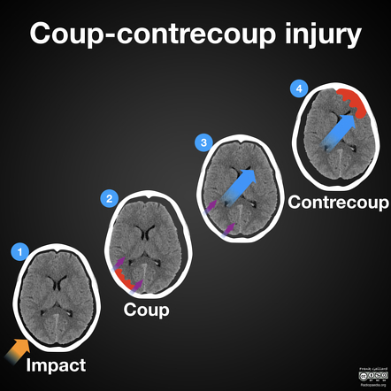

Slide 33
MRI BRAIN

Slide 34
INTRODUCTION TO MRI BRAIN
MRI (Magnetic Resonance Imaging)
An MRI scanner is actually a large, powerful magnet in which the patient lies. This powerful magnet is used to send signals to the body which interact with body protons. Then these protons in the body send magnetic signals according to their properties back to the scanner which receives these signals and forms and image with the help of computer attached to the scanner
MRI sensitization Body sensitized & magnetized body sends magnetic signals Received by MRI scanner Computer image formed from proton map

Slide 35
FAT -------------------high T1, high T2
Water / fluid-------low T1, high T2
Pathology may it be ischemia, inflammation or tumor has more fluid so they will show high T2 signal
Next we have special sequences
FLAIR: CSF fluid signal is suppressed so pathology gets prominent
DWI (diffusion weighted): detects movement free diffusion of protons. Restricted diffusion is high on DWI. Restricted diffusion seen in ischemia
Contrast enhancement: Gadolinium is given intravenously & T1W images are acquired. T1 pre & post contrast images are then assessed. Fluid in Pathology is usually low on T1 & hence if there is contrast enhancement it is better picked on T1 images.

Slide 36
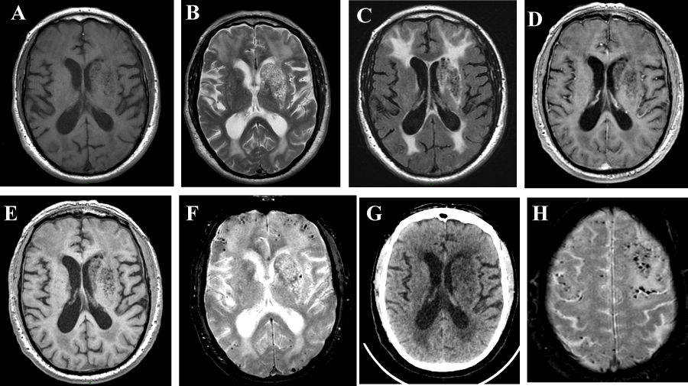
FEW IMPORTANT SEQUENCES FOR BRAIN MR IMAGING

Slide 37
ADVANTAGES OF MRI
No radiations
Multiplanar imaging (axial, sagittal , coronal or oblique) without repositioning the patient. CT can only take axial cuts and planar images are reconstructed.
MRI has superior soft tissue contrast
Advanced techniques like diffusion, perfusion & spectroscopy allow precise tissue characterization
Some angiographic imaging technique s can be performed without intravenous contrast

Slide 38
DISADVANTAGES OF MRI
Expensive
Longer acquisition time
Noise & claustrophobia
MRI not safe with some metallic implants and foreign bodies

Slide 39
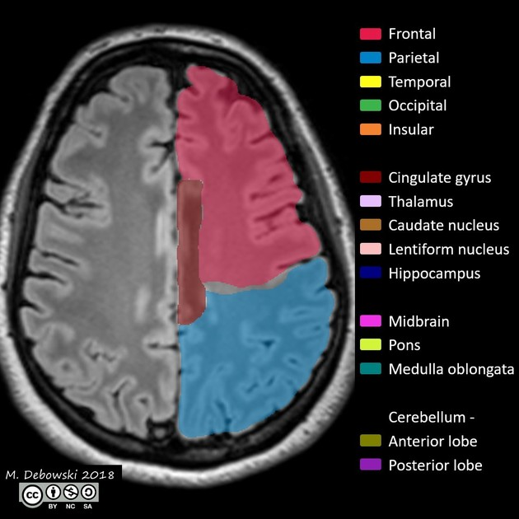
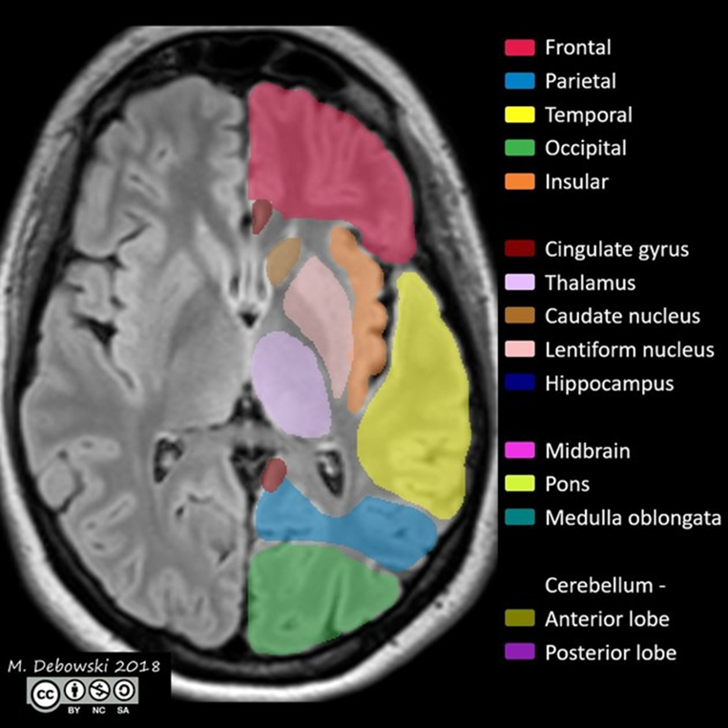
NORMAL ANATOMY
Horizontal integration

Slide 40
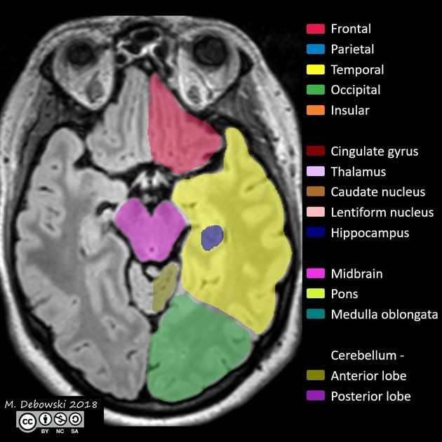
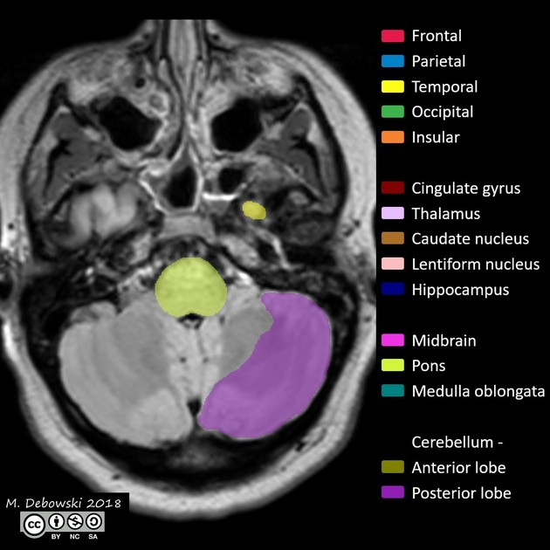

Slide 41
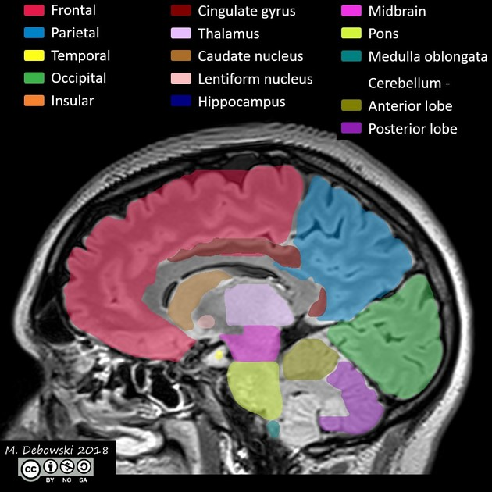

Slide 42
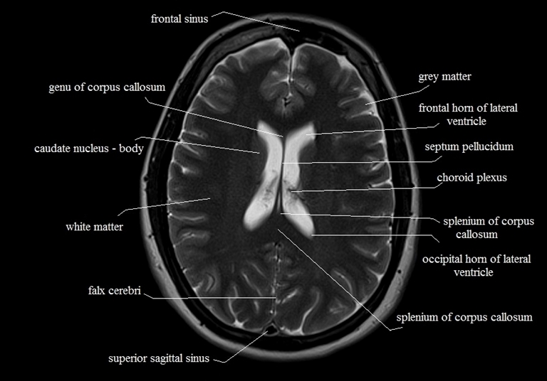

Slide 43
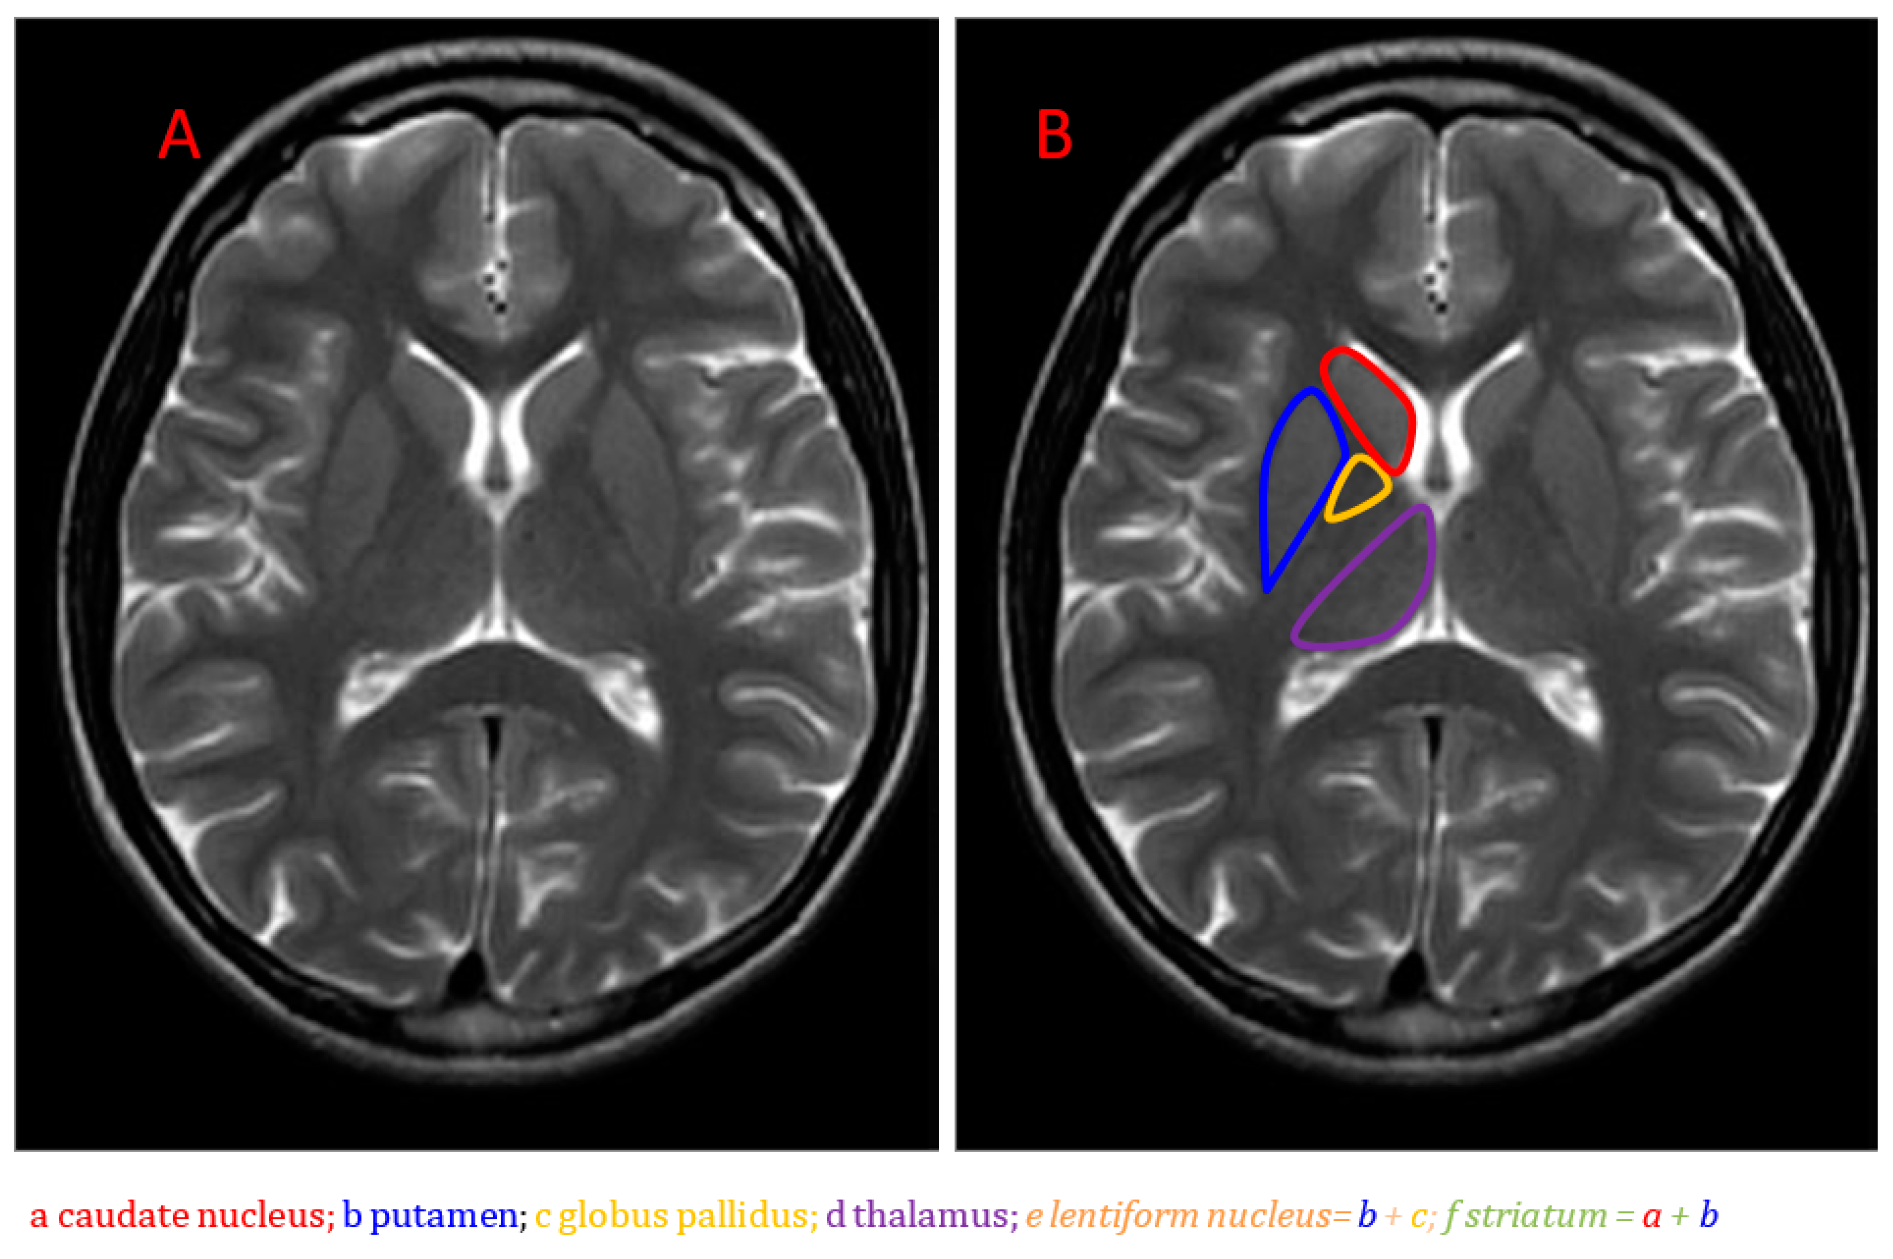

Slide 44
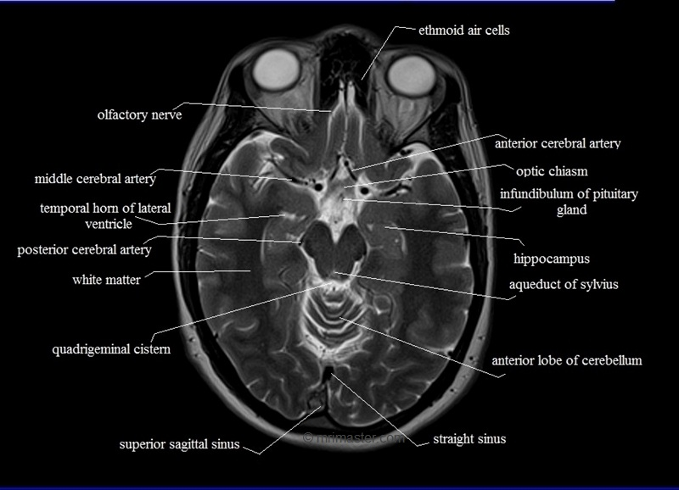

Slide 45
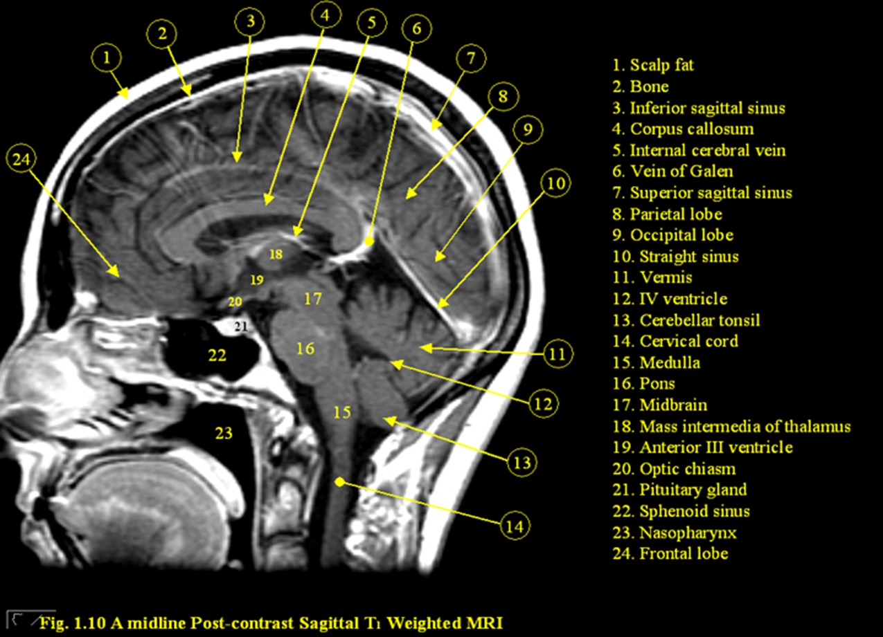
Sagittal view

Slide 46
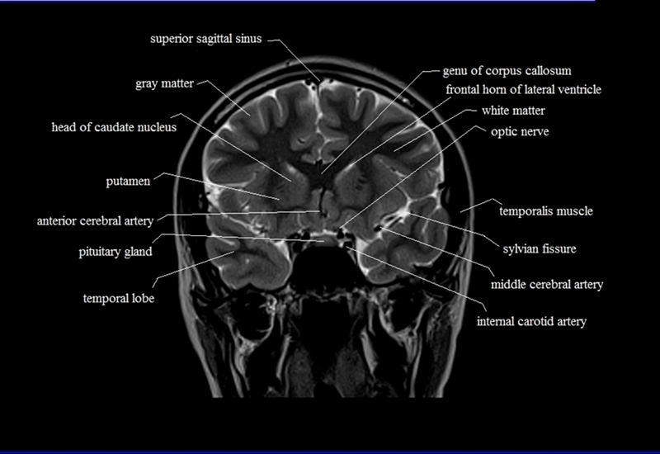

Slide 47
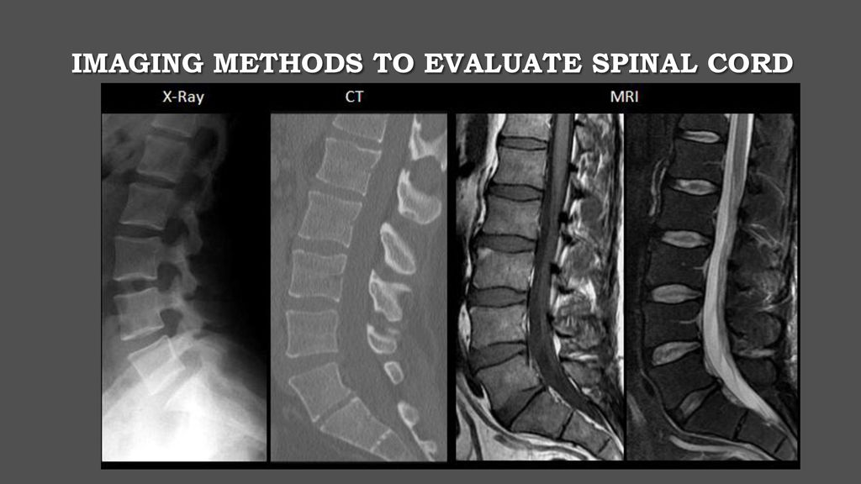

Slide 48
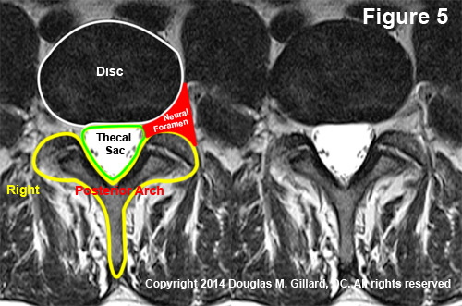

Slide 49
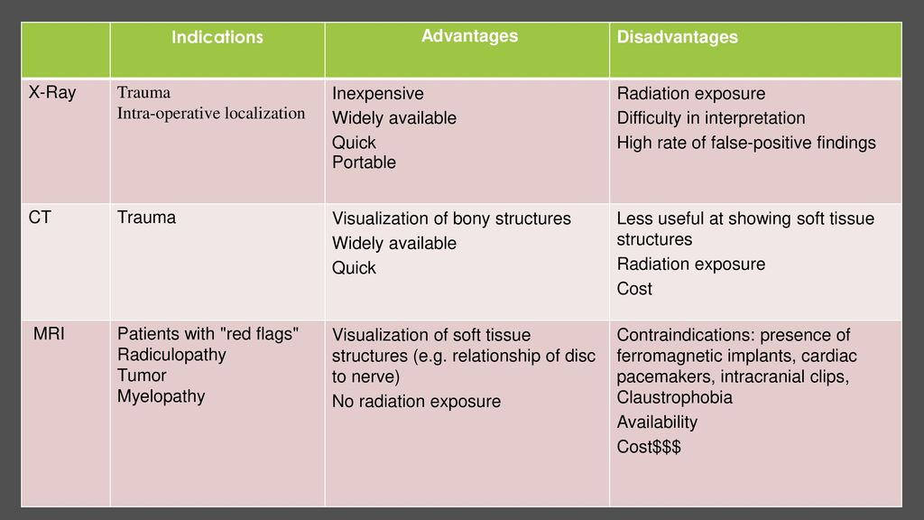
Stroke
Headache
Many others

Slide 50
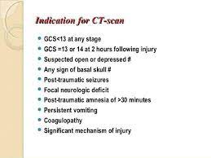
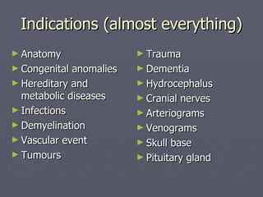
Indications
CT
MRI

Slide 51
Pathologies on MRI
Vertical integration

Slide 52
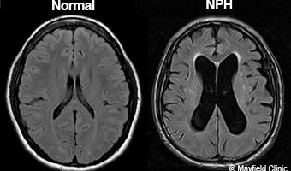

Slide 53
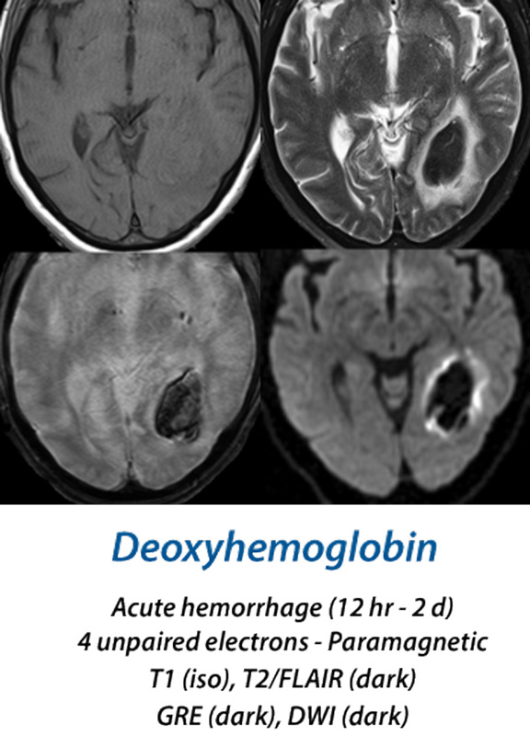

Slide 54
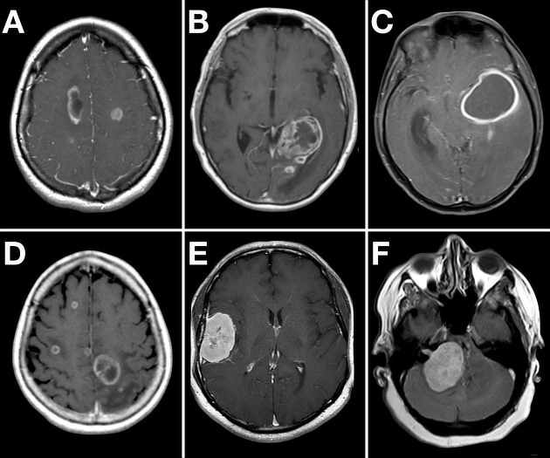

Slide 55
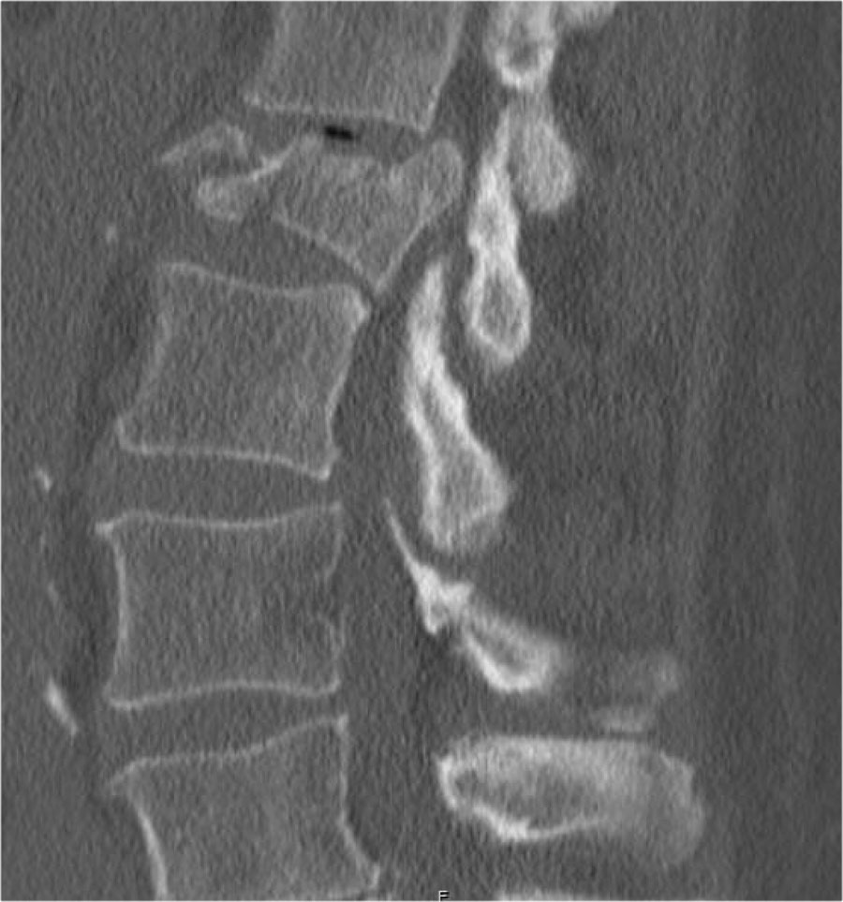

VERTEBRAL FRACRURE

Slide 56

SPINA BIFIDA CT &MRI

Slide 57


DEMYELINATING DISEASES

Slide 58


DEGENERATIVE DISEASE

Slide 59

Clinical scenario and management (vertical intregration)

Slide 60


Research articals

Slide 61


Slide 62


Slide 63



Slide 64
THANKYOU

