Slide 1
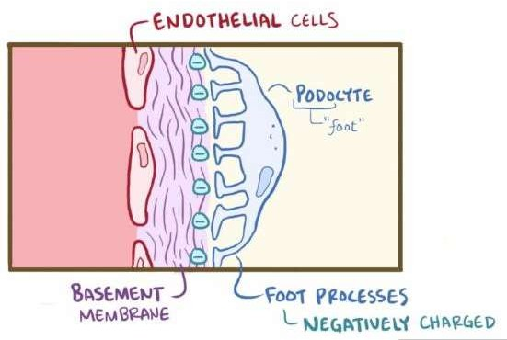
Nephrotic syndrome
Dr. Kiran Fatima
Pathology Department
Rawalpindi Medical University

Slide 4
How to use HEC digital library
Steps to access HEC digital library
Go to the website of HEC national digital library.
On home page, click on the institutes.
A page will appear showing the universities from public and private sector and other institutes which have access to hec national digital library (HNDL).

Slide 5
Select your desired Institute.
A page will appear showing the resources of the institution
Journals and Researches will appear
You can find a Journal by clicking on JOURNALS AND DATABASE and enter a keyword to search for your desired journal.

Slide 6
Learning objectives
Classify glomerular diseases
Describe the features of nephrotic syndrome
Describe, compare and distinguish the pathogenesis, clinical presentations, light microscopic features, Immunofluorescence and electron microscopic features of the glomerular diseases causing nephrotic syndrome

Slide 7
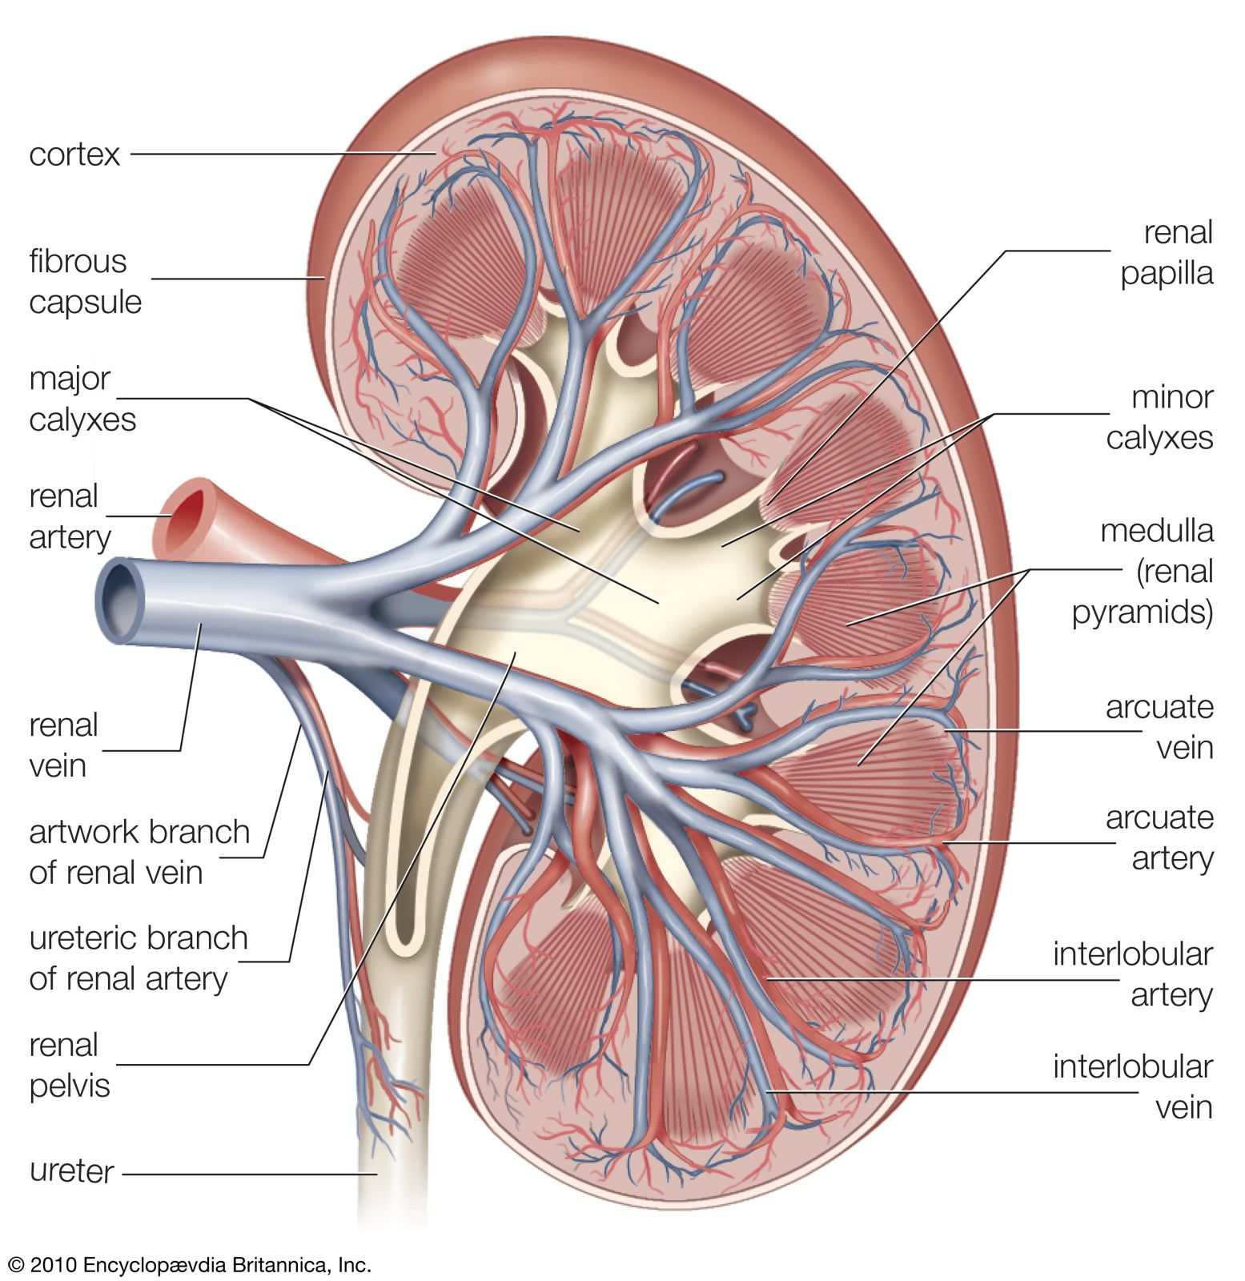
spiral

Slide 8
Causes of nephrotic syndrome
Pathology
core

Slide 9
Pathogenic mechanisms
Pathology
core
Glomerular permeability of
capillary walls
Permeability to plasma proteins- Heavy proteinuria
Increase lipoprotein
synthesis
Hyperlipidemia
Decreased S. albumin and
colloid pressure
Edema
Lipiduria

Slide 10
Secondary causes causes of nephrotic syndrome
Pathology
core
SLE (lupus nephritis)
Diabetes mellitus.
Amyloidosis
Viral infections
Malignancy
Pre-eclampsia
Some glomerulonephritis (including RPGN)
Vasculitic disorders
Miscellaneous

Slide 11
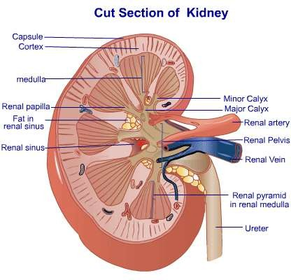
Diabetic nephropathy
Pathology
core
The kidneys are prime targets of diabetes
The lesions include mainly:
(1) glomerular lesions;
(2) renal vascular lesions, principally arteriolosclerosis
(3) pyelonephritis, including necrotizing papillitis.

Slide 12
Diabetic nephropathy
Pathology
core
Glomerular lesions
Capillary basement membrane thickening
Nodular glomerulosclerosis
Diffuse mesangial sclerosis

Slide 13
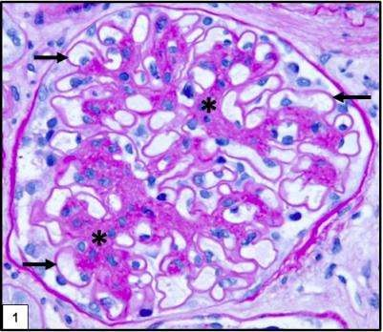
Diabetic nephropathy
Pathology
core
1. Capillary basement membrane thickening
Renal glomerulus showing markedly thickened glomerular basement membrane

Slide 14
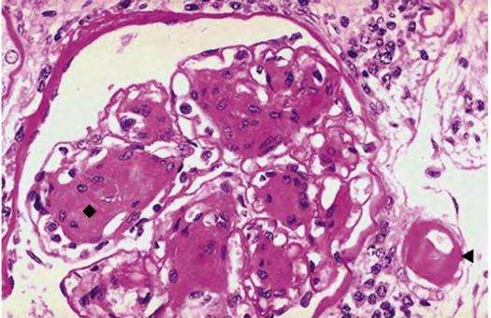
Diabetic nephropathy
Pathology
core
2. Nodular glomerulosclerosis
(Kimmelstiel-Wilson lesion)
Characterized by nodules of pink hyaline material that form in mesangial regions between glomerular capillary loops.
Caused by a marked increase in mesangial matrix
Markedly thickened arteriole at the lower right, which is typical of hyaline arteriolosclerosis seen in diabetic kidneys.

Slide 15
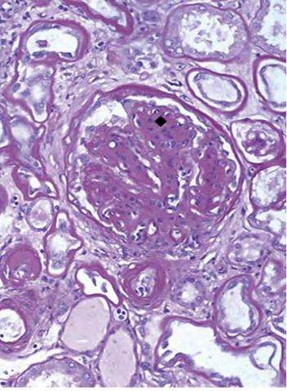
Diabetic nephropathy
Pathology
core
3. Diffuse mesangial sclerosis
Increase in mesangial matrix and mesangial cell proliferation and basement membrane thickening.

Slide 16
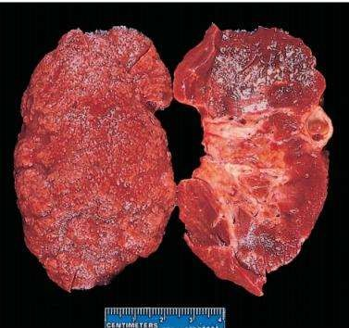
Diabetic nephropathy
Pathology
core
Both the diffuse and the nodular forms of glomerulosclerosis induce sufficient ischemia to cause scarring of the kidneys
Nephrosclerosis manifested by a finely granular–appearing cortical surface.
On sectioning there is marked thinning of the cortex.
Additional features seen here are some irregular depressions, the result of pyelonephritis

Slide 17
Amyloidosis
Pathology
core
Extracellular deposition of misfolded proteins that aggregate to form insoluble fibrils.
Results in tissue damage and functional compromise
Glomerular disease : deposition of amyloid in mesangium , capillary walls and in interstitium.
Causes:
Excessive production or mutations of proteins that are prone to misfolding
and aggregation
Defective or incomplete proteolytic degradation of extracellular proteins.

Slide 18
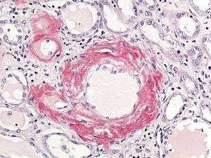
Renal amyloidosi s
core
LM-
Homogenous, smudgy deposits,
Congo red birefringence is most specific for diagnosis .
Faintly PAS positive Silver stain - negative.

Slide 19
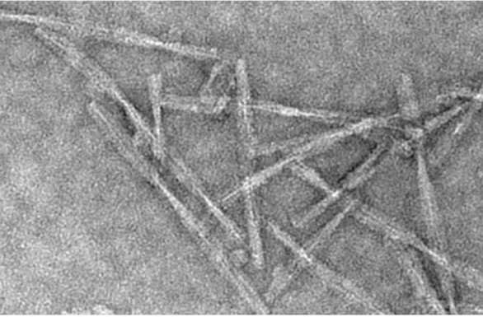
Amyloidosis electron microscopy
Pathology
core
EM-
Randomly arranged non- branching 7.5-10 nm fibrils

Slide 20
Lupus nephritis
Pathology
core
SLE is an autoimmune disease with systemic manifestations
Renal involvement in SLE: 100 %
Clinical manifestations: 50 – 70 % of patients
F:M ratio 10:1 CLINICAL PRESENTATION
microscopic hematuria
proteinuria (according to stage /class) of disease.

Slide 21
Longitudinal

Slide 22
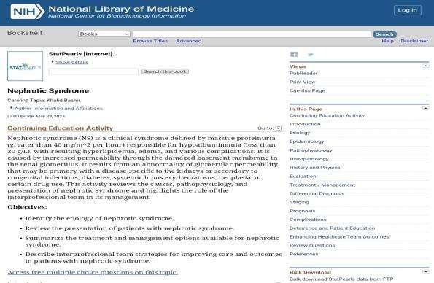
Longitudinal
Research
https://www.ncbi.nlm.nih.gov/books/NBK470444/

Slide 23
Longitudinal
Family medicine
A 7-year-old boy is brought to the clinic with complaints of generalized swelling, particularly around his eyes and ankles. His parents report that his urine has become frothy. Urinalysis reveals massive proteinuria (>3.5g/day), and blood tests show hypoalbuminemia and hyperlipidemia. He does not have a history of recent infections or hypertension. The child responds well to corticosteroid therapy.
What is the most likely underlying diagnosis?
A. Focal segmental glomerulosclerosis (fsgs)
Minimal change disease
Membranous nephropathy
Iga nephropathy
Post-streptococcal glomerulonephritis
Answer: B. Minimal change disease

Slide 24
Take home massage
Nephrotic syndrome is characterized by heavy proteinuria (>3.5g/day), hypoalbuminemia, hyperlipidemia, and generalized edema.
It results from increased glomerular permeability, commonly due to diseases like minimal change disease, membranous nephropathy, or focal segmental glomerulosclerosis.
Treatment involves managing the underlying cause, reducing protein loss (via corticosteroids or immunosuppressants), and addressing complications such as edema and hyperlipidemia.

