Slide 1
Chronic Non-Communicable diseases (NCDs) (Coronary heart disease & Hypertension) Module-III (Endocrinology) Dr. Sana Bilal, Dr. Imrana Saeed
Department of Community Medicine RMU -2024

Slide 3
Vision & Mission of RMU
Wisdom
Truth
Service
Vision
Highly recognized and accredited center of excellence in Medical Education, using evidence-based training techniques for development of highly competent health professionals, who are lifelong experiential learner and are socially accountable.
Mission Statement
To impart evidence-based research-oriented health professional education in order to provide best possible patient care and inculcate the values of mutual respect, ethical practice of healthcare and social accountability.

Slide 4
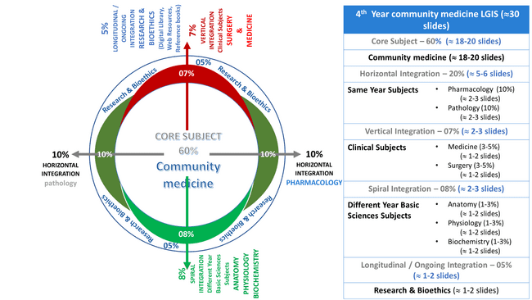
Prof Umar model

Slide 5
Gist of the contents of the Session
Statement of learning outcomes (01 slide)
Order & Components of the teaching material (PPT)
Core subject ( contains throughout relevant clinical contents) ( 28 slides)
Research pertinent to enhance understanding o the subjects (02 slides)
Family Medicine : pertinent case (01 slides)
End o the session relevant assessments ( 01 slides)
Suggested reading and additional readings ( 01 slide)

Slide 6
Learning Objectives
At the end of this session students should be able to;
Explain criteria of Chronic Non-Communicable diseases. (NCDs)
Appraise the burden of NCDs in inter- & national context.
Describe list of major NCDs of the region.
Describe common Risk Factors of NCDs.
Explain gaps in knowledge in natural history of NCDs & General preventive approaches
Explain epidemiology, prevention & control strategies for cardiovascular diseases (CHDs)
Explain epidemiology, prevention & control strategies for Hypertension
Explain rules of halves & tracking of Blood Pressure strategy (hypertension)

Slide 7
Chronic Non-Communicable Disease (NCD)
Core Content
4
Commission on chronic illness USA defined Chronic Diseases
“ as comprising all impairments or deviations from normal, which have one or more of following characteristics:
permanent
leave residual disability
have slow onset
multi-factorial causation
non-reversible pathological alteration
Requires special training of patient for rehabilitation
long period of supervision, observation or care

Slide 8
NCDs Facts Sheet
Core Content
5
Major cause of morbidity & mortality in both developed and developing countries. (CVDs, Cancers). Adult age / working pop.
NCDs are showing upward trends (lifestyle & behavioral patterns, aging of population, modern medical care etc)
Alarming trend for Developing countries. (economic impact)
shares > 60% of Global deaths (36M) (projected 52M in year 2030)
Cardiovascular diseases: >48%
Cancers > 21%
Future Threat: mortality expected to rise by 5 times higher than to communicable in developing countries
Preventability: 80% for Cardiovascular diseases and type II Diabetes and 40% cancers are preventable

Slide 9
Major Risk Factors of NCDs
Core Content
Tobacco: Smoking is responsible for:
Lung cancer by 71%
Chronic Respiratory diseases by 42%
Cardiovascular diseases by 10%
Insufficient physical inactivity.
20-30% higher risk of all cause mortality.
Unhealthy diet:
Use of fruit & vegetables reduces risk of CVD, DM, stomach & colorectal cancer.
High Salt intake increases risk of CVDs, HTN etc
Fats: (fast foods) saturated fats and trans fatty acid fats
High Blood Pressure:
high relevance with cardiovascular diseases.

Slide 10
Major Risk Factors of NCDs
Core Content
5. Overweight & Obesity:
Heart diseases, DM, Stroke & certain Cancers
6. Raised cholesterol:
Highest prevalence in high-income countries.
7. Cancer associated infections:
Human Papilloma virus (HPV) ,Hep-B Virus
8. Harmful use of Alcohol.
9. Environment risk factors
Occupational hazards (mesothelioma, scrotal cancers )
Air pollution ( Asthma)
10. Mental Stress
Hep-C virus, Helicobacter pylori

Slide 11
What would be precise determinants of NCDs (These Gaps in knowledge are challenging and demands scientific inquiry)
Absence of a known agent.
this makes both diagnosis & specific prevention difficult
Multifactorial causation.
One to one cause-effect relationship don’t exist
Most NCDs results form multiplicity of the risk factors (cumulative effects)
Long latent period
Long latent period- makes difficult to link the specific cause.
Indefinite onset
Most are slow in onset and progress
Some time disease and non-diseases states are blurred (DM, HTN)

Slide 12
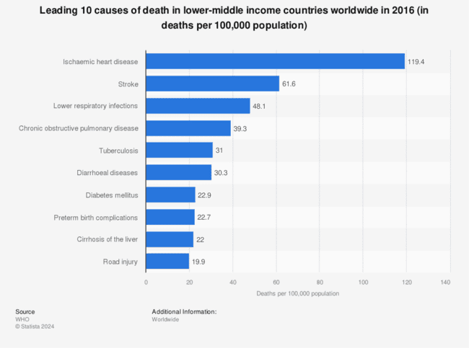
Core Content

Slide 13
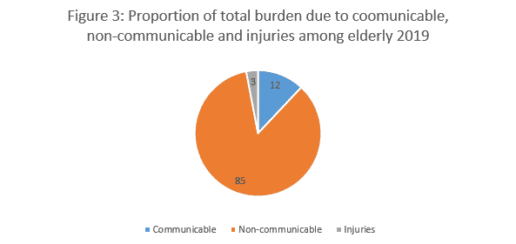
Core Content
https://pide.org.pk/research/burden-of-diseases-among-elderly-in-pakistan/

Slide 14
Prevention & Control approaches to NCDs
Core Content
Primary prevention
(most effective)
Educational approach
Regulatory approach
Service approach
Integrated approach
Primordial Prevention
Primary Prevention
Health Promotion
Specific Protection
Secondary Prevention
Early Diagnosis & Treatment
Tertiary Prevention
Disability Limitation
Rehabilitation
Integrated Approach
The STEPS NCDs risk factors surveillance survey” by WHO. To have information to plan actions
Questionnaires (demographics)
Physical assessment
Biochemical assessment
WHO Global Action Plan for the Prevention and Control of NCDs (2013-2020)
2030 Agenda for Sustainable Development (SDGs)
Preventive Health Inquiry (PHI)
Practical Journal Assignment

Slide 15
Cardiovascular Diseases (CVDs)
14
Core Content
group of diseases of heart and vascular system.
CHDs, HTN, Stroke, RHDs
Coronary Heart Diseases (or IHD) : the impairment of heart function due to inadequate blood flow to the heart compared to its needs, caused by obstructive changes in the coronary circulation to the heart.
Modern Epidemic. (50% of NCDs death)
Coronary Heart Diseases
Angina Pectoris
Myocardial infarction
Irregularities of the Heart
Cardiac Failure
Sudden Death

Slide 16
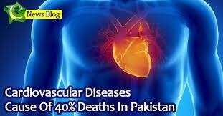
Core Content
17

Slide 17
Cellular mechanism of atherosclerosis
Horizontal integration

Slide 18
Statistical measures of CHDs
18
Core Content
Proportional mortality ratio
Loss of life expectancy. (If all CHDs removed, gain can be 3.4 to 9.4 years)
CHD incidence rate.
Age specific death rate for CHDs
CHD-Prevalence rate. (may based on ECG findings)
Case fatality rate. (proportion of attacks that were fatal in within 28 days of onset of CHD)
Measurement of risk factor level. (cigarette smoking, serum Cholesterol levels)
Medical care. ( proportion of med care for CHDs)

Slide 19
Risk factors of CHDs
Diabetes Mellitus
Obesity.
Oral Contraceptives
Assoc with high BP in women
Hormones
Low Estrogen level
20
Modifiable
Tobacco smoking.
Responsible for 25% CHD deaths U65Y
Degree of risk correlates with no. of cigarettes smoked per day.
On cessation of smoking risk of death with CHD declines in first year, gradually thereafter, almost as for non-smokers after 10-20years.
High blood pressure
Single useful predictor of CHD
Elevated serum cholesterol
220mg/dl may be taken as threshold level.
HDL >40mg/dl found protective from CHD
Cho-/HDL ratio: >3.5 is clinical goal for prevention of CHD
Core Content
Non-Modifiable
Age: with increasing age
Gender: male
Family History:
Genetic Factors
Personality Type-A
Previous cardio vascular events

Slide 20
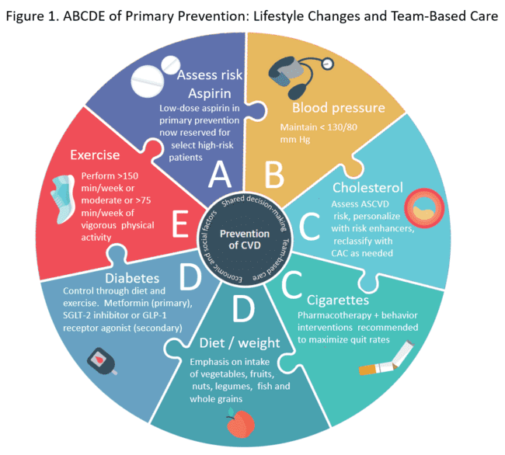
Core Content
https://www.acc.org/latest-in-cardiology/articles/2019/03/21/14/39/abcs-of-primary-cv-prevention-2019-update-gl-prevention

Slide 21
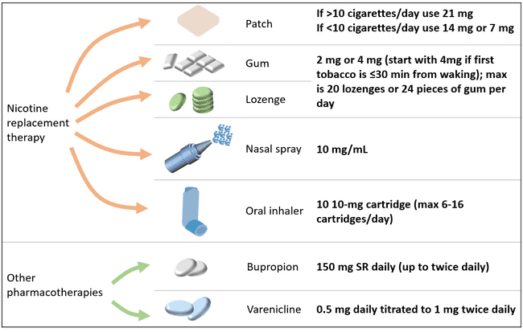
Vertical integration
https://www.acc.org/latest-in-cardiology/articles/2019/03/21/14/39/abcs-of-primary-cv-prevention-2019-update-gl-prevention

Slide 22
Prevention of CHD
Core Content
Primary Prevention: (WHO Expert committee recommendations)
Population Strategy (prevention in whole population)
Specific I interventions
Dietary Changes
Limit daily fat intake to 20-30% of the daily caloric need
Limit Saturated fats >10% of daily caloric intake
Limit dietary cholesterol intake below 100mg per 1000 kcal per day
Added Salt less than 5gm /day
Add complex carbs (whole grain, fruit & vegetables)
Smoking . Smoke free society
Blood Pressure. Goal is to reduce mean BP
Physical Activity.
Primordial Prevention in whole population: prevention of emergence and spread of RFs of CHD & lifestyles that yet have not become endemic (Holistic)
High Risk strategy.
Identification of high-risk groups
Risk specific advice
Secondary Prevention:
Aim is to prevent recurrence and progression of CHDs
Therapeutics
Surgical interventions
Devices / new techs

Slide 23
Hypertension
Core Content
General Classification
Primary (Essential) – 90%
Secondary – 10%
Category | Systolic Blood Pressure (mm of hg) | Diastolic Blood Pressure (mm of hg)
Normal | <120 | <80
Pre-hypertension | 120-139 | 80-90
Hypertension
Stage I (mild) | 140-159 | 90-99
Stage II (moderate) | 160-179 | 100-109
Stage III (severe) | >180 | >110

Slide 24
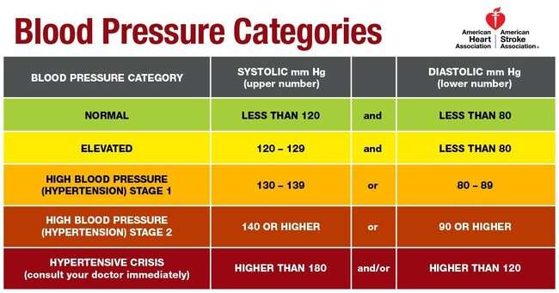
27
Vertical integration

Slide 25
Risk Factors of Hypertension
Core Content
Age: BP rises with age
Gender: variable. Postmenopausal women may have high BP (Estrogen >)
Genetics: In both hypertensive parents: 45% chances of HTN in children as compared to only 3% in both normotensive parents.
Obesity:
Salt intake: high salt intake
Saturated Fats
Alcohol intake
Decreased Physical activity
Stress: ( increase in nor-adrenaline).
Socioeconomic factors:
Other factors: OCPs (oestrogen)

Slide 26
Prevention & Control measures
Core Content
HTN is preventable condition
WHO recommendations
Primary Prevention:
Population strategy: (regardless of level of risk)
High Risk Strategy
Secondary Prevention:
Early detection & treatment
Rule of halves

Slide 27
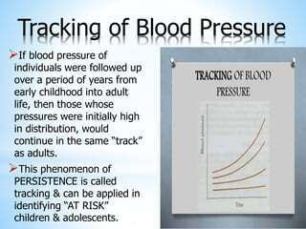
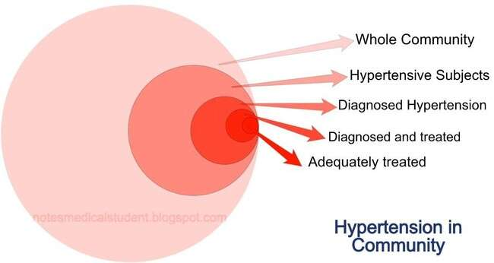
Prevention of Hypertension
30
Iceberg phenomenon of Hypertension in the community
(Rules of Halves)
Core Content

Slide 28
Research
. 2022 Nov 30;28(11):798-804. doi: 10.26719/emhj.22.083.
Burden of noncommunicable diseases in Pakistan
Tahseen Kazmi ¹, Mlf Nagi ², Shama Razzaq ³, Shamaila Hussnain ¹, Noor Shahid ¹, Unsa Athar ²
Results:
Demographics: Most of the respondents were women (64.5%). The greatest proportion of the participants were aged 30-39 years (42.4%).
NCDs Prevalence: Of all the respondents, 40.1% had hypertension, 15.8% had diabetes and 17.0% had ischaemic heart disease.
Risk factors prevalence: Of the risk factors examined, 68.8% of the respondents were overweight or obese, 37.0% had pre-hypertension, 13.6% used tobacco, and 1.8% used alcohol.
https://pubmed.ncbi.nlm.nih.gov/36515443/#:~:text=Of%20all%20the%20respondents%2C%2040.1,%2C%20and%201.8%25%20used%20alcohol.

Slide 29
artificial intelligence

Slide 30
Quiz : Role of family physician
Family Medicine
A family physician was visited by bank officer for his advice on his health condition. Patient was hypertensive and overweight. The family physician in addition to medical management gave dietary advice as:
To restrict his total fats intake less than 30% of caloric intake
To prefer diet which is rich in trans-fatty acids.
To avoid dietary fats which contains apolipoprotein-A-1.
To restrict total daily added salt intake less than 5gm.
To prefer dietary fats rich in low density lipoproteins.

Slide 31
Reading sources:
Primary (recommended textbooks)
J Parks textbook of Preventive & social Medicine. Ch.6 Pages 363 - 377( 26th edition)
Textbook of Community Medicine & Public Health. By Muhammad Illyas , Dr Irfanullah Siddiqui (latest edition)
Additional readings
WHO NCDs facts sheets for Pakistan.
https://www.who.int/publications/m/item/hypertension-pak-country-profile-pakistan-2020

