Slide 1
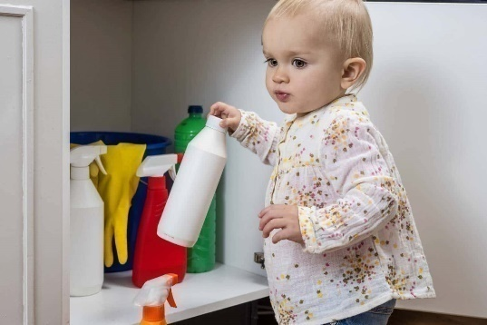
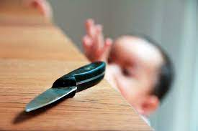
Non-communicable Diseases BLOCK II- Ophthalmology Block
(Blindness & Accidents, Injuries)
Dr. Imrana Saeed APMO
Dr. Asif Maqsood Butt Sr Demonstrator

Slide 2
Vision & Mission of RMU
Wisdom
Truth
Service
To impart evidence based research oriented medical education
To provide best possible patient care
To inculcate the values of mutual respect and ethical practice of medicine

Slide 3
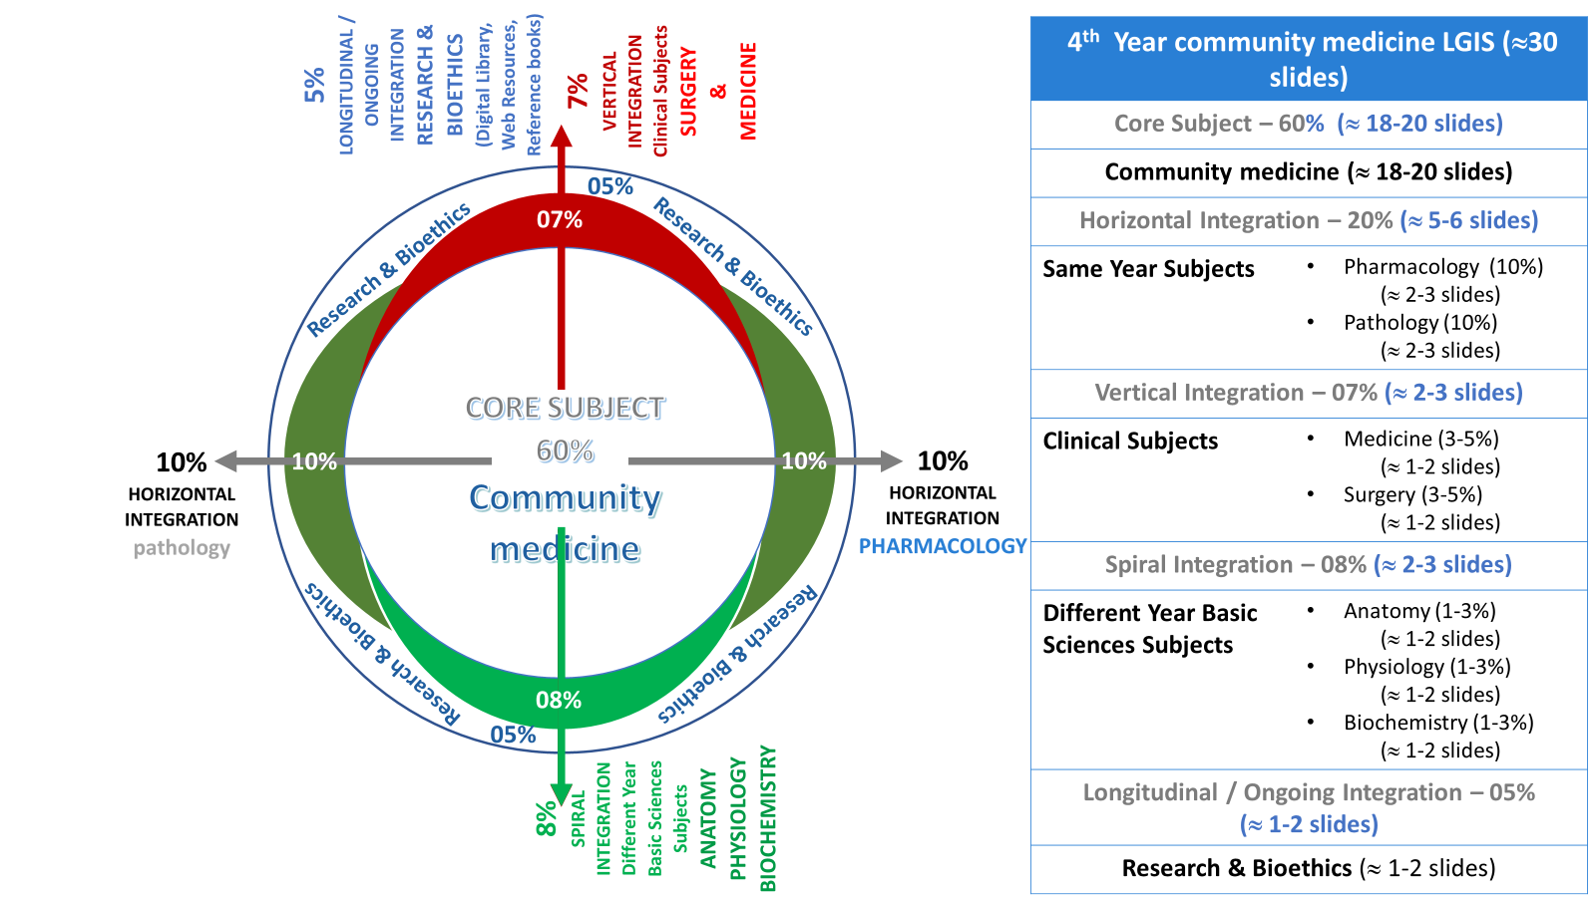
Prof Umar model

Slide 4
Learning Objectives
Describe epidemiology of blindness
Describe patterns of preventable blindness in the community
Recommend approaches to prevention of blindness in the community
Categorize different types of accidents
Describe risk factors involved in accidents
Recommend different preventive strategies for accident controls
Categorize different types of accidents
Describe risk factors involved in accidents
Recommend different preventive strategies for accident controls

Slide 5
Lecture Sequence
SLIDE TITLE | SLIDE No | SLIDE TITLE | SLIDE No
Problem Statement | 06 | ACCIDENTS AND INJURIES | 17
Blindness And Vision Impairment | 07 | RTA PROBLEM STATEMENT | 18
Global Causes Of Blindness | 08 | Risk factors RTA | 19
Epidemiological Determinants | 09 | RTA prevention | 20
Relationship With General Health | 10 | Domestic accidents | 21
Community Ophthalmology | 11 | Drowning | 22
Newer Interventions | 12 | Burns / Falls / Poisoning | 23-27
Specific Programs | 15 | Assessment | 28
Vision 2020 | 15 | Research Ethics , family medicine | 29-31

Slide 6
Blindness--problem statement
According to world health organization, Globally, at least 2.2 billion people have a near or distance vision impairment.
In at least 1 billion – or almost half – of these cases, vision impairment could have been prevented or has yet to be addressed.
Notes:
https://www.who.int/news-room/fact-sheets/detail/blindness-and-visual-impairment

Slide 7
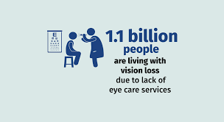
Global Causes Of Blindness
Nearly 82 percent of the people who are visually impaired are 50 years and older which is roughly 20% of world population
19 million children are visually impaired of these 12 million children are visually impaired due to refractive errors
CORE CONCEPTS
Unaddressed refractive error | Cataract | Glaucoma | Corneal opacities | Diabetic retinopathy | Trachoma | Presbyopia
88.4 million | 94 million | 7.7 million | 4.2 million | 3.9 million | 2 million | 826 million
Notes:
https://www.who.int/news-room/fact-sheets/detail/blindness-and-visual-impairment

Slide 8
Epidemiological Determinants
Age
Sex
Malnutrition
Occupation
Social class
Social factors
CORE CONCEPTS
Notes:
https://www.cdc.gov/visionhealth/basics/ced/index.html#:~:text=The%20leading%20causes%20of%20blindness,disorders%20include%20amblyopia%20and%20strabismus.

Slide 9
Relationship With General Health
Malnutrition
Vitamin A Deficiency Manifestation
Xerophthalmia , Corneal Ulcers
Chronic Diseases : Diabetic Retinopathy
Accidents And Trauma : Cornea Trauma
Congenital Causes
CORE CONCEPTS

Slide 10
Blindness And Vision Impairment
Category | Worse than | Better than
Mild or no impairment |  | 6/18
Moderate impairment | 6/18 | 6/60
Severe impairment | 6/60 | 3/60
Blindness | 3/60 | 1/60
Blindness | 1/60 | Light perception
Blindness | No light perception
larger the second number worse the vision. Normal vision is 6/6
Horizontal integration

Slide 11
Community Ophthalmology
Eye health care workers
Eye health care educators
Ophthalmic assistants were trained to work at village or door to door level
Worked in the community level
giving eye care , health education
The idea was incorporated to address high level of blindness
It incorporated community level intervention
Public health interventions together with ophthalmology care

Slide 12
Newer Interventions
Primary Eye Care
Epidemiological Approach
Team Concept
Establishment Of National Programs
CORE CONCEPTS

Slide 13
Primary Eye Care(health education& specific protection )
Secondary Care (early diagnosis & prompt treatment)
To prevent disease to before occurrence
Health Education
Trained Health Care Workers to
Promote Personal Health & hygiene
specific protection
Vit A drops
Immunization for rubella& measles
To prevent loss of vision from established disease
Correction of refractive errors
Definitive treatment for Cataract, glaucoma ocular trauma
Mobile eye clinics & eye camp approach
Horizontal integration
Tertiary care(Disability limitation & rehabilitation)
Examples
Cataract - surgery
Corneal scaring -keratoplasty
Low vision - vision aids

Slide 15
Specific Programs
Trachoma control program
School health services
Vitamin A prophylaxis
Occupational health services
CORE CONCEPTS

Slide 16
Accidents And Injuries
CORE CONCEPTS

Slide 17
Road Traffic Accident (Problem Statement)
Every year around 1.4 millions people die of road traffic accidents apart from fatal and serious injuries requiring medical care and treatment.
01
Rates are higher in young age group. under 25 years accounts for 30% killed and injured in road traffic accidents.
02
46% of those dying on roads are vulnerable groups pedestrians, cyclists motorists
03
More than 90% deaths from RTAs happen in low and middle income countries
04
STATISTICS

Slide 18
Risk Factors
Motorcyclists helmets: reduce risk of death by 40% and risk of severe injury by 70%
Seat belts : reduces risk of fatality in front seat passengers by 40-50% and rear seat passengers by 25-75%
Drink driving : Increased risk with blood alcohol levels of 0.04gm/dl
Speed: Pedestrians have 90% chance of surviving a car crash at speed less than 30km/hour
30 km /h traffic zones, school residential areas can reduce crashes

Slide 19
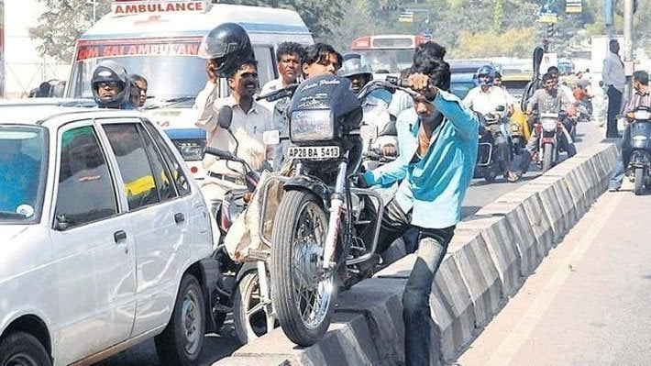
Prevention
CORE CONCEPTS
Data collection
Safety education
Promotion of safety measures
Alcohol and drugs
Primary care
Elimination of causative factors
Enforcement of laws
Rehabilitation services
Accident research

Slide 20
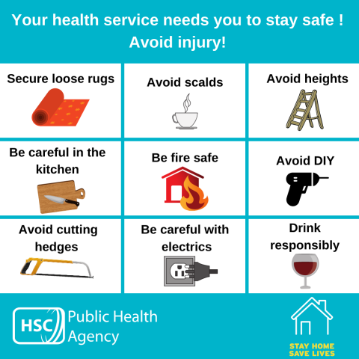
Domestic Accidents
Drowning
Burns
Falls
Poisoning
Injuries from sharps and instrument
Bites injuries from animals
CORE CONCEPTS
Notes:
BURN FIRST AID & INITIAL MANAGEMENT جلنا، ابتدائی طبی امداد اور ابتدائی علاج https://youtu.be/5igORQozarI

Slide 21
Drowning
CORE CONCEPTS
Prevention
Risk Factors
Age
Gender
Access to water
Others
Infants left unsupervised
Unsafe or overcrowded
Alcohol use
Medical conditions
Tourist
Floods etc
Engineering methods
Safe water system
Pool fences or barriers
Safe water zone
Covering of wells
Emptying buckets & baths
Laws & regulations
Community awareness

Slide 22
Burns
Hot liquids, hot solids & flame
Risk factors
Age
Gender
Socioeconomic
Occupations
Alcohol abuse and smoking
Lack of awareness
unsafe handling of chemicals
CORE CONCEPTS

Slide 23
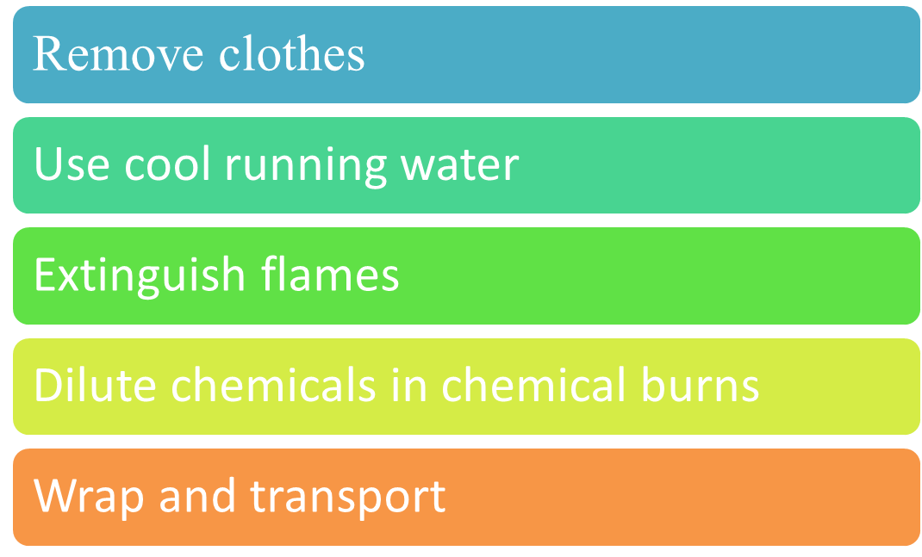
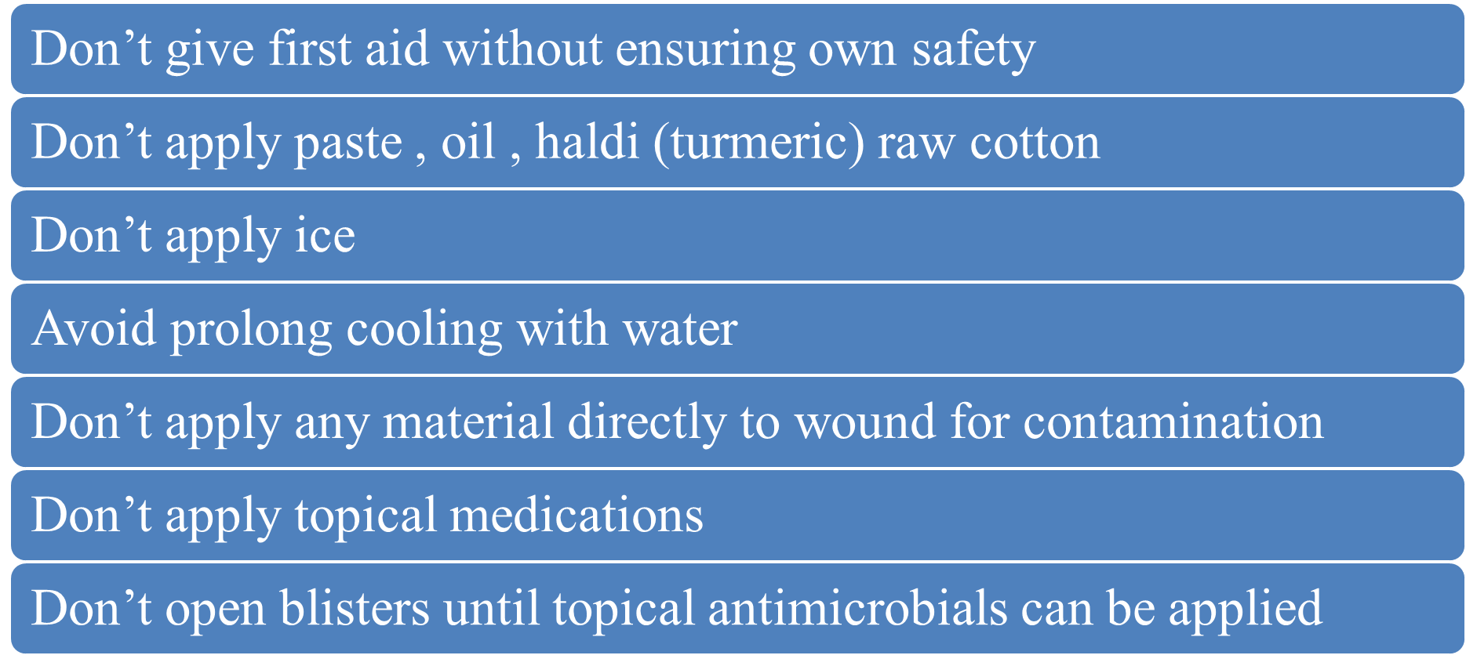
Burns
Vertical integration
Burn Do’s
Burn Don’t

Slide 24
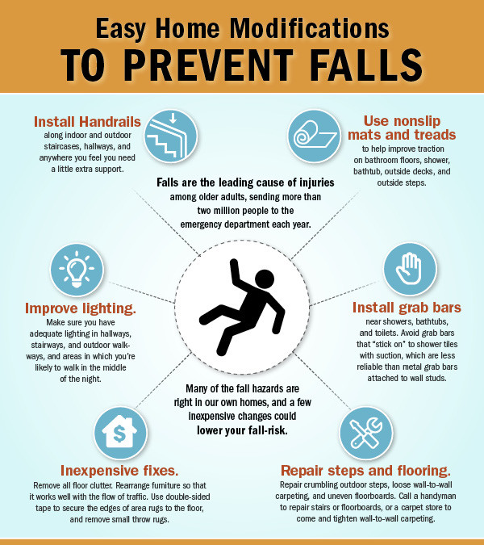
Falls
Risk factors
Occupation
Alcohol
Socioeconomic
Medical condition
Unsafe environment
Prevention
Screening
Environmental modification
Training
CORE CONCEPTS

Slide 25
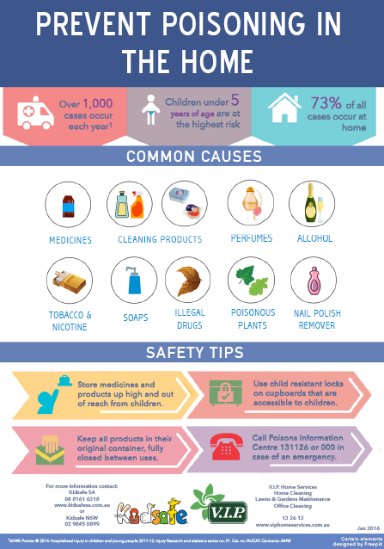
Poisoning
Causative Agents
Pesticides
Kerosene
Prescription drugs
Household chemicals
Prevention

Slide 26
Assessment
A 35-year-old male with a history of poorly controlled diabetes presents with blurry vision in both eyes. On exam, there are microaneurysms, hemorrhages, and exudates in the retina. What is the most likely diagnosis?
a. Cataracts
b. Glaucoma
c. Age-related macular degeneration
d. Diabetic retinopathy
Vit A deficiency
EOLA
Answer: d. Diabetic retinopathy

Slide 27
Assessment
Which of the following is NOT a modifiable risk factor for motor vehicle accidents?
a. Alcohol consumption
b. Seat belt use
c. Speeding
d. Driver's age
Old tyres
EOLA
Answer: d. Driver's age

Slide 28
Research Article & Family Medicine
https://www.ncbi.nlm.nih.gov/pmc/articles/PMC5865509/
The WHO ‘ten key activities for healthy eyes in children’ provide a clear blueprint for what needs to be addressed at primary care level. They address both prevention and active management of eye diseases in children and fall into three categories: health promotion (eg, breast feeding, face washing), ensuring high coverage of specific preventive measures (eg, VAS, measles immunisation) and the detection and referral of treatable eye conditions (eg, cataract, glaucoma).

Slide 29
Workplace accidents & ethics
Safety Culture, Moral Disengagement, and Accident Underreporting by Laura Petitta,Tahira M. Probst, Claudio Barbaranelli
Using Rest’s (1986) model of ethical decision making as a framework ethical safety behavior requires first a recognition (i.e., moral awareness) by employees that their decision to report an accident has the potential to help or harm others and that they have volition in making the decision to report.

Slide 30
Learning sources
K.PARK Text book of community medicine
Additional sources . World health organization for global data

