Slide 2
GIT Module LGIS PHYSIOLOGY)
2nd Year MBBS (2025)
Functional Movements Of GIT,GIT Hormones And Its Blood Flow
Dr. Ali Zain
PGT physiology
Date: 00-00-0000

Slide 3
Table Of Contents
Sr # | Content | Slide #
1 | Motto, Vision | 4
2 | Professor Umar Model of Integrated Lecture | 3
3 | Bloom’s Taxonomy (Domains of learning) | 6
4 | Diagrammatic representation of Blooms taxonomy | 5
5 | Learning Objectives | 7
6 | Horizontal Integration | 24,27,28
7 | Core Concept | 8,9,10,11,12,13,14,15,16,18,19,20,21,22,23,24,25,26,27,28,29,30
8 | Vertical Integration | 17,39
9 | Biomedical Ethics (Lesson of the day) | 40
10 | Suggested research article | 41,42
11 | Promoting IT and Research culture (Digital library) | 43
12 | References of this lecture | 44

Slide 4
General Format for Large Group Interactive Session of Physiology:
S. No. Headings Domains/Type of Integration Ap roximate %
1. Title
Motor Functions of Stomach.
Physiology of regulation of gastric emptying
2.
Learning Objectives
Mentioned on the separate slide
Mentioned on the separate
slide
3.
Physiologic Anatomy (Histology)
Brain Storming/ Horizontal Integration
Interactive
15%
4.
Core Concepts of the Topic
Core concepts of Physiology
60%
5.
Concept explained through Animations
Core Concepts of Physiology
10%
6.
Topic with key
Interactive
5%
7.
Research article relevant to the topic with reference
Promotion of research culture
Use of Digital Library
Critical Thinking
Self-directed Learning
5%
8.
PM&DC Code of Ethics/Professionalism/Communicati on Skills with reference
Professional Ethics
Self-directed Learning
Interactive
5%

Slide 5
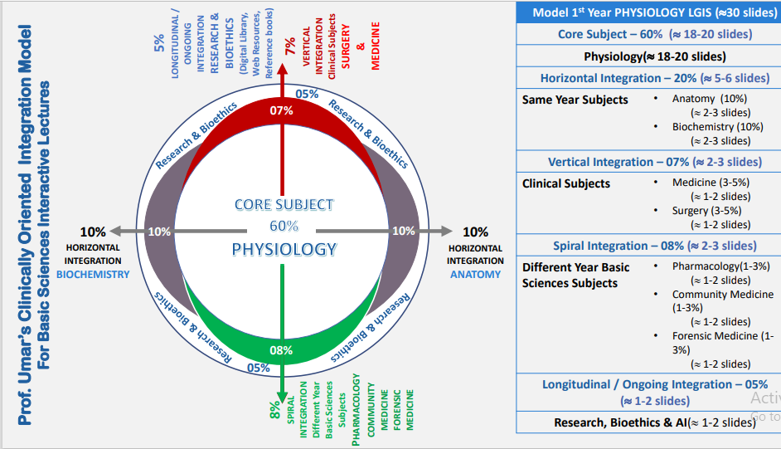
Physiology of Pancreas Pancreatic secretions
LGIS Physiology

Slide 6
Vision; The Dream/Tomorrow
To impart evidence-based research oriented medical education
To provide best possible patient care
To inculcate the values of mutual respect and ethical practice of medicine

Slide 7
BLOOM'S TAXONOMY : DOMAINS OF LEARNING
Sr. # | Domain of learning | Abbreviation | Levels of the domain | Meaning
1 | cognition | C | C1 | Recall / Remembering
2 |  |  | C2 | Understanding
3 |  |  | C3 | Applying / Problem solving
4 | Psychomotor | P | P1 | Imitation / copying
5 |  |  | P2 | Manipulation / Follows instructions
6 |  |  | P3 | Precision / Can perform accurately
7 | Attitude | A | A1 | Receiving / Learning
8 |  |  | A2 | Respond / Starts responding to the learned attitude
9 |  |  | A3 | Valuing / starts behaving according to the learned attitude

Slide 8
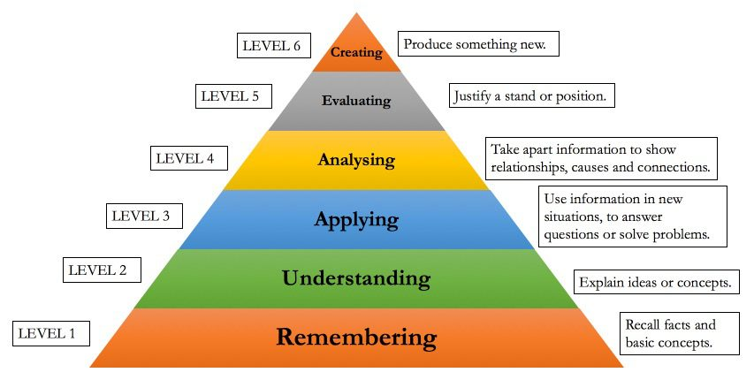
BLOOM'S TAXONOMY OF THE COGNITIVE DOMAIN

Slide 9
Learning objectives
Understand the fundamental physiological processes involved in the gastrointestinal tract (GIT) during functional movements. | C1 & C2
Explain the neural control mechanisms that regulate peristalsis and other motor functions in the GIT. | C1 & C2
Analyze the role of hormones in coordinating and modulating digestive processes during functional movements. | C2 & C3
Apply knowledge of GIT physiology to real-life scenarios, emphasizing the importance of maintaining digestive health. | C3
Understand the interactions between gastrointestinal hormones and neural control in coordinating digestive functions | C2

Slide 10
Horizontal integration (Anatomy )

Slide 11
Physiological anatomy of stomach
Horizontal integration with Physiology

Slide 12
Core Concept

Slide 13
Functional Movements of GIT
Two types of functional movements in GIT
propulsive “PERISTALSIS” movement
mixing movement
Core concept

Slide 14
Propulsive Movements
The basic movement of gastrointestinal tract is peristalsis.
A contractile ring appear around the gut and then moves food bolus in forward direction.
Peristalsis is an inherent property of many syncytial smooth muscles.
Stimulation at any point can cause a contractile ring to appear in the circular smooth muscle of the gut few cm behind that point.
This ring then spreads along the tube.
Core concept

Slide 15
Mechanism Of Peristalsis
Stimulation of peristalsis is distention of the gut
If a large amount of food collects at any point in the gut
Stretching of gut wall
Stimulate the enteric nervous system
Gut wall contract 2to3 cm behind
Contractile ring will appear
Peristalsis movement
Core concept

Slide 16
Functions of Myenteric Plexus in Peristalsis
In the congenital absence of these plexus, peristalsis occur very weakly in that segment.
Peristalsis is greatly depressed or completely blocked in the entire gut when the person is treated with atropine to paralyze the cholinergic endings of myenteric plexus
therefore, effectual peristalsis requires an active myenteric plexus
Core concept

Slide 17
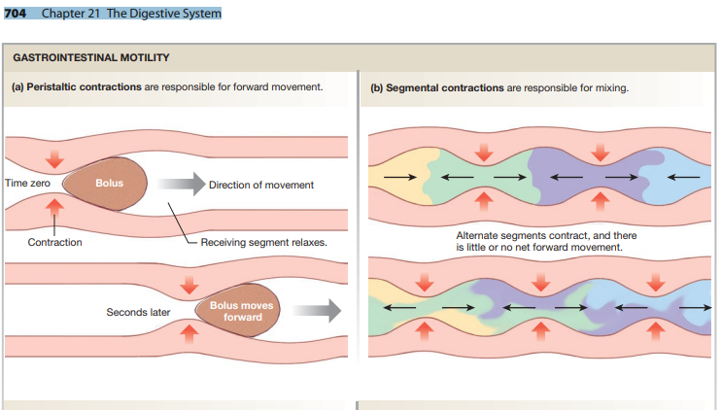
Core concept
704 Chapter 21 The Digestive System
Silverthorn Physiology, 6th Edition

Slide 18
Directional Movement of Peristaltic Waves Toward the Anus.
When a segment of the intestinal tract is excited by distention and thereby initiates peristalsis, the contractile ring causing the peristalsis normally begins on the orad side of the distended segment and moves toward the distended segment, pushing the intestinal contents in the anal direction for 5 to 10 centimeters before dying out.
At the same time, the gut sometimes relaxes several centimeters downstream toward the anus, which is called “Receptive Relaxation,” thus allowing the food to be propelled more easily toward the anus than toward the mouth .this is mediated by VIP/NO
Peristaltic Reflex and the “Law of the Gut”
Core concept

Slide 19
This complex pattern does not occur in the absence of the myenteric plexus. Therefore, the complex is called the Myenteric Reflex Or The Peristaltic Reflex. The peristaltic reflex plus the anal direction of movement of the peristalsis is called the “Law Of The Gut.
Core concept

Slide 20
Role Of Neurotransmitters In Forward Direction Of Peristalsis
Local stretch serotonin sensory neurons myenteric plexus. two types of response
Cholinergic neurons that passing to retrograde direction they will produce Ach and substance P and end result will b smooth muscle contraction (contraction ring).
Cholinergic neurons that travels in anterograde direction will produce NO/VIP , adenosine and end result will be relaxation ahead.
Core concept

Slide 21
One group of interneurons activates excitatory motor neurons above the bolus - these neurons, which contain acetylcholine and substance P, stimulate contraction of smooth muscle above the bolus.
Another group of interneurons activates inhibitory motor neurons that stimulate relaxation of smooth muscle below the bolus. These inhibitor neurons appear to use nitric oxide, vasoactive intestinal peptide and ATP as neurotransmitters
Core concept

Slide 22
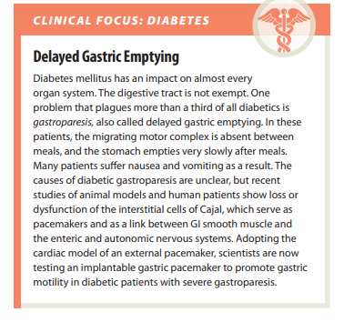
Vertical Integration With Medicine
704 Chapter 21 The Digestive System
Silverthorn Physiology, 6th Edition

Slide 23
Mixing Movements
Mixing movements differ in different parts of the alimentary tract. In some areas, the peristaltic contractions themselves cause most of the mixing. This is especially true when forward progression of the intestinal contents is blocked by a sphincter so that a peristaltic wave can then only churn the intestinal contents, rather than propelling them forward.
At other times, local intermittent constrictive contractions occur every few centimeters in the gut wall. These constrictions usually last only 5 to 30 seconds;
Core concept

Slide 24
Migrating motor complex
During period of fasting pattern of electrical and motor activity in GIT smooth muscles become modified
So that cycle of motor activity migrate from the stomach to distal ileum
MMC starts with quiescent period phase 1 then period of irregular electrical and mechanical activity 2 and it ends with burst of regular activity 3
Core concept

Slide 25
then new constrictions occur at other points in the gut, thus “chopping” and “shearing” the contents first here and then there. These peristaltic and constrictive movements are modified in different parts of the gastrointestinal tract for proper propulsion and mixing.
Core concept

Slide 26
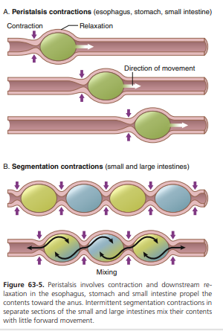
Core concept
Chapter 63 General Principles of Gastrointestinal Function—Motility, Nervous Control, and Blood Circulation Guyton & Hall

Slide 27
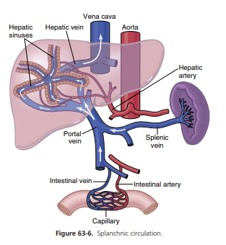
Gastrointestinal Blood Flow
GIT blood flow is part of Splanchnic Circulation it includes blood through the gut itself plus blood flows through spleen , pancreas and liver.
It is almost 1200 to 1500 ml/min, and It is 25% of cardiac output
It is specially designed circulation ,all blood that courses through the gut , spleen, pancreas then flows immediately into the liver by the way of portal vein.
Millions of minute liver sinusoids perform different functions.
UNIT XII Gastrointestinal Physiology
Guyton and hall
Core concept

Slide 28
Effect Of Gut Activity And Metabolic Factors On GIT Blood Flow
Blood flow depends on local activity and normally it is equal on each area .
During active reabsorption blood flow in villi and subsequent regions of submucosa increases as much as eight folds.
After a meal blood flow increase( POST PRANDIAL HYPEREMIA).
It reduces to normal after 2 to 4 hours.
Core concept

Slide 29
Possible Causes Of Increased Blood Flow During GIT Activity
VASODILATOR substances are released from mucosa of intestinal tract during the digestive process. These are CCK, VIP, Gastrin, secretin, and they control specific motor activity.
Two kinins from gut wall are produced specially by GIT glands i.e., kallidin and bradykinin both are powerful vasodilators.
Decreased oxygen conc.in gut increases blood flow 50 to 100%.its is either due to hypoxia of gut wall or due to release of adenosine( a well-known vasodilator).
Core concept

Slide 30
Villous Has Unique Blood Flow
Horizontal Integration With Anatomy
UNIT XII Gastrointestinal Physiology

Slide 31
Nervous Control of GIT Blood Flow
Parasympathetic stimulation
Stomach and lower colon
blood flow and glandular secretion (not direct effect)
Sympathetic stimulation
Direct effect on all tract
Intense vasoconstriction
Greatly reduced blood flow.
Core concept

Slide 32
Auto regulation escape is also there with help of local regulatory factors.
During heavy exercises & in case of stress, sympathetic system get activated that leads to vasoconstriction as blood flows to heart and muscle increases for short period of time.
In case of circulatory shocks there is more need of blood for vital organs so 200 to 400 ml of extra blood moves toward vital organs while diverting GIT.
Core concept

Slide 33
Superior Mesenteric Artery
Horizontal integration with anatomy
UNIT XII Gastrointestinal Physiology
Guyton & Hall physiology

Slide 34
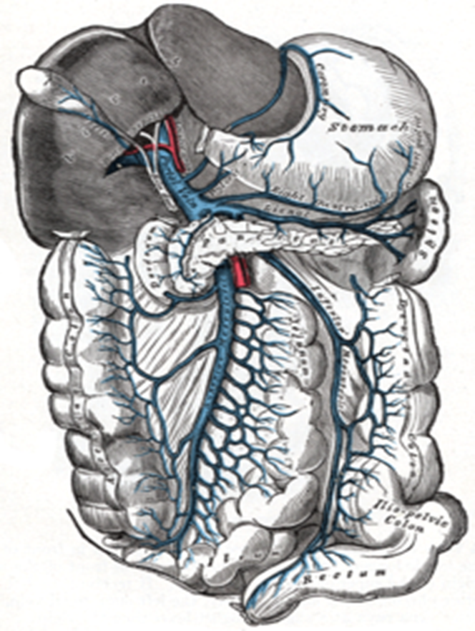
Horizontal integration with anatomy
Area Of Supply Of Inferior Mesenteric Arteries
Portal Circulation

Slide 35
Portal Circulation
All the blood from the GI system below the esophagus drains into the Hepatic Portal Vein, the Portal system also drains the spleen and pancreas. Blood is conveyed to the liver for processing where it passes through millions of liver sinusoids. This allows the reticuloendothelial cells that line the sinusoids to remove bacteria and other particulate matter. Blood finally leaves the liver via The Hepatic vein where it drains into the Inferior Vena Cava.
Core concept

Slide 36
The total blood flow to the liver is about 1.5 Liters per minute of which two-thirds is carried by the portal vein. The Blood in the portal vein is more oxygen saturated than blood in the Systemic Venous System - about 80-90% saturated and provides about 70% of the oxygen requirements of the liver.
Core concept

Slide 37
Gastrointestinal Hormones
The gastrointestinal hormones (or gut hormones) constitute a group of hormones secreted by enteroendocrine cells in the stomach, pancreas, and small intestine that control various functions of the digestive organs. Later studies showed that most of the gut peptides, such as secretin, cholecystokinin or substance P, were found to play a role of neurotransmitters and neuromodulators in the central and peripheral nervous systems.
Core concept

Slide 38
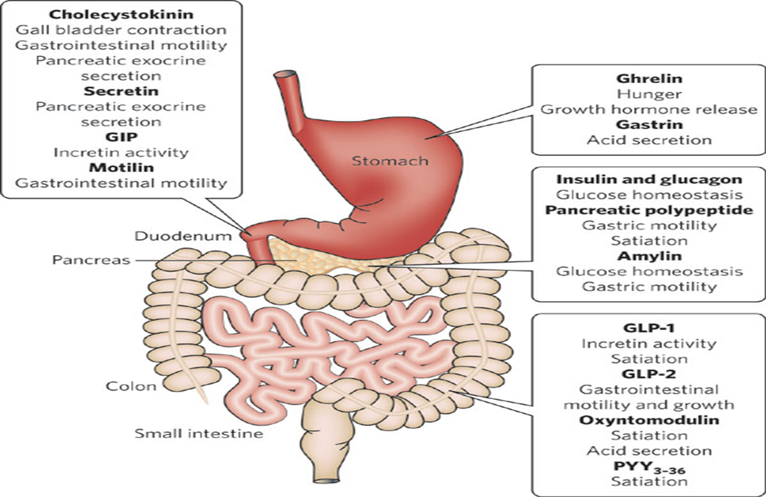
Types Of Gastrointestinal Hormones
Core Component

Slide 39
Types Of Gastrointestinal Hormones
Core Component
Chapter 63 General Principles of Gastrointestinal Function—Motility, Nervous Control, and Blood Circulation Guyton and hall

Slide 40
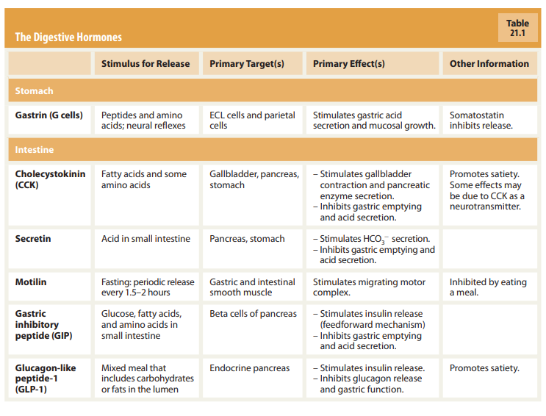
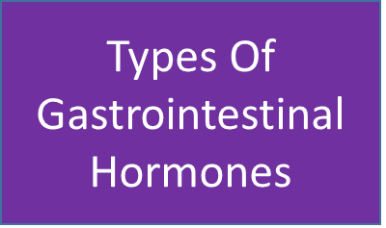
Core Component
704 Chapter 21 The Digestive System
Silverthorn Physiology, 6th Edition

Slide 41
VASOACTIVE INTESTINAL PEPTIDE
Types Of Gastrointestinal Hormones
Enteric nerves and in blood ,brain autonomic nerves.
Increases water and electrolyte secretion from pancreas and gut;
Releases hormones from pancreas, gut, and hypothalamus.
Relaxes smooth muscle of gut, blood, and genitourinary system.
Decreases production of acid in stomach.
Core Component

Slide 42
Peptide YY
Types Of Gastrointestinal Hormones
Hormone that is produced by islets of pancreas and gut mucosa
It has 36 amino acids.
Its secretion is increased by proteins, fasting, fats, exercise, acute hypoglycemia.
Secretion decreases by somatostatin, intravenous glucose
It inhibit HCL production and gastric motility.
Core Component

Slide 43
Types Of Gastrointestinal Hormones
Ghrelin
is a peptide hormone
released from the stomach and liver
is often referred to as the "hunger hormone" since high levels of it are found in individuals that are fasting.
Ghrelin agonistic treatments can be used to treat illnesses such as anorexia and loss of appetites in cancer patients.
Ghrelin treatments for obesity are still under intense scrutiny and no conclusive evidence has been reached.
This hormone stimulates growth hormone release.
Core Component

Slide 44
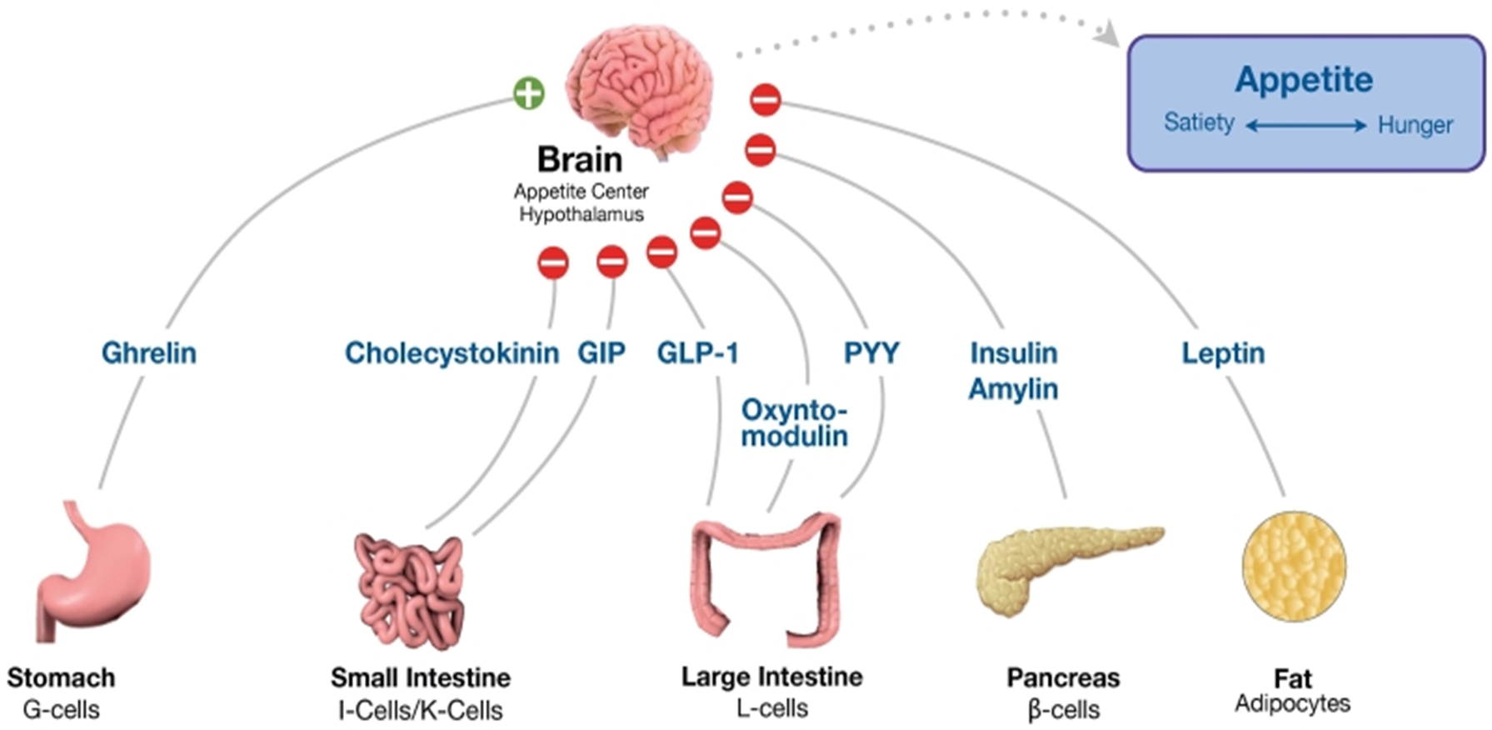
Core Component

Slide 45
Brainstorming/Review
Brainstorming
Question & Answer

Slide 46
Brainstorming/Review
Two medical students studying for their physiology final decide to take a break for a lunchtime hamburger. Before reaching the cafeteria, nervous impulses from the dorsal vagal complex will initiate gastric acid secretion by triggering release of which neurotransmitter from the enteric nervous system?
Norepinephrine
Vasoactive intestinal polypeptide
Substance P
Gastrin-releasing peptide
Nitric oxide

Slide 47
Brainstorming/Review
The correct answer is D.
The cephalic phase of the gastric secretory response is initiated by the release of gastrin-releasing peptide from enteric nerve endings adjacent to G cells in the antrum of the stomach. Gastric secretion during the cephalic phase, in common with most intestinal secretory responses, is not normally triggered by sympathetic nerve activity, nor is norepinephrine a transmitter expressed by the enteric nervous system (rules out option A). The remaining enteric neurotransmitters listed are predominantly involved in causing the contraction (substance P) or relaxation (vasoactive intestinal polypeptide, nitric oxide) of gastrointestinal smooth muscle (rules out options B, C, and E).

Slide 48
Vertical Integration

Slide 49
Vipoma
is a neuroendocrine neoplasm secreting vasoactive intestinal peptide (VIP), usually presenting with severe watery secretory diarrhea, which can result in hypokalemia and metabolic acidosis and with flushes. Hypochlorhydria, stimulation of glycogen lysis, and hypercalcemia can be also found in VIPoma patients.
Vertical Integration With Medicine

Slide 50
Understanding Biomedical Ethics
Biomedical Ethics

Slide 51
Bioethics
Non-maleficence
The principle of nonmaleficence holds that there is an obligation not to inflict harm on others. It is closely associated with the maxim primum non nocere (first do no harm).
Longitudinal bioethics Curriculum

Slide 52
Suggested Research Article

Slide 53
Research
Longitudinal Research Curriculum
https: www.ncbi.nlm.nih.gov/pmc/articles/PMC6850045/

Slide 54
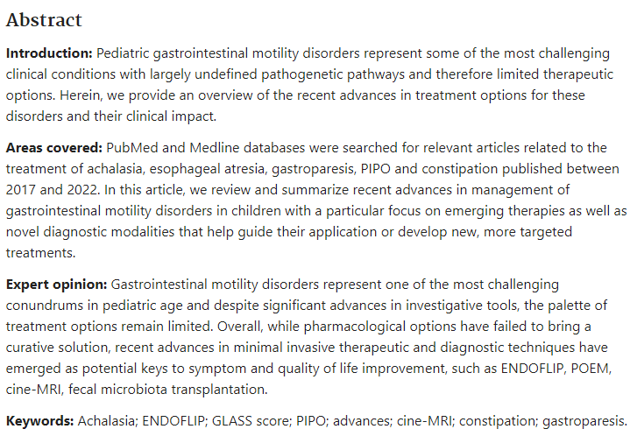
Longitudinal Research Curriculum

Slide 55
References
Books
Guyton textbook of physiology
Human Physiology by Dee Unglaub Silver thorn. 8TH Edition. Muscle (Chapter 12,Page 444)
Shrewood textbook of physiology
Ganong textbook of physiology
Research
https://pubmed.ncbi.nlm.nih.gov/38096022/
Video link/youtube
https://youtu.be/cCyTYsxECLw?si=6lcLehpq8OOvJC8K

Slide 56
How To Access Digital Library
Steps to Access HEC Digital Library:
Go to the website of HEC National Digital Library.
On Home Page, click on the INSTITUTES.
A page will appear showing the universities from Public and Private Sector and other Institutes which have access to HEC National Digital Library HNDL.
Select your desired Institute.
5. A page will appear showing the resources of the institution
6. Journals and Researches will appear
7. You can find a Journal by clicking on JOURNALS AND DATABASE and enter a keyword to search for your desired journal.

