Slide 2
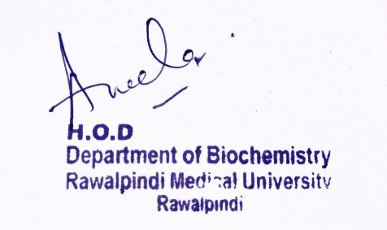
Gastrointestinal Tract (GIT) Module 2nd Year MBBS(LGIS) Metabolism of Individual Sugars
Presenter: Dr. Aneela Jamil Date: 27-01-25
(Assistant Professor)

Slide 3
Motto, Vision, Dream
To impart evidence based research oriented medical education
To provide best possible patient care
To inculcate the values of mutual respect and ethical practice of medicine
Wisdom
Truth
Service

Slide 4
Professor Umar Model of Integrated Lecture

Slide 5
Learning Objectives
At the end of this lecture students will be able to
Explain Fructose metabolism and related disorders
Describe the metabolism of Galactose with related disorders
Discuss the Sorbitol pathway and its importance

Slide 6
Metabolism of Fructose
Core Knowledge
Phosphorylation of fructose
Cleavage of fructose 1-Phosphate

Slide 7
1. Phosphorylation of Fructose
Core Knowledge
By either hexokinase or fructokinase
Hexokinase
produces fructose 6-phosphate
has a low affinity (high Km) for fructose
Fructokinase
produces fructose 1-phosphate
has high affinity for fructose
provides the primary mechanism for fructose phosphorylation
found in liver, kidney & small intestinal mucosa

Slide 8
2. Cleavage of Fructose 1-P
Fructose 1-P is cleaved by Aldolase B to Dihydroxyacetone phosphate & Glyceraldehyde
can enter glycolysis or gluconeogenesis

Slide 9
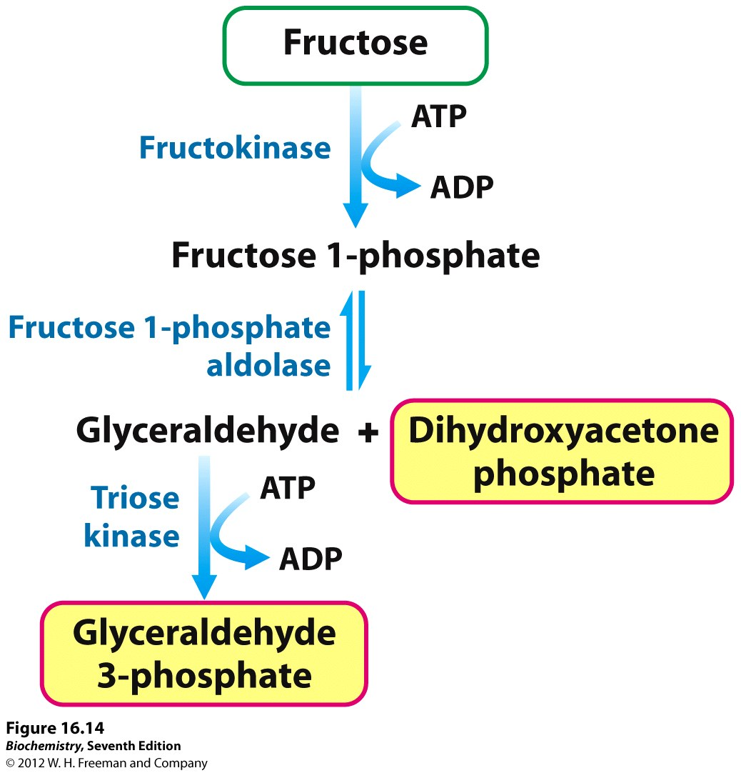
Core Knowledge

Slide 10
Galactose Metabolism
Core Knowledge
Phosphorylation of Galactose
Formation of UDP galactose
Conversion of UDP galactose to UDP glucose

Slide 11
Galactose Metabolism

Slide 12
Sorbitol Metabolism
Core Knowledge
Aldose reductase
reduces glucose producing sorbitol
found in many tissues
Sorbitol dehydrogenase
can oxidize sorbitol to produce fructose
in liver, ovaries, sperm & seminal vesicles

Slide 13
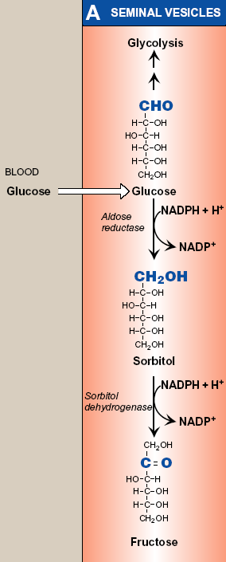
Sorbitol Metabolism
Core Knowledge

Slide 14
Sorbitol Metabolism
Core Knowledge
In Seminal Vesicles
pathway from glucose to fructose
energy source for sperm cells
In Liver
pathway from sorbitol to fructose
dietary sorbitol is converted into a substrate that can enter glycolysis or gluconeogenesis

Slide 15
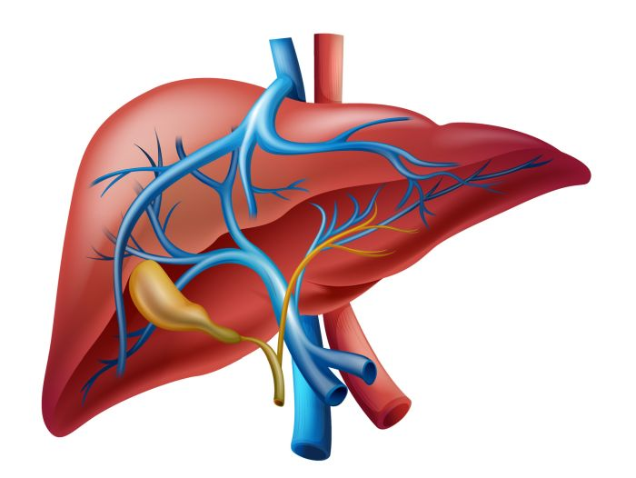
Anatomical & Physiological Aspects
Horizontal Integration

Slide 16
Anatomical & Physiological Aspects
Sources of fructose
sucrose (as disaccharide)
high-fructose corn syrup, many fruits & honey (as a free monosaccharide)
Sources of galactose
lactose obtained from milk & milk products
lysosomal degradation of complex CHOs

Slide 17
Disorders of Fructose Metabolism

Slide 18
Hereditary Fructose Intolerance
Phosphate sequestration
decrease ATP
increase AMP
Hyperuricemia
Decrease ATP
hypoglycemia
decrease synthesis of proteins (clotting factors)
hemorrhages

Slide 19
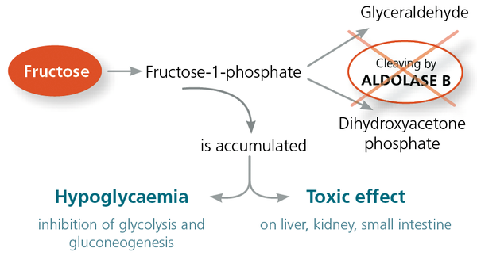

Slide 20
Disorders of Galactose Metabolism

Slide 21
Classic Galactosemia

Slide 22
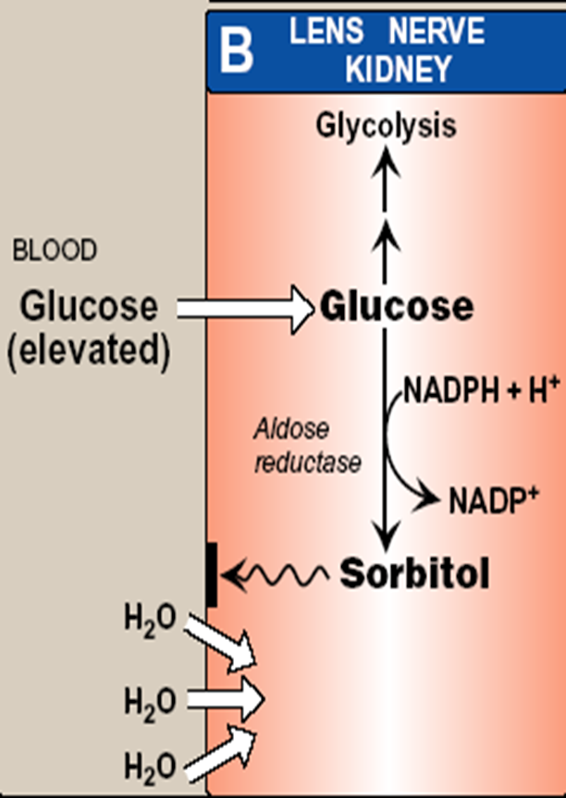
Sorbitol Pathway
In Diabetes mellitus
excess glucose
increase sorbitol production
sorbitol is trapped in the cell
Osmotic effect & cell swelling
diabetic cataract & microvascular complications

Slide 23
Family Medicine
Spiral Integration
Family Medicine plays important role in following manner:
Early Diagnosis
Education
Dietary Guidance
Monitoring
Refer to Specialists

Slide 24
Artificial Intelligence
Spiral Integration
Artificial Intelligence plays role in following aspects:
Decoding DNA sequences to
pinpoint genetic variations
identify genetic abnormalities
Utilizes extensive data from patient thereby enhancing prevention, diagnosis & treatment based on individual genetic profiles
Food Recommendations

Slide 25
Suggested Research Article
Spiral Integration
Link: https://link.springer.com/article/10.1007/s10545-017-0029-3
Journal Name:
Journal of Inherited Metabolic Disease
Title:
Sweet and sour: an update on classic galactosemia
Author Name:
Ana I. Coelho, M. Estela Rubio-Gozalbo, João B. Vicente & Isabel Rivera
Abstract:
Classic galactosemia is a rare inherited disorder of galactose metabolism caused by deficient activity of galactose-1-phosphate uridylyl transferase (GALT), the second enzyme of the Leloir pathway. It presents in the newborn period as a life-threatening disease, whose clinical picture can be resolved by a galactose-restricted diet. The dietary treatment proves, however, insufficient in preventing severe long-term complications, such as cognitive, social and reproductive impairments. Classic galactosemia represents a heavy burden on patients’ and their families’ lives. After its first description in 1908 and despite intense research in the past century, the exact pathogenic mechanisms underlying galactosemia are still not fully understood.

Slide 26
Bioethics
Spiral Integration
Appropriate information
Explain to patient or his family the genetic aspects of the condition
Counselling

Slide 27
How To Access Digital Library
Steps to Access HEC Digital Library
Go to the website of HEC National Digital Library
On Home Page, click on the INSTITUTES
A page will appear showing the universities from Public and Private Sector and other Institutes which have access to HEC National Digital Library HNDL
Select your desired Institute
A page will appear showing the resources of the institution
Journals and Researches will appear
You can find a Journal by clicking on JOURNALS AND DATABASE and enter a keyword to search for your desired journal

Slide 28
Learning Resources
Textbook of Biochemistry, Lippincott Illustrated Reviews 8th edition, chapter no. 12, page no. 293-303
Google scholar
Google images

