Slide 1


Slide 2



Renal Module
2nd Year MBBS(CBL)
Metabolic Acidosis
Presenter: Dr. Romessa Naeem Date: 30-01-25
(Demonstrator)

Slide 3
Motto, Vision, Dream
To impart evidence based research oriented medical education
To provide best possible patient care
To inculcate the values of mutual respect and ethical practice of medicine
Wisdom
Truth
Service

Slide 4
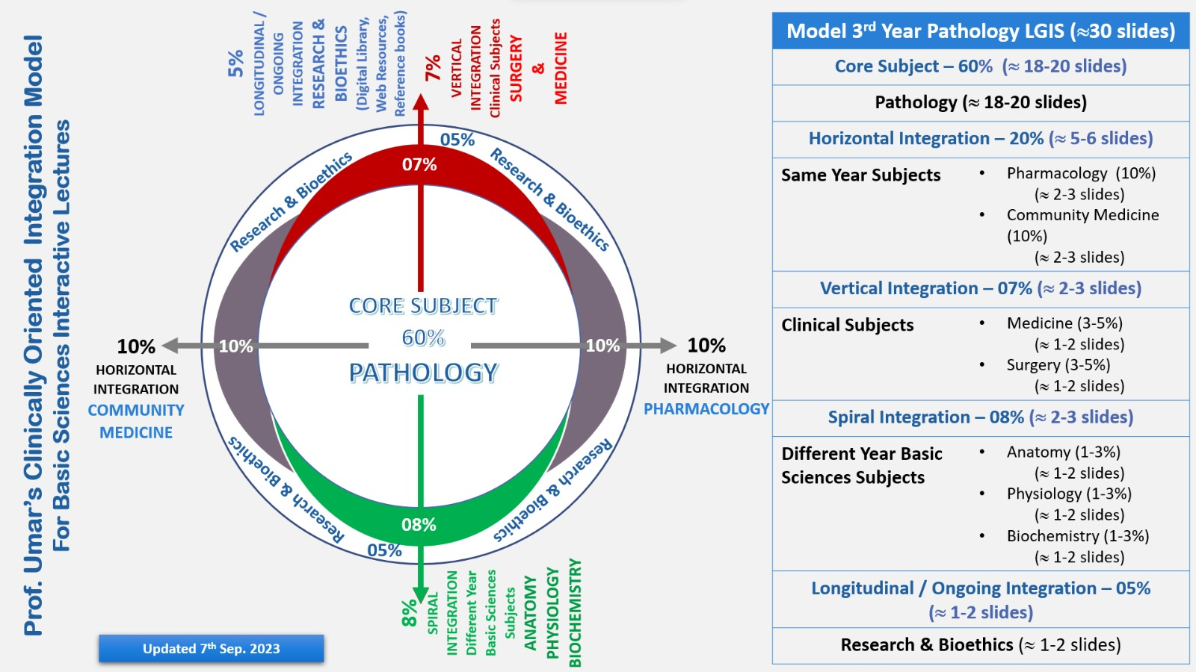
Professor Umar Model of Integrated Lecture

Slide 5
Learning Objectives
At the end of this session students should be able to
Explain the causes and compensation of metabolic acidosis
Describe the anion gap

Slide 6
Interactive Session
A 15 years male was brought to emergency room of Holy family hospital in comatose state late in afternoon . For the past few weeks , he was easily fatigued and unwell. His condition was attributed to change in weather (summer)and was managed at home with home remedies. However , symptoms of polydipsia and polyuria were overlooked(since he was given fluids in large quantities very frequently) .
On examination he was having rapid breathing and low blood pressure . Lab investigations showed raised plasma blood glucose , glucosuria, ketone bodies in urine and low pH. After thorough history ,examination and lab test, the boy was diagnosed as case of diabetic ketoacidosis(DKA).

Slide 7
Terms And Definitions
Core Knowledge
PH:
Acid Base hemostasis is concerned about the proper balancing of acid and bases, also called the pH.
Acidosis:
Process that increases H+ ions by increasing PCO2 or reducing HCO3-
Decrease in blood pH below normal range
Alkalosis:
Process that decreases H+ ions by reducing PCO2 or by increasing HCO3-
Elevation in Blood PH above normal range

Slide 8
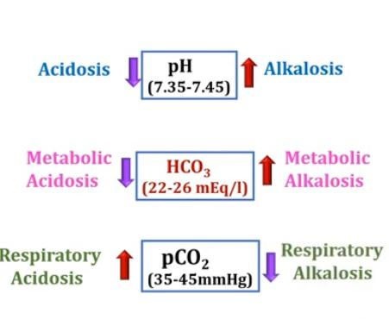
Types Of Acidosis And Alkalosis
Core Knowledge

Slide 9
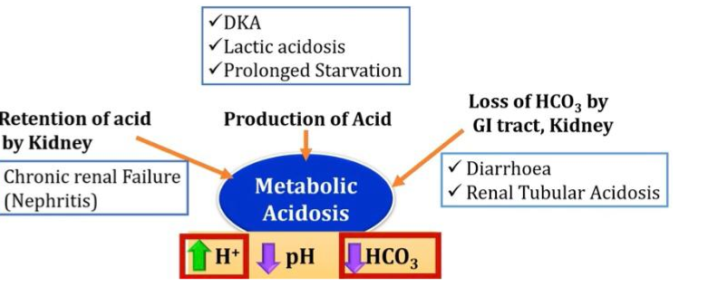
Causes of Metabolic Acidosis
Core Knowledge

Slide 10
Plasma Anion Gap
Core Knowledge
Anion gap = [Na+] – [Hco3 ]+[Cl]
=144-24-108
=12mEq/L
Normal Range = 8-16mEq/L

Slide 11
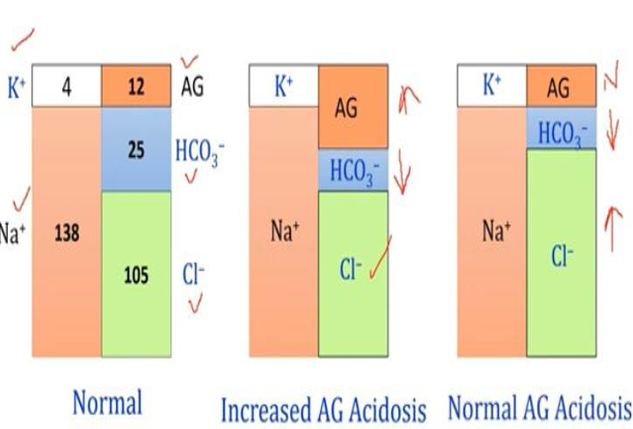
Anion Gap
Core Knowledge

Slide 12
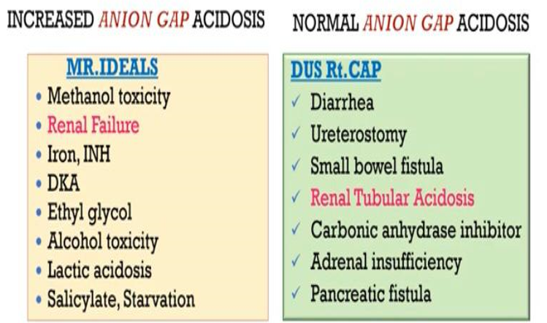
Causes of Metabolic Acidosis
Core Knowledge

Slide 13
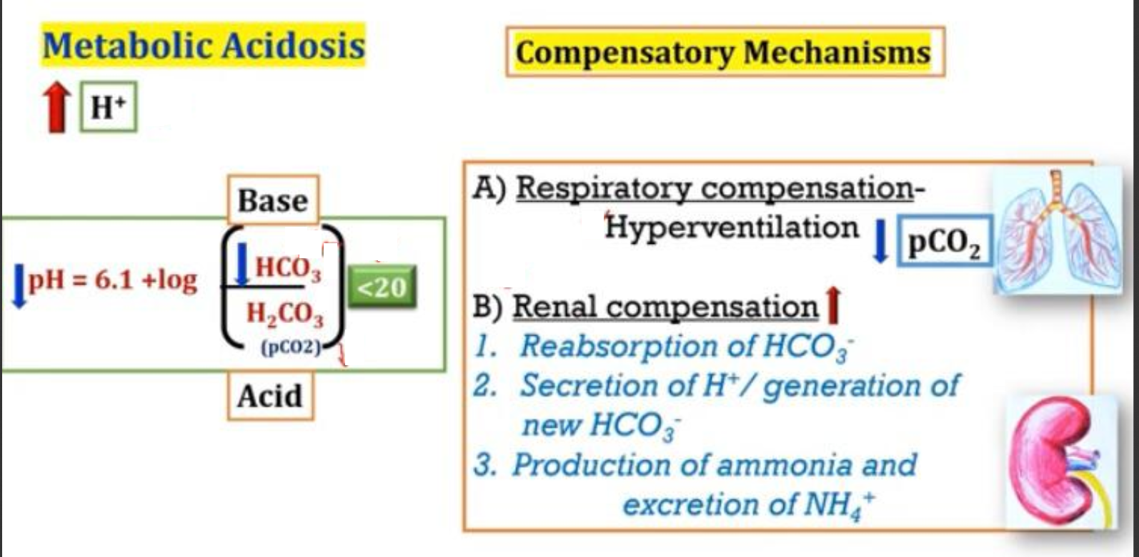
Core Knowledge

Slide 14
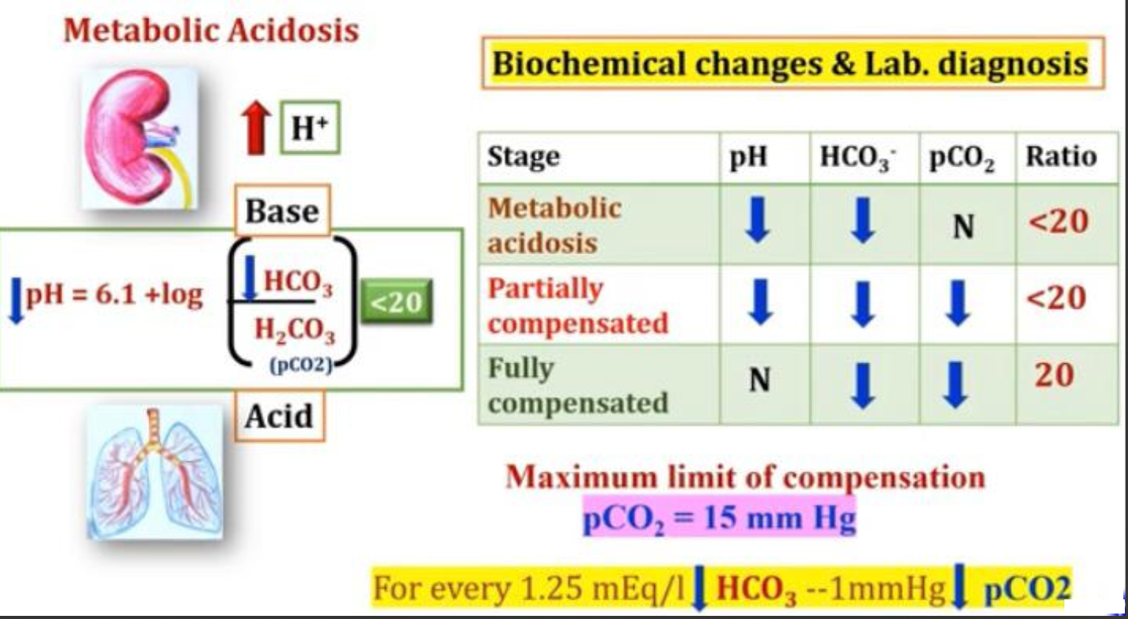

Slide 15
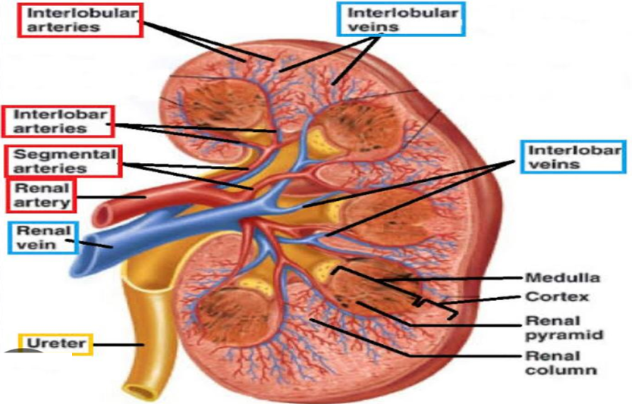
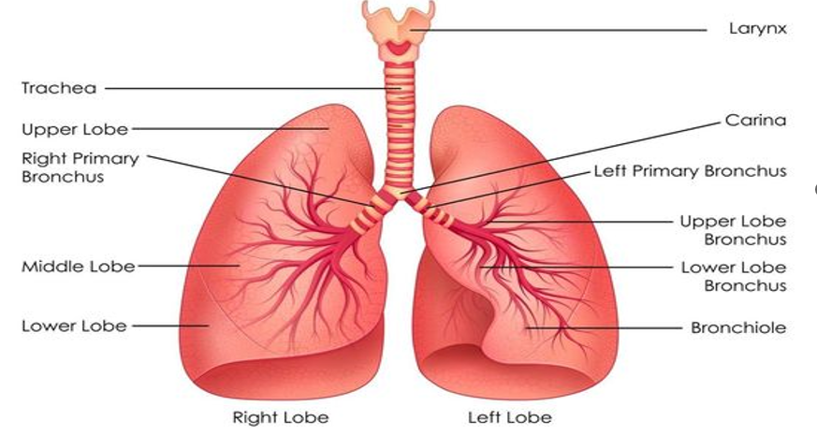
Anatomy of Kidney & Lungs

Slide 16
Physiology of Kidney & Liver
Function of Kidney:
Regulate electrolyte concentration
Regulate amount of fluid with in body
Help regulate blood pressure
Help maintain acid base balance
Filter wastes and excrete fluids
Function of Lungs:
Breathing is one of the most important function of lungs
Defense mechanism
Regulation of body temperature
Regulation of acid base balance
Metabolism of biologically active substances

Slide 17
Management of Diabetic Ketoacidosis
Spiral Integration
Early Recognition & Prevention: Family physicians play a crucial role in early detection of diabetes, patient education, and lifestyle interventions to prevent complications like DKA.
Holistic Care: They consider environmental, social, and psychological factors affecting health, such as seasonal changes and home management
Patient & Family Education: Educating caregivers on recognizing diabetes symptoms (polyuria, polydipsia, fatigue) prevents misinterpretation and delays in seeking care.

Slide 18
Ethical Consideration
Spiral Integration
Delayed Diagnosis & Responsibility: Ethical concerns arise when early symptoms are dismissed, leading to complications. Was there a lack of awareness or negligence ?
Informed Consent: Patients (or their guardians) must be informed about risks, treatment options, and complications .
Justice & Accessibility: Family should have access to healthcare or diabetes screening. Their decision should not be influenced by socioeconomic factors.

Slide 19
Role of AI in Managing Diabetic Ketoacidosis
Spiral Integration
Early Detection: AI-based screening tools can analyze patient symptoms and detect high-risk cases before severe complications occur .
Decision Support Systems: AI helps doctors diagnose DKA using lab reports and symptoms, reducing errors and delays.
Remote Monitoring & Alerts: AI-powered apps and wearables track glucose levels, alerting patients and caregivers about dangerous trends .
Predictive Analytics: AI can predict DKA risk based on patterns of hyperglycemia and patient behavior.

Slide 20
Suggested Research Article
Objectives:
Outline the causes of metabolic acidosis.
Describe the presentation of a patient with metabolic acidosis.
Summarize the treatment options for metabolic acidosis.
Explain the importance of enhancing coordination amongst the interprofessional team to enhance the delivery of care to patients with metabolic acidosis.
Introduction:
Acid-base disorders, including metabolic acidosis, are disturbances in the homeostasis of plasma acidity. Any process that increases the serum hydrogen ion concentration is a distinct acidosis. The term acidemia is used to define the total acid-base status of the serum pH. For example, a patient can have multiple acidoses contributing to a net acidemia. Its origin classifies acidosis as either a respiratory acidosis which involves changes in carbon dioxide, or metabolic acidosis which is influenced by bicarbonate (HCO3).
Link :
https://www.ncbi.nlm.nih.gov/
Journal Name :
Bookshelf
Title :
Metabolic Acidosis
Author Name:
MacKenzie Burger; Derek J. Schaller.

Slide 21
How To Access Digital Library
Steps to Access HEC Digital Library
Go to the website of HEC National Digital Library.
On Home Page, click on the INSTITUTES.
A page will appear showing the universities from Public and Private Sector and other Institutes which have access to HEC National Digital Library HNDL.
Select your desired Institute.
A page will appear showing the resources of the institution
6. Journals and Researches will appear
7. You can find a Journal by clicking on JOURNALS AND DATABASE and enter a keyword to search for your desired journal.

Slide 22
CBL Assessment
What is normal plasma pH?
Enlist causes of metabolic acidosis?
What are different types of alkalosis?
What are causes of increased anion gap?
How body compensate for metabolic acidosis?

Slide 23
Learning Resources
Lippincott Illustrated Reviews Biochemistry, 8th Edition, Chapter 31 page no. 409-412
Google scholar
Google images

Slide 24
THANK YOU

