Slide 1
A 42-year-old male presents to physician with symptoms that have been progressively worsening over the past year. He describes recurrent episodes of vertigo that last for several hours and are accompanied by a feeling of fullness in his right ear. He also reports fluctuating hearing loss in his right ear and persistent tinnitus.

Slide 2
MÉNIÈRE’S DISEASE

Slide 3
University Motto, Vision, Values & Goals
Mission Statement
To impart evidence-based research-oriented health professional education
Best possible patient care
Mutual respect, ethical practice of healthcare and social accountability.
Vision and Values
Highly recognized and accredited centre of excellence in Medical Education, using evidence-based training techniques for development of highly competent health professionals, who are lifelong experiential learner and are socially accountable.
Goals
The Undergraduate Integrated Learning Program is geared to provide you with quality medical education in an environment designed to

Slide 4
Sequence of LGIS
Learning objectives
Development of cochlea (core concept = 60%)
Anatomy, physiology, biochemistry (spiral integration 8%)
Pathology and community medicine (horizontal integration 20%)
Related clinical medical surgical (vertical integration – 7%)
Research, family medicine, bioethics, artificial intelligence (5%)

Slide 5
Learning Objectives
At the end of this lecture students shall be able to learn:
definition
Etiology of meniere disease
Signs and Symptoms
Examination
Investigations
Medical and Surgical Management

Slide 6
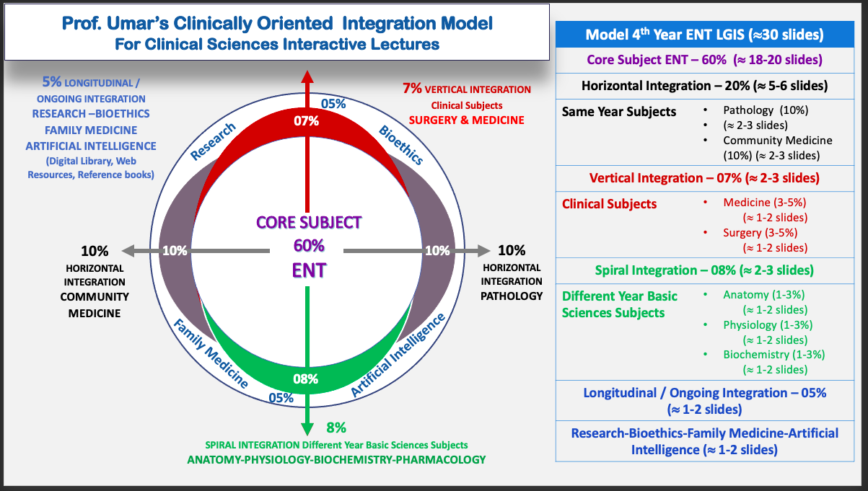
Prof Umer Model Of Integrated Lecture

Slide 7
INTRODUCTION
Ménière’s disease is an idiopathic inner ear disorder characterized
by recurrent spontaneous vertigo accompanied
by fluctuating or progressive sensorineural hearing loss,
tinnitus and aural fullness in the affected ear
Meniere’s disease affects the quality of life significantly

Slide 8
Notes:
Acute phase---- membrane rupture--- vertigo

Slide 10
PATHOPHYSIOLOGY
Endolymphatic hydrops
The cause of Meniere’s disease is unknown.
Endolymphatic hydrops was observed in a significant number of temporal bones from patients with hearing loss, without the classical symptoms of Meniere’s disease.
Membrane ruptures have been suggested to cause the acute episodes of vertigo.
Autoimmune factor
In approximately 1 in 3 patients with Meniere’s disease there seems to be an autoimmune factor.
Notes:
Autoimmune more in familial type

Slide 11
PATHOPHYSIOLOGY
Viral factor
A viral etiology has been suggested as well, most often involving the herpes simplex virus. (HSV)
Vertigo control in 91% of Meniere’s disease patients by means of acyclovir treatment also supports the potential viral etiology.
Allergic factor
An association with allergy has been observed by Derebery. Vertigo control (Class A and B) was achieved in 47.9% (n = 137) accepting allergy treatment.

Slide 12
A typical attack of Meniere’s disease
direction of the spontaneous nystagmus
Irritative phase the nystagmus will beat towards the affected ear in a horizontal or horizontal–torsional direction, a finding which usually lasts less than 1 hour.
paretic phase, the nystagmus will beat away from the affected ear and last hours to days.
recovery phase the nystagmus again beats towards the affected side because peripheral vestibular function recovers.
drop attacks (Tumarkin crises)
Due to acute otolythic dysfunction
patient suddenly drops to the ground (without losing consciousness) without associated vertigo.

Slide 13
Diagnostic tools to detect endolymphatic hydrops
Evidence supplementary to the diagnostic criteria (which are in fact based only on history and audiometry)
ELECTROCOCHLEOGRAPHY
COCHLEAR HYDROPS ANALYSIS MASKING PROCEDURE (CHAMP)
DELAYED MRI AFTER INTRATYMPANIC OR INTRAVENOUS INJECTION OF GADLINIUM
Notes:
Post mortem
DELAYED MRI AFTER INTRATYMPANIC OR INTRAVENOUS INJECTION OF GADLINIUM

Slide 14
A diagnosis of exclusion
The 2015 guidelines define Meniere’s disease as an idiopathic syndrome of endolymphatic hydrops and therefore other causes have to be excluded. The following conditions are explicitly mentioned:
Transient ischemic attack
vestibular neuritis
Vestibular migraine - no auditory symptoms
Vestibulopathy - postural imbalance & oscillopsia
Vestibular schwannoma
Endolymphatic sac tumour.
Notes:
The 1995 guidelines also mention trauma or surgery, infection (syphilis) and inflammatory disorders (Cogan’s syndrome) as potential causes of endolymphatic hydrops

Slide 15
For Diagnosis
Full clinical examination of the head and neck region (including vestibular examination)
Speech audiometry
Tympanometry
CT scan of the temporal bone (with or without intravenous injection of iodine-containing contrast),
MRI of the posterior fossa (with intravenous injection of gadolinium),
Blood analysis (haematology, thyroid, biochemical and genetic testing).
Notes:
To exclude these Meniere-like diseases any diagnostic
technique available to the clinician should be used
The posterior fossa MRI with intravenous administration of gadolinium is the most sensitive examination to exclude cerebellopontine angle and inner ear pathology
Liminal or threshold pure-tone audiometry: this test determines the subject's capacity to perceive a specific frequency or volume

Slide 16
Notes:
Documented SNHL

Slide 18
MANAGEMENT
Management of Acute Phase : Vestibular suppressents + Antiemetics
DIETARY RESTRICTIONS
Low-sodium and caffeine-free diet
Medication
DIURETICS
reduce endolymphatic volume and pressure
Hydrochlorothiazide, acetazolamide or a combination of hydrochlorothiazide and triamterene, are still the first-line medical therapy

Slide 19
BETAHISTINE DIHYDROCHLORIDE
Recommendation:
First-line medical treatment to prevent recurrence of vertigo may include betahistine dihydrochloride 16 mg thrice daily and/or diuretics.
Betahistine has a limited side effect profile while diuretics can cause electrolyte disturbances, potentially interact with patient-specific drugs and conditions.
HEARING AMPLIFICATION with Hearing aids
Notes:
Betahistine increaseblood supply to inner ear SERC DVERT
Fluctuations of hearing loss = Frustration

Slide 20
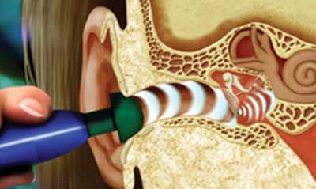
Transtympanic therapies
TRANSTYMPANIC LOW-PRESSURE THERAPY
(MENIETT)

Slide 21
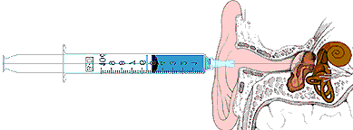
intratympanic therapies
Salvage treatment
INTRATYMPANIC INJECTION OF CORTICOSTEROIDS
Vertigo control in 80% of refractory cases without significant hearing loss.
INTRATYMPANIC INJECTION OF GENTAMICIN
Partial Chemo-labyrinthectomy
‘End-stage’ patients who develop drop attacks
Sensorineural hearing loss often seen
Notes:
aims to destroy
vestibular hair cell function (therefore also called partial
chemolabyrinthectomy). The typical Meniere’s disease vertigo
attacks are not detected

Slide 22
Surgery
ENDOLYMPHATIC SAC SURGERY
Endolymphatic sac decompression
Mastoid shunting
TENOTOMY OF THE TENSOR TYMPANI AND STAPEDIAL MUSCLE TENDONS
SELECTIVE VESTIBULAR NERVE SECTION
Surgical section of the vestibular nerve while preserving the facial and cochlear nerve.

Slide 23
Research
https://www.ncbi.nlm.nih.gov/pmc/articles/PMC10241347/
https://www.american-hearing.org/disease/menieres-disease/

Slide 24
Biomedical Ethics
Before doing any medical and surgical treatment, informed consent must be taken
Prognosis should be explained to patients and attendants

Slide 25
Artificial Intelligence
The Future of Artificial Intelligence in Ménière's DiseaseWhile these technologies can be helpful for diagnosis and treatment of inexperienced physicians, they can lower the barrier to medical knowledge at the same time, making it much easier for patients to have a diagnostic approach to their disease.

Slide 26
Family Medicine
Any patient who presents with progressive hearing loss in middle age should be referred to ENT specialist and tested for audiological assessment

Slide 27
REFERENCES
SCOTT BROWN OTOLARYNGOLOGY 8th edition
Disease of ENT Saleem Iqbal Bhutta
PL Dhingra, 7th edition

