Slide 2
Vision & Mission of RMU:

Slide 3
Block-X Otorhinolaryngology Module-II Measures of Mortality SMALL GROUP DISCUSSION(SGD) Dr. Maria Jabeen & Dr. Mehreen Noor

Slide 4
Learning Objectives:
Quantification of mortality data
Comprehend issue in death certification
Apply direct and indirect methods to adjust rates
Calculate 04 types of mortality rates in various scenarios
Identify uses of mortality data.

Slide 5
Prof Umar Model

Slide 6
Sequence of discussion
Sr. No | Headings | Approximate %
1. | Title of SGD
2. | Learning Objectives From Study Guide
3. | Core Concepts of the Topic | 70%
4. | Related Advanced Research Points | 05%
5. | Related Ethical Points | 10%
6. | Artificial Intelligence | 05%
7. | End Of Lecture Assessment | 10%

Slide 7
Definition of Epidemiology: Epidemiology is the study of the Frequency, Distribution and Determinants of disease, health related states or events in specified populations, and the application of this knowledge to the control & prevention of health problems.
Core Subject

Slide 8
Three Basic Concepts of Epidemiology:
Core Subject
1. Study of Frequency of disease
(magnitude )
2. Study of Distribution of disease
(In term of time-place-person)
3. Study of Determinants of disease
(In term of Agent-Host-Environment)

Slide 9
Fundamental concepts of Epidemiology:
Core Subject
Environment
Agent Host
Epidemiological Triad
(Occurrence of disease in population)

Slide 10
Classification Of Epidemiological Studies:
Core Subject
Observational studies. (no interference or manipulation of study conditions)
a. Descriptive studies (describe phenomenon of interest)
- Cross-sectional studies
- Longitudinal studies
others: Case reports & Case Series,
b. Analytical studies (examine & decide suspected association)
- Cross-sectional comparative studies
- Case-Control studies
- Cohort studies
- Ecological Studies – Migrational Studies

Slide 11
Core Subject
Interventional / Experimental Studies
a. Randomized controlled trials (RCTs or Clinical trials)
b. Field trials (primary Preventive measures trials: upon healthy people, of vaccines, chemoprophylaxis, on groups in population)
c. Community trials, given whole community is subject to intervention,
fluoridated water supply..
Animal studies, (prior to RCTs, etiological studies)
Laboratory experiments. (Prior to RCTs)

Slide 12
Mortality:
Core Subject
Measurement of diseases and mortality due to disease are essential needs of Epidemiology and Public health.

Slide 13
Limitations & uses of Mortality Data???????
Core Subject
Limitations of mortality data | Uses of mortality data
Incomplete reporting of deaths. Lack of accuracy in recording age, cause of death Issues of death certification & availability of diagnostic evidence Absence of post- mortem Lack of uniformity/standardization of procedures & coding system Diseases with low fatality | Explain trend, cause pattern Help in deciding public health priorities and taking actions Assessment and monitoring of public health program Clue to epidemiological research

Slide 14
Can you recall Measurement indicators of Mortality???
Core Subject
Crude Death Rate: Simplest measure of mortality.
Specific Death Rates
Actual observed rates with some specification like age- specific(U5MR), sex-specific(MMR), & cause-specific (T.B), social class(rural), race (Negros).

Slide 15
Any other indicator????
Core Subject
Case fatality Rates:
Represents the killing power of a disease or virulence of an infectious agent. It is the ratio of death to cases.
e.g. Cholera , Rabies, Typhoid. Dengue fever..
= No. of deaths due to a certain disease X 100 total No. of cases of that diseases

Slide 16
Survival rate
Core Subject
Proportion of survivors in a group followed over a specific period
Method of describing prognosis in certain disease conditions.
Important for cancer studies
No. of patients alive after 5 yrs x 100
Total No. of patients diagnosed or treated

Slide 17
Measurement indicators of Mortality
Core Subject
Proportional Mortality Rates:
Tell what proportion of total deaths are occurring due to a specific disease or in a particular age group. e.g. Proportionate MR for cancer is given by ;
= Deaths due to Cancers X 100 Total No. of deaths from all causes
Proportionate Mortality Rates are used when demographic detail (number, age, sex etc) is not available.

Slide 18
Standardized rates of Mortality
Core Subject
Crude death rate has some limitations.
Crude rates are standardized with some mathematical procedures for their more meaningful use like Comparison over population with different compositions.
Adjustment are commonly made for age but also can be made for sex, race etc.

Slide 19
Methods of Standardization of Rates
Core Subject
Direct
standardization
Define
standard population with known age composition
Age
specific death rates of the population whose crude death rate is to be standardized should be known(e.g.A).
Apply
age specific death rates of the crude population to various age groups of the standard population respectively and obtain expected number of deaths in each group.
Sum
all the deaths and get total number of expected deaths if the population “A” was having standard population age composition.
Divide
the total No. of expected deaths by the total number of standard population and a standardized rate will be obtained

Slide 20
Indirect Standardization
Core Subject
Standardized Mortality Ratio (SMR)
expressed in percentage.
Compares mortality in a certain occupation (may to be high) with Mortality in general population.
Measure of likely excess risk of dying in the study pop:
Observed deaths
SMR = -------------------------- X 100
Expected deaths
SMR above 100 means this much % mortality is in excess
Little details are required.
Basis of fund allocation in developed countries.

Slide 21
https://www.who.int/data/gho/data/themes/mortality-and-global-health-estimates/GHO/mortality-and-global-health-estimates
Research
LIFE EXPECTANCY | MORTALITY | DALYs
73.4years | 8.9million | 50%
Was the average life expectancy at birth globally in 2019 | Deaths are attributed to IHD , the world’s leading cause of death in 2019 | Drop in DALYs since 2000 due to communicable, maternal, perinatal and nutritional conditions

Slide 22
Ethical considerations and adherence to evidence-based practice
Ethics
Mortality conferences provide an opportunity to identify many system failures. Poor outcome is multifactorial. Technical and ethical aspects should be considered for quality care improvement.
https://academic.oup.com/ejcts/article/40/5/1039/444990

Slide 23
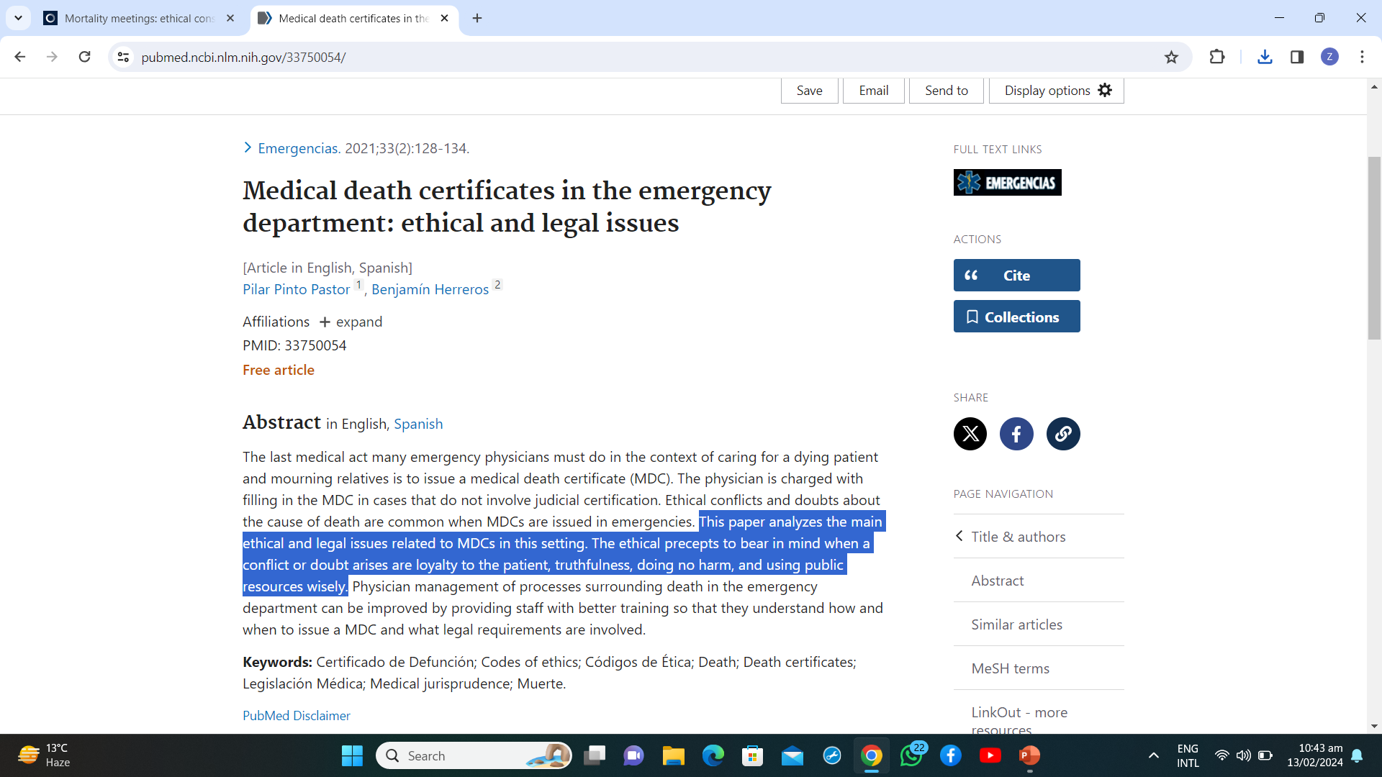
Ethics & Medical Death Certificate:
https://pubmed.ncbi.nlm.nih.gov/33750054/
Ethics

Slide 24
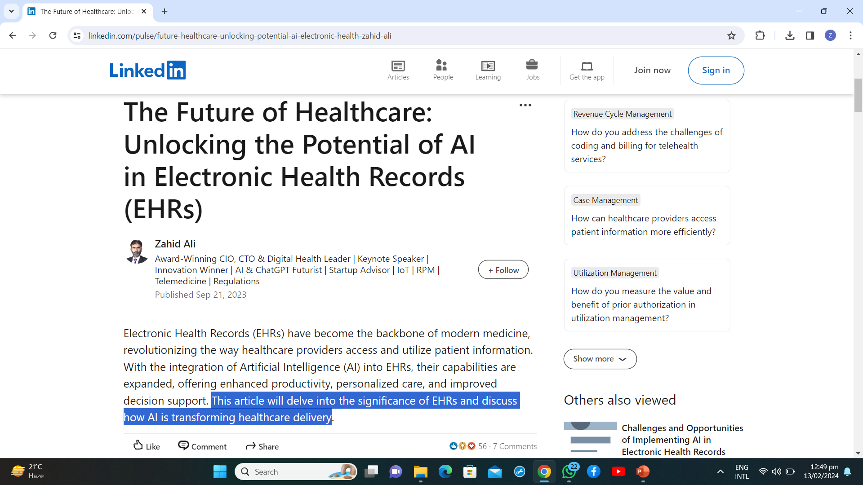
https://www.linkedin.com/pulse/future-healthcare-unlocking-potential-ai-electronic-health-zahid-ali
Artificial Intelligence

Slide 25
Group activity Session

Slide 26
Group A
In a tertiary care hospital of Punjab , total number of deaths reported due to TB was 270 and due to food poisoning was 224 in a specified period of one year, total mid year population in a specific group was estimated as 38000. Calculate specific death rate due to TB.

Slide 27
GROUP A( MCQs based assessment)
Mortality data provide the starting point for many epidemiological studies, out of which a proportion of cases of a specified disease or condition which are fatal within a specified time
a. Survival rate
b. Case fatality rate
c. Proportionate mortality rate
d. Crude death rate
e. Specific death rate

Slide 28
GROUP B
An epidemiologist noted 120 patients of uterine cancer in holy family hospital in period of last 5 months. After duration of 5 years out of 120 patients, 70 were died. Calculate survival rate for the disease.

Slide 29
GROUP B ( MCQs based assessment)
Case fatality rate represents the killing power of disease, typically used in acute infectious diseases. In an outbreak of cholera in a village of Punjab of population 2000, 200 cases have occurred and 25 died. Calculate case fatality rate.
12.5%
30.5%
35%
40%
45%

Slide 30
GROUP C
Epidemiologist reported total 3150 cases of food poisoning in month of October, November in Rawalpindi/Islamabad. Out of which 158 severe cases lead to death. Calculate case fatality rate

Slide 31
GROUP C ( MCQs based assessment)
2. An investigator measures total number of deaths in holy family hospital in the duration of one year as 380 from different causes. Calculated mid-year population in a specific group was about to be 30,000. Calculate crude death rate.
11
11.5
12.6
13
14.5

