Slide 2
Block-X Otorhinolaryngology Module-I
Measures of Morbidity Dr. Saba Dr. Bushra

Slide 3
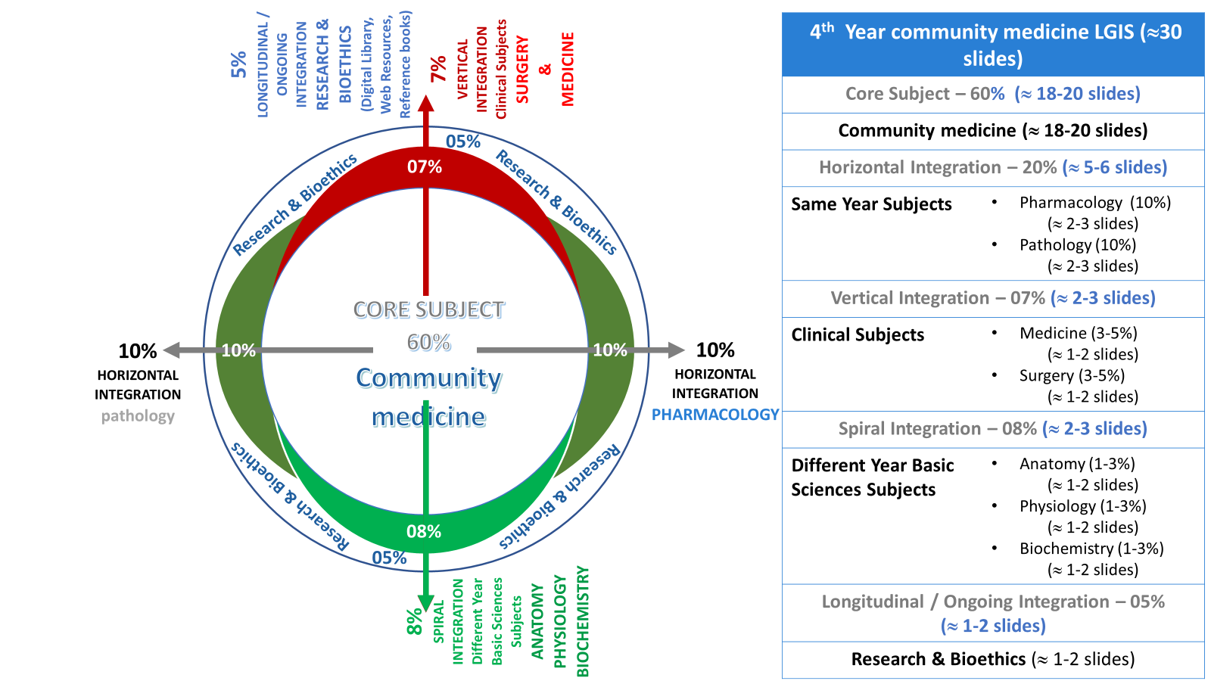
Prof Umar Model

Slide 4
Vision & Mission Statement of RMU
VISION STATEMENT | MISSION STATEMENT
Highly recognized and accredited center of excellence in medical education, using evidence based training techniques for development of highly competent health professionals, who are lifelong experiential learner and are socially accountable. | To impart evidence based research oriented health professional education in order to provide best possible patient care and inculcate the values of mutual respect, ethical practice of healthcare and social accountability.

Slide 5
SGD (Small group discussion) Standardization of teaching content
Sr. No | Headings | Approximate %
1. | Title of SGD
2. | Learning Objectives From Study Guide
3. | Core Concepts of the Topic | 70%
4. | Related Advanced Research Points | 05%
5. | Related Ethical Points | 10%
6. | Artificial Intelligence | 05%
7. | End Of Lecture Assessment | 10%

Slide 6
Learning Objectives:
At the end of the session students will be able to;
Comprehend statistical tools used for measurement of disease in the population
Calculate incidence rate and prevalence rates in various scenarios
Derive relationship in incidence rates and prevalence Rates.
Interpret relationships in incidence rates and prevalence rates
How to read a relevant research article.

Slide 7
What is Morbidity????
Core Subject
any departure subjective or objective from a state of physiological well being.
3 aspects of morbidity measured by Morbidity rates:
Frequency | Duration | Severity

Slide 8
Uses of Morbidity Data
Core Subject
Describe the extent & nature of disease load in the community
Provides more comprehensive, accurate & clinically relevant information on patient characteristics
Serves as starting point for etiological studies & plays role in disease prevention
Needed for monitoring & evaluation of disease control activities

Slide 9
Measurement indicators of Morbidity
Core Subject
Diseases Incidence rate
Diseases Prevalence rate Attack rate
Secondary attack rate

Slide 10
the No. of new cases occurring in a defined population during a specified time period.
Core Subject
Incidence
No. of new cases of specific disease
must include the unit of time used in final expression.
Its use is restricted to acute conditions
during a given time period
× 1000
population at risk during that period

Slide 11
Attack Rate:
Core Subject
It is an incidence rate, expressed as %. (100)
Used when population is exposed to risk for a limited time period such as during an epidemic.
No. of new cases of specified
= disease during a specified time interval × 100
total population at risk during same interval

Slide 12
the No. of exposed persons developing the disease within the range of one incubation period following exposure to a primary case.
Core Subject
Secondary Attack Rate:
Index case
Case which come first in notice of the epidemiologist.
Primary Case
First case of the disease in an outbreak.

Slide 13
Refers to all current cases (old & new) existing at a given point in time or over a period of time in a given population.
Core Subject
Prevalence Rate:
Although referred to as a rate, prevalence rate is really a ratio.
Types of prevalence:
Point prevalence
Period prevalence

Slide 14
Point Prevalence:
Core Subject
It is defined as the No. of all current cases (old & new) of a disease at one point in time in relation to a defined population.
Point prevalence=
No.of all current cases of disease(old and new)
existing at given period of time × 100 estimated population at the same point in time

Slide 15
the No. of all current cases (old & new) of a disease during a defined period of time (annual
….)expressed in relation to a defined population.
Core Subject
Period Prevalence:
It includes cases arising before but extending into or through this period and also the cases arising in the period

Slide 16
Period Prevalence:
Core Subject
Total number of existing cases of a disease (old and new)
of specified disease during given period of time X 100 Estimated mid interval population at risk

Slide 17
Relationship Between Prevalence & Incidence
Core Subject
P = I × D
Where
P= prevalence I= Incidence D= duration
Prevalence has been compared with a photograph, an instantaneous record
Incidence has been compared with a film, a continuous record.

Slide 18
Uses of Prevalence
Core Subject
Helps to estimate the magnitude of health / disease problems
Identify high risk populations
useful for administrative and planning purposes e.g. hospital beds, manpower needs, rehabilitation facilities

Slide 19
Ethics
The Journal of Perinatal Education (JPE): ethics of childbirth and maternity care.
Moral experienced by childbirth educators and other maternity care.
https://www.ncbi.nlm.nih.gov/pmc/articles/PMC3574464/

Slide 20
Research
Measuring morbidity: self-report or health care records?
Prevalence of specific diagnoses such as diabetes.
For other conditions, self-report and consultation records provide different measures of prevalence, and the choice of measure will depend on the morbidity.
https://academic.oup.com/fampra/article/27/1/25/480762

Slide 21
https://link.springer.com/chapter/10.1007/978-981-99-1414-2_29
Artificial Intelligence

Slide 22
Activity by each group

Slide 23
MCQs:
GROUP A:
Incidence also refers to the new spells or episodes of disease arising in a given period of time. A patient had suffered 3 times with cough and common cold in a year, total exposure of patients to that risk was 100. calculate incidence.
20
25
30
35
40

Slide 24
A village has a total of 100 under 5 children. The coverage with measles vaccine in this age group is 60%. Following the occurrence of a measles case in a child after a visit outside, 26 children developed measles.. Calculate secondary attack rate.
25%
40%
50%
65%
70%

Slide 25
GROUP B:
1. A study starts with 5000 people . Out of these 125 have the disease . What is the prevalence of that disease in the specified time period and per 1000 population.
20
25
30
35
40

Slide 26
In a population of 5000 of a small village in Punjab , incidence of a specific disease is 10 and mean duration of disease is 5 years . Calculate prevalence.
40
50
60
70
80

Slide 27
GROUP C:
In which one of the following circumstances will the prevalence of a disease in the population increase, all else being constant?
If the incidence rate of the disease falls
If survival time with the disease increases
If the recovery of the disease is faster
If the population in which the disease is measured increases
When the exposed individual has a greater risk of disease

Slide 28
In a bulk of hundred children out of whom 28 are immunized 2 of them get measles simultaneously. Subsequently 14 get measles . Assume the efficacy of the vaccine to be 100%. Caculate secondary attack rate.
5%
10%
20%
21%
24%

Slide 29
Scenario:
An epidemic of cholera was noted in remote village of Punjab in the month of July 2022.. Total population reported who were exposed to develop that disease were 1250,out of which 478 cases of cholera were diagnosed..
What type of special incidence rate is applied to this scenario.
Calculate that incidence rate
What are the uses of incidence rate

