Slide 1


Slide 2


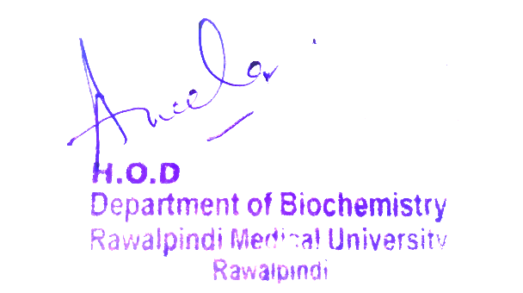
Cardiovascular System (CVS) Module
First Year MBBS(LGIS)
Carbohydrate & Lipid Classification
Presenter: Dr. Romessa Naeem Date: 27-01-25
(Demonstrator)

Slide 3
Motto, Vision, Dream
To impart evidence based research oriented medical education
To provide best possible patient care
To inculcate the values of mutual respect and ethical practice of medicine
Wisdom
Truth
Service

Slide 4
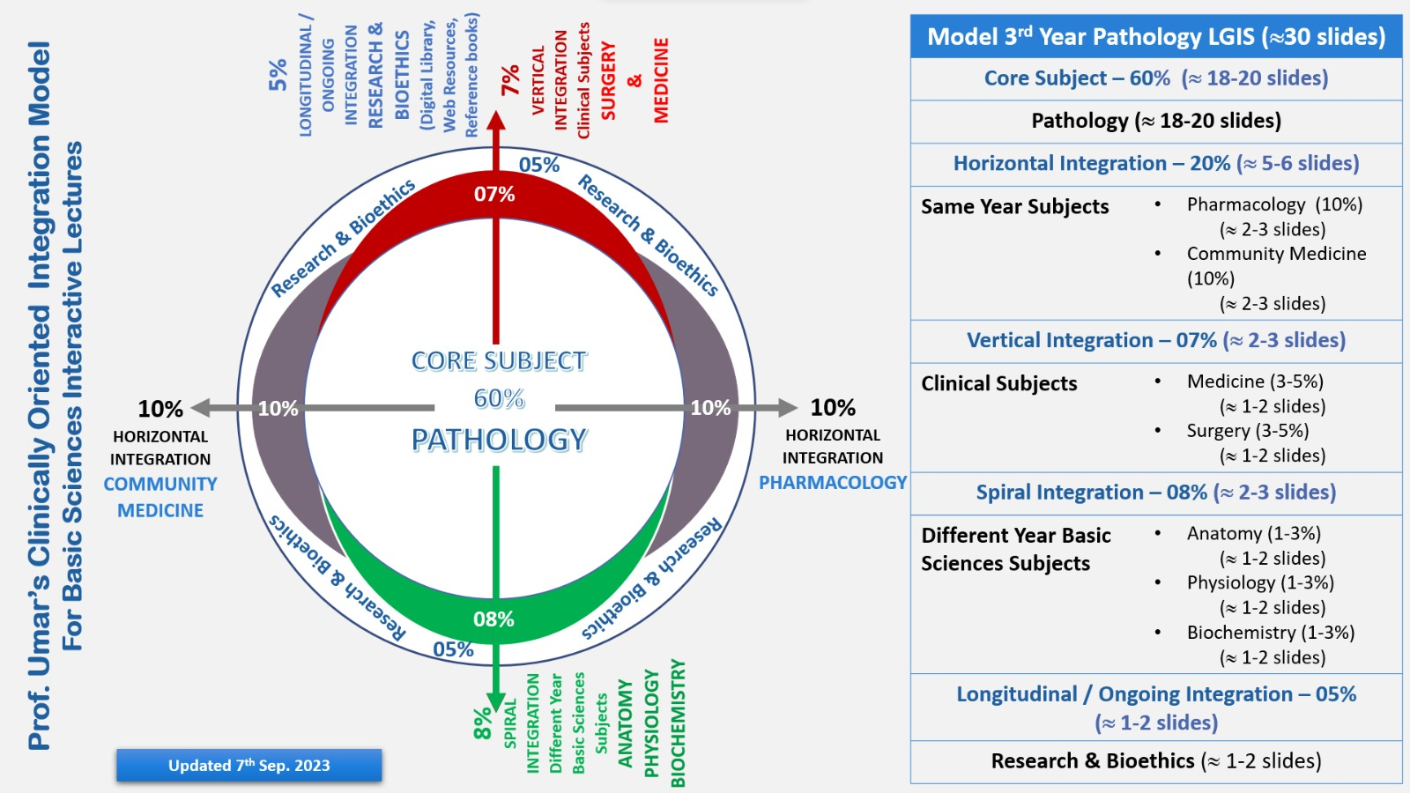
Professor Umar Model of Integrated Lecture

Slide 5
Learning Objectives
At the end of this session students should be able to
Explain classification of carbohydrates.
Discuss classification of Lipids.

Slide 6
Interactive Session
A 50-year-old male patient presents to the outpatient department with complaints of increased thirst, frequent urination, and unexplained weight loss over the past three months. He also reports feeling fatigued and having episodes of blurred vision. On examination, his BMI is 32 kg/m², and his random blood glucose level is 290 mg/dL.

Slide 7
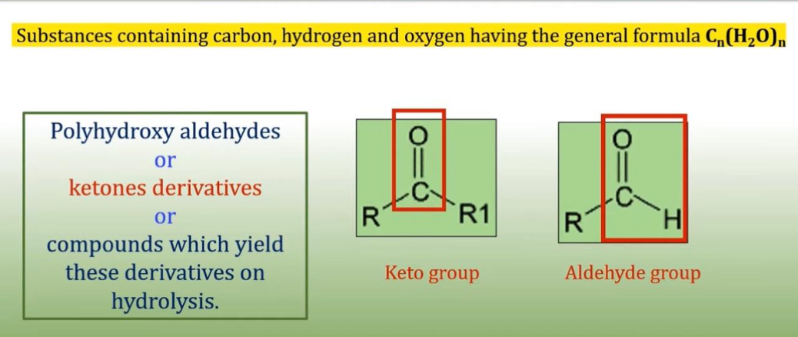
Carbohydrates : Definition
Core Knowledge

Slide 8
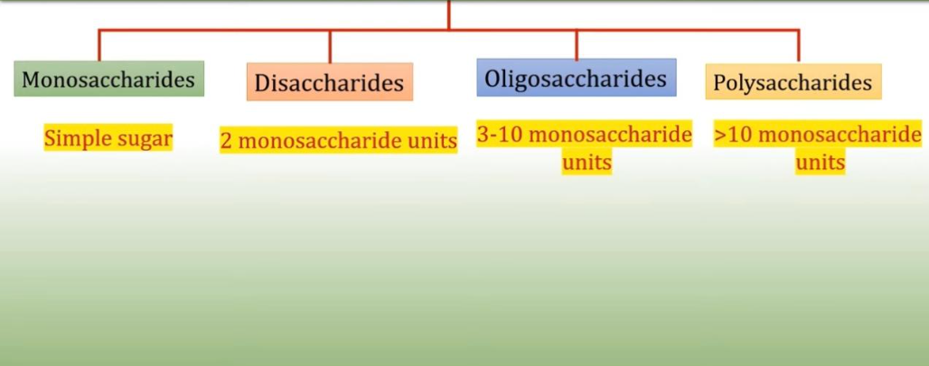
Classification of Carbohydrates
Core Knowledge

Slide 9
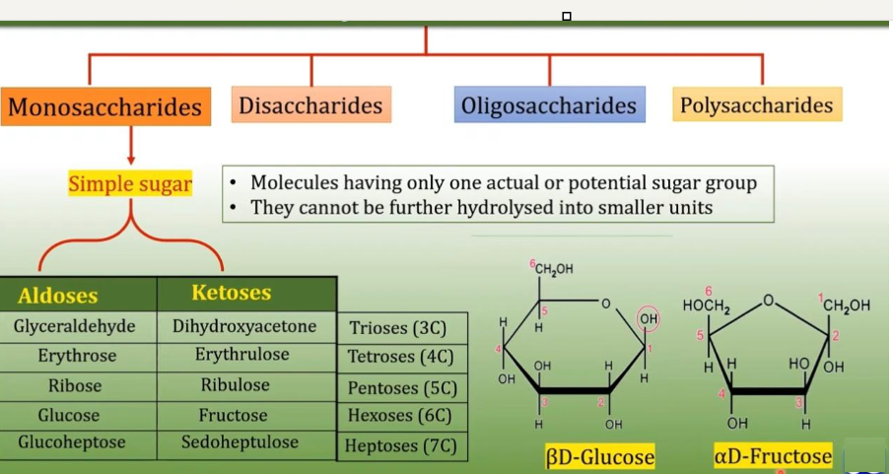
Classification of Carbohydrates
Core Knowledge

Slide 10
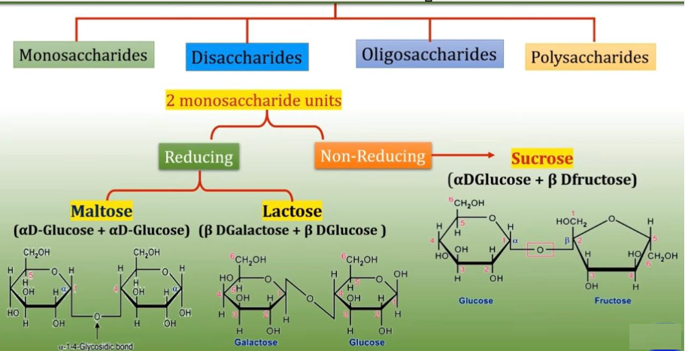
Classification of Carbohydrates
Core Knowledge

Slide 11
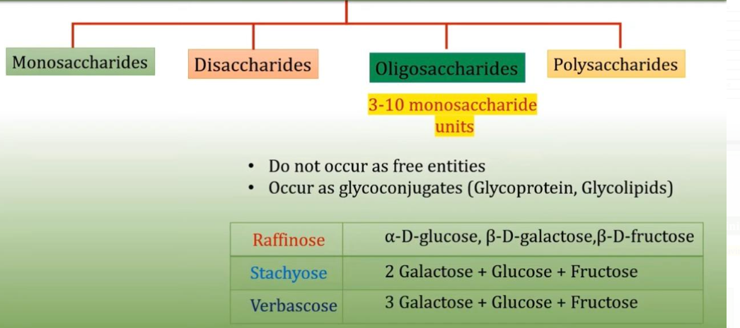
Classification of Carbohydrates
Core Knowledge

Slide 12
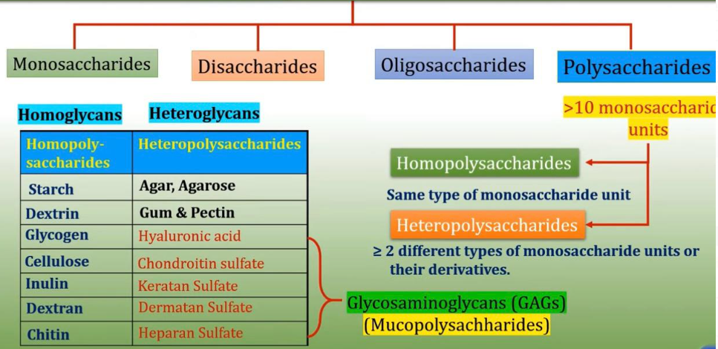
Classification of Carbohydrates
Core Knowledge

Slide 13
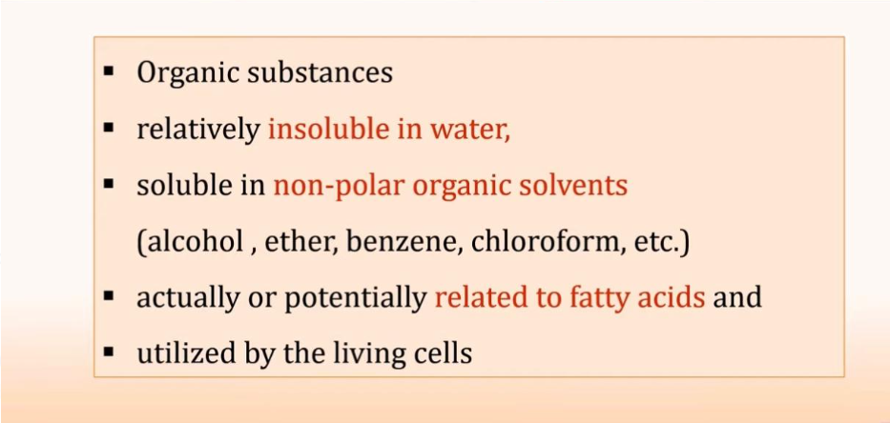
Lipids :Definition
Core Knowledge

Slide 14
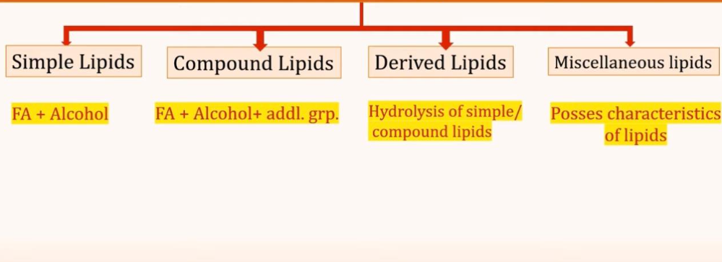
Classification of Lipids
Core Knowledge

Slide 15
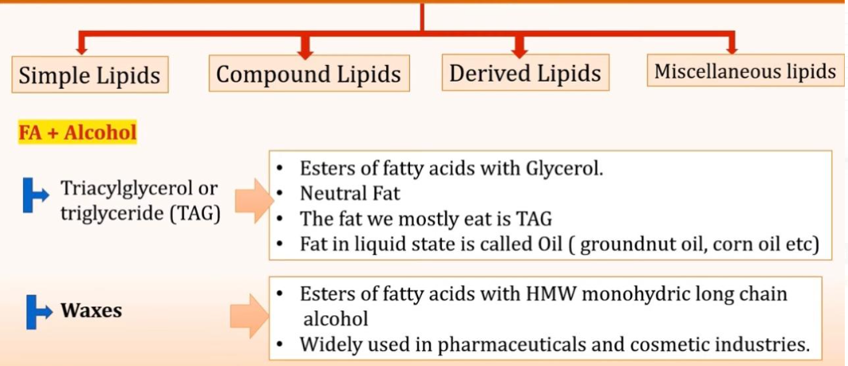
Classification of Lipids
Core Knowledge

Slide 16
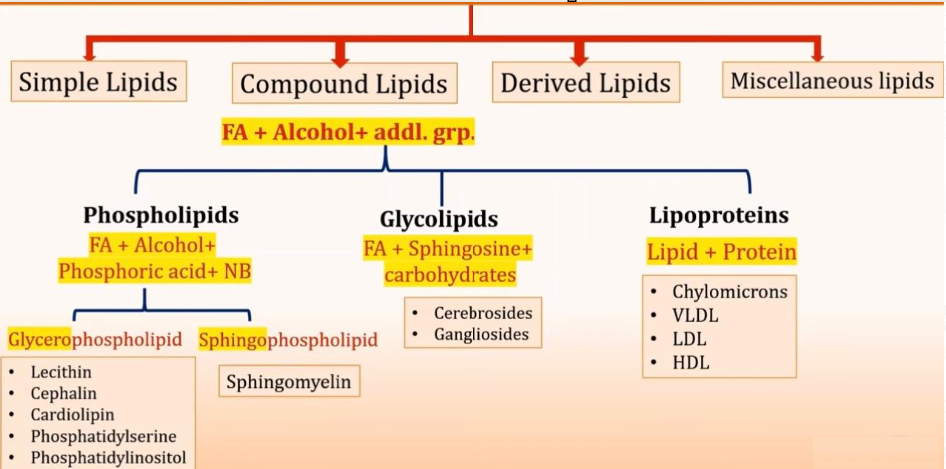
Classification of Lipids
Core Knowledge

Slide 17
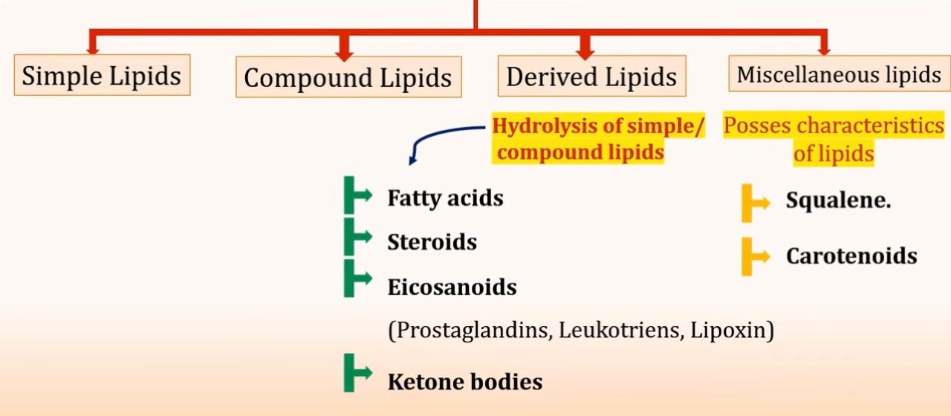
Classification of Lipids
Core Knowledge

Slide 18
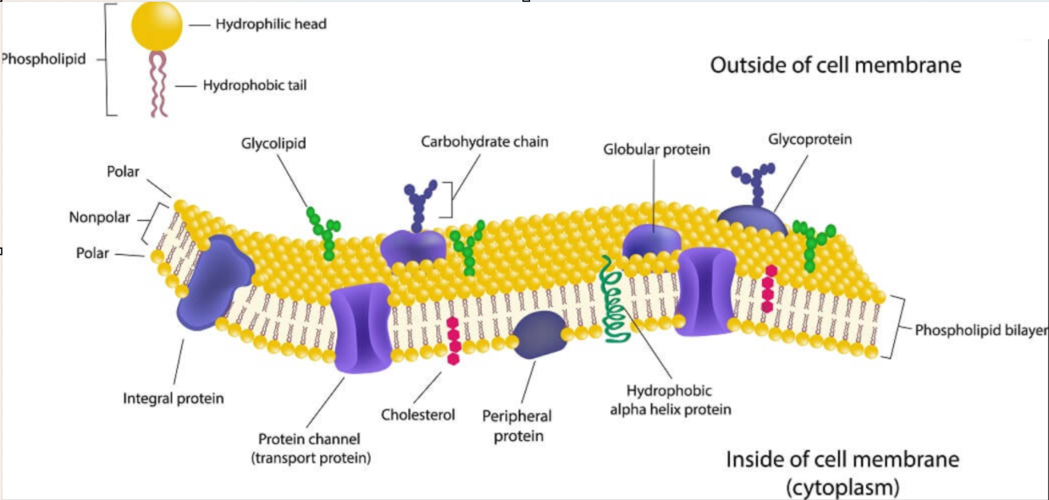
Anatomy of Cell Membrane

Slide 19
Physiology of Cell Membrane
Selective Permeability
Protection and Support
Transport
Cell Recognition
Endocytosis and Exocytosis

Slide 20
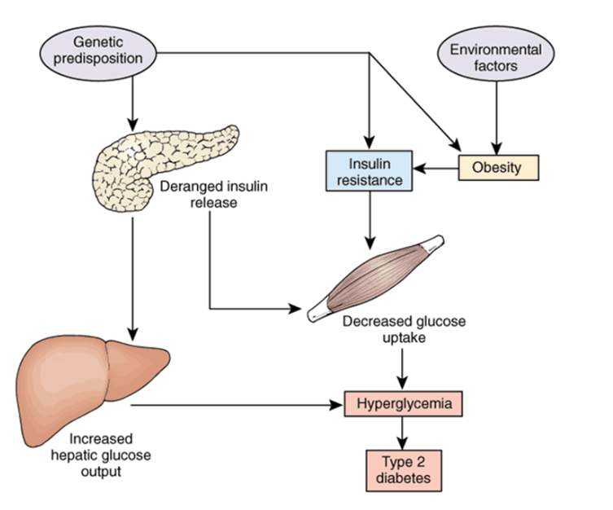
Diabetes Mellitus

Slide 21
Management of Diabetes Mellitus
Spiral Integration
Family Medicine plays important role in following manner:
Diagnosis
Education & Counselling
Dietary Guidance
Monitoring
Refer to Specialists

Slide 22
Ethical Consideration
Spiral Integration
Informed Consent
Equal Access to healthcare
Resource Allocation
Confidentiality & Privacy

Slide 23
Role of AI in Managing Diabetes Mellitus
Spiral Integration
Artificial Intelligence plays role in following aspects:
Accurate Diagnosis using AI algorithms
Personalized Nutrition
Predictive Analysis
Food Recommendations
Drug Development
Remote Monitoring through AI chatbots

Slide 24

Suggested Research Article
Link: https://www.nature.com/
Journal Name:
Title:
Dietary iron intake predicts all-cause and cardiovascular mortality in patients with diabetes
Author Name: Chenchen Yang,
Tingting
Introduction
Diabetes mellitus is a prevalent global health concern, with approximately 451 million individuals affected in 2017. Projections from the International Diabetes Federation indicate that this number is expected to rise significantly, reaching an estimated 693 million individuals by 2045 [1]. Diabetes has been linked to a heightened risk of both all-cause mortality and cardiovascular mortality [2]. It is of great significance to identify factors to delay the progress of diabetes and reduce mortality.
In this study, we aimed to investigate the relationship between dietary iron intake and all-cause or cause-specific mortality in diabetic individuals.

Slide 25
Learning Resources
Text Book of Biochemistry, Lippincott 8th edition, chapter no. 7 page no. 92-94
Text Book of Harper 32nd Edition chapter# 15 Page #143-148 chapter #21 page #196
First Aid for USMLE step 1 page #350
Google scholar
Google images

Slide 26
THANK YOU

