Slide 1
Legal Aspects of Medical practice-IV PMDC & Medical Ethics
Dr Urooj Shah
Dr Naila Batool
Forensic Medicine & Toxicology

Slide 3
Motto of RMU

Slide 4
Vision of RMU The Dream/ Tomorrow
To impart evidence based research oriented medical education
To provide best possible patient care
To inculcate the values of mutual respect and ethical practice of medicine

Slide 5
Prof Umar’s LGIS model

Slide 6
Learning Objectives
Briefly describe the objectives, structure & function of PMDC.
Enumerate the obligations and privileges of RMPs & RDPs according to PMDC rules.
Define Professional misconduct and enlist examples Professional misconduct
Define Professional secrecy and privileged communication and briefly explain its types.
Briefly describe different types of medical documentation.

Slide 7
Pakistan Medical and Dental Council Ordinance (1962)
Two specific objectives:
To established Pakistan Medical & Dental Council (a statutory body)
To perform allocated duties

Slide 8
Constitution of PMDC:
Federal government of Pakistan is responsible to established PM&DC.
Elected members:
One member of the national assembly
One from each provincial assembly
One from each medical university
One from each public sector medical college
One from each private medical colleges
Four registered medical practitioners (one from each province)
Two registered dental practitioners
RMP’s and RDP’s shouldn’t be in government service.
Members should be Pakistani’s and residing in Pakistan.

Slide 9
Nominated members:
One legal member (ex judge of supreme/high court)
Medical members
Director General Health Pakistan (President)
Secretary Health from each province
Four from the federal government and one from armed forces
The council elects:
A President
An Executive committee
Sub committees (2-3)

Slide 10
Functions/ Statuted Duties of PMDC
The Pakistan Medical and Dental Council was duly constituted under the Medical & Dental Council Ordinance in 1962 and in June 1964 and is empowered to:
Look after public interest – by maintaining proper medical/dental standards.
Supervise Medical/Dental Education in the country.
Maintain a register of qualified doctors and dentists, qualifying from duly recognized institutions.
Take such disciplinary actions, which may be required for criminal convictions or serious professional misconduct of a doctor.
The Council is not an Association or a Union for protecting professional interests.

Slide 11
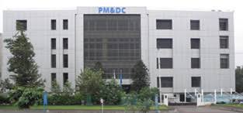
Functions/ Statuted Duties of PMDC
Maintenance of RMP’s/ RDP’s Medical Register
Professional Conduct Scrutiny
Proficiency Standard Monitoring of RMP’s/ RDP’s

Slide 12
Maintenance of RMP’s/ RDP’s Medical Register
Medical register has two parts i.e. A and B
Ordinary medical practitioner: having only MBBS degree
Specialist: having additional medical qualification
Register is prepared/ updated ------- Registrar ---------under supervision of President of the Council.
It is a public document within the meaning of Evidence
Act 1872, open to public inspection.

Slide 13
Medical Register
List-I
Provisionally Registered RMP
(For a specified period)
List-II
Fully Registered RMP
(Independent Practice)
List-III
Registered RMP having additional Med. Qualification

Slide 14
Professional Conduct Scrutiny
Court Conviction Patient Complaint Hospital Administration
President of PM&DC
Frivolous complaints rejected
Complaint dismissed
Warned to improve conduct
Doctor asked to explain

Slide 15
DISCIPLINARY COMMITTEE
jkjk
Complaint dismissed
Name suspended for a period
Name erased from register
Disciplinary proceedings against a medical practitioner.

Slide 16
Proficiency Standard Monitoring of RMP’s/ RDP’s (Three Pronged Strategy)
Eligibility criteria for Medical/ Dental Teachers
Evaluation of medical/ Dental Courses
Inspection of Medical/ Dental Institution

Slide 17
Obligations of RMP’s and RDP’s
Notification of change of address of practice or transfer within a period for 30 days of the change
Not using any name, title, description or abbreviation indicating that he possesses additional qualification, which is not conferred on him.
Shall comply with the Code of Medical Ethics

Slide 18
Privileges of RMP’s and RDP’s
Seeking of employment against job(govt or armed forces) and permission for independent practice
Issue medical certificates to patients for administrative and judicial purpose
Charging of fee for rendered medical/dental services

Slide 19
Professional Misconduct
If a medical man during his professional work has done something which is regarded disgraceful or dishonorable by his colleagues of good repute and competency, he is guilty of professional misconduct.
Example:
Abuse of medical practitioners privileges
Abuse of doctor patient relation
Abuse of professional knowledge
Associating unqualified persons
Advertising to have unreasonable gains

Slide 20
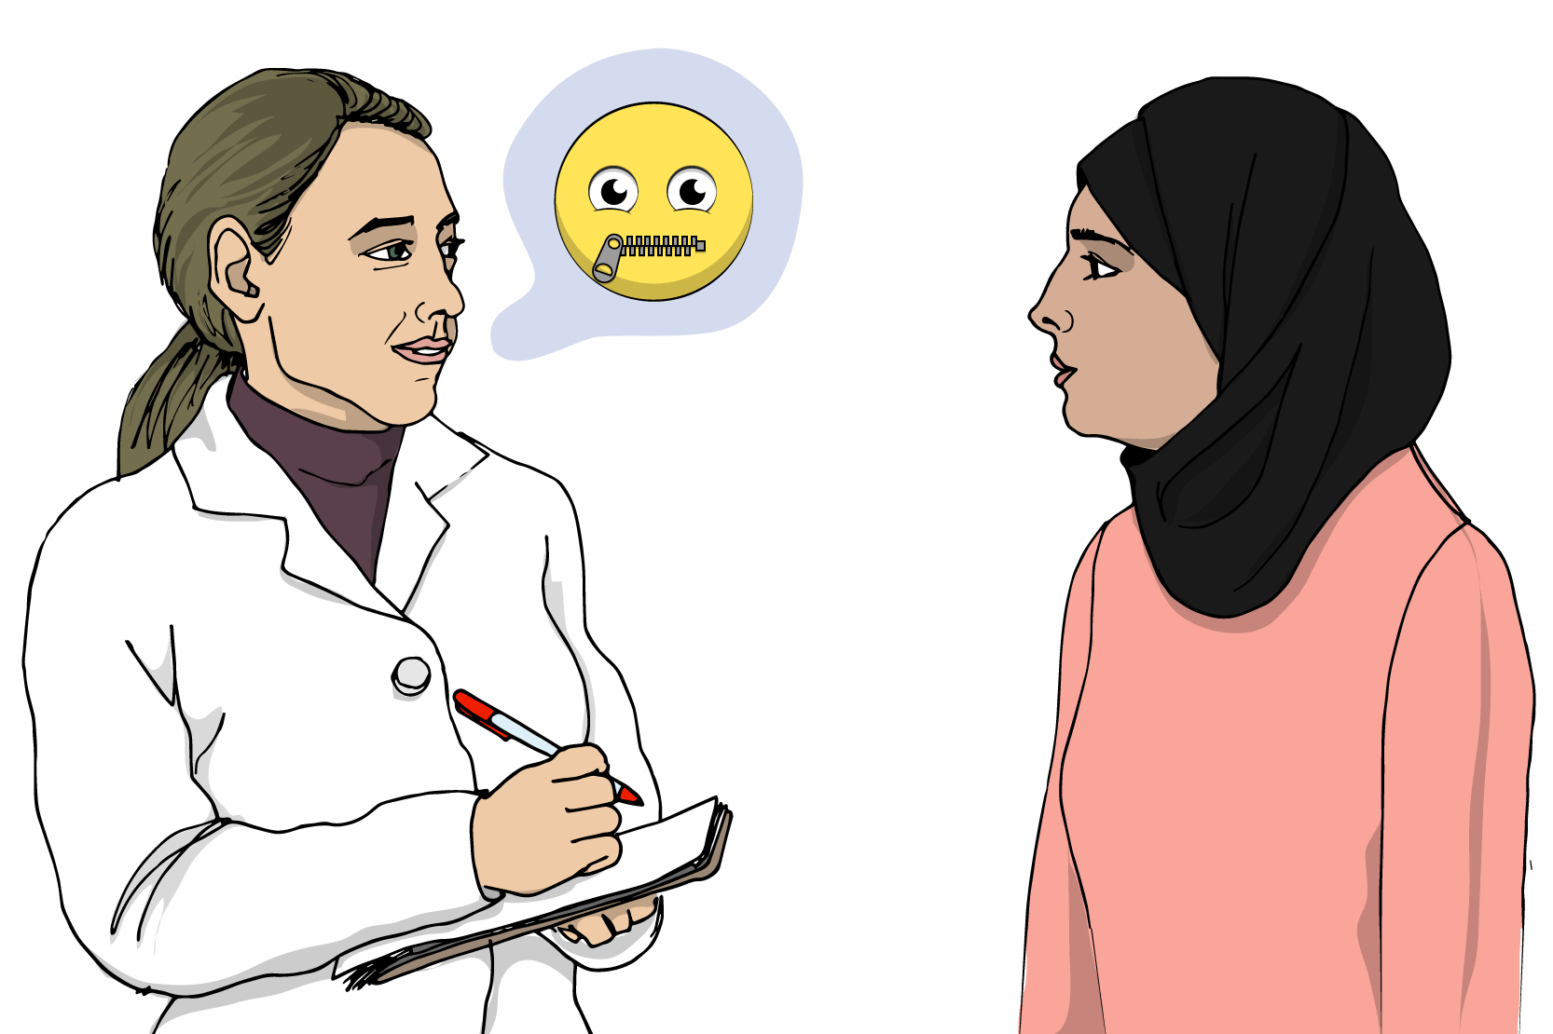
Professional Secrecy
Definition: “Professional secrecy is the obligation imposed on professionals to keep information confidential that is obtained from a client when practising their profession.”
It is important both in law and medical ethics
Medical information about the patient is confidential
Disclosure of patient’s secret can lead to legal action

Slide 21
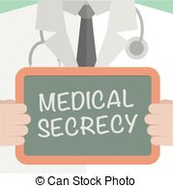
Professional Secrecy
Trial of Professional secrecy violation is in civil court against the medical practitioner
Ethical action can be taken by disciplinary committee of PM&DC
This is not absolute privilege; therefore careful disclosure of information to the agencies for the protection of the society.

Slide 22
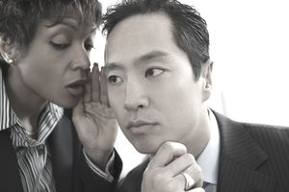
Privileged Communication
Definition: “It is disclosure of patient’s information in good faith in the course of legal duty.”
Types:
There are two types of privileged communication.
Absolute privilege
Qualified privilege

Slide 23
Privileged Communication
Absolute Privilege
The court of law and parliament of the country has Absolute authority to receive information about the patient.
Refusal may be contempt of court.
Medical practitioner can pass on the information on a piece of paper (professional secrecy).

Slide 24
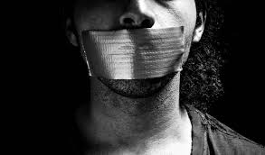
Privileged Communication
Qualified Privilege
All notifications of births, deaths and industrial, infectious or contagious diseases should be reported.
Rationale of this disclosure is that the interest of the community is superior to that of the individual.

Slide 25
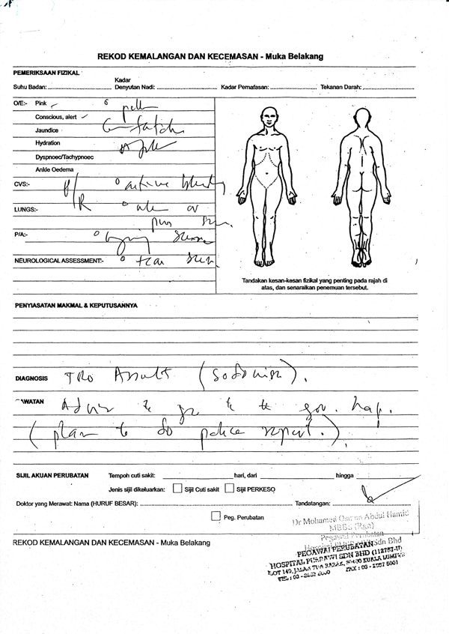
Medical Documentation
Most common medical documents in medical practice
Medical prescription
Medical report
Medical certificate
Medical notification

Slide 26
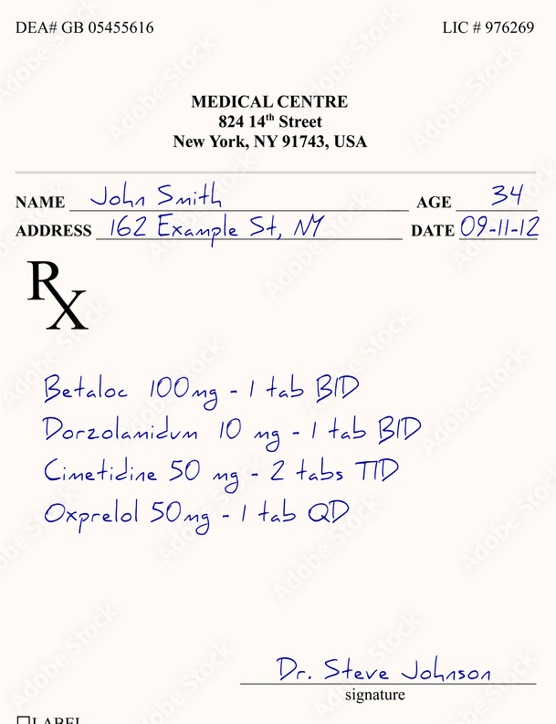
Medical Documentation
Medical prescription:
“ A prescription, often abbreviated ℞ or Rx, is a formal communication from a physician or other registered healthcare professional to a pharmacist, authorizing them to dispense a specific prescription drug for a specific patient. ”

Slide 27
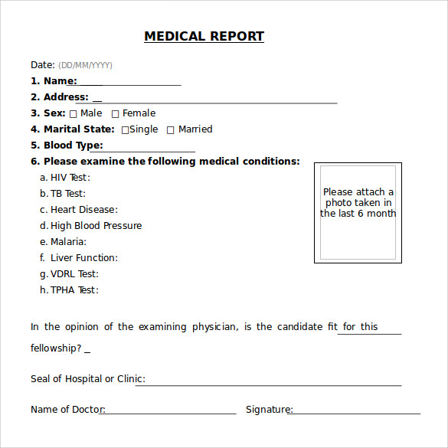
Medical Documentation
Medical report:
“ Medical records are comprehensive records of patients' consultations and are maintained by GPs and other practice staff. Medical reports are based on information within a patient's medical record and/or a clinical examination. ”

Slide 28
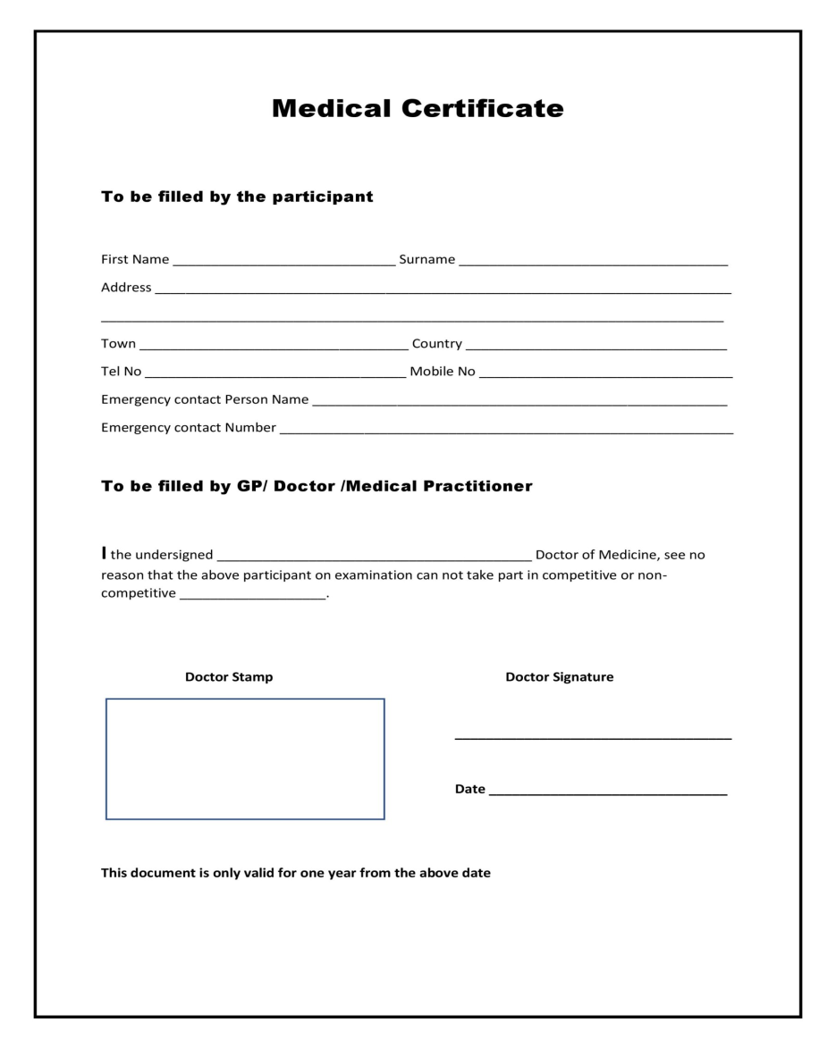
Medical Documentation
Medical certificate:
“It is a written statement from a physician or another medically qualified health care provider which attests to the result of a medical examination of a patient.”

Slide 29
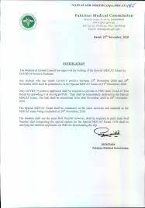
Medical Documentation
Medical notification:
“It is the act of reporting the occurrence of a communicable disease or of an individual affected with such a disease to health authorities.”

Slide 30
Research
https://www.sciencedirect.com/science/article/abs/pii/S1357303920300803
https://academic.oup.com/qjmed/article/102/8/513/1598923
https://www.pmc.gov.pk/Documents/law/PMDC%20Code%20of%20Ethics%202018.pdf
https://pmdc.pk/
https://prr.hec.gov.pk/jspui/bitstream/123456789/7000/1/Nargis_Khan_Administrative_Social_Sciences_2015_SR_24.10.2016.pdf

Slide 31
Biomedical Ethics
Ethics not only deal with choices made by the clinicians but patients as well and the duties and obligations of clinicians to their patients.
Ethical practice is a systematic approach to medical decision making and considering the interests of all affected by the decision.
https://journals.lww.com/chri/fulltext/2021/08010/professionalism_and_bioethics.3.aspx

Slide 32
Family Medicine
https://www.ncbi.nlm.nih.gov/books/NBK574557/
The most common problem family physicians face with procedures is not that they are doing procedures but they are actually lacking in communication skills https://www.ncbi.nlm.nih.gov/pmc/articles/PMC2779963/
https://www.aafp.org/pubs/fpm/issues/2003/0300/p29.html

Slide 33
How To Access Digital Library
1. Go to the website of HEC National Digital Library.
2. On Home Page, click on the INSTITUTES.
3. A page will appear showing the universities from Public and Private Sector and other Institutes which have access to HEC National Digital Library HNDL.
4. Select your desired Institute.
5. A page will appear showing the resources of the institution
6. Journals and Researches will appear
7. You can find a Journal by clicking on JOURNALS AND DATABASE and enter a keyword to search for your desired journal.

Slide 34
THANK YOU

