Slide 1
Legal Aspects of Medical practice-III Medical Ethics
Dr Urooj Shah
Dr Naila Batool
Forensic Medicine & Toxicology

Slide 3
Motto of RMU
Wisdom
Truth
Service

Slide 4
Vision of RMU The Dream/ Tomorrow
To impart evidence based research oriented medical education
To provide best possible patient care
To inculcate the values of mutual respect and ethical practice of medicine

Slide 5
Prof Umar’s LGIS model

Slide 6
Learning Objectives
Define medical ethics and enlist the principles of medical ethics.
Define consent and briefly describe its various types.
Enlist the rules of a Consent and State the age of consent.
Define medical negligence with examples.
Briefly describe different types of negligence and burden of proof.
Enlist different defences available to a doctor in case of medical negligence and precautions to avoid negligence.

Slide 7
Medical Ethics
Ethics:
“Ethics offers a concept to evaluate and guide moral decision making”
The word ethics is derived from a Greek word “ethos” , which means “character”.
Medical etiquette refers to “conventional laws, customs of courtesy and code of conduct for doctor with his colleagues

Slide 8
Medical Ethics
Definition
“Medical ethics are the moral principles for registered medical practitioners in their dealings with each other ,their patients and state”
Medical ethics covers the following:
Confidentiality of information of patient
Informed consent
Prompt diagnosis & management with followup.
Hippocrates (400BC)
Greek physician
Code of ethical principles for doctors and their students
Hippocratic oath

Slide 9
Medical Ethics
4 Principles of Medical ethics:
Autonomy
Beneficence
Confidentiality
D no harm
Equity-Justice
Medicolegal Issues during Medical Treatment & Procedures
Consent
Negligence

Slide 10
Consent
Definition:
“Means voluntary agreement, compliance or permission”
Types of Consent:
Implied
Express
Blanket

Slide 11
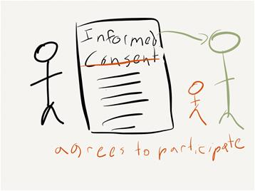
Consent
Implied Consent:
Most common variety of consent, for example, patient comes & sit on the stool, it means he has already consented
Express Consent/ Informed Consent:
It is the type of consent when the patient having fullknowledge about his medical treatment and its implications, agrees to it.
Oral
Written
Oral consent:
Oral consent is obtained in the presence of a disinterested party. Oral consent is valid in the eyes of law.
Written consent:
Written consent is necessary for evidential purposes (proof).

Slide 12
Consent
3. Blanket:
It is obtained without fully explaining the treatment.
Taken in case of surgery
Signature of the patient/ guardian is taken on a printed form, but not valid in law ---------- is the best Consent.

Slide 13
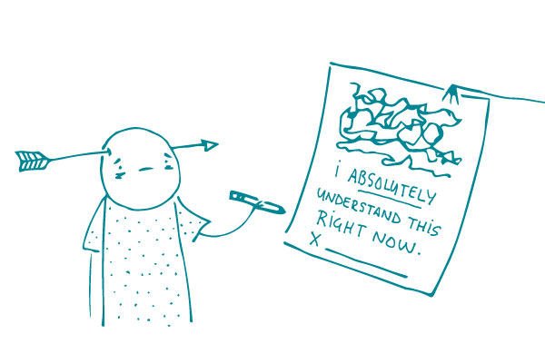
Consent
Rules of a Consent
Consent must be:
Full 4. Clear
Free 5. Informed
Voluntary 6. Personal
7. Direct

Slide 14
Consent
Age of consent:
Patient should be a ------------- major
Children under the age of majority -------- Parents/guardian
Unconscious and mentally ill patient --------------- Parents/guardian
Refusal to consent is an absolute bar for examination except under court order
No consent needed for medico-legal autopsy. Done by court order.
A doctor can withhold an information from the patient in good faith, he should tell this to the patients relatives.

Slide 15
Consent
Examples:
Insertion of intrauterine contraceptive device should be inserted with the consent of husband
Insertion of IUCD to save a women from pregnancy if she is suffering from a life threatening disease is justified.
Permanent sterilization of both male and female with surgery must never be performed on minors even with the permission of parents.
Permanent sterilization to save the life of the women in good faith is permitted.
In organ transplantation surgery, consent from both donor and recipient is required.
In the dead consent for organ transplant is obtained from the next of kin.

Slide 16
Consent form

Slide 17
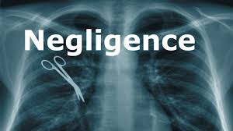
Medical Negligence
Definition:
“ A medical practitioner has a duty to conform to professional standards and to exercise reasonable carefulness to avoid damage to his patient ”
e.g. misdiagnosis, incorrect treatment, surgical mistakes
Types of Medical Negligence
Civil Negligenc
Contributory Negligence
Third Party Negligence
4. Criminal Negligence

Slide 18
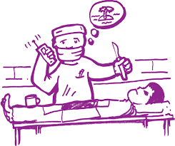
Medical Negligence
Civil Negligence:
Results from wrong treatment, undue prolongation of treatment, causing undue sufferings.
Civil court --------------------- money.
Extraction of a healthy tooth
Failure to X-ray a fractured body part
Failure to give anti-tetanus vaccine
2. Contributory Negligence
Patient becomes negligent and is careless in carrying out medical instructions.
*Compensation is reduced.

Slide 19
Medical Negligence
Third party Negligence
Para medical staff become careless and may cause damage to patient’s health
Liabiality of compensation shifts from Medical practitioner to Para Medical staff.
*compensation is shared by para-Medical staff.

Slide 20
Criminal Negligence:
From gross and wicked recklessness, showing no regard for the safety of patient’s life resulting sometimes in death of patient.
Trial in Criminal court (state matter) e.g.
Over anaesthetizing the patient
Leaving patient un-attendant after opening the abdomen by a surgeon

Slide 21
Medical Negligence
What Defenses are available to the doctor?
Res Ipsa Loquitur:
Things speaks for it self.
Novus actus intervenience:
Breaking the chain.
Respondent superior (caption of the ship):
Incharge or head will be responsible.
Dicotomy:
Fee sharing or fee splitting.

Slide 22
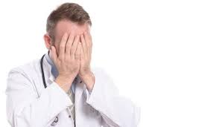
Medical Negligence
Burden of Proof of Negligence
It rests on the patient except in res ipsa loquitur.
In such cases the burden of proof shifts from the patient to the doctor to prove that he is not negligent. e.g
Leaving instruments in the abdomen.
Burns due to live electric cautery.

Slide 23
Medical Negligence
Precautions to avoid negligence
To prevent, first and foremost, patient injuries and, secondarily, malpractice claims, physicians should:
Follow their patients complaints to full diagnosis,
Prepare themselves mentally before procedures,
Know when its time to consult with a colleague or make a referral.

Slide 24
Biomedical Ethics
What is the ethical principle of negligence?
Negligence: lack of the required precautions and attention; when in spite of having the knowledge, it is not applied and causes damage.
Incompetence: Lack of skills and experience of technical and practical knowledge; acting without having the knowledge and causing damage.
https://www.healthcareethicsandlaw.co.uk/intro-healthcare-ethics-law/principlesofbiomedethics
https://www.intechopen.com/chapters/75717

Slide 25
Research
Medical Mistakes That Show Negligence
Improper Anesthesia During Surgery. ...
Problems During Childbirth. ...
Missing a Cancer Diagnosis. ...
Undiagnosed Conditions Like Heart Disease. ...
Misdiagnosing a Blood Clot. ...
Medication Prescription Errors. ...
Post-Surgical Negligence
https://ohiotiger.com/common-examples-of-medical-negligence/
https://www.ncbi.nlm.nih.gov/pmc/articles/PMC2779963/
https://www.elsevier.es/en-revista-clinics-22-articulo-medical-errors-medical-negligence-defensive-S1807593222005026

Slide 26
Family Medicine
The most common problem family physicians face with procedures is not that they are doing procedures but they are actually lacking in communication skills https://www.ncbi.nlm.nih.gov/pmc/articles/PMC2779963/
https://www.aafp.org/pubs/fpm/issues/2003/0300/p29.html
A doctor can be held guilty of medical negligence only when he falls short of the standard of reasonable medical care.
https://www.ncbi.nlm.nih.gov/pmc/articles/PMC2779963/

Slide 27
How To Access Digital Library
1. Go to the website of HEC National Digital Library.
2. On Home Page, click on the INSTITUTES.
3. A page will appear showing the universities from Public and Private Sector and other Institutes which have access to HEC National Digital Library HNDL.
4. Select your desired Institute.
5. A page will appear showing the resources of the institution
6. Journals and Researches will appear
7. You can find a Journal by clicking on JOURNALS AND DATABASE and enter a keyword to search for your desired journal.

Slide 28
THANK YOU

