Slide 1
Legal Aspects of Medical practice-II Witness & Evidence
Dr Gulzaib Pervaiz
Dr Shahida Bashir
Forensic Medicine & Toxicology

Slide 3
Motto of RMU

Slide 4
Vision of RMU The Dream/ Tomorrow
To impart evidence based research oriented medical education
To provide best possible patient care
To inculcate the values of mutual respect and ethical practice of medicine

Slide 5
Prof Umar’s LGIS model

Slide 6
Learning Objectives
Define witness and briefly enlist its types.
Define evidence and enumerate and briefly describe the different types of evidence.
Briefly explain the admissibility of evidence in court.
Briefly explain the stages of evidence recording in the court.
Differentiate between dying declaration and dying deposition.

Slide 7
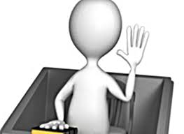
Witness
Definition:
“A witness is a person who sees an event(crime or accident)”.
A fact or information after its presentation to the court of law by a witness is called testimony.”

Slide 8
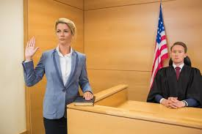
Types of witnesses
Common witness
Expert witness
Hostile witness

Slide 9
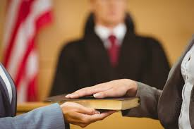
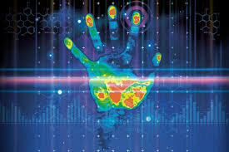
How is a witness called??
Common/ordinary witness:
Who testifies what he actually saw or heard.
Expert witness:
Who is qualified and trained to draw conclusion from the facts observed by him or presented to him.
Examples:
hand writing experts
finger print experts
ballistics experts
chemical examiner

Slide 10
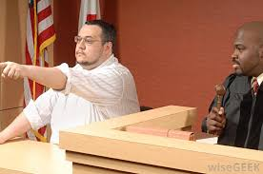
Hostile witness:
Who gives statements contrary to the facts or conceals facts intentionally.
Such a witness is guilty of the crime of perjury.

Slide 11
How a witness is called by the court?
First call ------ Summon ------- must be obeyed
Second call ----- Warrants to arrest
Third call ------ Written proclamation/ execution of bond

Slide 12
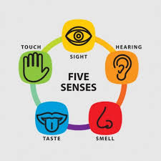
Evidence
Definition:
“ A fact or an information which a witness is
capable of perceiving through any of his senses
i.e. vision, hearing, smell, taste or touch”
It is presented to the court of law after taking an oath.

Slide 13
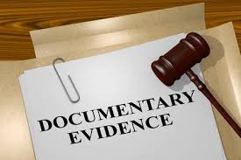
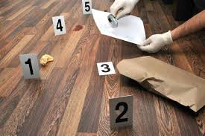
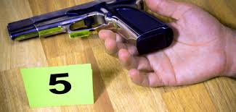
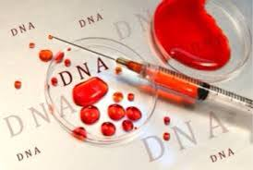
Types of Evidence
Direct Evidence
Documentary Evidence Primary Secondary
Physical Evidence
Circumstantial Evidence

Slide 14
Direct evidence:
“Means testimony given by a witness as to what, he has himself perceived by his own senses”
Also known as Oral evidence. Examples: A man saw a car hitting a boy,his evidence is a direct evidence.

Slide 15
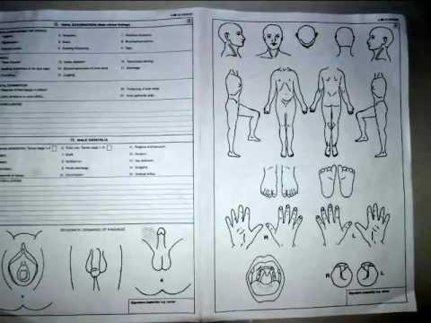
Documentary evidence:
All documents produced for the information of the court of law.
Examples:
Medical certificates
Age certificates
Postmortem reports
Dying declaration
Documentary evidence is admissible in the court after cross examination.

Slide 16
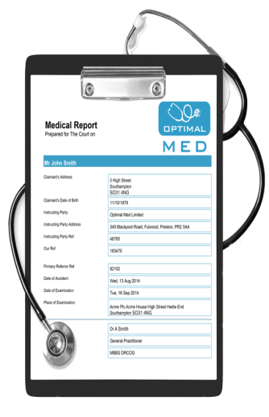
Documentary evidence:
Primary document:
The original document itself.
Where a document is executed in several parts, each part is a primary evidence.
Where a document is executed in counterparts, each counterpart is a primary evidence.
Where a uniform process, e.g. printing, photography, lithography makes a number of documents, each one is primary evidence of the contents of the rest.
Secondary document:
Includes certified copies made from original document.

Slide 17
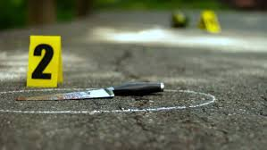
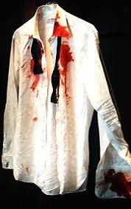
Physical evidence:
Items that come from a nonliving origin e.g. fibers, rope, knife, revolver etc.
Circumstantial evidence:
It consists of facts from which an inference can be drawn. It is far more reliable than evidence given by a eye witness……Why??? Examples:
Blood on the clothes of the accused.
A dead man on the road with broken glass pieces and tire marks.
Crime Scene???

Slide 18
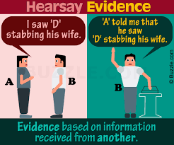
Hearsay or indirect evidence
Evidence of the witness who has no personal knowledge of facts but repeats only what he has heard from someone else.
It is not admissible in the court of law except dying declaration
Example:
If A has not himself seen B hitting X but he has heard from Y, then this is the ------------ evidence.
If A has seen B hitting X with a stick and he has himself witnessed the incident. This is a ----------- evidence.

Slide 19
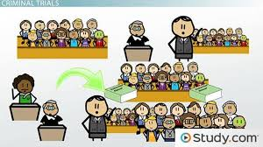
Stages of Evidence of a witness
Examination-in-chief
Cross examination
Re-examination
Questions by the court

Slide 20
Examination-in- chief (Direct examination)
Main component of evidence.
Questions are put to the witness by the lawyer for the side which has summoned him.
Purpose: all facts placed before the court.
No leading questions. e.g. Doctor is this injury caused by a sharp weapon?
Doctor what type of weapon causes this injury?

Slide 21
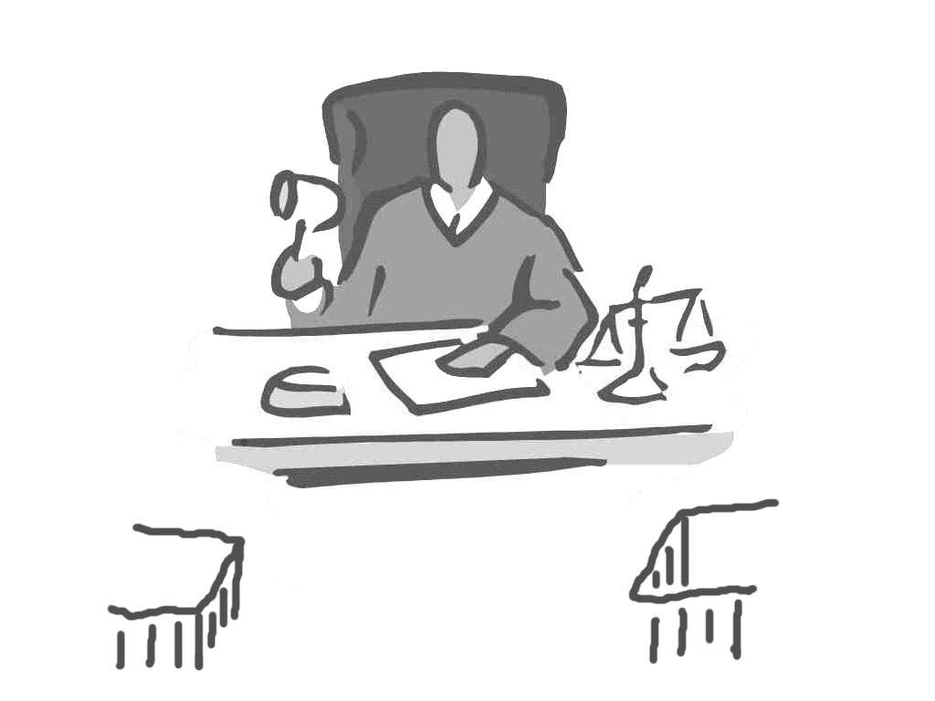
Examination-in- chief
Clerk of the court
witness
accused
Prosecution attorney
Defense attorney

Slide 22
Cross examination
Second part of the evidence.
Conducted by the lawyer of the opposite party who defends the case.
Purpose: to weaken the evidence of the witness by showing that his details are inaccurate, conflicting etc.
Leading questions are allowed.

Slide 23
Cross examination
Clerk of the court
witness
accused
Prosecution attorney
Defence attorney

Slide 24
Re- examination (Re-direct examination)
Third part of the evidence.
Conducted by the party who has called the witness.
Purpose: to rectify discrepancies.
No leading questions.

Slide 25
Re-examination
Clerk of the court
witness
accused
Prosecution attorney
Defence attorney

Slide 26
Questions by the court
The judge may ask questions to the witness at any stage of trial.
Clerk of the court
?
witness
1 Examination-in-chief
accused
?
2 Cross examination
?
Re-examination
?

Slide 27
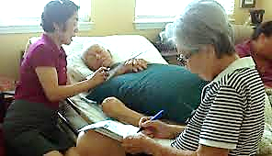
Deposition
It is the statement:
In court of law
Of a witness
On oath
In writing
In presence of accused
Read over
Signed by person making it and the judge
Declaration: A formal statement.

Slide 28
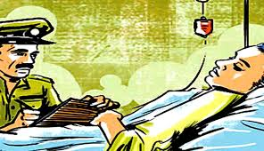
Dying Deposition
When an important witness is suffering from serious illness, unable to come to court of law to record his evidence, court of law will go to him (hospital or house) to record his evidence as dying deposition.
All conditions of deposition will be fulfilled at the place where the witness is present.

Slide 29
Dying declaration
Statement of the dying victim of criminal assault, whose death is imminent, he is the only eye witness, no time to arrange dying deposition, recorded by the medical practitioner.

Slide 30
Difference between dying declaration & dying deposition
Dying declaration | Dying deposition
Compos mentis | Compos mentis
Oath not necessary | Oath is essential
Recorded by any credible person | Recorded by a justice of peace
Accused not necessary | Accused essential
Homicides cases | Any case
Statement of the dying person | Statement of dying person and cross examination by accuse
Read over and signed | Signature of dying witness is necessary
Send to illaqa magistrate sealed | Not necessary
Valid on the death of declarant | Remains valid even after declarants recovery
Value less | Value more

Slide 31
Exceptions to Admissibility of Evidence
Dying declaration
Dying deposition
Statement of witness in a previous case
Professional text books
Statement of person whose production entails extra expense or time
Law of necessity

Slide 32
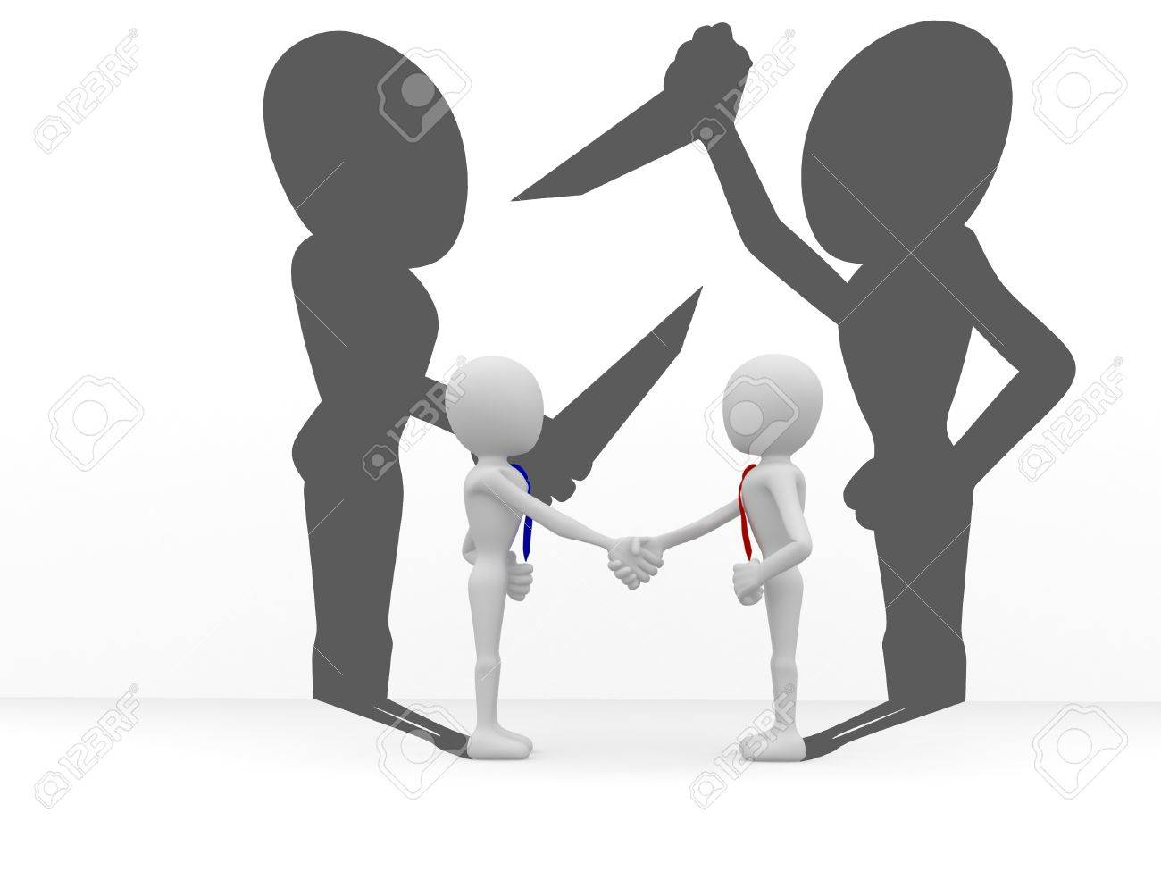
Mens rea: Evil or criminal intention.
Actus reus: Evil action.
Mens rea + Actus reus = Crime
Mens rea - Actus reus = No crime
No Mens rea + Actus reus =Accident
Mens rea is absent
Insanity
Immaturity
Intoxication

Slide 33
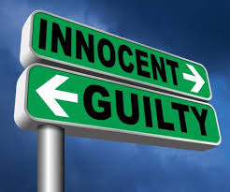
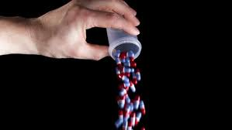
General Presumption in Law
Everyone is sane and responsible for his actions.
Everyone is innocent until proved guilty.
If any doubt about the allegations, the court will resolve the case in favor of the accused.
General Exception in Law
Immaturity ------- Sec 83
Insanity -------- Sec 84
Intoxication -------- Sec 85

Slide 34
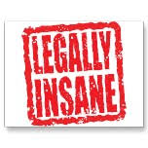
Plea of Insanity (Three verdicts)
Unfit to plead: Sane at the time of crime-------- later becomes insane ------- not able to defend himself ------- court suspends proceedings ------- sanity is restore.
Guilty but insane: Defendant completely absolved of his guilt ----- due to insanity.
Diminished responsibility: Defendant is not completely absolved but hsis sentence is mitigated or reduced.

Slide 35
Rules For Insanity:
Mc naughton’s rule
Durham’s rule
Irresistible impulse

Slide 36
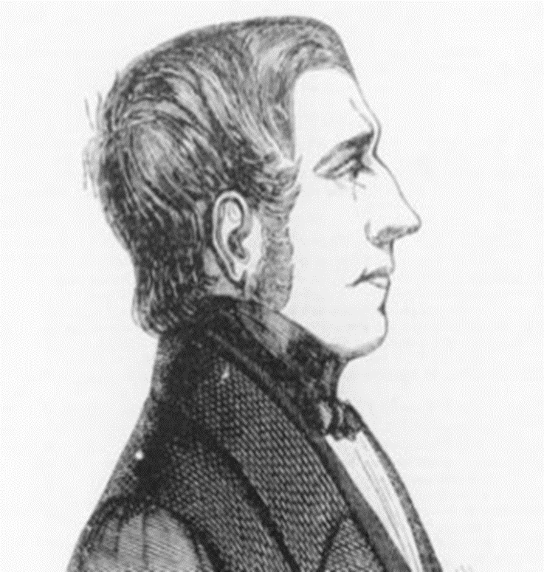
History of Mc Naughton’s Rule
Daniel Mc Naughton’s in 1843 tried to kill England’s Prime Minister Sir Robert Peel.
Mc Naughton thought Peel wanted to kill him, so he tried to shoot Peel. But instead shot and killed Peel’s secretary Edward.
Medical experts testified Mc Naughton was under the effect of delusion of persecution & he was found NOT GUILTY by reason of Insanity.

Slide 37
Mc Naughton’s Rule
Defendant has to prove that:
At the time of commission of crime he was suffering from defect of reason.
Defect of reason was due to disease of mind.
Due to disease of mind.
He did not know nature and quality of his action
If he did know nature and quality of his action, he did not know, that what he was doing was wrong
“RIGHT from WRONG”
Mac Naughton’s rule takes into account defendants capacity to make moral judgment.
It require clinical diagnosis of insanity.

Slide 38
Durham Rule
A modified or improved form of Mac Naughton’s Rule.
The United States Court of Appeals adopted the Durham Rule in 1954.
“ An accused is not criminally responsible if his unlawful act was the product of mental disease.”
Durham Rule is based on medical concepts proved by the Psychiatrists

Slide 39
Irresistible Impulse
Was first adopted in Alabama Supreme Court in 1887, as appendage to Mc Naughton’s Rule
Means the defendant, by reason of disease of mind, was not able to control his impulse[behavior] to commit the crime.
“Policeman at the shoulder” require clinical diagnosis of insanity

Slide 40
Research
"A Comparative Study of Perjury in Legal System of Pakistan and Islamic Law," https://ideas.repec.org/a/src/jbsree/v6y2020i4p1571-1579.html
https://link.springer.com/article/10.1007/s11077-019-09367-x
https://psycnet.apa.org/record/2008-13075-009
https://onlinelibrary.wiley.com/doi/10.1002/bsl.2031

Slide 41
Biomedical Ethics
Whenever physicians serve as witnesses they must:
Accurately represent their qualifications.
Testify honestly.
Not allow their testimony to be influenced by financial compensation.
https://code-medical-ethics.ama-assn.org/ethics-opinions/medicaltestimony#:~:text=Whenever%20physicians%20serve%20as%20witnesses,be%20influenced%20by%20financial%20compensation.
The Ethical Medical Expert Witness-Allen press
https://meridian.allenpress.com/jmr/article/89/3/125/470706/The-Ethical-Medical-Expert-Witness

Slide 42
Family Medicine
Family physicians have a responsibility to their peers and patients to participate in malpractice litigation in a manner that ensures that evidence is properly and thoroughly evaluated.
The family physician as a legal consultant https://pubmed.ncbi.nlm.nih.gov/3998671/
https://engagedscholarship.csuohio.edu/cgi/viewcontent.cgi?article=2991&context=clevstlrev

Slide 43
How To Access Digital Library
1. Go to the website of HEC National Digital Library.
2. On Home Page, click on the INSTITUTES.
3. A page will appear showing the universities from Public and Private Sector and other Institutes which have access to HEC National Digital Library HNDL.
4. Select your desired Institute.
5. A page will appear showing the resources of the institution
6. Journals and Researches will appear
7. You can find a Journal by clicking on JOURNALS AND DATABASE and enter a keyword to search for your desired journal.

Slide 44
THANK YOU

