Slide 2
Foundation Module First Year MBBS
Homeostasis Control System I & II
Supervised by Prof. Samia Sarwar Chairperson Physiology Presenter :Dr. Uzma Kiani (FCPS PHY)
Dated : 00-00-2025
Physiology Department

Slide 3
Motto, Vision, Dream
To impart evidence based research oriented medical education
To provide best possible patient care
To inculcate the values of mutual respect and ethical practice of medicine
Wisdom
Truth
Service

Slide 4
Professor Umar Model of Integrated Lecture

Slide 5
Learning Objectives
To enlist the control mechanisms of the body
To discuss the functions of control mechanisms of the human body
To summarize the regulation of negative feedback control systems
Apply knowledge of feedback control mechanism to clinical medicine
To Understand the concept of error and correction

Slide 6
Interactive Session

Slide 7
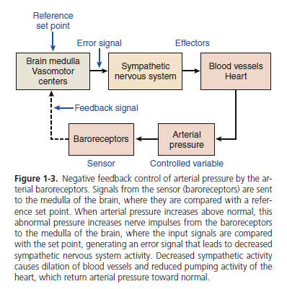
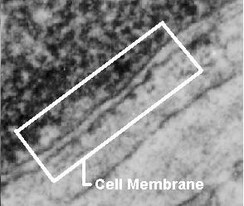
Negative Feed Back Cycle
Core Concept
All cells have a cell membrane
Functions:
Controls what enters and exits the cell to maintain an internal balance called homeostasis
Provides protection and support for the cell

Slide 8
Core Concept

Slide 9
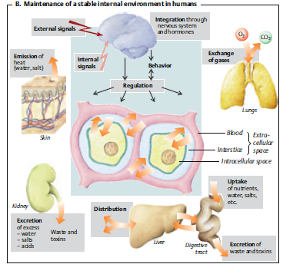
Core Concept

Slide 10
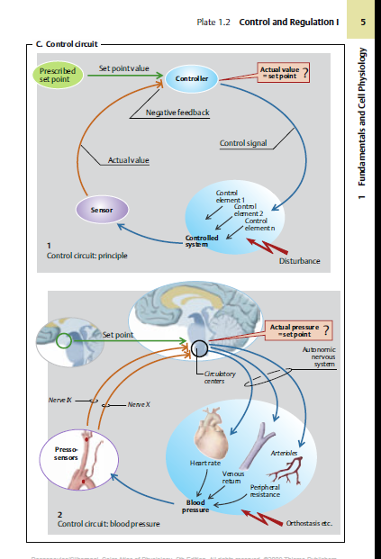
Core Concept

Slide 11
Core Concept

Slide 12
Core Concept

Slide 13
Vertical Integration

Slide 14
VERTICAL INTEGRATION

Slide 15
Spiral Integration

Slide 16
Biomedical Ethics
Spiral Integration/ Ethics
In bioethics, Justice refers to everyone having an equal opportunity.
This principle seeks to eliminate discrimination in biological studies and healthcare.
Healthcare and research should not be based on sex, race, religious beliefs etc

Slide 17
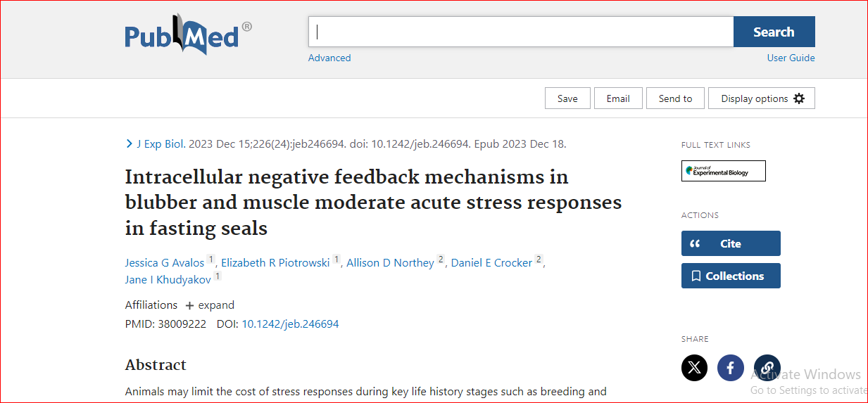
Research
Spiral Integration/ Research
https://pubmed.ncbi.nlm.nih.gov/37301413

Slide 18
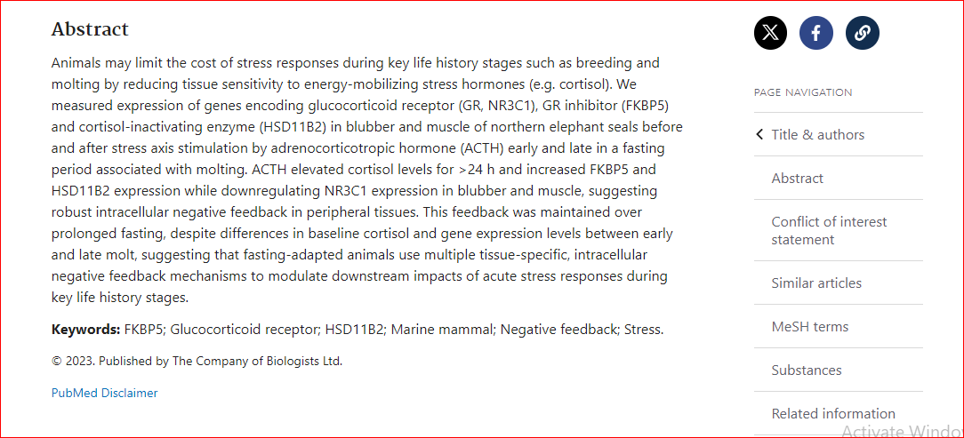
Spiral Integration/ Research

Slide 19
How To Access Digital Library
Promoting IT & Research Culture
Steps to Access HEC Digital Library
Go to the website of HEC National Digital Library.
On Home Page, click on the INSTITUTES.
A page will appear showing the universities from Public and Private Sector and other Institutes which have access to HEC National Digital Library HNDL.
Select your desired Institute.
5. A page will appear showing the resources of the institution
6. Journals and Researches will appear
7. You can find a Journal by clicking on JOURNALS AND DATABASE and enter a keyword to search for your desired journal. Link:https://www.topstudyworld.com/2020/05/access-hec-digital-library.html?m=1

Slide 20
References
References
• Ganong’s Review of Medical Physiology.25TH Edition.
• Physiology by Linda S. Costanzo 6 th Edition. Cellular Physiology
• Human Physiology by Dee Unglaub Silver thorn. 8th Edition.
• Textbook of Medical Physiology by Guyton & Hall.14th Edition.
Video links:
https://www.youtube.com/watch?v=bfuOljRU1nk
2. https://www.youtube.com/watch?v=zv8LHyH7_rI

