Slide 2
Foundation Module First Year MBBS
Active Transport II
Supervised by Prof. Samia Sarwar Chairperson Physiology Presenter :Dr. Sheena Tariq (Demonstrator PHY)
Dated : 00-00-2025
Physiology Department

Slide 3
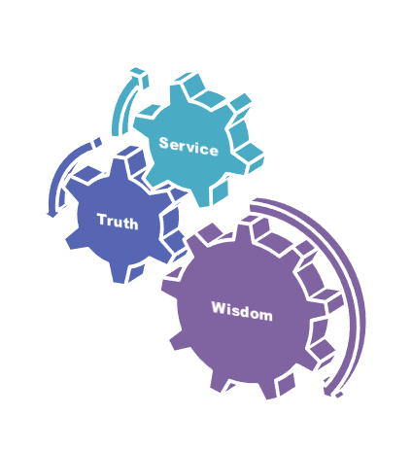
Motto, Vision, Dream
To impart evidence based research oriented medical education
To provide best possible patient care
To inculcate the values of mutual respect and ethical practice of medicine
Wisdom
Truth
Service

Slide 4
Professor Umar Model of Integrated Lecture

Slide 5
Learning Objectives
Distinguishing between primary active transport and secondary active transport
Distinction between co transport (symport) and counter transport (antiport) mechanisms in secondary active transport
Understanding the concept of electrochemical potential and its significance in driving secondary active transport processes.
Identifying specific examples of secondary active transport processes

Slide 6
Interactive Session

Slide 7
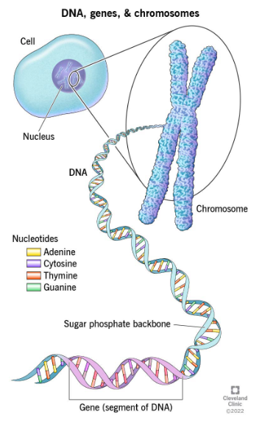
HUMAN PHYSIOLOGY
Horizontal Integration with Anatomy
Human physiology explains the specific characteristics and mechanisms of the human body that make it a living being.
3Ps
Physiology, purpose, process

Slide 8
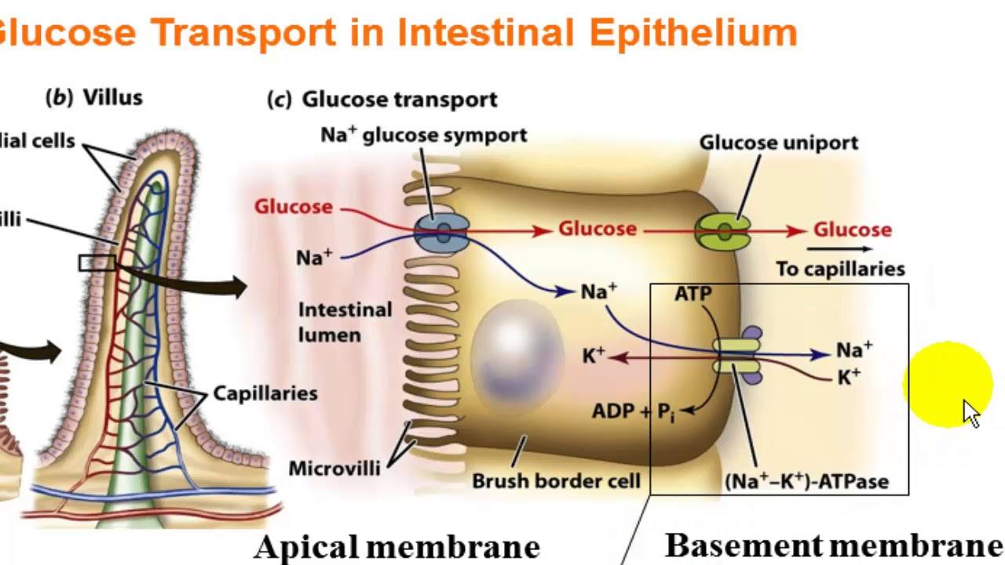
Horizontal Integration with Anatomy

Slide 9
Horizontal Integration with Anatomy

Slide 10
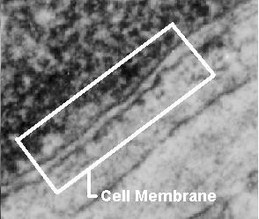
Cell Membranes
Core Concept
All cells have a cell membrane
Functions:
Controls what enters and exits the cell to maintain an internal balance called homeostasis
Provides protection and support for the cell

Slide 11
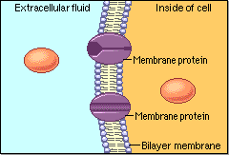
Functions of Cell Membrane
Core Concept
Protective Function
Selective permeability
Absorptive function
Excretory function
Exchange of gases
Maintenance of shape and

Slide 12
Transport Mechanisms
Core Concept

Slide 13
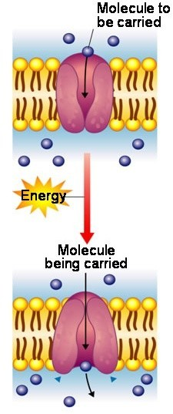
What is Active Transport?
Core Concept
Active transport is the transport of substances from a region of lower concentration to higher concentration using energy, usually in the form of ATP.
Examples: Na, K and Ca active transport.
sodium-potassium pump
Calcium pump
Potassium hydrogen pump

Slide 14
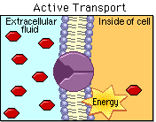
Active Transport - Why?
Core Concept
Cells cannot rely solely on passive movement of substances across their membranes.
In many instances, it is necessary to move substances against their electrical or chemical gradient to maintain the appropriate concentrations inside of the cell or organelle.

Slide 15
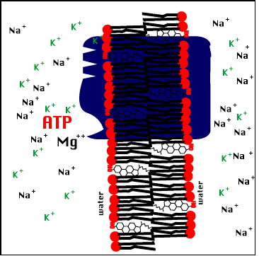
Primary Active Transport
Core Concept
Primary active transport is the transport of sustances uphill using energy (ATP hydrolysis)
It cause a conformational change that results in the transport of the molecule through the protein.
Eg. Na+-K+ pump.

Slide 16
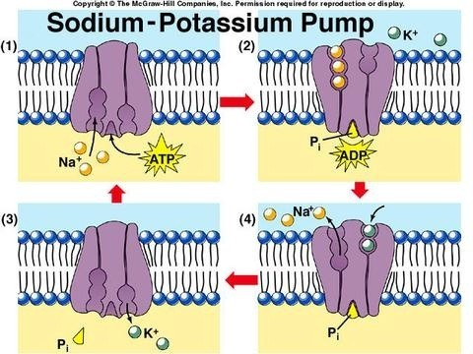
Pumps Involved In Active Transport
Core Concept
Sodium-potassium pump Found in many cells
Calcium pump
Found in membrane of Sarcoplasmic reticulum
Potassium hydrogen pump
Found in Gastrointestine cell membrane

Slide 17
Secondary Active Transport
Core Concept
The transport of substances against a concentration gradient involving energy to establish a gradient across the cell membrane, utilizes the gradient to transport a molecule of interest up its concentration gradient .
The transport may be
In the same direction (Symport)
In the opposite direction (Antiport)

Slide 18
Mechanisms of Secondary Active Transport
Core Concept

Slide 19
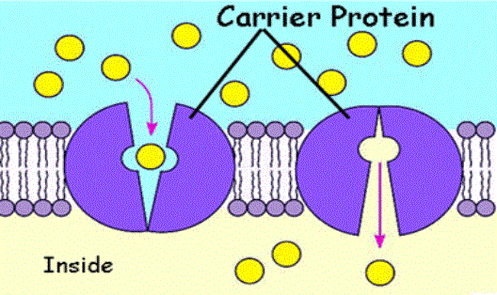
Carriers Type Processes
Core Concept
Carriers are transport proteins that binds ions and other molecules and then change their configuration moving the bound molecules from one side of cell membrane to the other.
Types of carriers : 1.Uniporters
2.Symporters 3.Antiporters

Slide 20
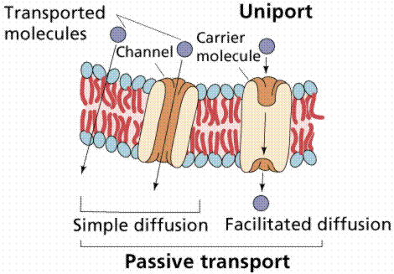
Uniport
Core Concept
The movement of a single Substance.
It requires no energy from the cell.
Examples.
Simple diffusion.
Facilitated diffusion.

Slide 21
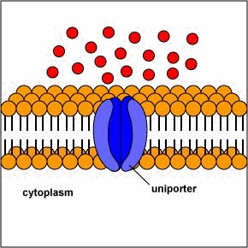
Mechanism of Uniport
Core Concept
Chromosomes becomes visible
Centriolar migration
Assembling of microtubules
Formation of asters

Slide 22
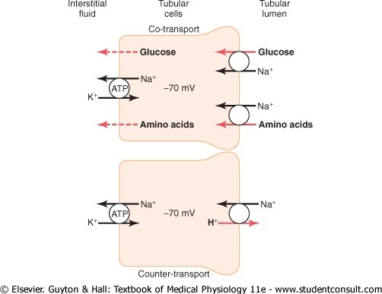
Symport (Co-transport)
Core Concept
Transport of two substances using the energy produced by concentration difference developed by primary active transport
Substances are moving in the same direction.
Example: transport of amino acids, Glucose,

Slide 23
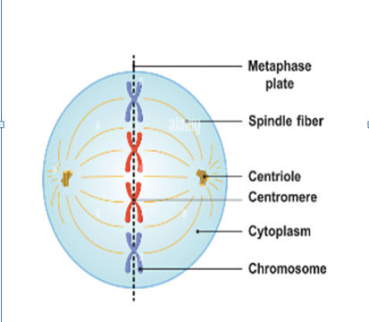
Core Concept
Equatorial plate and chromosomal alignment
Centromeres lie in single transverse plane
Chromosomes acquire two groups of kinetochore microtubules which exert pull on chromosomes

Slide 24
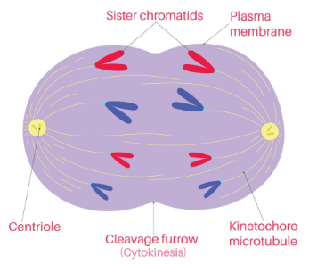
Anaphase
Core Concept
Separation of sister chromatids due to split in centromeres
Chromosomes clustered at spindle poles
Formation of cleavage furrow starts

Slide 25
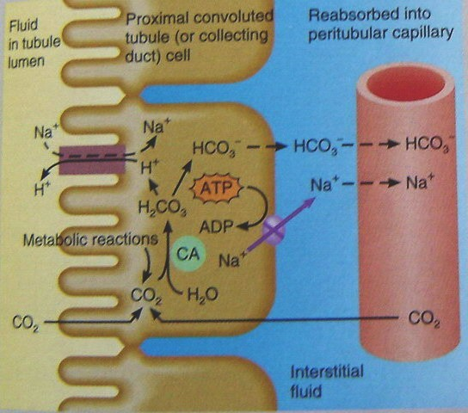
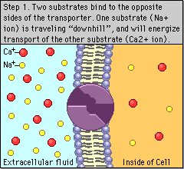
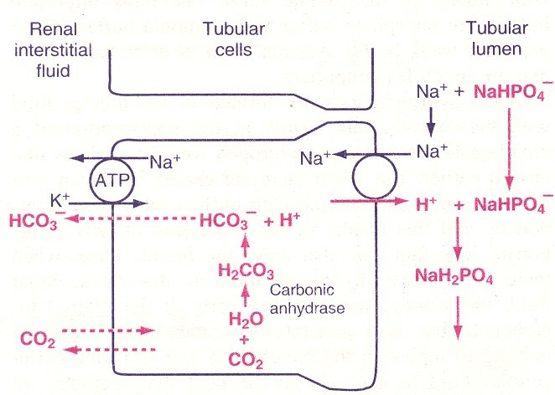
Antiport (Counter-transport)
Core Concept
In this process, the two substances move across the
membrane in opposite directions.
Example:
Exchange of H+ and Na+ in Renal tubule.

Slide 26
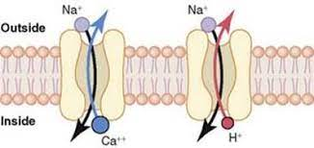
Meiosis
Core Concept
Special type of cell division in germ cells
Two successive cell divisions
Meiosis I
Meiosis II
Four daughter cells
Haploid chromosomes + genetic variation

Slide 27
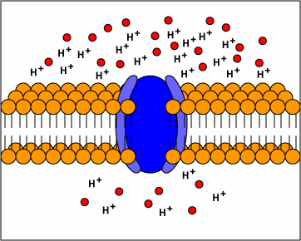
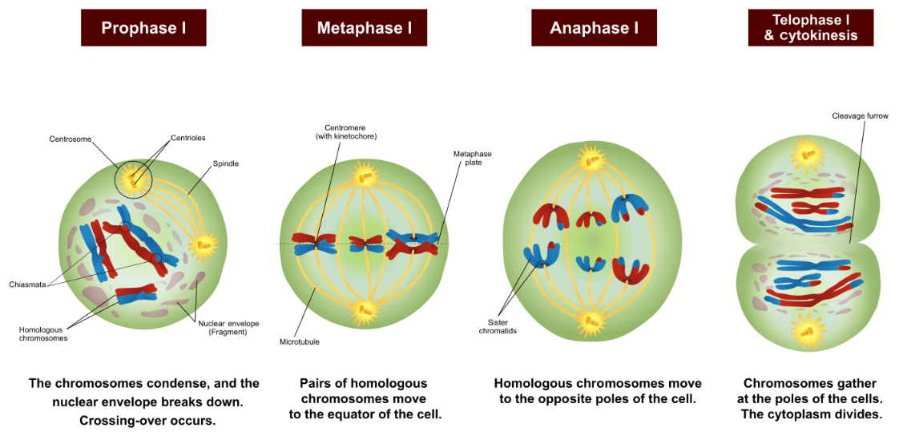
Mechanism of Counter-transport
Core Concept
Higher conc. of H+
Lower conc. of H+

Slide 28
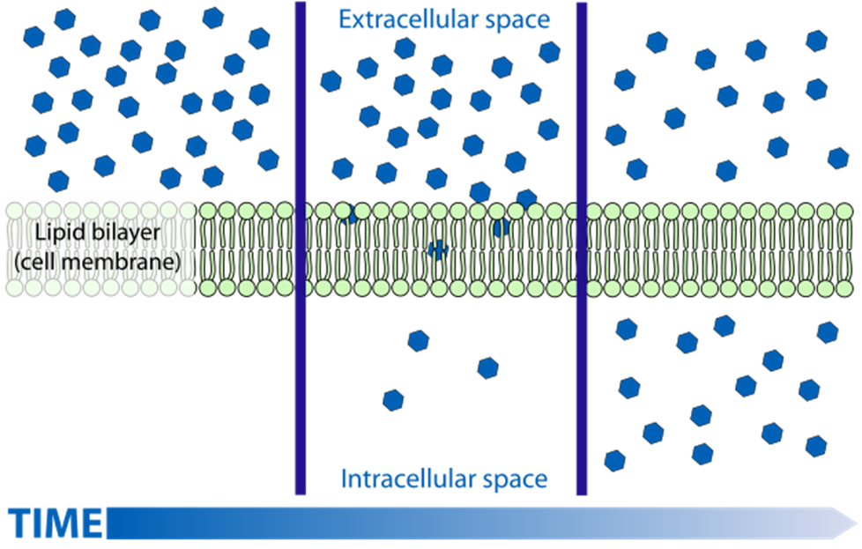
Core Concept

Slide 29
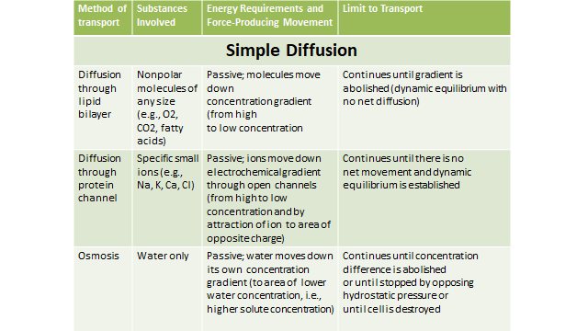
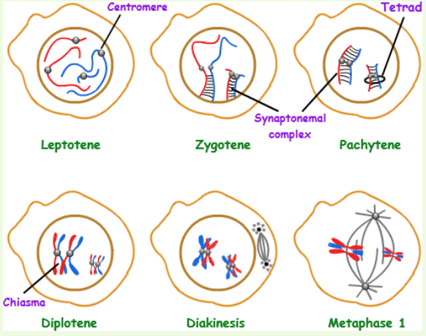
Phases of Prophase I
Core Concept

Slide 30
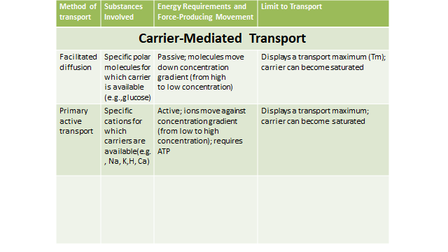
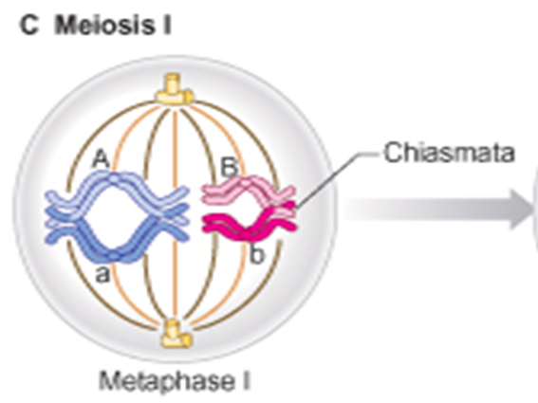
Metaphase I
Core Concept
Bodies attach to the spindle microtubules are bivalents, not single chromosomes
Homologous pairs lie parallel to the equatorial plate, with one on either side.

Slide 31
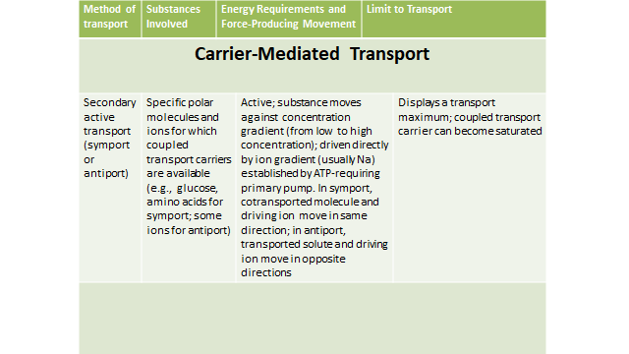
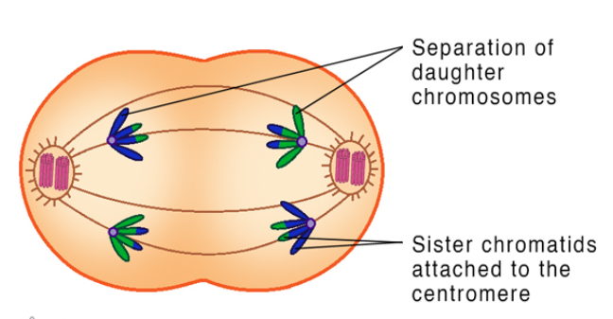
Anaphase I
Core Concept
Homologous pair completely separates from each other & move to opposite poles of spindles
No division of centromeres occurs & whole chromosome move to opposite poles
Positioning of bivalent pairs is random.

Slide 32
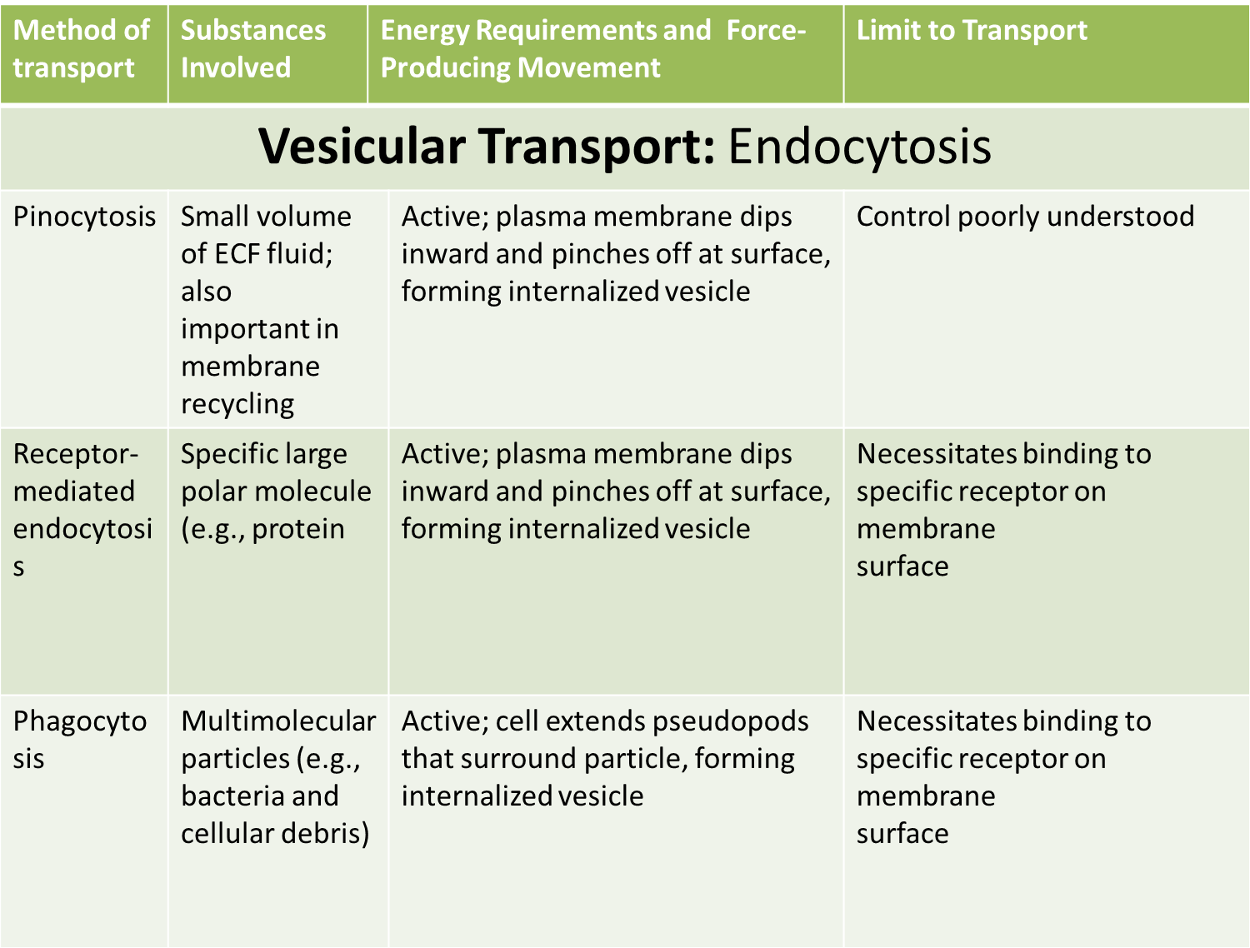
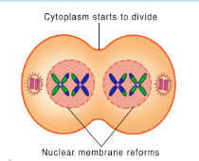
Telophase I
Core Concept
Assortment of maternal and paternal chromosomes in each Telophase nucleus is also random.
Nuclei reconstructed & Cytokinesis divide parent cell into two daughter cells

Slide 33
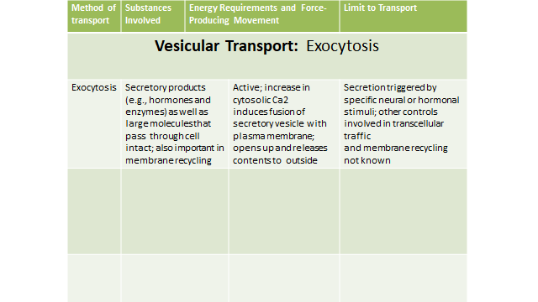
Meiosis II
Core Concept
Meiosis II is more like mitosis - commences after a short interval
No DNA synthesis occurs.
Unlike mitosis, the separating chromatids are genetically different.
Cytoplasmic division also occurs

Slide 34
Vertical Integration

Slide 35
Cystic Fibrosis
Vertical Integration with Internal Medicine
Cystic fibrosis is a genetic disorder caused by mutations in the cystic fibrosis transmembrane conductance regulator (CFTR) gene, which encodes a chloride ion channel.
Dysfunction of CFTR impairs chloride and water transport across epithelial cells, leading to the production of thick, sticky mucus in various organs, particularly the lungs and digestive system.
This results in respiratory infections, digestive problems, and other complications

Slide 36
Vertical Integration with Internal Medicine
Secondary active transporters are essential for renal function and electrolyte balance.
Disorders affecting these transporters can lead to renal diseases such as renal tubular acidosis, Bartter syndrome, or Gitelman syndrome.

Slide 37
Vertical Integration with Internal Medicine
Aspect | Description
Diagnosis and Screening | Conduct comprehensive history-taking and physical examination. Order urinalysis, blood tests (e.g., electrolyte panel, renal function tests), and imaging studies (e.g., renal ultrasound). Screen for risk factors and symptoms suggestive of renal tubular disorders.
Management of Symptoms | Provide symptomatic relief for electrolyte imbalances, metabolic abnormalities, and kidney dysfunction. Prescribe medications (e.g., diuretics, electrolyte supplements), dietary modifications, and lifestyle interventions to alleviate symptoms.
Referral to Specialists | Refer patients to nephrologists or other specialists for specialized evaluation and management. Collaborate with specialists to ensure comprehensive care and tailored treatment plans.
Long-Term Monitoring | Monitor patients longitudinally to assess treatment efficacy, disease progression, and potential complications. Perform regular evaluations, adjust treatment plans as necessary, and coordinate follow-up appointments.
Patient Education | Educate patients and families about renal tubular disorders, including causes, symptoms, treatment options, and lifestyle modifications. Provide counseling on medication adherence, dietary restrictions, fluid management, and preventive measures.
Preventive Care | Emphasize preventive measures to reduce the risk of developing renal tubular disorders or exacerbating existing conditions. Promote a healthy lifestyle, regular physical activity, adequate hydration, and strategies to maintain electrolyte balance and kidney health.
Multidisciplinary Care | Collaborate with pharmacists, dietitians, social workers, and allied health professionals to provide comprehensive care. Coordinate multidisciplinary interventions, ensure continuity of care, and address psychosocial needs and barriers to treatment adherence.

Slide 38
Spiral Integration

Slide 39
Spiral Integration with AI
Artificial Intelligence (AI) plays a significant role in various aspects of managing cystic fibrosis (CF), a genetic disorder that affects the lungs and digestive system. Here are several ways AI contributes to the understanding, diagnosis, treatment, and management of cystic fibrosis:
Disease Understanding and Research: AI algorithms can analyze vast amounts of genetic, clinical, and imaging data to identify patterns, biomarkers, and potential therapeutic targets associated with cystic fibrosis
Early Detection and Diagnosis: AI-powered algorithms can assist healthcare providers in the early detection and diagnosis of cystic fibrosis. Machine learning models trained on medical imaging data, such as chest X-rays and CT scans, can accurately identify characteristic features of CF-related lung disease, helping clinicians make timely and accurate diagnoses
l and clinical evaluation.

Slide 40
Artificial Intelligence
Spiral Integration with AI
Predictive Analytics and Prognostication: AI algorithms can predict disease progression and outcomes in individuals with cystic fibrosis based on various clinical and genetic factors.
Drug Discovery and Development: AI accelerates the drug discovery and development process by facilitating the identification of novel drug targets, drug candidates, and therapeutic interventions for cystic fibrosis. AI-powered computational models can simulate molecular interactions, predict drug efficacy and safety profiles, and prioritize potential drug candidates for further preclinical and clinical evaluation.
Remote Monitoring and Management: AI-enabled remote monitoring systems allow individuals with cystic fibrosis to track their symptoms, medication adherence, and lung function parameters from home. By analyzing real-time health data collected through wearable devices and digital health platforms, AI algorithms can detect early signs of disease exacerbations, facilitate timely interventions, and improve overall disease management and quality of life.

Slide 41
Artificial intelligence helps in
Spiral Integration with AI
Disease Understanding and Research
Early Detection and Diagnosis
Predictive Analytics and Prognostication
Drug Discovery and Development
Remote Monitoring and Management

Slide 42
Beneficence
Spiral Integration with Biomedical Ethics
The principle of beneficence is the obligation of physician to act for the benefit of the patient and supports a number of moral rules to protect and defend the right of others, prevent harm, remove conditions that will cause harm, help persons with disabilities, and rescue persons in danger. It is worth emphasizing that, the language here is one of positive requirements. The principle calls for not just avoiding harm, but also to benefit patients and to promote their welfare.

Slide 43
Suggested Research Article
Spiral Integration with Research
Common folds and transport mechanisms of secondary active transporters
Abstract
Secondary active transporters exploit the electrochemical potential of solutes to shuttle specific substrate molecules across biological membranes, usually against their concentration gradient. Transporters of different functional families with little sequence similarity have repeatedly been found to exhibit similar folds, exemplified by the MFS, LeuT, and NhaA folds. Observations of multiple conformational states of the same transporter, represented by the LeuT superfamily members Mhp1, AdiC, vSGLT, and LeuT, led to proposals that structural changes are associated with substrate binding and transport. Despite recent biochemical and structural advances, our understanding of substrate recognition and energy coupling is rather preliminary. This review focuses on the common folds and shared transport mechanisms of secondary active transporters. Available structural information generally supports the alternating access model for substrate transport, with variations and extensions made by emerging structural, biochemical, and computational evidence.
PubMed Disclaimer
Reafernce: /https://europepmc.org/article/med/10688414
2019 Medicine journal

Slide 44
How To Access Digital Library
Promoting IT & Research Culture
Steps to Access HEC Digital Library
Go to the website of HEC National Digital Library.
On Home Page, click on the INSTITUTES.
A page will appear showing the universities from Public and Private Sector and other Institutes which have access to HEC National Digital Library HNDL.
Select your desired Institute.
5. A page will appear showing the resources of the institution
6. Journals and Researches will appear
7. You can find a Journal by clicking on JOURNALS AND DATABASE and enter a keyword to search for your desired journal. Link:https://www.topstudyworld.com/2020/05/access-hec-digital-library.html?m=1

Slide 45
Brainstorming

Slide 46
Structured Questions Related To Topic
Brainstorming
Active Transport Systems
1. Which of the following transport systems require energy?
a) Diffusion
b) Facilitated diffusion
c) Phagocytosis
d) Osmosis
e) Filtration

Slide 47
Brainstorming
2. Which membrane pump is responsible for keeping the potassium ion concentration higher inside than outside a cell?
a) The sodium-potassium pump
b) The hydrogen-potassium pump
c) The calcium-hydrogen pump
d) The ATP-ADP pump

Slide 48
Brainstorming
3.A sodium-potassium pump is an example of what type of pump?
a) A primary active transport system
b) A secondary active transport system
c) A primary passive transport system
d) A secondary passive transport system

Slide 49
Brainstorming
4. In a Symporter system:
a) the transported molecule travels with the sodium ion into a cell
b) the transported molecule travels with the sodium ion out of a cell
c) the transported molecule travels into the cell while the sodium ion travels out of the cell
d) the transported molecule travels out of the cell while the sodium ion travels into the cell

Slide 50
Brainstorming
5.Exocytosis is an example of:
a) A primary active transport system
b) A secondary active transport system
c) A vesicular transport system
d) Phagocytosis

Slide 51
References
References
Ganong’s Review of Medical Physiology.25THEdition, Overview of Cellular Physiology in Medical Physiology (Chapter 02, Page 45).
Human Physiology by Dee Unglaub Silver thorn 8ThEdition.
Membrane dynamics chapter 5,page 160
Physiology by Linda S. Costanzo 6th Edition. Cellular physiology, chapter 1, page 5
Physiological Basis of Medical Practice by Best & Taylor’s.13th Edition. Properties and functions of cell membrane, chapter 2, page 18
Textbook of Medical Physiology by Guyton & Hall.14th Edition. Membrane Physiology. (Section02,Chapter04, Page51)

