Slide 1
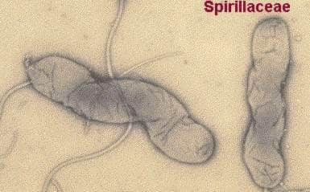
Campylobacter & Helicobacter
Microbe Module
3rd Year MBBS
BY:
Dr Kiran Fatima
Pathology department
Rawalpindi medical university

Slide 2
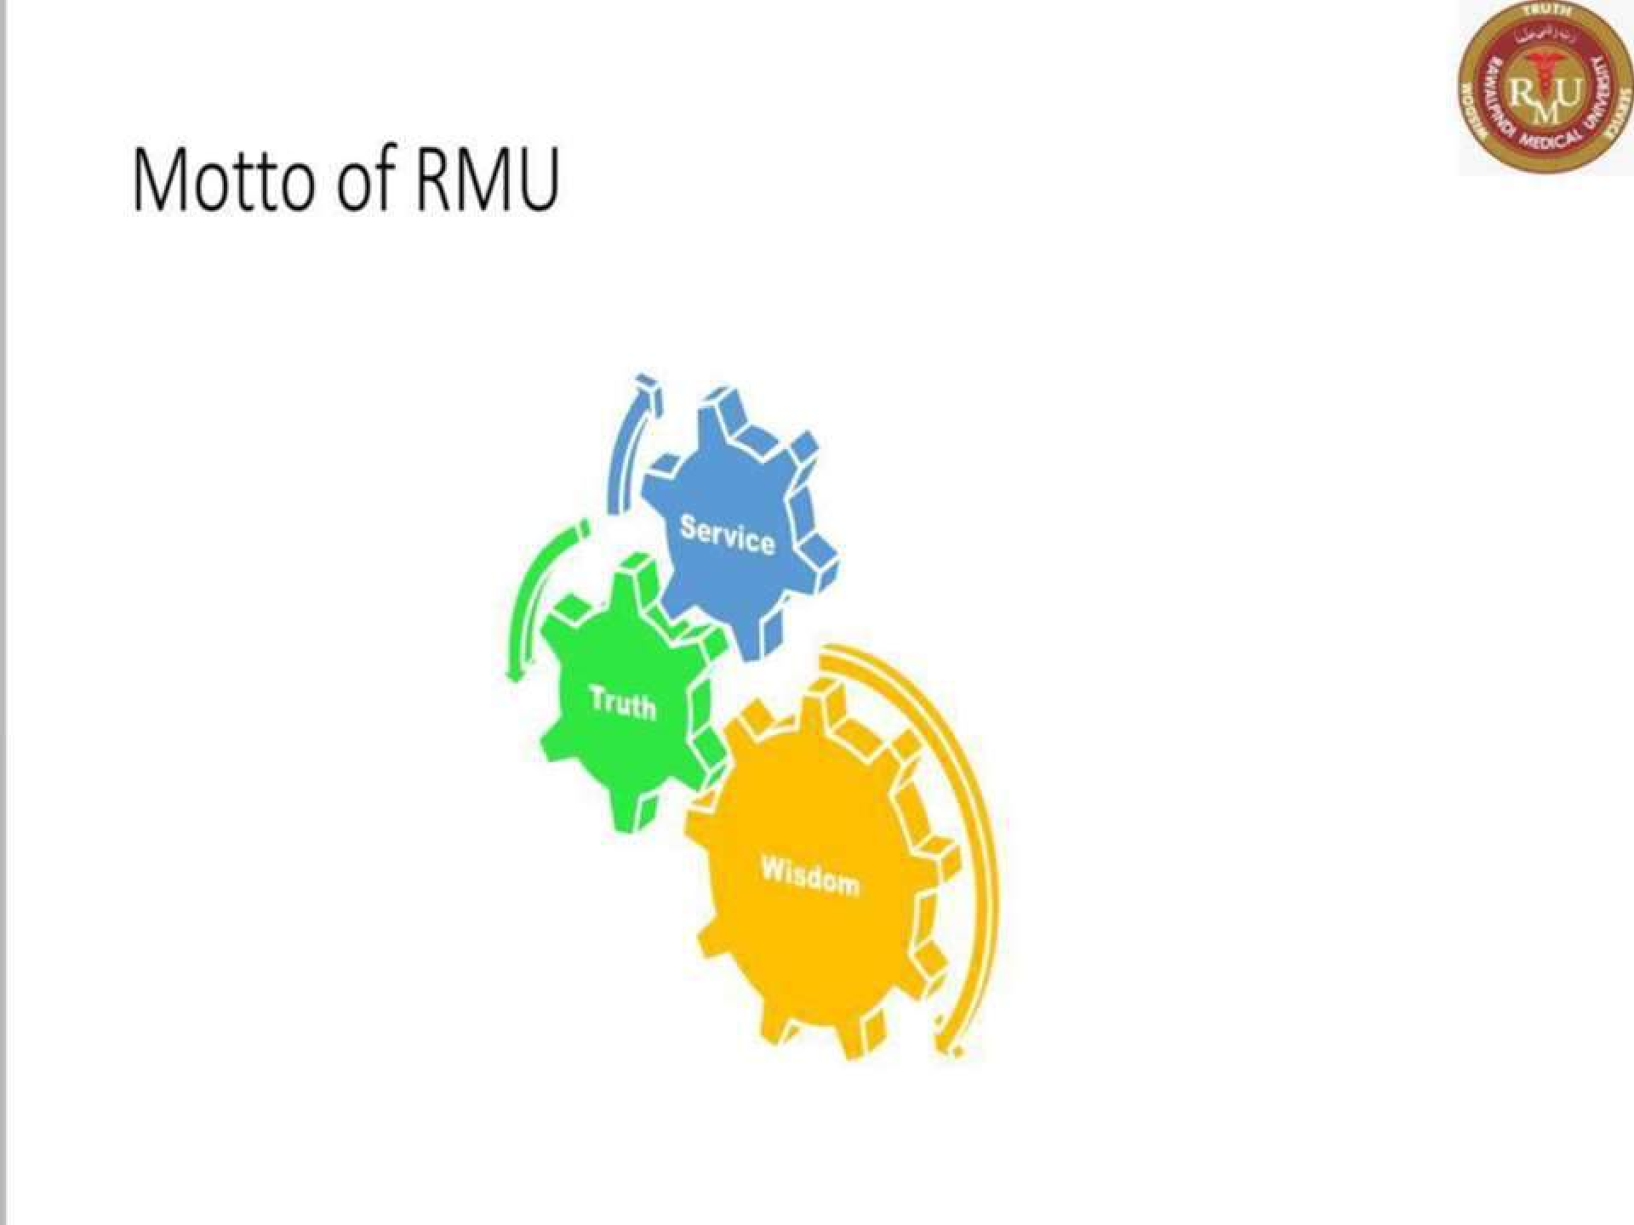

Slide 3
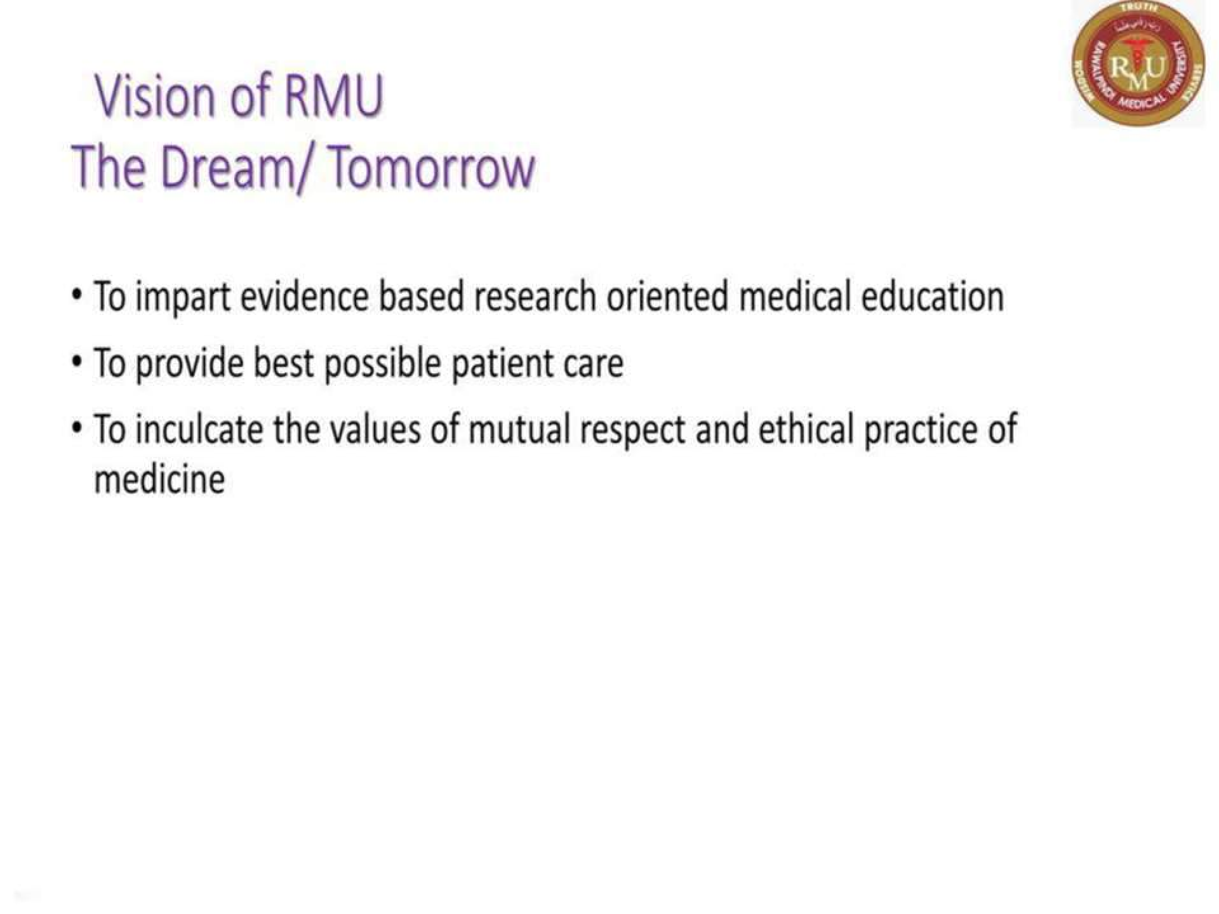

Slide 4
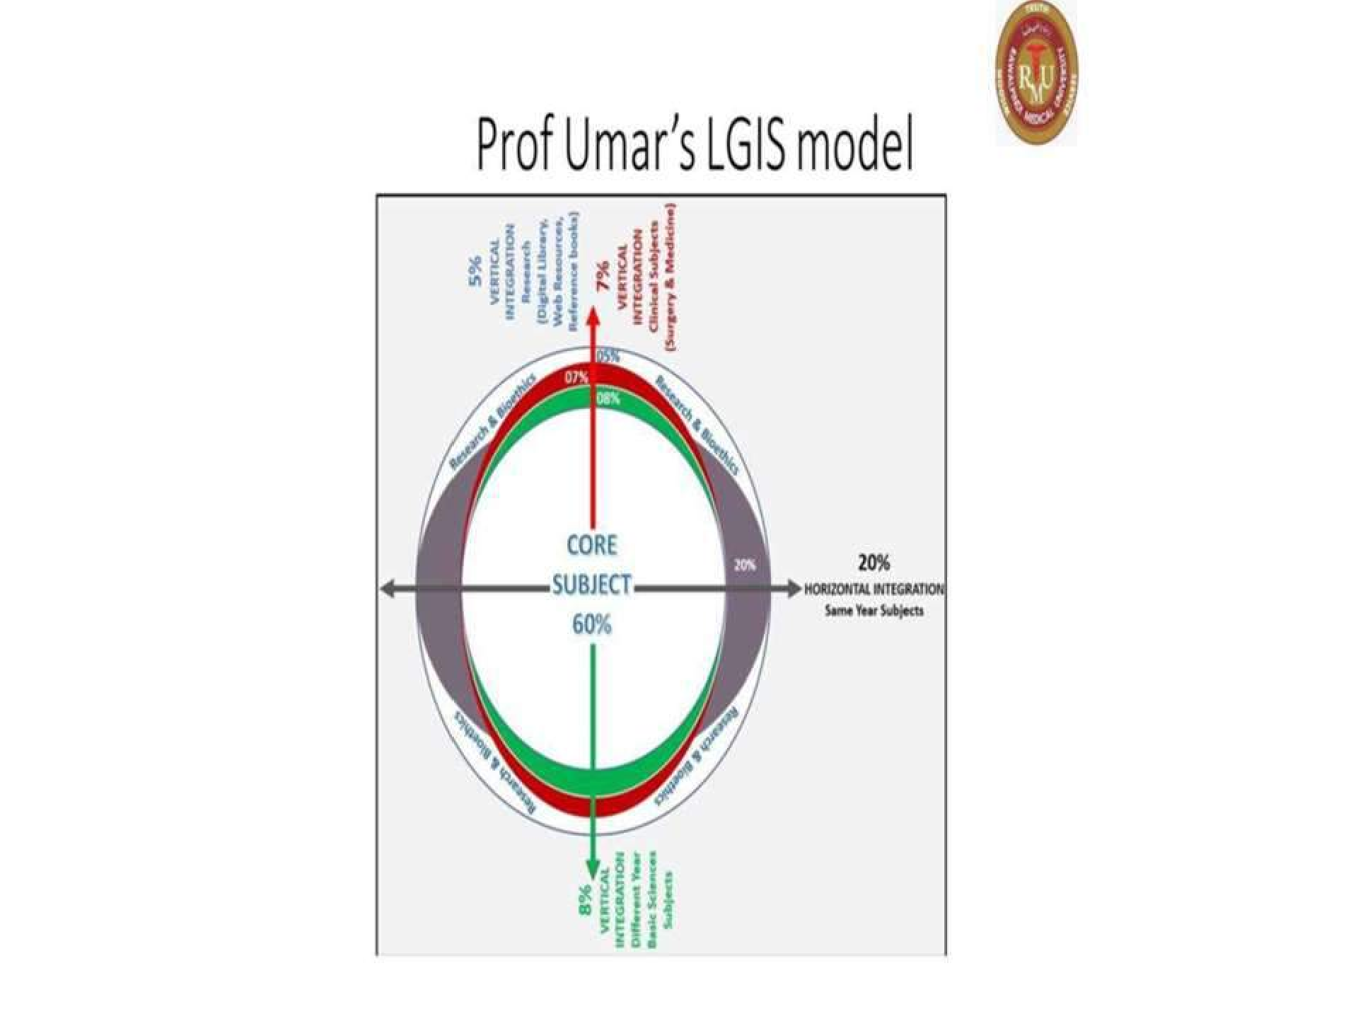

Slide 5
Learning outcomes
By the end of this lecture, you will be able to:
Distinguish H. pylori and Campylobacter by their classification and associated diseases (gastritis, peptic ulcers, gastric cancer, GI illnesses).
Explain the mechanisms of H. pylori survival, damage to the stomach, and Campylobacter colonization.
Identify diagnostic tests for both bacteria (stool tests, breath test, endoscopy).
Discuss treatment options for H. pylori (antibiotics) and
Campylobacter (antibiotics, supportive care).

Slide 6
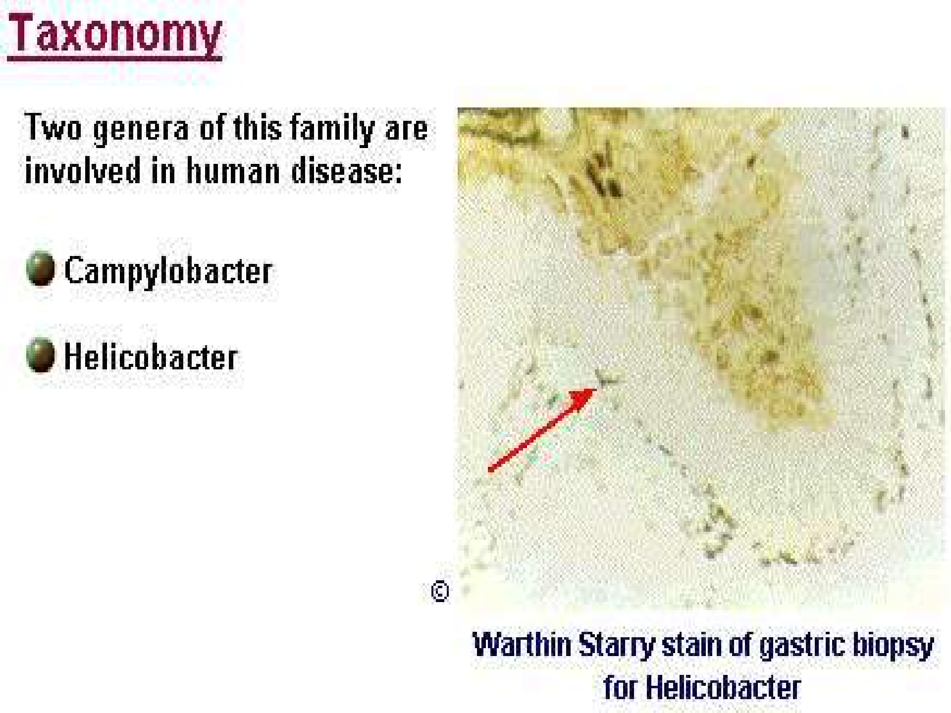
Pathology
spiral

Slide 7
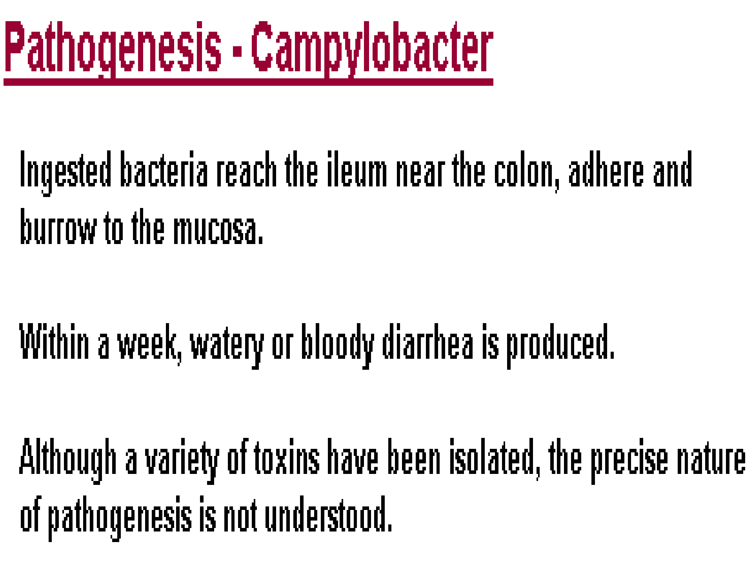
Pathology
core

Slide 8
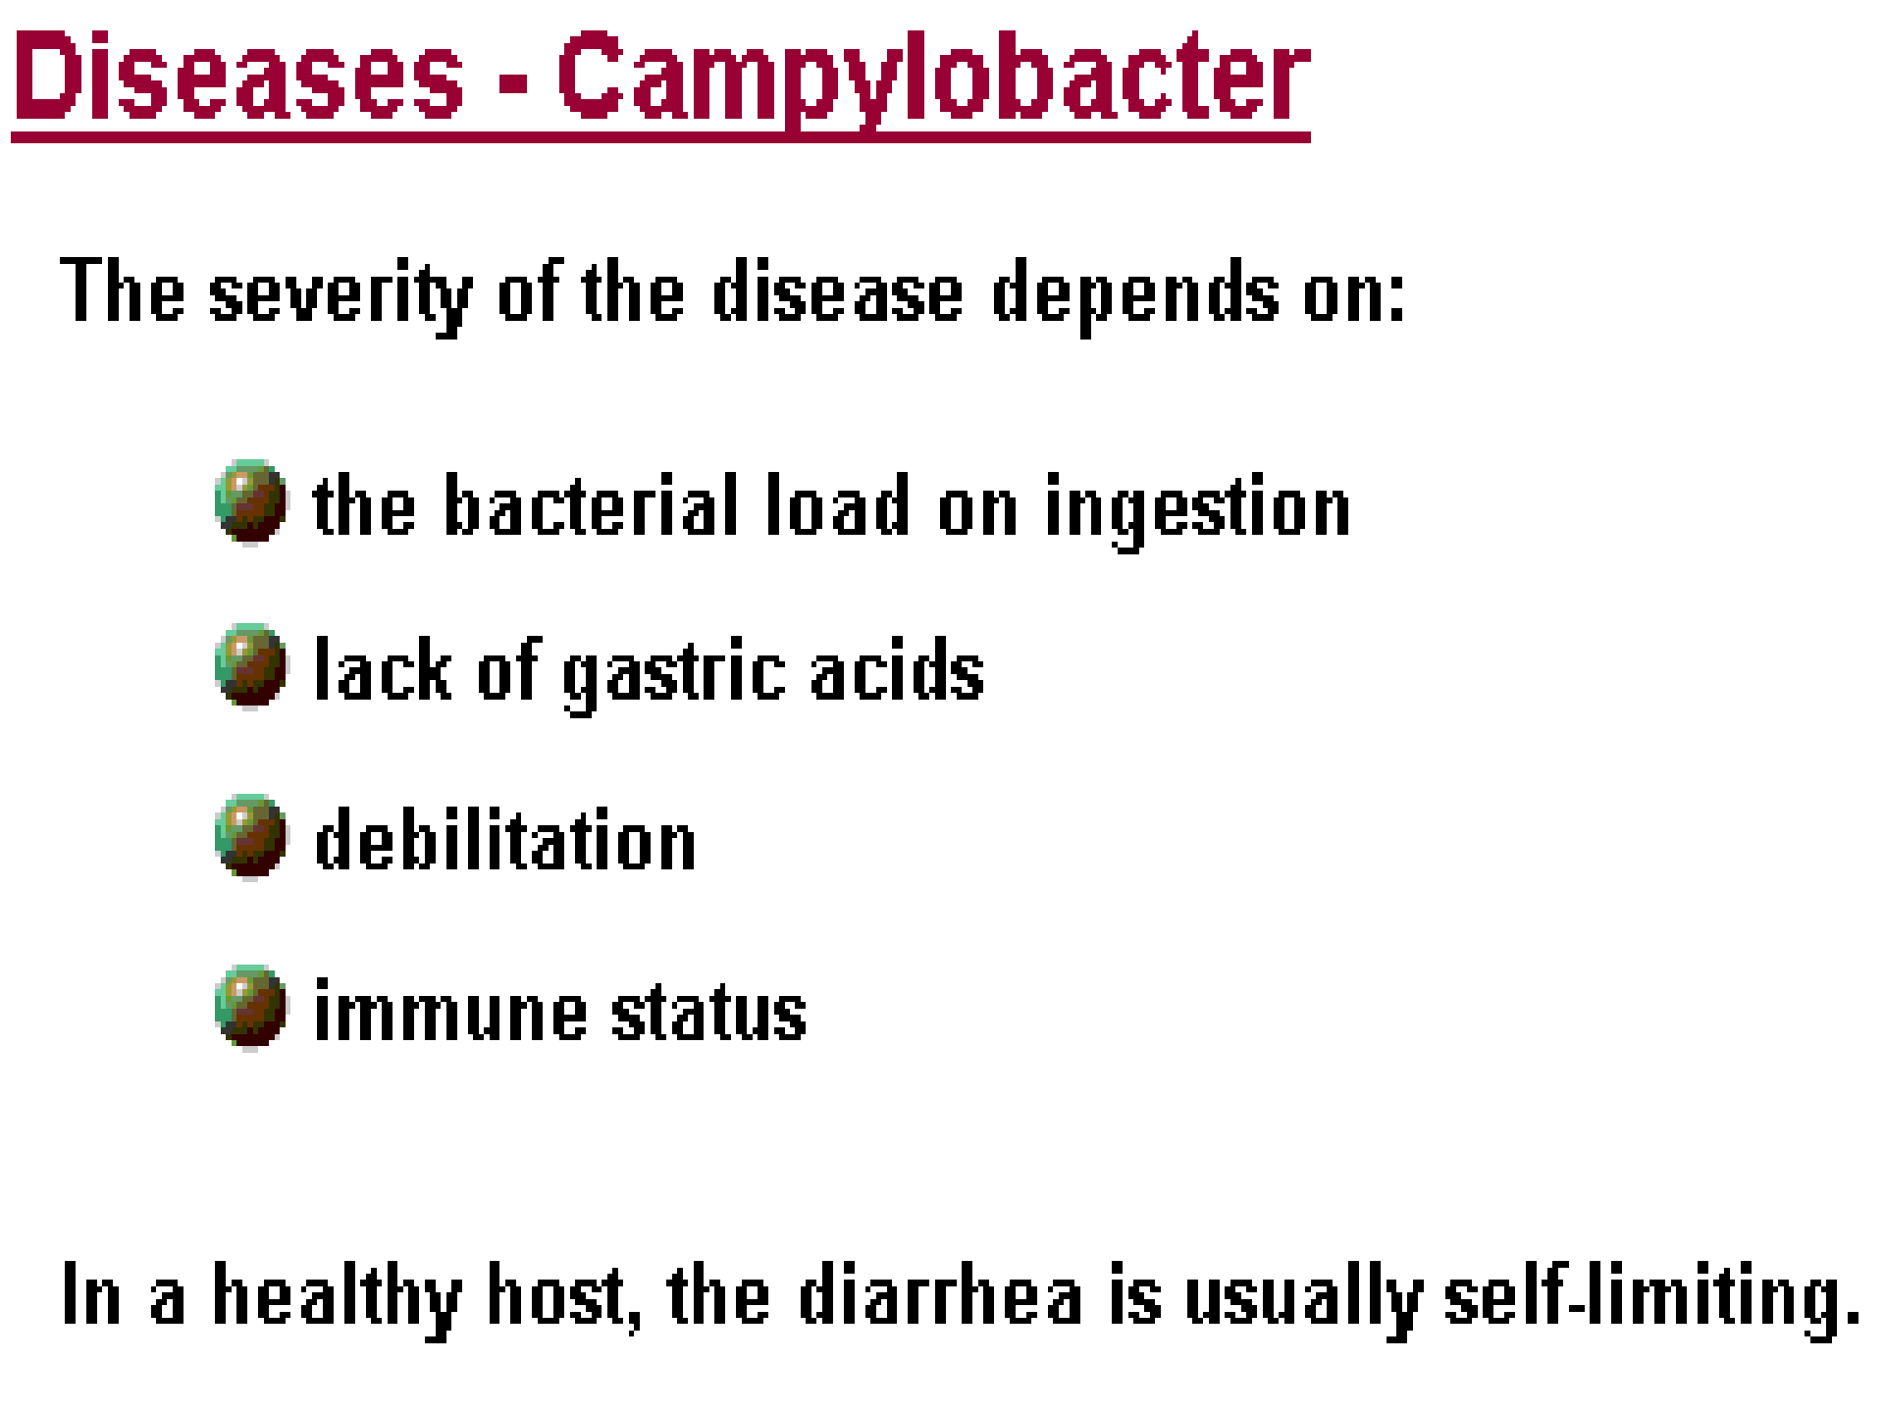
Pathology
core

Slide 9
Pathology core
Food poisoning caused by Campylobacter species can be
severely debilitating but rarely life-threatening. It has been linked with subsequent development of Guillain- Barré syndrome (GBS), which usually develops two to three weeks after the initial illness.
Contaminated drinking water and unpasteurized milk provide an efficient means for distribution.
Contaminated food is a major source of isolated infections, with incorrectly prepared meat and poultry normally the source of the bacteria.
Culture : Skirrow's medium is blood agar infused with a cocktail of antibiotics: vancomycin,and trimethoprim under microaerophilic conditions at 42 degrees.

Slide 10
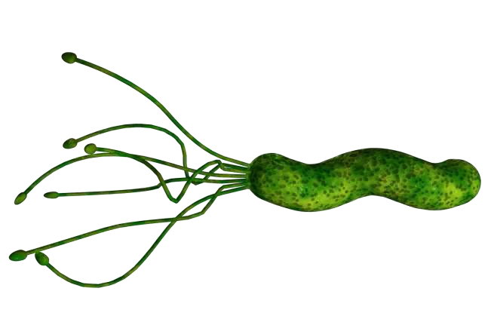
Helicobacter pylori
Pathology
core
Morphology: Gram-negative, aerobic or microaerophilic, spiral-shaped bacilli. Motile with Flagella .
Closely related to Helicobacter are species of the genera Aquaspirillum, Azospirillum, Spirillum, and Camplyobacter.

Slide 11
Pathology core
In 1875, German scientists found helical
shaped bacteria in lining of the human stomach. The bacteria could not be grown in culture and results forgotten.
The bacterium was rediscovered in 1979 by Australian pathologist Robin Warren, who did further research on it with Barry Marshall beginning in 1981; they isolated the organisms from mucosal specimens from human stomachs and were the first to successfully culture them. In their original paper, Warren and Marshall contended that most stomach ulcers and gastritis were caused by infection by this bacterium and not by stress or spicy food as had been assumed before.

Slide 12
Pathology core
Medical community slow to recognize role of this bacterium in stomach ulcers and gastritis, believing that no microorganism could survive for long in the acidic environment of the stomach.
Realization after further studies were done, Marshall drank a Petri dish of H. pylori, developed gastritis, bacteria were recovered from his stomach lining, thereby satisfying three out of the four Koch's postulates. The fourth satisfied after second endoscopy ten days after revealed signs of gastritis and the presence of "H. pylori".
Marshall able to treat himself using a fourteen day dual therapy with bismuth salts and metronidazole. Marshall and Warren went on to show that antibiotics are effective in the treatment of many cases of gastritis
In 2005, Warren and Marshall were awarded the Nobel Prize in Medicine for their work on H. pylori.

Slide 13
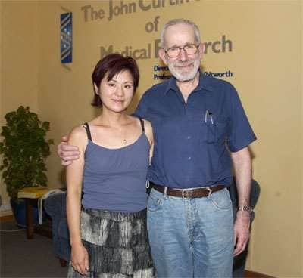
Nobel Laureate Dr J Robin Warren

Slide 14
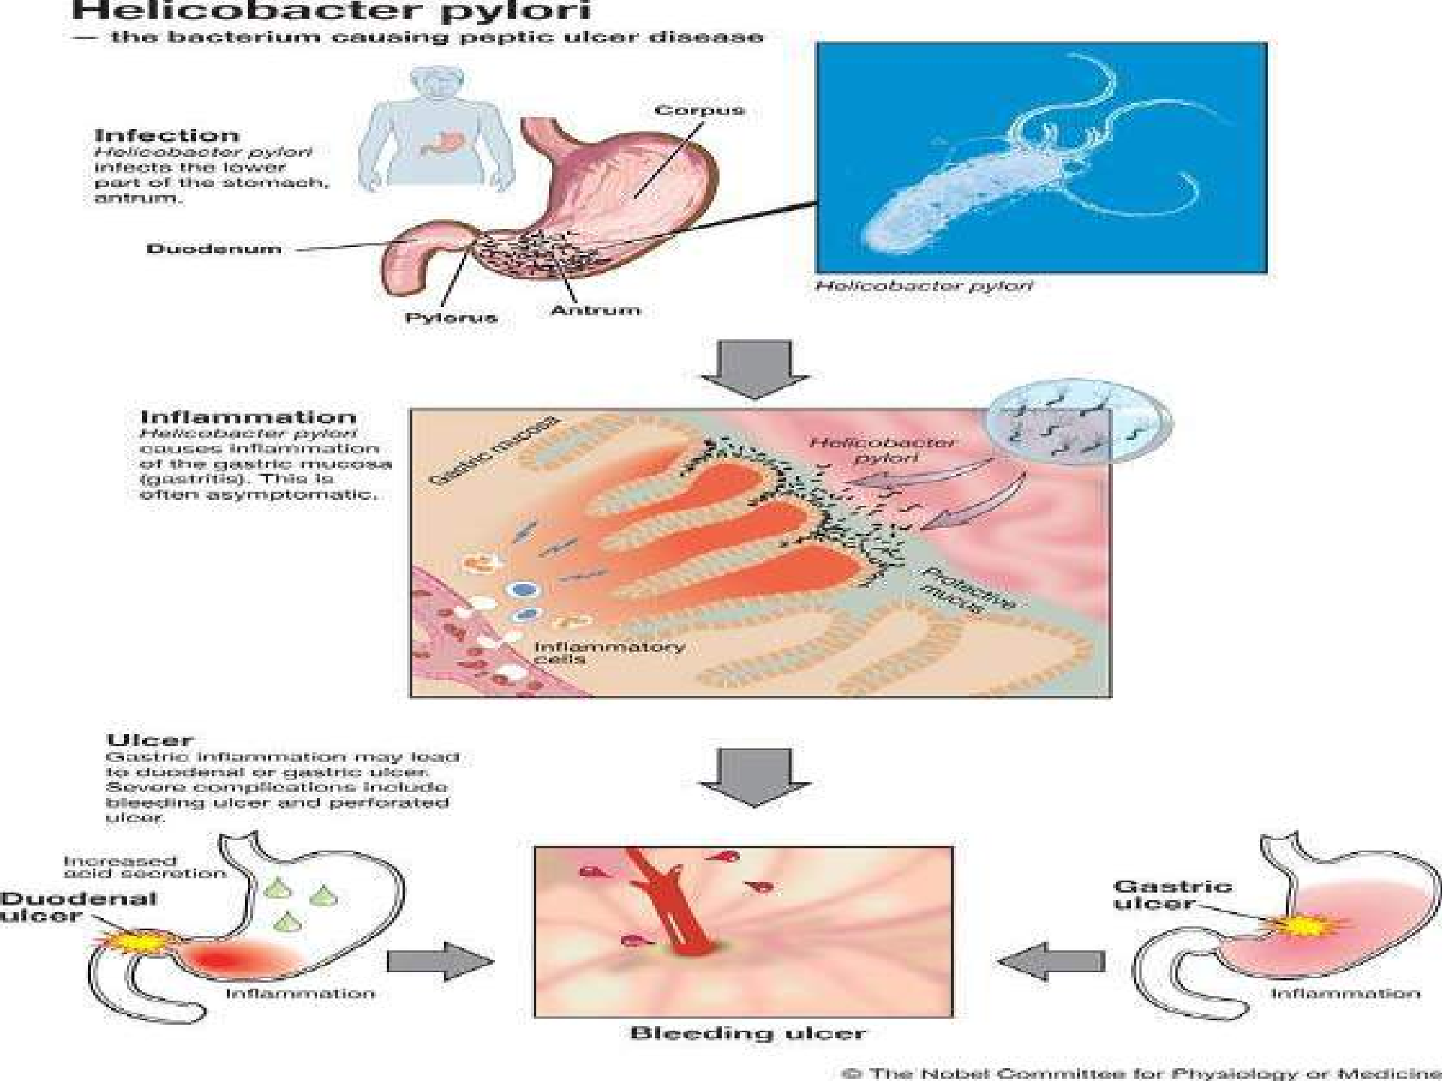
Pathology
core

Slide 15
Genetics :
Pathology
core
Helicobacter pylori many strains of H . pylori which are distinguished by the human disease with which they are associated.
Habitat:
Helicobacter pylori lives in interface between the surface of gastric epithelial cells and the overlying mucus gel.
Also gastric epithelium in the duodenum and esophagus.

Slide 16
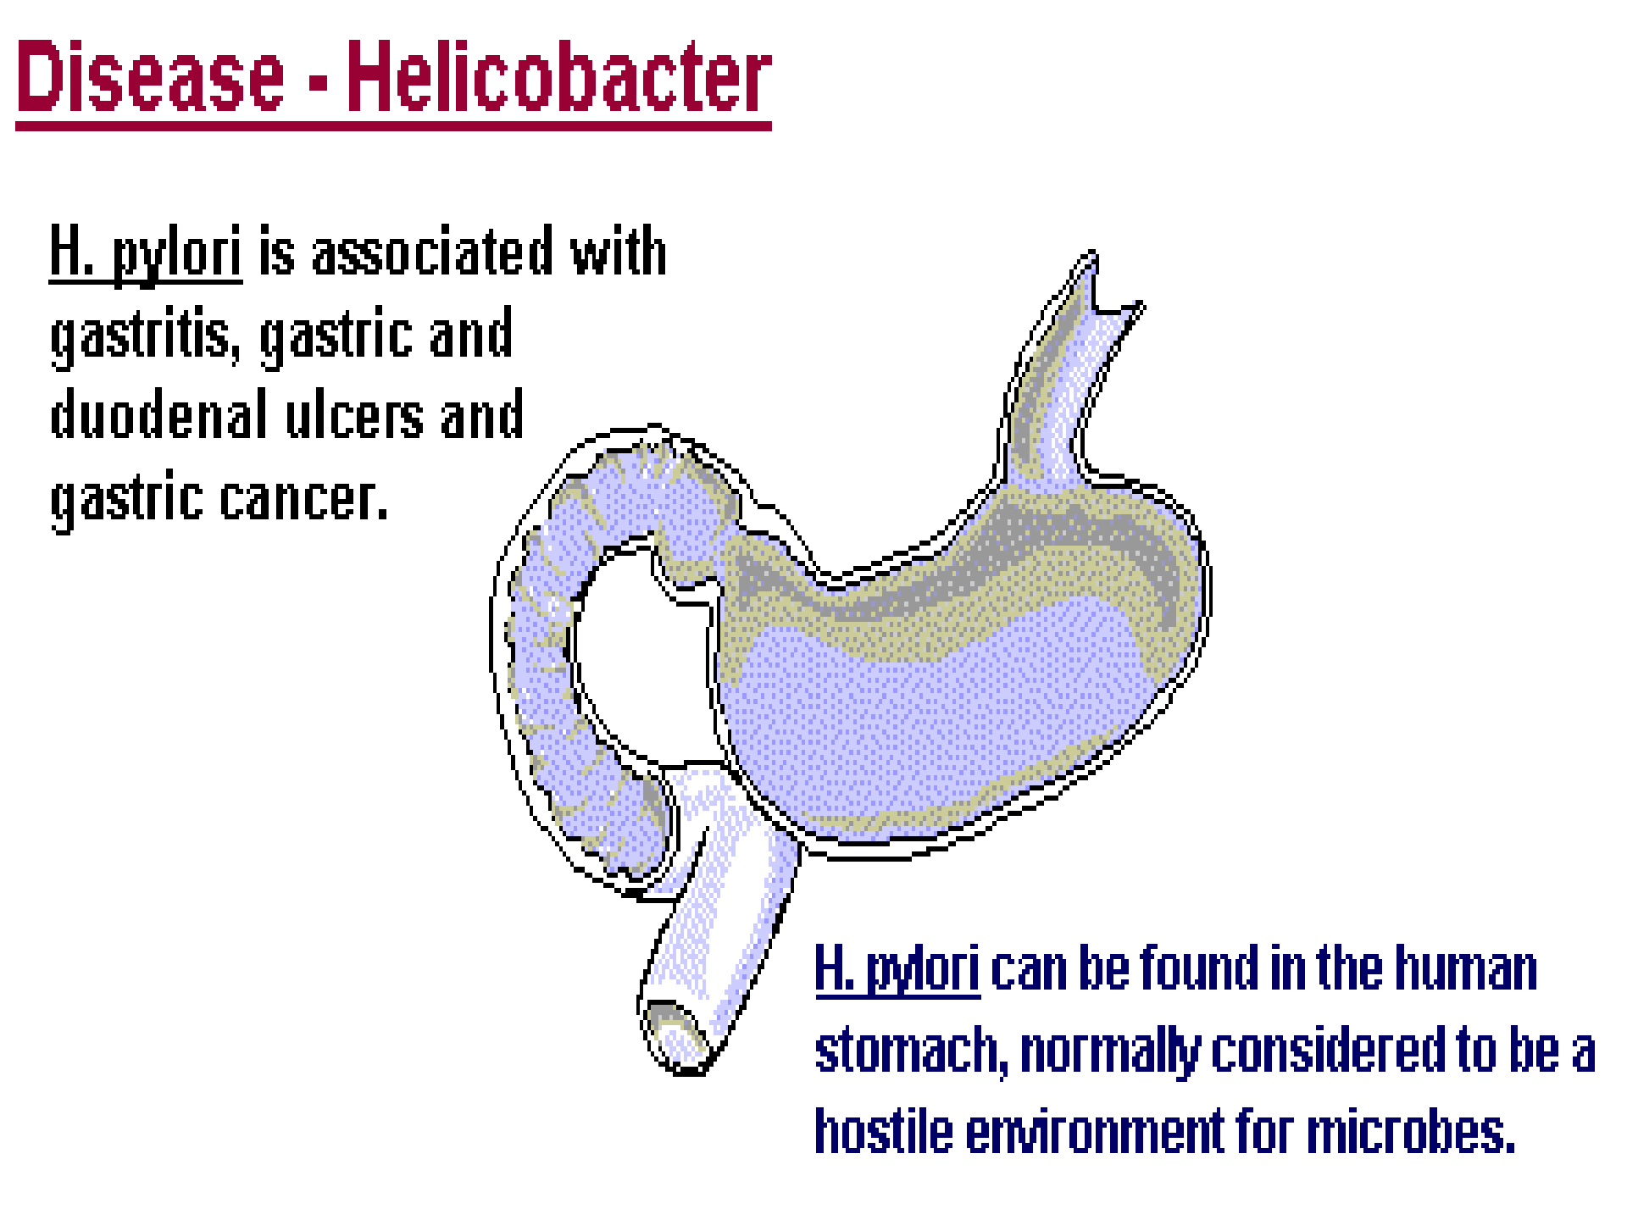
Pathology
core

Slide 17
Pathology
core
1983 that H. pylori was recognized as having any medical importance.
Now, it has been proven that H. pylori infection is the main cause of chronic superficial gastritis associated with both gastric and duodenal ulcers.

Slide 18
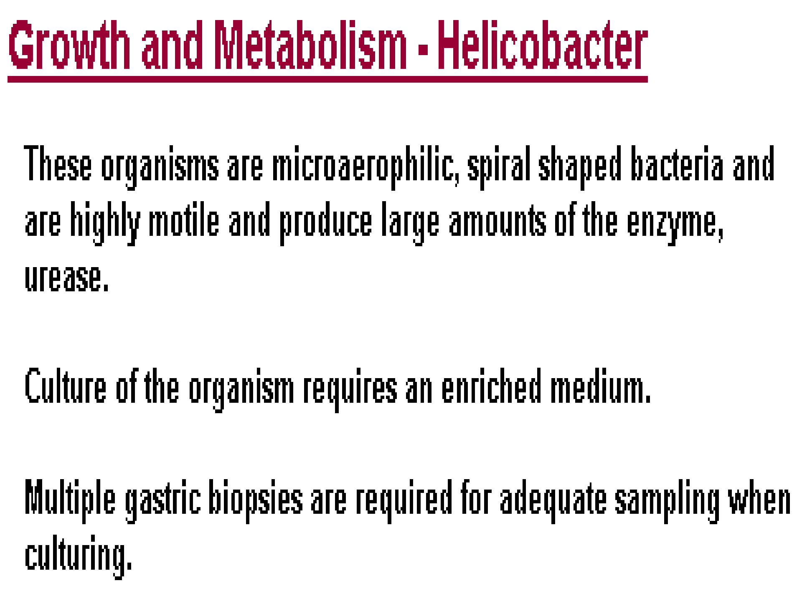
Pathology
core

Slide 19
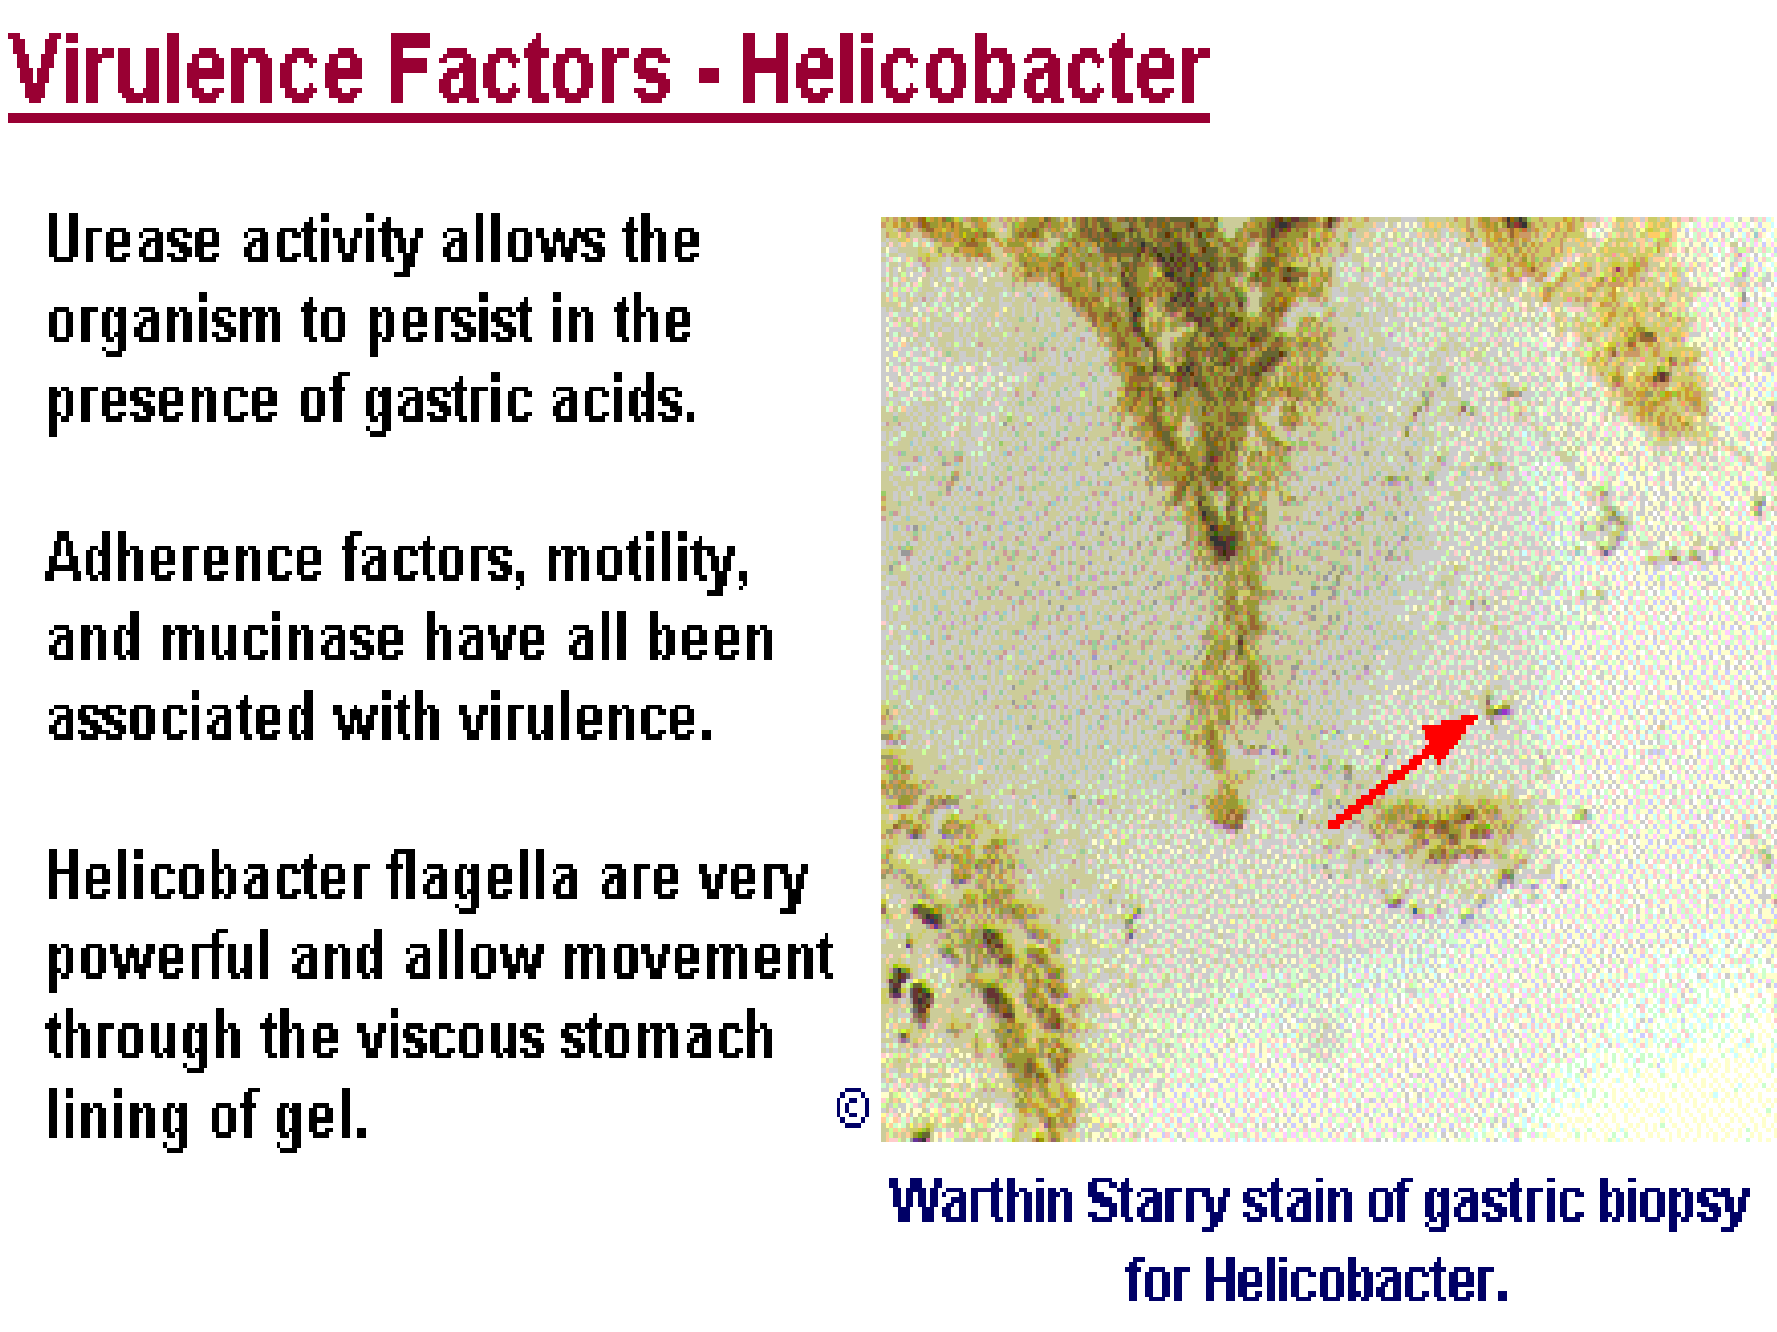
Pathology
core

Slide 20
Helicobacter pylori inf^{Pa}e^{thol}c^{ogy} tion persist^{c}s^{ore} for life
H. pylori produces urease …formation of ammonia… pH increases.
Cytotoxins, Toxic proteins, Platelet AF and Lipopolysaccharides.

Slide 21
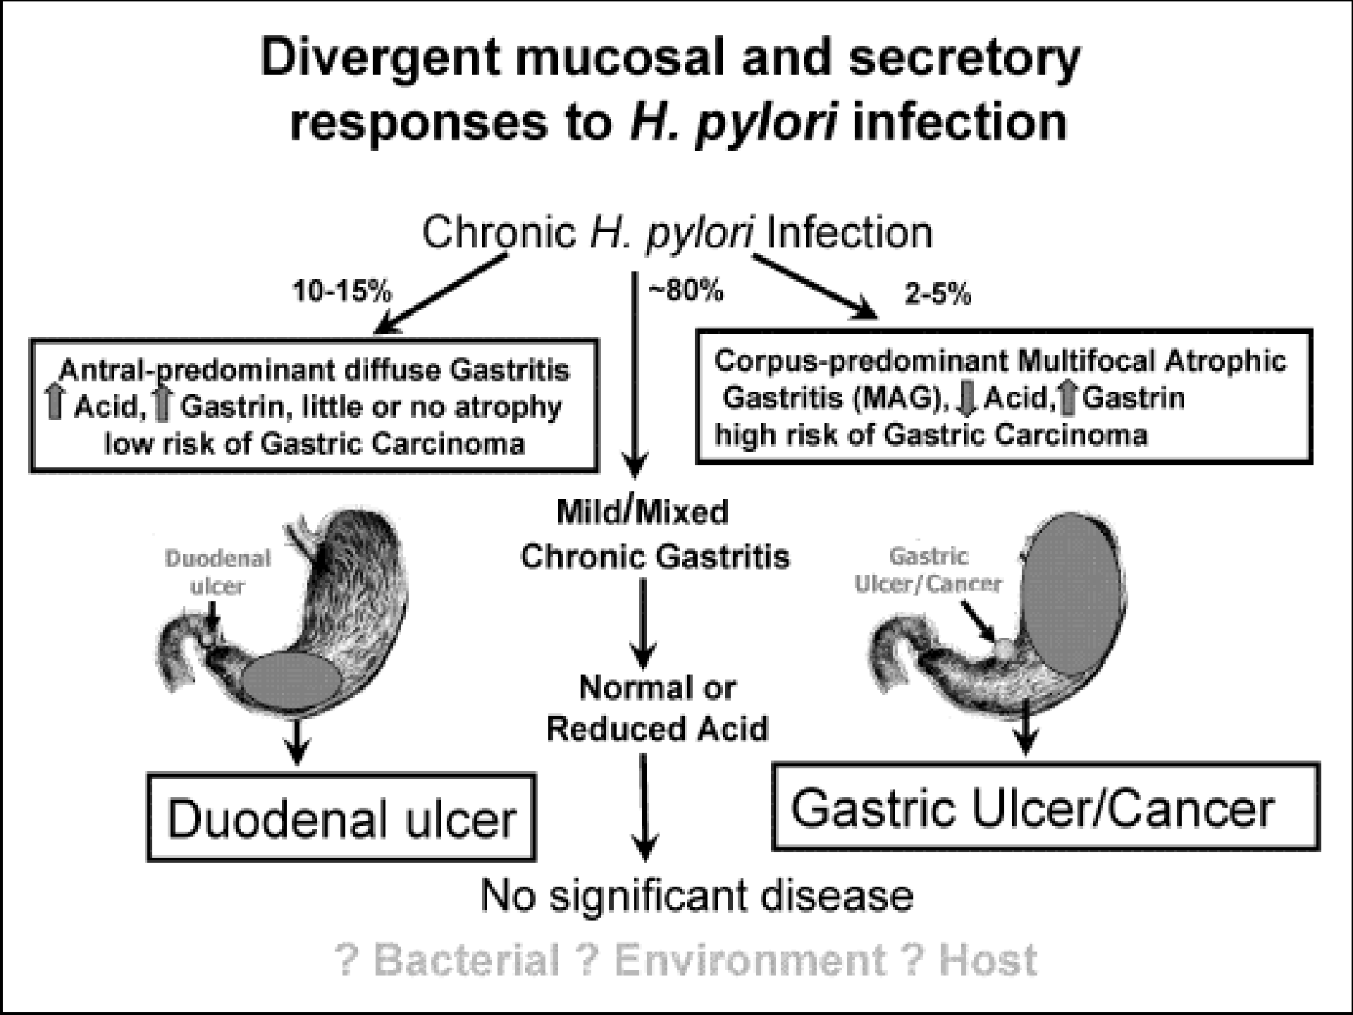
Pathology
core

Slide 22
Pathology core
Diseases
1. Chronic superficial gastritis, which is an inflammation of the stomach lining due to the infiltration of lymphocytes, plasma cells, eosinophils, and monocytes into the mucosal lining of the stomach, which causes injury to the gastric glands.
2.The immune response can also cause inflammation of the duodenum, leading to duodenal ulcers.
3. Atrophic gastritis, which is a nonspecific inflammation of the entire lining of the stomach, may be the result of the infiltration of lymphocytes into the stomach.
4. Malt-type and other lymphomas

Slide 23
Invasive techniques:
Vertical
Diagnosis of H. pylori Infection
Culture. Because of fastidious nature of H. pylori, Culturing tedious and is no more sensitive or specific than simple Histologic analyses. Culturing H. pylori also involves the cost of endoscopy, making the method even less practical.
Histologic analysis of biopsy. Routine Histologic
analysis of biopsy samples is common and practical.
Helpful also to visualize the mucosa, permitting detection of Histologic gastritis and lesions such as MALT-type lymphomas.
Requires endoscopy, diagnosis days after the procedure.

Slide 24
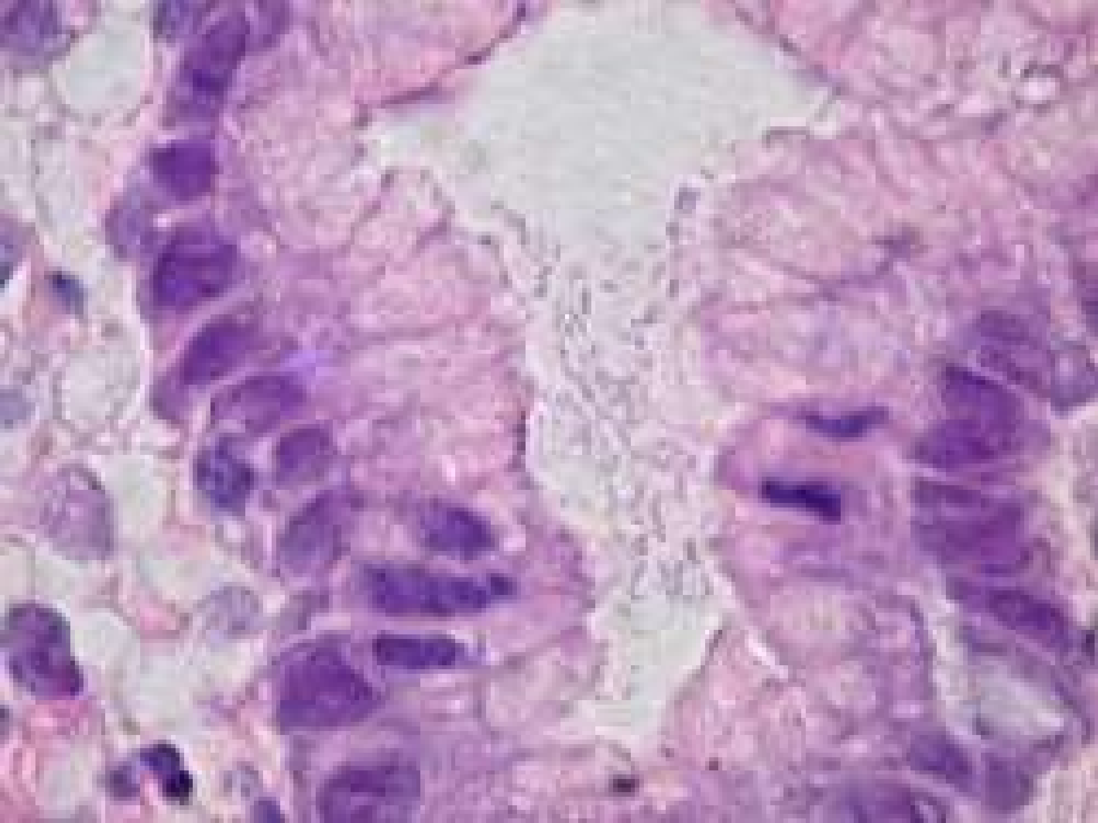
Pathology
core

Slide 25
Campylobacter-like organi^{P}s^{atho}m^{logy} (CLO) test.
Vertical
This test is based on the fact that mucosal biopsy specimensinoculated into a medium containing urea and phenol red, a dye that turns pink in a pH of 6.0 or greater. Inexpensive, Only one-half hour is required for diagnosis of infection, and the test has shown 98% sensitivity and 100% specificity. Invasive technique of choice for diagnosing
H. pylori infection.

Slide 26
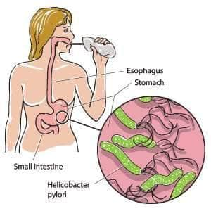
Noninvasive Techniques:
Pathology
Vertical
Helicobacter pylori Urea Breath Test Urease activity detected by a breath test.
Urea radioactively labeled with carbon 13 and carbon 14 is ingested. Bacterial urease splits off labeled carbon dioxide, which
can be detected in the breath. 100% sensitivity and specificity.
•
Detection of IgG and secretory IgA.
Enzyme-linked immunosorbent assay (ELISA). elevated antibody titer indicates current infection. Accuracy and low cost makes this test an attractive choice for detecting H. pylori

Slide 27
Treatment of Peptic Ulcer Disease
Pathology
Horizontal
Many excellent treatments for peptic ulcer disease exist.
In duodenal ulcers and gastric ulcers, histamine H2-receptors can be blocked to cause healing in about 90% of cases within 8 weeks.
Antibiotics a must.

Slide 28
Triple Therapy
Pathology
Horizontal
Eradication of Helicobacter pylori is defined as the absence of the organism four or more weeks after eradication therapy.
Eradication rate for single-drug therapy is only 19% for double-drug therapy is still only 48% . 82%, achieved by combining
Bismuth + Metronidazole + Tetracycline.

Slide 29

Prevention & Control
``Safe drinking water``
Longitudinal

Slide 30
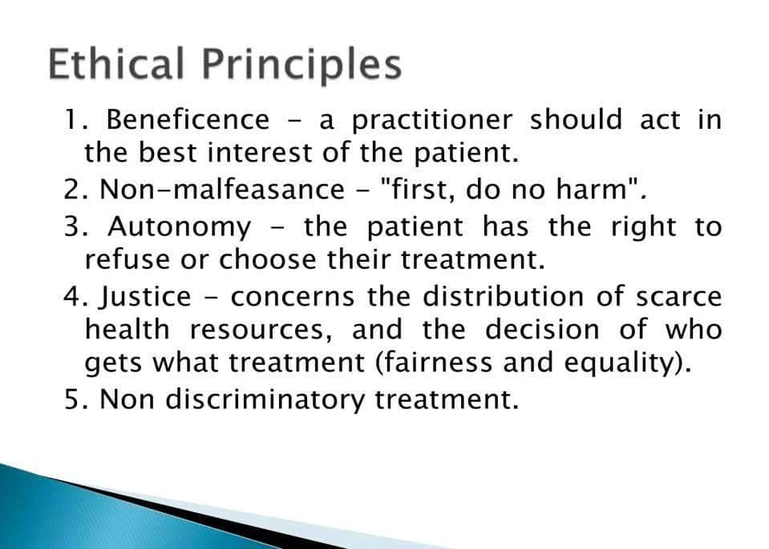
Longitudinal
Longitudinal

Slide 31
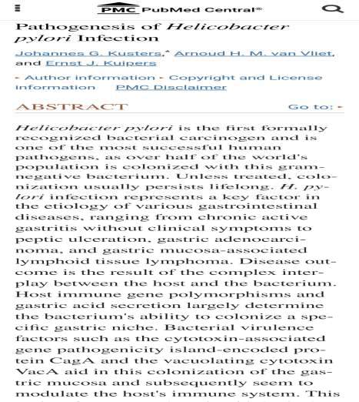
Longitudinal
RESEARCH
https://www.ncbi.nlm.nih.g ov/pmc/articles/PMC1539 101/

Slide 32

Longitudinal

Slide 33
FAMILY MEDICINE
Longitudinal
Scenario 1: Sarah has been experiencing stomach pain and burning for weeks. She also notices bloating and feels nauseous after eating.
MCQ:
Which bacterium is more likely to be causing Sarah's symptoms?
a) Helicobacter pylori (commonly associated with gastritis) CORRECT
b) Campylobacter (typically causes diarrhea)
Scenario 2: John recently traveled to a country with poor sanitation and has been suffering from severe diarrhea, cramps, and chills since returning home.
MCQ:
What is the most likely cause of John's illness?
a) Helicobacter pylori (prefers the stomach environment)
b) Campylobacter (known to cause these intestinal symptoms) CORRECT

Slide 34
Take home message
Helicobacter pylori and Campylobacter, though both bacterial foes, target different parts of your digestive system. H. pylori burrows in your stomach, potentially causing ulcers and stomach cancer.
Campylobacter sets up camp in your intestines, leading to diarrhea and cramps. Contaminated food and water, or close contact, can spread both. Safe food handling and good hygiene are your best
defenses!

Slide 35


