Slide 2
Foundation Module First Year MBBS
Cell-to-Cell Adhesion
Supervised by Prof.Samia Sarwar Chairperson Physiology Presenter :Dr.Sidra Hamid (FCPS PHY)
Dated : 29-01-2025
Physiology Department

Slide 3
Motto, Vision, Dream
To impart evidence based research oriented medical education
To provide best possible patient care
To inculcate the values of mutual respect and ethical practice of medicine
Wisdom
Truth
Service

Slide 4
Professor Umar Model of Integrated Lecture

Slide 5
Bloom's Taxonomy : Domains of Learning
Sr. # | Domain of learning | Abbreviation | Levels of the domain | Meaning
1 | cognition | C | C1 | Recall / Remembering
2 |  |  | C2 | Understanding
3 |  |  | C3 | Applying / Problem solving
4 | Psychomotor | P | P1 | Imitation / copying
5 |  |  | P2 | Manipulation / Follows instructions
6 |  |  | P3 | Precision / Can perform accurately
7 | Attitude | A | A1 | Receiving / Learning
8 |  |  | A2 | Respond / Starts responding to the learned attitude
9 |  |  | A3 | Valuing / starts behaving according to the learned attitude

Slide 6
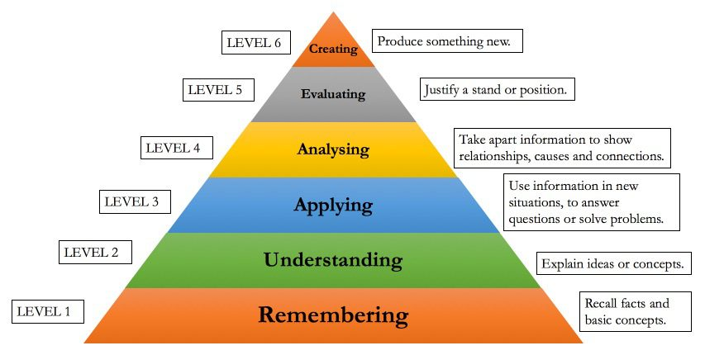
Diagrammatic Representation of Bloom’s Taxonomy

Slide 7
Learning Objectives
Describe the structure of various intracellular connections
Give the physiological importance of cell junctions

Slide 8
Cell To Cell Adhesion
Core Concept
Core Knowledge
Cell are attached to basal lamina and to each other by cell adhesion molecule (CAMs) that form intercellular connections.

Slide 9
Cell To Cell Adhesion
Core Concept
Core Knowledge
Three ways of cell connections:
I. CAMs
II. ECM
III. Specialized cell junctions

Slide 10
“It Is How Cells Talk With Each Others”!
Core Concept
Core Knowledge

Slide 11
CAMs
Core Concept
Core Knowledge
CAMs pass through cell membrane and are anchored to the cytoskeletion.
Homophilic binding:
binding to like molecules on other cells.
Heterphilic binding :
binding to non-self molecules.
Some bind to laminins.

Slide 12
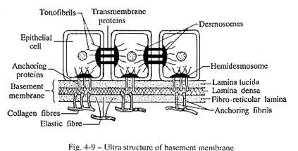
Core Concept
Core Knowledge
HOMOPHILIC BINDING
HETEROPHILIC BINDING

Slide 13
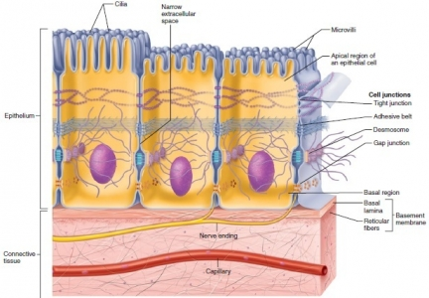
Horizontal Integration (Histology)

Slide 14
Roles of CAMs
Horizontal Integration (Biochemistry)
Horizontal Integration
Embryonic development
Inflammation and wound healing.
Holding tissue together.
Metastasis of tumors.
Cell signaling (apoptosis)
Cell locomotion.

Slide 15
Classification of CAMs
Horizontal Integration (Biochemistry)
Four families:
I. Integrins
II. Adhesion molecules of lgG superfamily of immunoglobulins.
III. Cadherins.
IV. Selectins.

Slide 16
Extra Cellular Matrix
Core Concept
Core Knowledge
Intricate mesh work of fibers proteins embedded in a watery gel like substance “ the interstitial fluid.”

Slide 17
Extra Cellular Matrix
Core Concept
Core Knowledge
Fibrous proteins:
i. Collagen
ii. Elastin
iii. Fibronectin

Slide 18
Extra Cellular Matrix
Core Concept
Core Knowledge
Collagen
flexible, non-elastic, give tensite strength to sheeths against longitudinal stress.(scurvy)
Elastin
rubbery protein for elasticity and recoil in tissue like lungs.
Fibronectin
for cell to cell adhesion, reduced in tumors resulting in cellular metastasis.

Slide 19
ECM
Core Concept
Core Knowledge
ECM is the secretion of the local cell present in the EC matrix (fibroblasts).
Specialized for each tissue e.g cartilage and bone.
Play role in cell growth and differentiation.
Only RBCs have survived to grow and move without attaching to ECM.

Slide 20
Specialized Cell Junctions
Core Concept
Core Knowledge
Broadly categorized in:
I. Junctions that fasten the cell to each other or surrounding.
Tight junctions
Desmosomes
Hemidesmosomes.
II. That permit flow of ions.
Gap junctions.

Slide 21
Core Concept
Core Knowledge

Slide 22
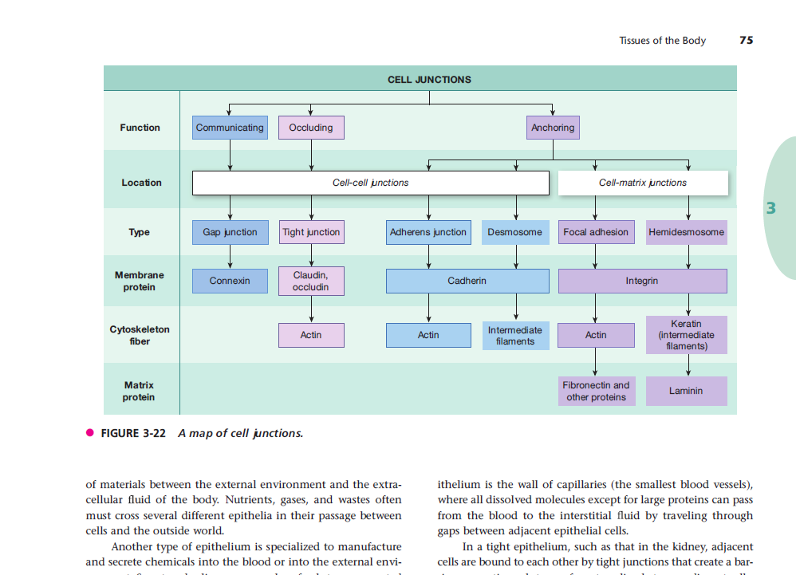
Core Concept
Core Knowledge

Slide 23
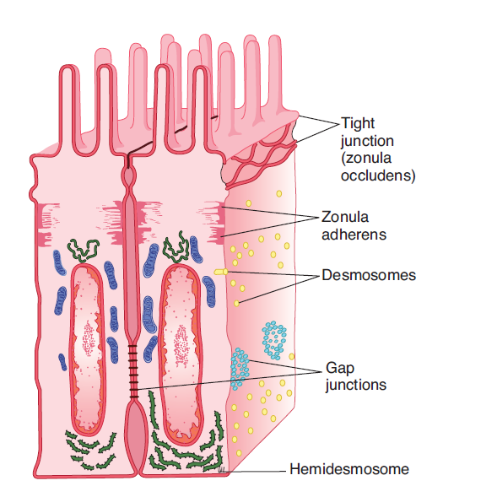
Core Concept
Core Knowledge

Slide 24
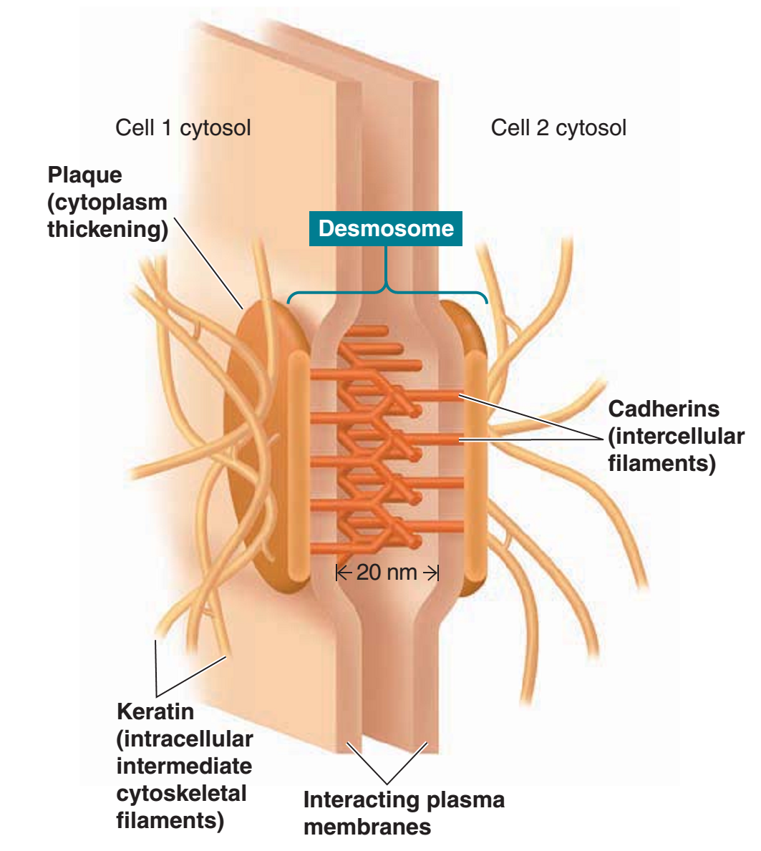
Core Concept
Core Knowledge

Slide 25
Core Concept
Core Knowledge

Slide 26
Desmosomes /Adhering Junctions
Core Concept
Core Knowledge
Structure:
Cytoplasmic thickening on the inner side of cell membrane ---plague.
Filaments extending between cell and adhering the plagues on both sides.
These intermediate filaments run parallel to membrane and others radiating away from it.

Slide 27
Core Concept
Core Knowledge
Roles:
For tensile strength e.g heart, uterus, skin.
Present where considerable stretching is present, e.g skin ( Keratin).

Slide 28
Hemidesmosomes
Core Concept
Core Knowledge
Half desmosomes.
Attach cell to basal lamina
Connect intercellularly to intermediate filaments.
Contain integrins in place of cadeherins.

Slide 29
Core Concept
Core Knowledge

Slide 30
Focal Adhesions
Core Concept
Core Knowledge
Attach cell to basal lamina
Labile structure
Associated with actin filaments
Involved in cell movement.

Slide 31
Zonula Adherens
Core Concept
Core Knowledge
In epithelial cells a continuous structure on the basal side of tight junctions and is a major site for attachment of intracellular microfilaments.

Slide 32
Core Concept
Core Knowledge

Slide 33
Core Concept
Core Knowledge
Tight Junctions/Zonula Occludens

Slide 34
Tight Junctions
Core Concept
Core Knowledge
Adjacent cells bind firmly with each other at points of direct contact to seal off passage way between two cells.
Highly selective barriers present in sheets of epithelial tissues which cover body surfaces or line tissue cavities.

Slide 35
Tight Junctions/Zonula Occludens
Core Concept
Core Knowledge

Slide 36
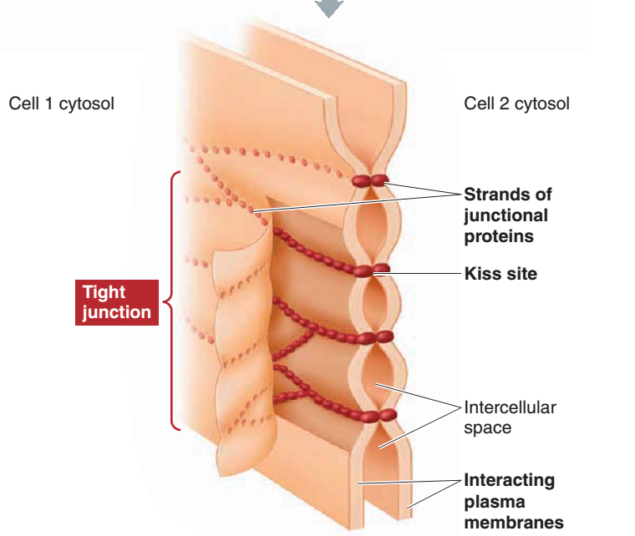
Tight Junctions/Zonula Occludens
Core Concept
Core Knowledge

Slide 37
Core Concept
Core Knowledge
Tight Junctions/Zonula Occludens

Slide 38
Tight Junctions/Zonula Occludens
Core Concept
Core Knowledge
Allow paracellular transport of some ions depending on the protein make up of tight junctions.
Occludin, junctional adhesion molecules (JAMs) and claudins are the main families of proteins involved.

Slide 39
Tight Junctions/Zonula Occludens
Core Concept
Core Knowledge
Locations:-
Renal epithelium, choroid plexus, intestinal mucosa.
Maintain different distribution of tissue across the epithelia.

Slide 40
Kiss Sites / Junctional Proteins
Core Concept
Core Knowledge
Lateral edges of cells are joined in a tight seal near the laminal border.
Junctional proteins on the outer surface of cell fuse directly preventing paracellular transport.

Slide 41
Core Concept
Core Knowledge
Tight Junctions/Zonula Occludens

Slide 42
Gap Junctions/Connexons
Core Concept
Core Knowledge
Cytoplasmic tunnel between two movement of ions 1000 Da.

Slide 43
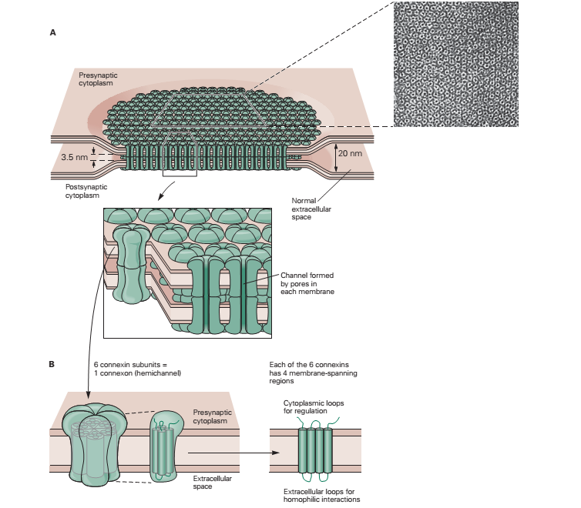
Core Concept
Core Knowledge
Gap Junctions/Connexons

Slide 44
Gap Junctions/Connexons
Core Concept
Core Knowledge
Connexons are formed from “6” connexin subunits.
These subunits determine their permeability and selectivity.
Diameter of conduit is 2 nm.
Sugars, aminoacids, ions can pass.

Slide 45
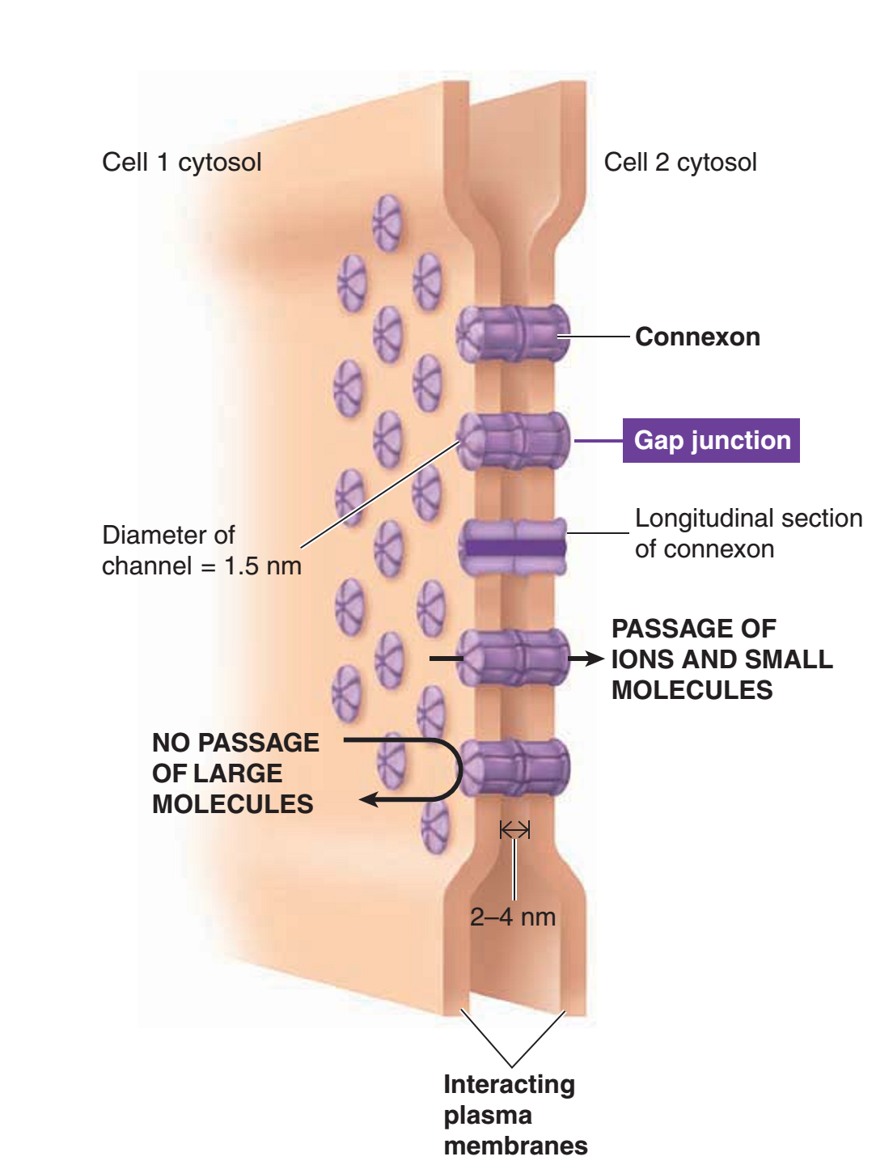
Gap Junctions/Connexons
Core Concept
Core Knowledge

Slide 46
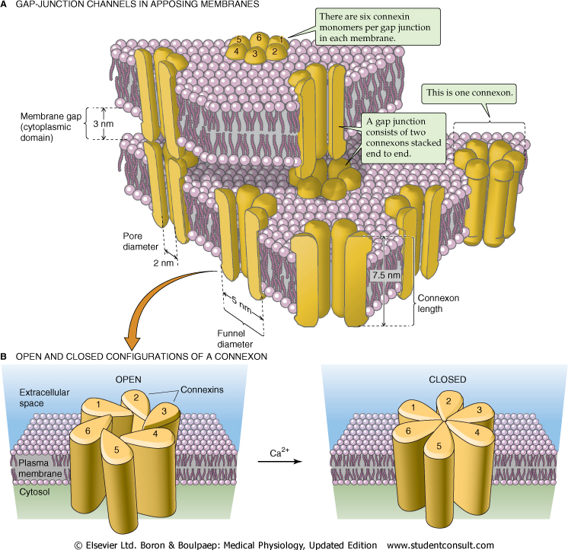
Core Concept
Core Knowledge
Gap Junctions/Connexons

Slide 47
Gap Junctions/Connexons
Core Concept
Core Knowledge
For electrical signaling between cell e.g heart uterus.
In ovary when egg is developing the gap junctions are involved in transmission of nutrients.

Slide 48
Spiral Integration

Slide 49
Spiral Integration/ Bioethics
Ethical Considerations
From an ethical standpoint, the scenario raises considerations regarding patient autonomy, informed consent, and confidentiality
The physician must ensure that patient fully understands her diagnosis, treatment options, and potential implications
Discuss the necessity of a tongue biopsy for confirmation of oral thrush and obtaining informed consent for the procedure
Additionally, the physician must respect patient’s privacy and confidentiality throughout the diagnostic and treatment process

Slide 50
Family Medicine Preventive Care Approach
Spiral Integration/ Family Medicine
Spiral Integration
Personalized Counseling:
Tailor prevention plans to patient-specific risk factors and lifestyle.
Educate family members about the importance of supporting patients in dietary and medication adherence.
Clear Communication with Specialists:
Coordinate care with nephrologists, endocrinologists, or dietitians for high-risk or complex cases.
Patient Empowerment:
Provide simple, actionable advice for recognizing symptoms and managing early signs of derangements.
Use visual aids or handouts to enhance understanding.
Community Health Initiatives:
Promote awareness about balanced diets, hydration, and regular check-ups through local health programs.

Slide 51
Spiral Integration/ Research
Yufei Wu, Sean X. Sun,
Mechanics of cell-cell junctions,
Biophysical Journal,
Volume 122, Issue 16,
2023,
Pages 3354-3368,
ISSN 0006-3495,
https://doi.org/10.1016/j.bpj.2023.07.011.
(https://www.sciencedirect.com/science/article/pii/S0006349523004629)
Abstract: Tissue cells in epithelial or endothelial monolayers are connected through cell-cell junctions, which are stabilized by transmembrane E-cadherin bonds and intracellular actin filaments. These bonds and junctions play a crucial role in maintaining the barrier function of epithelia and endothelia and are believed to transmit forces between cells. Additionally, E-cadherin bonds can impact the shape of cell-cell junctions. In this study, we develop a continuum mechanical model of the cell-cell junction by explicitly incorporating the cell membrane, distributions of E-cadherin bonds, cytoplasmic fluid pressure, and F-actin dynamics. The static force-balanced version of the model is able to analyze the influences of cell cortical tension, actin dynamics, and cytoplasmic pressure on the junction shape and E-cadherin bonds. Furthermore, an extended model that incorporates fluid flow, across the cell boundary as well as around the cell, is also examined. This model can couple cell-shape changes with cell cortical tension and fluid flow, and predicts the additional effect of fluid motion on cell-cell junction mechanics. Taken together, our models serve as an intermediate link between molecular-scale models of cell-junction molecules and cell-scale models of tissue and epithelia.

Slide 52
Prompting IT & Research Culture
How To Access Digital Library
Steps to Access HEC Digital Library
Go to the website of HEC National Digital Library
On Home Page, click on the INSTITUTES
A page will appear showing the universities from Public and Private Sector and other Institutes which have access to HEC National Digital Library HNDL
Select your desired Institute
A page will appear showing the resources of the institution
Journals and Researches will appear
You can find a Journal by clicking on JOURNALS AND DATABASE and enter a keyword to search for your desired journal

Slide 53
References
References
Guyton and Hall Textbook of Medical Physiology 14th Edition
Ganong’s Review of Medical Physiology 25th Edition
Sherwood, 9th edition.
Silverthorn Physiology, 6th edition
Vander’s Human Physiology, 14th edition

