Slide 2
Foundation Module First Year MBBS
Receptors & Signal Transduction
Supervised by Prof.Samia Sarwar Chairperson Physiology Presenter :Dr.Sidra Hamid (FCPS PHY)
Dated : 28-01-2025
Physiology Department

Slide 3
Motto, Vision, Dream
To impart evidence based research oriented medical education
To provide best possible patient care
To inculcate the values of mutual respect and ethical practice of medicine
Wisdom
Truth
Service

Slide 4
Professor Umar Model of Integrated Lecture

Slide 5
Bloom's Taxonomy : Domains of Learning
Sr. # | Domain of learning | Abbreviation | Levels of the domain | Meaning
1 | cognition | C | C1 | Recall / Remembering
2 |  |  | C2 | Understanding
3 |  |  | C3 | Applying / Problem solving
4 | Psychomotor | P | P1 | Imitation / copying
5 |  |  | P2 | Manipulation / Follows instructions
6 |  |  | P3 | Precision / Can perform accurately
7 | Attitude | A | A1 | Receiving / Learning
8 |  |  | A2 | Respond / Starts responding to the learned attitude
9 |  |  | A3 | Valuing / starts behaving according to the learned attitude

Slide 6
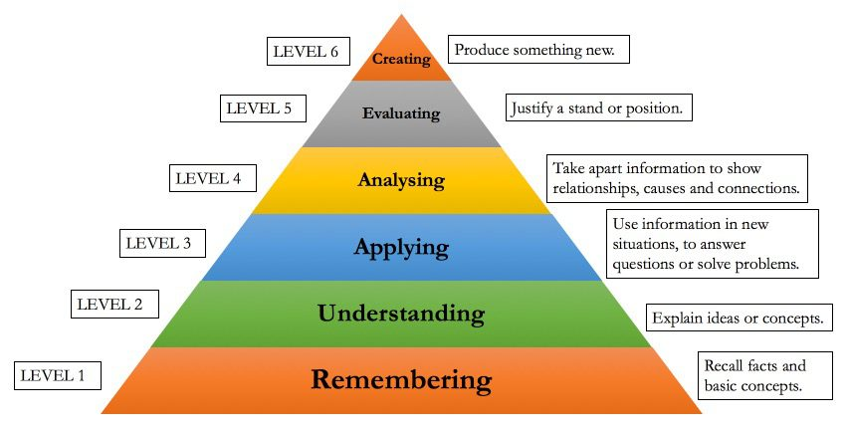
Diagrammatic Representation of Bloom’s Taxonomy

Slide 7
Learning objectives
At the end of the session the students should be able;
Define ligand
Define receptors
Identify different types of receptors
Signal transduction

Slide 8
Core Knowledge

Slide 9
Core Concept
Extracellular messenger molecules (ligands/signal)
Receptors at target cell
Signal transduction pathway
Effectors
Cell Communication (cell signaling)

Slide 10
Ligand
Core Concept
Natural DDD
Natural endogenous substances which act on various receptors in the body
• Acetylcholine, GABA, Adrenaline, Glutamate etc
• Most drugs act by altering the activity of
ligands having either similar effects, opposite or block effect of ligand
Notes:
SMALL LIPOPHILIC
WATER SOLUBLE NO GAS
NO

Slide 11
Receptor
Core Concept
Macromolecule or binding site located on the surface or inside the effector cell that serves to recognize the signal and initiate a response to it

Slide 12
Receptor
Core Concept
Intracellular receptors
Cytoplasm (Type –I) (androgen, glucocorticoid, mineralocorticoid and progesterone)
Nucleus (Type-II) (peroxisome proliferator, retinoic acid, & thyroid receptors)
Cell surface receptors
Ligand gated Ion channels
Enzyme linked receptors
G-protein coupled receptors
LOCATION

Slide 13
Receptor
Core Concept
Structure
Intracellular Receptor
Ligand binding domain
DNA binding domain
Transcription activating domain
Cell Surface Receptor
External ligand binding domain
Hydrophobic transmembrane spanning domain
Intracellular domain

Slide 14
Receptor & Ligand Binding
Core Concept
Each receptor has a recognition site which is specific region of the receptor to which signal molecule binds
Notes:
Specific receptor for a specific ligand

Slide 15
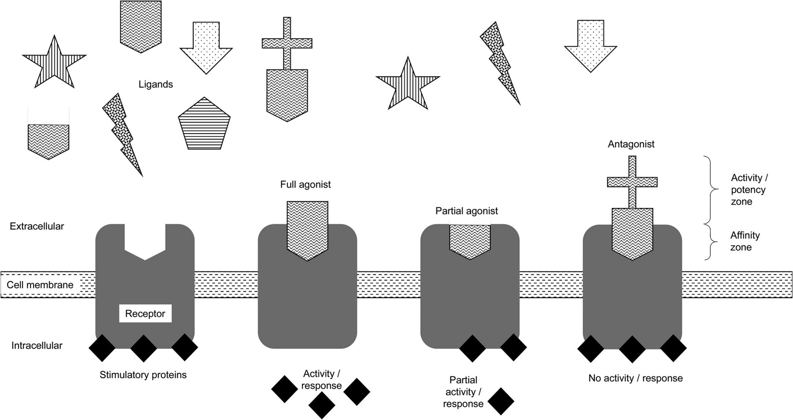
Core Concept

Slide 16
Receptor regulation
Core Concept
Normal
Up Regulation
Down Regulation

Slide 17
Signal transduction
Core Concept
Signal transduction (also known as cell signaling) is the transmission of molecular signals from a cell's exterior to its interior. Signals received by cells must be transmitted effectively into the cell to ensure an appropriate response. This step is initiated by cell-surface receptors.

Slide 18
Horizontal Integration (Biochemistry)

Slide 19
Hormone Receptors
Horizontal Integration/ Biochemistry
Membrane proteins
Specific for each hormone
Sensitivity/Responsiveness is determined by :
1.Number of receptors
(Larger the number; greater the response)
2.Affinity of receptors
(Higher the affinity; greater the response)

Slide 20
Sensitivity can be changed by:
Core Concept
Change in number of receptors by:
a. Increase or decrease synthesis
b. Increase or decrease degradation i.e.
inactivation/activation
i.e..
* Down regulation of receptors
* Up regulation of receptors
e.g. increase T3→decreaseTRH receptors in Ant. pituitary gland

Slide 21
G-Protein : (Molecular Switch)
Core Concept
Membrane bound protein ;couples hormone receptor to effector enzyme
α-GDP or GTP Gs ,Gi proteins
β
γ
Site of hormone receptors:
*Cell membrane ; Catecholamines
*Cytoplasm ;Steroids
*Nucleus ; T4
Number:2000-100,000 receptors on each cell

Slide 22
Mechanism Of Action Of Hormones
Core Concept
Endocrine Gland releases Hormone that
binds with specific receptor on target cell and
triggers intracellular signals by :
a. Altering membrane permeability
b. Acting through 2nd messenger system
c. Activating specific genes to form new
proteins
and produce
Physiological Response

Slide 23
1. Altering Membrane Permeability
Core Concept
By opening/closure of ion channels
Na⁺, K⁺, Ca⁺⁺ channels
Examples: Action of Catecholamines, Ach

Slide 24
2.Acting Through 2nd Messenger System
Core Concept
a. Adenyl Cyclase - cAMP 2nd messenger system
b. Phospholipase-C 2nd messenger system
c. Ca-Calmodulin 2nd messenger system

Slide 25
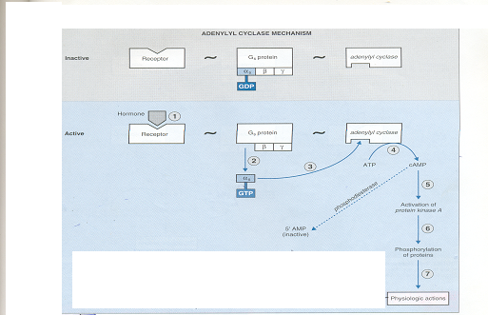
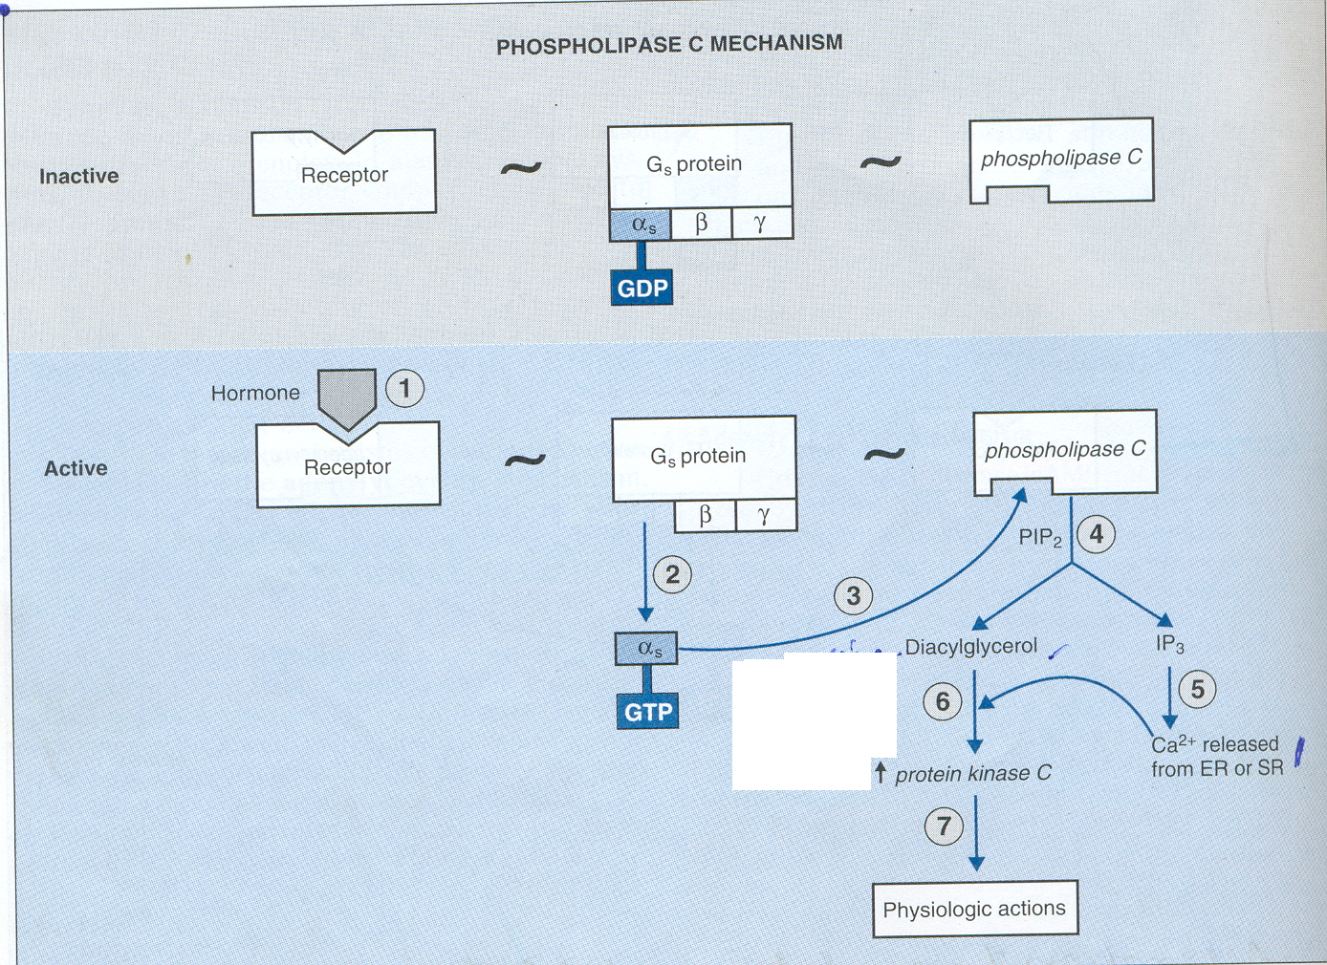
a. Adenyl Cyclase Mechanism
Core Concept

Slide 26
b. Phospholipase C Mechanism
Core Concept

Slide 27
Hormones Using Phospholipase C Mechanism
Core Concept
Angiotensin-II (Vascular smooth muscle)
Catecholamines(α-receptors)
GnRH
GHRH
TRH
Oxytocin
Vasopressin(V1 receptors on vascular smooth muscles)

Slide 28
c. Ca Calmodulin Mechanism
Core Concept
Operates in response to Ca⁺⁺ entry into cell
1. Ca⁺⁺ entry may be initiated by;
a. change in memb potential causing opening of Ca⁺⁺ channels
b. hormones interacting with memb receptors causing opening
of Ca⁺⁺ channels in cell memb or ER or Mitochondria
2. Binding of Ca⁺⁺ with Calmodulin
3. Activation/Inactivation of calmodulin dependent protein kinase

Slide 29
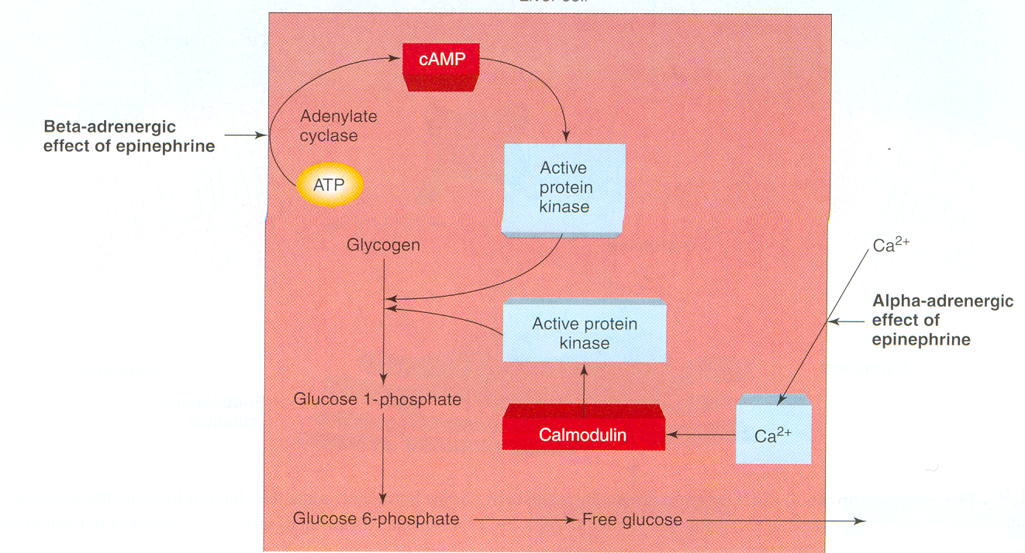
Core Concept
c. Ca Calmodulin Mechanism

Slide 30
3.Hormone Action Through Activation of Genes & Protein synthesis
Core Concept
Via nuclear transcription & ribosomal translation
Synthesis of proteins function as ; enzymes, transport proteins, structural proteins
e.g. steroid hormones; cortisol, aldosterone and T4 ,etc

Slide 31
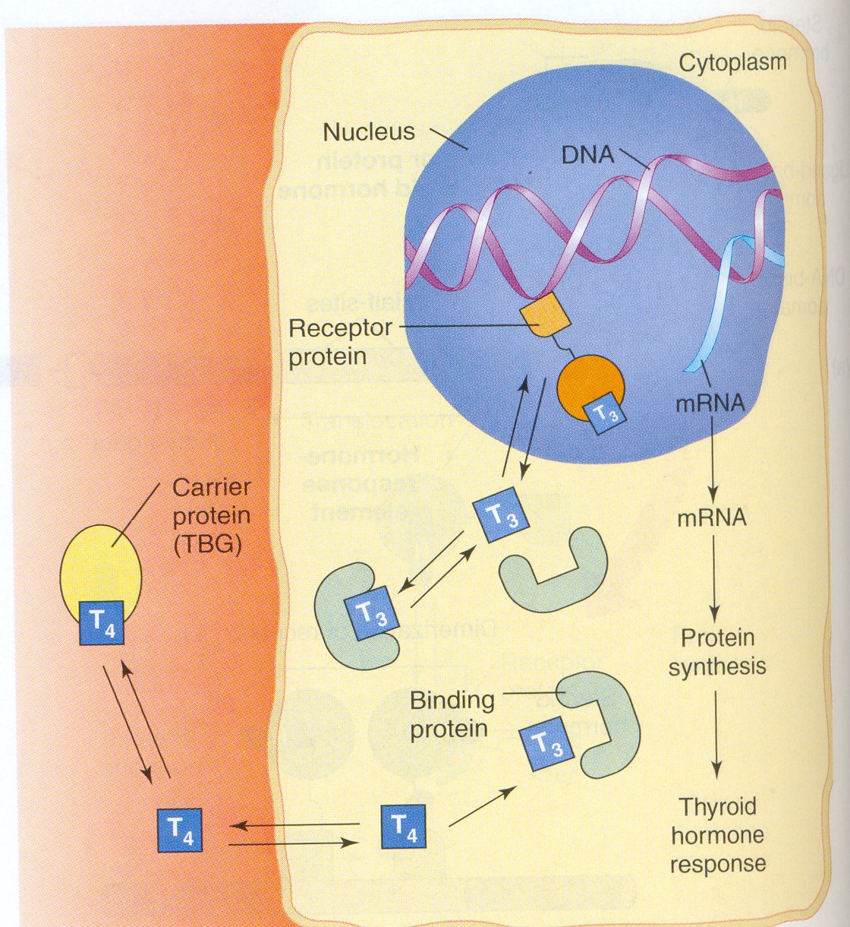
Core Concept
Hormone Action Through Activation of Genes & Protein synthesis

Slide 32
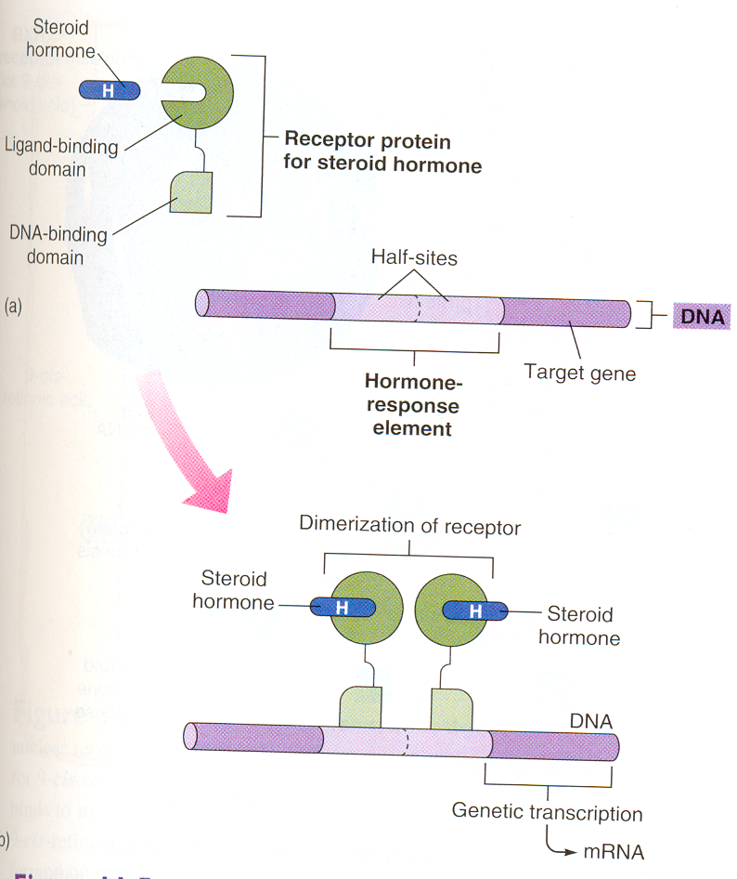
Core Concept
Hormone Action Through Activation of Genes & Protein synthesis

Slide 33
Vertical Integration (Pharmacology & Medicine)

Slide 34
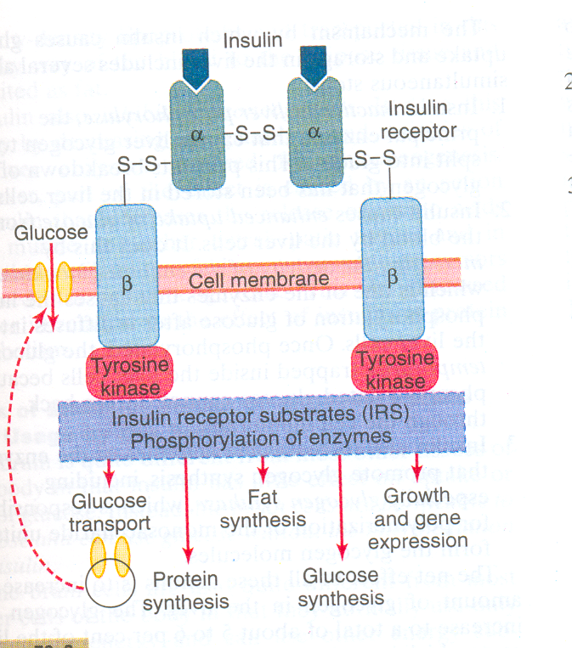
Mechanism of Action of Insulin
Vertical Integration/Pulmonology & Medicine

Slide 35
Spiral Integration

Slide 36
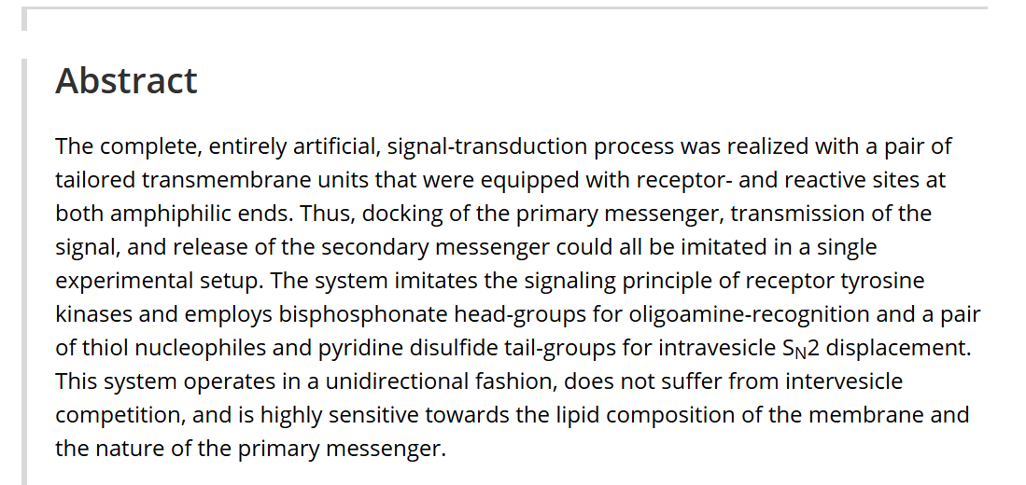
Spiral Integration/Research
Artificial Signal Transduction with Primary and Secondary Messengers
Kai Bernitzki, Dr. Michael Maue, Prof. Thomas Schrader
First published: 07 September 2012
https://doi.org/10.1002/chem.201200623

Slide 37
Lesson of the Day Autonomy
Spiral Integration/Bioethics
Autonomy means that the patients are able to make independent decisions. This means that doctors & nurses should be sure patients have all of the needed information that is required to make a decision about their medical care and are educated. They do not influence the patient's choice.
The Right of Self-Determination or Autonomy would include the right to refuse treatment, the right to participate in research or refuse it. To exercise this right would require Informed Consent.

Slide 38
How To Access Digital Library
Promoting IT & Research Culture
Steps to Access HEC Digital Library
Go to the website of HEC National Digital Library.
On Home Page, click on the INSTITUTES.
A page will appear showing the universities from Public and Private Sector and other Institutes which have access to HEC National Digital Library HNDL.
Select your desired Institute.
5. A page will appear showing the resources of the institution
6. Journals and Researches will appear
7. You can find a Journal by clicking on JOURNALS AND DATABASE and enter a keyword to search for your desired journal. Link:https://www.topstudyworld.com/2020/05/access-hec-digital-library.html?m=1

Slide 39
References
References
Guyton and Hall Textbook of Medical Physiology 14th Edition
Ganong’s Review of Medical Physiology 25th Edition
Sherwood, 9th edition.
Silverthorn Physiology, 6th edition
Vander’s Human Physiology, 14th edition

