Slide 2
Foundation Module First Year MBBS
Transport across Cell Membrane, Osmosis
Supervised by Prof. Samia Sarwar Chairperson Physiology Presenter :Dr. Faizania Shabir (AP PHY)
Dated : 00-00-2025
Physiology Department

Slide 3
Motto, Vision, Dream
To impart evidence based research oriented medical education
To provide best possible patient care
To inculcate the values of mutual respect and ethical practice of medicine
Wisdom
Truth
Service

Slide 4
Professor Umar Model of Integrated Lecture

Slide 5
Learning Objectives
Recall transport mechanism across the cell membrane with special emphasis on osmosis and osmotic pressure
Recall factors affecting osmosis
Comprehend the concept of moles and osmoles
Recall osmolarity of body fluids
Discuss tonicity
Comprehend concept of isotonic, hypertonic and hypotonic

Slide 6
Interactive Session

Slide 7
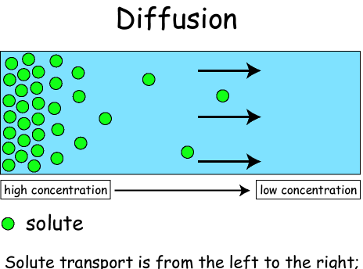
What is Diffusion?
Core Concept
Diffusion is the movement of molecules from high concentration to low concentration, until equilibrium is reached.

Slide 8
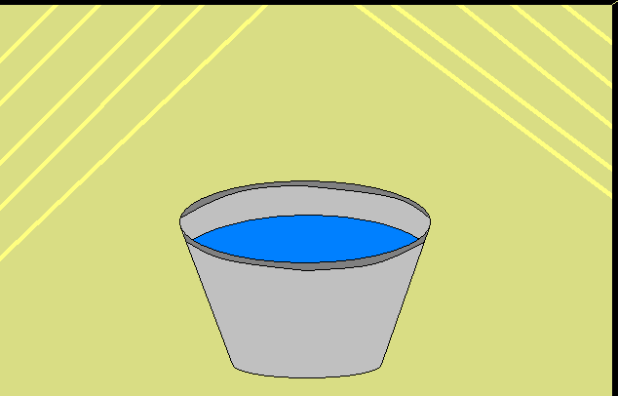
What is Equilibrium?
Core Concept
Static equilibrium: no change in the system is occurring.
For example, a bucket of water is in equilibrium because there is no change occurring to it.

Slide 9
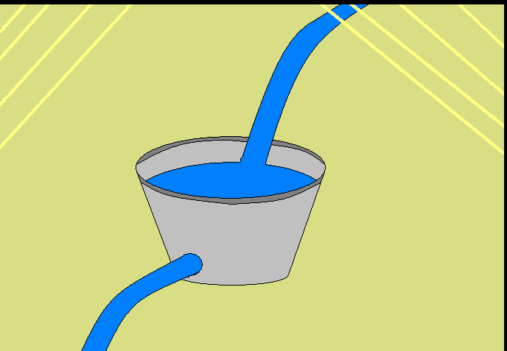
Core Concept
Dynamic equilibrium: changes in the system are occurring, but at the same rate as one another.
For example, a bucket of water with a hole in it is releasing water. At the same time more water is being poured in the bucket at the same rate it is pouring out.

Slide 10
For Example
Core Concept
Suppose you have a balloon filled with helium. As you know this balloon will not float forever and after a day or so will eventually shrink and remain on the ground.
This is an example of diffusion. The helium slowly escapes the balloon across the surface until the concentration is equal on both sides.
Why is it some balloons float for longer periods of time than others?

Slide 11
How is this Important?
Core Concept
Diffusion is an important concept for humans because our very existence depends on it.
The cells of the human body utilize diffusion every day!
Can you think of where in the human body diffusion might be important?

Slide 12
Osmosis
Core Concept
Osmosis can be defined as diffusion across a semi-permeable membrane.
Osmosis is a special case of diffusion commonly found in biological systems (e.g. your cells).
Water transport and turgor pressure in the cell is maintained by osmosis.

Slide 13
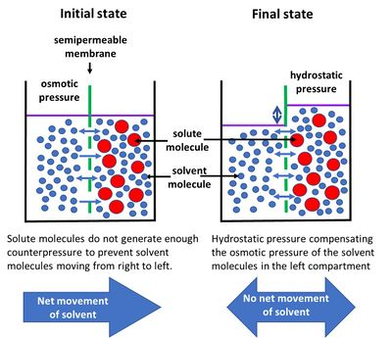
Core Concept

Slide 14
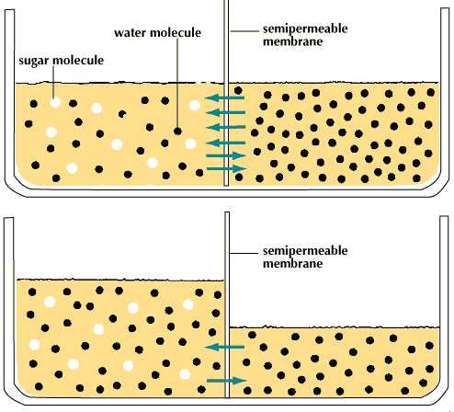
Semi-Permeable Membrane
Core Concept
Cell membranes have the ability to decide what comes in and what goes out.
Osmosis enables certain molecules to pass through the membrane.

Slide 15
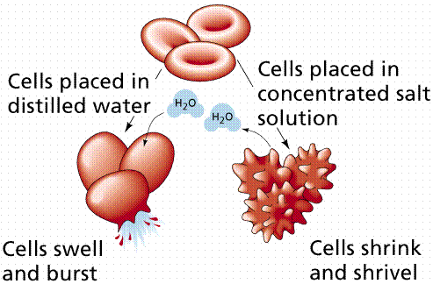
Core Concept
Turgor Pressure
Turgor: pressure against the cell membrane
Hypotonic: there is an excess of water and the cell bursts.
Hypertonic: there is not enough water and the cells shrivels..
Osmosis regulates these occurrences.

Slide 16
How is Osmosis Useful to Us?
Core Concept
Reverse osmosis is used in every day applications like desalination, water purification, water treatment and food processing.
Forward osmosis is currently being researched to also perform these processes.

Slide 17
Spiral Integration

Slide 18
Truth Telling
Spiral Integration/ Ethics
Enabling patients to make informed choices:
The provided information enables patients to make choices about health care and other aspects of their lives.
Relevant case
If you have been informed about the result of an HIV test taken by someone in your community who then asks to know his/her result.

Slide 19
Solution
Spiral Integration/ Ethics
The doctor should tell the patient about the result of test .Explain the disease in detail, its treatment options and prognosis .it will help him to make right decision at right time.

Slide 20
Research
Spiral Integration/ Research

Slide 21
How To Access Digital Library
Promoting IT & Research Culture
Steps to Access HEC Digital Library
Go to the website of HEC National Digital Library.
On Home Page, click on the INSTITUTES.
A page will appear showing the universities from Public and Private Sector and other Institutes which have access to HEC National Digital Library HNDL.
Select your desired Institute.
5. A page will appear showing the resources of the institution
6. Journals and Researches will appear
7. You can find a Journal by clicking on JOURNALS AND DATABASE and enter a keyword to search for your desired journal. Link:https://www.topstudyworld.com/2020/05/access-hec-digital-library.html?m=1

Slide 22
References
References
Books
Guyton And Hall Textbook of Medical Physiology 14th Edition
Ganong’s Review of Medical Physiology 25th Edition
Sherwood, 9th Edition
Silverthorn Physiology, 6th Edition
Vander’s Human Physiology, 14th Edition
Research https://www.sciencedirect.com/science/article/pii/S0147651322004109
YouTube/Videolink https://www.youtube.com/watch?v=kV_J8O0HIQI

