Slide 2
Foundation Module First Year MBBS
Cell Organelles & Cell Function – I & II
Supervised by Prof. Samia Sarwar Chairperson Physiology Presenter :Dr. Faizania Shabir (AP PHY)
Dated : 00-00-2025
Physiology Department

Slide 3
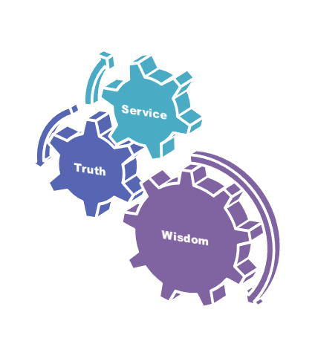
Motto, Vision, Dream
To impart evidence based research oriented medical education
To provide best possible patient care
To inculcate the values of mutual respect and ethical practice of medicine
Wisdom
Truth
Service

Slide 4
Professor Umar Model of Integrated Lecture

Slide 5
Learning Objectives
Describe cytoskeleton & cell locomotion
Discuss functions of cilia and amoeboid movement
Describe the mechanism of ATP generation
Enlist three major processes of ATP consumption in the body
Understand cell ingestion and other independent roles of cell

Slide 6
Interactive Session

Slide 7
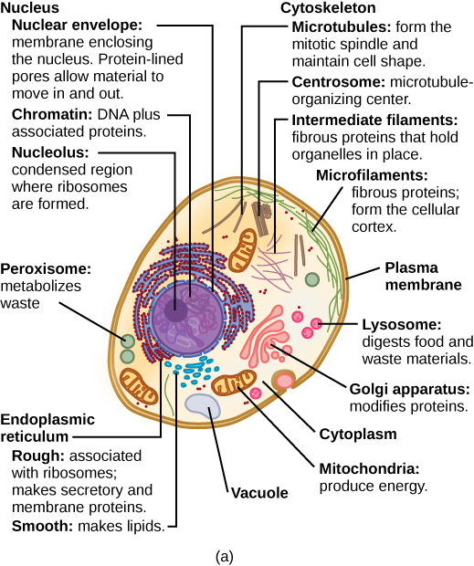
Horizontal Integration/Anatomy
Cell organelle

Slide 8
Cytoskeleton Functions
Core Concept
Support
Maintain cell shape
Organizing structure
Motility/Movement
Changes in cell location
Limited movements of parts of the cell
Interactions with motor proteins
Regulation
Regulates biochemical activities
Transition of naturally occurring mechanical signals coordinate cell’s response

Slide 9
Cytoskeleton Components
Core Concept
Microtubules
• Microfilaments (Actin Filaments)
• Intermediate Filaments

Slide 10
Microtubules
Core Concept
25 nm in diameter
200 nm – 25 micrometer in length
• A. Functions • Shape/support cell • Tracks where organelles can move with motor proteins • Separate chromosomes during cell division

Slide 11
Core Concept
B. Tubulin • Is a globular protein that constructs microtubule wall • Dimer – made of 2 subunits/polypeptides: α-tubulin and β-tubulin • Grow length by adding tubulin dimers (or disassembled)

Slide 12
Core Concept
C. Centrosomes • Microtubules grow out from centrosomes, near nucleus • Centrioles: set pair in a centrosome, nine sets of triplet microtubules arranged in a ring, reciprocate before animal cell divides (absent in yeast and plant cells) • Helps organize microtubule assembly

Slide 13
Core Concept
D. Cilia & Flagella
Microtubules have extensions projecting from some cells
They help propel unicellular eukaryotes through water; are on animal, algae and plant sperm (flagella), can move fluid over tissue surface, helps sweep mucus out of windpipes, helps move egg toward uterus
Bends organelle’s movements

Slide 14
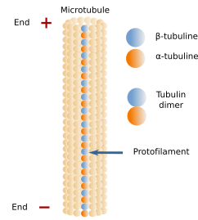
Microtubule
Core Concept

Slide 15
Microfilament
Core Concept
Solid rods (7 nm in diameter) • A. Functions • Provide structural support • Gives organelle gel-like consistency • Resists compression • Motility: cell contractions, amoeba movement • Cytoplasmic streaming: in plants, circular flow of cytoplasm (speeds up material distribution)

Slide 16
Core Concept
B. Actin: globular protein making up microfilaments
C. Twisted double chain of actin subunits
D. Microvilli: bundles of microfilaments – increase cell surface area
E. Parallel actin proteins joined by thicker filaments made of myosin that “walk” along actin
F. Pseudophodia: extensions allowing amoeba to crawl along surfaces

Slide 17
Core Concept

Slide 18
Intermediate Filaments
Core Concept
• Smaller than microtubules but fatter than microfilaments (8-12 nm in diameter) • A. Functions • Bears tension • Reinforces cell shape • Fix organization of certain organelles

Slide 19
Core Concept
Diverse class of cytoskeletal elements: different functions
Contructed from different subunit belonging to protein family who include keratins
C. Permantn fixtures of cells (microfilaments and microtubules get assembled/reassembled)

Slide 20
Core Concept

Slide 21
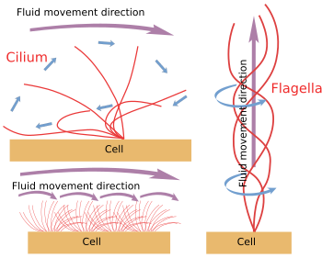
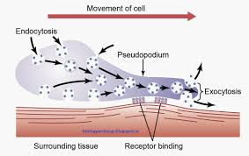
Core Concept
Ameboid and ciliary movement

Slide 22
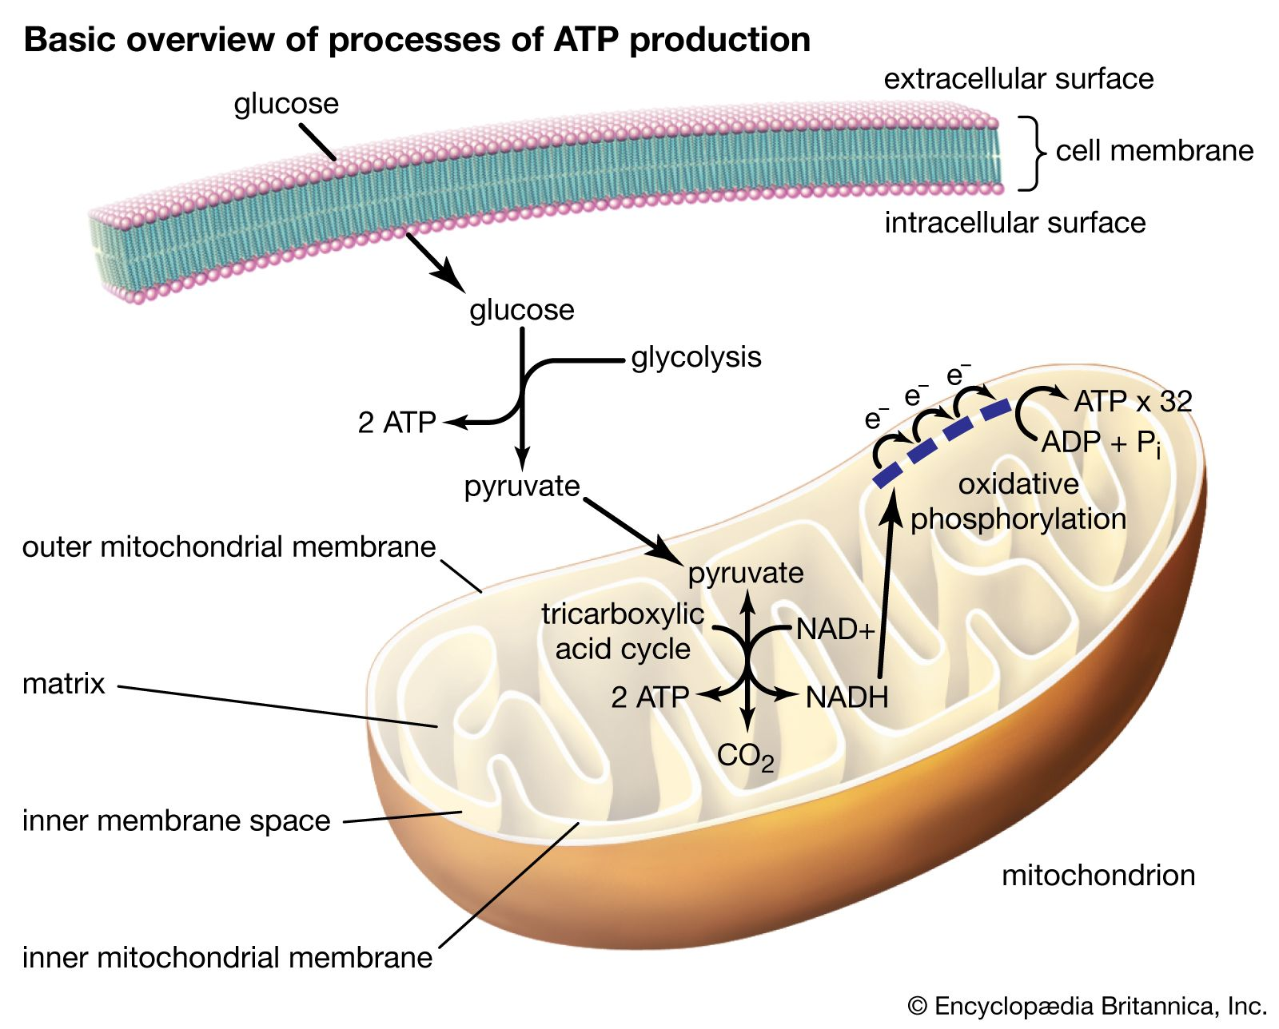
Core Concept
Mitochondria & ATP Production

Slide 23
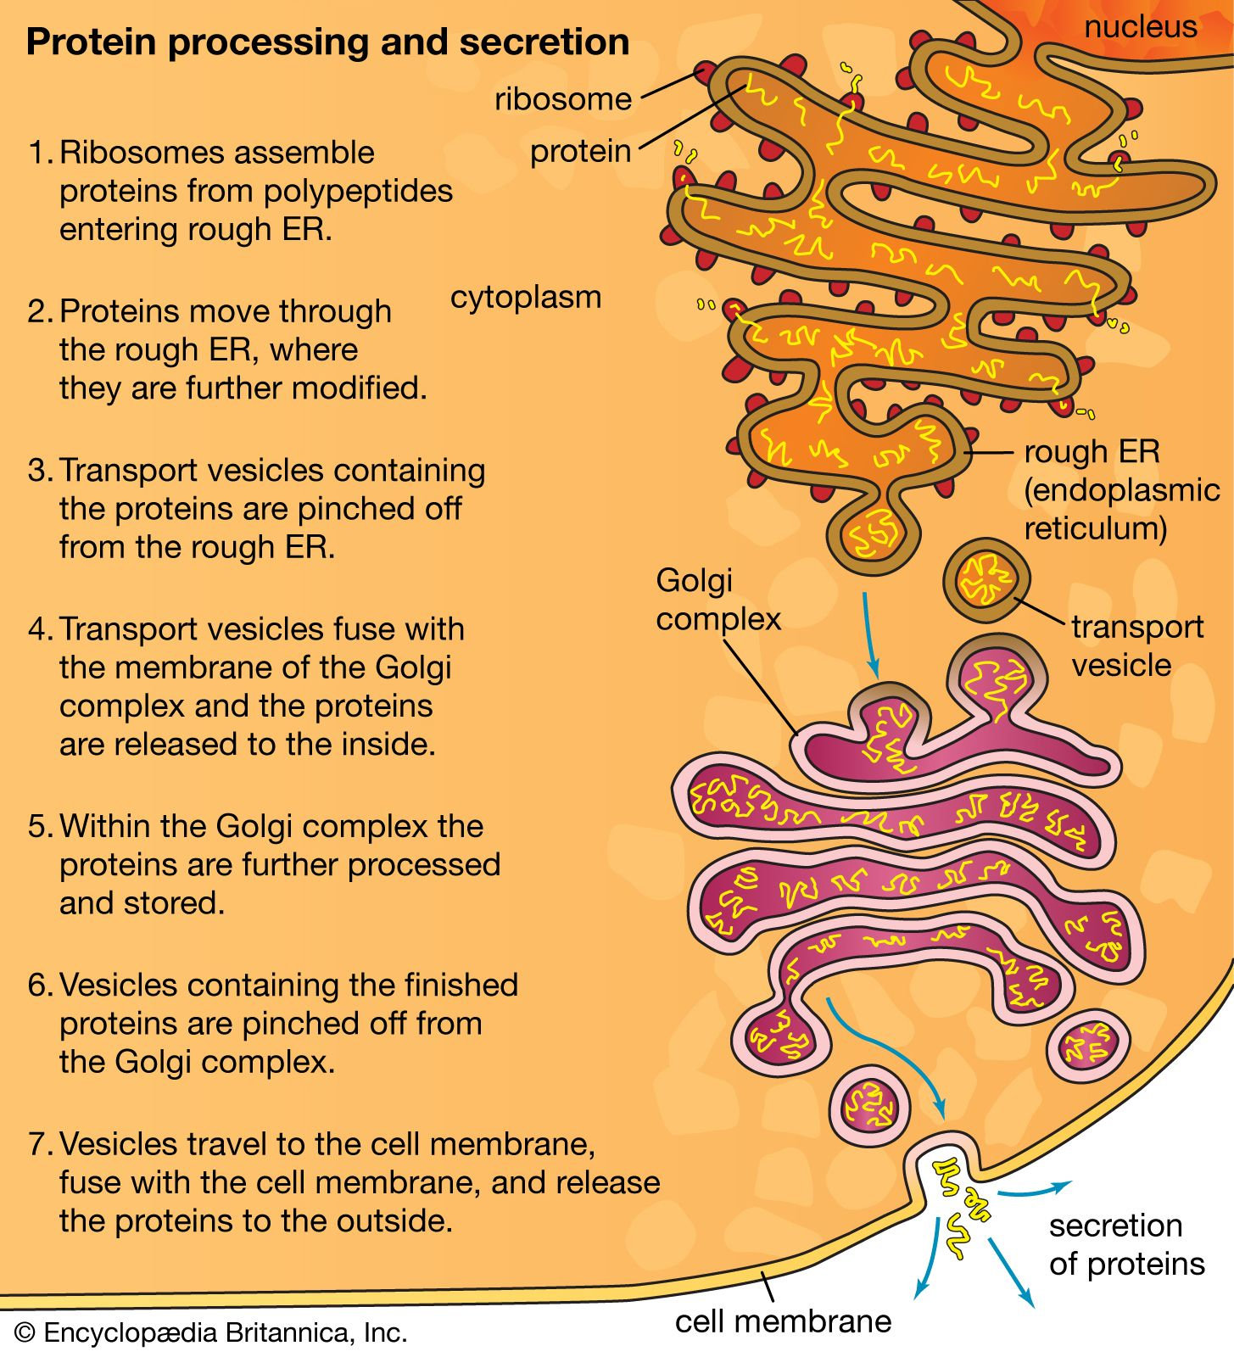
Core Concept
Endoplasmic Reticulum Functions

Slide 24
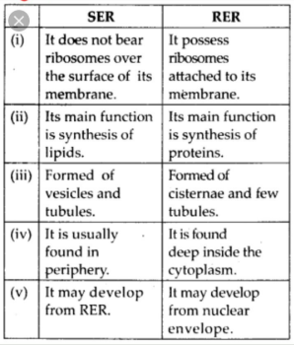
Core Concept

Slide 25
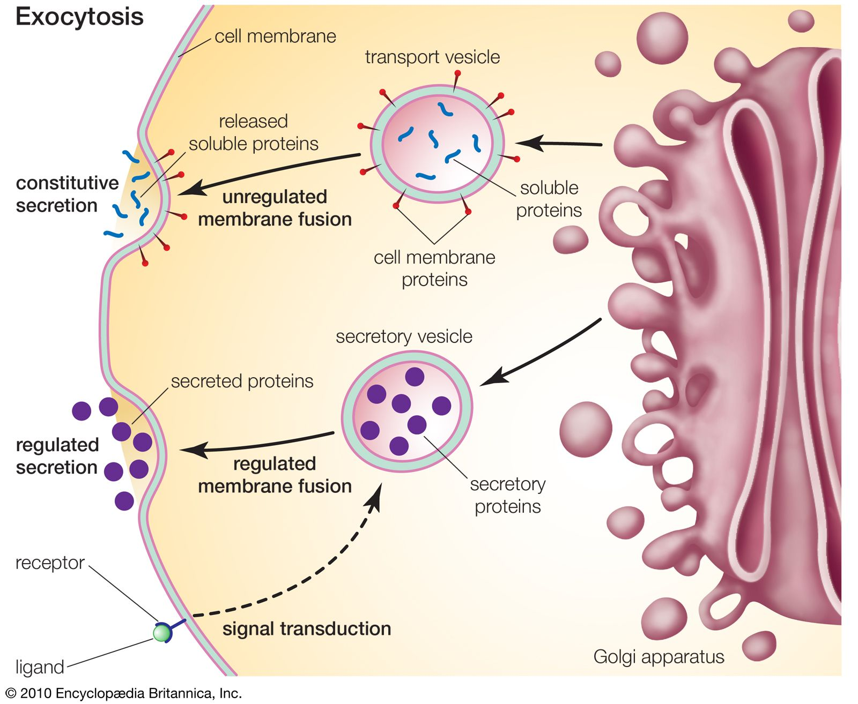
Core Concept
Golgi Apparatus Functions

Slide 26
Core Concept

Slide 27
Spiral Integration

Slide 28
Ethics of Physician Pharmaceutical Interaction
Spiral Integration/ Ethics
In dealing with pharmaceutical and allied healthcare industry a medical practitioner shall always ensure that ,there shall never be any compromise either with his/her own professional autonomy and/or with the autonomy and health of the patient.

Slide 29
Example
Spiral Integration/ Ethics
Relevant case: A medical rap came to a physician, tried to convince him for prescribing drug of his pharmaceutical industry. He offered him Europe tour for doing this.
Solution: the doctor should not accept this offer at the expense of patient’s health and safety. He should refuse it and write only those medicines which are good for patients

Slide 30
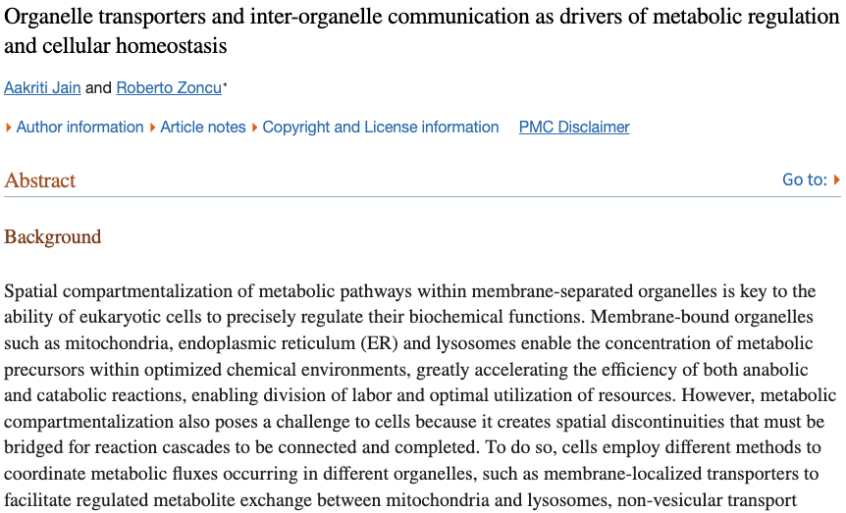
Research
Spiral Integration/ Research
Link:- https://www.ncbi.nlm.nih.gov/pmc/articles/PMC9043965/

Slide 31
How To Access Digital Library
Promoting IT & Research Culture
Steps to Access HEC Digital Library
Go to the website of HEC National Digital Library.
On Home Page, click on the INSTITUTES.
A page will appear showing the universities from Public and Private Sector and other Institutes which have access to HEC National Digital Library HNDL.
Select your desired Institute.
5. A page will appear showing the resources of the institution
6. Journals and Researches will appear
7. You can find a Journal by clicking on JOURNALS AND DATABASE and enter a keyword to search for your desired journal. Link:https://www.topstudyworld.com/2020/05/access-hec-digital-library.html?m=1

Slide 32
References
References
Books
Guyton And Hall Textbook of Medical Physiology 14th Edition
Ganong’s Review of Medical Physiology 25th Edition
Sherwood, 9th Edition
Silverthorn Physiology, 6th Edition
Vander’s Human Physiology, 14th Edition
Research https://www.sciencedirect.com/science/article/pii/S0147651322004109
YouTube/Videolink https://www.youtube.com/watch?v=kV_J8O0HIQI

