Slide 2
Foundation Module First Year MBBS
Cell Membrane Ion Channels, Transport Across Cell Membrane
Supervised by Prof. Samia Sarwar Chairperson Physiology Presenter :Dr. Faizania Shabir (AP PHY)
Dated : 00-00-2025
Physiology Department

Slide 3
Motto, Vision, Dream
To impart evidence based research oriented medical education
To provide best possible patient care
To inculcate the values of mutual respect and ethical practice of medicine
Wisdom
Truth
Service

Slide 4
Professor Umar Model of Integrated Lecture

Slide 5
Learning Objectives
Enlist various types of ion channels
Enumerate modes of transport mechanism across the cell membrane
Define and discuss factors affecting diffusion

Slide 6
Interactive Session

Slide 7
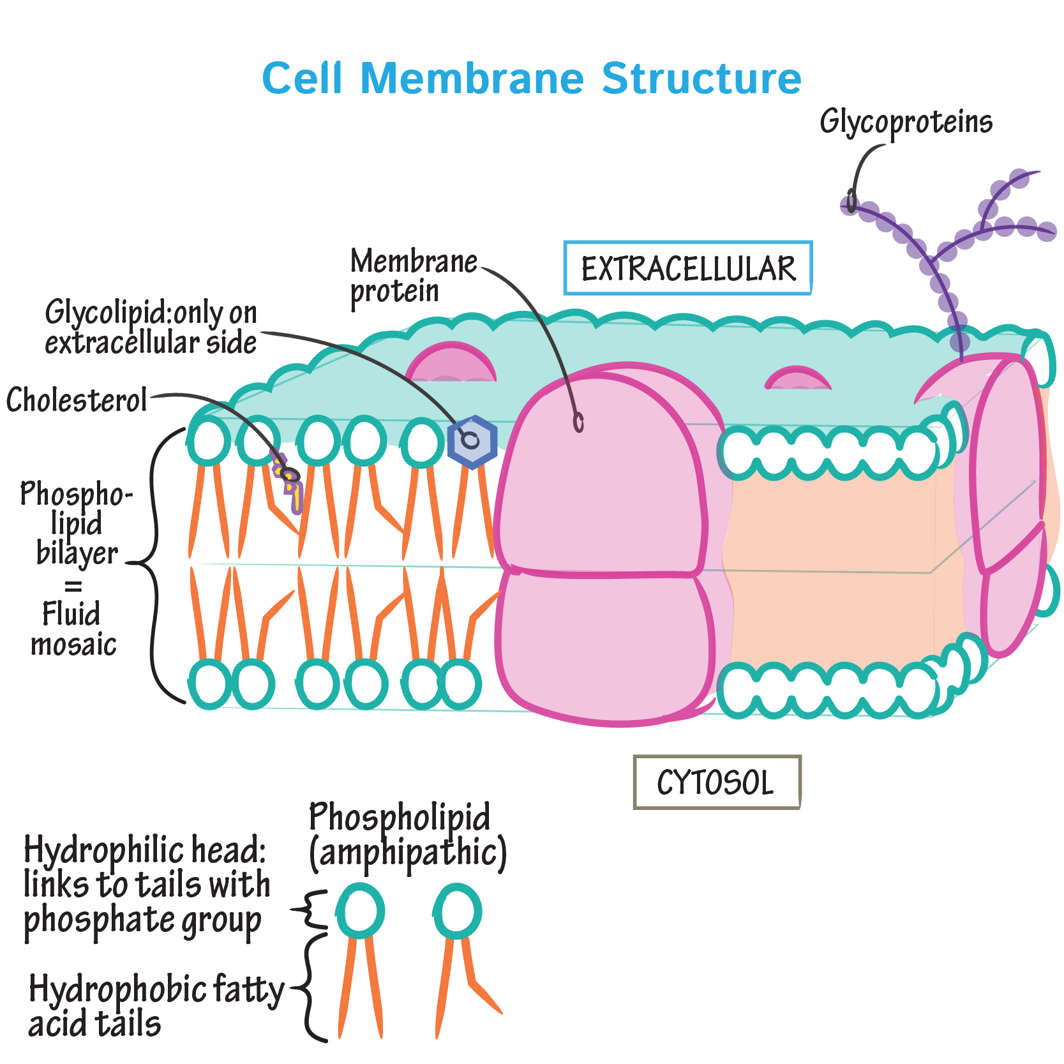
Horizontal Integration/Anatomy

Slide 8
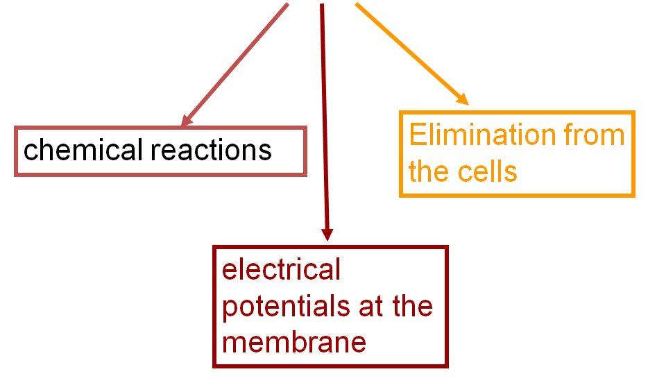
Substances Transported For
Core Concept
Support
Maintain cell shape
Organizing structure
Motility/Movement
Changes in cell location
Limited movements of parts of the cell
Interactions with motor proteins
Regulation
Regulates biochemical activities
Transition of naturally occurring mechanical signals coordinate cell’s response

Slide 9
Cell Membrane
Core Concept
Microtubules
• Microfilaments (Actin Filaments)
• Intermediate Filaments

Slide 10
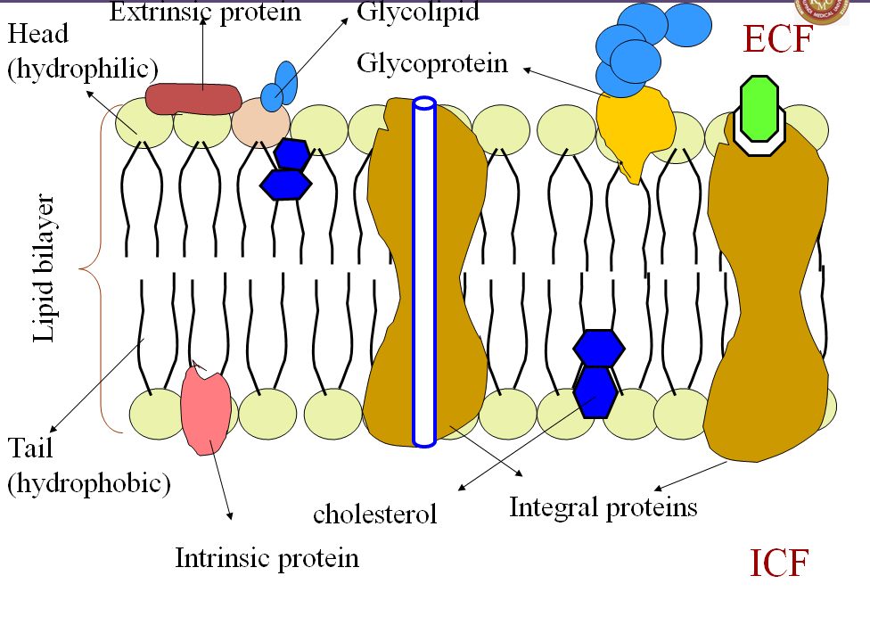
Microtubules
Core Concept
25 nm in diameter
200 nm – 25 micrometer in length
• A. Functions • Shape/support cell • Tracks where organelles can move with motor proteins • Separate chromosomes during cell division

Slide 11
Functions of Cell Membrane
Core Concept
Acts as semi permeable barrier –(selective)
Maintains difference in composition of ICF & ECF & fluid in various organelles
Protects cell from toxic substances
Excretion of waste products
Transport of nutrients
Receives signals from the outside
Chemical signals
Electrical signals
Site for attachment to the neighboring cells

Slide 12
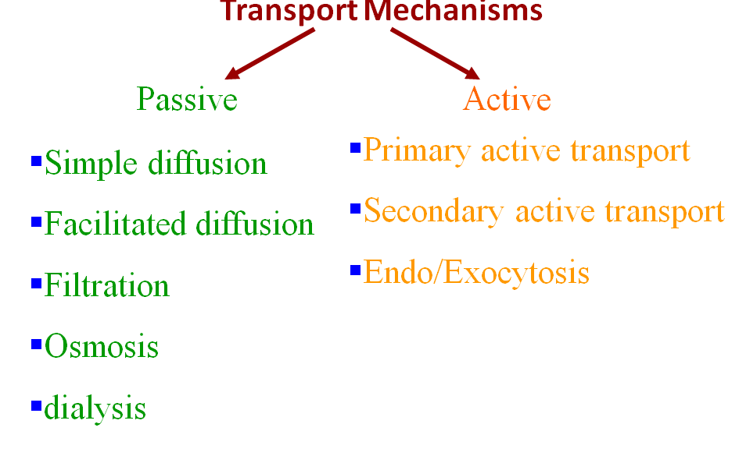
Transport across Cell Membrane
Core Concept
C. Centrosomes • Microtubules grow out from centrosomes, near nucleus • Centrioles: set pair in a centrosome, nine sets of triplet microtubules arranged in a ring, reciprocate before animal cell divides (absent in yeast and plant cells) • Helps organize microtubule assembly

Slide 13
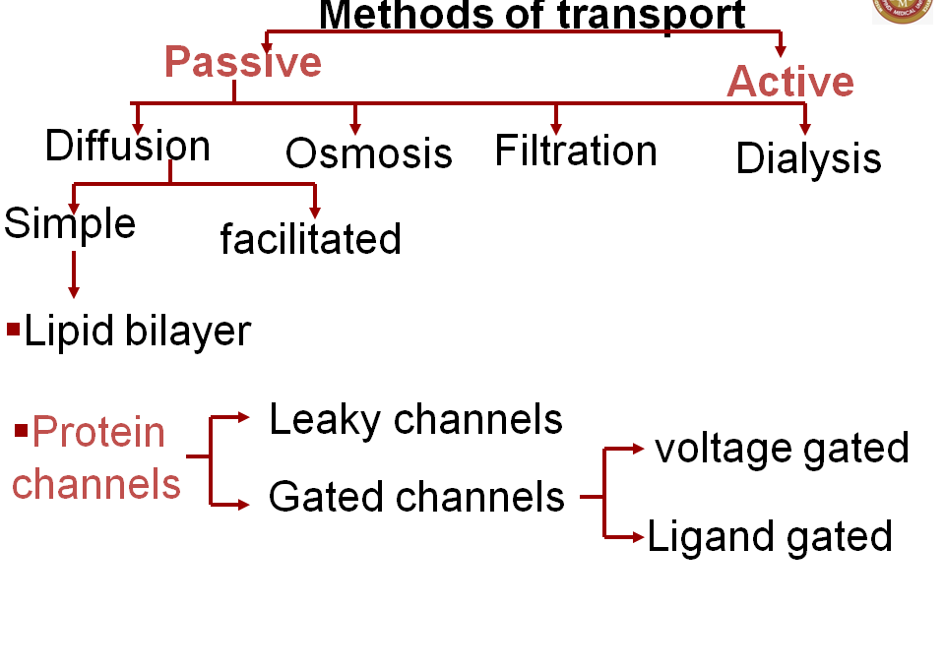
Core Concept
D. Cilia & Flagella
Microtubules have extensions projecting from some cells
They help propel unicellular eukaryotes through water; are on animal, algae and plant sperm (flagella), can move fluid over tissue surface, helps sweep mucus out of windpipes, helps move egg toward uterus
Bends organelle’s movements

Slide 14
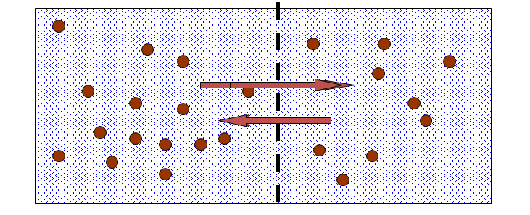
Simple Diffusion
Core Concept
Movement of molecules from higher concentration to lower concentration till equilibrium is reached

Slide 15
Diffusion can takes place through:
Core Concept
Lipid bilayer
Lipid soluble substances- O2,Co2,alcohol, steriods etc
Lipid insoluble – water (through spaces bet lipid mol) urea, sugar
(less or no permeability)
iii) Electrolytes – impermeable
– charge on fatty acid chain
- Hydrated forms are larger

Slide 16
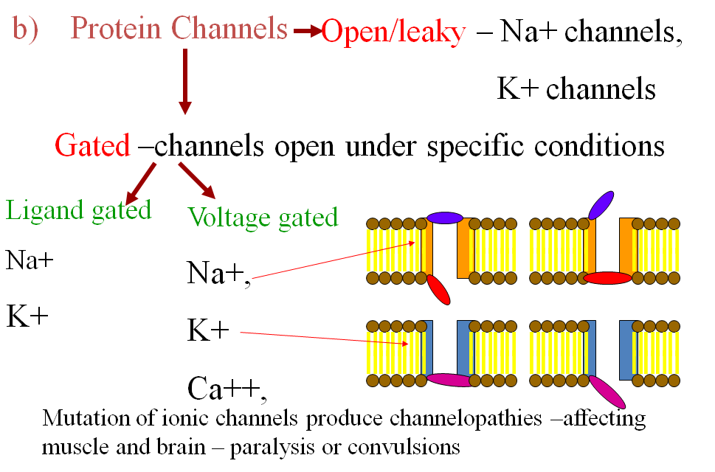
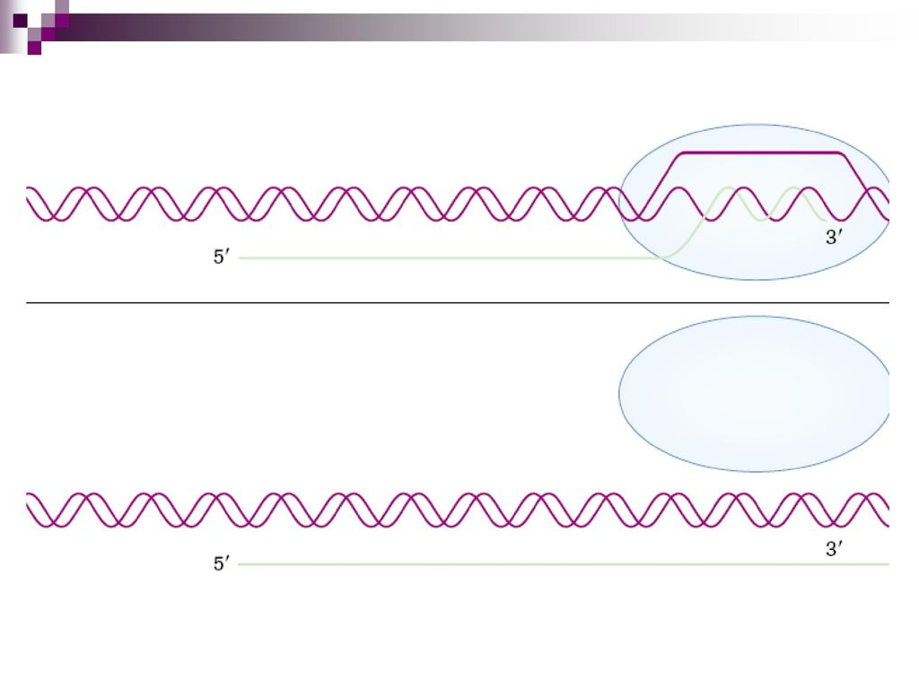
Core Concept
B. Actin: globular protein making up microfilaments
C. Twisted double chain of actin subunits
D. Microvilli: bundles of microfilaments – increase cell surface area
E. Parallel actin proteins joined by thicker filaments made of myosin that “walk” along actin
F. Pseudophodia: extensions allowing amoeba to crawl along surfaces

Slide 17
Core Concept

Slide 18
Core Concept
Fick’s law of diffusion –
ΔC∙P∙A
Q α ─ ─ ─ ─
MW∙ ΔX
Q = net rate of diffusion
ΔC = conc. gradient of a substance
P = permeability of membrane to the sub.
A = surface area of a membrane
MW = molecular wt. of sub.
ΔX = thickness or distance

Slide 19
Core Concept
Facilitated diffusion :
- for larger water soluble mols.
- type of passive transport
- along the conc. Gradient
- carrier mediated transport
- receptor site on one side

Slide 20
Core Concept
- Peculiarities of carrier mediated transport –
specificity,
competitive or noncompetitive inhibition – phloridzin for glucose
saturation,
blocking of receptor
V_{max}
Examples – transport of glucose, amino acids, galactose, etc. in the peripheral cells or counter transport of Ci and HCO3 in renal tubules

Slide 21
Core Concept
III. Osmosis & osmotic pressure–
when two solutions of different concentrations are separated by a semi permeable membrane ( impermeable to solute and permeable to water ) water mols. diffuse from solution having less conc. To the sol. having higher conc.

Slide 22
Core Concept
Osmotic pressure is the minimum pressure applied on the solution with high conc. which prevents osmosis.
- depends upon total no. of particles of dissolved solutes rather than type of the particles
Osmols or mOsmols – expresses conc. of
osmotically active particles
1 osmol = total no. of particles in gram molecular
wt. of non diffusible substance per kg. of water

Slide 23
Applied -
Core Concept
Isotonic, hypotonic & hypertonic solutions
Isotonic solution – fluids having osmolarity same as that of plasma ( 290 mOsmols ) . Red cells suspended in such solution do not shrink or swell. ( 0.9 % NaCl, 5% glucose )
In Hypotonic soln. RBCs swell and hemolysis may occur.
In hypertonic solution RBCs shrink because water moves out.

Slide 24
Active Transport
Core Concept
Primary active transport
Secondary active transport
Endocytosis
Pinocytosis
Phagocytosis
Exocytosis

Slide 25
Peculiarities of Active Transport
Core Concept
Carrier mediated transport
Rapid rate of transport
Transport takes place against electrochemical gradient (uphill )
Expenditure of energy by transport protein which incorporates ATPase activity

Slide 26
Core Concept
Carrier protein shows specificity, saturation
competitive inhibition, blocking
Substances transported – Na⁺ , K⁺, H⁺, Cl ^{-,} I ⁻ , Glucose, Amino acids

Slide 27
Core Concept
Primary active transport
Examples - Na⁺ - K⁺ pump, Ca⁺⁺ pump
H⁺-K⁺ pump
Inner surface of carrier mol. has ATPase which is activated by attachment of specific ions and causes hydrolysis of ATP molecule
Energy released from ATP causes conformational change in the carrier which transports ions to the opposite side.

Slide 28
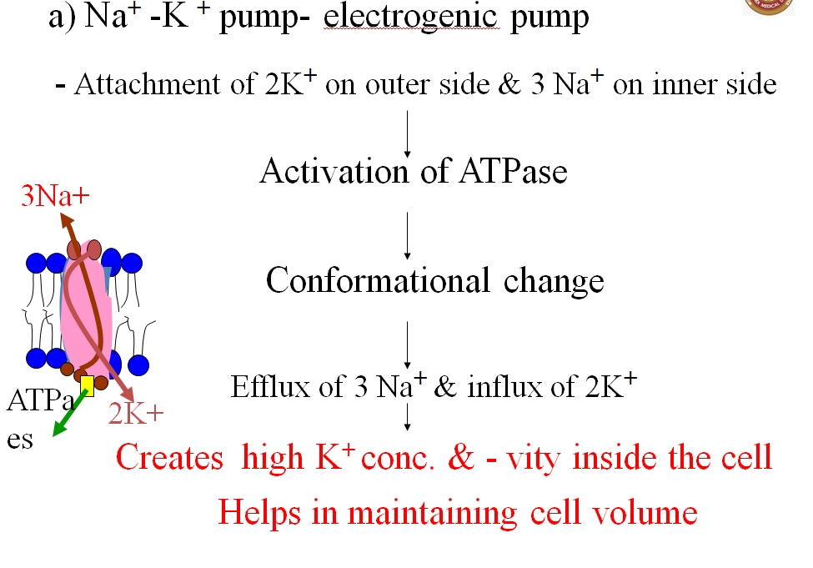
Core Concept

Slide 29
II. Secondary Active Transport
Core Concept
Active transport depending upon conc. gradient of Na+ from ECF to ICF created by utilization of energy
Carrier does not have ATPase activity
Substance is transported along with Na+ (Na increases affinity of carrier for gl.)
Na+ is transported only when glucose mol. is attached

Slide 30
Examples
Core Concept
Reabsorption of glucose & amino acids in PCT & Intestinal mucosa – Co-transport mechanism
H+ secretion by tubular epithelium – counter transport mechanism
c)In heart Na-K ATPase indirectly affects Ca transport. Antiport in cardiac muscle membrane exchanges IC Ca for EC Na

Slide 31
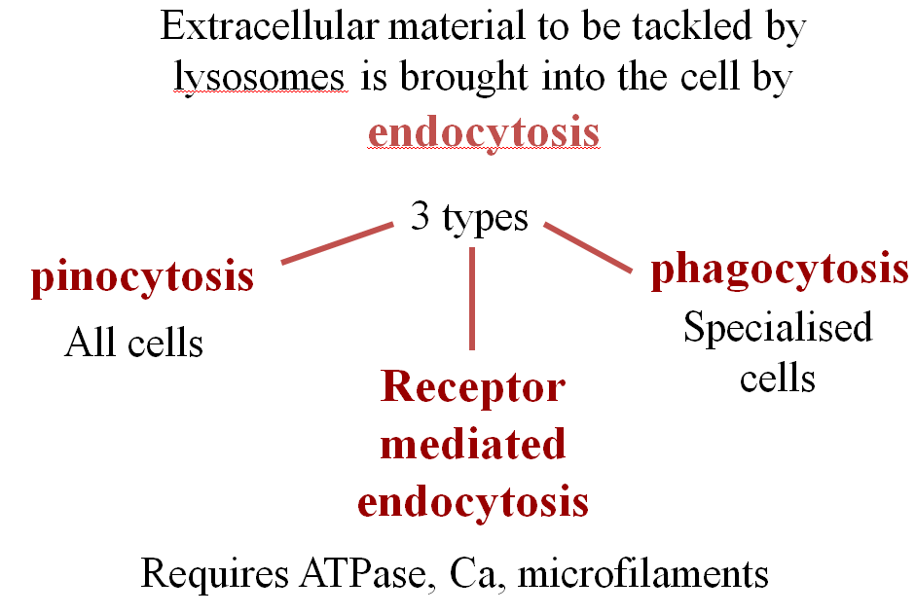
Core Concept

Slide 32
Spiral Integration

Slide 33
Truth Telling
Spiral Integration/ Ethics
Provision of information
In the practice of medicine, truth telling involves the provision of information about the situation of patients.
Relevant case
If you have been informed about the result of an HIV test taken by someone in your community who then asks to know his/her result. What will be your responsibility as a doctor?

Slide 34
Solution
Spiral Integration/ Ethics
You should tell the person the truth even though this might be very upsetting to that person.

Slide 35
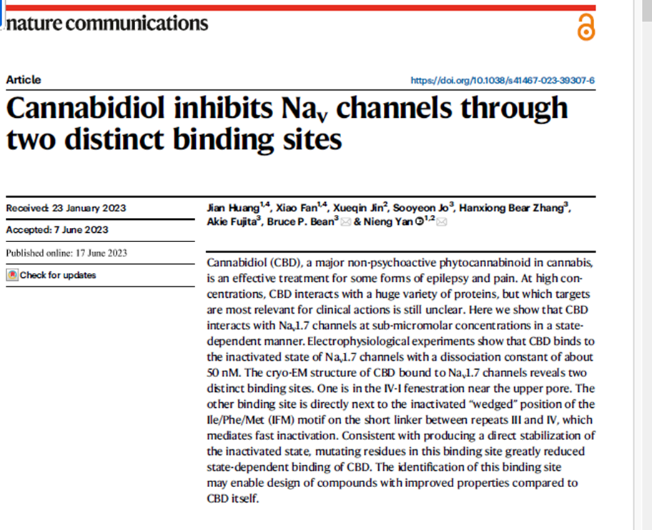
Research
Spiral Integration/ Research

Slide 36
How To Access Digital Library
Promoting IT & Research Culture
Steps to Access HEC Digital Library
Go to the website of HEC National Digital Library.
On Home Page, click on the INSTITUTES.
A page will appear showing the universities from Public and Private Sector and other Institutes which have access to HEC National Digital Library HNDL.
Select your desired Institute.
5. A page will appear showing the resources of the institution
6. Journals and Researches will appear
7. You can find a Journal by clicking on JOURNALS AND DATABASE and enter a keyword to search for your desired journal. Link:https://www.topstudyworld.com/2020/05/access-hec-digital-library.html?m=1

Slide 37
Brainstorming

Slide 38
Multiple Choice Question
Brainstorming
Q.No.1 A Baby boy delivered at 32 weeks of gestation was brought to NICU. He was cynosed,flaccid and
his Apgar score was 5/10. What is the diagnosis of this patient?
A) Pneumonia
B) Acute respiratory distress syndrome
C) Emphysema
D) Asthma
E) Atelectasis
Reference from Guyton and Hall textbook of medical physiology fourteenth edition page
number 545

Slide 39
Multiple Choice Question
Brainstorming
Q.No.1 A Baby boy delivered at 32 weeks of gestation was brought to NICU. He was cynosed,flaccid and
his Apgar score was 5/10. What is the diagnosis of this patient?
A) Pneumonia
B) Acute respiratory distress syndrome*
C) Emphysema
D) Asthma
E) Atelectasis
Reference from Guyton and Hall textbook of medical physiology fourteenth edition page
number 545

Slide 40
References
References
Books
Guyton And Hall Textbook of Medical Physiology 14th Edition
Ganong’s Review of Medical Physiology 25th Edition
Sherwood, 9th Edition
Silverthorn Physiology, 6th Edition
Vander’s Human Physiology, 14th Edition
Research https://www.sciencedirect.com/science/article/pii/S0147651322004109
YouTube/Videolink https://www.youtube.com/watch?v=kV_J8O0HIQI

