Slide 2
Foundation Module First Year MBBS
Cell Membrane & Classification of Cell Organelles
Supervised by Prof. Samia Sarwar Chairperson Physiology Presenter :Dr. Faizania Shabir (AP PHY)
Dated : 00-00-2025
Physiology Department

Slide 3
Motto, Vision, Dream
To impart evidence based research oriented medical education
To provide best possible patient care
To inculcate the values of mutual respect and ethical practice of medicine
Wisdom
Truth
Service

Slide 4
Professor Umar Model of Integrated Lecture

Slide 5
Learning Objectives
Describe the structure of cell membrane: fluid mosaic model
Enlist functions of cell membrane
Enlist membrane bound and non-membrane bound organelles
Differentiate between cytoplasm and cytosol

Slide 6
Interactive Session

Slide 7
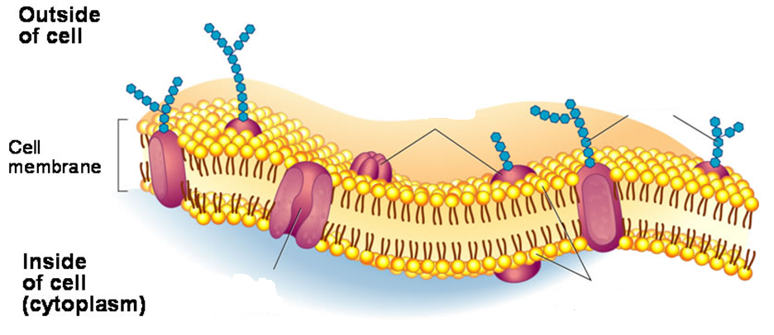
Horizontal Integration/Anatomy
Anatomy of a Cell Membrane

Slide 8
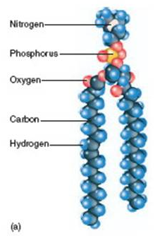
Core Concept
Horizontal Integration/Anatomy
Phospholipid, Hydrophilic, hydrophobic, polar, nonpolar, phosphate, glycoprotein, protein

Slide 9
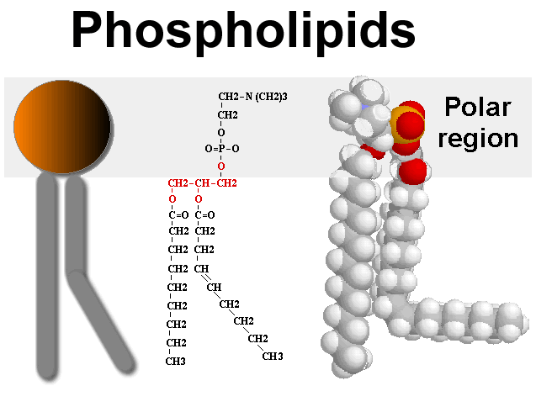
Horizontal Integration/Biochemistry

Slide 10
Selectively Permeable
Core Concept
perme = “allow”
A characteristic of cell membranes that allows it to regulate the passage of molecules
Selective permeability depends on the structure of the membrane
Not to be confused with semi-permeability
Dialysis tubing is semi-permeable. What characteristic allows molecules to travel through the membrane?
Our cell membranes are “selective” due to:
Proteins embedded within membrane
decide what can pass: big, small, necessary, unnecessary, charged, etc.
Properties of the phospholipids that make up the layer
Nonpolar, hydrophobic

Slide 11
Membrane Proteins
Core Concept
Some molecules may need “help” (of a protein) to get through the cell membrane, so require help from transport proteins:
Large molecules
Charged molecules or ions (Na⁺ or Cl⁻ )
Molecules that may be traveling up their concentration gradient

Slide 12
Cross-Section of the Cell Membrane
Core Concept
Which molecules will allowed through the lipid bilayer and which ones may need the help of a protein?
H₂O, CO₂, Glucose (C₆H₁₂O₆), Starch (lots of glucoses), Potassium (K⁺), Na⁺

Slide 13
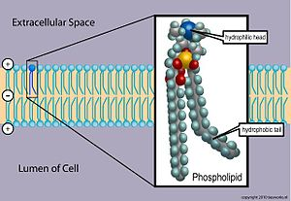
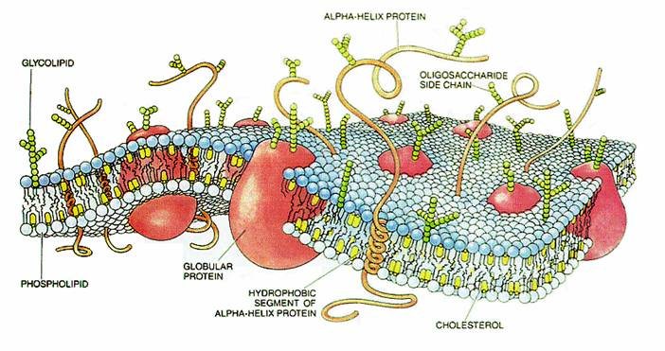
Recap: Cell Membranes
Core Concept
Characteristics:
Selectively Permeable
Regulates what enters/exits cell
Helps transport certain molecules across with help of proteins
“Bilayered”
Hydrophobic
Hydrophilic
Embedded proteins (different functions)
Cell identification
Enzymes
Transport of molecules
Etc!

Slide 14
Interchangeable terms
Core Concept
Cell Membrane
Phospholipid Bilayer
Lipid Bilayer
Plasma Membrane
Fluid Mosaic Model

Slide 15
Types of Molecular Movement
Core Concept

Slide 16
Spiral Integration

Slide 17
Public Health Ethics
Spiral Integration/ Ethics
Public health is understood within these principles as what we, as a society, do collectively to assure the conditions for people to be healthy

Slide 18
Example
Spiral Integration/ Ethics
Relevant case
An influenza epidemic has begun in Pakistan confirmed by (WHO) with some reported deaths Public health officials are strongly recommending the immediate implementation of some restrictive measures to help slow the spread of the infection. A family were died in a car accident. Over 70 people attended funeral

Slide 19
Solution
Spiral Integration/ Ethics
Public health authorities issue an order requiring everyone who attended the funeral to stay home to avoid spread of disease.

Slide 20
Research
Spiral Integration/ Research
Abstract
A Na+ current is present in human jejunal circular smooth muscle cells. The aim of the present study was to determine the role of the cytoskeleton in the regulation of the Na+ current. Whole cell currents were recorded by using standard patch-clamp techniques with Cs+ in the pipette to block K+currents. Cytochalasin D and gelsolin were used to disrupt the actin cytoskeleton and phalloidin to stabilize it. Colchicine was used to disassemble the microtubule cytoskeleton (and intermediate filaments) and paclitaxel to stabilize it. Acrylamide was used to disrupt the intermediate filament cytoskeleton. Perfusion of the recording chamber at 10 ml/min increased peak Na+ current recorded from jejunal smooth muscle cells by 27 ± 3%. Cytochalasin D and gelsolin abolished the perfusion-induced increase in Na+current, whereas incubation with phalloidin, colchicine, paclitaxel, or acrylamide had no effect. In conclusion, the Na+ current expressed in human jejunal circular smooth muscle cells appears to be regulated by the cytoskeleton. An intact actin cytoskeleton is required for perfusion-induced activation of the Na+ current.

Slide 21
How To Access Digital Library
Promoting IT & Research Culture
Steps to Access HEC Digital Library
Go to the website of HEC National Digital Library.
On Home Page, click on the INSTITUTES.
A page will appear showing the universities from Public and Private Sector and other Institutes which have access to HEC National Digital Library HNDL.
Select your desired Institute.
5. A page will appear showing the resources of the institution
6. Journals and Researches will appear
7. You can find a Journal by clicking on JOURNALS AND DATABASE and enter a keyword to search for your desired journal. Link:https://www.topstudyworld.com/2020/05/access-hec-digital-library.html?m=1

Slide 22
Brainstorming

Slide 23
Multiple Choice Question
Brainstorming
Q.No.1 A Baby boy delivered at 32 weeks of gestation was brought to NICU. He was cynosed,flaccid and
his Apgar score was 5/10. What is the diagnosis of this patient?
A) Pneumonia
B) Acute respiratory distress syndrome
C) Emphysema
D) Asthma
E) Atelectasis
Reference from Guyton and Hall textbook of medical physiology fourteenth edition page
number 545

Slide 24
Multiple Choice Question
Brainstorming
Q.No.1 A Baby boy delivered at 32 weeks of gestation was brought to NICU. He was cynosed,flaccid and
his Apgar score was 5/10. What is the diagnosis of this patient?
A) Pneumonia
B) Acute respiratory distress syndrome*
C) Emphysema
D) Asthma
E) Atelectasis
Reference from Guyton and Hall textbook of medical physiology fourteenth edition page
number 545

Slide 25
References
References
Books
Guyton And Hall Textbook of Medical Physiology 14th Edition
Ganong’s Review of Medical Physiology 25th Edition
Sherwood, 9th Edition
Silverthorn Physiology, 6th Edition
Vander’s Human Physiology, 14th Edition
Research https://www.sciencedirect.com/science/article/pii/S0147651322004109
YouTube/Videolink https://www.youtube.com/watch?v=kV_J8O0HIQI

