Slide 2
Foundation Module First Year MBBS
Active Transport - I
Supervised by Prof. Samia Sarwar Chairperson Physiology Presenter :Dr. Faizania Shabir (AP PHY)
Dated : 00-00-2025
Physiology Department

Slide 3
Motto, Vision, Dream
To impart evidence based research oriented medical education
To provide best possible patient care
To inculcate the values of mutual respect and ethical practice of medicine
Wisdom
Truth
Service

Slide 4
Professor Umar Model of Integrated Lecture

Slide 5
Learning Objectives
Define active transport
Classify active transport
Comprehend various types of active transport with examples with special emphasis on Na-K pump

Slide 6
Interactive Session

Slide 7
Active Transport
Core Concept
Process that moves materials across the plasma membrane
Requires energy from the cell in the form of ATP
Materials move against the concentration gradient:
low concentration high concentration
3 Kinds: Pumps, Endocytosis, and Exocytosis

Slide 8
Active Transport Pumps
Core Concept
An ATP molecule breaks down into ADP, releasing a phosphate group and a whole lot of energy.
The phosphate group attaches to a protein pump, causing it to change its shape so that it can move a small molecule or ion across the plasma membrane.
The protein changes shape again so that the molecule can be released on the other side.
There are many types of carrier proteins and they only carry specific molecules across the plasma membrane.

Slide 9
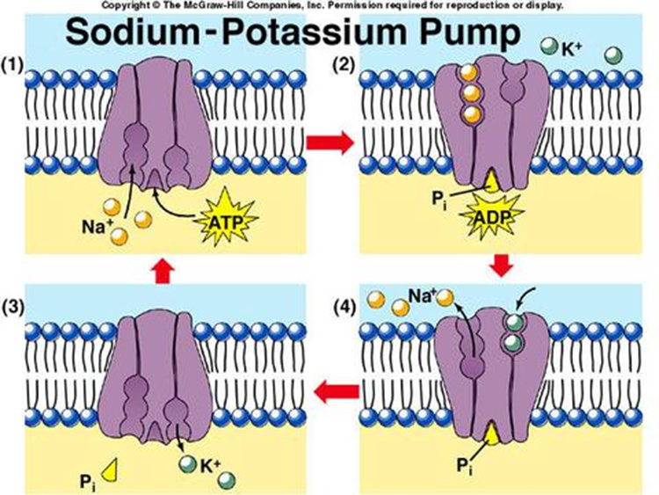
Core Concept
Example of active transport: sodium-potassium pump in nerve cells
Sodium ions are kept at low concentrations inside the cell and potassium ions are at higher concentrations. Outside the cell, it is the opposite. When a nerve message is sent, the ions pass across the membrane to send the message. After the message has passed, the ions must be actively transported back to their starting positions across the membrane.
Source: www.mhhe.com/biosci/genbio/enger/student/olc/art_quizzes/genbiomedia/0645.jpg

Slide 10
Endocytosis
Core Concept
When a cell actively takes large molecules into itself by folding the plasma membrane inward, forming a vesicle
Source: http://kenpitts.net/bio/images/endocytosis.gif

Slide 11
Exocytosis
Core Concept
When a cell actively releases large molecules by folding the plasma membrane outward, forming a vesicle
Source: http://kenpitts.net/bio/images/exocytosis.gif

Slide 12
How vesicles carry materials from the ER Golgi apparatus plasma membrane
Core Concept
​Ribosome makes a protein.
ER forms a vesicle (vacuole) and places protein in it.
Vesicle carries protein to Golgi apparatus and drops it off.
Protein is modified in Golgi apparatus.
Golgi apparatus forms new vesicle and places protein in it.
If protein is leaving the cell, the vesicle moves to the plasma membrane and fuses with it.
Exocytosis – protein is moved out of the cell.

Slide 13
Active Transport vs. Passive Transport
Core Concept
Source: http://thebasisoflife.wikispaces.com/file/view/c8x16types-transport.jpg/30540339/c8x16types-transport.jpg

Slide 14
Active Transport: Review
Core Concept
Pumps, Endocytosis, Exocytosis
Molecules move against the concentration gradient
Requires energy from the cell (ATP)

Slide 15
Spiral Integration

Slide 16
Consent
Spiral Integration/ Ethics
“Autonomous authorization of a medical intervention by individual patients”
Relevant case:
A 35 years female presented with complaints of pain in right hypochondrium, nausea & vomiting On USG abdomen, multiple gallstones were present. She was diagnosed with acute cholecystitis. She has multiple such episodes
She was advised cholecystectomy

Slide 17
Solution
Spiral Integration/ Ethics
The patient didn’t allow the procedure
The doctor can’t proceed according to medical ethics

Slide 18
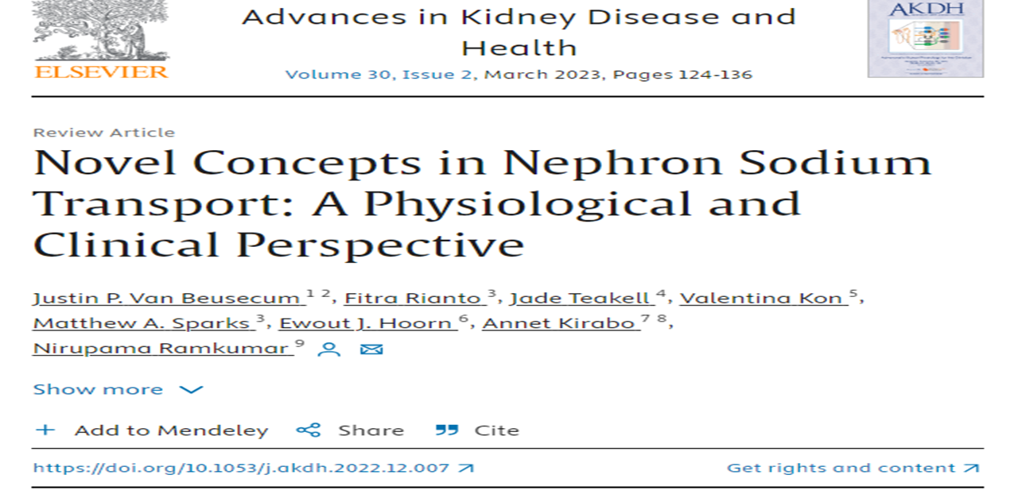
Research
Spiral Integration/ Research

Slide 19
How To Access Digital Library
Promoting IT & Research Culture
Steps to Access HEC Digital Library
Go to the website of HEC National Digital Library.
On Home Page, click on the INSTITUTES.
A page will appear showing the universities from Public and Private Sector and other Institutes which have access to HEC National Digital Library HNDL.
Select your desired Institute.
5. A page will appear showing the resources of the institution
6. Journals and Researches will appear
7. You can find a Journal by clicking on JOURNALS AND DATABASE and enter a keyword to search for your desired journal. Link:https://www.topstudyworld.com/2020/05/access-hec-digital-library.html?m=1

Slide 20
Brainstorming

Slide 21
Multiple Choice Question
Brainstorming
The Sodium Potassium pump
Is an ion channel
Transports 3 Sodium ions to cell interior
Transports 3 Potassium ions to cell exterior
Maintains cell volume

Slide 22
Multiple Choice Question
Brainstorming
The Sodium Potassium pump
Is an ion channel
Transports 3 Sodium ions to cell interior
Transports 3 Potassium ions to cell exterior
Maintains cell volume*

Slide 23
References
References
Books
Guyton And Hall Textbook of Medical Physiology 14th Edition
Ganong’s Review of Medical Physiology 25th Edition
Sherwood, 9th Edition
Silverthorn Physiology, 6th Edition
Vander’s Human Physiology, 14th Edition
Research https://www.sciencedirect.com/science/article/pii/S0147651322004109
YouTube/Videolink https://www.youtube.com/watch?v=kV_J8O0HIQI

