Slide 2
LOWER GENITAL TRACT INFECTIONS
Department of Obs& Gynae
Rawalpindi teaching hospital Hospital

Slide 3
University Motto, Vision, Values & Goals
Mission Statement To impart evidence-based research-oriented health professional education Best possible patient care Mutual respect, ethical practice of healthcare and social accountability. Vision and Values Highly recognized and accredited centre of excellence in Medical Education, using evidence-based training techniques for development of highly competent health professionals, who are lifelong experiential learner and are socially accountable. Goals The Undergraduate Integrated Learning Program is geared to provide you with quality medical education in an environment designed to:

Slide 4
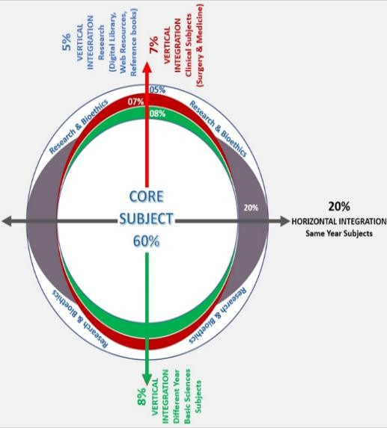
PROF UMER MODEL OF INTEGRATED LECTURE

Slide 5
A 32 years old sexually active women presented in OPD with complaint of vaginal disharge for 1 month. She is married for 6 years and has 2 vaginal deliveries. She never practice any contraceptive methods. She has no comorbidities. On examination vitally stable, abdomen soft, nontender and speculum examination shows whitish discharge.
What are the differential diagnosis?

Slide 6
Learning Objectives
At the end of this lecture you will be able to
Enlist lower genital tract infections
Describe pathophysiology of lower genital tract infections
Differentiate signs and symptoms of different infections
Select appropriate treatment of different lower genital tract infections
Formulate management plan for patient with vaginal discharge

Slide 7
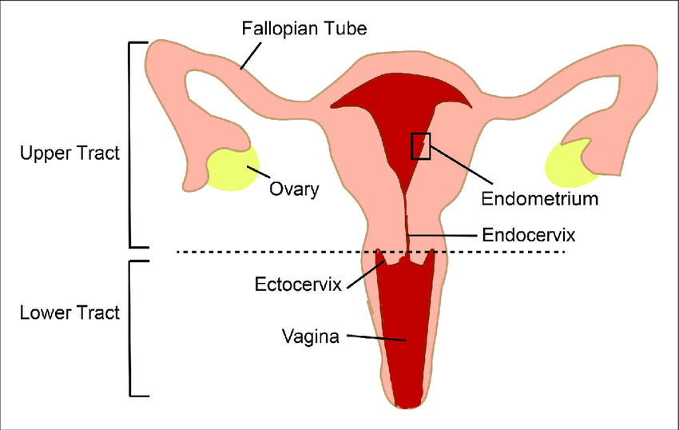

Slide 8
In reproductive age group normal defense mechanism of lower genital tract includes:
Stratified squamous epithelium under estrogen influence
Vaginal pH between 3.5-4.5
Lactobacilli

Slide 9
Lower Genital Tract Infections
Vulvovaginal Candidiasis
Trichomonas Vaginalis
Bacterial Vaginosis
Gonorrhoea
Chlamydia

Slide 10
Vulvovaginal Candidiasis
Most common genital infection
Caused by Candida albicans(80-92%), non albican species like C.tropicalis
Signs and symptoms:
Vulval itching and soreness, thick curdy vaginal discharge, dyspaerunia and dysuria
Vulval edema, vulval excoriation, redness and erythema
Curdy white discharge
Normal vaginal pH

Slide 11
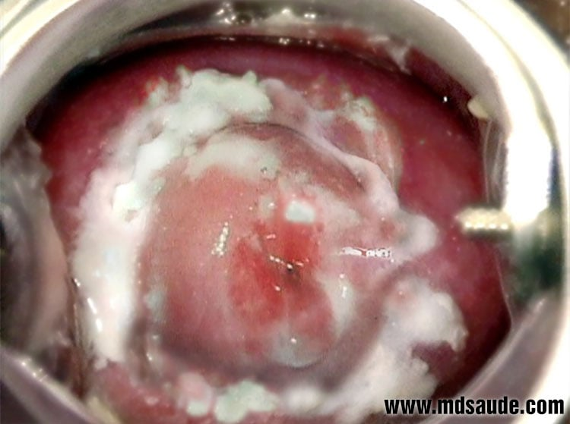

Slide 12
Predisposing factors:
Pregnancy
High dose COCP
Immunosuppresion
Broad spectrum antibiotics
Diabetes mellitus
Hormone replacement therapy
HIV infected women

Slide 13
DIAGNOSIS
Perineal or vaginal swab
Gram stain or wet film examination
Direct plating on fungal media

Slide 14
TREATMENT
General and supportive care:
Avoid using any soaps, perfumes and synthetic underwear
High dose estrogen oral contraceptive pills should be changed to lower-dose pill
Check blood sugar levels to rule out undiagnosed diabetes mellitus
Avoid recurrent courses of broad spectrum antibiotics

Slide 15
Treatment can be based on whether the infection is uncomplicated, complicated or recurrent infection:
Uncomplicated infection:
Azoles/Imidazoles are mainstay of treatment with cure rate of over 80%
Common imidazoles are clotrimazole, econazole and miconazole
Commonly prescribed Clotrimazole single 500mg pessary or 100mg pessary over 6 days
Oral imidazoles, Fluconazole 150mg single dose
Oral imidazoles are contraindicated in pregnancy

Slide 16
Complicated Infection
Commonly seen acute severe infection in pregnancy, women with diabetes or immunosuppression.
Topical treatment can be extended to upto 2 weeks
No evidence to treat asymptomatic male partner

Slide 17
Recurrent Infection
Defined as, “Atleast four episodes of infection per year and/or positive microscopy of moderate to heavy growth of C.albicans”
Induction regimen to treat acute episode followed by maintenance regimen to treat further recurrences
Fluconazole 150mg given in three doses orally every 72 hours followed by maintenance dose of 150mg weekly for six months (90% cure rate)

Slide 18
Recurrent Infection
In pregnancy, topical imidazoles can be used for 2 weeks for induction followed by weekly dose of clotrimazole 500mg for possibly 6-8 weeks.

Slide 19
TRICHOMONAS VAGINALIS
Flagellate protozoan
Can cause severe vulvovaginitis
Also cause urinary tract infections
Recurrences occur if male partner is not simultaneously treated

Slide 20
Sign and symptoms:
Vulval soreness and itching
Foul smelling vaginal discahrge, frothy yellowish green in nature
Dysuria and abdominal discomfort
Appearance of strawberry cervix due to presence of punctate hemorrhages

Slide 21
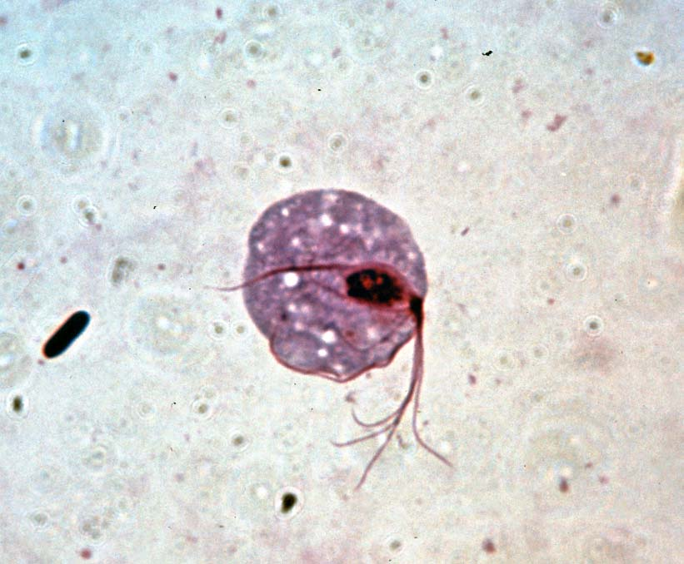
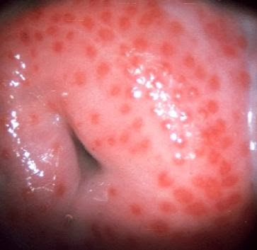
TRICHOMONAS VAGINALIS VULVOVAGINITIS

Slide 22
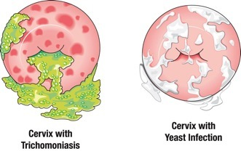

Slide 23
Diagnosis:
Microscopy of vaginal discharge and culture in Finnberg-Whittington medium
Wet mount
Treatment:
Metronidazole single dose of 2g or 400mg twice daily with cure rate upto 95%
Tinidazole 2g oral single dose also effective but cost more

Slide 24
BACTERIAL VAGINOSIS
Occurs due to growth and increase in anaerobic species with simultaneous reduction in the vaginal flora causing an increase in vaginal pH making it alkaline(4.5-7.0)
Commonly involved organisms are Gardnerella vaginalis, Mycoplasma hominis, Bacteriodes spp.

Slide 25
BACTERIAL VAGINOSIS
Sign and symptoms:
Fishy malodorous vaginal discharge
Creamy or greyish-white vaginal discharge commonly adherent to vaginal wall
More prominent during and after menstruation
Asymptomatic carriers

Slide 26
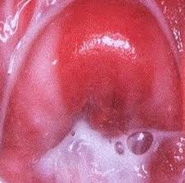

Slide 27
DIAGNOSIS
There are three criteria;
Amsel criteria:
Presence of clue cells on microscopic examination
Creamy greyish white discharge
Vaginal pH more than 4.5
Release of fishy odour on addition of alkali (positive Whiff test)
There should be at least 3 criteria out of 4 to diagnose BV

Slide 28
DIAGNOSIS
Hay/Ison criteria:
Grade 1. Normal: Lactobacillus predominate
Grade 2. Intermediate: Lactobacillus seen with the presence of Gardnerella or Mobiluncus spp.
Grade 3. Bacterial vaginosis: Lactobacilli absent or markedly reduced with predominance of Garderella or Mobiluncus spp.

Slide 29
DIAGNOSIS
Nugent criteria:
Based on the proportion of anaerobic species giving a quantitative score between 0 and 10.
Less than 4: Normal
4 to 6: Intermediate
More than 6: Bacterial vaginosis

Slide 30
HAY/ISON CRITERIA:
Grade I : Normal- lactobacillus more
Grade II: Intermediate- lactobacillus with Gardenerella and/or Mobiluncus spp
Grade III: Bacterial Vaginosis- lactobacillus absent / markedly reduced with predominance of
Gardenerella and/or Mobiluncus spp
BACTERIAL VAGINOSIS
AMSEL CRITERIA:
3 out of 4 required for diagnosis
creamy grey white discharge
vaginal pH >4.5
fishy smell
Clue cells
NUGENT CRITERIA:
Based on proportion of anaerobic spp. Score b/w 0 and 10
<4: Normal
4-6: Intermediate
>6: Bacterial Vaginosis

Slide 31
MANAGEMENT
Metronidazole, an oral dose of 400mg twice a day for 5 days or a single dose of 2g.
Alternatively, it can be used as a local intravaginal gel usually applied at night for 5-7 days.
Clindamycin 300mg twice daily or a topical vaginal cream is also effective but expensive

Slide 32
Pregnancy and Bacterial Vaginosis
Presence of bacterial vaginosis in 1st trimester can lead to late 2nd trimester miscarriages and preterm labour.
Women with previous history of 2nd trimester loss or preterm delivery should have a vaginal swab performed in early pregnancy and if BV is detected it should be actively treated in early 2nd trimester.
Metronidazole is safe to use in pregnancy but prolonged doses should be avoided

Slide 33
GONORRHOEA
Sexually transmitted disease caused by Niesseria gonorrhoea
Can lead to ascending infection causing endometritis, endosalpingitis and pelvic inflammatory disease

Slide 34
Sign and symptoms:
Asymptomatic
Increased vaginal discharge with lower abdominal/pelvic pain
Dysuria with urethral discharge
Endocervical mucopurulent discharge and contact bleeding
Pelvic tenderness with cervical excitation
Mucopurulent urethral discharge

Slide 35
DIAGNOSTIC TESTS
Gram staining
Culture medium using an agar medium
Nucleic acid amplification tests(NAATs)
Nucleic acid hybridization tests
Endocervical swabs should be taken and if symptomatic, swabs from rectum and pharynx should also be taken

Slide 36
TREATMENT
Screen both partners and refer then to genitourinary medicine clinic
Contact tracing
Cephalosporins are mainstay of treatment
Parenteral third generation cephalosporin plus azithromycin
In pregnancy it is safe to use penicillins and cephalosporins

Slide 37
COMPLICATIONS
Chronic pelvic pain
Tubal infection
Subfertility

Slide 38
GENITOURINARY CHLAMYDIA
Obligate intracellular bacterium
Sexually transmitted infection
There are several serovars of chlamydia D-K infect the genitourinary system

Slide 39
Signs and symptoms:
Asymptomatic
Vaginal discharge and lower abdominal pain
Postcoital bleeding
Intermenstrual bleeding
Mucopurulent cervical discharge with contact bleeding
Dysuria with urethral discharge

Slide 40
COMPLICATIONS
Pelvic inflammatory disease
Perihepatitis: Fitz-Hugh-Curtis syndrome
Neonatal conjuctivitis and pneumonia
Adult conjuctivitis
Reiter’s syndrome

Slide 41
Perihepatitis: Fitz-Hugh-Curtis syndrome

Slide 42
DIAGNOSTIC TESTS
Nucleic acid amplification technique, 90% sensitive
Real-time polymerase chain reaction
Culture is expensive, not routinely recommended

Slide 43
TREATMENT
General advice:
Avoid intercourse before treatment of both partners is complete
Use of condoms
Contact tracing of all partners
Simultaneous treatment of partner

Slide 44
TREATMENT
Antibiotic treatment:
Doxycycline 100mg orally twice a day for 7days
Azithromycin 1g orally single dose

Slide 45
ETIOLOGY | CAUSATIVE AGENT | CHARACTER | EXAMINATION | ASSOCIATION | DIAGNOSIS | TREATMENT
PHYSIOLOGICAL |  | Clear/ white Mucoid | - | - | - | Reassure
CANDIDIASIS | candida albicans 80 – 90% | Whitish Curdy itchy | Vulval edema, excoriation redness and erythma | Dysuria Dysperunia | Normal vaginal Ph 3.5-4.5 Typical white plaques , vaginal swabs, spores on wet slides | Anti-fungal clotrimazole 500mg pessary /cream Fluconazole 150 mg single dose
TRICHOMONIASIS VULVOVAGINITIS | Trichomonas vaginalis | Frothy, greenish, offensive, itchy | strawberry appearance punctate hemorrhages | Dysuria abdominal discomfort | wet smear Finnberg-Whittington or Diamonds medium | Metronidazole 400mg BD for 5-7 days/ 2g oral single dose
BACTERIAL VAGINOSIS | mixed anaerobes Gardenerella vaginalis, Mycoplasma hominis, Bacteriodes spp., Mobilincus spp | Fishy, malodorous, creamy, greyish white |  |  | Vaginal Ph alkaline 4.5-7.0 AMSEL CRITERIA, HAY/ISON CRITERIA NUGENT CRITERIA | Metronidazole same as above Clindamycin 2% cream

Slide 46
ETIOLOGY | CAUSATIVE AGENT | CHARACTER | EXAMINATION | ASSOCIATION | DIAGNOSIS | TREATMENT
GONORRHOEA | Neisseria gonorrhoea | Endocervical mucopurulent discharge | Pelvic tenderness with cervical excitation | Dysuria Proctitis with rectal bleeding, Mucopurulent urethral discharge | Gram staining NAATs Endocervical swabs | Antibiotics Parenteral cephalosporin plus azithromycin

Slide 47
ETIOLOGY | CAUSATIVE AGENT | CHARACTER | EXAMINATION | ASSOCIATION | DIAGNOSIS | TREATMENT
CHLAMYDIA | Chlamydia trachomatis | Mucopurulent cervical discharge |  | Postcoital bleed Intermenstrual bleed | NAATs Real time PCR | Antibiotics Avoid intercourse Use condoms Contact tracing and treatment of partners Doxycycline 100mg orally BD for 7 days Azithromycin 1g single dose orally

Slide 48
Recent advances
Floroqinolone trials:
Two nonrandomized studies of laparoscopically confirmed salpingitis supports the efficacy of ofloxacin for the treatment of gonococcal and chlamydial PID by demonstrating that ofloxacin, administered every 12 h intravenously followed by a 10- to 14-day oral regimen with 100% cure rates
Azithromycin trials ( single dose for chlamydia, N gonorrhoea, anerobes)
Doxycycline and metronidazole trials
Inpatient Meronem trials ( for aerobic and anaerobic bacteria)

Slide 49
Biomedical ethics
In patient presenting with vaginal discharge speculum examination must be done

Slide 50
Family medicine
In sexually transmitted disease partner should be treated.

