Slide 1
DR OBAID-UR-RAHMAN
FCPS (Ortho),FELLOWSHIP IN ARTHROPLASTY
Department of Orthopaedic Surgery
Benazir Bhutto hospital, Rawalpindi

Slide 2
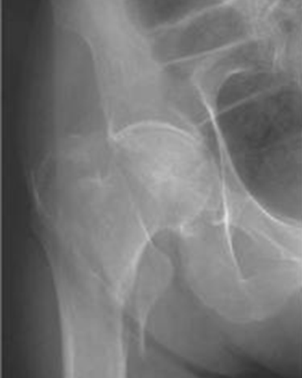
LOWER LIMB FRACTURES

Slide 3
LAY OUT
Incidence of lower limb fractures
Age distribution of lower limb fractures
Hip fractures
Fractures of proximal femur
Fractutres of shaft of femur
Fractures of tibia
Fractures of ankle

Slide 4
LEARNING OBJECTIVES
At the end of this session, students will be able to
Diagnose lower limb fractures
Classify lower limb fractures
Know the emergency management of lower limb fractures
Know the definitive management of lower limb fractures

Slide 5
CORE SUBJECT
Orthopaedic surgery

Slide 6
Core subject spiral integration with community medicine
Incidence of lower limb fractures
Age distribution of lower limb fractures

Slide 7
Distribution of specific bone involvement in patients admitted in orthopaedic department of BBH *
PATTERN OF FEMORAL FRACTURES IN TERTIARY CARE HOSPITAL OF NORTHERN PUNJAB, PAKISTAN
ObaidurRahman, Rana Muhammad Adnan, Rafeya Khan, Faiz ur Rahman, Muhammad Irfan Zia, Jahanzaib Amin, Imtiaz Ahmad,Saleem Ahmed

Slide 8
HIP TRAUMA FRACTURES OF FEMUR FRACTURES OF TIBIA

Slide 9
Distribution of femoral fractures in different age groups *

Slide 10
Core subject spiral integration with Anatomy
Anatomy of hip joint and proximal femur
Blood supply of Head of femur

Slide 12
BLOOD SUPPLY

Slide 13
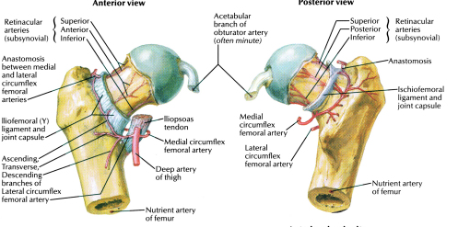
HIP TRAUMA IN ADULTS
DISLOCATION
FRACTURE
INTRA CAPSULAR
HEAD OF FEMUR
NECK OF FEMUR
EXTRA CAPSULAR
PER TROCHANTERIC
SUB TROCHANTERIC

Slide 14
FRACTURES OF THE NECK OF FEMUR

Slide 15
Garden’s Classification
Garden I
incomplete fracture
Garden II
fracture line is complete
Garden III
a complete fracture ,with partial displacement of the fragments.
Garden IV
complete displacement of the fracture, poor prognosis.

Slide 16
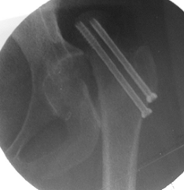
Close Reduction Internal Fixation (C.R.I.F.) with cannulated screws

Slide 17
Close Reduction Internal Fixation with cannulated screws Non weight bearing -3 to 6 months

Slide 18
HEMIARTHROPLASTY
Significantly better pain relief after cemented Thompson than after the use of uncemented Austin-moore prostheses

Slide 19
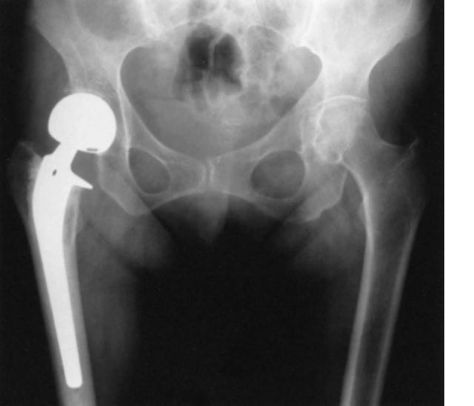
BIPOLAR HEMIARTHROPLASTY

Slide 20
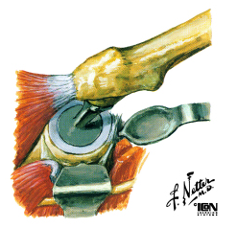
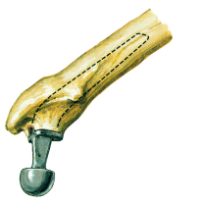
TOTAL HIP REPLACEMENT

Slide 21
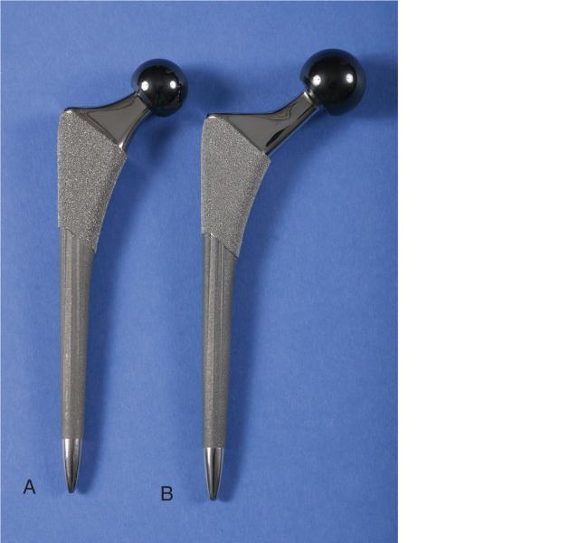
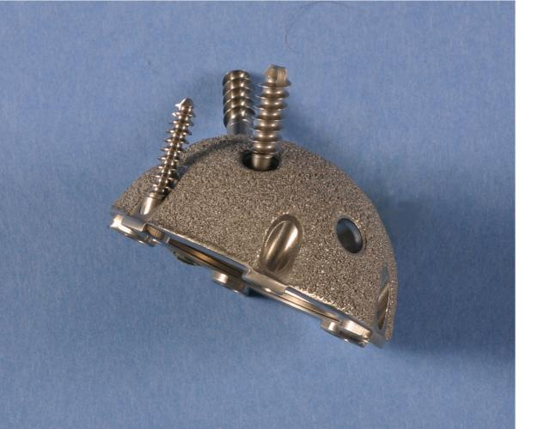
TOTAL HIP REPLACEMENT

Slide 22
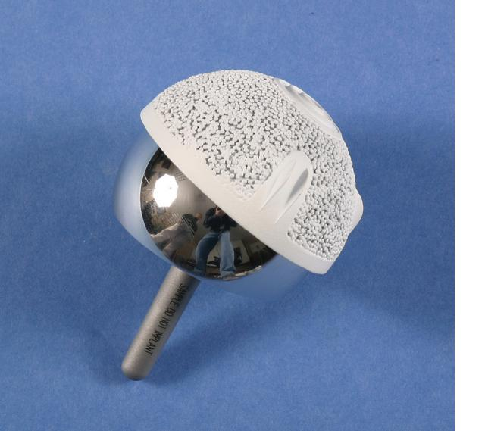
HIP RESURFACING ARTHROPLASTY

Slide 23
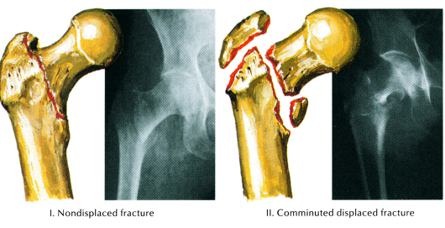
INTER TROCHANTERIC FRACTURE

Slide 24
CLASSIFICATION BOYD & GRIFFIFIN

Slide 25
TREATMENT CRIF-DHS

Slide 26
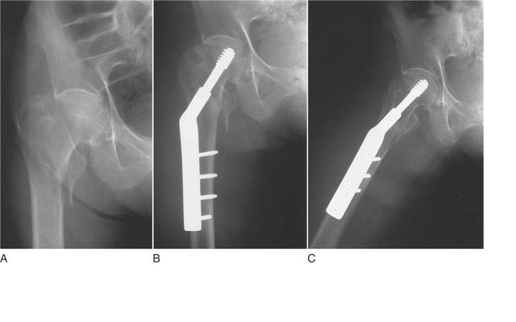
HIP TRAUMA IN ADULTS --SUMMARY--
 | Age | Diseased Hip | Mobility
CRIF | <65
Hemi A. | >65
THR | >65 | +
DISLOCATION
FRACTURE
INTRA CAPSULAR
HEAD OF FEMUR
NECK OF FEMUR
EXTRA CAPSULAR
PER TROCHANTERIC
SUB TROCHANTERIC

Slide 27
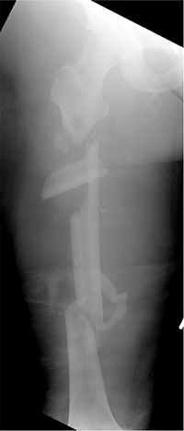
FEMORAL SHAFT FRACTURE

Slide 28
SHAFT OF THE FEMUR
The largest bone of the body
Principal load-bearing bone
Fractures can cause prolonged morbidity and extensive disability unless treatment is appropriate

Slide 29
Types
Notes:
Winquist and Hansen Classification of Fracture Comminution (27,28)
Grade Degree of Comminution 0 No comminution. I Small butterfly fragment or commuted segment with at least 50% cortical contact remaining between the diaphyseal segments. II Large butterfly fragment or comminuted segment with <50% cortical contact between the diaphyseal segments. III Large butterfly fragment or comminuted segment with <50% cortical contact between the diaphyseal segments. IV Complete cortical comminution such that there is no predicted cortical contact between the diaphyseal segments. Segmentally comminuted.

Slide 30
Treatment Methods
Closed reduction and spica cast immobilization
Skeletal traction Femoral cast bracing External fixation Internal fixation
Intramedullary nailing
- early weight bearing,
removal after 1.5yrs
Plate fixation
- late weight bearing,
- removal after 3yrs

Slide 31
INTERLOCKING INTRA MEDULLARY NAILING

Slide 32
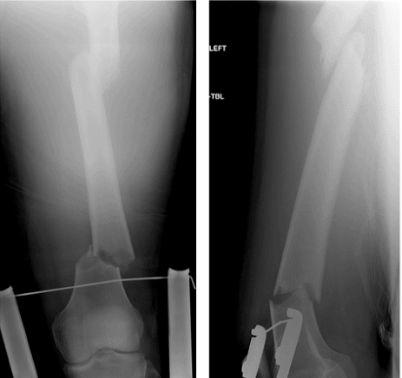
Intramedullary Nailing

Slide 33
Reconstruction nail

Slide 34
Plate fixation

Slide 35
TIBIAL SHAFT
Most commonly fractured long bone
Open fractures are more common
The blood supply to the tibia is more precarious than that of bones enclosed by heavy muscles
High-energy trauma
compartment syndrome
neural or vascular injury
Notes:
Because one third of the tibial surface is subcutaneous throughout most of its length, open fractures are more common in the tibia than in any other major long bone. The blood supply to the tibia is more precarious than that of bones enclosed by heavy muscles
. The presence of hinge joints at the knee and the ankle allows no adjustment for rotary deformity after fracture, and special care is necessary during reduction to correct such deformity High-energy tibial fractures may be associated with compartment syndrome or neural or vascular injury
Delayed union, nonunion, and infection are relatively common complications of tibial shaft fractures.

Slide 36
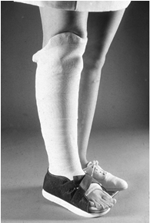
TREATMENT
Non-operative Treatment
- Closed, stable, isolated, minimally displaced fractures caused by low
energy trauma
- Stable low-velocity gunshot fractures
Operative Treatment
- High-energy trauma
- Unstable, comminuted
- Soft-tissue trauma
Notes:
The indications for operative and non-operative treatment of tibial shaft fractures continue to be refined. and associated with varying degrees of soft-tissue trauma

Slide 37
Locked Intramedullary Nailing
Indications
Currently - treatment of choice for most type I, type II, and type IIIA open and closed tibial shaft fractures
segmental and bilateral tibial fractures.
Advantages
preserves the soft-tissue sleeve around the fracture site
allows early motion of the adjacent joints
Disadvantage
compartment syndrome
Notes:
Currently - treatment of choice for most type I, type II, and type IIIA open and closed tibial shaft fractures and is especially useful for segmental and bilateral tibial fractures.
especially useful for segmental and bilateral tibial fractures. Intramedullary nailing preserves the soft-tissue sleeve around the fracture site and allows early motion of the adjacent joints

Slide 38
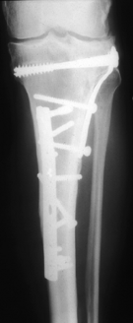
Plate & Screw Fixation
Indications
- Intra articular fractures
- Proximal diaphyseal fractures
- Distal diaphyseal fractures
Advantages
stable fixation
allow early motion of the knee and ankle
maintain length and alignment.
The greatest disadvantage
requires soft-tissue stripping, which can lead to wound complications and infection

Slide 39
L- BUTTRESS PLATE

Slide 40
Plate and Screw Fixation

Slide 41
ANKLE FRACTURES

Slide 42
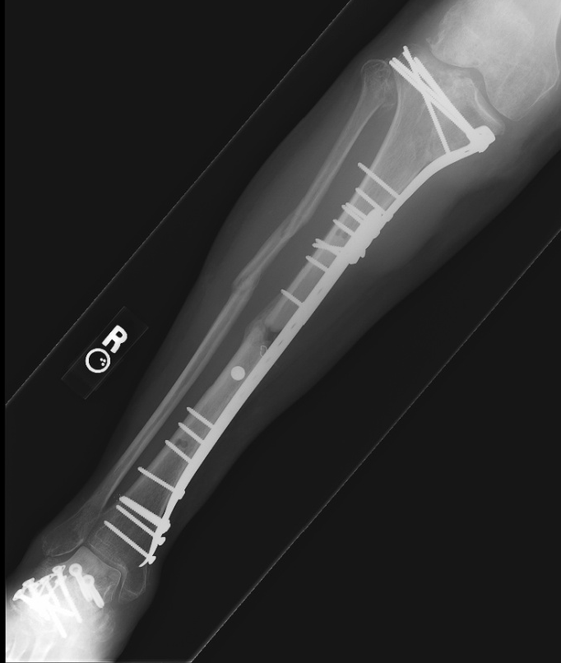
“Percutaneous” Plating (M.I.P.O)
Current Indications
(1) Tibial shaft fracture with periarticular metaphyseal comminution that precludes locked intramedullary nailing
(2) Soft-tissue damage of such severity that it prohibits the use of standard incisions
Notes:
To decrease the frequency of delayed union, nonunion, and infection after tibial shaft fractures, “percutaneous” plating was developed to obtain stable fixation, while preserving the fracture environment.
This technique involves plating of any associated fibular fracture, prebending a 3.5-mm dynamic compression plate to match the tibial anatomy, and placing the plate and screws through small incisions

Slide 43
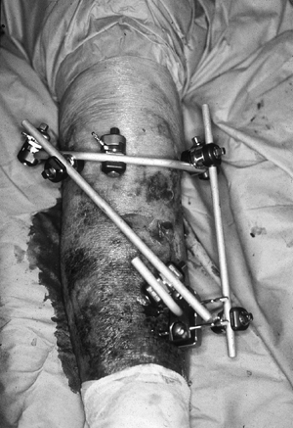
External Fixation
Three types :
Half-pin fixators
Wire and ring fixators
Hybrid fixators
Advantages :
provides stable fixation
preserves soft tissues and bone vascularity
leaves wounds accessible
causes little blood loss.

Slide 44
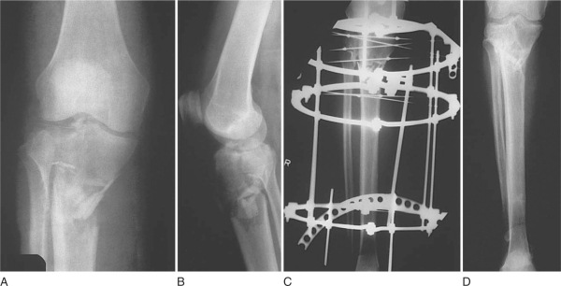
ILIZAROVE EX-FIX [Wire and ring fixators]

Slide 45
HYBRID FIXATOR

Slide 46
Hybrid EX-Fixator

Slide 47
AMPUTATION

Slide 48
Summary (for long bone fractures in lower limbs)
Closed reduction and Cast immobilization
tibia [adults & children], femur [children]
External fixation : open ,comminuted Fractures , vascular injury
Internal fixation
Intramedullary nailing Shaft fractures - early weight bearing
Plate fixation Periarticular Fractures
- late weight bearing

Slide 49
REFERENCES
*Pattern of femoral fractures in tertiary care Hospital of northern Punjab Pakistan: Journal of Rawalpindi Medical College, July-Dec 2013, Volume 18: Obaid-ur-Rahman, R M Adnan, Rafeya Khan
PATTERN OF FEMORAL FRACTURES IN TERTIARY CARE HOSPITAL OF NORTHERN PUNJAB, PAKISTAN
ObaidurRahman, Rana Muhammad Adnan, Rafeya Khan, Faiz ur Rahman, Muhammad Irfan Zia, Jahanzaib Amin, Imtiaz Ahmad,Saleem Ahmed

Slide 50
TAKE HOME MESSAGE
Lower limb fractures are a common presentation in emergency department.
Young patients present with long bone fractures after road traffic accidents.
Distal neurovascular status is very important in assessment of fractures.
early and adequate management can lower morbidity significantly.

Slide 51
MCQs
A 30-year-old male presents to the emergency department after a high-speed motor vehicle accident. His left thigh is swollen and deformed. He has severe pain and is unable to move his leg. On examination, distal pulses are present, but there is significant soft tissue swelling. X-ray confirms a midshaft femoral fracture. What is the most appropriate management?
A) Open reduction and internal fixation (ORIF) with plating
B) Skeletal traction followed by early mobilization
C) Intramedullary nailing after initial stabilization
D) Immediate weight-bearing as tolerated
E) External fixation with a plan for delayed fixation

Slide 52
Answer: C) Intramedullary nailing after initial stabilization

Slide 53
MCQs
An 82-year-old female with osteoporosis falls at home and is unable to stand. She was community ambulatory before the fall. Examination reveals external rotation and shortening of the affected limb. X-ray confirms a displaced femoral neck fracture. What is the preferred surgical management?
A) Non-weight-bearing with bed rest and pain control
B) Open reduction and internal fixation with screws
C) Total hip replacement
D) Skeletal traction for 6 weeks followed by rehabilitation
E) Conservative management with a hip brace

Slide 54
Answer: C) Total Hip Replacement.

Slide 55
MCQs
A 40-year-old construction worker falls from a scaffold and lands on his leg. The lower leg is visibly deformed, with bone protruding through the skin. On debridement there is marked contamination of wound. What is the most appropriate management?
A) Immediate internal fixation to stabilize the fracture
B) Intravenous antibiotics, tetanus prophylaxis, urgent irrigation/debridement and external fixation.
C) Application of an external fixator without wound debridement
D) Non-surgical management with a long leg cast
E) Immediate amputation due to infection risk

Slide 56
Answer: B) Intravenous antibiotics, tetanus prophylaxis, urgent irrigation/debridement and external fixation.

Slide 57
THANK YOU

