Slide 2
Motto Vision; The Dream/Tomorrow
To impart evidence based research oriented medical education
To provide best possible patient care
To inculcate the values of mutual respect and ethical practice of medicine

Slide 3
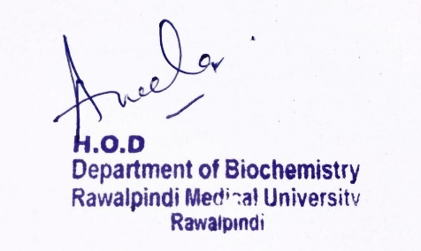
Renal Module 2nd Year MBBS (LGIS)
Potassium & Bicarbonate Metabolism - 2
Presenter: Dr Nayab Ramzan Date: 13-02-25
Deptt of Biochemistry
RMU

Slide 4
Professor Umar Model of Integrated Lecture

Slide 5
Learning Objectives
At the end of the lecture, students will
be able to:
Explain the daily requirements,
sources and functions of Potassium.
Describe causes and effects of hypokalemia and hyperkalemia
Explain the sources, functions, daily requirements of bicarbonate along with it’s deficiency and toxic effects on body.
Practice the principles of bioethics & apply strategic use of A.I in the related clinical condition.
Read relevant research articles related to the Core Knowledge.

Slide 6
Potassium Metabolism
Core Knowledge
Principal Cation of Intracellular fluid
Normal daily requirement of K⁺ is 1.5-4.5 gram but average diet contains 4-8 grams of K⁺.
Average person takes in about 4 gram K⁺ daily of which 90% is absorbed from the GIT.
Sources being dates, tomatoes, fruits and fruit juices, potato, fish, milk, spinach, melons, banana, beans and beef
Normal serum K⁺ levels: 3.5-5 mEq/l

Slide 7
Potassium Metabolism
Core Knowledge
K⁺ is reabsorbed in PCT and lesser extent in ascending limbs of loop of Henle.
The remaining unabsorbed K⁺ is secreted into the tubular lumen in DCT and collecting ducts → excreted
Distal nephron regulates K⁺ through
1. Aldosterone
2. Greater K⁺ excreted if hyperkalemia is present

Slide 8
Potassium Metabolism
Core Knowledge
K⁺ readily absorbed in the small intestine (absorbed K⁺ is made to enter cells by insulin released on food and by basal levels of plasma catecholamines, this prevents post prandial hyperkalemia).

Slide 9
Potassium Metabolism
Core Knowledge
The kidney cannot preserve K⁺ so effectively as it can Na⁺ and conservation of Na⁺ is at the expense of K⁺, so there is some obligatory K⁺ loss in urine which amounts to about 40 mEq or 160 mg/day.
When K⁺ intake falls below the minimal requirement, serum K⁺ concentration drops and cells begin to utilize H⁺ in place of K⁺ resulting in intracellular acidosis and extra cellular alkalosis.

Slide 10
Functions of Potassium
Core Knowledge
1. Along with Na+ ions, the K⁺ ions are req for the activity of Na+K+ATPase pump.
This pump is stimulated by a raised intracellular Na+ and is inhibited in chronic illnesses e.g heart failure and renal failure and by cardiac glycosides (e.g. digoxin)
2. K⁺ is needed for many enzyme reactions, glycogenesis require presence of K⁺

Slide 11
Functions of Potassium
Core Knowledge
3. K⁺ ions are needed for neuron and muscle activity i.e. production of resting membrane potential.
K⁺ ions bring about the repolarization phase of action potentials.
4. A proper plasma K⁺ level is essential for normal heart functioning (myocardial relaxation-diastole) and contraction of skeletal muscle.

Slide 12
Functions of Potassium
Core Knowledge
5. In kidney (renal tubules) K⁺ ions are required for exchange with Na⁺.
6. K⁺ is the chief cation of intracellular fluid and is retained in much greater amounts during growth and pregnancy

Slide 13
Hyperkalemia
Vertical Integration
Hyperkalemia (Increased concentration of K⁺ in the blood):
This is due to the following:
Increased potassium is released into the blood.
Or due to the kidney, which cannot excrete the potassium.
Or due to low urine output

Slide 14
Conditions with Hyperkalemia
Vertical Integration
1. Release of cellular K⁺: Large amounts of K⁺ may be liberated from injured or infected muscles, Intra vasc hemolysis, rhabdomyolysis, burnt tissues or hematomas, severe exercise, sudden tumor lysis with chemotherapeutic agents e.g Burkitt’s lymphoma→release so much K+ →fatal hyperkalemia.
Insulin deficiency and hyperglycemia also promote shifting of cellular K+ into ECF →hyperkalemia
2. Chronic dehydration and shock: It leads to decreased urine formation leading to K⁺ retention
3. Fever: Raised body temperature results in excessive breakdown of body proteins which liberates cellular K⁺ ions which enter the plasma producing hyperkalemia.

Slide 15
Conditions with Hyperkalemia
Vertical Integration
4. Renal failure: The kidney (DCT) is not capable of secreting excessive K⁺, retention of K⁺ takes place.
5. Addison’s disease: In this less K⁺ is secreted by distal convoluted tubules, it is due to def of aldosterone
6. Iatrogenic: Administration of K⁺ by I/V route may result in hyperkalemia, precautions should be taken when K⁺ is given intravenously with repeated ECG exams &/or serum potassium levels.
Spironolactone
Digoxin
Succinylcholine

Slide 16
Conditions with Hyperkalemia
Vertical Integration
7. Metabolic acidosis: H+ ions displace K⁺ ions from cells
8. Pseudohyperkalemia: This is brought about by a movement of K⁺ ions from RBCs to the plasma during drawing blood of patient; it occurs due to prolonged use of a tourniquet, with or without repeated fist clinching, hemolysis and by marked leukocytosis and thrombocytosis.
9. Hyperkalemic periodic paralysis: It is a genetic disorder in which there is a mutation in the gene for the skeletal muscle Na channel and hyperkalemia may occur by stimuli that normally produce only a slight hyperkalemia.

Slide 17
Hyperkalemia
Vertical Integration
SYMPTOMS:
Nervous symptoms include mental confusion, weakness of muscles and numbness and tingling sensations in extremities.
TREATMENT:
Hyperkalemia is treated by removing the primary cause if possible.
Acidosis + salt or water deprivation is corrected.
Insulin with glucose may be given to shift plasma K⁺ into cells.
Suitable ion exchange resins are administered to withdraw K⁺ ions from plasma into gut
Peritoneal dialysis
Hemodialysis

Slide 18
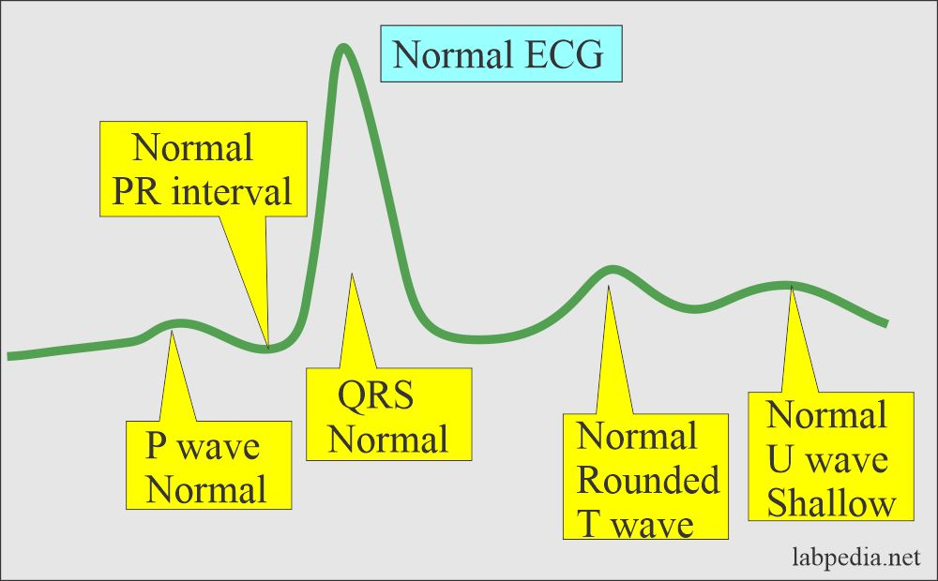
Hyperkalemia
Vertical Integration
Hyperkalemia exerts its chief effects on heart. The ECG changes are characteristic, the T wave become high and peaked tall and tented , P wave disappears and QRS complex become broad.
Widespread intra cardiac blocks appear first in atria, then at AV node and finally in ventricle. Bradycardia and arrhythmias appear, there may be sudden cardiac arrest in diastole.

Slide 19
Hypokalemia
Vertical Integration
Hypokalemia (Decreased concentration of the K⁺ in the blood):
This is due to potassium loss in vomiting, diarrhea, GIT fistula, and diuretics.
Aldosterone increase leads to a decrease in potassium.

Slide 20
Hypokalemia
Vertical Integration
Hypokalemia is seen in the following circumstances:
1. Decreased K⁺ Intake as in starvation and when K⁺ free fluids are given I/V for prolonged period (total parenteral nutrition), old age, kwashiorkor.
2. Excessive Renal Loss as occurs in diuresis and diuretic (acting proximal to Collecting Ducts-furosemide and thiazides)-these drugs result in bringing more Na+ ions to DCTs, this leads to a greater exchange of K⁺ ions which are lost in urine.
3. Loss From GIT: as in vomiting, diarrhea, suctional drainage, laxative abuse and gastrointestinal fistulas.
4. Excessive Transfer To Cells: This is seen in the following conditions:

Slide 21
Hypokalemia
Vertical Integration
Symptoms include:
Anorexia, nausea, muscle weakness and mental depression and confusion.
There may be paralytic ileus(muscle contractions that move food through the intestines are temporarily paralyzed).
Cardiovascular signs are irregular pulse and fall in BP.
Hypokalemia →low insulin secretion →hyperglycemia.
These changes are not specific but may pose a potentially fatal problem (with K⁺ levels less than 1.5 mmol /L)

Slide 22
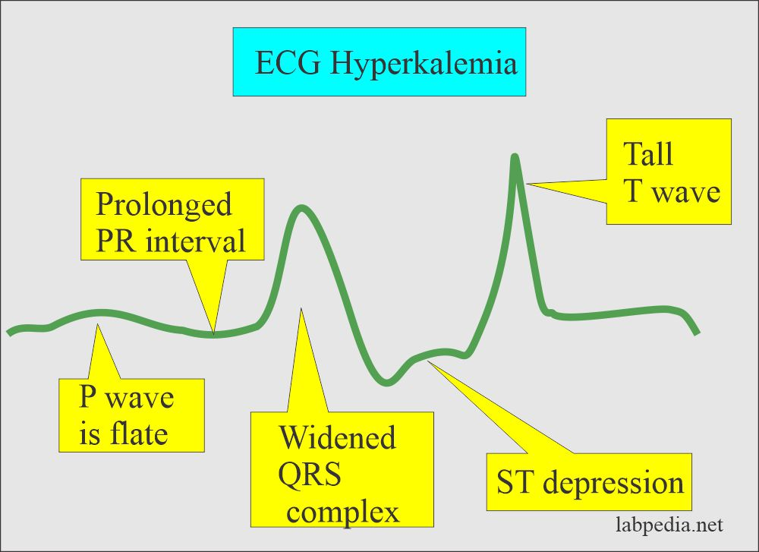
Hypokalemia
Vertical Integration
Changes In ECG In Hypokalemia are the Following :
T – waves are depressed/inverted due to delayed vent repolarization
P – wave has peaked.
ST – depression.
U- appearance prominence of U wave.
Severe hypokalemia →prolonged PR interval, decreased voltage and ventricular arrhythmias

Slide 23
Bicarbonate
Core Knowledge
Second most abundant anion (after chloride) in the ECF
Total CO2 comprises the bicarbonate ion (HCO3 ), carbonic acid (H2CO3), and dissolved CO2, with HCO3 accounting for more than 90% of the total CO2 at physiologic pH.
Because HCO3 composes the largest fraction of total CO2, total CO2 measurement is indicative of HCO3 measurement.

Slide 24
Bicarbonate as Buffer
Core Knowledge
HCO3 is the major component of the buffering system in the blood.
Carbonic anhydrase in RBCs converts CO2 and H2O to carbonic acid, which dissociates into H+ and HCO3 .
CO2 + H2O ←⎯CA→ H2CO3 ←⎯CA→ H+ HCO3 CA, carbonic anhydrase
HCO3 diffuses out of the cell in exchange for Cl to maintain ionic charge neutrality within the cell (chloride shift)

Slide 25
Bicarbonate Metabolism & Absorption
Core Knowledge

Slide 26
Bicarbonate Metabolism & Absorption
Core Knowledge

Slide 27
Bicarbonate Metabolism
Core Knowledge

Slide 28
Secretion and Reabsorption in the Nephron
Horizontal Integration
Locations of Secretion and Reabsorption in the Nephron.
Arrows pointing away from the tubule indicate substances that are returning to the blood.
Arrows pointing towards the tubule indicate additional substances being removed from the blood and moved into the filtrate.

Slide 29
Bicarbonate as a Buffer
Vertical Integration
Clinical Correlates
Converts potentially toxic CO2 in the plasma to an effective buffer: HCO3 .
In alkalosis, with a relative increase in HCO3 compared to CO2, the kidneys increase excretion of HCO3 into the urine, carrying along a cation such as Na.
This loss of HCO3 from the body helps correct pH
HCO3 buffers excess H by combining with acid, then eventually dissociating into H2O and CO2 in the lungs where the acidic gas CO2 is eliminated.

Slide 30
Bicarbonate as a Buffer
Vertical Integration
Clinical Correlates
Among the responses of the body to acidosis is an increased excretion of H into the urine.
In addition, HCO3 reabsorption is virtually complete, with 90% of the filtered HCO3 reabsorbed in the proximal tubule and the remainder in the distal tubule

Slide 31
Clinical Correlates
Vertical Integration
Bicarbonate Buffer System
Acid-base imbalances cause changes in HCO3 and CO2 levels.
A decreased HCO3 may occur from metabolic acidosis as HCO3 combines with H to produce CO2, which is exhaled by the lungs.
The typical response to metabolic acidosis is compensation by hyperventilation, which lowers pCO2.

Slide 32
Bicarbonate Buffer System
Core Knowledge
Clinical Correlates
Elevated total CO2 concentrations occur in metabolic alkalosis as HCO3 is retained, often with increased pCO2 as a result of compensation by hypoventilation. Typical causes of metabolic alkalosis include severe vomiting, hypokalemia, and excessive alkali intake

Slide 33
Management of Metabolic Alkalosis
Spiral Integration
Family Medicine
Correct underlying cause:
Identify and treat the cause (e.g., vomiting, diuretic use, or electrolyte imbalances).
Restore fluid and electrolyte balance:
Administer intravenous fluids (e.g., normal saline) to correct dehydration and electrolyte abnormalities, especially low potassium or chloride.
Acidifying agents:
In severe cases, administer medications like hydrochloric acid or acetazolamide to help lower the pH.
Discontinue causative drugs:
If diuretics or antacids are causing alkalosis, stop or adjust them as necessary.

Slide 34
Role of AI in Management of Hypertension
Spiral Integration
Artificial Intelligence
AI can potentially aid in enhancing diagnostic accuracy and efficiency.
AI-powered decision support systems can also help clinicians in selecting appropriate treatment modalities
AI-driven predictive models may help anticipate the risk of complications of the Disease in susceptible populations

Slide 35
Ethical Considerations
Spiral Integration
Bioethics
From an ethical standpoint, the scenario raises considerations regarding patient autonomy, informed consent, and confidentiality
The physician must ensure that patient fully understands her diagnosis, treatment options, and potential implications
Discuss the necessity of a healthy lifestyle & treatment plan. This requires clear communication and understanding of risks and benefits.
Additionally, the physician must respect patient’s privacy and confidentiality throughout the diagnostic and treatment process

Slide 36
Suggested Research Article
Spiral Integration
Research Article
Link:
https://www.ncbi.nlm.nih.gov/books/NBK482291/
Journal Name: StatPearls [Internet]. 2023 July.
Title:
Physiology, Metabolic Alkalosis
Author Names:
Joshua E. Brinkman;
Sandeep Sharma
Abstract:
Normal human physiological pH is 7.35 to 7.45. A decrease in pH below this range is acidosis, an increase over this range is alkalosis. Metabolic alkalosis is defined as a disease state where the body’s pH is elevated to greater than 7.45 secondary to some metabolic process. Before going into details about pathology and this disease process, some background information about the physiological pH buffering process is important. The primary pH buffer system in the human body is the bicarbonate (HCO3)/carbon dioxide (CO2) chemical equilibrium system. Where:
H + HCO3 <--> H2CO3 <--> CO2 + H2O
HCO3 functions as an alkalotic substance. CO2 functions as an acidic substance. Therefore, increases in HCO3 or decreases in CO2 will make blood more alkalotic. The opposite is also true where decreases in HCO3 or an increase in CO2 will make blood more acidic. CO2 levels are physiologically regulated by the pulmonary system through respiration, whereas the HCO3 levels are regulated through the renal system with reabsorption rates. Therefore, metabolic alkalosis is an increase in serum HCO3

Slide 37
Learning Resources
Essentials of Medical Biochemistry by Mushtaq Ahmed. Ninth edition, Vol 2, chapter 13, pages 201-205.
BIOCHEMISTRY Lippincott Illustrated Reviews, Eighth Edition, Page 448
Harper’s Illustrated Biochemistry 32nd Edition
Google Scholar
Google Images

Slide 38
How To Access Digital Library
Steps to Access HEC Digital Library
Go to the website of HEC National Digital Library.
On Home Page, click on the INSTITUTES.
A page will appear showing the universities from Public and Private Sector and other Institutes which have access to HEC National Digital Library HNDL.
Select your desired Institute.
A page will appear showing the resources of the institution
Journals and Researches will appear
You can find a Journal by clicking on JOURNALS AND DATABASE and enter a keyword to search for your desired journal.

