Slide 1


Slide 2


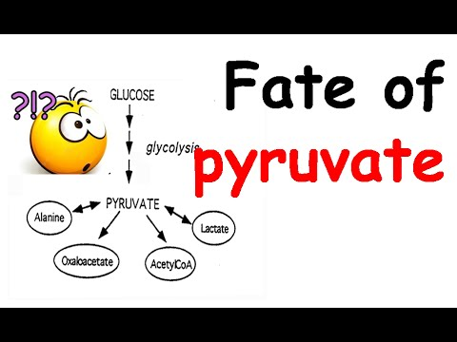

Large Group Interactive Session (LGIS)
Gastrointestinal tract Module
Fates of Pyruvate
2nd Year MBBS
Introduction to Carbohydrate Metabolism and Glycolysis
Large Group Interactive Session (vLGIS)
Presenter: Dr. Uzma Zafar Date: 23-01-25
(Demonstrator)

Slide 3
Motto, Vision, Dream
To impart evidence based research oriented medical education
To provide best possible patient care
To inculcate the values of mutual respect and ethical practice of medicine
Wisdom
Truth
Service

Slide 4
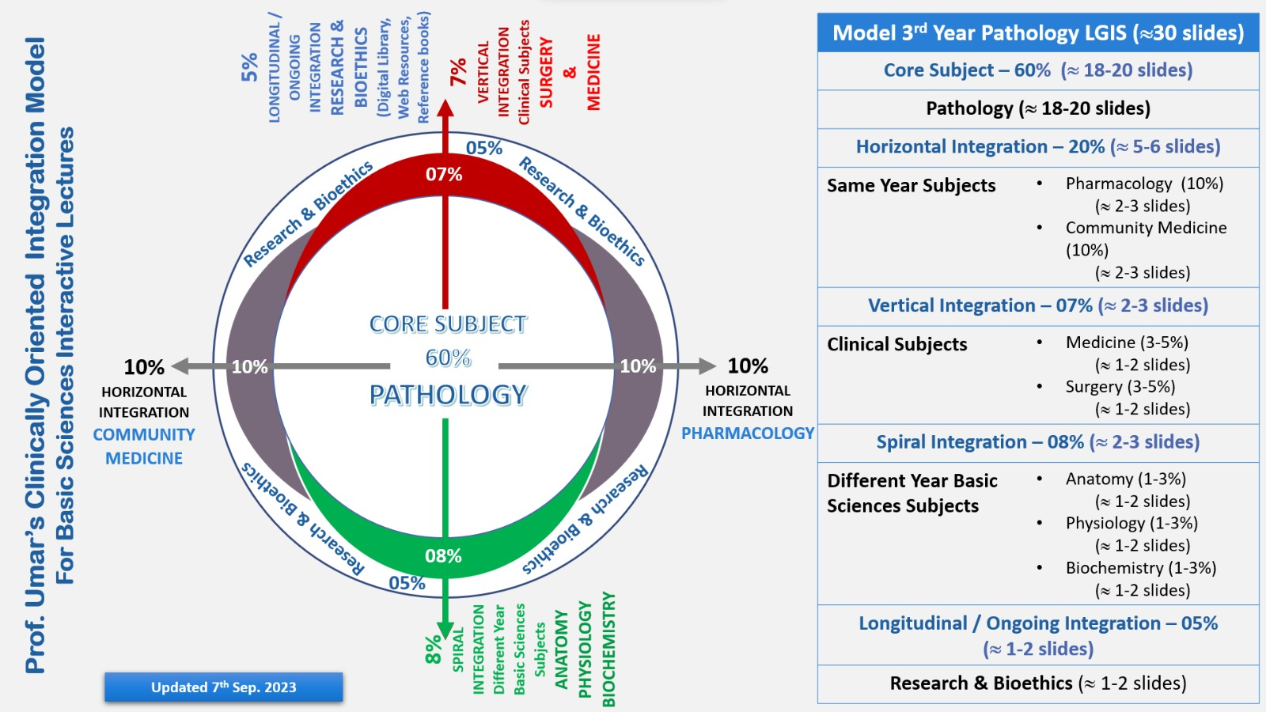
Professor Umar Model of Integrated Lecture

Slide 5
Learning Objectives
At the end of the lecture, students will be able to:
Describe fates of pyruvate.
Explain related clinical disorders.

Slide 6
Interactive Session
A junior physician at the hospital, presents a case during the morning round.
Case Presentation:
"An 18-year-old male athlete was brought to the emergency department after intense exercise during a marathon. He complained of severe muscle cramps and fatigue. On examination, he had tachycardia and rapid breathing. Laboratory findings revealed the following:
Blood glucose: 90 mg/dL
Serum lactate: Elevated at 5 mmol/L (normal: 0.5–2.2 mmol/L)
Arterial blood pH: 7.25 (normal: 7.35–7.45)

Slide 7
Fates of Pyruvate
Core Knowledge
The presence or absence of oxygen determines the fates of the pyruvate produced in glycolysis.
When plenty of oxygen is available, pyruvate is first converted to acetyl-CoA.
In the absence of oxygen, the fate of pyruvate is different in different organisms. In vertebrates, pyruvate is converted to lactate.
In other organisms, such as yeast, convert pyruvate to ethanol and carbon dioxide.

Slide 8
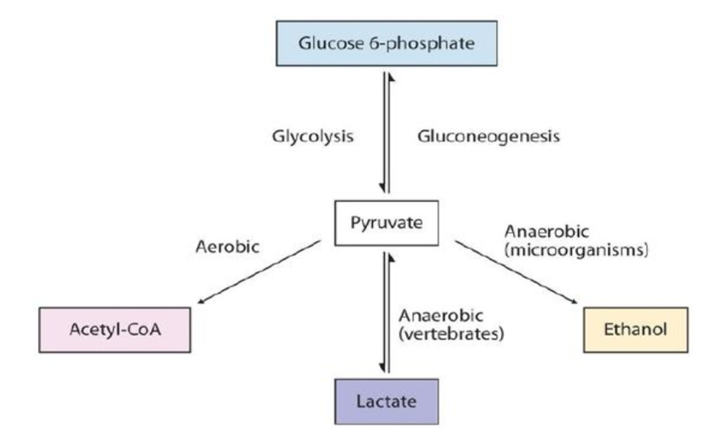
Fates of Pyruvate (cont.)
Core Knowledge
Core Knowledge

Slide 9
1) Pyruvate Reduction to Lactate
Core Knowledge
Pyruvate is reduced to lactate in anaerobic conditions like in skeletal muscles during constant contraction and relaxation, brain cells, retina, RBCs, microbial cells, etc.
Lactate fermentation reaction is catalyzed by the enzyme “lactate dehydrogenase”. During this process, NADH is oxidized to NAD+, which facilitates the reduction of pyruvate to lactate.

Slide 10
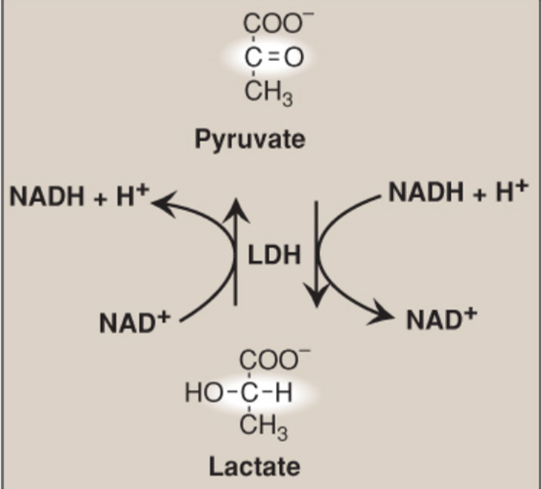
Pyruvate Reduction to Lactate (cont.)
Core Knowledge
Interconversion of pyruvate and lactate by lactate dehydrogenase (LDH)
Core Knowledge

Slide 11
Lactate Formation in Muscle
Core Knowledge
In exercising skeletal muscle, NADH production exceeds the oxidative capacity of the ETC. This results in an elevated NADH/NAD+ ratio, favoring reduction of pyruvate to lactate by LDH.
Therefore, during intense exercise, lactate accumulates in muscle, causing a drop in the intracellular pH, potentially resulting in cramps. Much of this lactate eventually diffuses into the bloodstream and can be used by the liver to make glucose.

Slide 12
Lactate Utilization
Core Knowledge
The direction of the LDH reaction depends on the relative intracellular concentrations of pyruvate and lactate and on the ratio of NADH/NAD+.
In the liver and heart, this ratio is lower than in exercising muscles. Liver converts pyruvate to glucose by gluconeogenesis or converted to acetyl CoA that is oxidized in the TCA cycle.
Heart muscle exclusively oxidizes lactate to carbon dioxide and water via the TCA cycle.

Slide 13
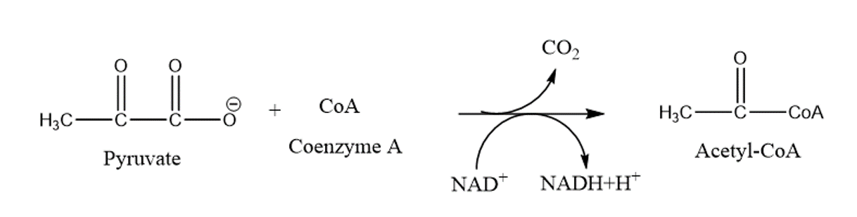
2) Oxidative Decarboxylation to Acetyl CoA
Core Knowledge
Oxidative decarboxylation of pyruvate by the PDHC is an important pathway in tissues with a high oxidative capacity such as cardiac muscle.
PDHC irreversibly converts pyruvate, the end product of aerobic glycolysis, into acetyl CoA, a TCA cycle substrate and the carbon source for fatty acid synthesis.

Slide 14
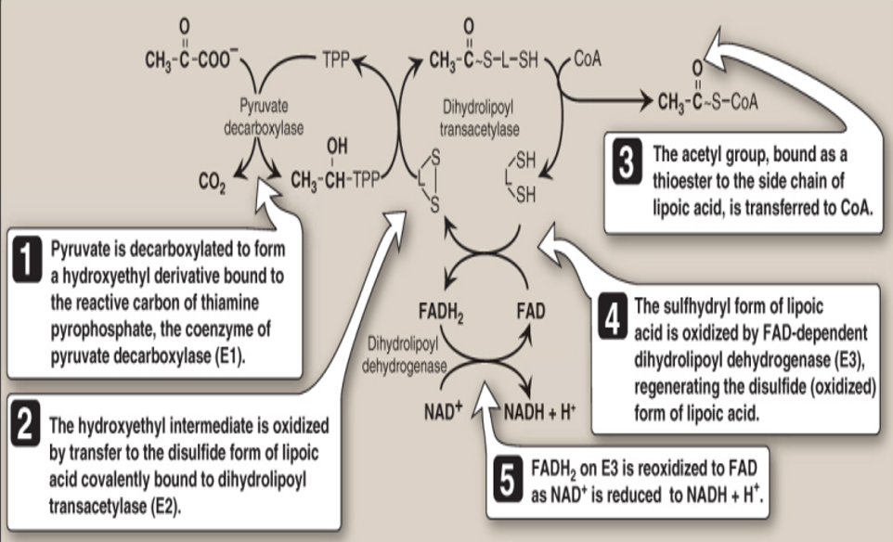
Acetyl CoA Production
Core Knowledge

Slide 15
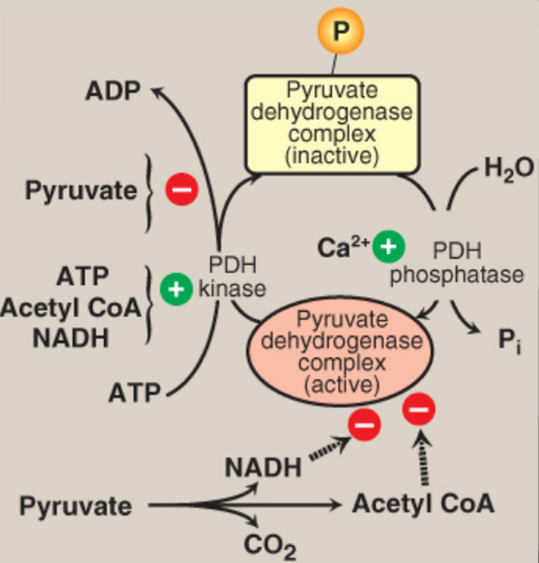
Regulation of Pyruvate Dehydrogenase (PDH) Complex
Core Knowledge
Regulation of pyruvate dehydrogenase (PDH) complex.

Slide 16
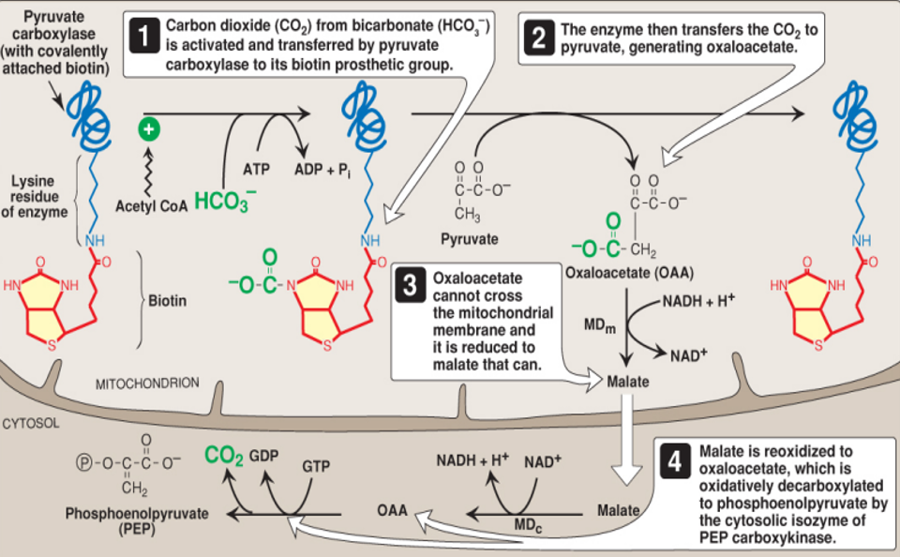
3) Carboxylation to Oxaloacetate
Core Knowledge

Slide 17
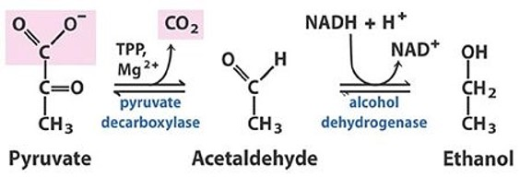
4) Reduction to Ethanol (microorganisms)
Core Knowledge
The reduction of pyruvate to ethanol occurs as follow. The decarboxylation of pyruvate to acetaldehyde by thiamine-requiring pyruvate decarboxylase occurs in yeast and certain other microorganisms but not in humans

Slide 18
Lactic Acidosis
Vertical Integration
Lactic acidosis means elevated concentrations of lactate in the plasma. It is a type of metabolic acidosis
It occurs when there is a collapse of the circulatory system, such as with myocardial infarction, pulmonary embolism, and uncontrolled hemorrhage, or when an individual is in shock
The failure to bring adequate amounts of O2 to the tissues results in impaired oxidative phosphorylation and decreased ATP synthesis.
To survive, the cells rely on anaerobic glycolysis for generating ATP, producing lactic acid as the end product

Slide 19
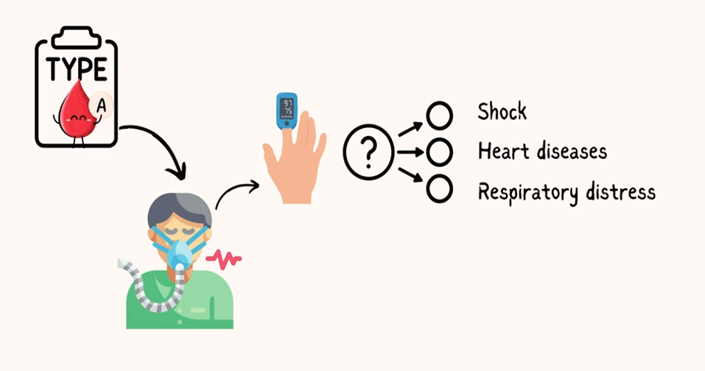
Lactic Acidosis
Core Knowledge

Slide 20
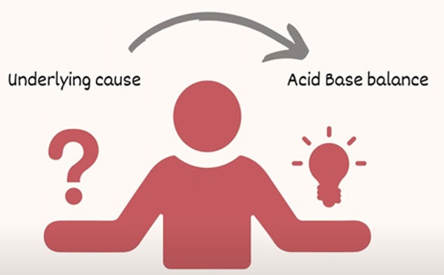
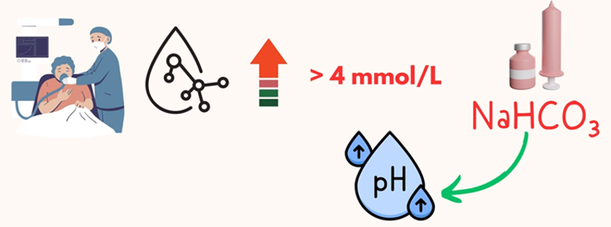
Family Medicine
Spiral Integration
Family Medicine plays important role in following manner:
Address the underlying cause and stabilize the patient’s acid-base balance
Administer Sodium bicarbonate (IV) which acts as buffer
Refer to specialist if condition worsens

Slide 21
Spiral Integration
Artificial Intelligence
Artificial Intelligence plays role in following aspects:
Data acquired from the population affected with Lactic acidosis is used to make ML (Machine Learning) tools. ML model is used to predict clinical trajectories for Lactic acidosis. Clinical analysis of model outputs can be used to prescribe precise medication
AI can also be used to prescribe personalized food recommendations and help with drug development.

Slide 22
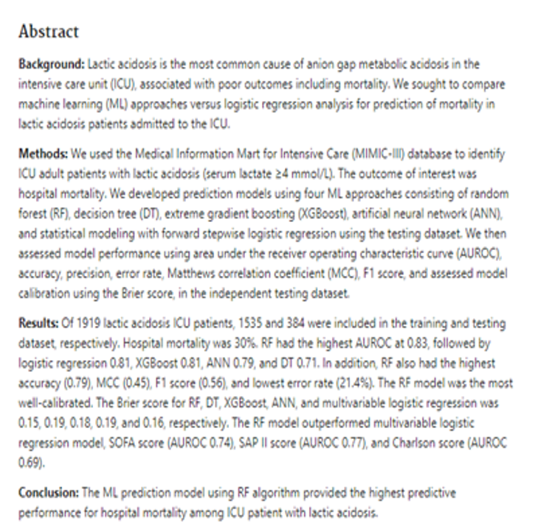
Suggested Research Article
Spiral Integration
Link: https://pubmed.ncbi.nlm.nih.gov/34768540/
Journal Name: PubMed
Title:
Machine Learning Prediction Models for Mortality in Intensive Care Unit Patients with Lactic Acidosis
Author Name: Pattharawin et al.

Slide 23
Bioethics
Spiral Integration
Informed consent
Doctor-patient confidentiality
Proper explanation of the treatment options
Nutritional support
Access to health care

Slide 24
How to Access Digital Library
Steps to Access HEC Digital Library
Go to the website of HEC National Digital Library.
On Home Page, click on the INSTITUTES.
A page will appear showing the universities from Public and Private Sector and other Institutes which have access to HEC National Digital Library HNDL.
Select your desired Institute.
A page will appear showing the resources of the institution
Journals and Researches will appear
You can find a Journal by clicking on JOURNALS AND DATABASE and enter a keyword to search for your desired journal.

Slide 25
Learning Resources
Textbook of Biochemistry, Lippincott 8th edition, chapter no. 8, page no. 115 to 116
Textbook of Biochemistry, Lippincott 8th edition, chapter no. 9, page no. 120 to 121
Google scholar
Google images

Slide 26
Fate of Pyruvate

Slide 27
THANK YOU

